Slide 1
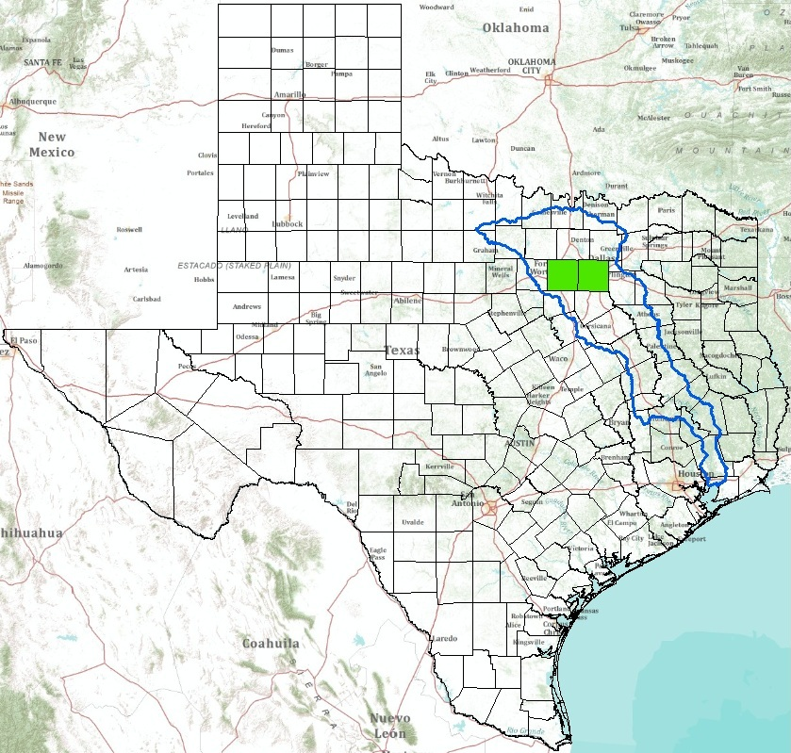
Municipal Setting Designations in Texas
A Case Study of Tarrant & Dallas Counties
CE394K: GIS for Water Resources
Professor David Maidment
Jeni Webb
November 18, 2010
Notes:
-Texas, Trinity River Basin, Tarrant + Dallas Counties
-I’m in the community & regional planning program, focusing on environmental planning
-Researching brownfields and groundwater remediation

Slide 2
Agenda
Background on HB 3152: Municipal Setting Designation (MSD)
Literature – what are others saying about this law?
Research question
Methodology + Findings
Future work
Notes:
-brief background
-describe differing opinions
-my research
-my future work

Slide 3
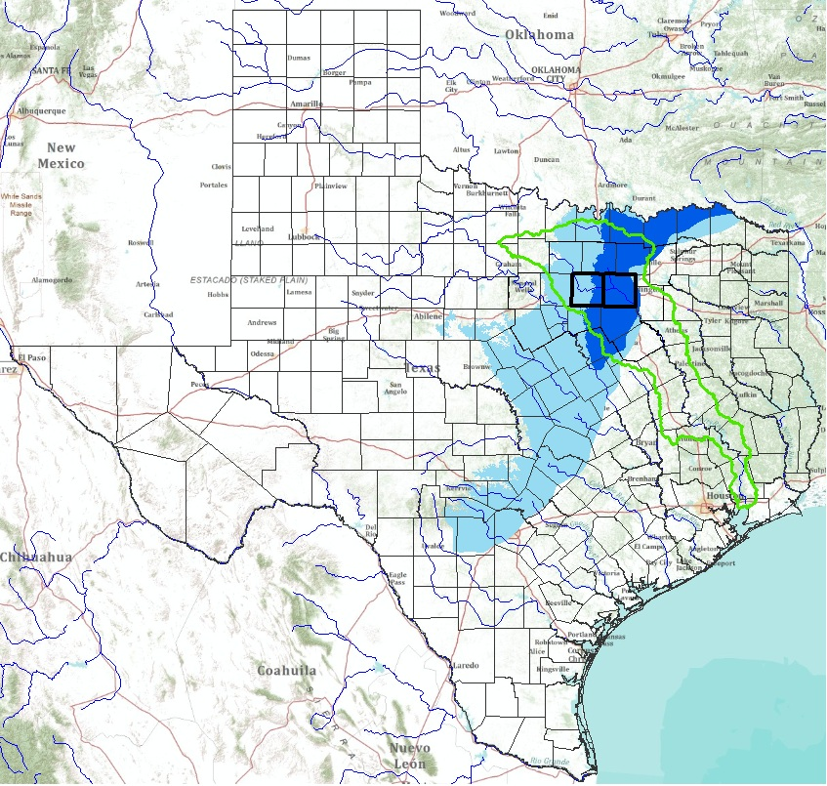

Slide 4
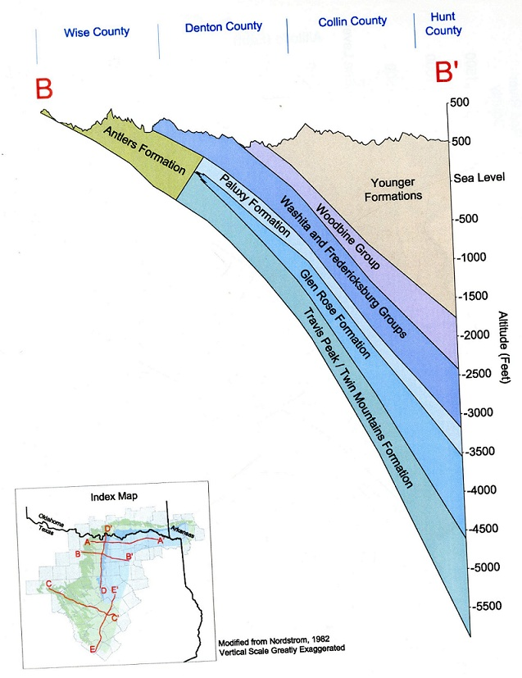

Slide 5
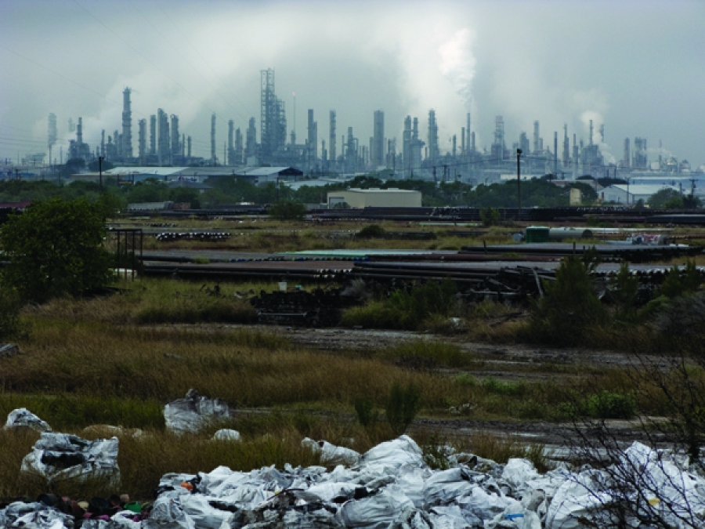
The TCEQ regulates contaminated groundwater in Texas
Texas VCP provides incentives for property owners to remediate contaminated sites
Contaminated groundwater can be very difficult and expensive to clean
Creates conditions where property owners cannot afford to complete the VCP
www.texaobserver.org
http://www.fortworthgov.org/dem/info/default.aspx?id=8040
Notes:
-VCP offers property owners an opportunity to take on the task of cleaning up environmental contamination themselves; in return, the TCEQ will issue them a certificate of completion that absolves the property owner and sometimes even the lender from future liabilities associated with environmental risk
-before MSDs, the TCEQ required property owners in the Voluntary Cleanup Program to remediate contaminated groundwater to drinking water standards
-some argued that this was not the highest and best use of funds since the groundwater wasn’t used as drinking water before contamination, and there were no plans to use it in the future
-some environmental lawyers and the then-manager of the Texas VCP (Chuck Epperson) brainstormed and came up with the MSD

Slide 6
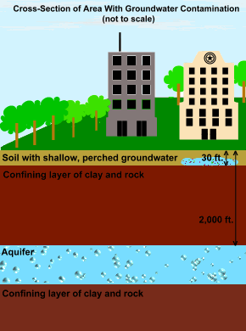
The Municipal Setting Designation (MSD) was passed in 2003
Works in concert with the Texas VCP
Alleviates requirement to remediate contaminated groundwater to potable standards
Saves time & money, but has inherent environmental concerns
Designed to expedite Certificates of Completion
http://www.fortworthgov.org/dem/info/default.aspx?id=8040
Notes:
-shallow, perched groundwater
-MSDs thus far have been less than 200 feet below surface
-the contaminated groundwater is above the confining layer of the aquifer

Slide 7
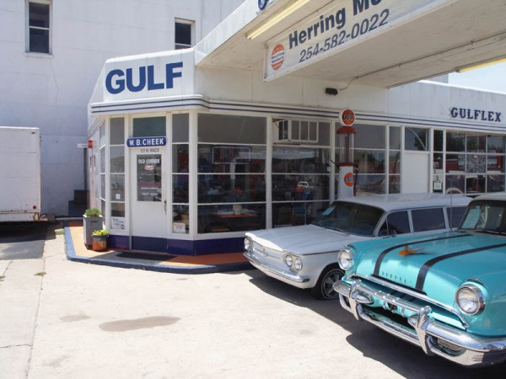
Since 2003, over 130 MSDs have been approved by the TCEQ
Over 75% of MSDs lie within the Dallas-Fort Worth MSA
Case study focuses on Tarrant & Dallas Counties
Some historical land uses led to groundwater contamination
Drinking water comes from surface reservoirs (e.g. Lake Ray Hubbard)
http://trtdg.com/wp-content/uploads/2008/07/tx-hillsboro-old-corner-gulf.jpg
Notes:
-in addition to the 130 that have been approved, another 10 are pending at the TCEQ now
-Fort Worth was sort of a pioneer with this program, and other cities have used both Fort Worth’s and Dallas’ ordinances to implement this program
-historical land uses that are linked with shallow groundwater contamination include
filling stations and other businesses the use underground storage tanks;
dry cleaning businesses; and
manufacturing plants where solvents are used
-one tenet of the MSD legislation is that a municipality must have another, reliable public water supply such as surface water reservoirs…the D-FW region has several major reservoirs

Slide 8
Literature – what are others saying about this law?
Support
Oppose
Expedites VCP Certificates of Completion
Saves time & money
Promotes economic development
Increases property values
Expands the property tax base
Violates the “polluter pays” principle upon which CERCLA is founded
Increases risk of vapor intrusion
Risks spreading contamination through groundwater-surface water interaction
MSD legislation does not stipulate an end point
Notes:
-this was a controversial policy when it passed in 2003 and remains so today
-here are the major viewpoints from each side of the argument
-CERCLA, better known as Superfund law, is the national law enforced by the EPA that requires polluters to pay for cleaning up contaminated sites; by establishing liability, CERCLA and some of the TCEQ’s earlier programs require the polluters to pay…some who oppose the MSD program argue that it violates this “polluter pays” principle

Slide 9
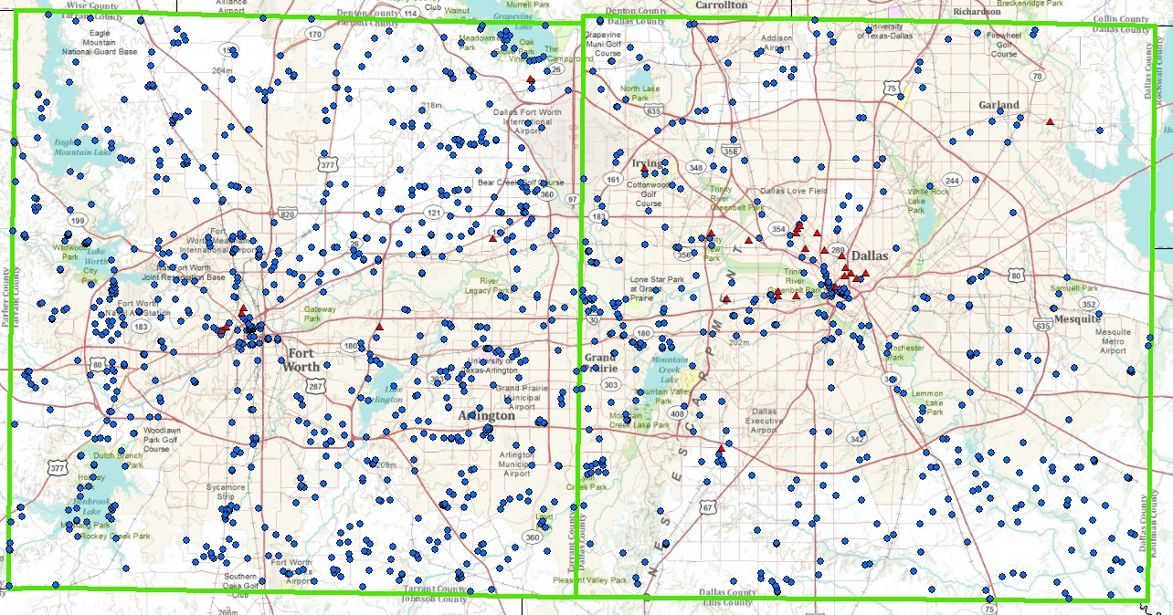
Research Question: :
Using ArcGIS to Examine Spatial Relationships
Can we identify areas of concern where contaminated sites risk polluting water resources?
Notes:
Are some MSDs riskier than others based on contaminant class and depth to groundwater?
Can we identify areas of concern where contaminated sites are within .5 mi of water resources?
Can we use census data to identify environmental justice issues based on the spatial distribution of MSDs?

Slide 10
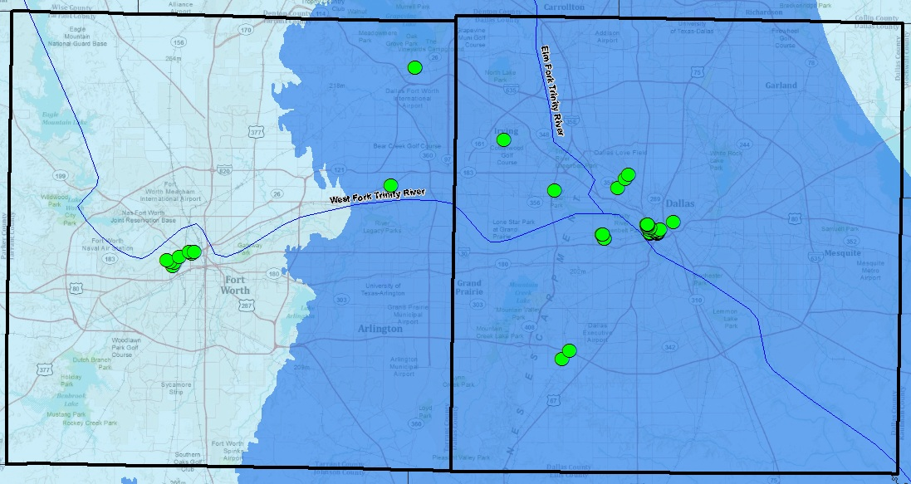
Methodology
Collect raw GIS data
  TWDB
  TCEQ
  NCTCOG
  ArcGIS Online
Use ArcGIS tools to examine the spatial relationships between MSDs and water resources

Slide 11
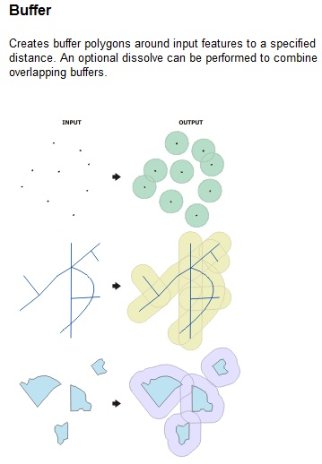
ArcGIS identifies areas of concern for MSDs
MSDs are based on parcels with a specific address
Geo-coding, or “address matching” represents these addresses spatially
The Buffer tool establishes a distance threshold for comparing features (e.g. .5 miles)

Slide 12
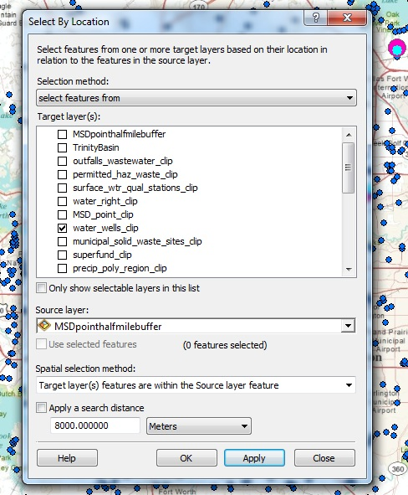
ArcGIS helps identify sites for future MSDs
The Select by location tool helps examine spatial relationship between water resources and contamination
Enables land use planners to be proactive in identifying potential MSD sites

Slide 13
Findings
All existing MSDs are less than 200 feet below the ground surface
Woodbine and Trinity Aquifers are present in the case study area
42 wells are within .5 miles of an MSD
Of those, none are less than 200 feet below

Slide 14
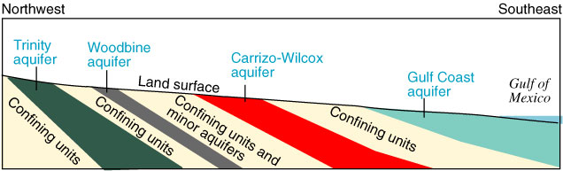
Findings
Risks contamination through existing wells
MSD law does not stipulate an end point for certificates of completion
http://pubs.usgs.gov/circ/circ1171/html/gw_aquifer_old.htm

Slide 15
Future Work
Geo-code MSD point addresses that have been added since 2007 for inclusion in the study
Add NHD Flowline for surface water comparison
Use X-Tools Pro to convert the EPA’s Brownfields data from .kmz to .shp for comparison

