Slide 1
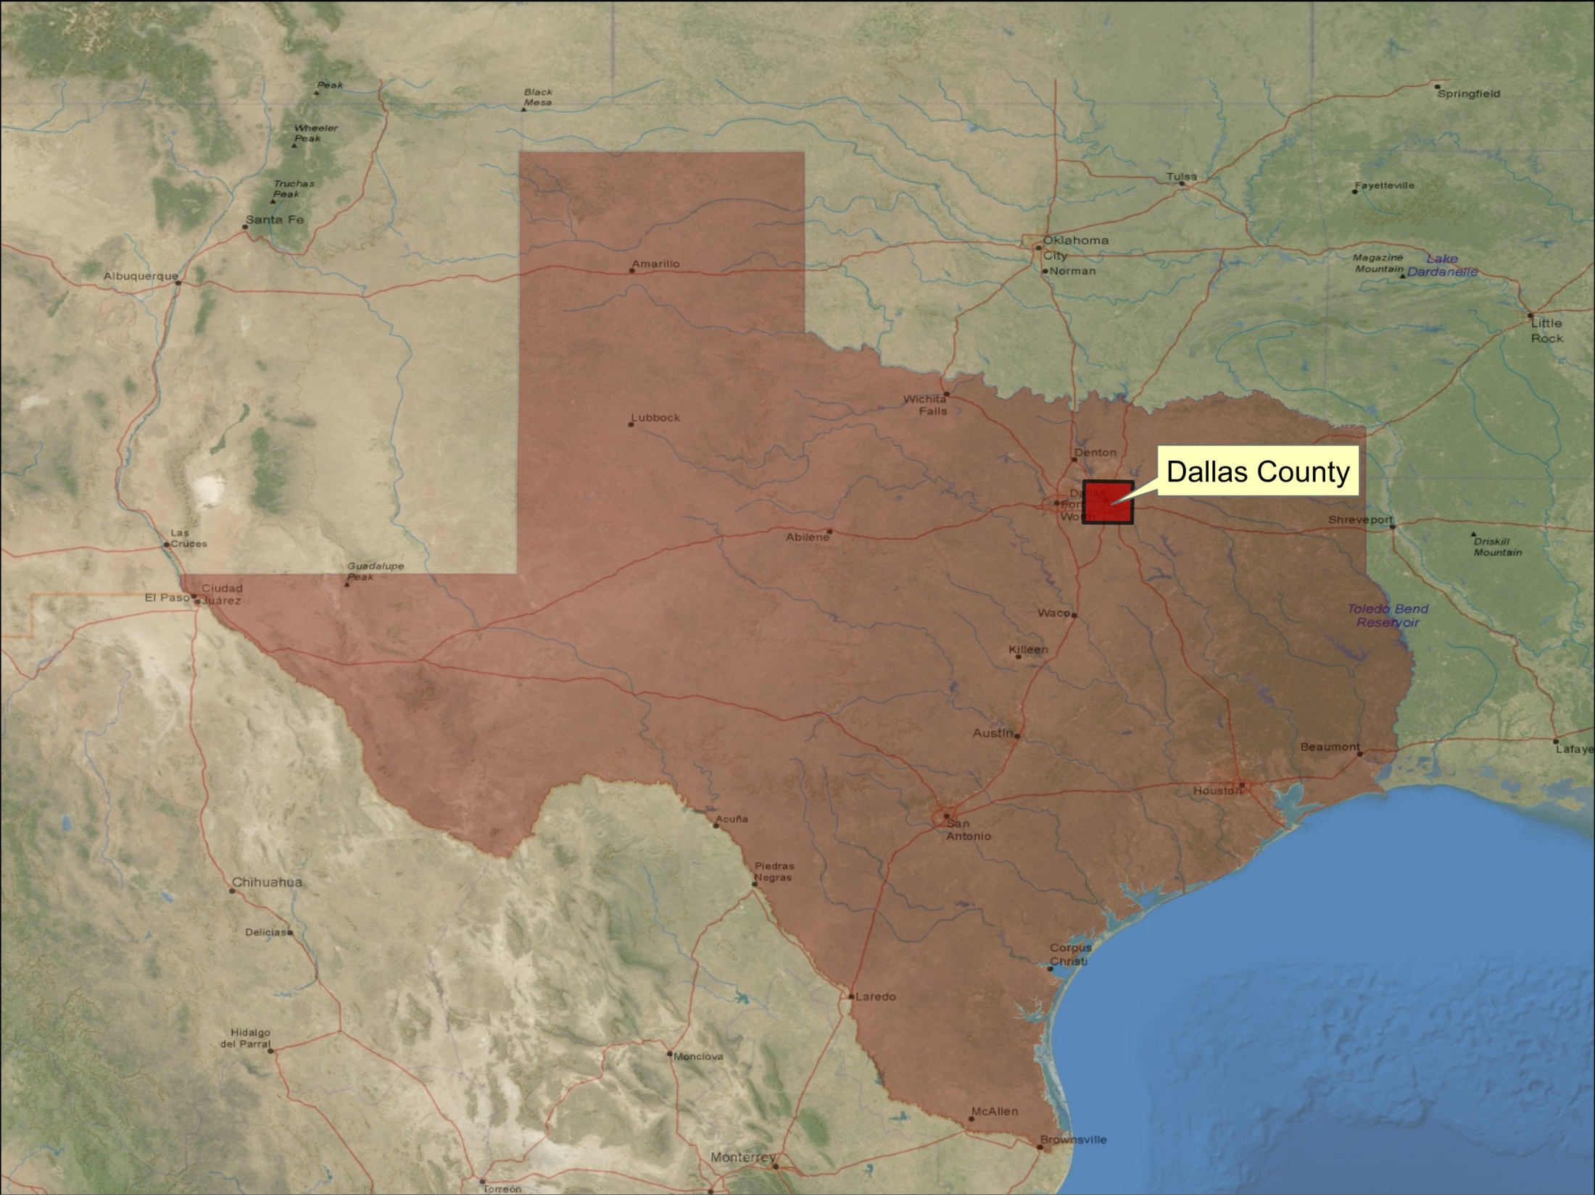
“Storm precipitation analysis in Dallas County”
“GIS in Water Resources”
by Gonzalo E. Espinoza

Slide 2


Introduction
Design Hydrologic systems
  Drainage
  Hydraulic Structures
Nextrad (NOAA)
  High Resolution Doppler weather radars.
  Source of Daily and Hourly data.
GIS
  Data Acquisition
  Data Processing
  Results

Slide 3

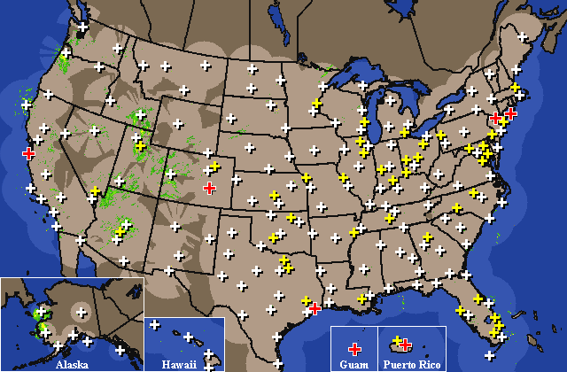
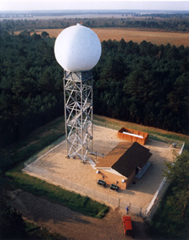
Data Acquisition
13 years
  1997 - 2009
147 Virtual Stations
Daily Data (147)
  697,500
Hourly Data (5)
  569,00

Slide 4
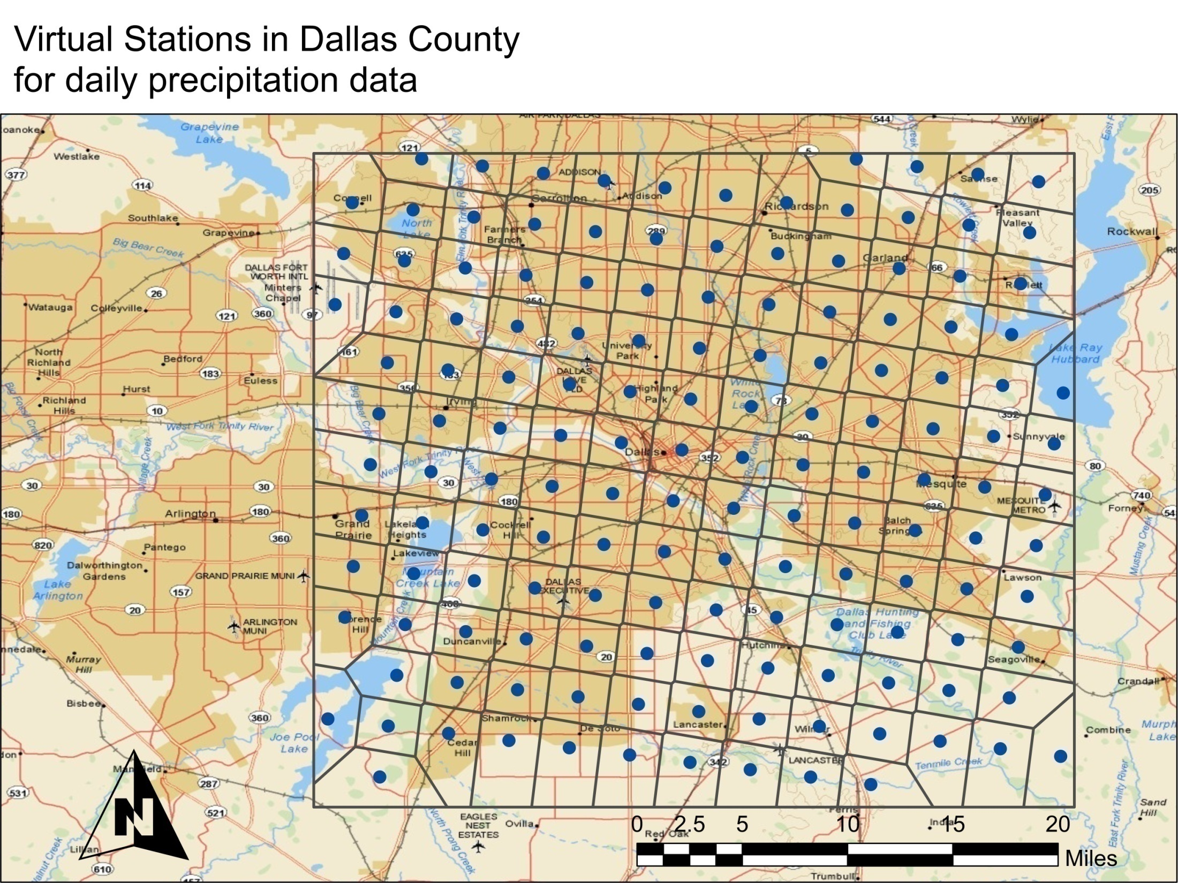

Slide 5
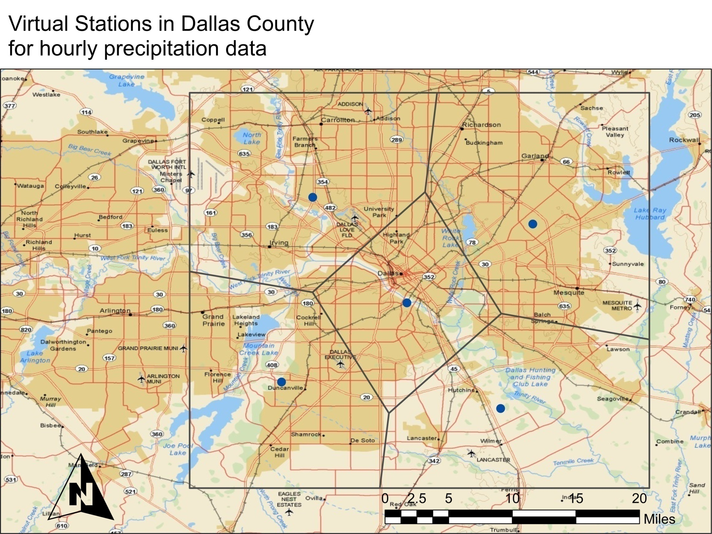

Slide 6
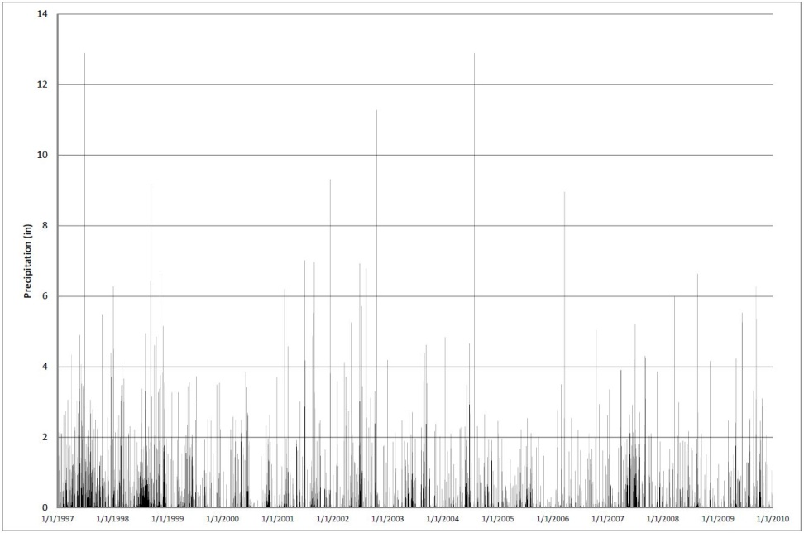
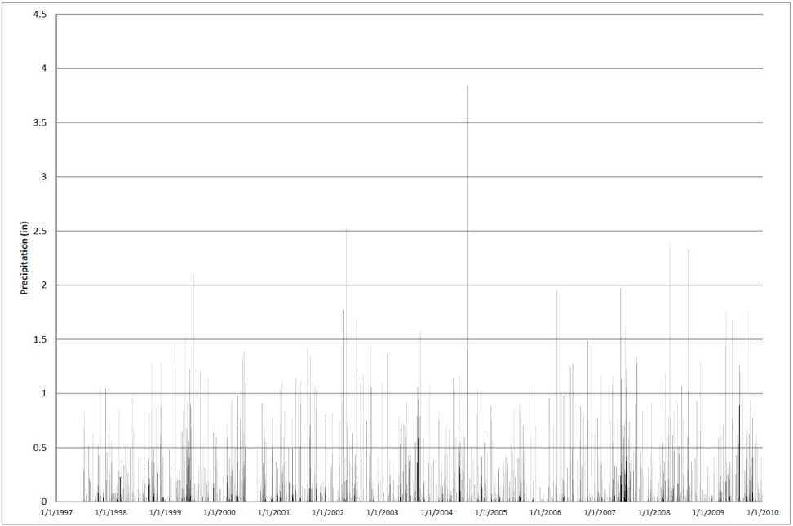
Precipitation: Raw Data
Daily Hourly

Slide 7

Data Processing
Export table HydroDesktop
Add Table ArcGIS
Project x,y
Time Enabled bar
Thiessen Polygons Tool
Mean Center
Maximum Series
  Daily
  Hourly
Probability Distribution
i-d-T and p-d-T curves

Slide 8
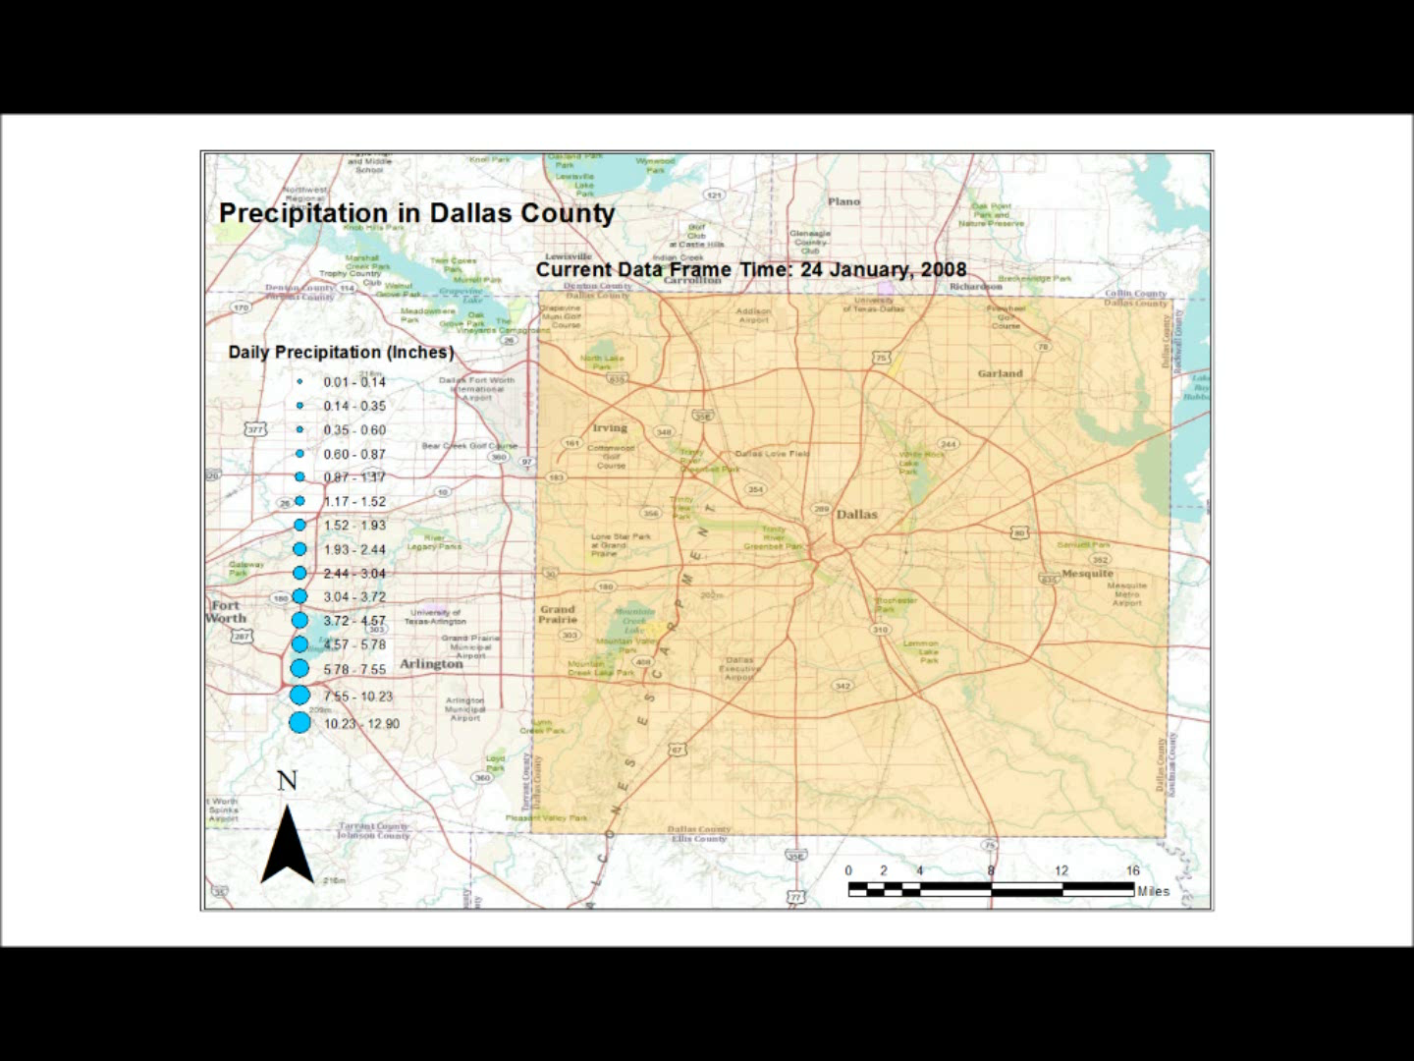
https://webspace.utexas.edu/gee272/www/Index_files/GIS/pMovie.wmv

Slide 9
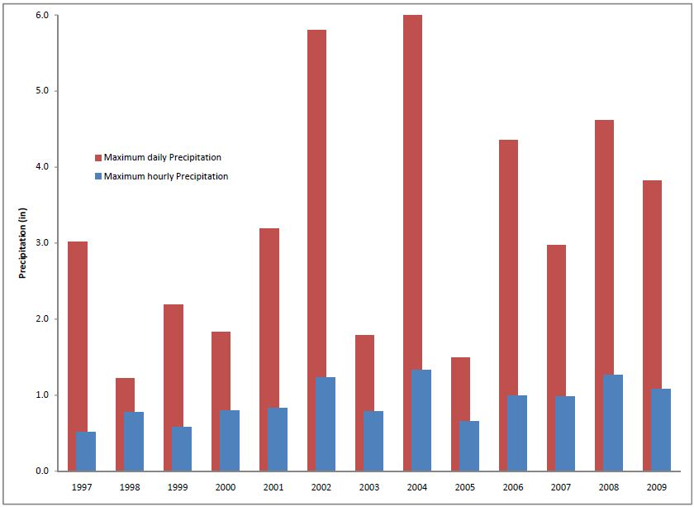
Maximum Series

Slide 10
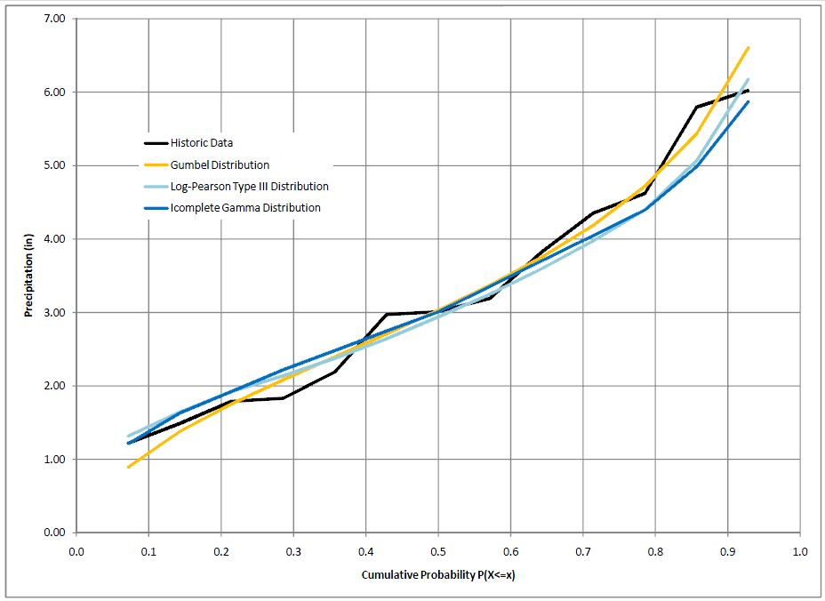
Probability Distributions

Slide 11
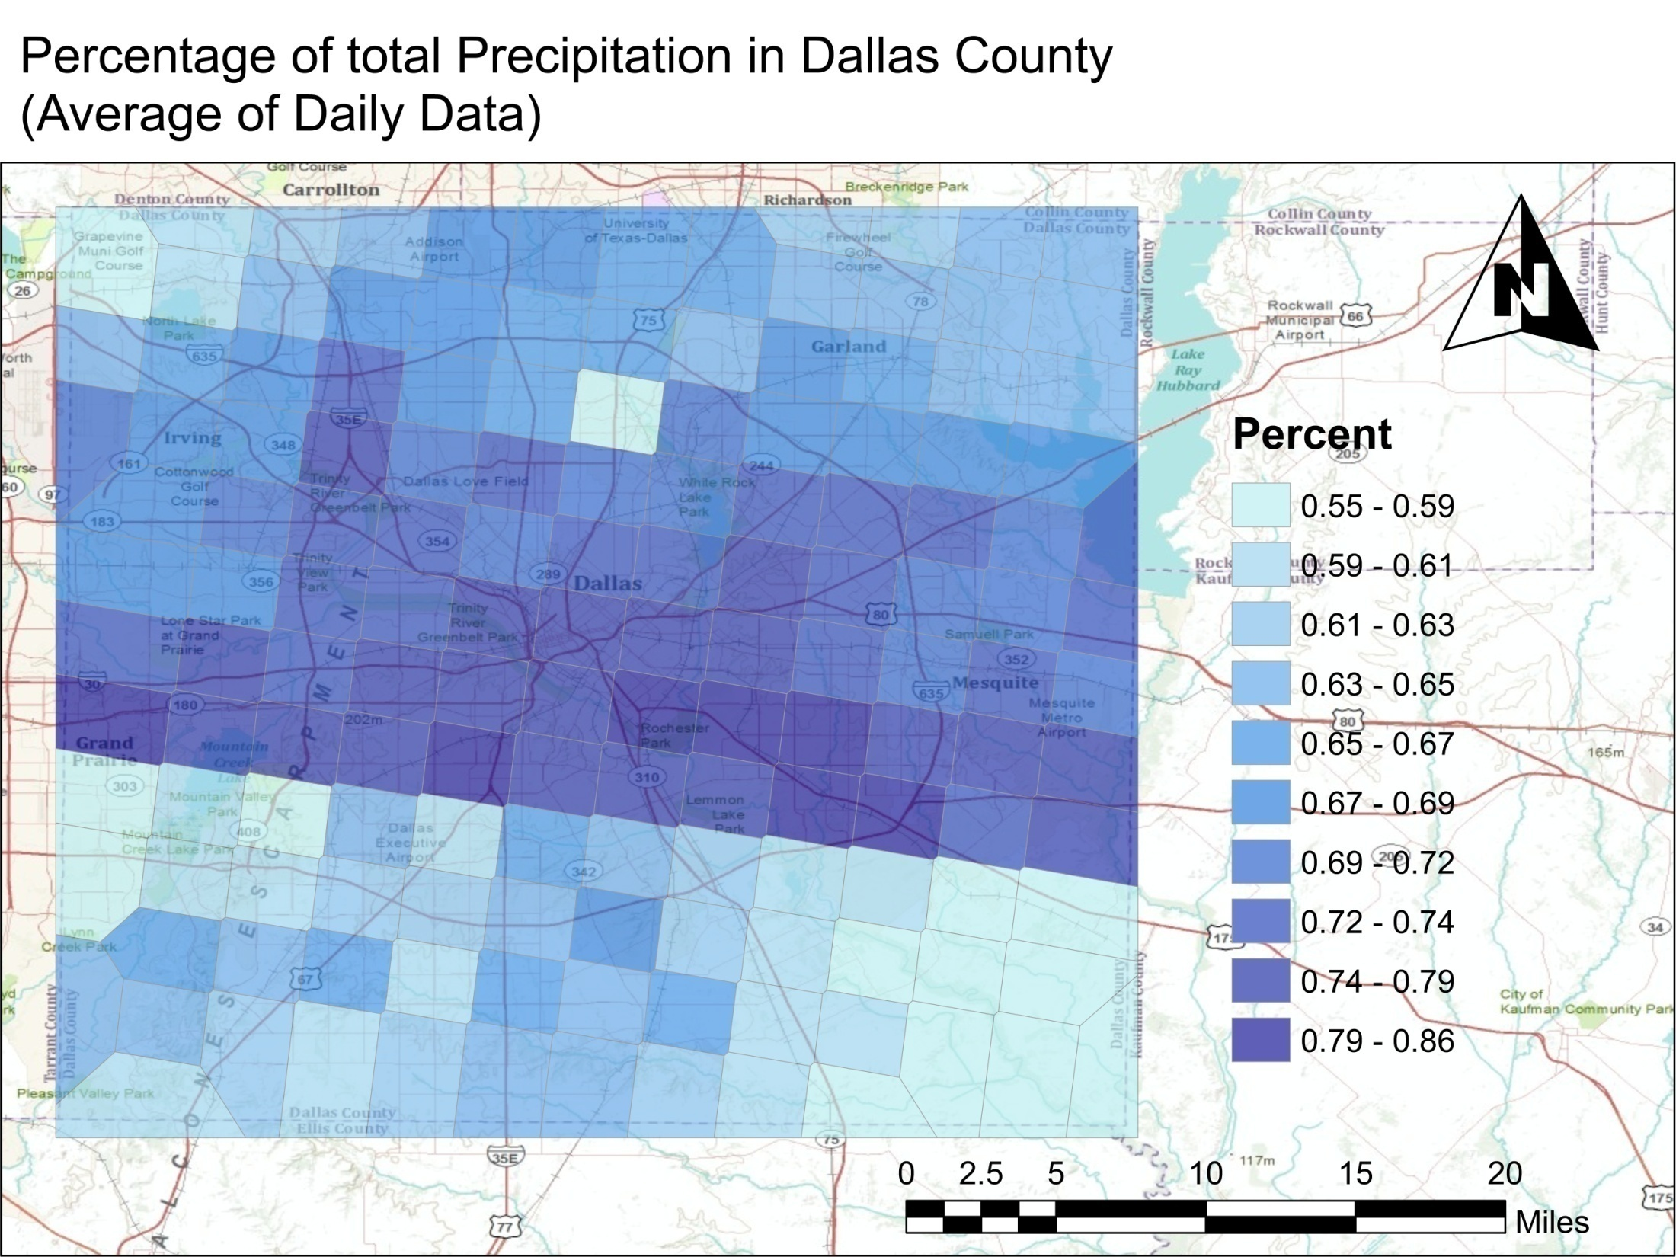

Slide 12
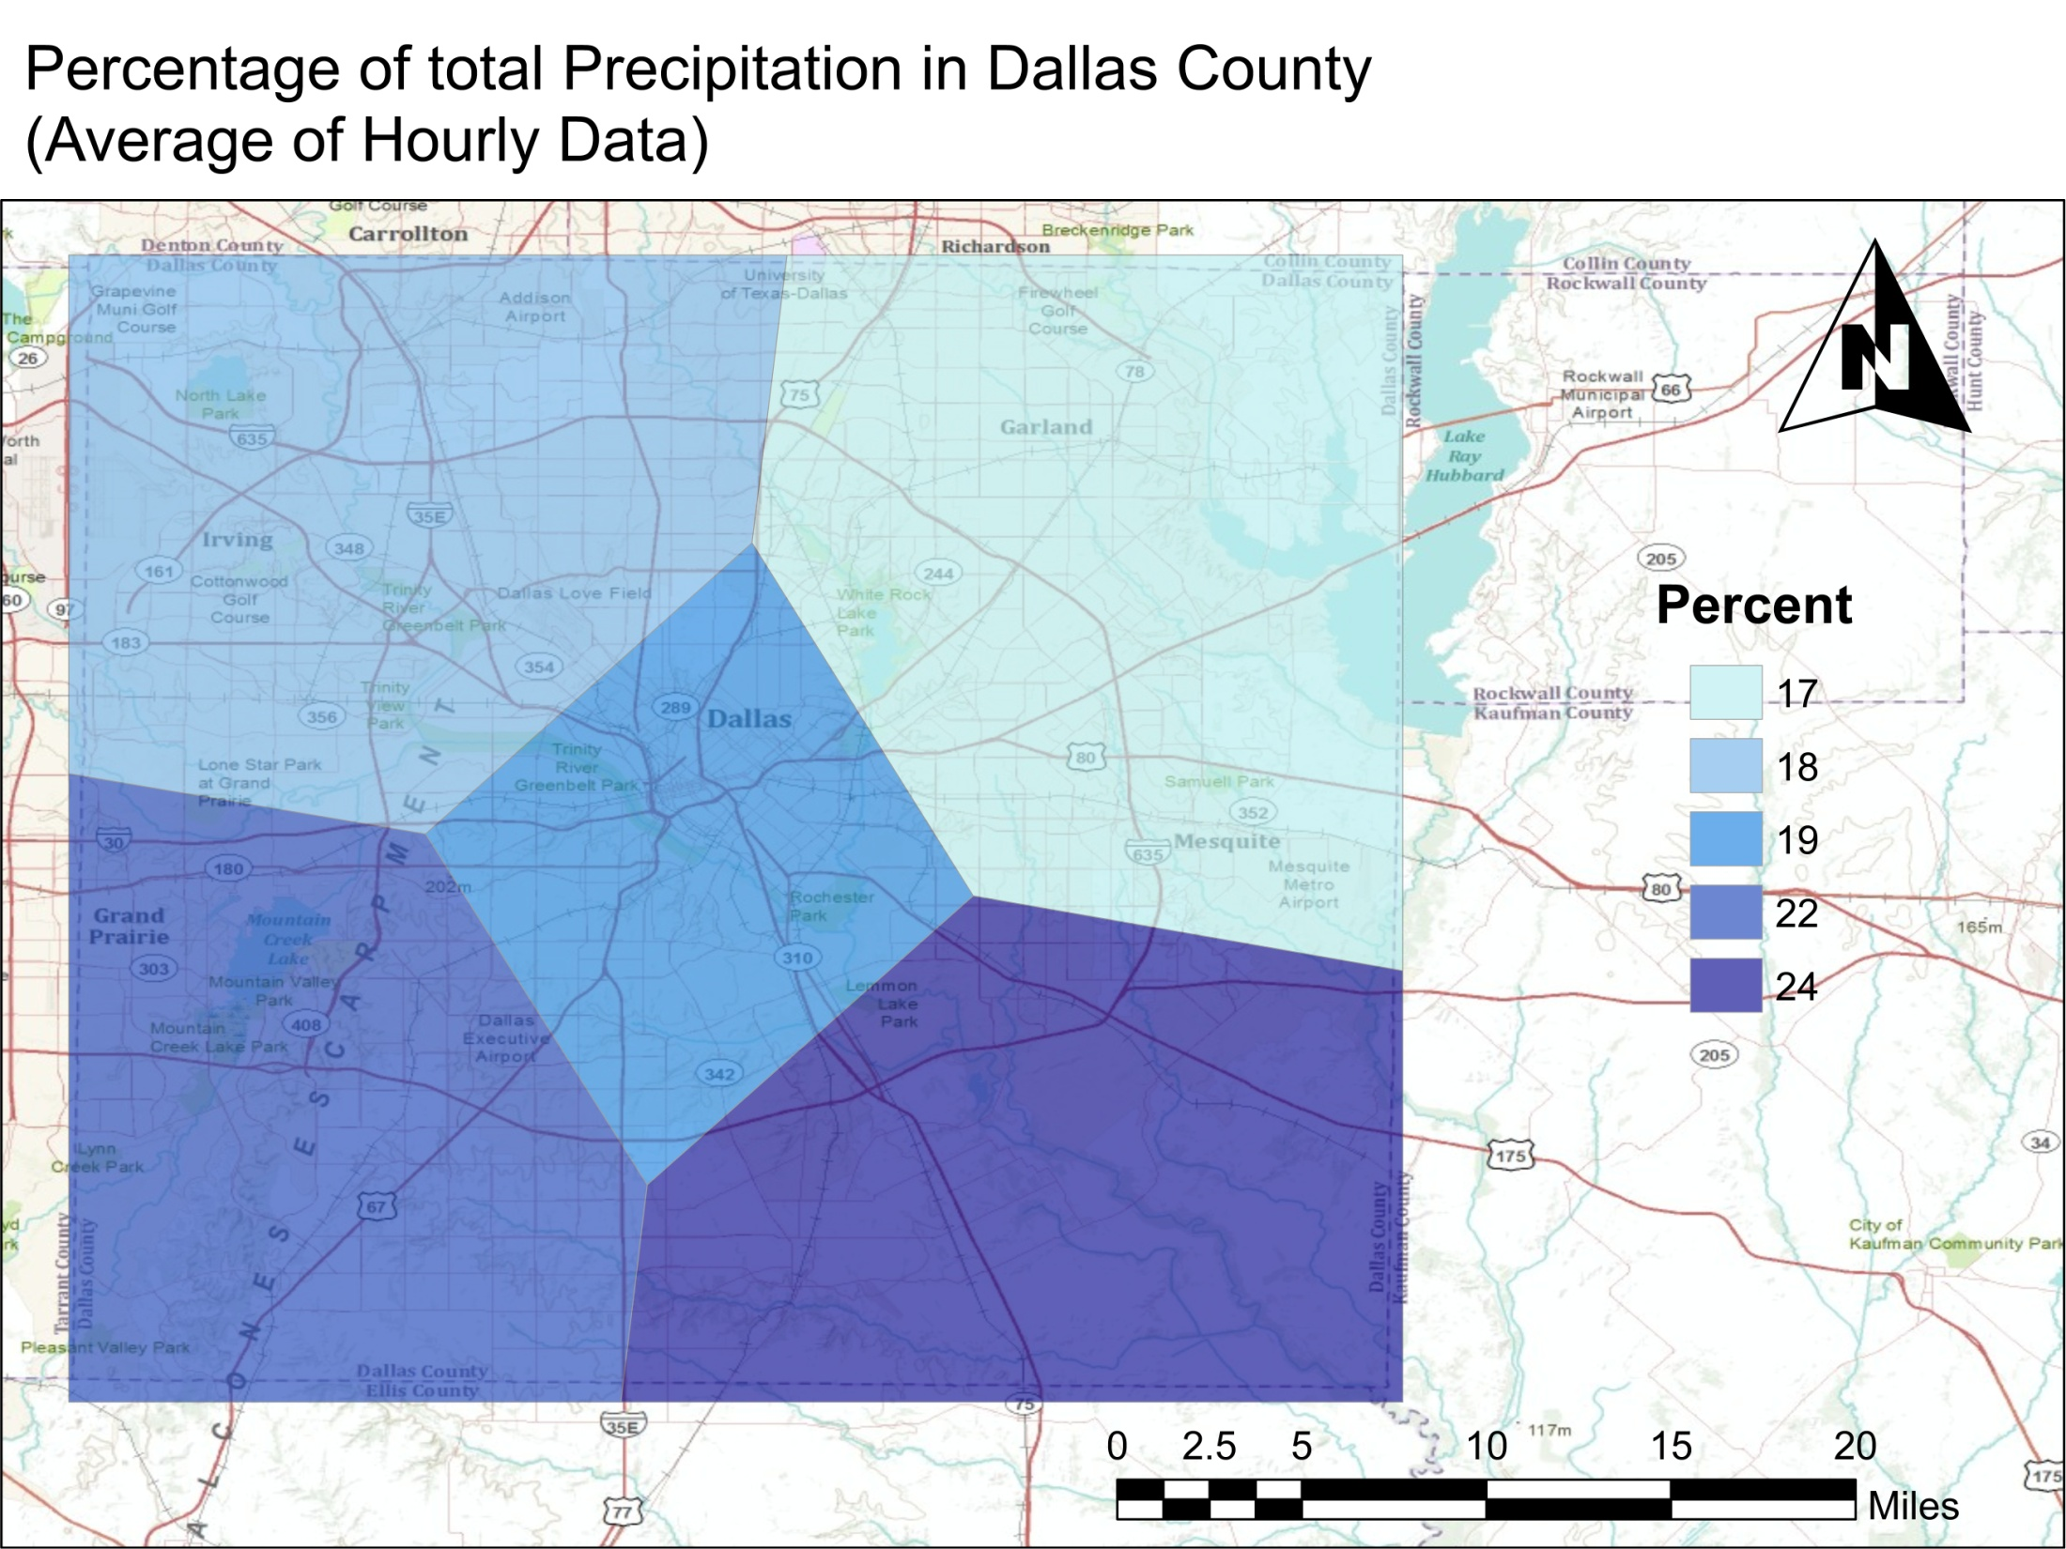

Slide 13
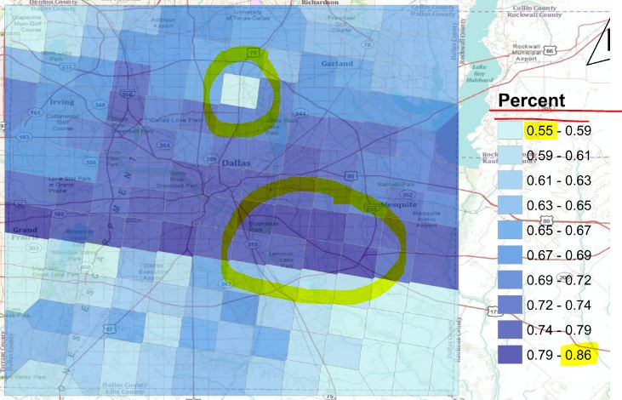
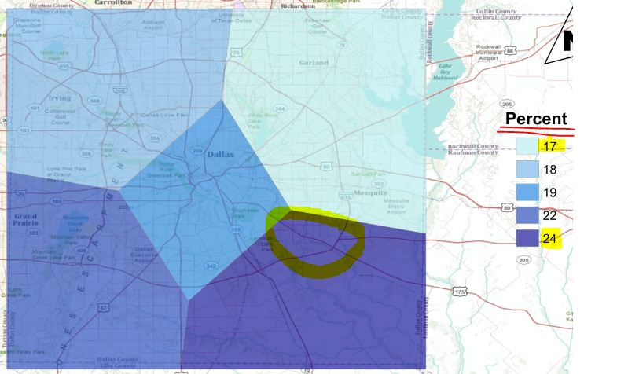
Precipitation Distribution
Daily Data
Hourly Data
147 Stations
AAP = 33.76 inches
Uniform
5 Stations
AAP = 34.20
South East

Slide 14
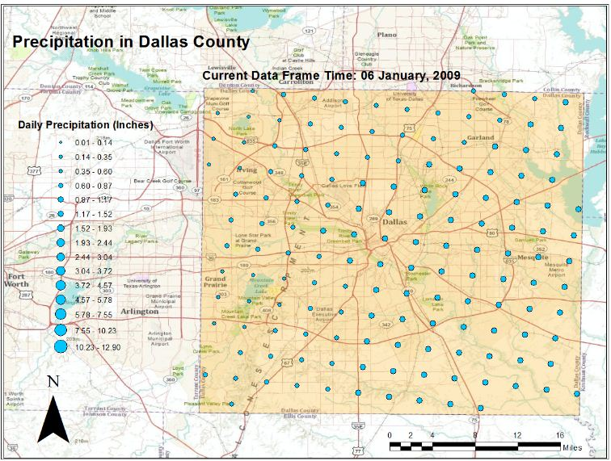
Results
98.7% AAP
Same Mean / Different distribution
Representative values of precipitation
In order to compare, select the same stations

Slide 15
Conclusions
Derived Data
  Representative
  Smaller Extrapolated Area
Computational Time
  Downloading, Processing and Projecting
  IT fast development
HydroDesktop
  Powerful Tool
  Sometime Crashes (Beta Version)

Slide 16
Questions?
https://webspace.utexas.edu/gee272/www/Index_files/Page305.htm
Contact Information:
ic.esda@mail.utexas.edu

