Slide 1
Marble Falls Flood of 2007
Alex Houston

Slide 2
Marble Falls Flood of 2007
Where were the most dangerous spots to be?
What was the storm water quality and its affects?

Slide 3
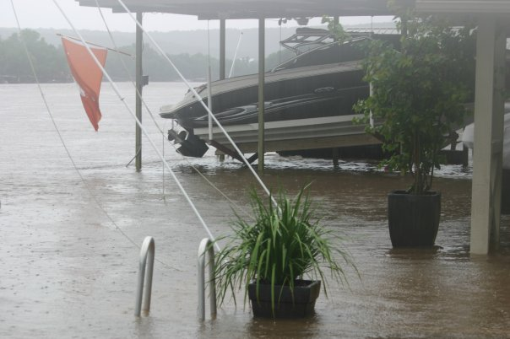
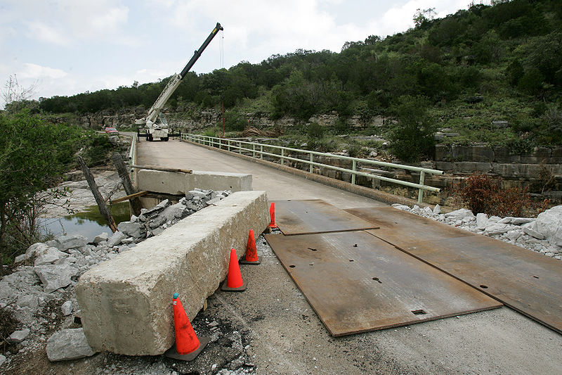
Background
During the night of the 26th and morning of the 27th, 19 inches of rain fell on one community

Slide 4
Repercussions
Washed out bridges,
Boat docks were immersed in water
At least 150 businesses were damaged
Left people stranded on rooftops and in trees
Water treatment plant damaged leaving water unusable even if boiled
Recreational band on lakes

Slide 5
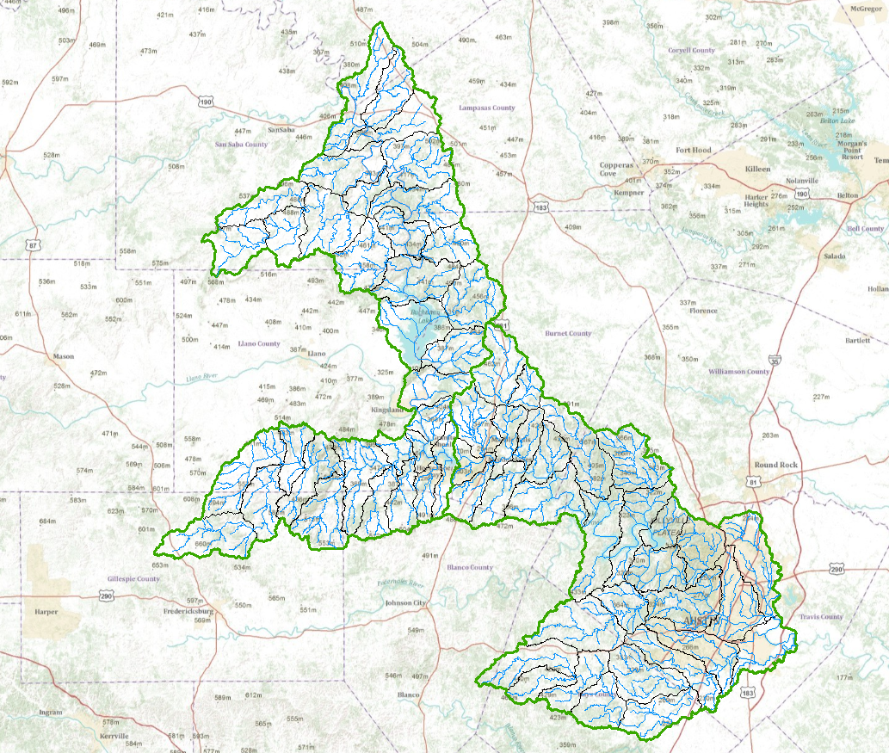
Watersheds
Lake LBJ Basin
Lake Travis Basin

Slide 6
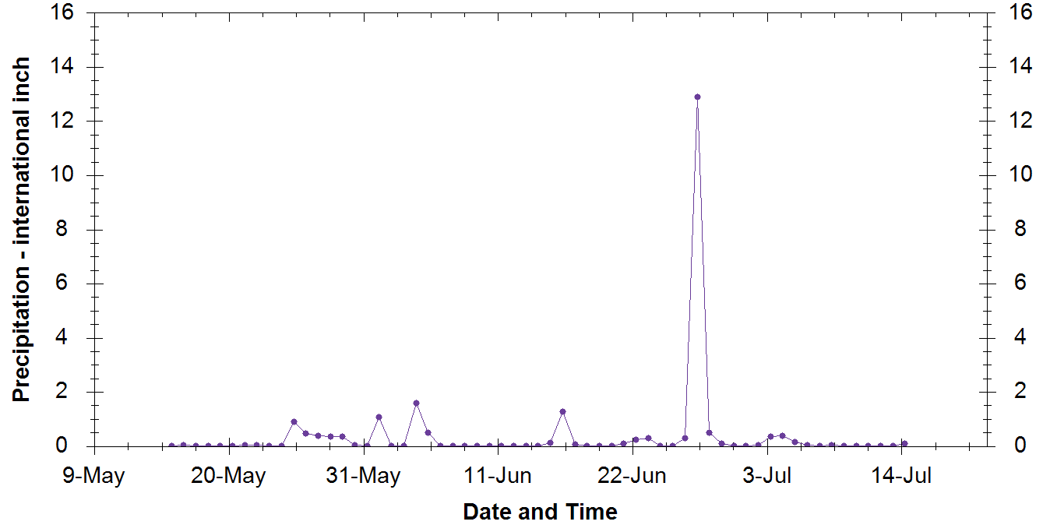
Marble Falls Month of Rain

Slide 7
Rain Time Series

Slide 8
DEM
The lower elevations occur around Marble Falls.

Slide 9
To-do list
Water quality data to see what the affects of the rain were on the lakes
Finish DEM processing to find where the most dangerous parts of Marble Falls were during the Flood

Slide 10
Questions?

