Slide 1
Water Quality in the San Marcos Basin
GIS in Water Resources
Aurore Mercelat

Slide 2
Agenda
Objectives and location
Problematic
Groundwater quality
Surface water quality
Conclusions
Future work

Slide 3
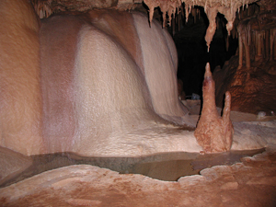
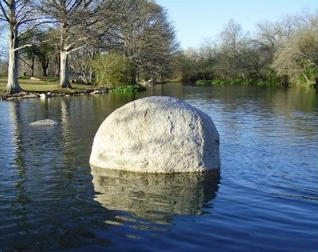
Objectives
Compare water quality:
  Groundwater vs Surface water
  Drinking water vs recreational water
Source:
http://blog.texasrvtravel.com/
https://www.acsmeetings.org/

Slide 4
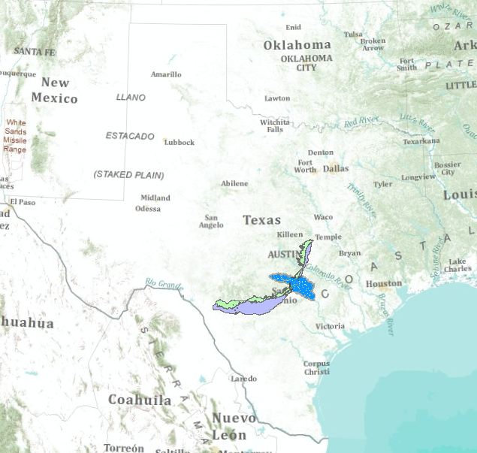
Where does our study take place?
Why?
Edwards aquifer: groundwater
Rivers: surface water
San Marcos city: on the aquifer and near several rivers

Slide 5
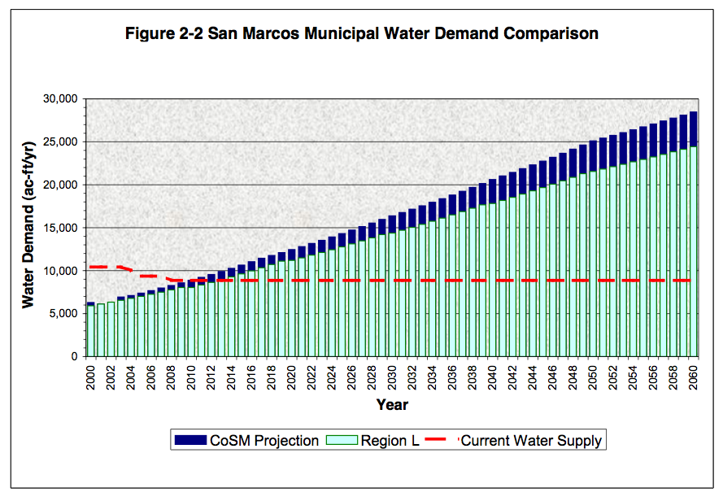
Problematics
Source: City Of San Marcos Water Supply Master Plan, December 2004

Slide 6
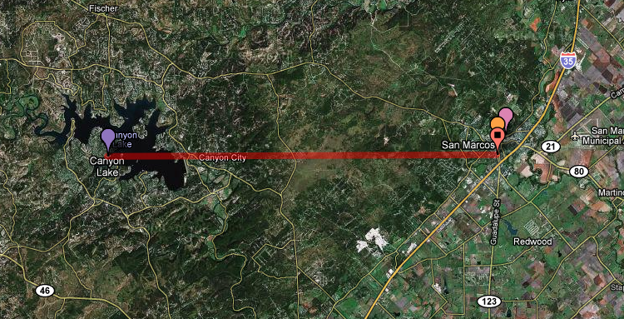
Water supplies of San Marcos
Current water supplies:
      Mainly Edwards aquifer:
        BUT, new regulations to protect the aquifer
Potentiel water supplies:
      Reclaimed water (wastewater reuse)
      Surface water
        Canyon Lake: costs ➔ leasing and carrying the water (≈ 30 km)
        San Marcos river (rights already owned) (some km)
      Other groundwater resources
What would be the difference of quality between groundwater and surface water?

Slide 7
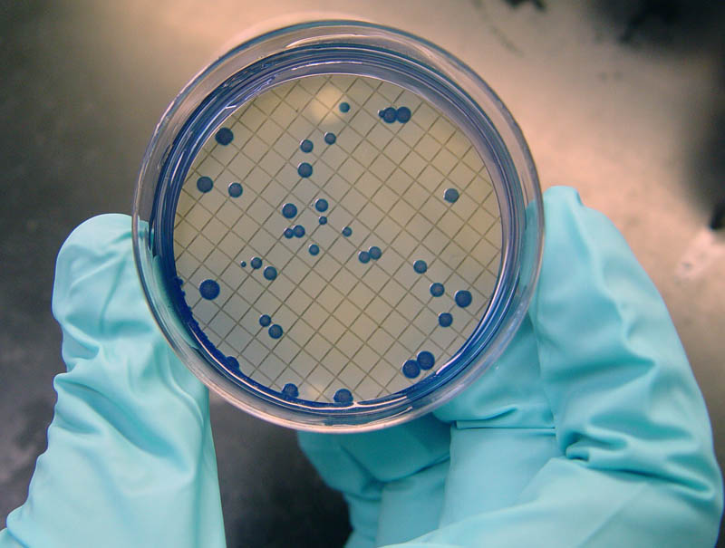
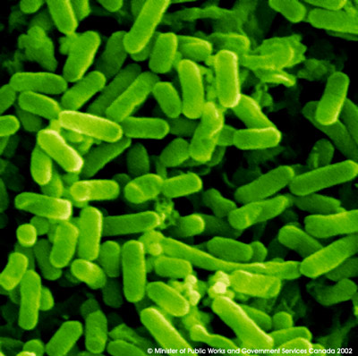
Groundwater resource: the Edwards Aquifer
"Water quality in the Edwards is exceptionally good" (http://www.edwardsaquifer.net/)
    Metals: usually below drinking water standards
    Ions: healthy mix
    Fecal coliform bacteria: indicators of harmful bacteria presence
Source: http://www.ars.usda.gov

Slide 8
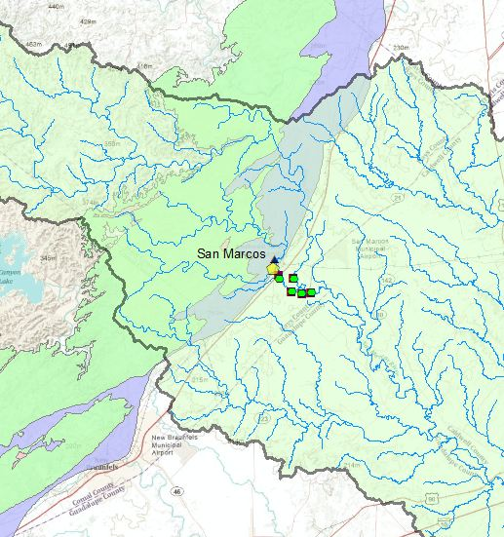
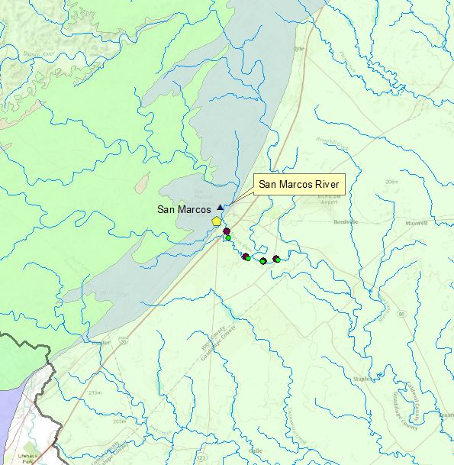
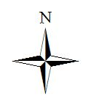
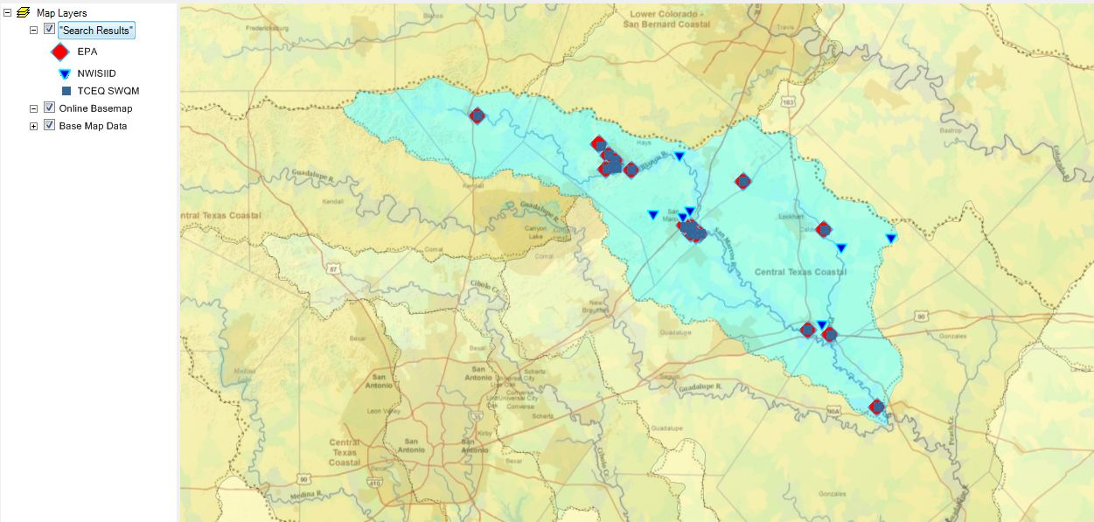
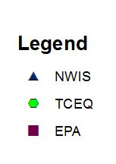
Surface water around San Marcos

Slide 9
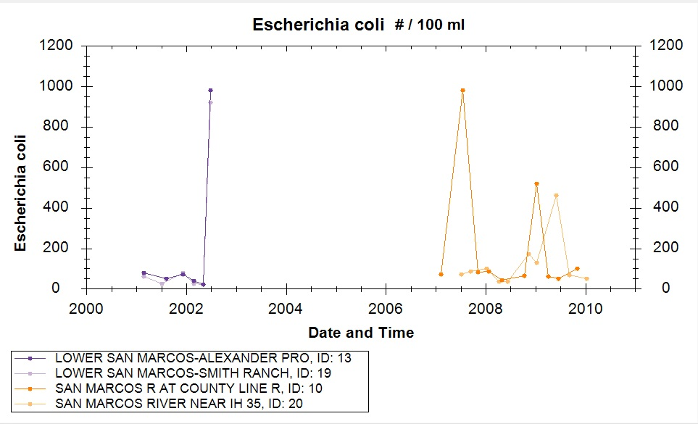
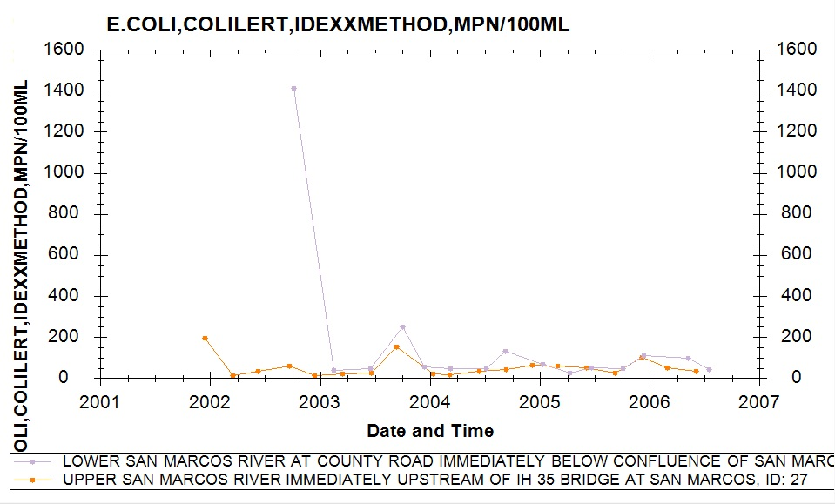
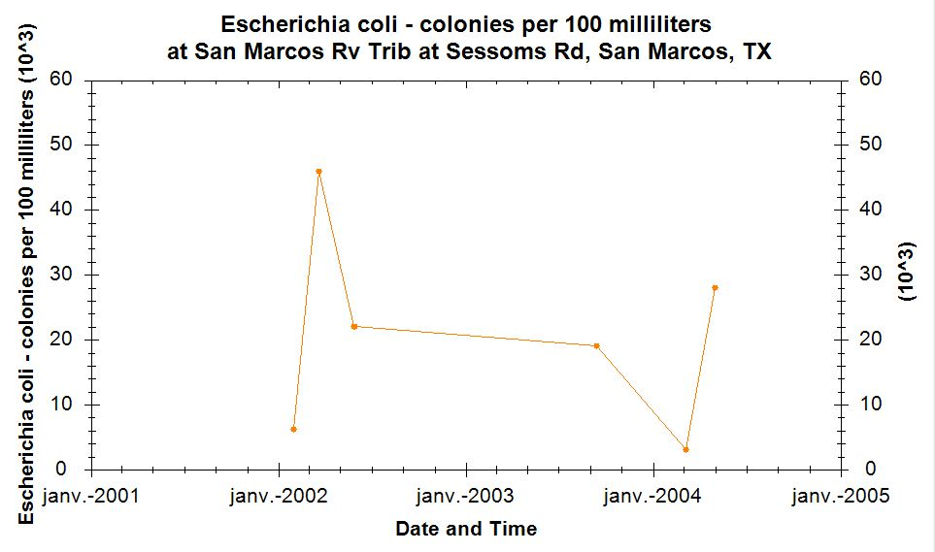
Bacteriological quality
EPA measurements
TCEQ measurements
NWIS measurements
2000
2000
126
126
2000

Slide 10
Conclusions
Surface water is prone to variations
  can exceed drinking water requirements
  can exceed recreational water requirements
Generally, less clean than Edwards' water
  Why is it so?
  What are the potential sources of pollution?

Slide 11
Edwards ' Water, Naturally healthy?
Natural treatments:
  Dilution
  Settling
  Biological activity: neutralize organic material
  Natural Degradation

Slide 12
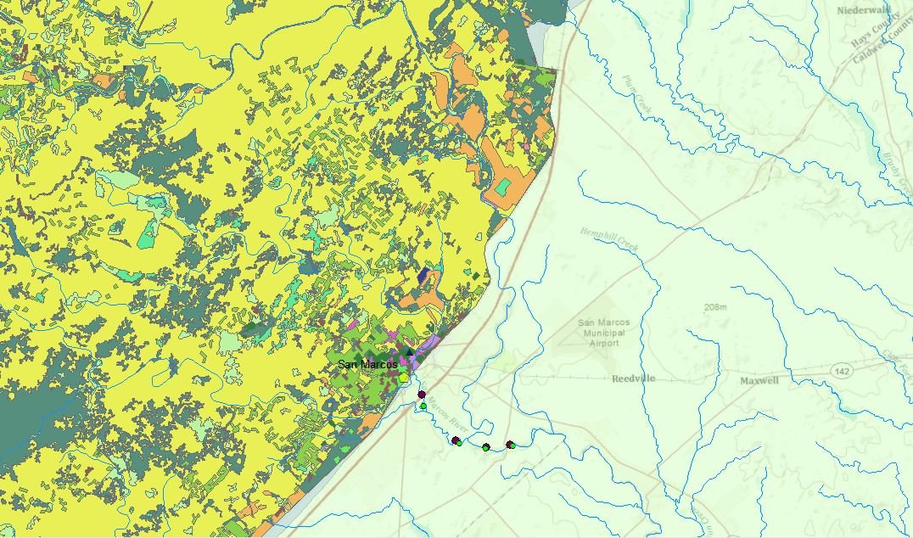
Future work
Identify the potential sources of pollution

Slide 13
Thank you for listening...

