Slide 1
Erosion Potential in Travis County
David Rounce

Slide 2
Outline
Why Erosion Potential
RUSLE Model
Process of Project
Relevance

Slide 3
Importance of Erosion
Naturally transports sediment downstream
Nonpoint Source Pollution
  Degrade waters for aquatic life
  Decrease depth of streams
  Increase turbidity
  Nutrient Pollution
Notes:
Transport sediment, both good and bad, pointsource vs nonpoint source pollution

Slide 4
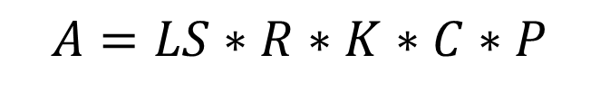
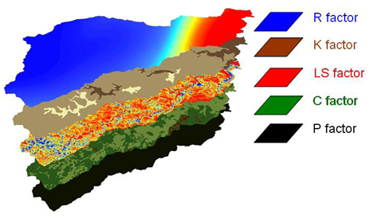
RUSLE Model
A = Avg Annual Soil Loss
(tons/acre∙yr)
LS = Slope Steepness & Length Factor
R = Rainfall Energy Factor
(ft∙tonsf∙in/acre∙hr∙yr)
K = Soil Erodibility Factor
(tons∙acre∙hr/hundreds_acre∙ft∙tonsf∙in)
C = Cover Factor
P = Support Practice Factor
Adapted from Khosrowpanah et al. (2007)
Notes:
How do we measure erosion… RUSLE Model
Average Annual Soil Loss- tolerance parameter from USDA
R is an interesting factor; I used avg yearly data, but this can be changed to focus on wet months, single events, etc.
P is also interesting because it is based off of measures you take to reduce soil erosion like PAM which I’ll get into later.

Slide 5
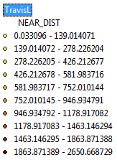
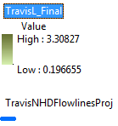
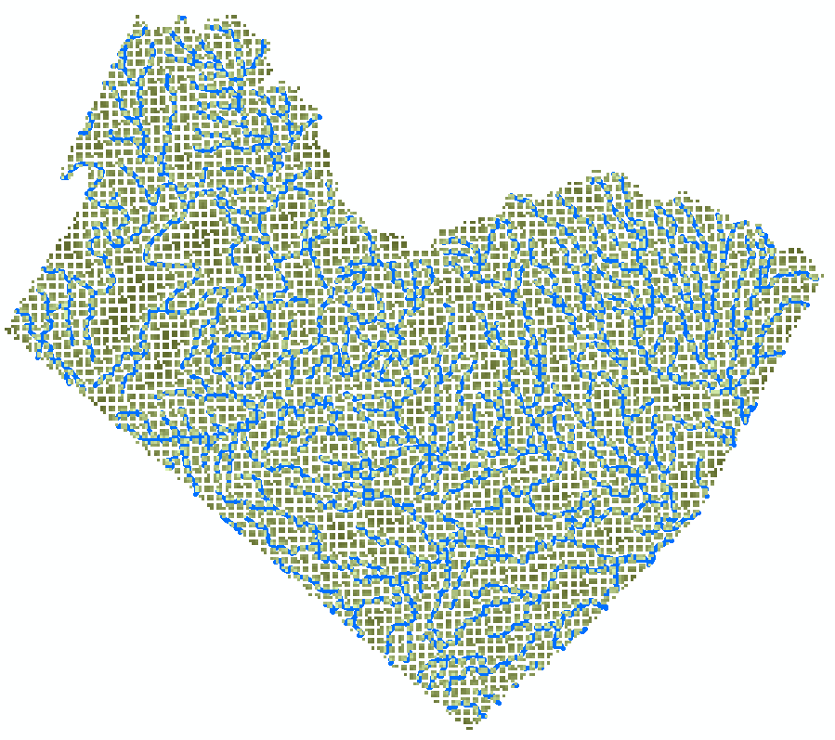
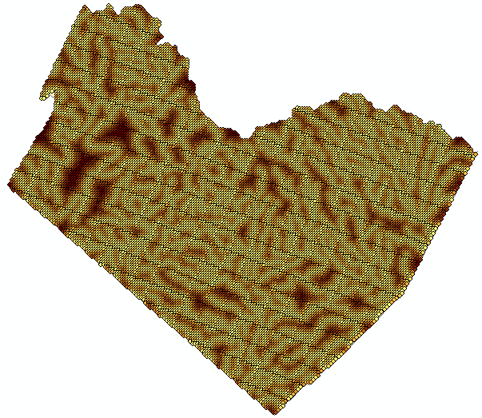
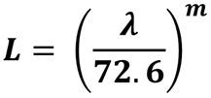
Slope Length
Horizontal Distance from
any point to stream
Near Function
  NHDPlus Flowlines
assumption: m=0.25
Notes:
Greek Letter is Lamda!; 72.6ft is the length standard erosion plot, m is variable slope length exponent
Error in Near Function- doesn’t necessarily mean downhill

Slide 6
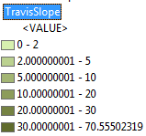
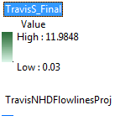
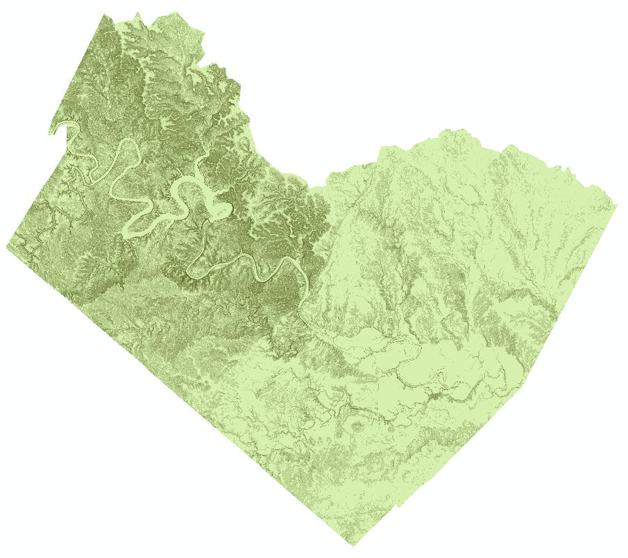
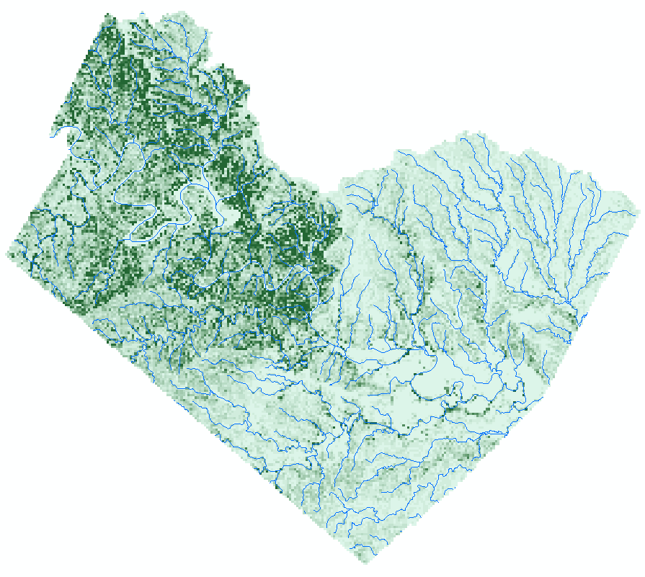
Slope Steepness
1/3” Seamless DEM
Projected to TX Lambert
preserves length
Slope to S

Slide 7
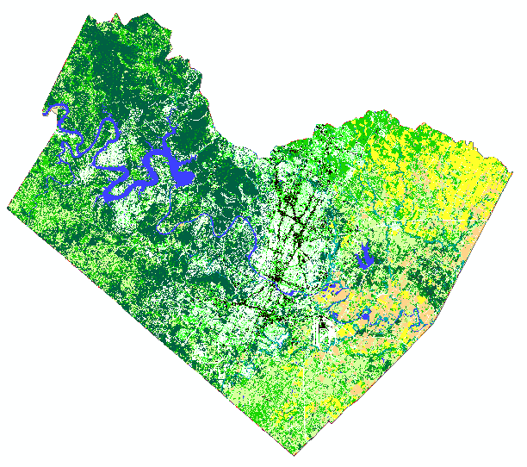
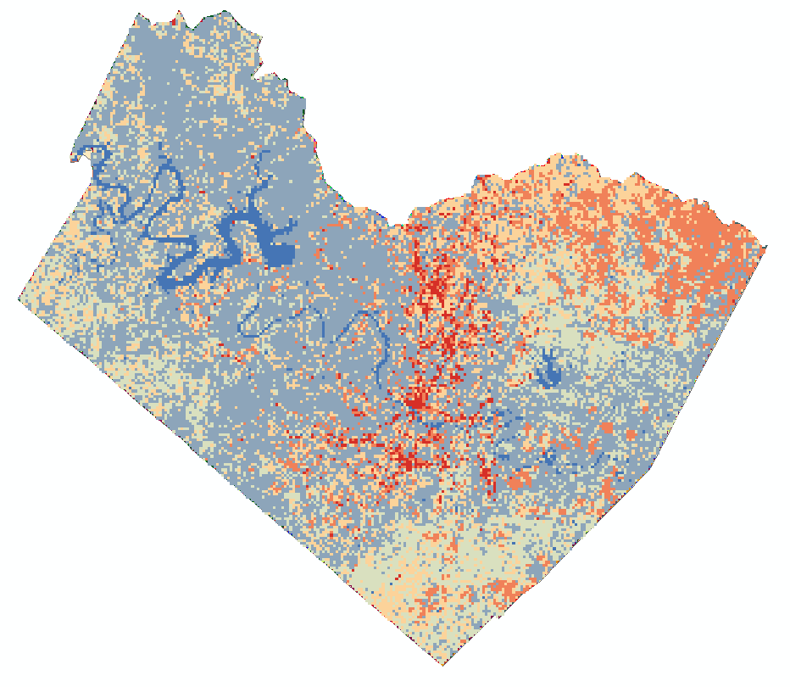
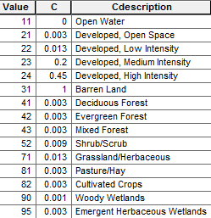
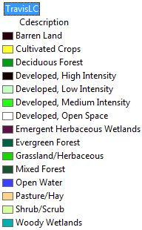
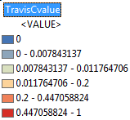
Cover Factor
USDA Soil Data
  Land Cover Classification
Land Cover to C value
Notes:
Sometimes known as Cover & Management Factor

Slide 8
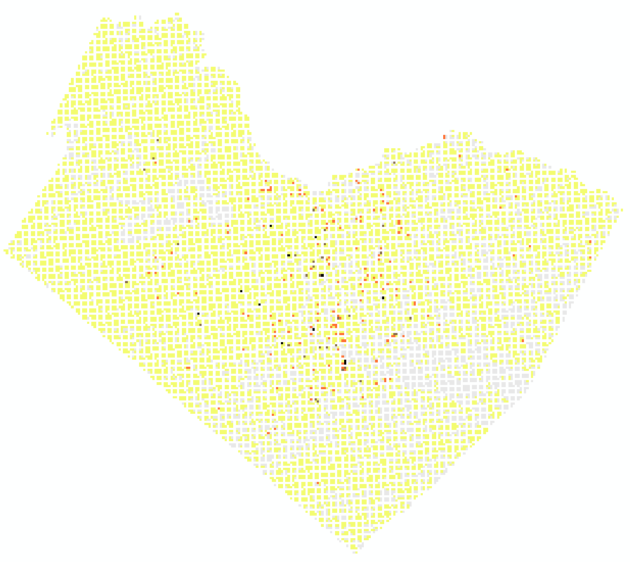
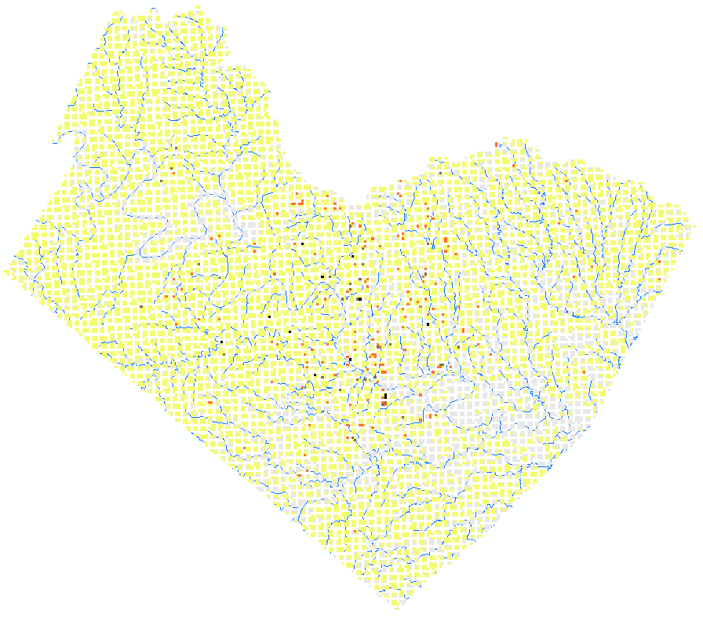
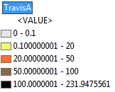
Average Annual Soil Loss
$$A=LS∗R∗K∗C∗P$$
Assumptions:
  R=260
  K=0.25
  P=1.0

Slide 9
Improvements
National Resource Conservation Services (NRCS)
  Rasters of K and T (Tolerable Soil Loss)
  Soil Data Viewer
Near Function
Level of detail
  100m to 30m to 3m
Time period
  Monthly average, N-year Event

Slide 10
My Research
Effectiveness of Polyacrylamides (PAM) at reducing stormwater runoff from construction sites
Incorporate P (support practice factor) into model
Model on the Small Scale
Model on the Large Scale
Notes:
Small scale- individual construction projects, understand how the change is going to impact soil erosion and what needs to be done
Large scale- understand what regions of the state are most susceptible to erosion

Slide 11
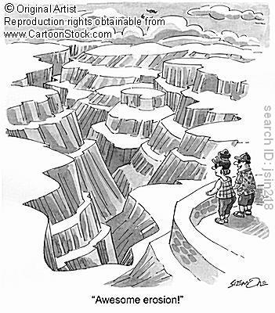
Questions
References:
Haan, C.T., Barfield, B.J. and Hayes J.C. (1994). Design Hydrology and Sedimentology for Small Catchments. Academic Press, Inc, California.
Khosrowpanah, S., Heitz, L., Wen, Y., and Park, M. (2007). “Developing a GIS-based Soil Erosion Potential Model of the Ugum Watershed.” Technical Report No. 117. Water Environmental Research Institute of the Western Pacfic, University of Guam.
USGS, http://seamless.usgs.gov/
USDA-NRCS, www.soils.usda.gov/survey/geography/ssurgo

