Slide 1
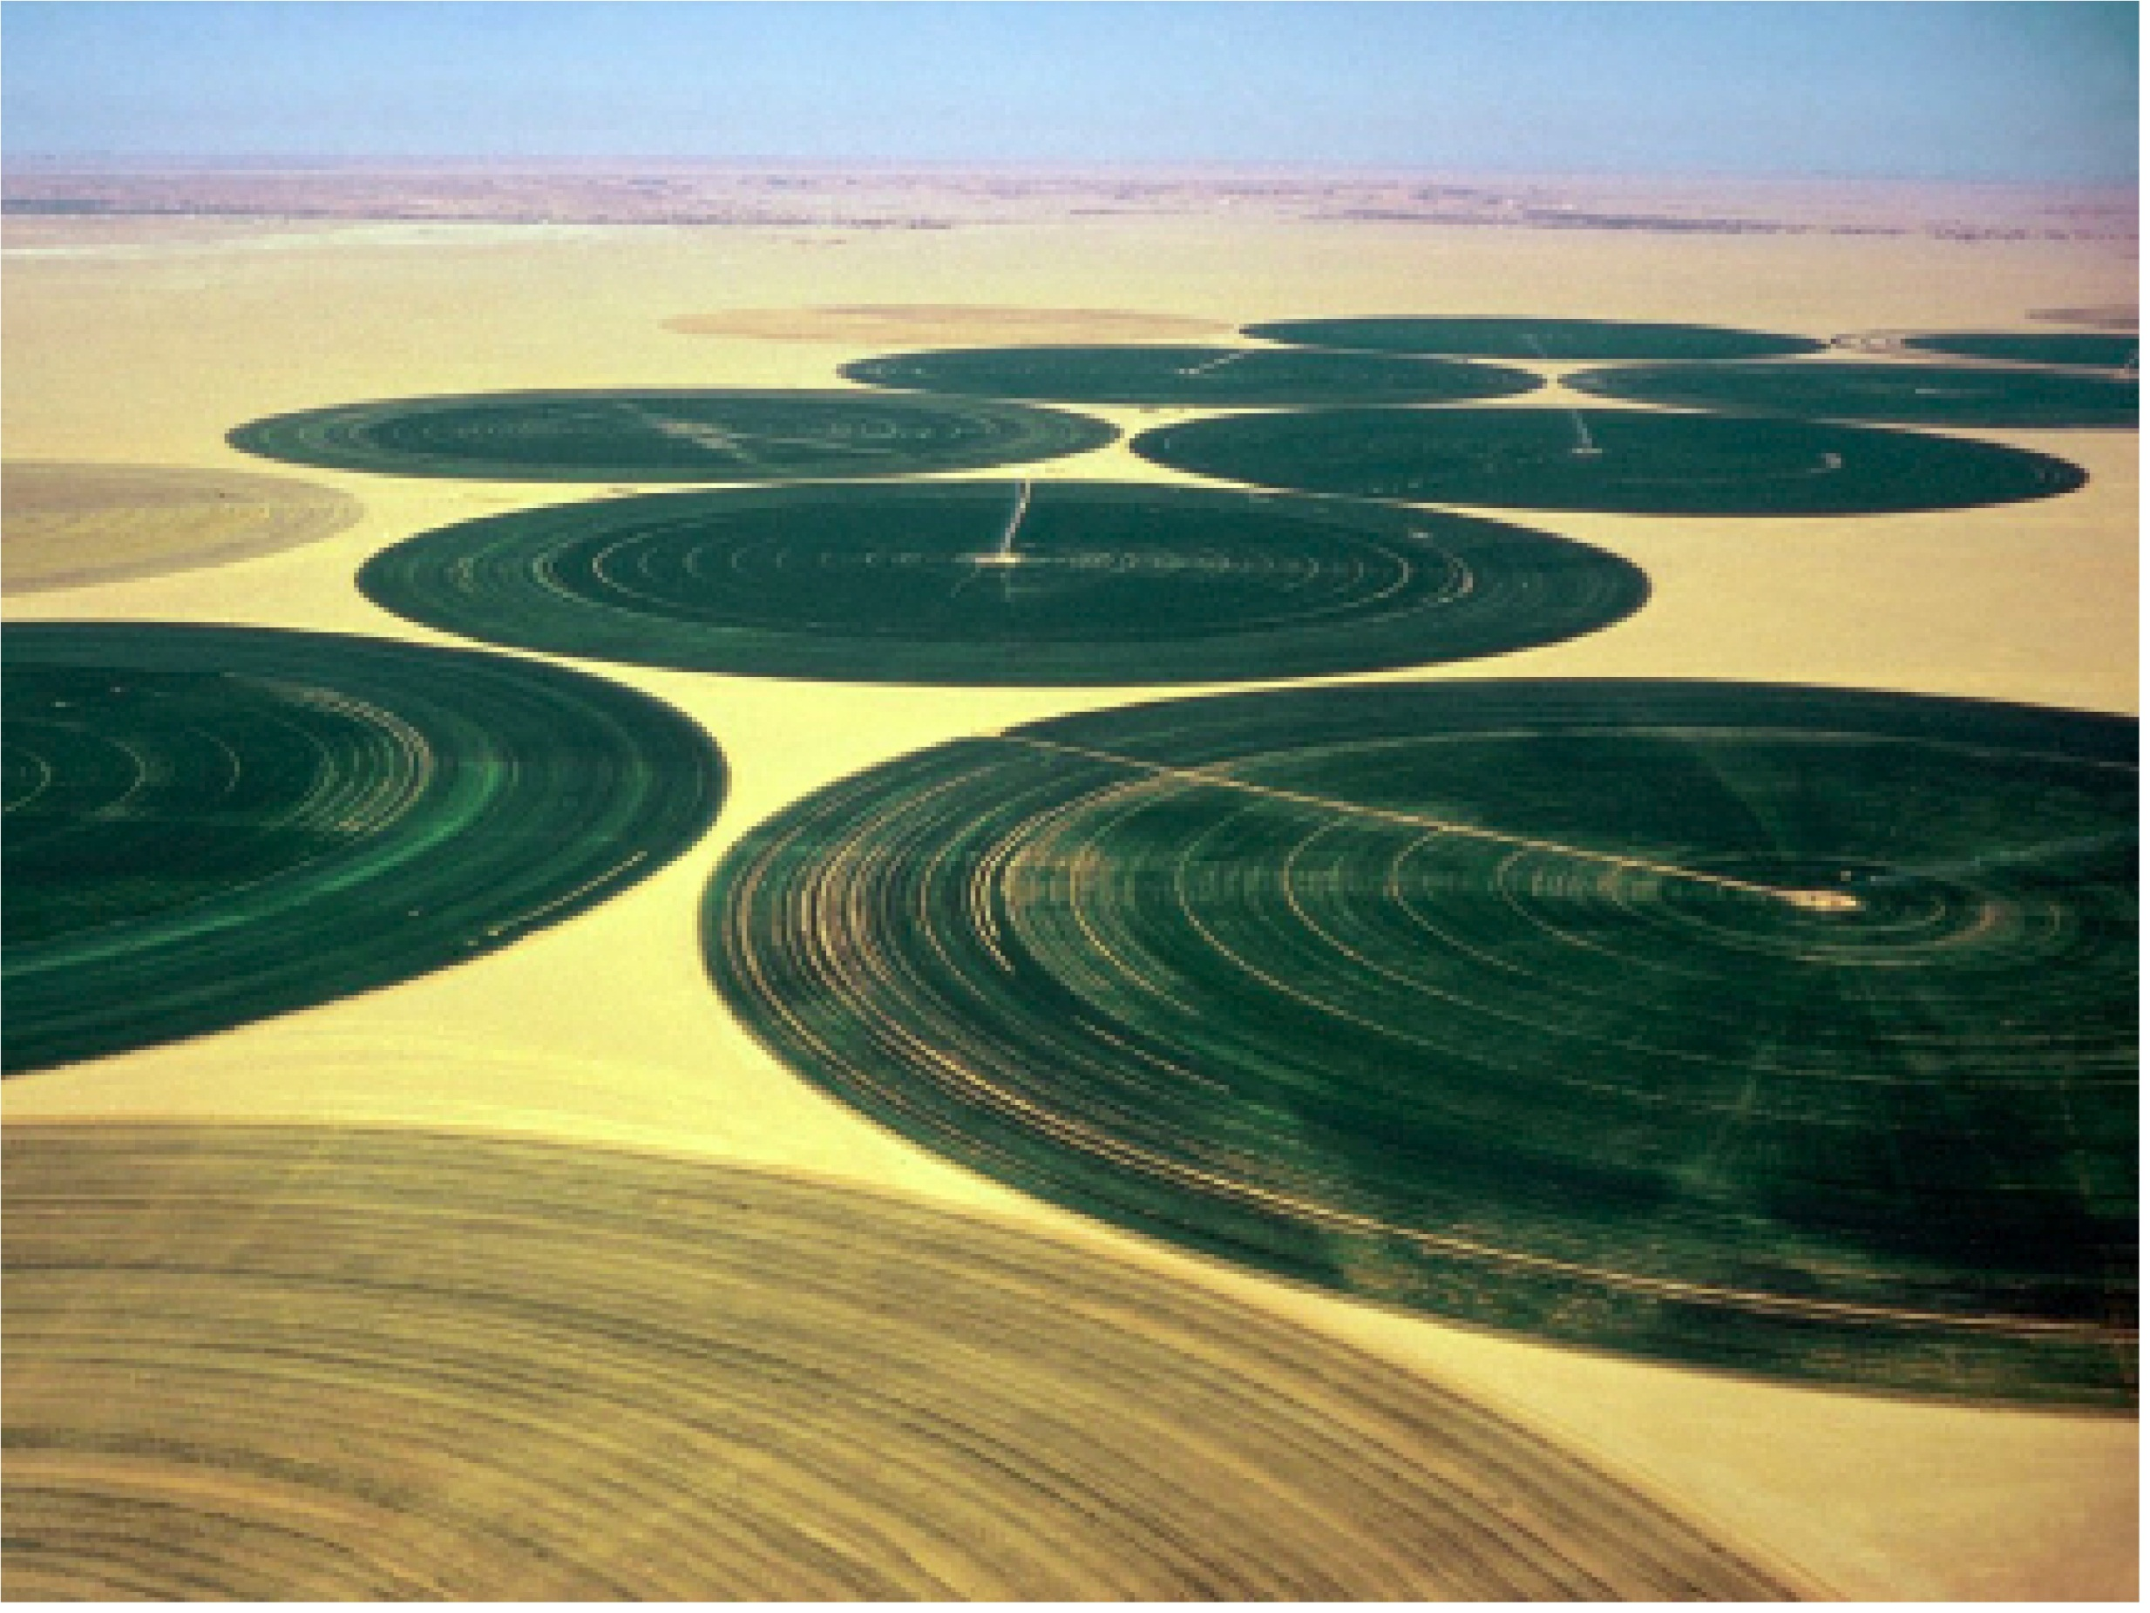
Remote Sensing of Evapotranspiration
The Surface Energy Balance Algorithm for Land (SEBAL)

Slide 2
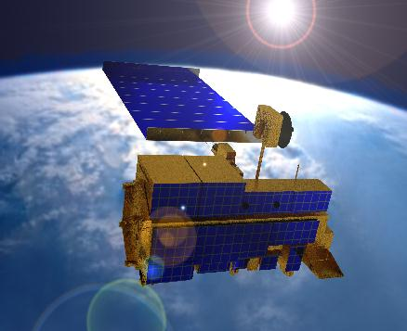
What is MODIS?
Moderate-Resolution Imaging Spectroradiometer
Launched in 1999 aboard the EOS AM (Terra); EOS PM (Aqua) followed in 2002
Monitors 36 spectral
bands between 0.4 μm
and 14.4 μm
Images entire Earth
every 1-2 days at 1 km
resolution
X data products provided by NASA
with full QA/QC

Slide 3
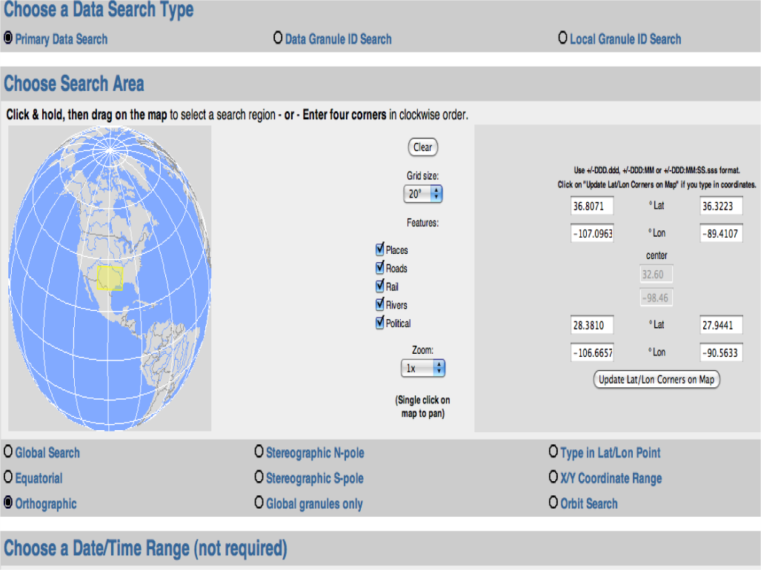
Accessing MODIS Data
Level 1 and Atmosphere Archive and Distribution System (LAADS)
Warehouse Inventory
Search Tool (WIST)
submits orders via
EOS ClearingHouse
(ECHO)
Direct access via FTP
HDF files can be manipulated with C, Fortran, Perl, MATLAB, IDL, Mathmatica and now ArcGIS

Slide 4
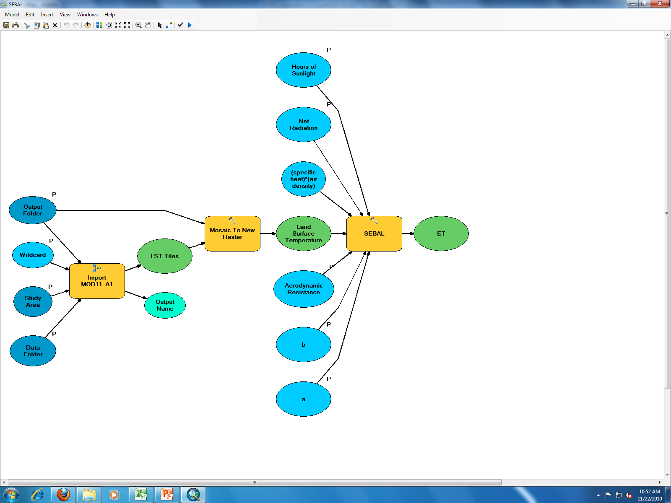
ET$=\left(Rn − \left(LST∗a+b\right)\frac{cp∗ρa}{rah}\right)∗3600 ∗ h/ 2450000$
Sensible Heat Flux

Slide 6
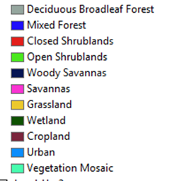
Evapotranspiration
and Land Use

Slide 8
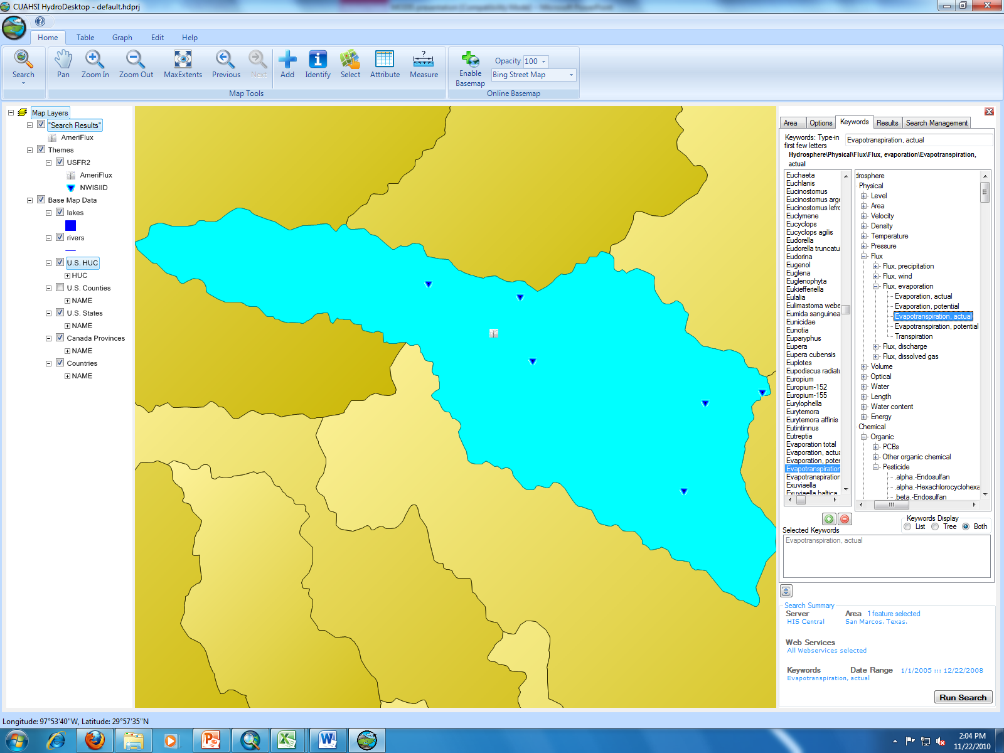
Validating the Method

Slide 11
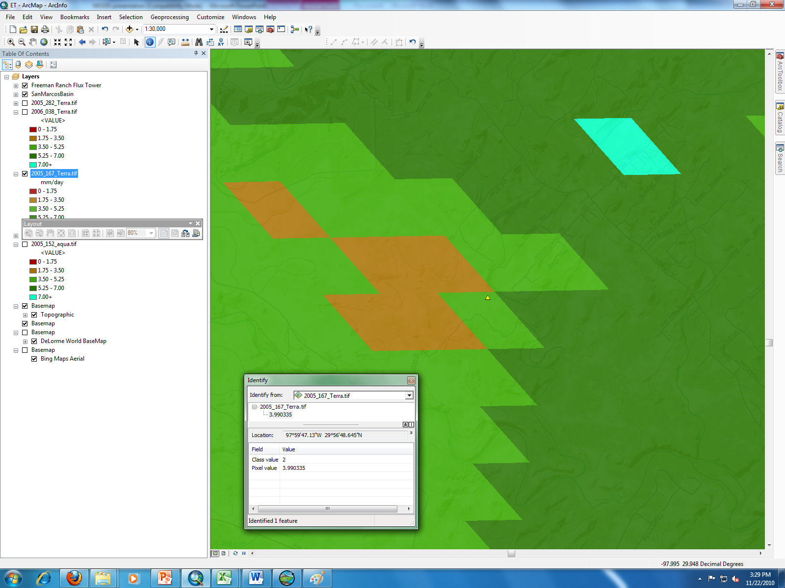
ET

Slide 12
SEBAL vs Flux Tower Data

Slide 13
Next Steps
Develop principle for constraining maximum evapotranspiration
Develop principle for estimating net radiation on cloudy days
Any Questions?

