Slide 1
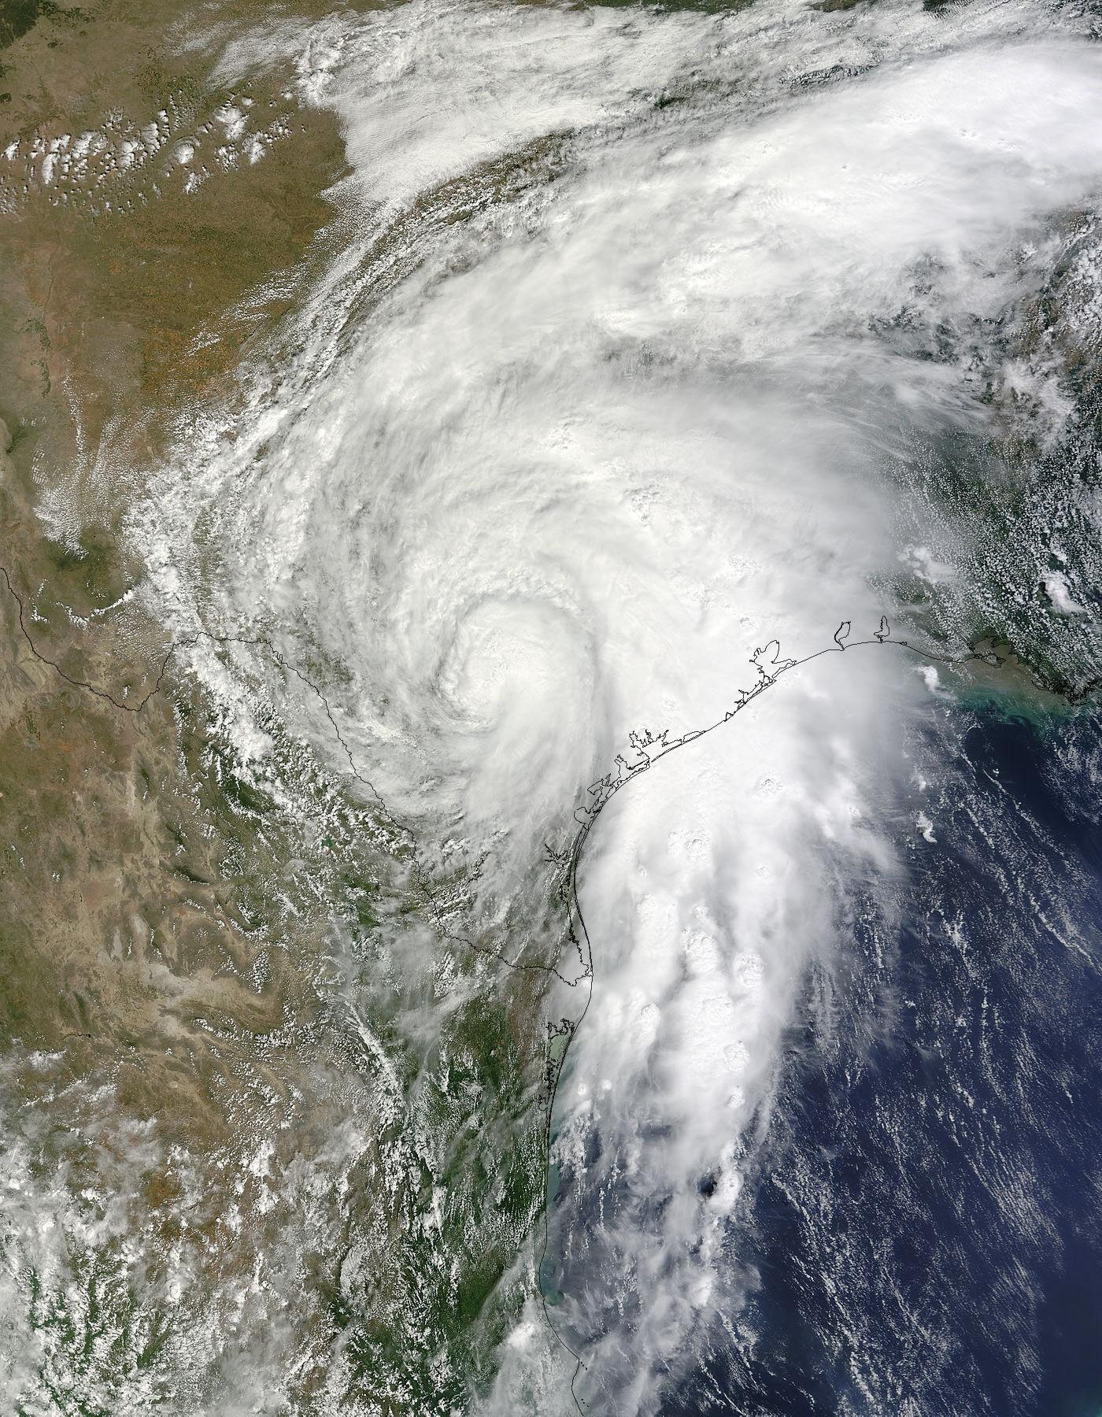
Tropical Storm Hermine & it’s Impact on Texas
Steven Vargas, PE

Slide 2
Introduction
Tropical Storm Hermine formed off the Bay of Campeche on September 3, 2010.
Over the next several days, Hermine produced record-setting rainfall, flooding and damage in Texas and primarily up and down the IH-35 corridor.
Because of the magnitude of flooding, the governor of Texas declared those areas affected by the storm as disaster areas.

Slide 3
Flooding after TS Hermine
8 fatalities
Over $115 million in property damage

Slide 4
Project Purpose
Perform an evaluation of the storm and its consequences in Texas
Storm Track
Precipitation
Stream discharge
Flooding area
Better understand water resource data and how to integrate different source data using ArcGIS

Slide 5
Data Sources
National Hurricane Center provides historical tropical cyclone track GIS data at: http://maps.csc.noaa.gov/hurricanes/viewer.html
National Climate Data Center provides NEXRAD Radar rainfall data at: http://lwf.ncdc.noaa.gov/oa/radar/radarresources.html
NHDplus provided surface water dataset of Texas
USGS stream gages & real time dataset
NEXRAD historical radar

Slide 6
Storm History &Track

Slide 7
Storm Precipitation
Rain gages
-419 rain gages operated by National Weather Service (NWS) in Texas
Radar data
-NEXRAD collected rainfall radar data

Slide 8
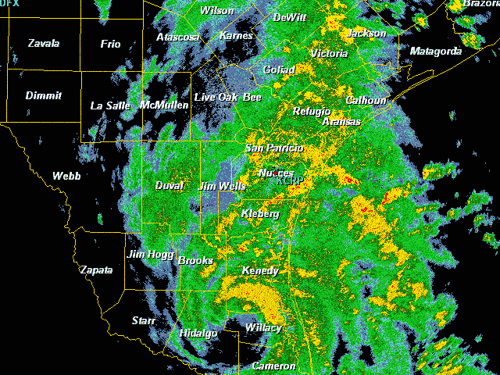
Landfall Radar on Sept 7, 2010

Slide 9
Storm Total Rainfall

Slide 10
Normal Rainfall for Sept 2010

Slide 11
Observed Rainfall for Sept 2010

Slide 12
Departure from Normal Rainfall for Sept 2010

Slide 13
Departure from Normal Rainfall for Sept 2010 as Percentage

Slide 14
Rainfall totals from TS Hermine for Sept 6-9,2010.

Slide 15
One-Day Rainfall totals from TS Hermine on Sept 8, 2010.

Slide 16
Texas Waterways-ArcGIS Layer

Slide 17
USGS Texas Gauge Locations

Slide 18
TX Mean Annual Flow (cfs)

Slide 19
TX Stream Flow Maxima (cfs) during Hermine Storm Event

Slide 20
Conclusion
Tropical Storm Hermine was a damaging tropical storm that hit areas within the IH-35 corridor particularly hard.
It wasn’t a particularly abnormal storm but the training effect of rain bands made it destructive.
Area infrastructure was not adequate to mitigate the subsequent flooding.

Slide 21
Questions?

