Slide 1
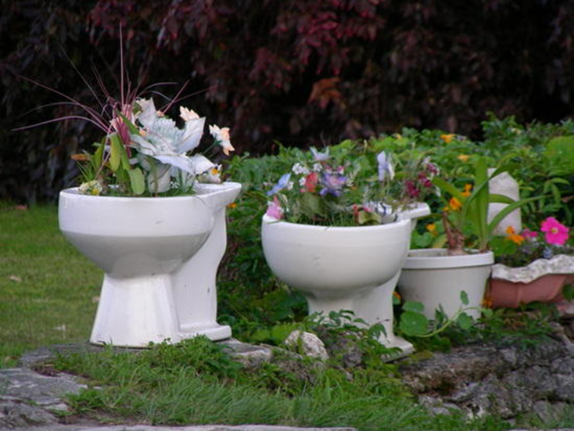
Wastewater Reuse Expansion in Austin
Ryan Grosskopf

Slide 2
Austin Wastewater Reuse
2009
5.2 MGD
15 MGD
Primary Uses
Cooling water
Golf courses
2034
Landscape irrigation
Avg potable water production of 142 MGD
Avg water production ???
Summer residential landscape use: ~25%

Slide 3
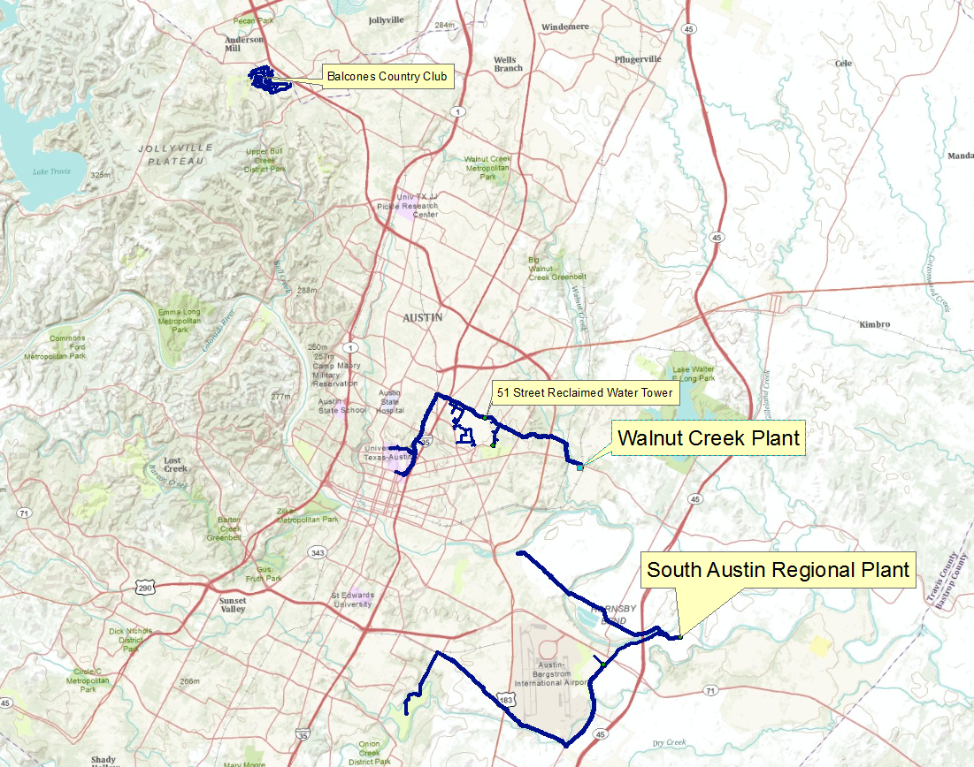
Centralized Austin Reuse

Slide 4
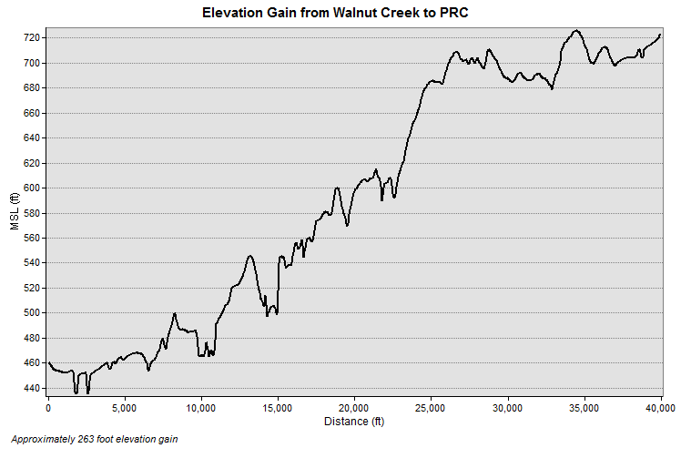
Problem?

Slide 5
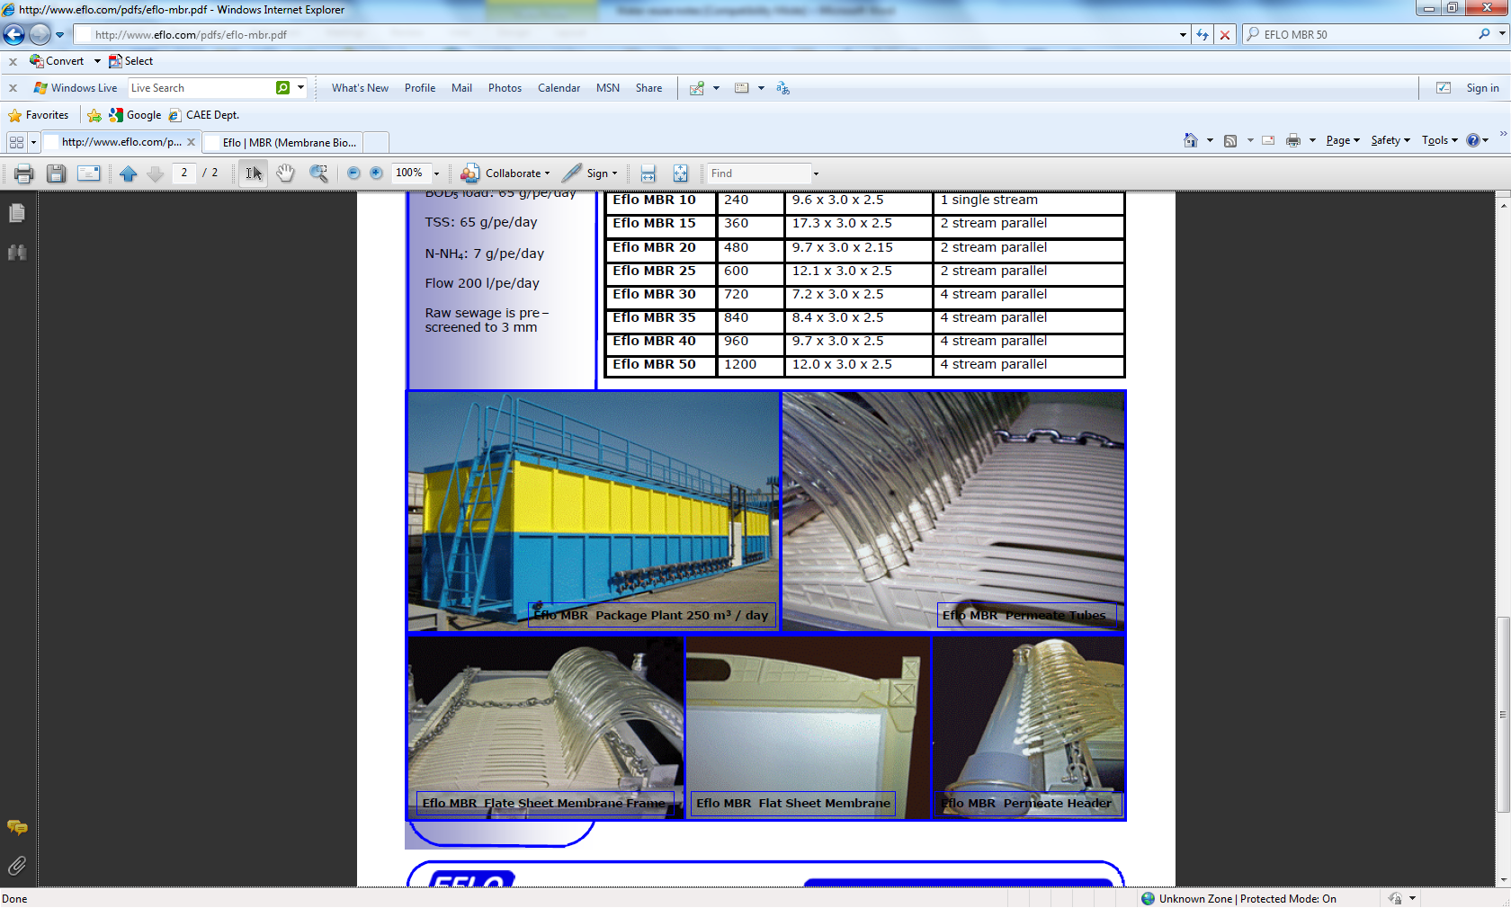
Possible Solution: MBRs and Decentralized Reuse
Small Footprint
Low maintenance
Sewer mining
$7-20 / gallon capacity
http://www.eflo.com/pdfs/eflo-mbr.pdf
250 m³/day or about 66,000 gpd

Slide 6
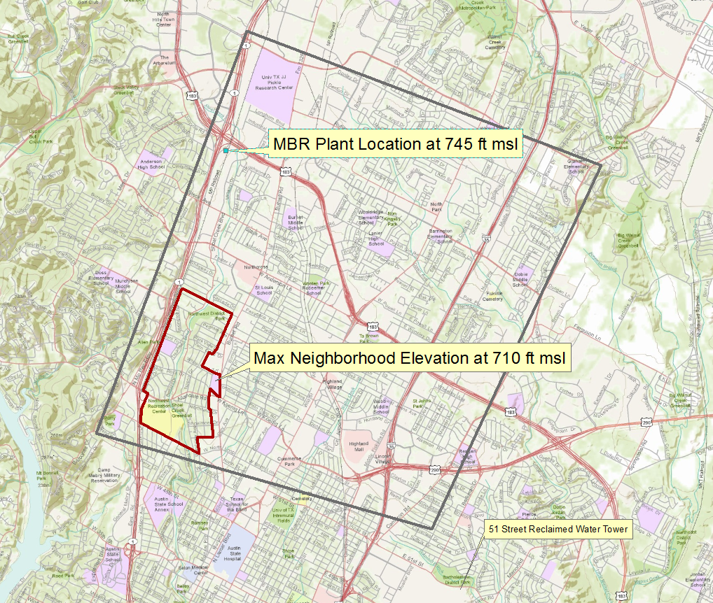
Where?
Determine Treatment Plant and Use Locations
City of Austin
USGS
2008 Land Use Dataset
2010 Wastewater and Reuse Network Data
1/3’ DEM

Slide 7
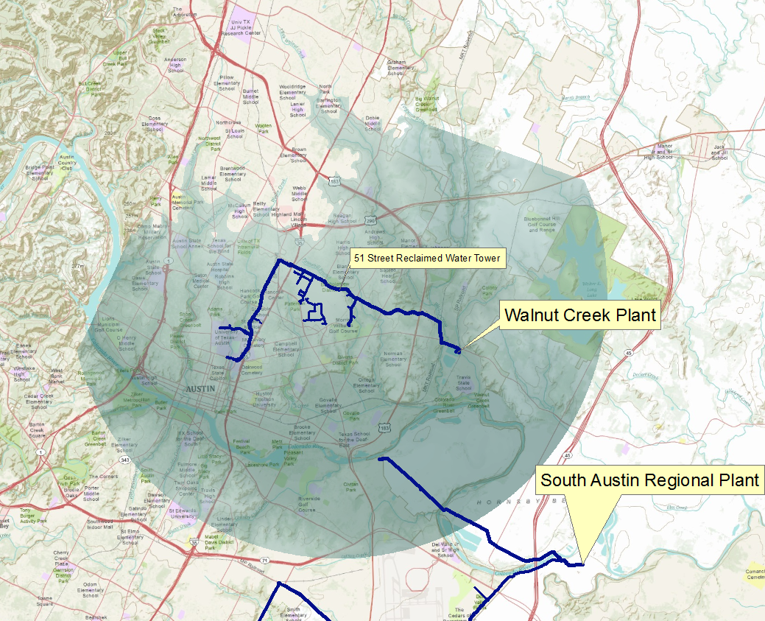
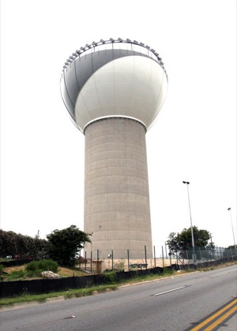
Current Infrastructure Limitations: 51st Street Tower
http://www.austinchronicle.com/

Slide 8
Which Neighborhood for Service?
Accuwater Evapotranspiration Index
2009 annual average:
.042 inches/day
Package MBR plant capacity
.025-.300 MGD
Elevation
~70 feet of head required for irrigation sprinklers
Land Use | Irrigated Area
Single Family | 40%
Duplexes | 30%
Apartment/Condo | 0%
Commercial | 0%
Office | 0%
Government Services | 0%
Educational | 20%
Meeting and Assembly | 0%
Cemetaries | 75%
Parks/Greenbelts | 20%
Undeveloped | 0%
Evaluation by hand…. TEDIOUS!
Notes:
Accuwater provides an evapotranspiration index for Austin based on turf, wind, precipitation, cloud cover, and temperature
2009 annual average: .042 in/day

Slide 9
Selected Neighborhood Land Use by Area:
~95% of property area likely has some irrigation

Slide 10
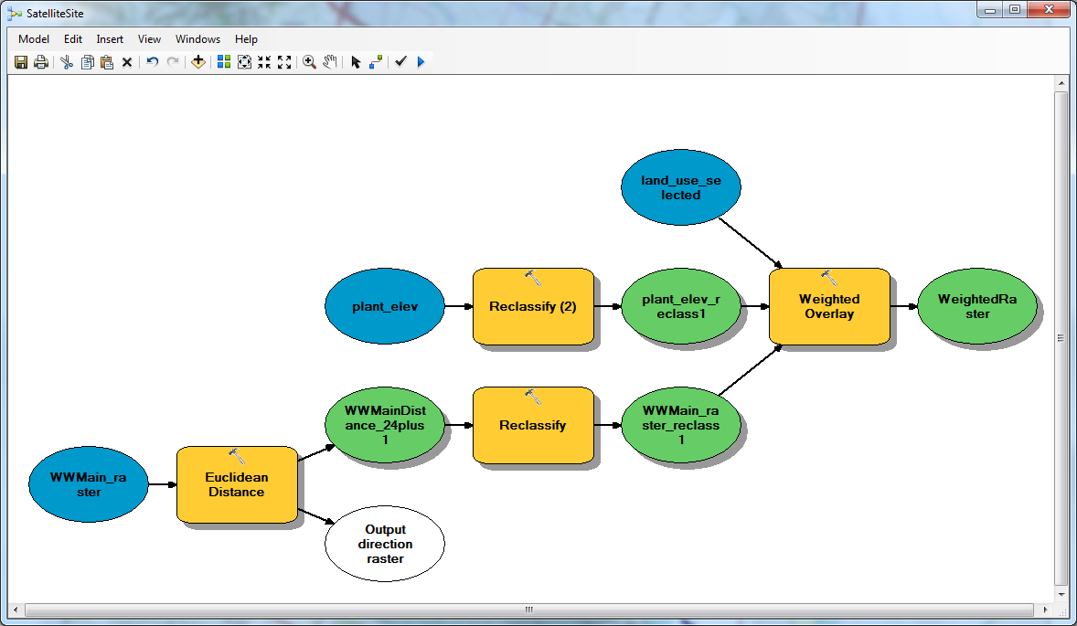
Plant Location
Distance from > 24” wastewater main
Elevation gain from neighborhood
Property type and size

Slide 11
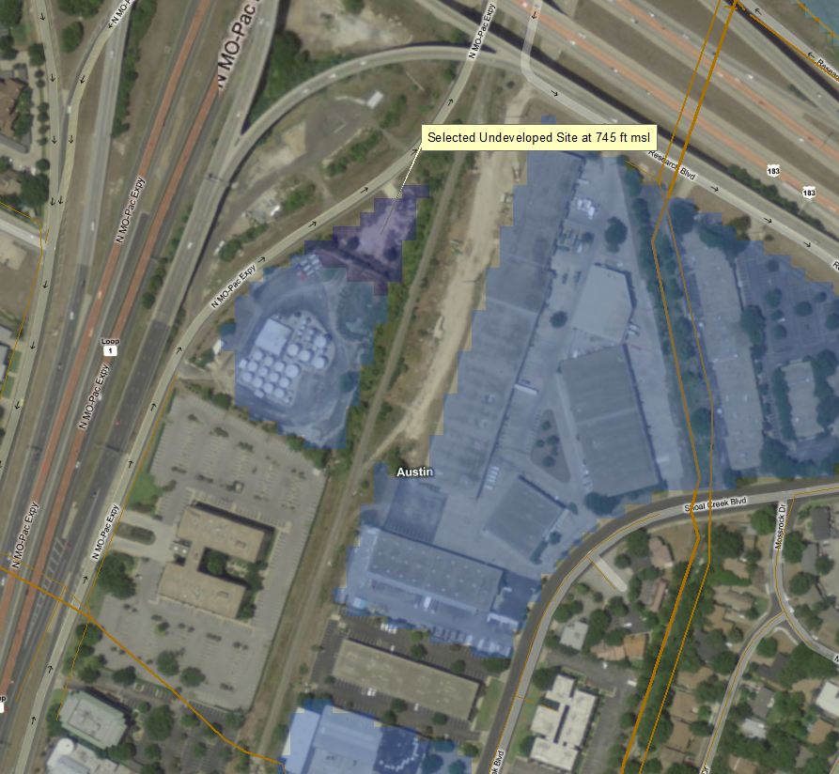
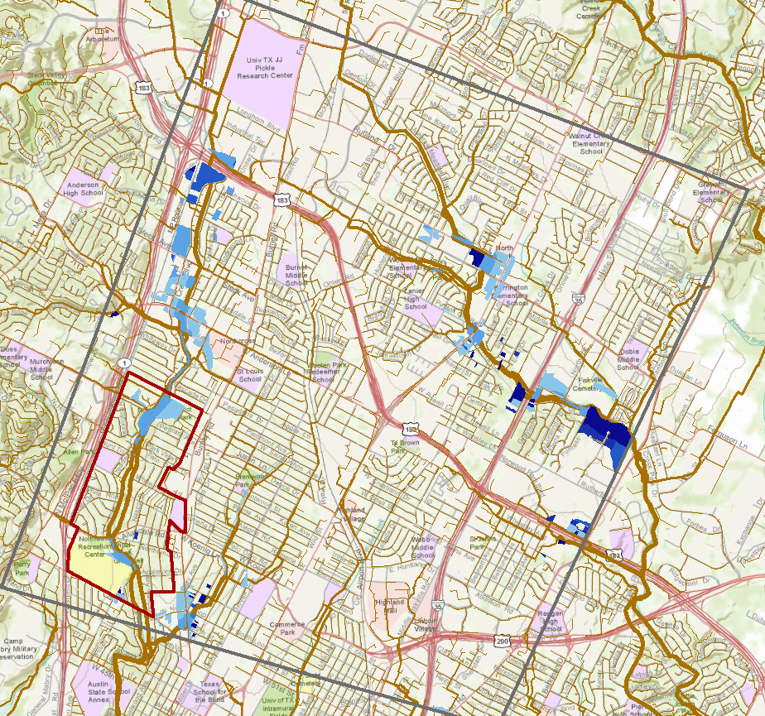
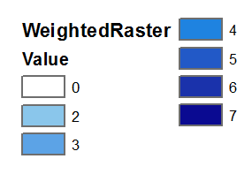
Jackpot!

