Slide 1
Flood Mapping
Prabhas Ranjan Gupta
30th November 2010

Slide 2
Introduction
Floods are the leading cause of natural disaster losses in the US (NRC, 2009).
Need for more accurate flood maps.
FEMA FIRMs
Flood depth and flood extent

Slide 3
Precipitation data
Rainfall-Runoff Model
Hydraulic model
Flood surface elevation
1
2
Terrain
Flood Map

Slide 4
Precipitation data input
WaterML
DSS
Rainfall runoff model: HEC-HMS
Precipitation data entry: manual/HEC-DSS
DSS Visual Utility Engine (DSSVue): WaterML plug-in
Precipitation data: National Weather Service (NWS)
WaterML format
HydroDesktop, HydroExcel: issues
Data source: CRWR Map Service

Slide 5
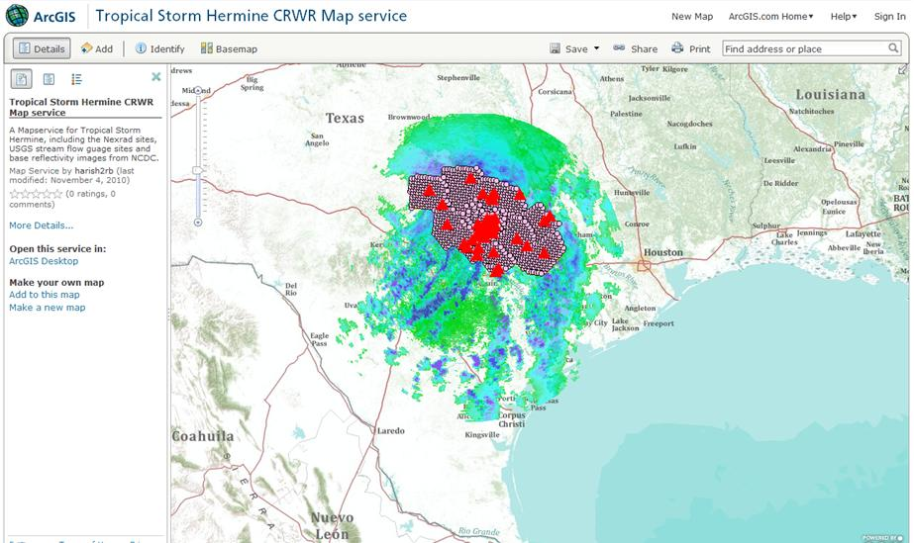

Slide 6
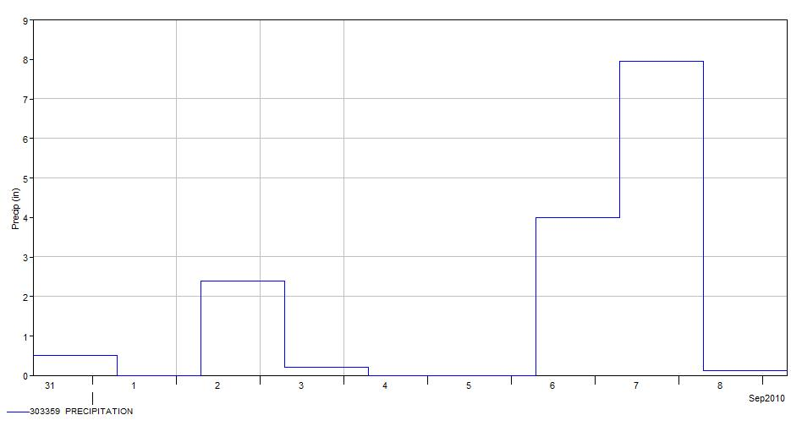
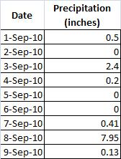
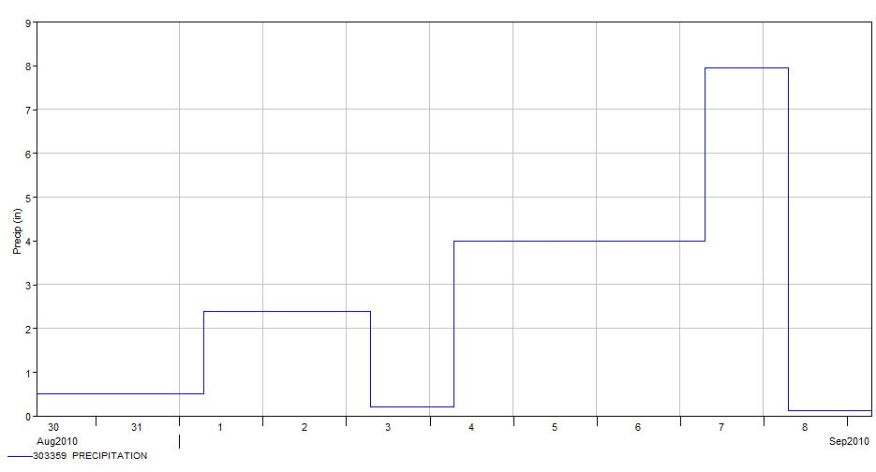
WaterML plug-in: issues
Actual data
After import
(Data for representation purposes only)

Slide 7
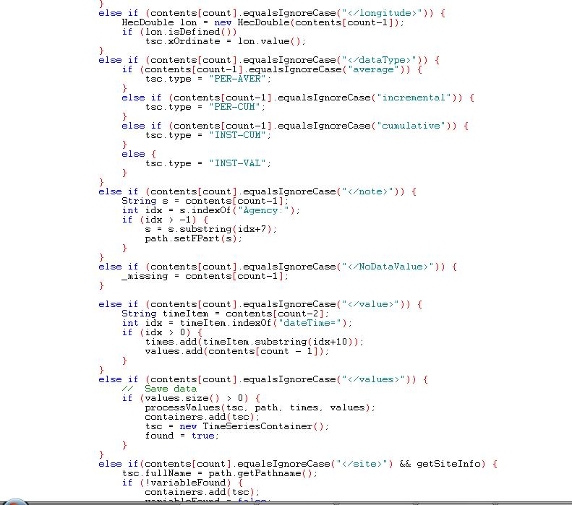

Slide 8
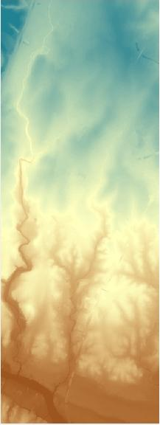
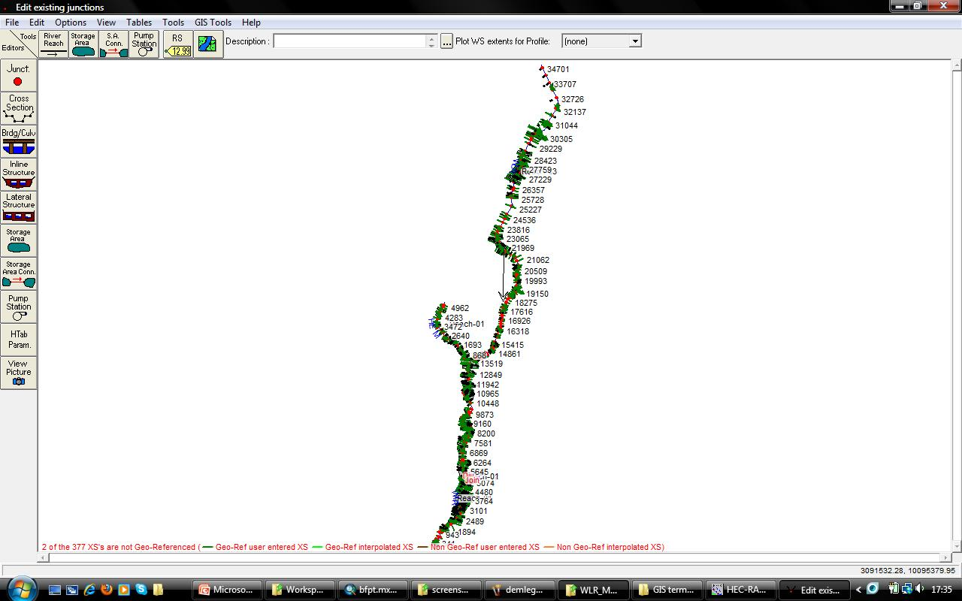
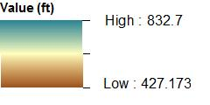
Creating a flood map: inputs

Slide 9
HEC-GeoRAS: extension for ArcGIS
HEC-GeoRAS doesn’t support ArcGIS 10 yet.
HEC-RAS
RAS Mapper
DEM
ArcMap
Flood extent
Basemap
Flood map

Slide 10
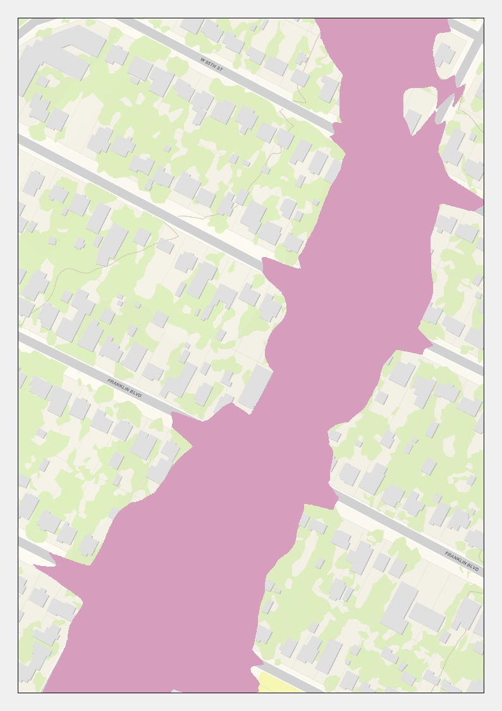

Slide 11
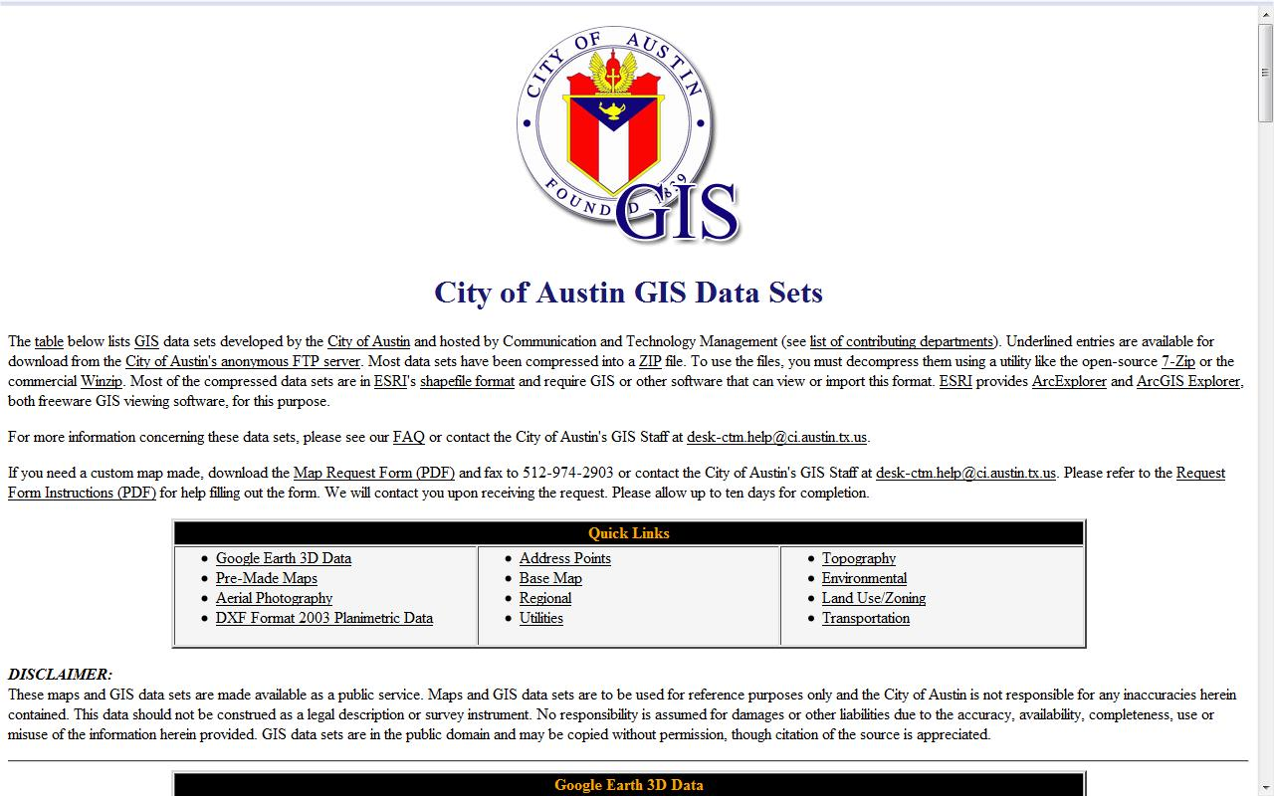
‘Burning’ buildings elevations into the DEM
Building footprints from the City of Austin.
(ftp://ftp.ci.austin.tx.us/GIS-Data/Regional/coa_gis.html)

Slide 12
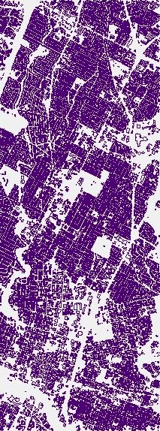
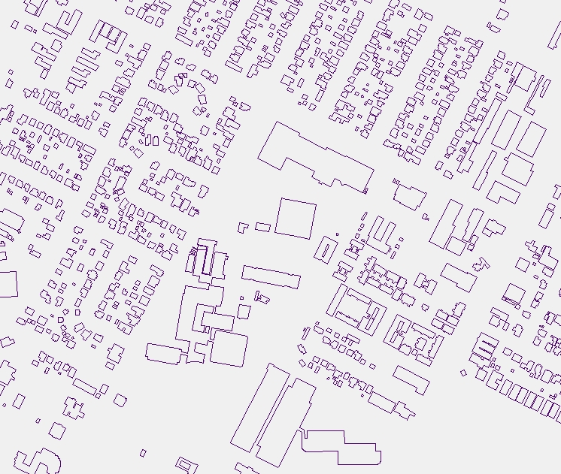

Slide 13
(screenshot from ArcScene 10)

Slide 14
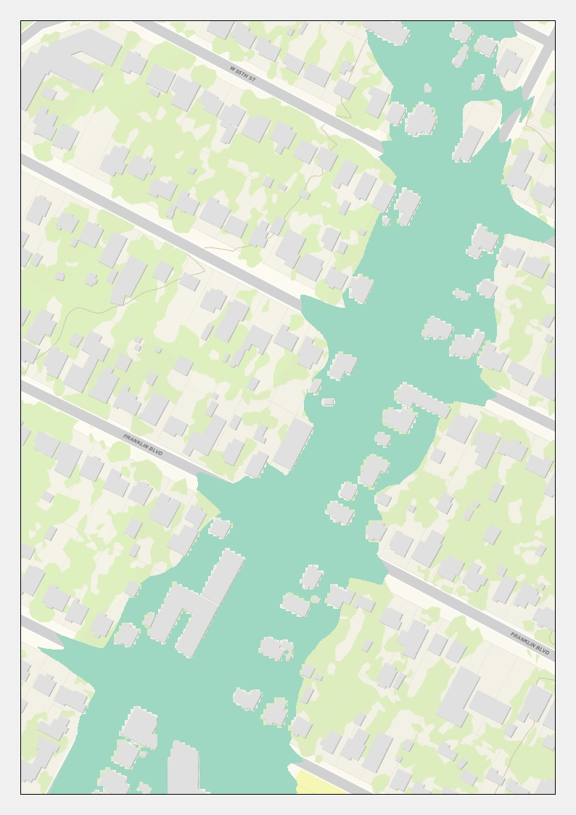
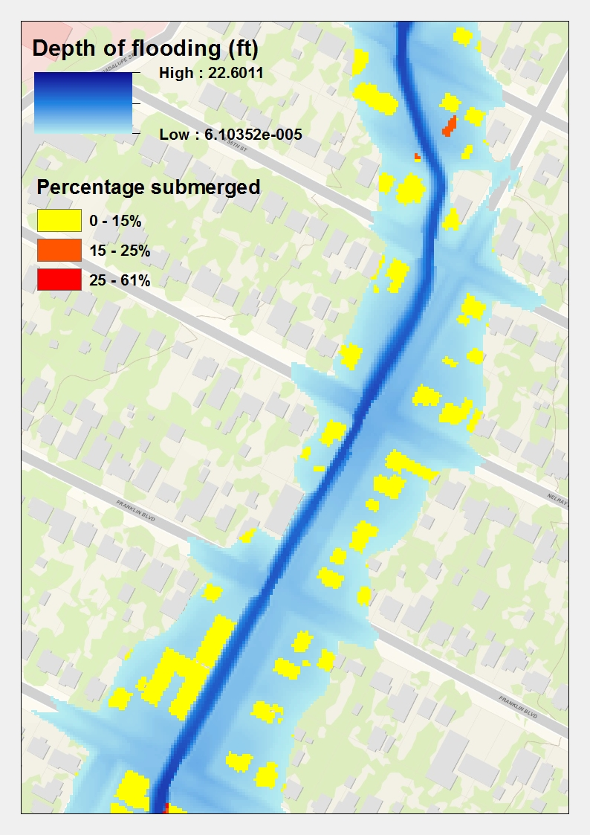

Slide 15
Future work: real-time flood mapping
Can floods be mapped as they occur?
Stage data from gages available in real-time.
Interpolation of water surface elevations.

Slide 16
References
NRC, 2009. Mapping the Zone: Improving Flood Map Accuracy, National Academies Press, Washington, D.C., 136pp.; available online at <http://www.nap.edu/catalog.php ?record _id=12573#toc >.
City of Austin GIS Data sets:
< ftp://ftp.ci.austin.tx.us/GIS-Data/Regional/coa_gis.html >

