Slide 1
Rainwater Harvesting in Austin, TX

Slide 2
Outline
Describe interest in rainwater harvesting
Estimate potential collection area
Use precipitation data
Estimate collected volume

Slide 3
Rainwater Harvesting
Only cost is personal system maintenance
Rainwater has very low hardness
Important alternative source as population increases

Slide 4
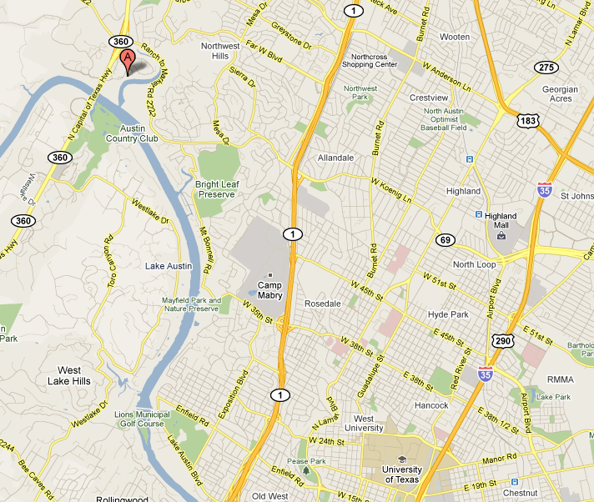
Site of Interest

Slide 5
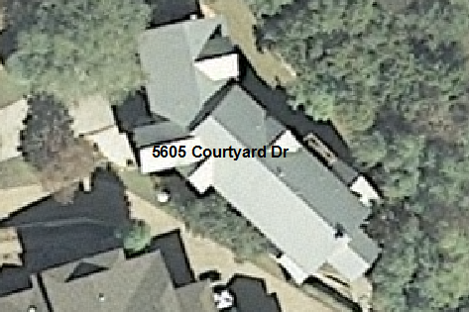
Estimating Roof Surface Area
ArcGIS 10
6 inch orthoimage available from CapCOG
2761 ft²

Slide 6
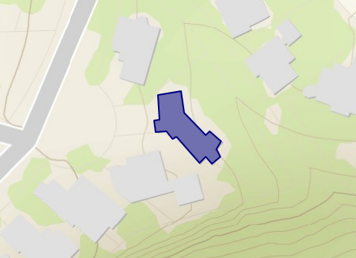
Estimating Roof Surface Area
ArcGIS Explorer
Free online version
2568 ft²
~200 ft² difference
Less resolution?
User error?

Slide 7
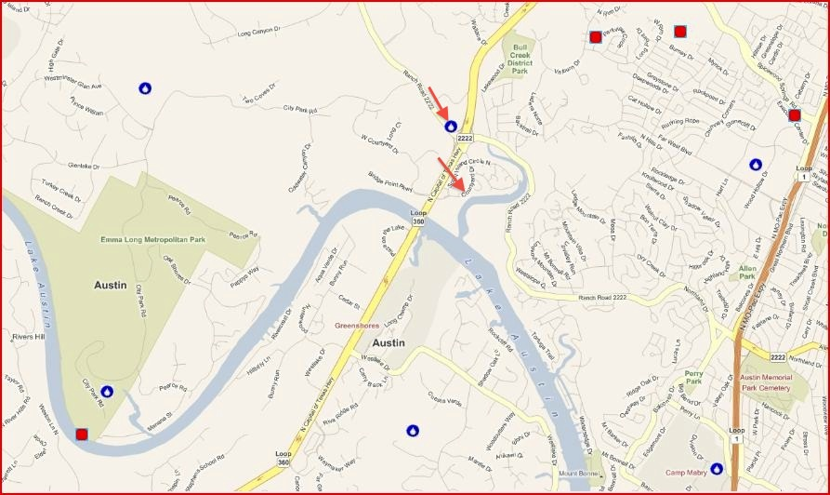
Finding Precipitation Data
Hydro Desktop – free and open source
Identified 6 gauges with robust data close to house
NOAA’s National Weather Service West Gulf River Forecast Center

Slide 8
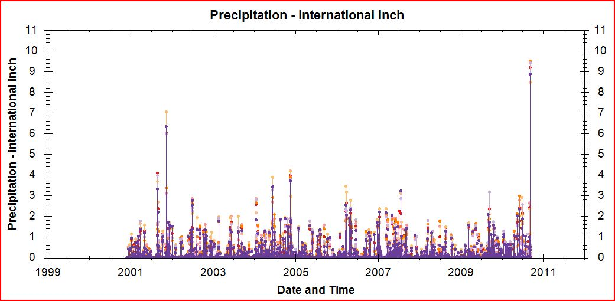
Assessing Precipitation Data
Histogram with data from all 6 sites
Rainfall localized, but gauges have similar spikes

Slide 9
Yearly Precipitation
Used gauge closest to house
A lot of rain during 2004
Draught in 2008 and into 2009
Date Range | Yearly Sum (in)
11/29/00-11/29/01 | 35.19
11/30/01-11/29/02 | 33.76
11/30/02-11/29/03 | 19.88
11/30/03-11/29/04 | 49.32
11/30/04-11/29/05 | 22.72
11/30/05-11/29/06 | 26.29
11/30/06-11/29/07 | 40.27
11/30/07-11/29/08 | 16.77
11/30/08-11/29/09 | 30.82
11/30/09-09/14/10 | 40.31

Slide 10
Estimating Collected Volume
70 gal/day/person (American Water Works Association)
193 m³/year for two people
Build a tank and let it fill for 1 year
Assume perfect capture

Slide 11
Water Balance
Year | Volume Harvested (m³) | Volume Used (m³) | Volume Remaining (m³)
1 | 213 | 0 | 213
2 | 205 | 193 | 224
3 | 120.5 | 193 | 151
4 | 299 | 193 | 257
5 | 138 | 193 | 202
6 | 159 | 193 | 168
7 | 244 | 193 | 219
8 | 102 | 193 | 128
9 | 187 | 193 | 122
10 | 244 | 193 | 173

Slide 12
Conclusions
Could build a 300-400 m³ tank
Tanks have overflow spout
Handle very wet seasons
In Austin, most homes still connected to municipal water supply
Safe during a draught
Still should consult a designer of rainwater harvesting systems

