Slide 1
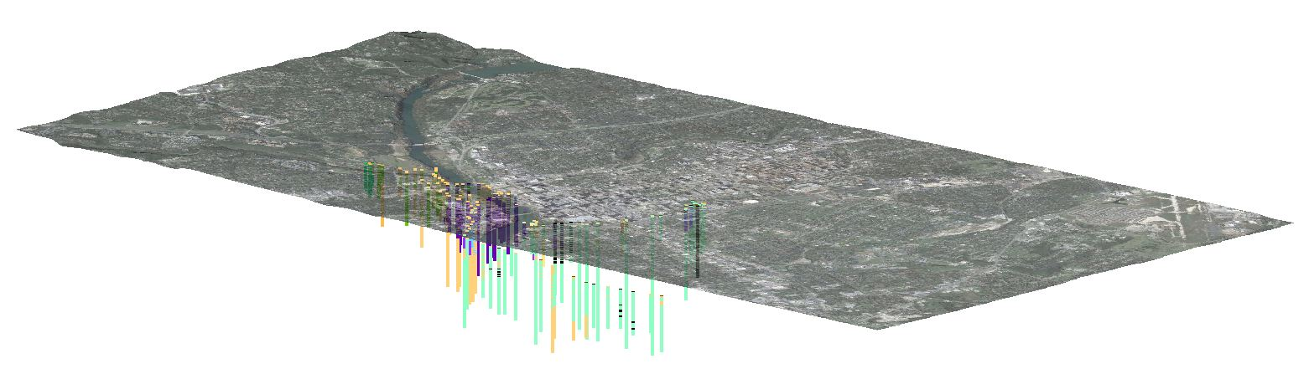
Soils and Geology of Austin, Texas
Robert Lawrence
November 30, 2010

Slide 2
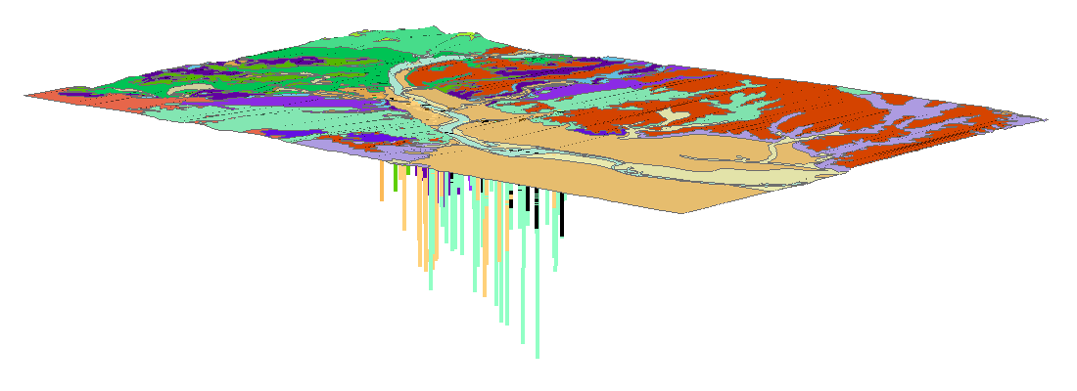
Overview
Austin Geology
Project Set Up
Analyzing Data
  Identifying Faults
  Zoning and Planning
  Piezometric Data
Conclusions

Slide 3
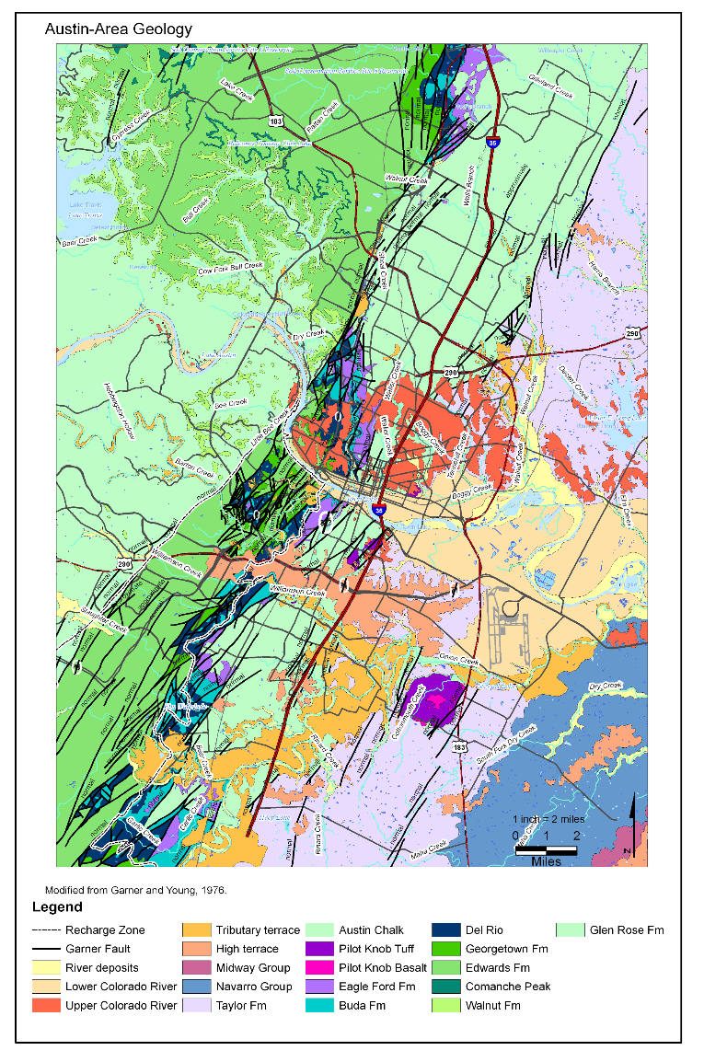
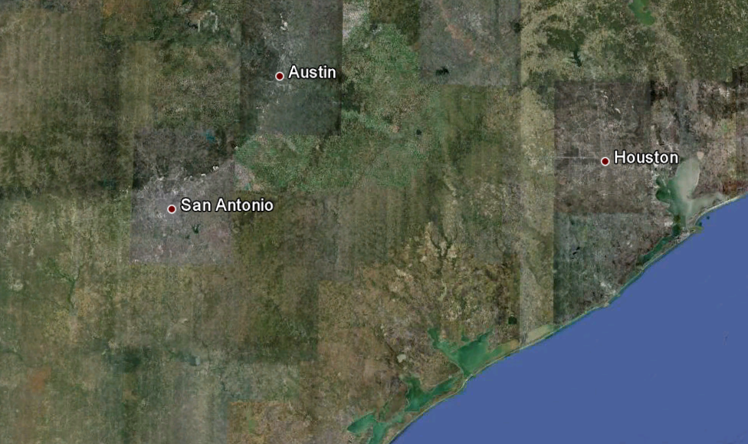
Austin Geology
Two Primary Features:
- Balcones Fault System
- Colorado River

Slide 4
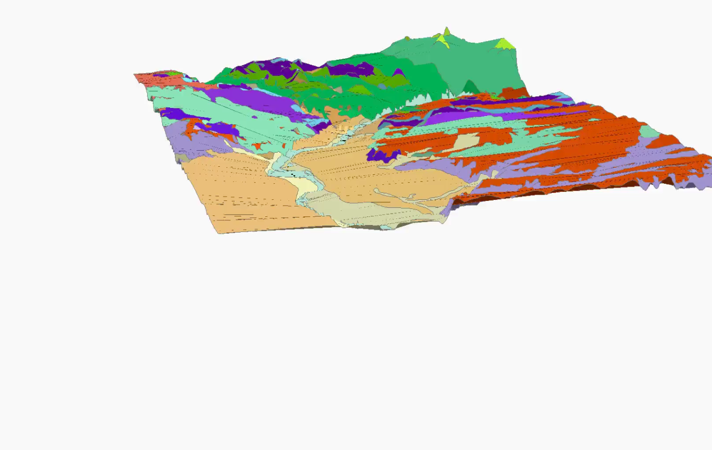
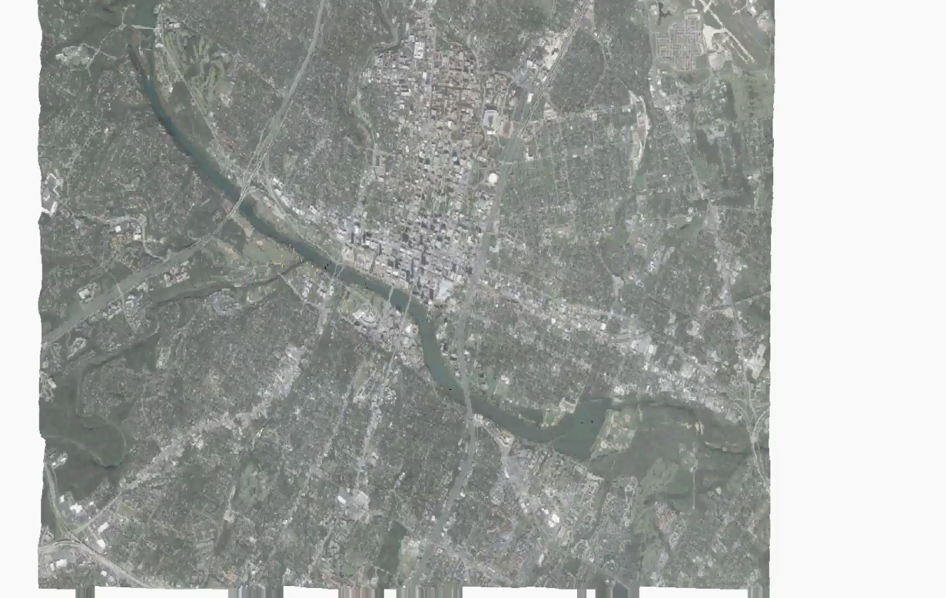
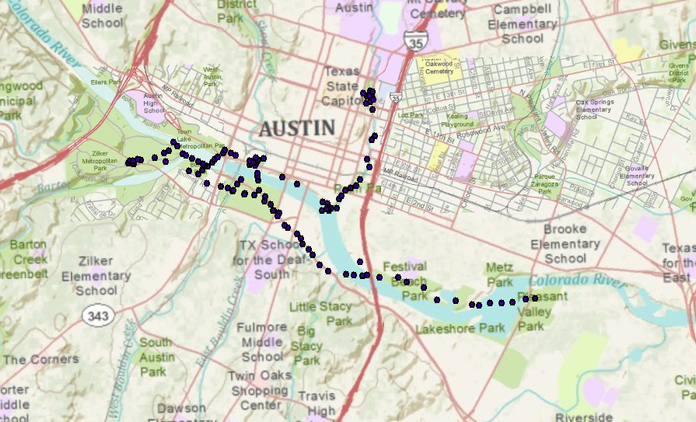
Project Set Up
Access Database
Query X, Y, Z
Create Shapefiles
ArcMap – 2D
ArcScene – 3D

Slide 5
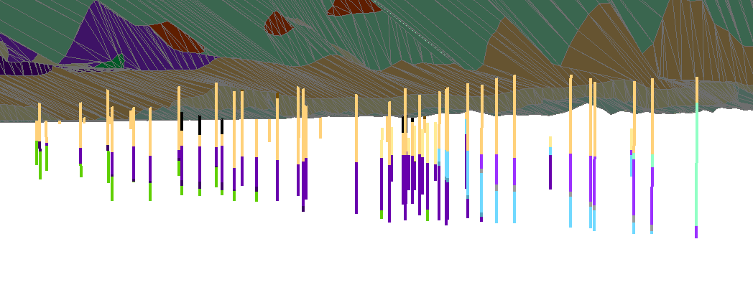
Finding Faults
Arc Scene
  Easy to Identify “Odd” Areas
ArcMap
  Query “Odd” Area
  Use 3D Analyst

Slide 6
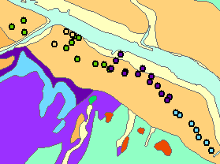
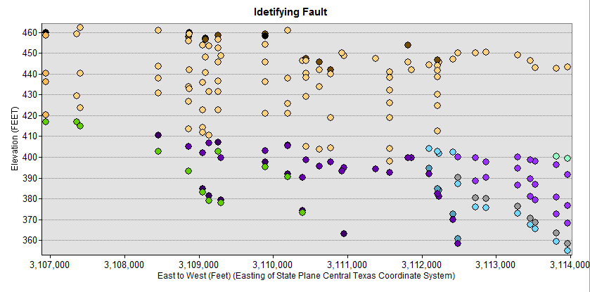
Finding Faults
2 ways to view:
  3D analyst in ArcMap
  3D view in ArcScene

Slide 7

Zoning and Planning
Look at Strength Parameters
  RQD (Rock Quality Designation)
  Undrained Shear Strength (Strength of Soil/Rock)
Possible Additions to Database
  Pipelines
  Electric, etc. Utilities
  Foundations
  Zoning Underground

Slide 8
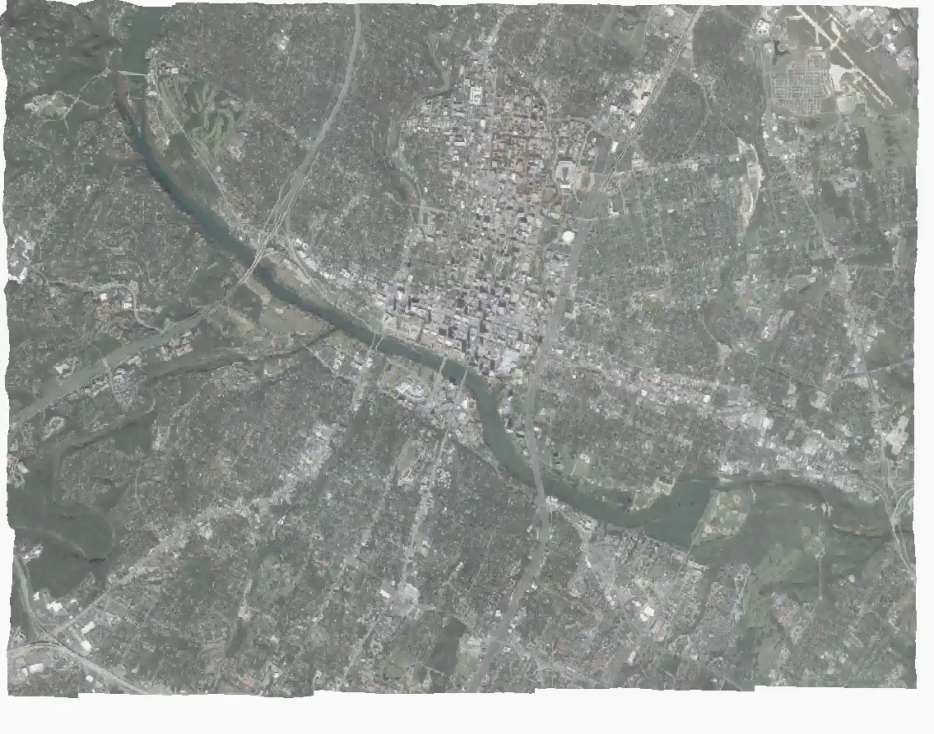
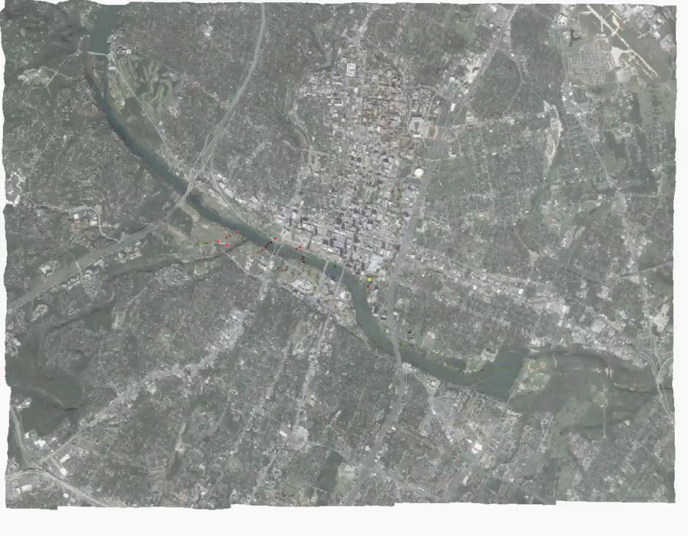
Zoning and Planning
RQD
Undrained Shear Strength
Green – 100 percent
Red – 0 percent
Green – stronger
Red – weaker

Slide 9
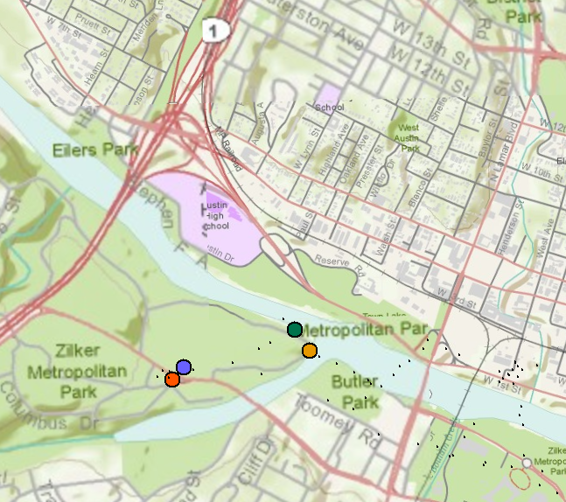
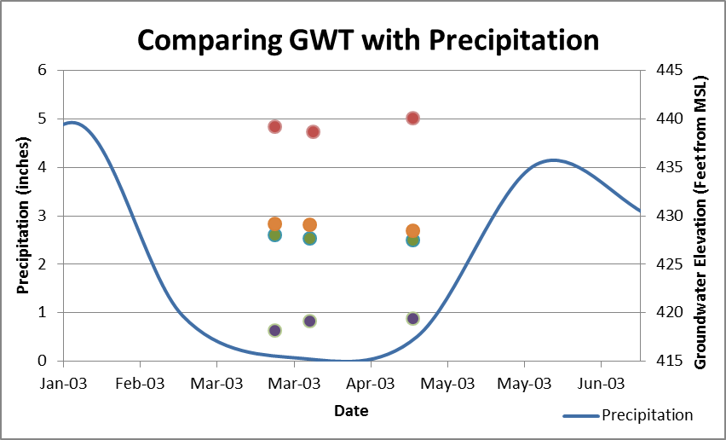
Piezometric Data
Currently Limited Data
Ground Water is Complicated
Purple Dot ≠ Red Dot
  Water Main Issues?
  Karst Formation?

Slide 10
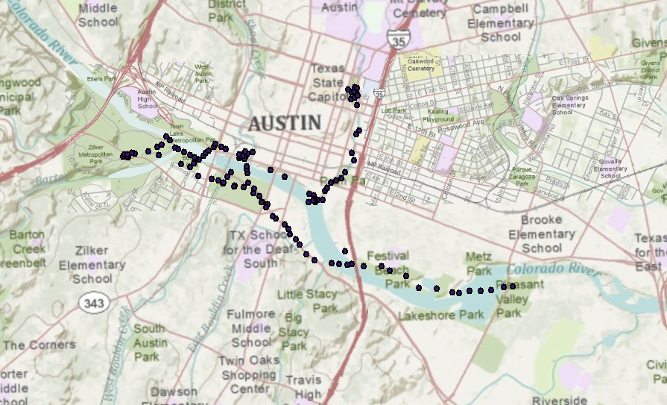
Conclusions
“Hidden” Faults can be Identified
Better Zoning and Planning
More Data = Better Information
Mapping the Underground is Important and Useful!

Slide 11
Questions?

