Slide 1
Arc Hydro Groundwater
Norm Jones (BYU)
Gil Strassberg (Aquaveo)
David Maidment (UT Austin)

Slide 2
Linking GIS and Water Resources
Water
Resources
GIS

Slide 3
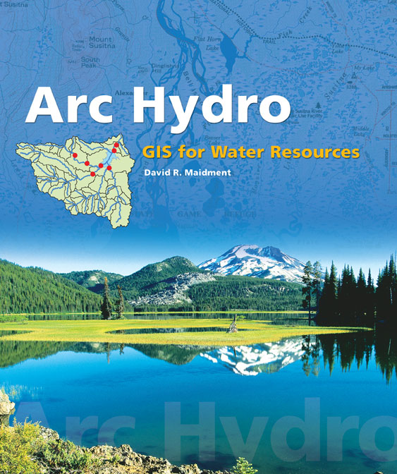
Arc Hydro: GIS for Water Resources
Published in 2002, now in revision for Arc Hydro II
Arc Hydro
  An ArcGIS data model for water resources
  Arc Hydro toolset for implementation
  Framework for linking hydrologic simulation models
The Arc Hydro data model and
application tools are in the public
Domain.
Notes:
Notes:
Industrial partners: ESRI, Danish Hydraulic Institute, Camp,Dresser and McKee, Dodson and Associates
Government partners:
Federal: EPA, USGS, Corps of Engineers (Hydrologic Engineering Center)
State: Texas Natural Resource Conservation Commission, Texas Water Development Board
Local: Lower Colorado River Authority, City of Austin, Dept of Watershed Protection
Academic Partners: University of Texas, Brigham Young University, Utah State University

Slide 4
Arc Hydro Groundwater – Time Line
2002 - Arc Hydro book and tools published
2003 - Initial groundwater data model discussions, initial designs at the Center for Research in Water Resources, UT Austin
2006 - First complete design of Arc Hydro Groundwater data model
2007 - First preconference meeting
2007 - ESRI and Aquaveo team to develop Arc Hydro Groundwater Tools
2009 - Arc Hydro Tools released
2010 (coming soon!) - Arc Hydro Groundwater book
Notes:
Notes:
Industrial partners: ESRI, Danish Hydraulic Institute, Camp,Dresser and McKee, Dodson and Associates
Government partners:
Federal: EPA, USGS, Corps of Engineers (Hydrologic Engineering Center)
State: Texas Natural Resource Conservation Commission, Texas Water Development Board
Local: Lower Colorado River Authority, City of Austin, Dept of Watershed Protection
Academic Partners: University of Texas, Brigham Young University, Utah State University

Slide 5
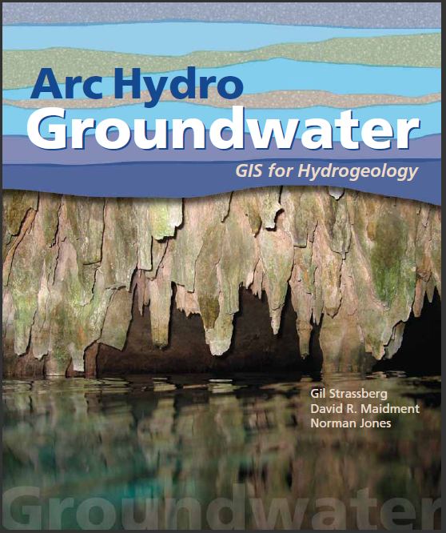
Arc Hydro Groundwater:
GIS For Hydrogeology
Describes the data model – public domain
Chapter for each data model component
Will be released later this year
Notes:
Notes:
Industrial partners: ESRI, Danish Hydraulic Institute, Camp,Dresser and McKee, Dodson and Associates
Government partners:
Federal: EPA, USGS, Corps of Engineers (Hydrologic Engineering Center)
State: Texas Natural Resource Conservation Commission, Texas Water Development Board
Local: Lower Colorado River Authority, City of Austin, Dept of Watershed Protection
Academic Partners: University of Texas, Brigham Young University, Utah State University

Slide 6
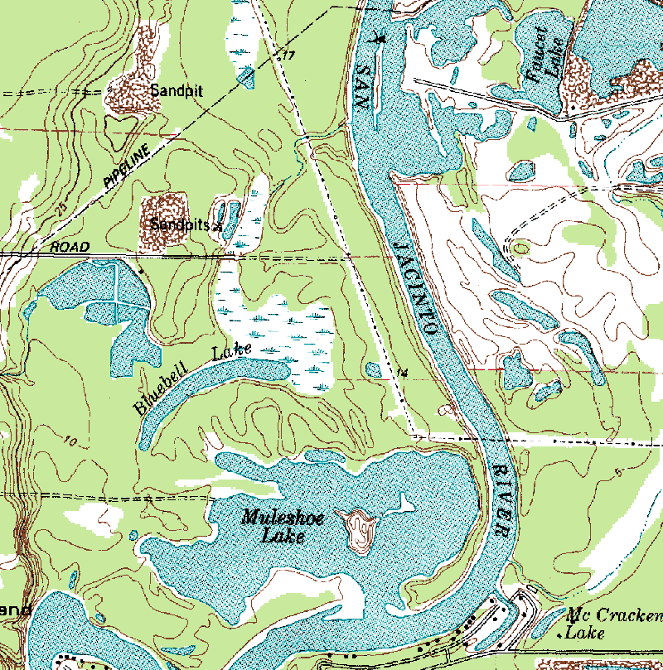
Arc Hydro—Hydrography
The blue lines on maps

Slide 7
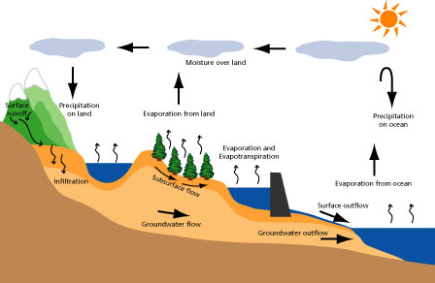
Arc Hydro—Hydrology
The movement of water through the hydrologic system

Slide 8
What makes Arc Hydro different?
ArcGIS: All features are labeled with a unique ObjectID
within a feature layer.
Arc Hydro: All features are labeled with a unique HydroID
across the geodatabase.
HydroID to ID relationships
link neighboring features and
help to trace water movement.
Arc Hydro is a unique “flavor”
or style of doing GIS.

Slide 9
What makes Arc Hydro different?
Arc Hydro connects space and time:
hydro features are linked to time series.
Flow
HydroID
Time
FeatureID
Time Series
Hydro Features

Slide 10
Challenges in developing Arc Hydro
ArcGIS is a very successful static, 2D or 2.5D system.
For surface water resources, we need
  Close connection between raster terrain and vector stream data
  Linkage to time varying water data observations stored at gauges
  Access to precipitation and evaporation data “fields”
For groundwater resources we need
  3D representation of boreholes and hydrogeologic units
  Integration with groundwater models, especially MODFLOW, which has become the ArcGIS of groundwater

Slide 11
Web Sites
ESRI Data Model Web site
http://resources.esri.com/ArcHydro/
Arc Hydro Groundwater Web sites www.archydrogw.com
www.aquaveo.com/archydro
Contact
Norm Jones (njones@aquaveo.com change to byu.edu? YES)
Gil Strassberg (gstrassberg@aquaveo.com)

Slide 12
Arc Hydro Groundwater
Data MODEL
Notes:
In general, in this presentation we give a general overview of the AHGW data model.
We will not go into much detail on each component/dataset, but rather give a general picture of the data model and the components.

Slide 13
What is Arc Hydro?
Data models (geodatabase designs):
    Best GIS practices in a specific field.
    Terminology, common language.
    Standard.
Tools – surface water, groundwater.
Community – user community advances best practices.
Notes:
Arc Hydro is not only the data models/books.
data models provide:
Summary of the “best practices” in the a certain field. How can we best store certain datasets, create maps, support workflows, etc.
Gives a common terminology. Users from different agencies, companies, universities can develop a common language.
The data model is public domain, published, and documented. So in fact it is a sort of standard, you can just refer users to the documentation to understand what the terms mean. Or why you did something a certain way.
Tools (surface water and groundwater) provide a wide array of GIS tools for hydrologic analysis and data management.
Community – over time there is special interest group that can share experience, develop resources, meet at conferences, etc.

Slide 14


Arc Hydro Groundwater Tools
Data model and tools are developed by Aquaveo in partnership with ESRI:
Groundwater Analyst
Subsurface Analyst
MODFLOW Analyst
Notes:
Talk about the AHGW tools, what each set of tools is used for.

Slide 15
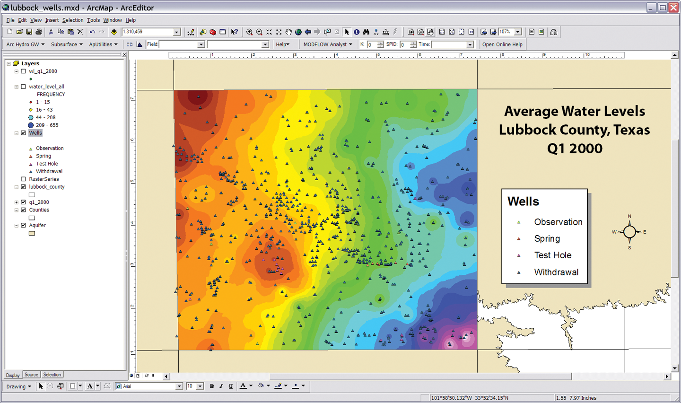
Groundwater Analyst
Wells
Time Series
Import Data

Slide 16
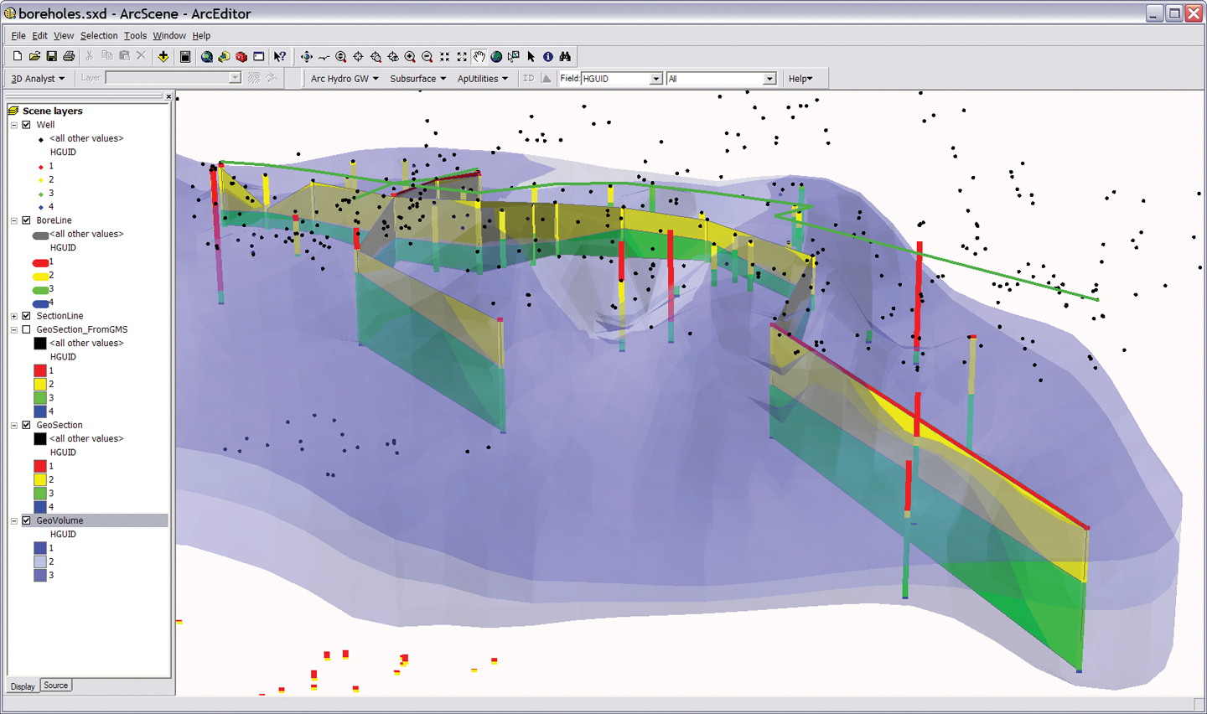
Subsurface Analyst
Borehole management
Borehole visualization
Cross-sections
GeoVolumes

Slide 17
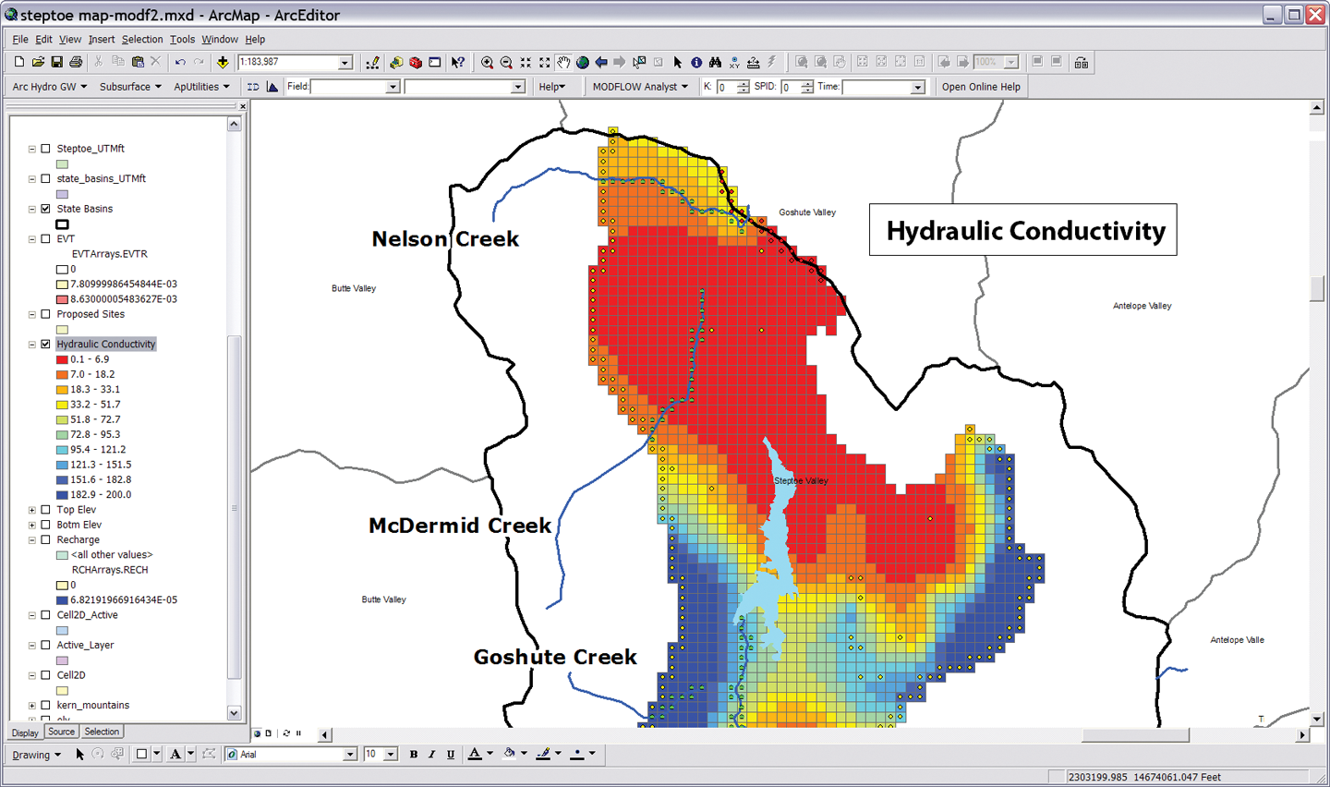
MODFLOW Analyst
  Import MODFLOW simulations
  Visualization
  Post-processing
  Build models

Slide 18
Arc Hydro Groundwater
Data model
Notes:
Next we will talk about the AHGW Data Model = Geodatabase design.
When we design a geodatabase we try to anticipate what types of datasets users will try to represent within ArcGIS. We then design specific feature classes and tables, and relationships to support the storage and management of these datasets. We give names to datasets and to fields to develop a standard language.

Slide 19
Arc Hydro Data Model
  General model for representing water resources, including surface water components and groundwater components centered on a common framework
Surface water
Groundwater
Network
Geology
Arc Hydro
Framework
Drainage
Boreholes
Hydrography
Hydrostratigraphy
Chanel
Simulation
Temporal
Notes:
When we released the first draft of AHGW for review, we got back comments that asked for tighter integration of the surface water data model and the groundwater data model.
We redesigned both data models to be structured around an Arc Hydro Framework (in green in the center).
Then the data models were broken into components that represent a specific aspect or type of datasets.
The temporal component deals with managing temporal data, and is shared by both data models. E.g., you can store surface water and groundwater time series in the same tables, and apply the same tools to map data.
You don’t have to implement all components, if you are dealing only with simulation model you just implement the simulation component.

Slide 20
Arc Hydro Groundwater Data Model
Notes:
This is an overview diagram of the AHGW data model.
You can review the different components, talk about what each component is for:
Framework – includes hydrography, monitoring points, wells, aquifers, tables for managing time series (the framework includes a simplified temporal component). – with the framework you can get started on most water resources projects.
Borehole data – description of vertical information recorded along boreholes (hydrostratigraphy, well construction).
Geology – representation of data from geologic maps.
Hydrostratigraphy – building 2D and 3D hydrogeologic models including surfaces, cross sections, volumes.
Temporal – dealing with time varying data – plots, tracks, animations.
Simulation – integration with groundwater simulation models, especially MODFLOW.

Slide 21
Components
Framework – Surface water features, wells, and aquifers
Temporal – Representation of time series data
Geology – Representation of data from geologic maps
Boreholes – Borehole log table and 3D description of borehole lines and contact points
Hydrostratigraphy – 2D and 3D description of hydrogeologic units
Simulation – Representation of groundwater simulation models

Slide 22
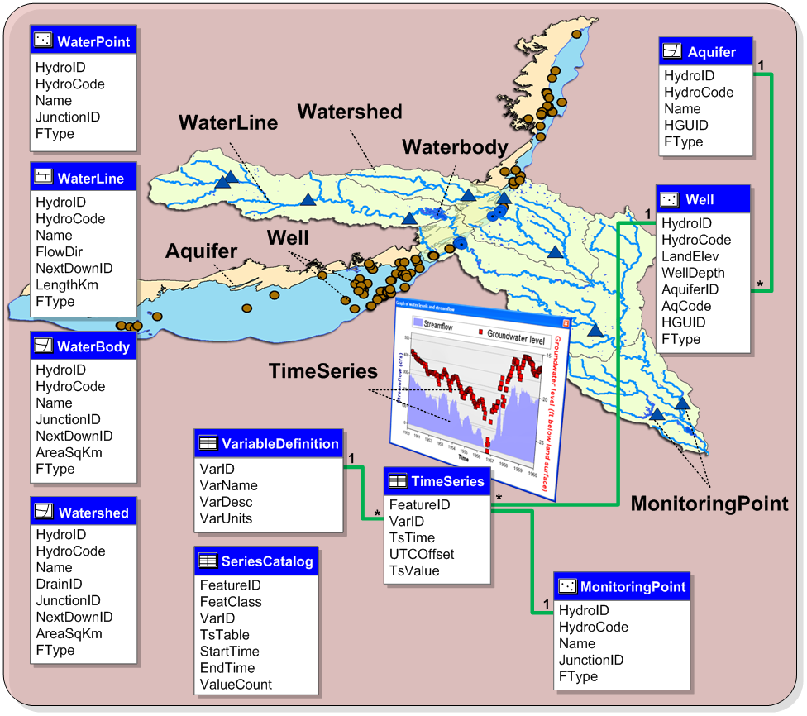
Framework
Notes:
On the left feature classes from the surface water data model – hydrography (points, lines, polygons) – the “Blue Lines” on maps.
Aquifer and Well features
Time Series – tabular structure for managing time series related with spatial features.
Time series are related to monitoring points and to wells.
The graph shows the change in water levels and streamflow.

Slide 23
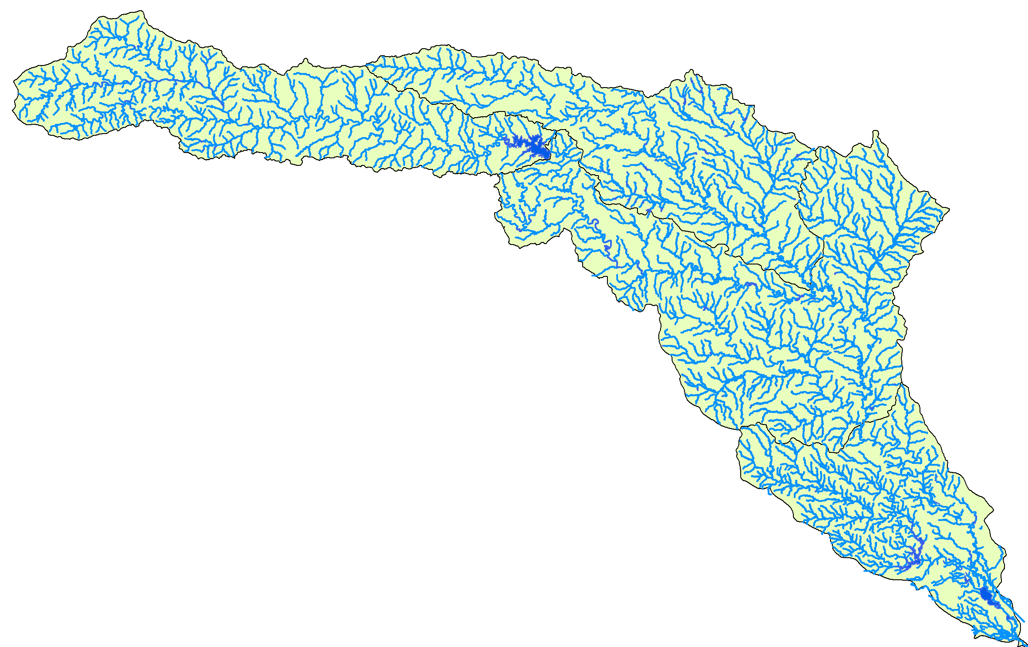
Hydrography
WaterLine, WaterBody represent hydrography
Watershed represents drainage areas
Notes:
Representation of hydrography – including lines (streams, rivers) polygons (water bodies, lakes, ponds, etc), and points for representing features such as diversions, springs, structures, etc.
Watershed represents the drainage areas. In Arc Hydro surface water there are different definitions for the drainage areas (catchment, watershed, basin). In the framework we only include a general feature class.

Slide 24
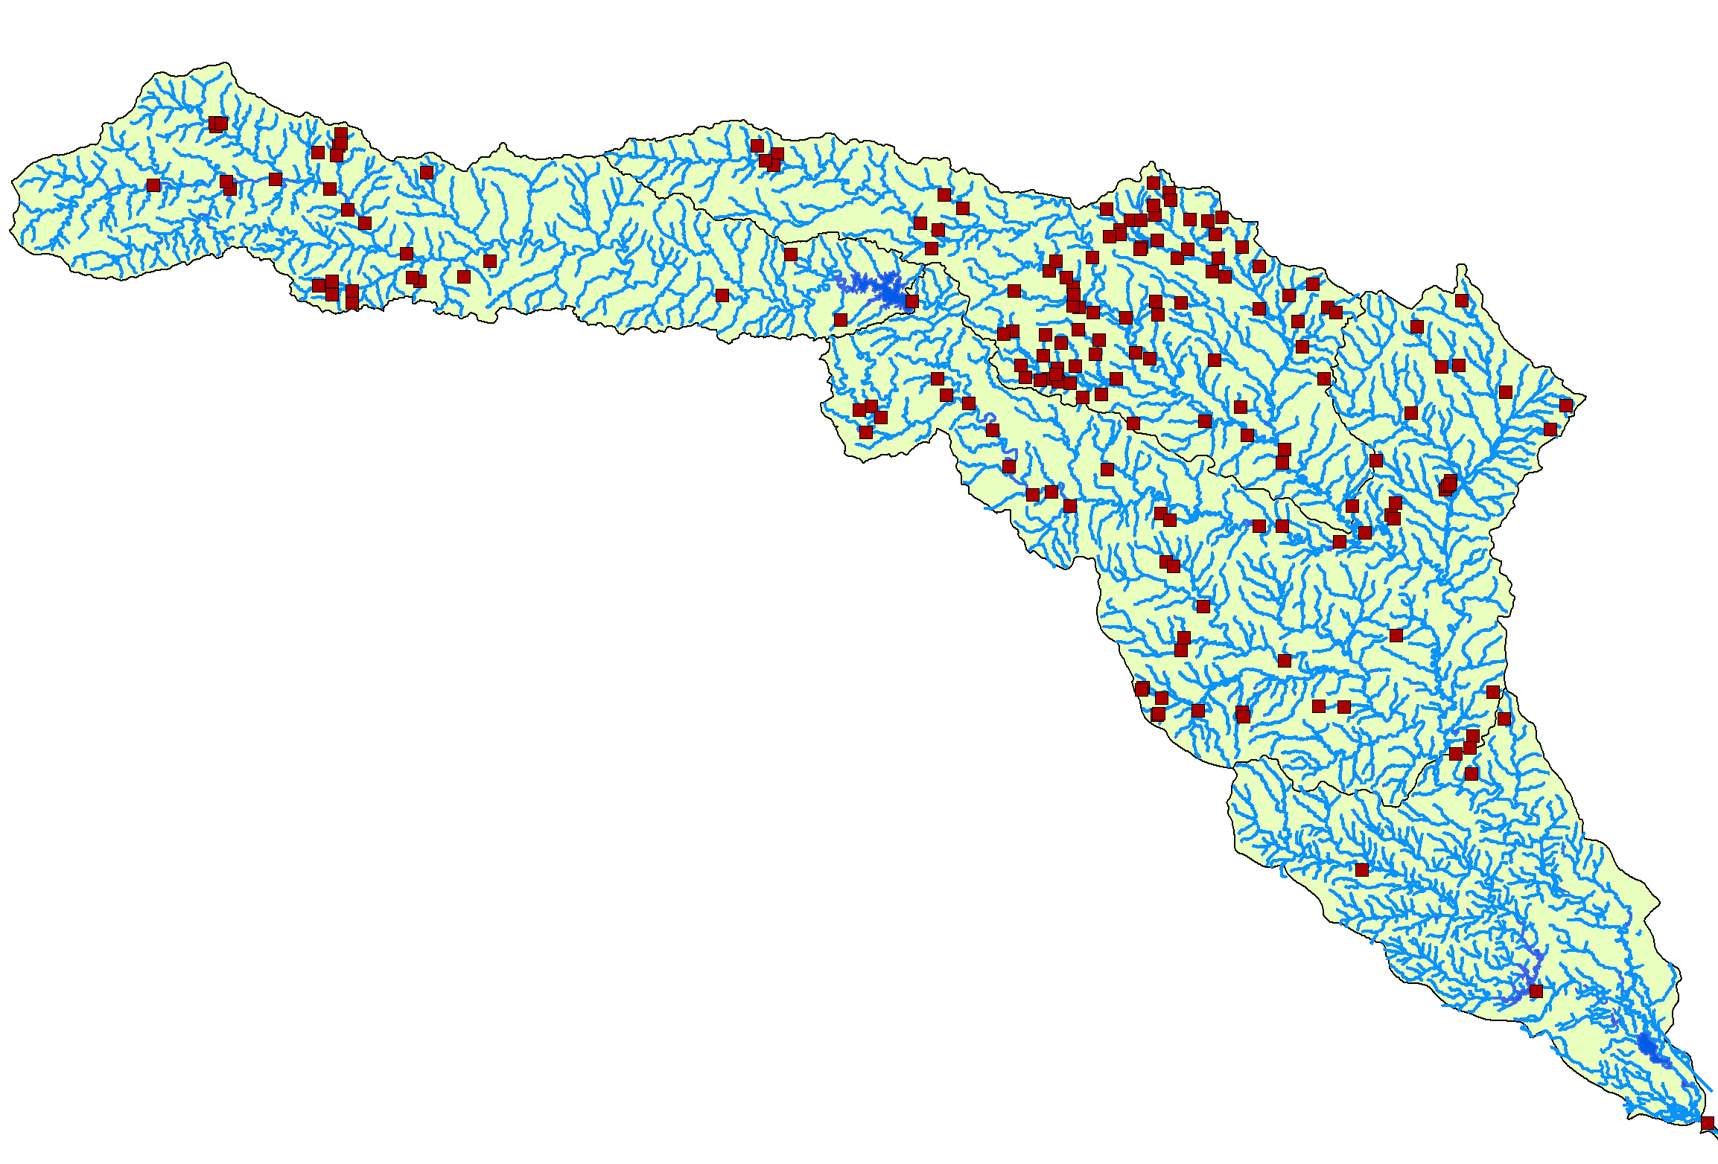
WaterPoint
WaterPoint represents points of interest such as structures, dams, springs, diversions, etc.
Notes:
General point features that represent different features: For example we can use WaterPoints to represent springs, or sinks that recharge an aquifer.
We can also use WaterPoint to represent features along a river network (in the surface water components there is a special component for representing river networks) and the features can be linked to the river network at junctions. Examples are structures, dams, diversion points.

Slide 25
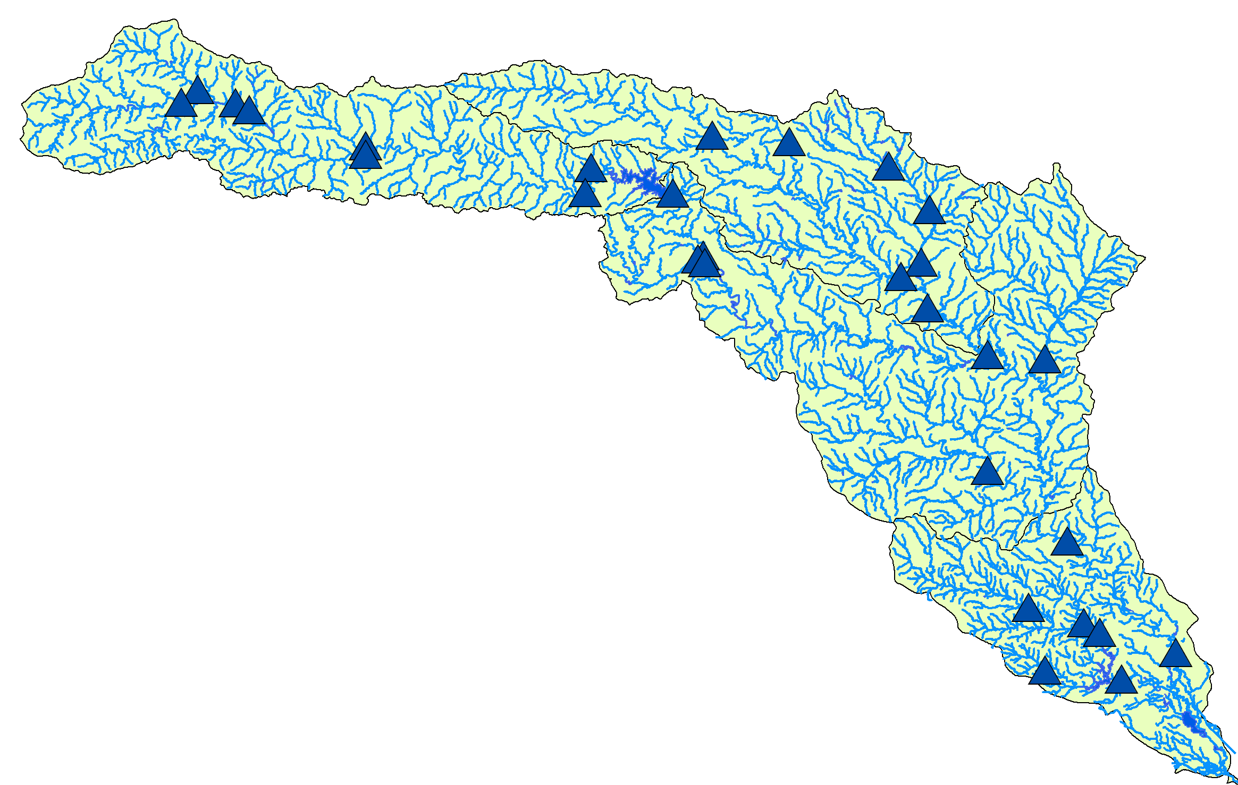
Monitoring Point
MonitoringPoint features represent locations where water is measures
Notes:
Monitoring points are locations where water is measured. Some examples – stream gages, collection points for water quality, rain gages. Basically any location where data is collected.
Monitoring points are related with time series.

Slide 26
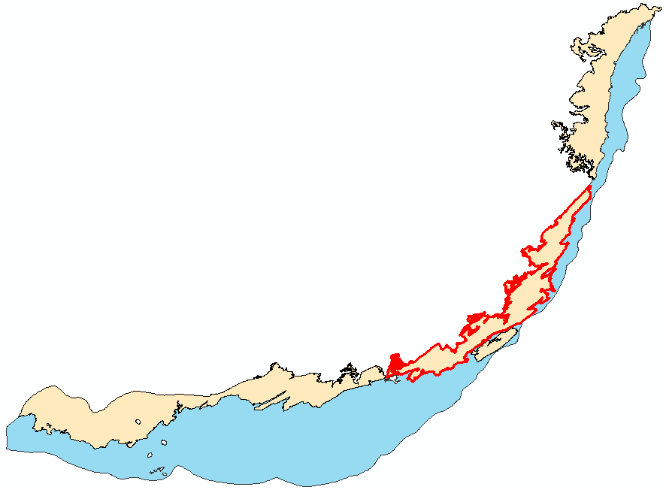
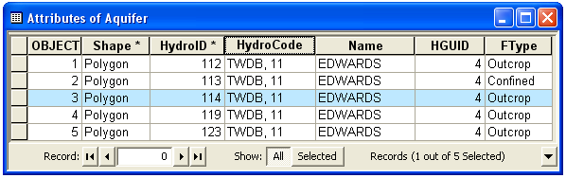

Aquifer features
An aquifer is defined by one or a set of polygon features
Aquifer features can be grouped by HGUID
Notes:
Aquifers are represented as 2D polygons.
An aquifer can be composed of multiple polygons – we assign the same HGUID to the polygons to group them
HGUID = hydrogeologic unit identifier – is defined in the HydrogeologicUnit table.
Feature can be categorized into types - FType – e.g., confined unconfined. This is standard for most of the AH feature classes.

Slide 27
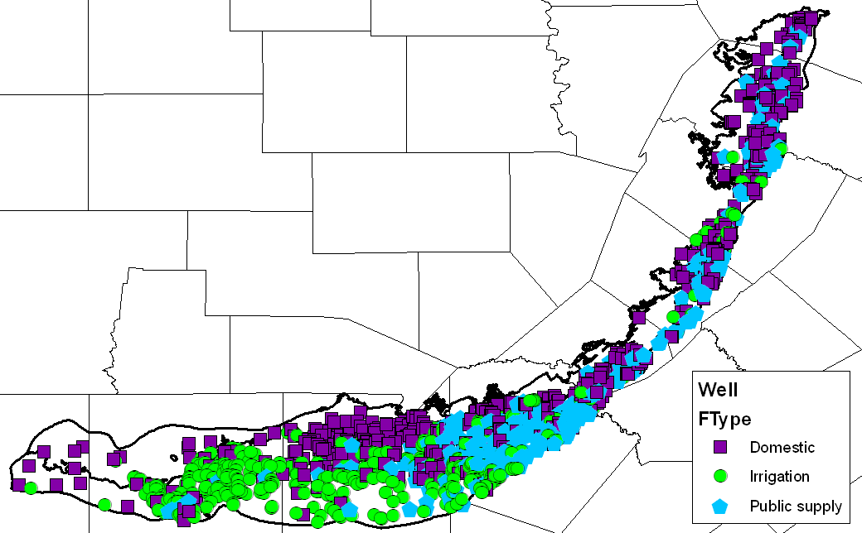
Well
Wells are defined as a 2D point in the Well feature class
In the Arc Hydro model we only predefine a set of basic attributes
Wells in the Edwards Aquifer
Notes:
Wells are defined as 2D Point features
We predefined a set of basic attributes, mostly to represent the 3D dimension of a well (LandElev, WellDepth) and the related aquifer (AquiferID, AqCode, and HGUID). Manu of the well databases have many more attributes such as owner, driller, water use, address, drill date, etc. In AHGW we tried to minimize the set of predefined attributes and you can add your own attributes as necessary.

Slide 28
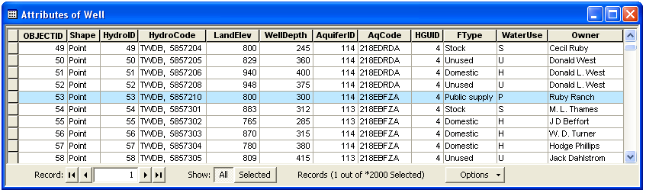
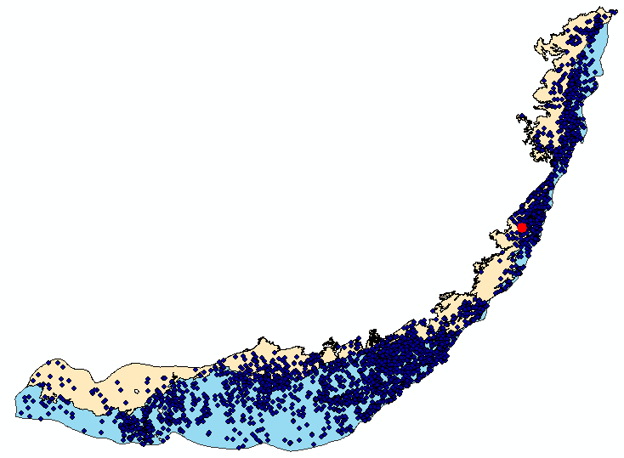
Aquifer and well
Well HydroID = 53
Notes:
Wells are related with Aquifer features
The AquiferID of a well feature = HydroID of an Aquifer feature
This is a one-to-many relationship where one aquifer is related to many wells
You can use this association to query for data in a specific aquifer.

Slide 29
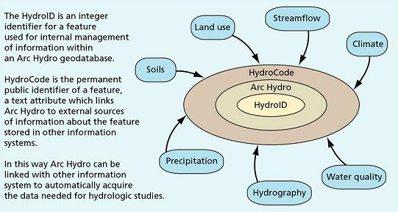
Hydro Features
HydroID – Unique ID within the geodatabase (internal relationships). Every feature in Arc Hydro is assigned a unique HydroID
HydroCode – Public identifier (external relationships)
Tables and tools to manage HydroIDs within a geodatabase

Slide 30
Components
Framework – Surface water features, wells, and aquifers
Temporal – Representation of time series data
Geology – Representation of data from geologic maps
Boreholes – Borehole log table and 3D description of borehole lines and contact points
Hydrostratigraphy – 2D and 3D description of hydrogeologic units
Simulation – Representation of groundwater simulation models

Slide 31
Space-time datasets

Slide 32
Components
Framework – Surface water features, wells, and aquifers
Temporal – Representation of time series data
Geology – Representation of data from geologic maps
Boreholes – Borehole log table and 3D description of borehole lines and contact points
Hydrostratigraphy – 2D and 3D description of hydrogeologic units
Simulation – Representation of groundwater simulation models

Slide 33
Geology
Representation of data from geologic maps
Simplified data model – not comprehensive geologic map design

Slide 34
Components
Framework – Surface water features, wells, and aquifers
Temporal – Representation of time series data
Geology – Representation of data from geologic maps
Boreholes – Borehole log table and 3D description of borehole lines and contact points
Hydrostratigraphy – 2D and 3D description of hydrogeologic units
Simulation – Representation of groundwater simulation models

Slide 35
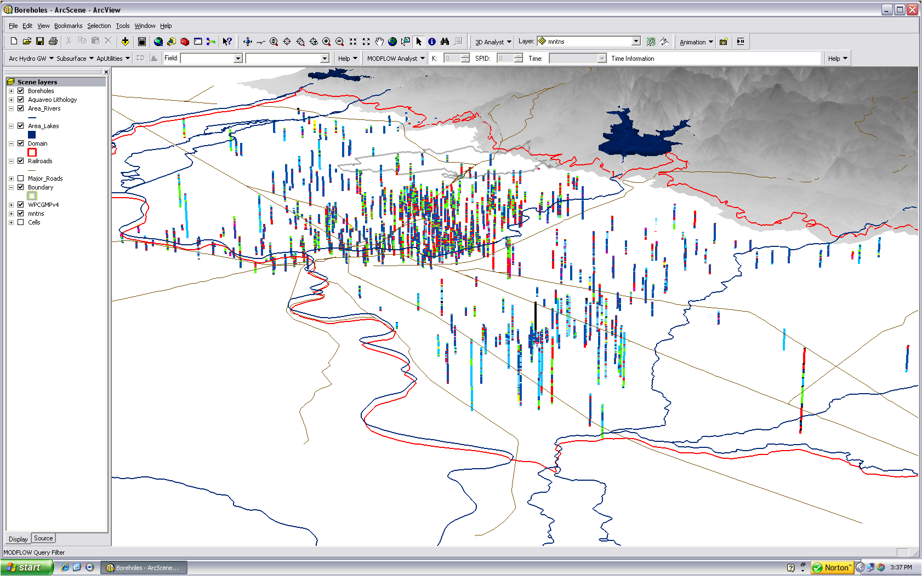
Boreholes
Notes:
Boreholes – represent 3D vertical elements along wells.
The Well feature gives the X,Y location. The borehole data represents the vertical dimension – what is happening along the well as we go from top to bottom.
The scene shows a set of stratigraphy in a 3D model near Roseville California.

Slide 36
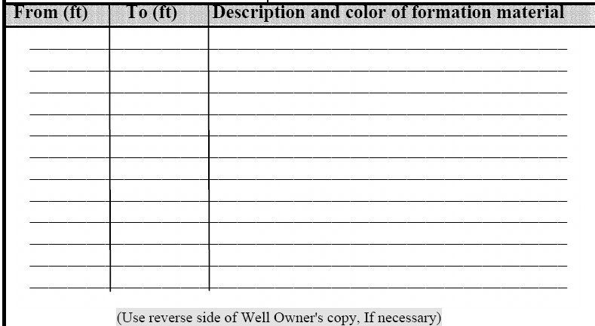

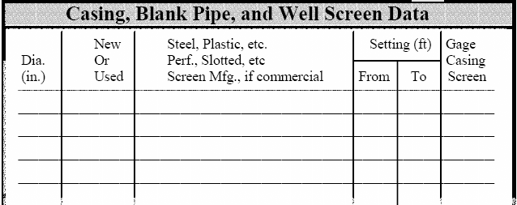
Wells and 3D data
3D data is referenced along wells
From depth (top) – To depth (bottom)
From
To
Notes:
Usually data are measured from the top of the whole downwards – this is a specific coordinate system for each well as each well has a different elevation.
In a tabular format we store the top and bottom elevations in FromDepth and ToDepth fields.
If we want to visualize data across multiple wells (in a map, cross section) we need to normalize the data to a common coordinate system (e.g. feet above mean sea level).

Slide 37
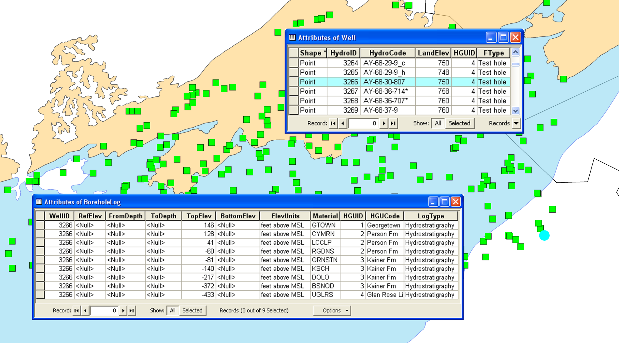
BoreholeLog table
Combining the well geometry (x, y) and the vertical data stored in the BoreholeLog table we can describe a set of 3D geometries (x, y, z)
Notes:
The Well feature gives the 2D location (X, Y coordinates).
Vertical borehole data are related to the well via the HydroID – WellID relationship.
The example shows data stored in the BoreholeLog table representing hydrostratigraphy.
You can see that a set of hydrogeologic picks (elevation is given by TopElev) have the same WellID – pointing to well 3266.
The top left figure shows the stratigraphy in a conceptual diagram.

Slide 38
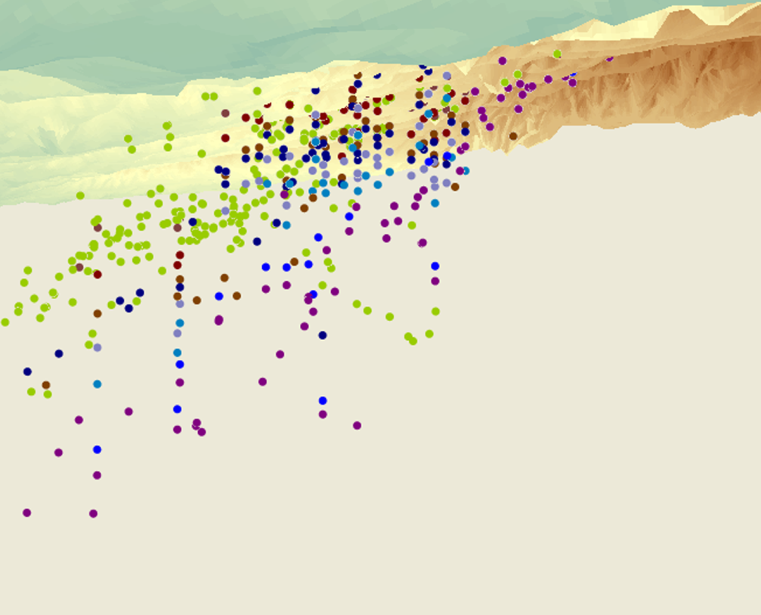
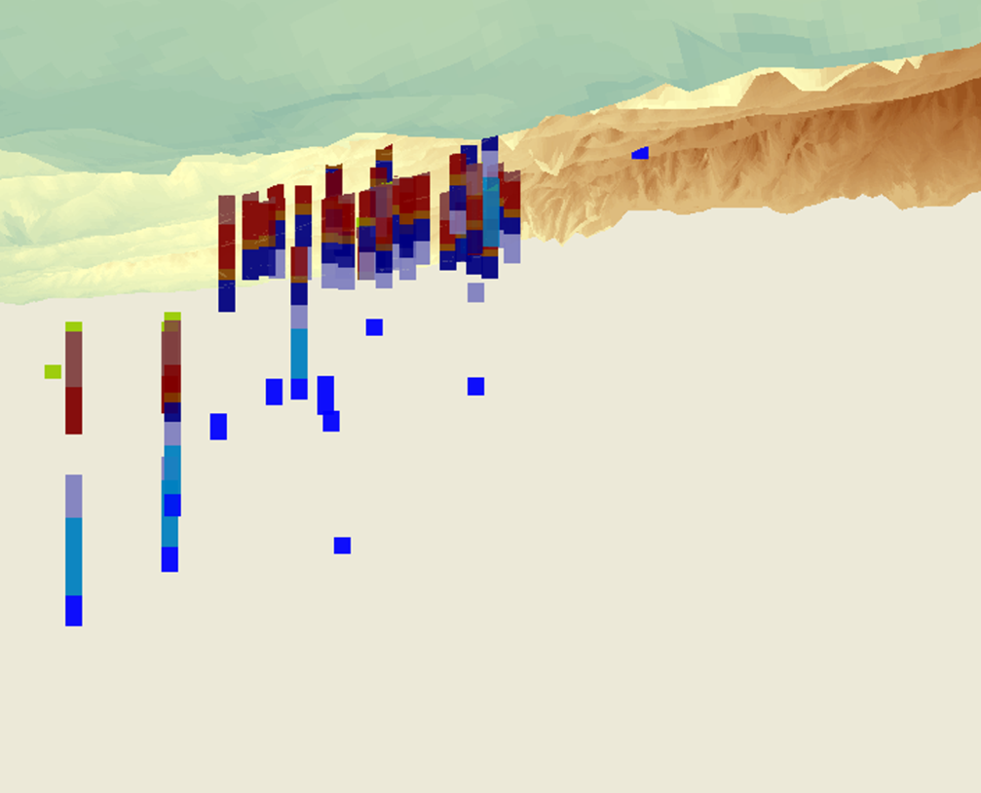
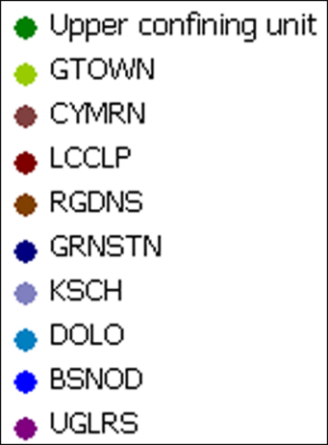
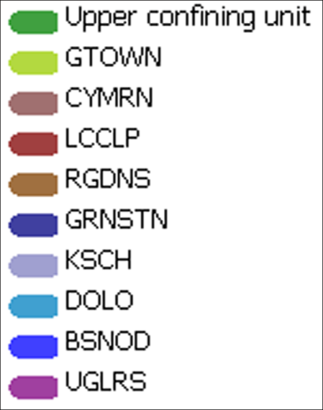
3D features (BorePoints and BoreLines)
From the tabular data we create 3D features that can be viewed in ArcScene.
Notes:
From the tabular data we can create 3D features that can be visualized in ArcScene.
On the left – BorePoints (3D points) representing hydrogeologic picks (top of a formation)
On the right – BoreLine features representing hydrostratigraphy as 3D intervals (3D line features).

Slide 39
Components
Framework – Surface water features, wells, and aquifers
Temporal – Representation of time series data
Geology – Representation of data from geologic maps
Boreholes – Borehole log table and 3D description of borehole lines and contact points
Hydrostratigraphy – 2D and 3D description of hydrogeologic units
Simulation – Representation of groundwater simulation models

Slide 40
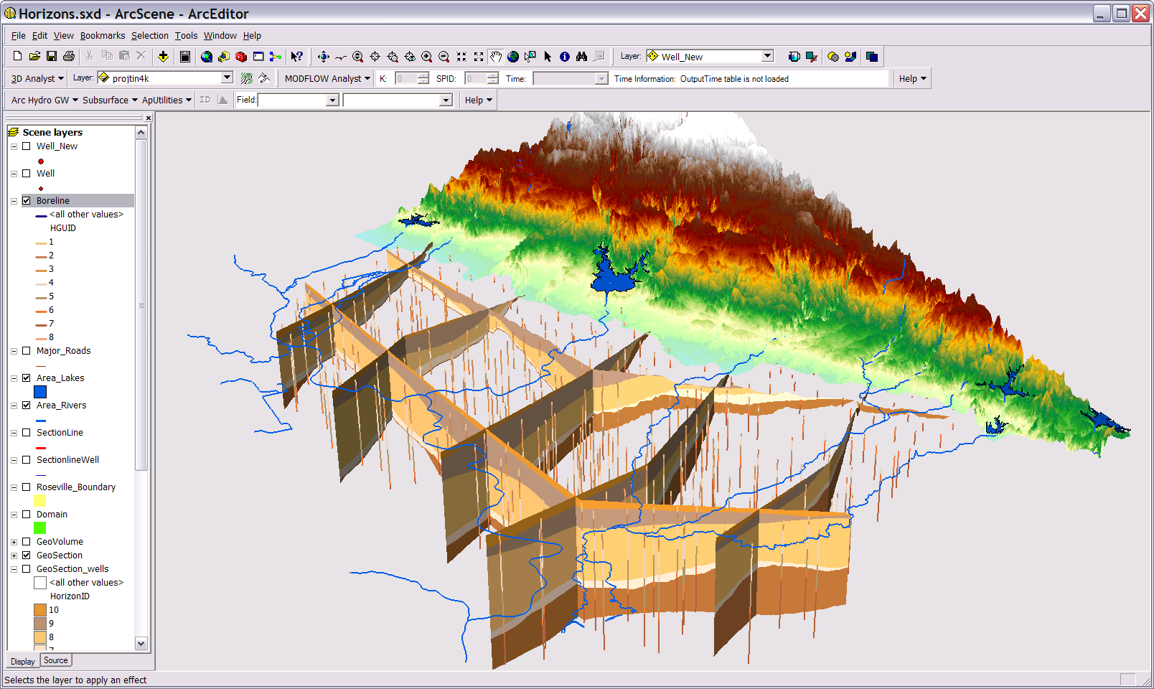
GeoSections
Notes:
GeoSections represent 3D panels (“slices”) of the subsurface.
GeoSections are represented as multipatch features (3D features) that can be rendered in ArcScene.
The GeoSection features shown here are from a subsurface model near Roseville California.
The sections were created by “slicing” a set of “stacked” rasters. Each raster represents the top of a hydrogeologic unit.

Slide 41
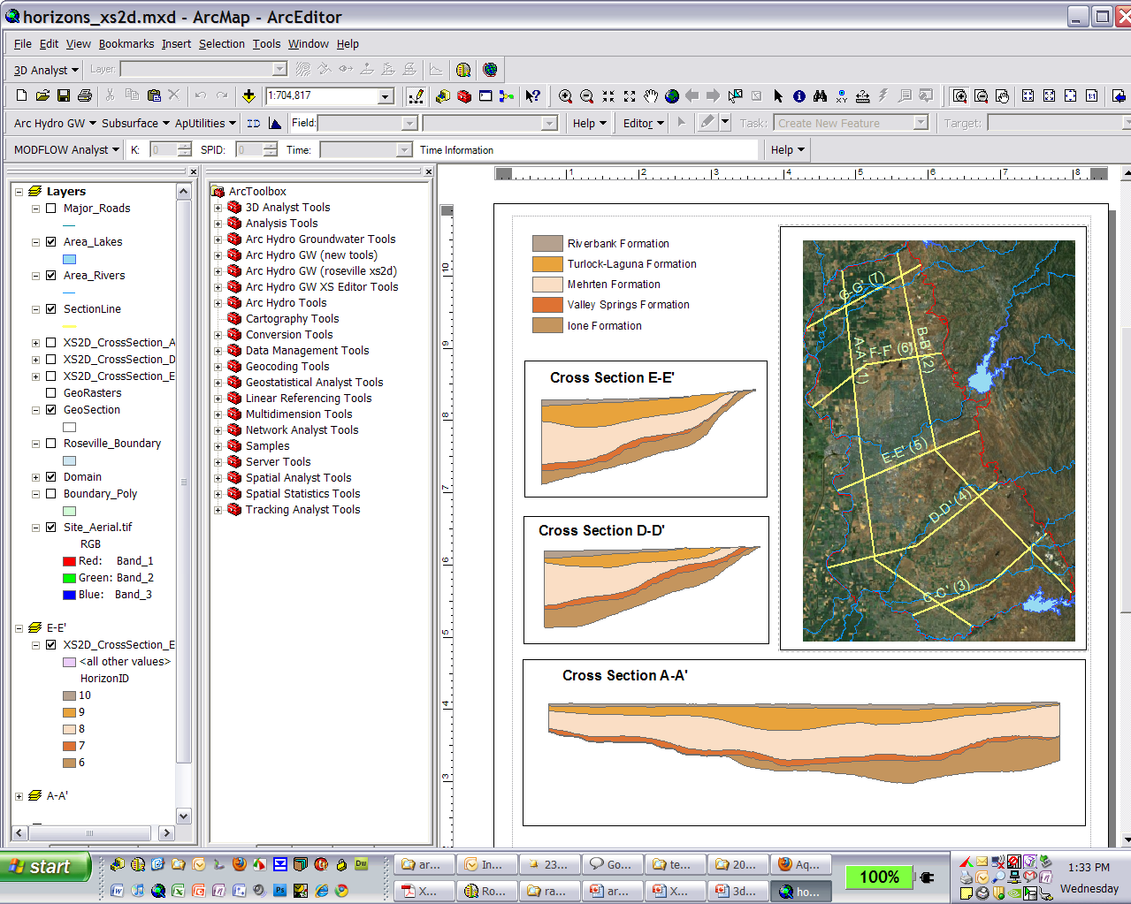
XS2D Component
Notes:
The XS2D component is used to create 2D cross sections in ArcMap.
The cross sections are displayed in “special” data frames.
To create a 2D cross section in ArcMap – we transform the Y coordinate to a Z coordinate.
Also, in many cases we apply an exaggeration factor to better visualize the data.

Slide 42
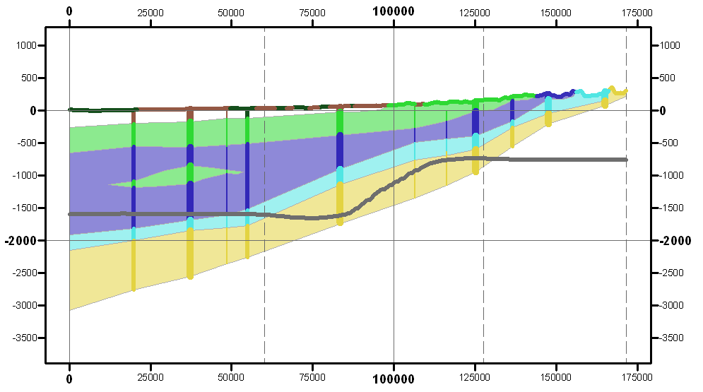
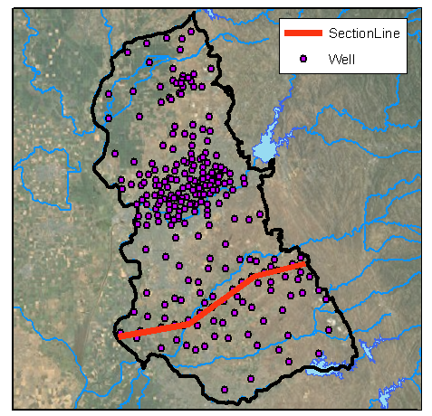
2D Cross Section Editing
Edit cross sections in ArcMap
Borehole data
Outcrop
Salt water interface
Panel divider
Panel
Notes:
The XS2D component we can also edit cross section and manually digitize the cross sections from different data sources: boreholes, DEM, geologic maps.
We can also add different types of data such as water levels, concentrations, well construction.

Slide 43
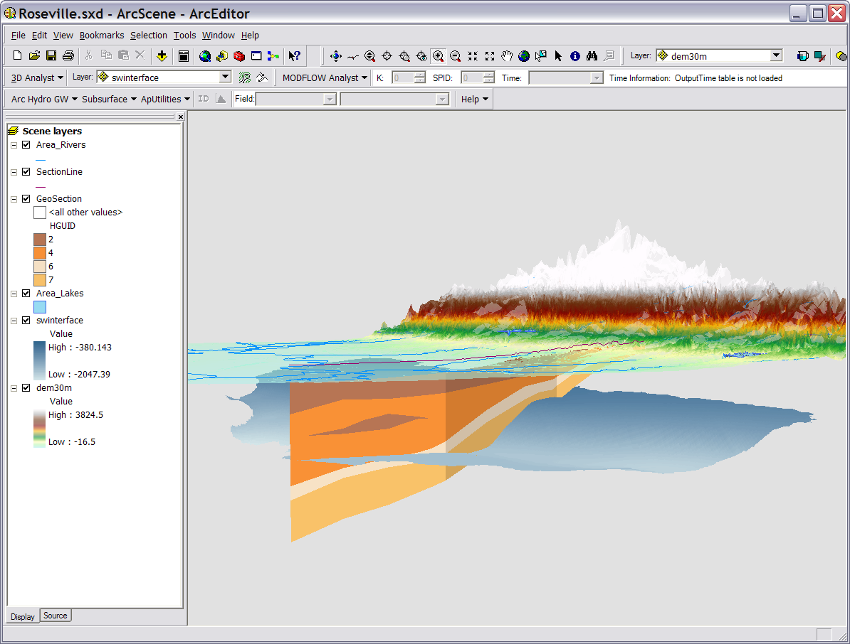
Transform to 3D GeoSection
Notes:
We can take the 2D cross sections and transform them to 3D GeoSections, so they can be visualized in ArcScene.

Slide 44
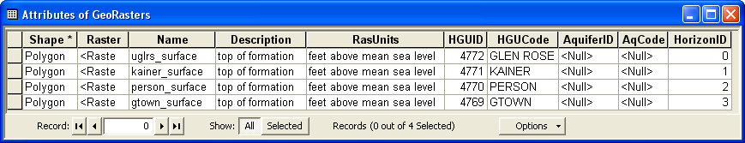
GeoRasters
Notes:
GeoRasters – store rasters in a raster catalog
Rasters can be indexed with a HGUID ( hydrogeologic unit identifier).
We also index with a HorizonID – gives the sequence of deposition from bottom to top.
Cataloging the rasters enables us to use tools to create 3D features - cross sections, volumes.

Slide 45
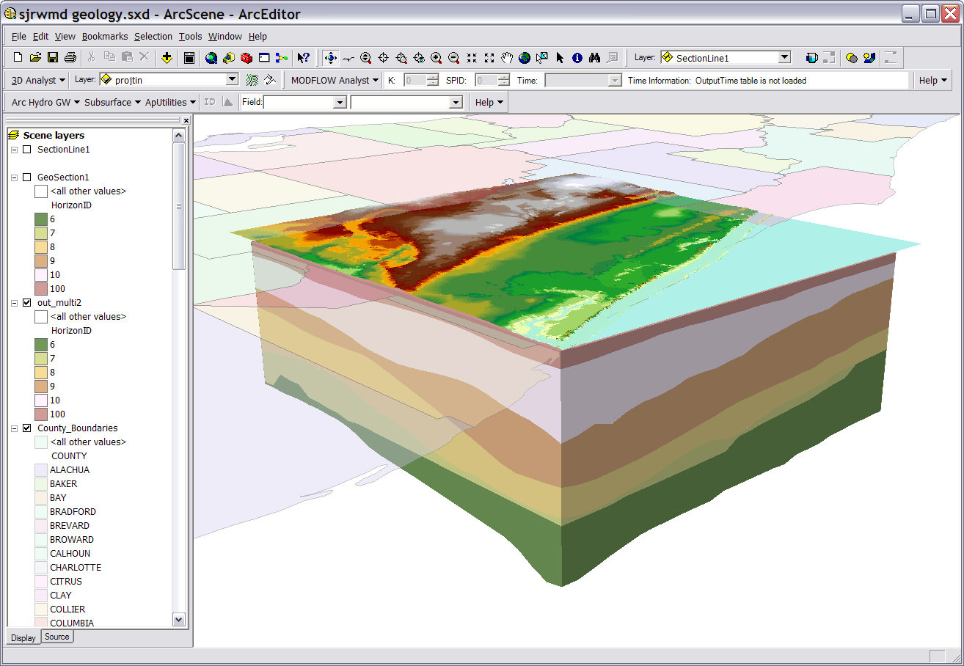
GeoVolumes
Notes:
GeoVolume - represents hydrogeologic units as 3D elements.
GeoVolumes are 3D multipatches.
Can be built with SA tools by filling between rasters in a GeoRaster catalog.

Slide 46
Components
Framework – Surface water features, wells, and aquifers
Temporal – Representation of time series data
Geology – Representation of data from geologic maps
Boreholes – Borehole log table and 3D description of borehole lines and contact points
Hydrostratigraphy – 2D and 3D description of hydrogeologic units
Simulation – Representation of groundwater simulation models

Slide 47
Simulation Feature Data Set
Notes:
On top of the simulation component a custom data model for representing MODFLOW models have been developed.
We call this the MODFLOW Data Model – will expand at the later parts of the course.
The simulation component includes 5 feature classes:
Boundary for giving the spatial location and orientation of the model
Cell2D and Node2D represent a 2D model mesh/grid, or one layer in a 3D model.
Cell3D and Node3D represent 3D models meshes/grids.
The CellIndex table is used to associate cells and nodes of the model based on the I, J, and K indices. It is part of the MODFLOW Data Model.

Slide 48
Data model and tools summary
Arc Hydro – general data model that includes a framework, and temporal, surface water, and groundwater components.
Arc Hydro (surface water) – surface water components + tools developed by ESRI.
Arc Hydro Groundwater – the groundwater components + tools developed by Aquaveo (Groundwater Analyst, Subsurface Analyst, and MODFLOW Analyst).
MODFLOW Data Model – geodatabase design for storing MODFLOW simulations. Developed by Aquaveo, and works tightly with MODFLOW Analyst tools
Notes:
Summary of the different data models and tools mentioned during the presentation. This is to avoid confusing terms and to clarify the different naming conventions.

