Slide 1
Data Sources for GIS in Water Resources by David R. Maidment, David G. Tarboton and Ayse Irmak
GIS in Water Resources
Fall 2010

Slide 2
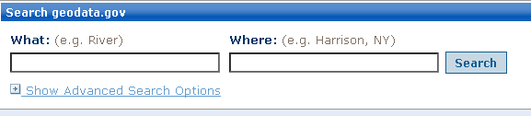
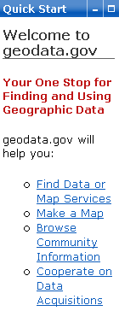
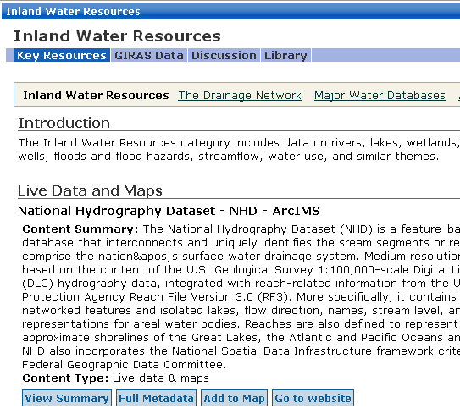
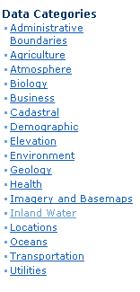
http://www.geodata.gov/
http://www.geodata.gov/

Slide 3
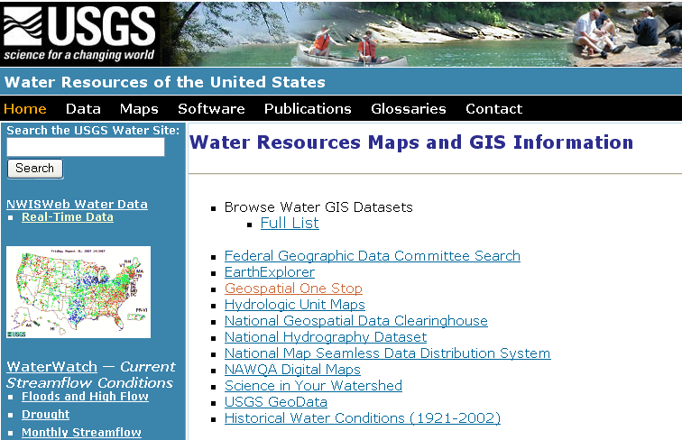
USGS GIS data for Water
http://water.usgs.gov/maps.html

Slide 4
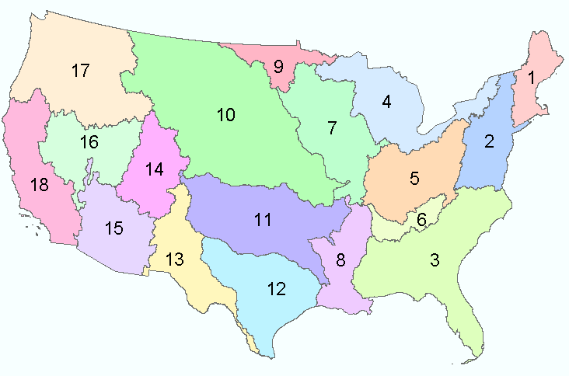
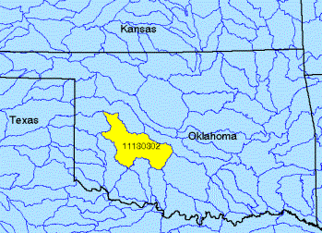
Watersheds of the US
2-digit water resource regions
8-digit HUC watersheds

Slide 5
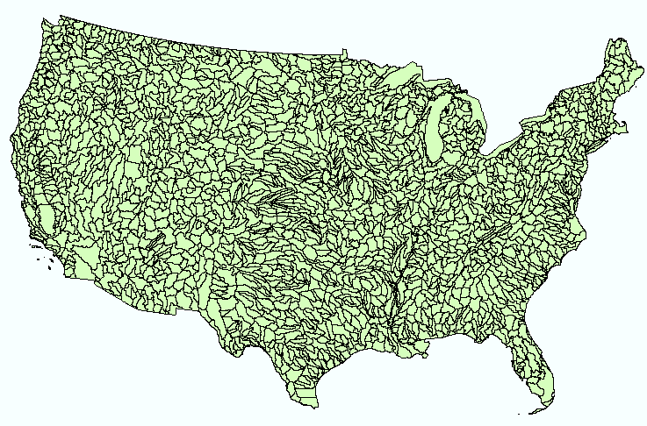
Hydrologic Unit Code Watersheds
~ 2000 for US, about the size of counties

Slide 6
Watershed Hierarchy
Digit #
2
4
6
8 HUC
10
12
NHDPlus
Available
In Progress

Slide 7
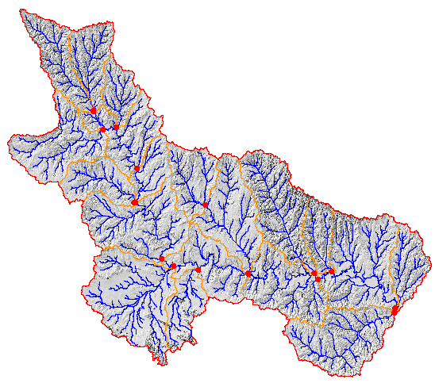
Watershed Boundary Dataset
National Program by USGS and USDA (NRCS)
Boundaries for 10- and 12- digit watersheds
First cut is by automated delineation from NED
Hand checked and edited
10-digit watersheds

Slide 8
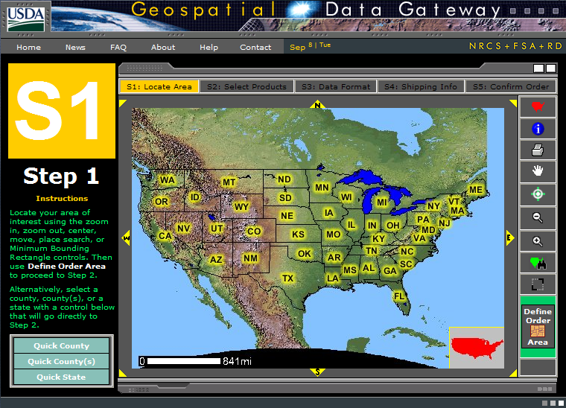
Watershed Boundary DataSet
http://www.ncgc.nrcs.usda.gov/products/datasets/watershed/

Slide 9
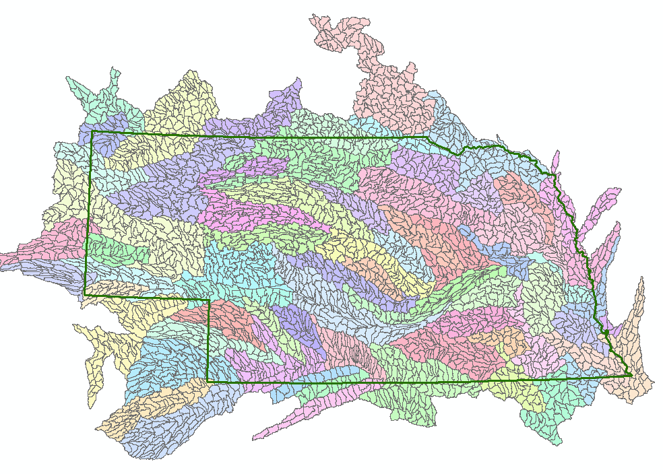
WBD for Nebraska
2990 HUC12 watersheds of average area 39.3 square miles
HUC12:HUC ~ 40:1 watersheds

Slide 10
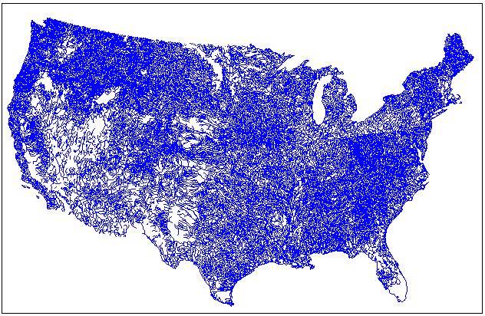
EPA River Reach File 1 (RF1)

Slide 11

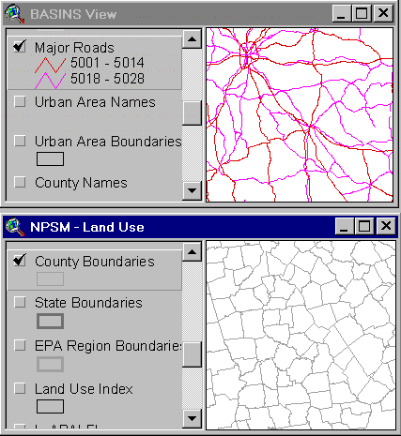
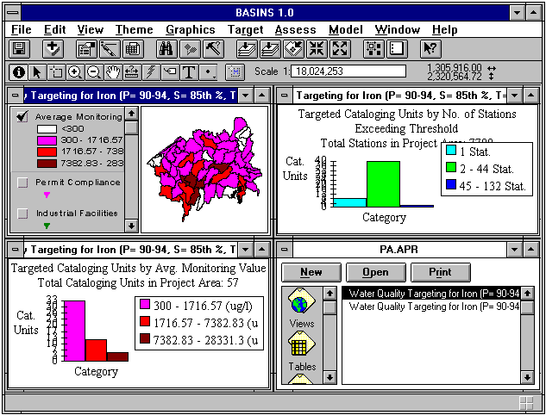

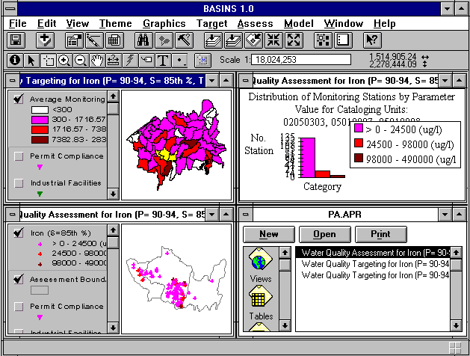

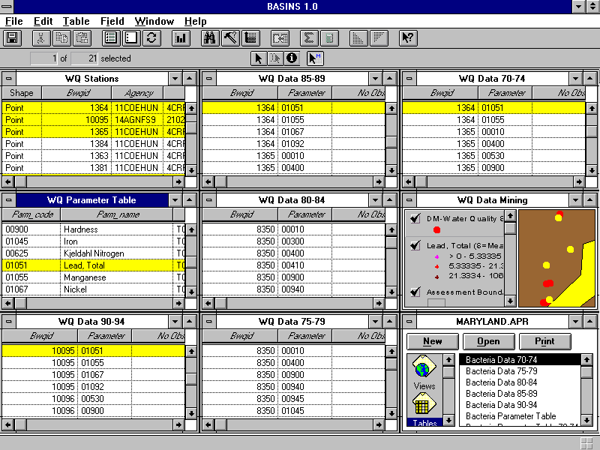
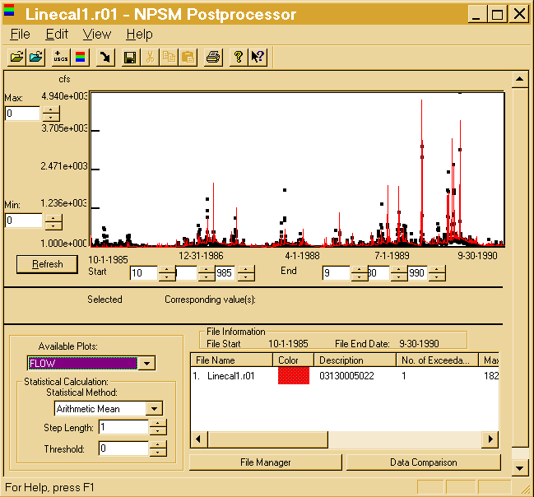
BASINS - Integrating GIS and Water Quality Modeling
Data
Cartographic
Monitoring
Loadings
Tools
Target
Assessment
Data Mining
Reporting
Models
HSPF - NPSM
QUAL2E
TOXIROUTE
Post-Processors
Target
Assess
DM
Decisions
Watershed Management
.
TMDL
.
Source Water Protection
.
Stormwater
State and Local Data

Slide 12

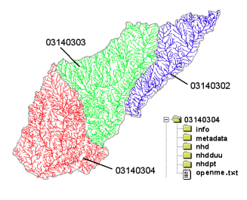
River networks
for 8-digit HUC
watersheds
http://nhd.usgs.gov/

Slide 13
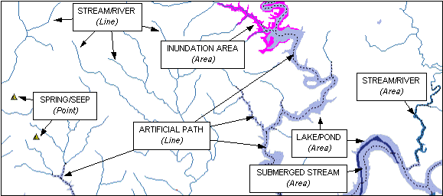

Slide 14

Lower West Fork, Trinity River Basin
HUC = 12030102

Slide 15
NHD River Reaches
412 River Reaches
In Upper West Fork of Trinity Basin

Slide 16
River Reach Codes
Used for river address locations
ReachCode =
12030102000151
ReachCode = 12030102000005
HUC#
Segment#
Location 0.392
on Reach
12030102000005

Slide 17
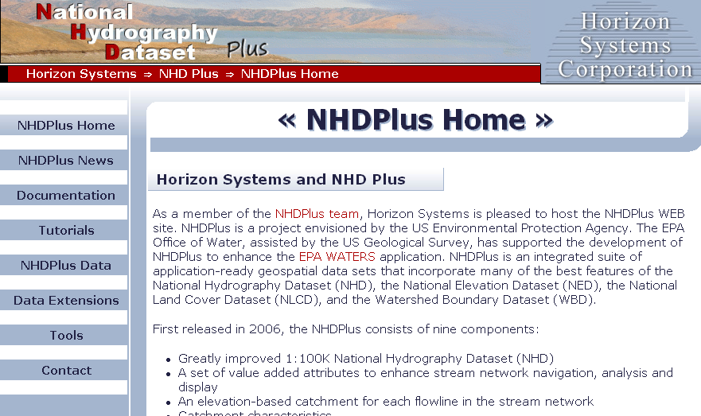
http://www.horizon-systems.com/nhdplus/

Slide 18
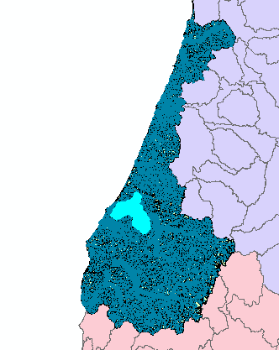
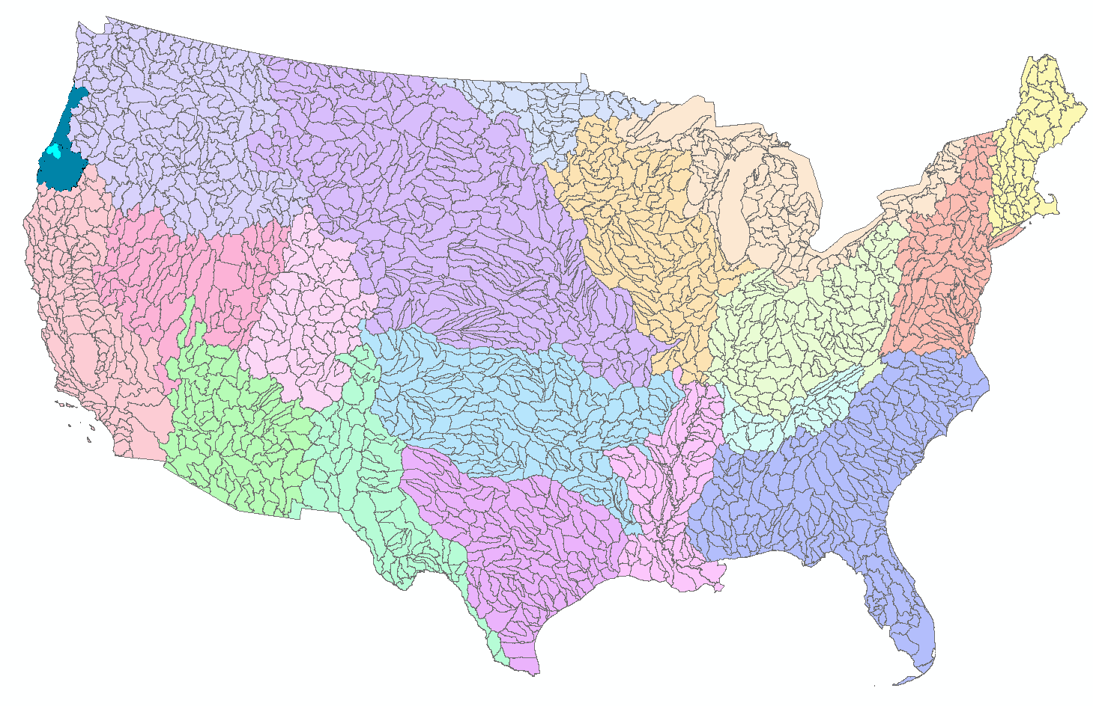
NHDPlus for a Portion of Oregon
http://www.horizon-systems.com/nhdplus/

Slide 19
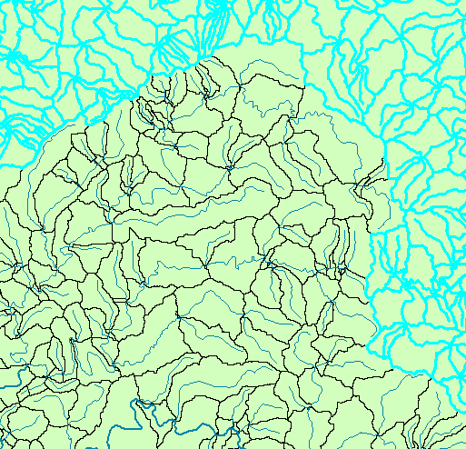
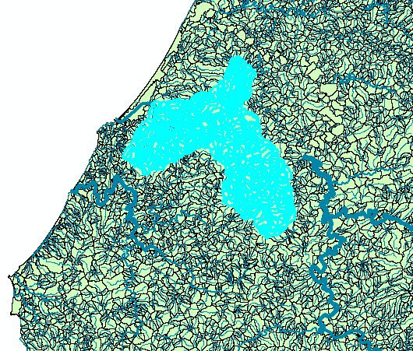
NHDPlus Reach Catchments ~ 3km²
Average reach length = 2km
2.3 million reaches for continental US
About 1000 reach catchments in each 8-digit HUC

Slide 20
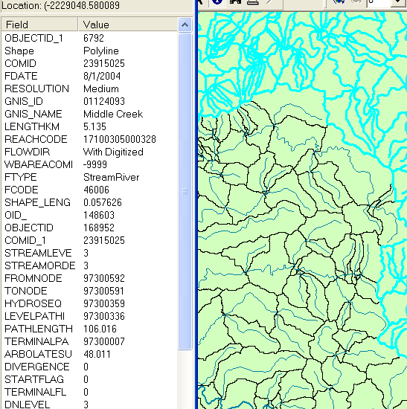
NHDPlus Reach Attributes
Slope
Elevation
Mean annual flow
  Corresponding velocity
Drainage area
% of upstream drainage area in different land uses
Stream order

Slide 21
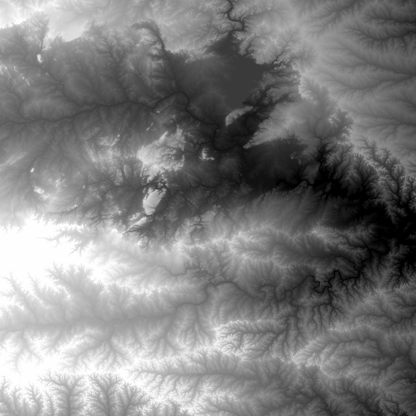
National Elevation Dataset
http://ned.usgs.gov/
Digital Elevation Model with 1 arc-second (30m) cells
Seamless in 1° blocks for the United States
10 billion data
Derived from USGS 1:24,000 quadrangle sheets
Get the data:
http://seamless.usgs.gov/

Slide 22
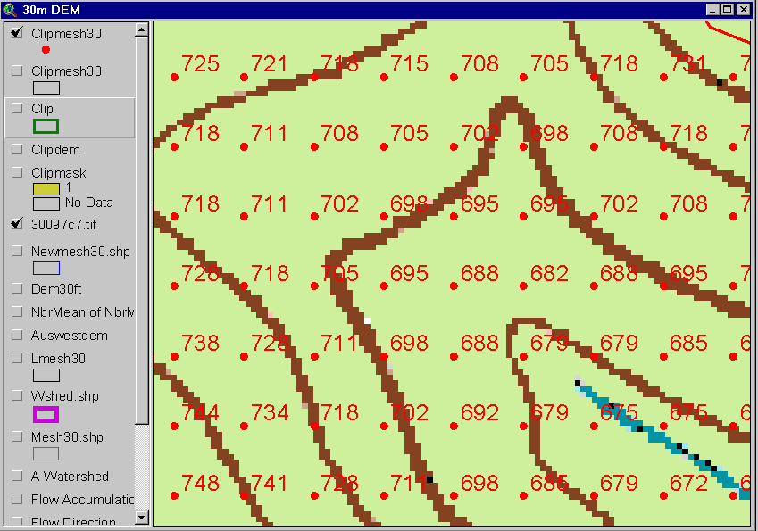
Digital Elevation Model (DEM)
720
720
Contours
740
720
700
680
740
720
700
680

Slide 23
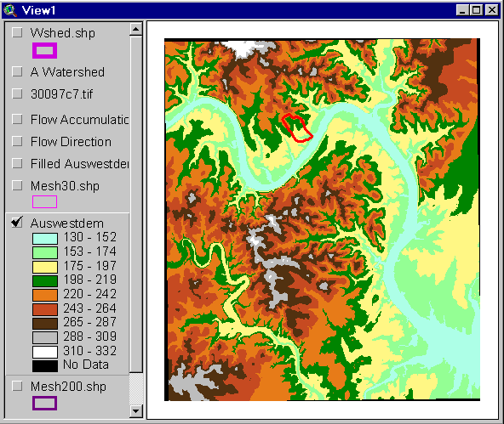
Austin West 30 Meter DEM

Slide 24
Eight Direction Pour Point Model
32
64
128
16
1
8
4
2
Water flows in the direction of steepest descent

Slide 25
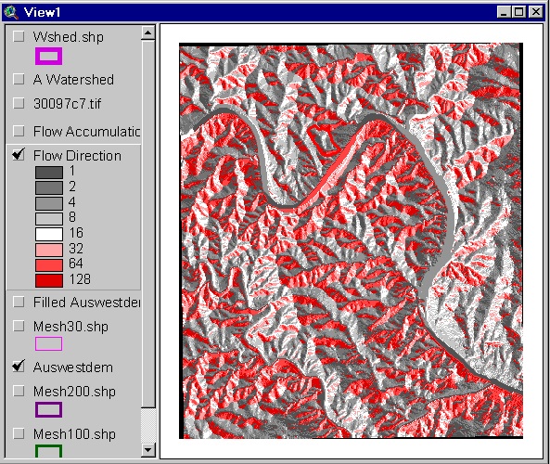
Flow Direction Grid
32
64
128
16
1
8
4
2

Slide 26
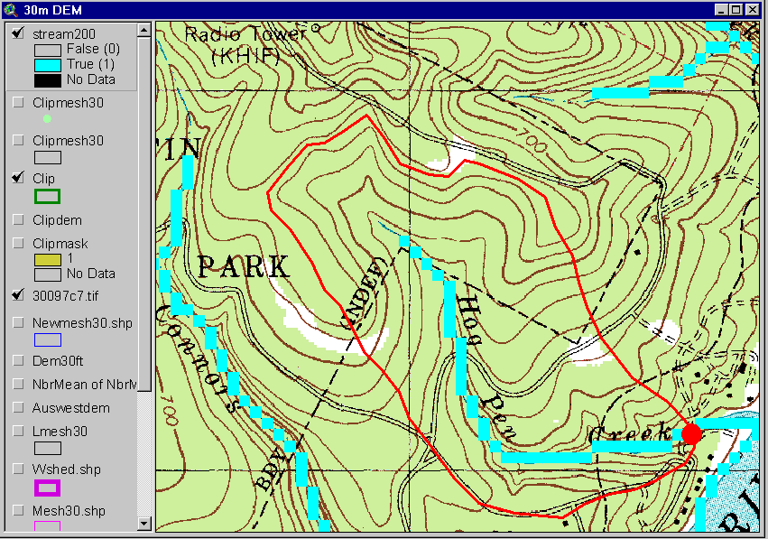
Delineation of Streams and Watersheds on a DEM

Slide 27
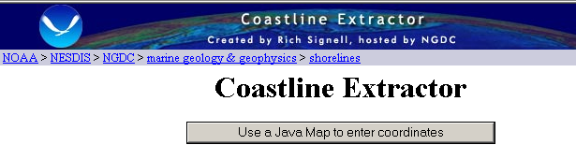
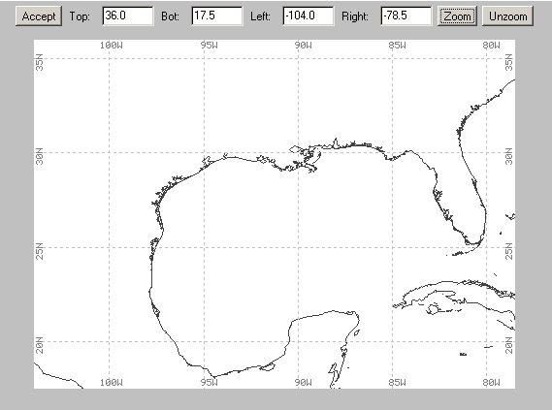
http://www.ngdc.noaa.gov/mgg/shorelines/shorelines.html

Slide 28

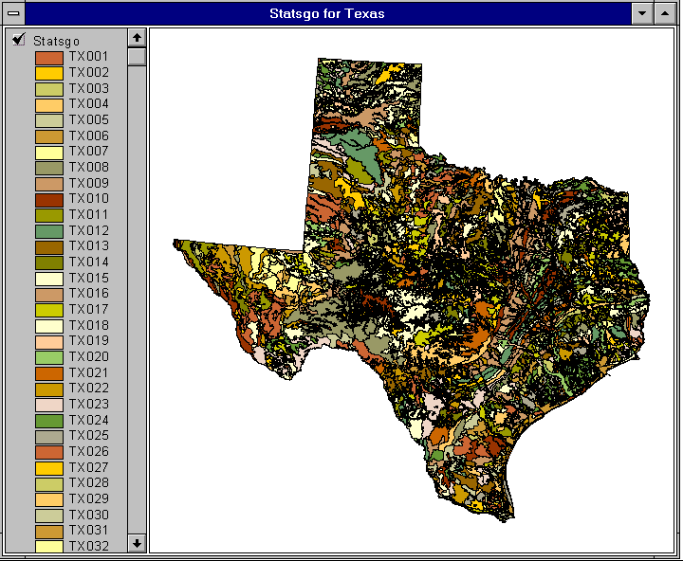

1:250,000 Scale Soil Information
http://www.ncgc.nrcs.usda.gov/products/datasets/statsgo/

Slide 29
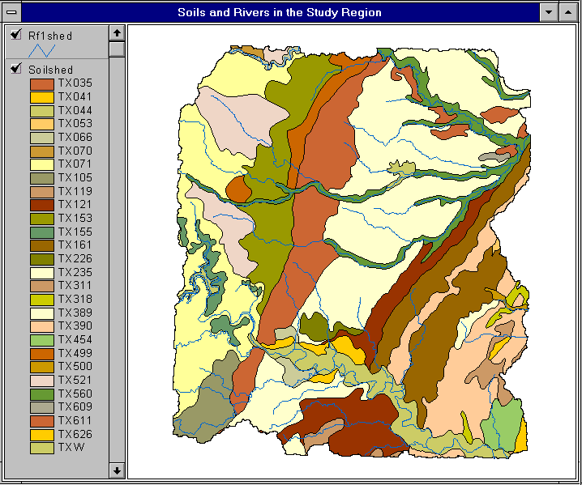

Slide 30
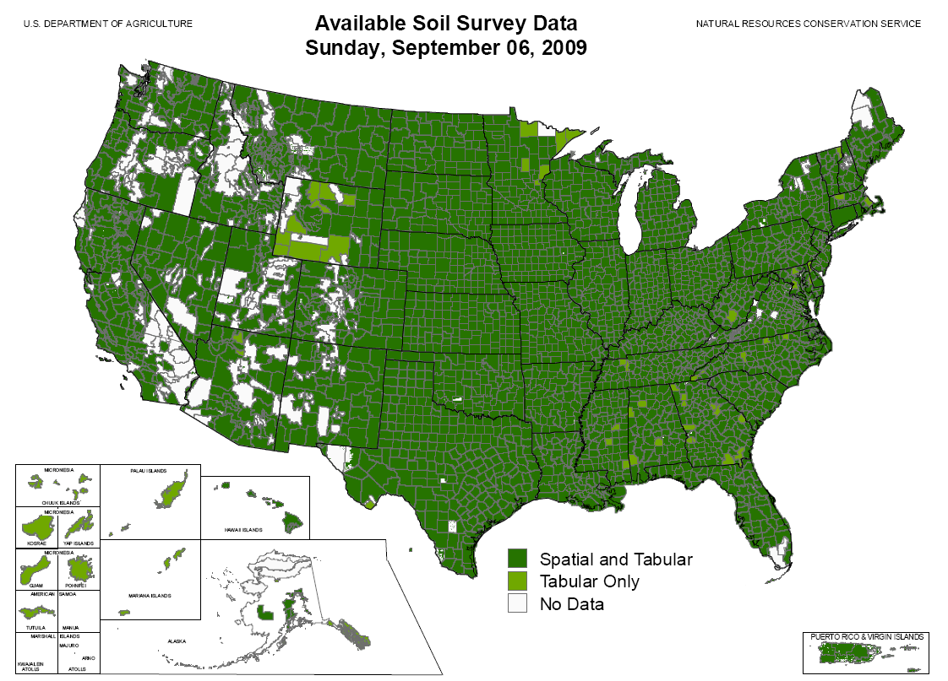
SSURGO:
County Level
Digital Soil Maps
1:24,000 scale
soil information
http://www.ncgc.nrcs.usda.gov/products/datasets/ssurgo/

Slide 31
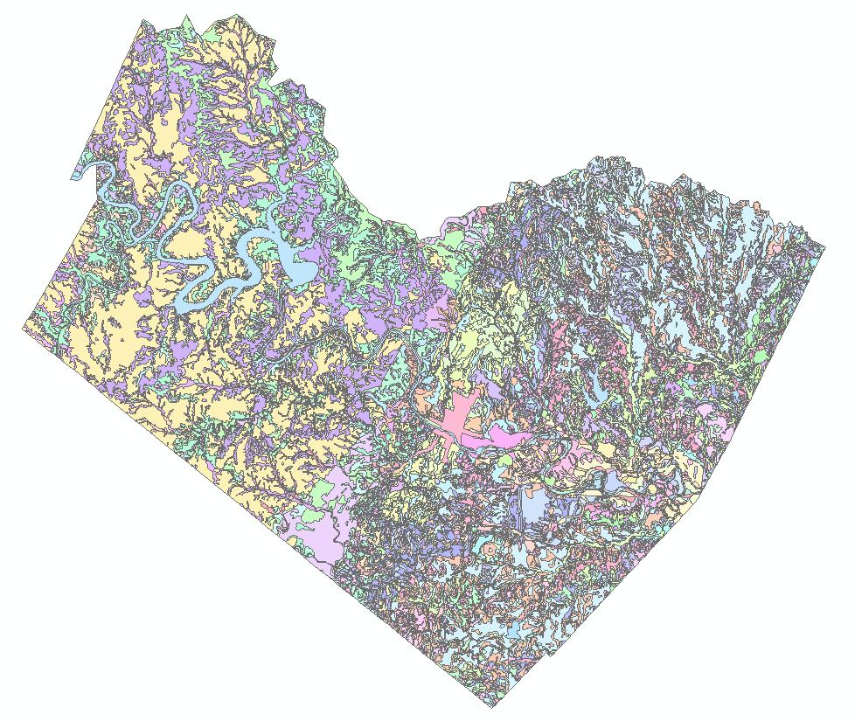
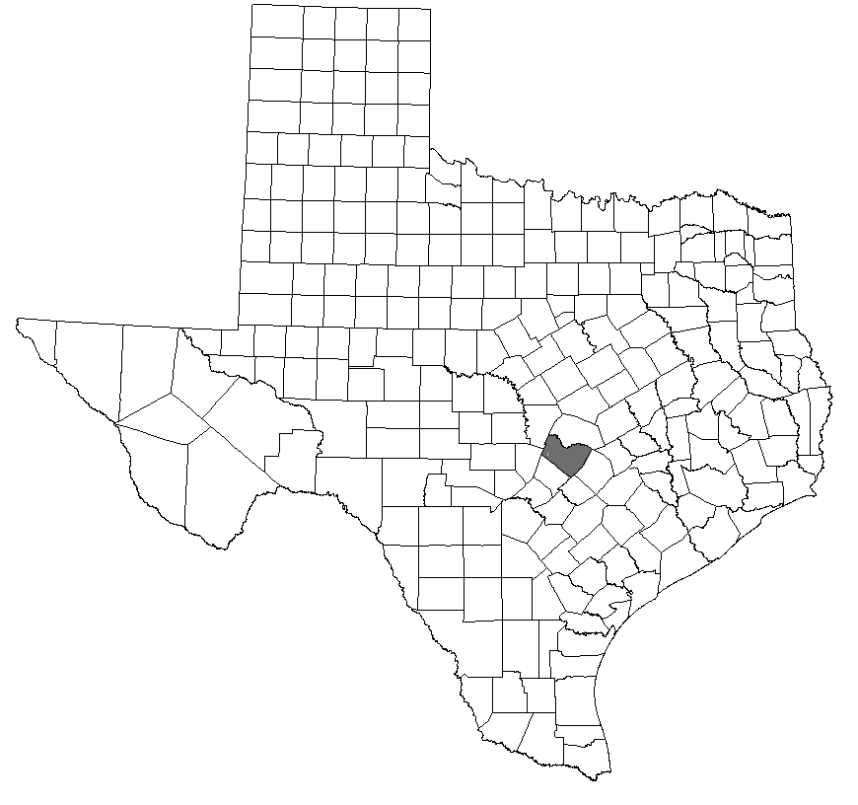
Ssurgo for Travis County
103 soil map units described by 7530 polygons of average area 35.37 ha (87 acres)

Slide 32

http://landcover.usgs.gov/

Slide 33
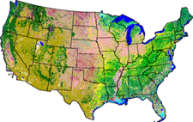
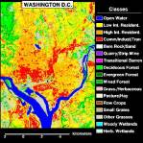
National Land Cover Dataset
Get the data:
http://seamless.usgs.gov/

Slide 34
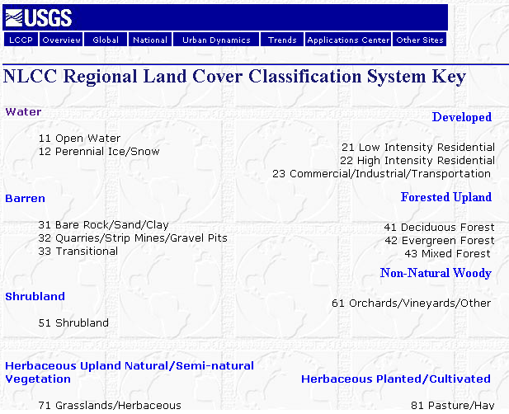

Slide 35

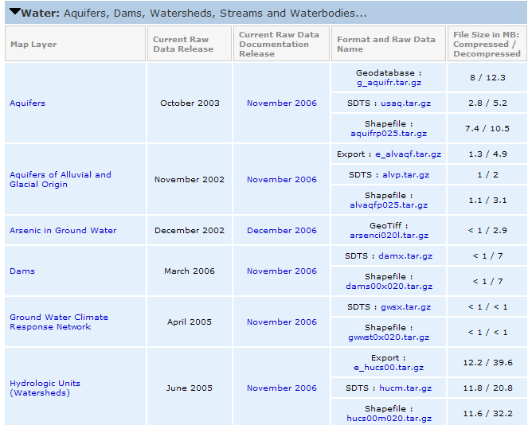
http://www.nationalatlas.gov/atlasftp.html

Slide 36
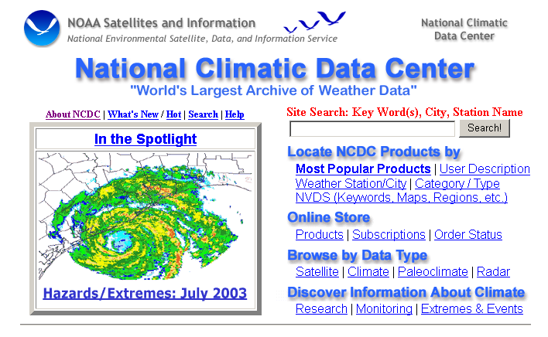
http://www.ncdc.noaa.gov/oa/ncdc.html

Slide 37

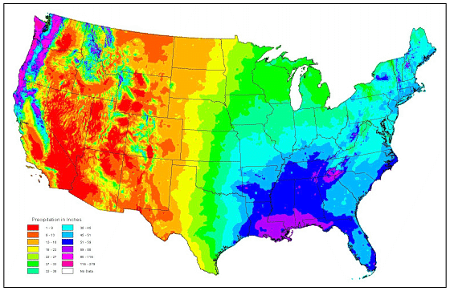
PRISM Mean Annual Precipitation
http://www.wcc.nrcs.usda.gov/climate/prism.html

Slide 38

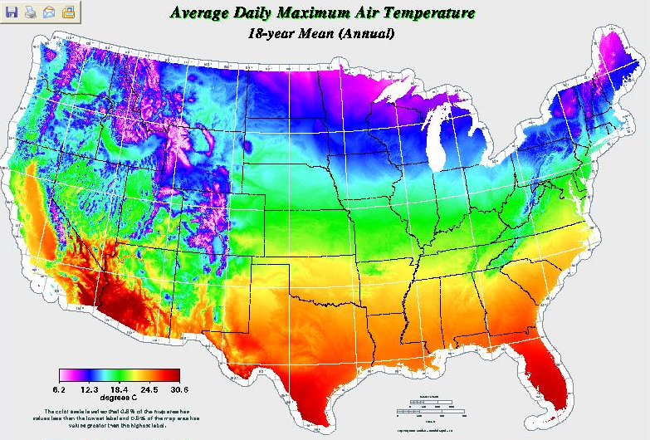
http://www.daymet.org/

Slide 39
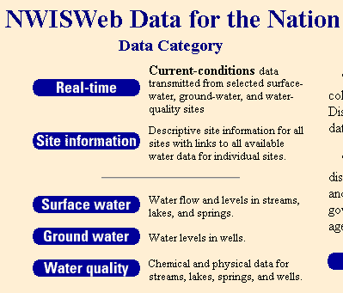
National Water Information System
Web access to USGS water
resources data in real time
http://waterdata.usgs.gov/usa/nwis/

Slide 40
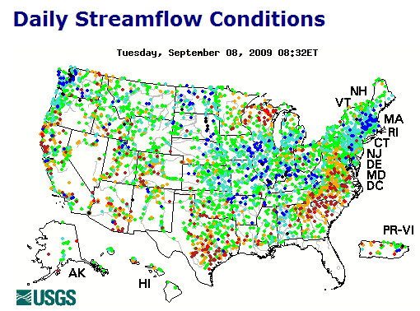
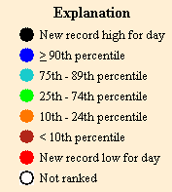
USGS Water Watch
Web access to USGS water resources data in real time
http://waterdata.usgs.gov/nwis/rt

Slide 41
USGS National Water Information System.
Real-time and Historic Data
  Streamflow and stage
  Groundwater levels
  Water Quality
  Site information
Tabular or Graphical Format

Slide 42
http://srtm.usgs.gov/

Slide 43
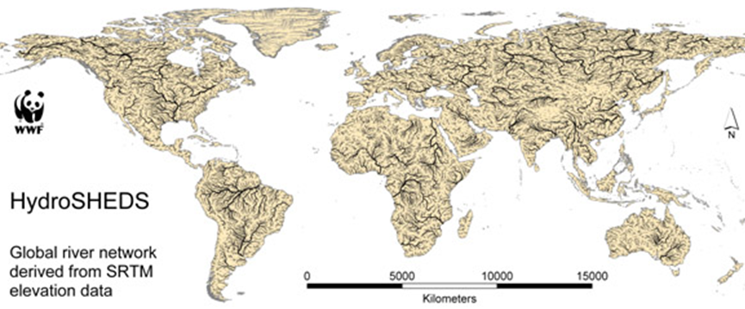
HydroSheds derived from SRTM
http://hydrosheds.cr.usgs.gov/

Slide 44
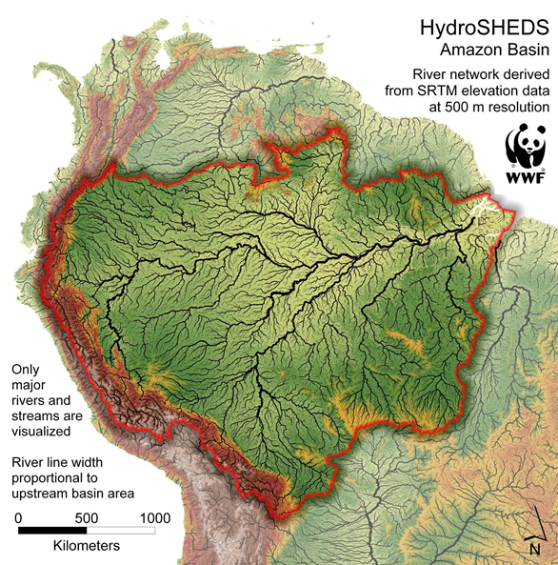

Slide 45
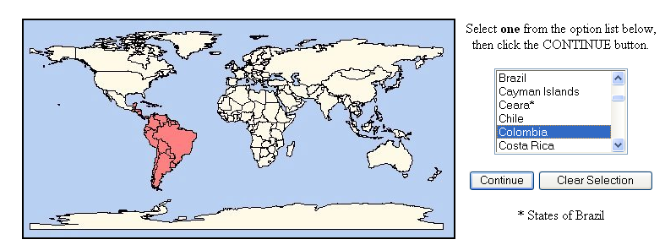
http://www.maproom.psu.edu/dcw/
1:1,000,000 scale vector data for the world

Slide 46

GTOPO30 - 1 km Digital Elevation Model of the Earth
http://eros.usgs.gov/#/Find_Data/Products_and_Data_Available/GTOPO30

Slide 47

Drainage in North America
Hydro1K is
derived from
GTOPO30
using raster
GIS analysis
http://eros.usgs.gov/#/Find_Data/Products_and_Data_Available/gtopo30/hydro

Slide 48

NASA Satellite Data
https://lpdaac.usgs.gov/

Slide 49

Global Energy and Water Experiment
http://www.gewex.org/

Slide 50



Slide 51



http://maps.utah.gov/

Slide 52

http://www.wrcc.dri.edu/

Slide 53


http://www.wcc.nrcs.usda.gov/snotel/

Slide 54


http://www.dnr.ne.gov/databank/geospatial.html

Slide 55

“National Map” in Nebraska
http://nmviewogc.cr.usgs.gov/viewer.htm?bbox=-104.5,39.5,-95,43.5

