Slide 1
Arc Hydro Groundwater & Time
Tim Whiteaker (UT Austin)
Gil Strassberg (Aquaveo)
David Maidment (UT Austin)

Slide 2
Linking GIS and Water Resources
Water
Resources
GIS

Slide 3
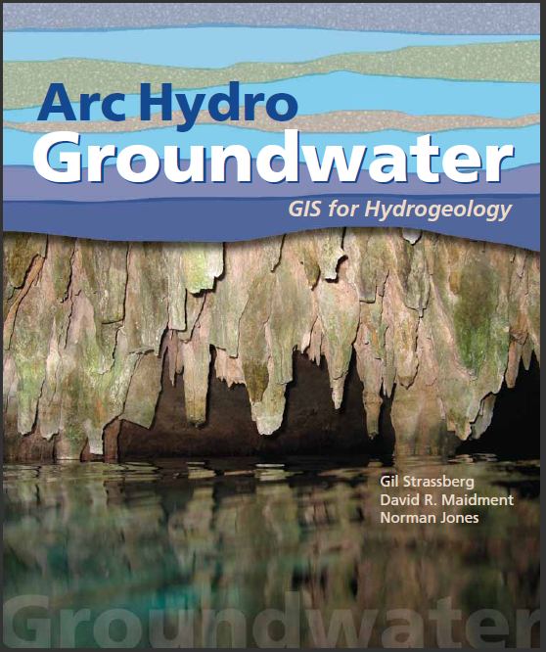
Arc Hydro Groundwater:
GIS For Hydrogeology
Describes the data model – public domain
Chapter for each data model component
Will be released later this year
Notes:
Notes:
Industrial partners: ESRI, Danish Hydraulic Institute, Camp,Dresser and McKee, Dodson and Associates
Government partners:
Federal: EPA, USGS, Corps of Engineers (Hydrologic Engineering Center)
State: Texas Natural Resource Conservation Commission, Texas Water Development Board
Local: Lower Colorado River Authority, City of Austin, Dept of Watershed Protection
Academic Partners: University of Texas, Brigham Young University, Utah State University

Slide 4
Space-time datasets

Slide 5
Space-time datasets
Single variable time series – A variable recorded at a location, such as stream discharge or groundwater levels
Multi variable time series – Multiple variables recorded simultaneously at the same location, such as chemical analysis of a water sample
Time varying surfaces (raster series) – Raster datasets indexed by time. Each rater is a “snapshot” of the environment at a certain time.
Time varying features (feature series) – A collection of features indexed by time. Each feature in a feature series represents a variable at a single time period.

Slide 6
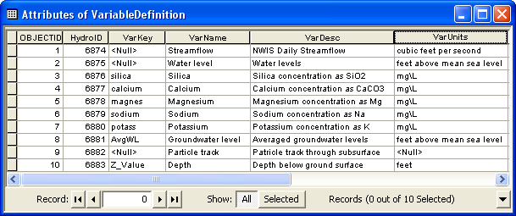
Variable Definition table
Catalog of time varying parameters (e.g. streamflow, water levels, concentrations, etc.)
Each variable is indexed with a HydroID

Slide 7
TimeSeries table
Each measurement is indexed by space, time, and type
Space = FeatureID
Time = TsTime
Type = VarID
VarID provides information on the variable

Slide 8
Time series views
We can “slice” through the data cube to get specific views of the data
Where?
What?
Where and What?
Query by location
(FeatureID = 2791)
Query by type
(VarID = 6875)
Query by location and type
(FeatureID = 2791 VarID = 6875)
TsTime
TsTime
TsTime
2791
FeatureID
FeatureID
2791
FeatureID
6875
6875
VarID
VarID
VarID

Slide 9
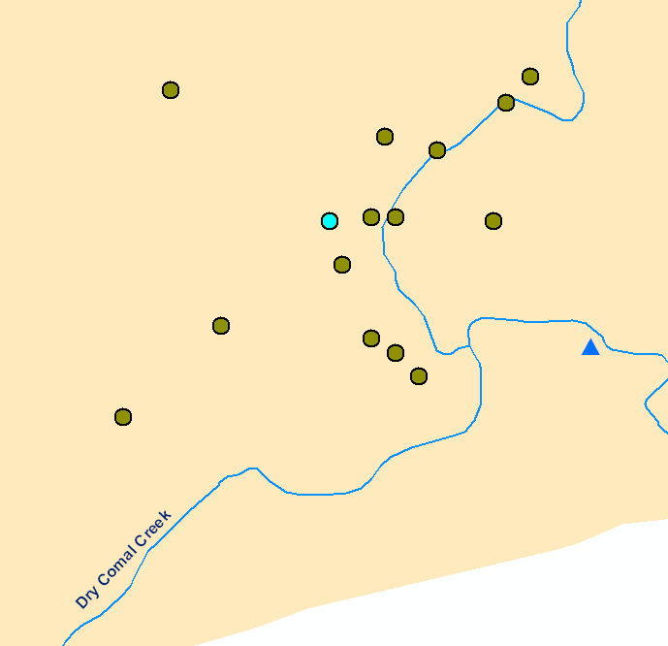
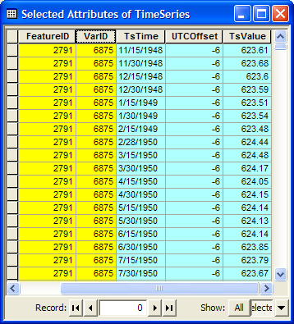
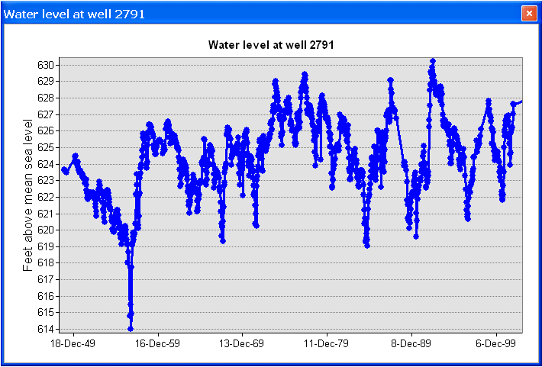
Time series views
Create a plot of time series related to a feature
Get all the data of VarID 6875 measured at Feature 2791
Well HydroID = 2791

Slide 10
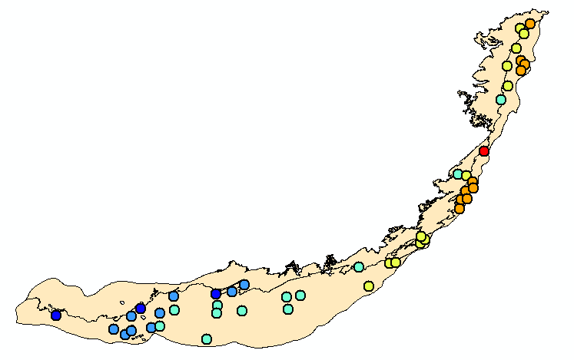
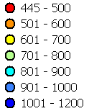
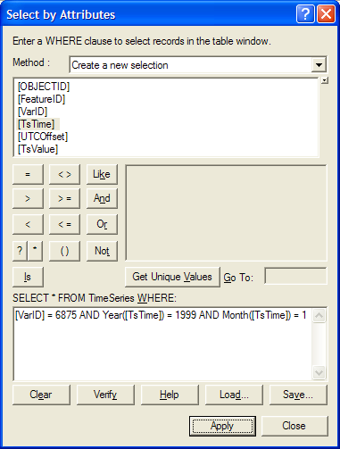
Time series views
A type-time view: Get water levels (TSTypeID =2) for 1/1999
TsTime
Water level in the Edwards Aquifer in 1/1999
1/1991
FeatureID
6875
VarID
Set of layers for different times creates an animation

Slide 11
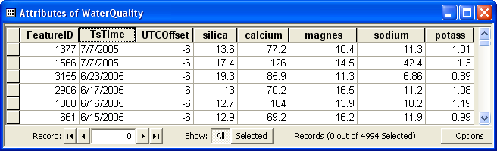
Multi-variable time series
Multiple variables recorded simultaneously at the same location
Example – water quality parameters
Indexed by location (FeatureID), and time (TsTime)
Relationship to the VariableDefinition table is through the VarKey
Variables (VarKey)

Slide 12
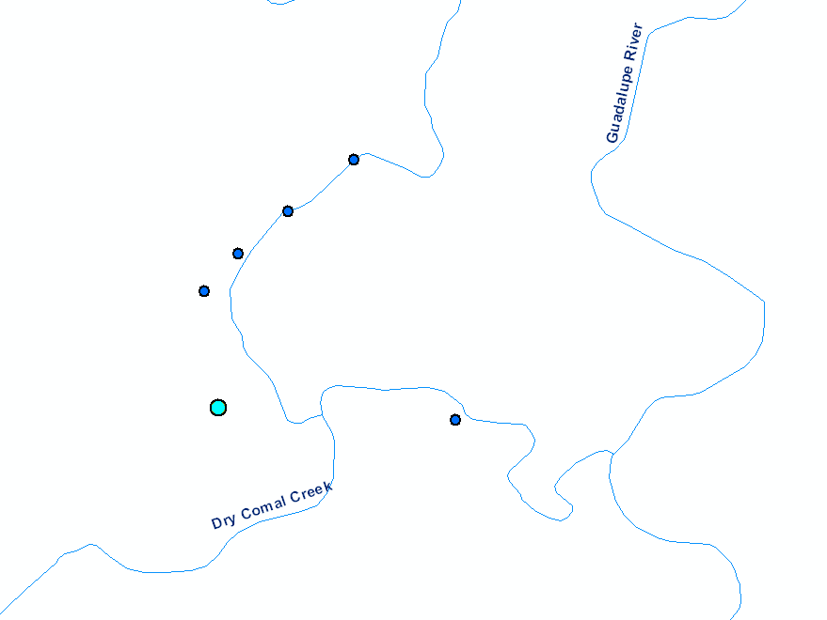
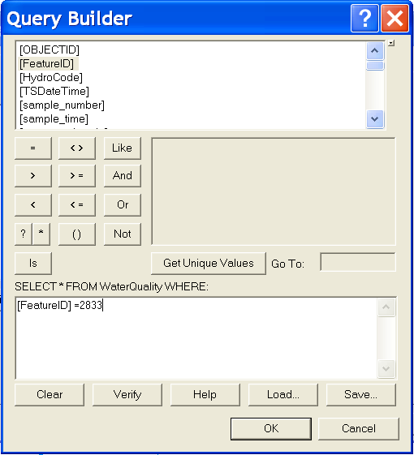
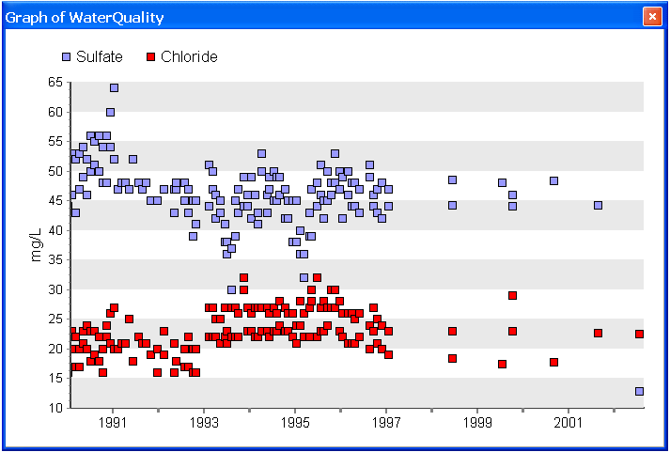
Multi-variable time series
Can query for multiple variables together
New Braunfels Springs
Well HydroID = 2833

Slide 13
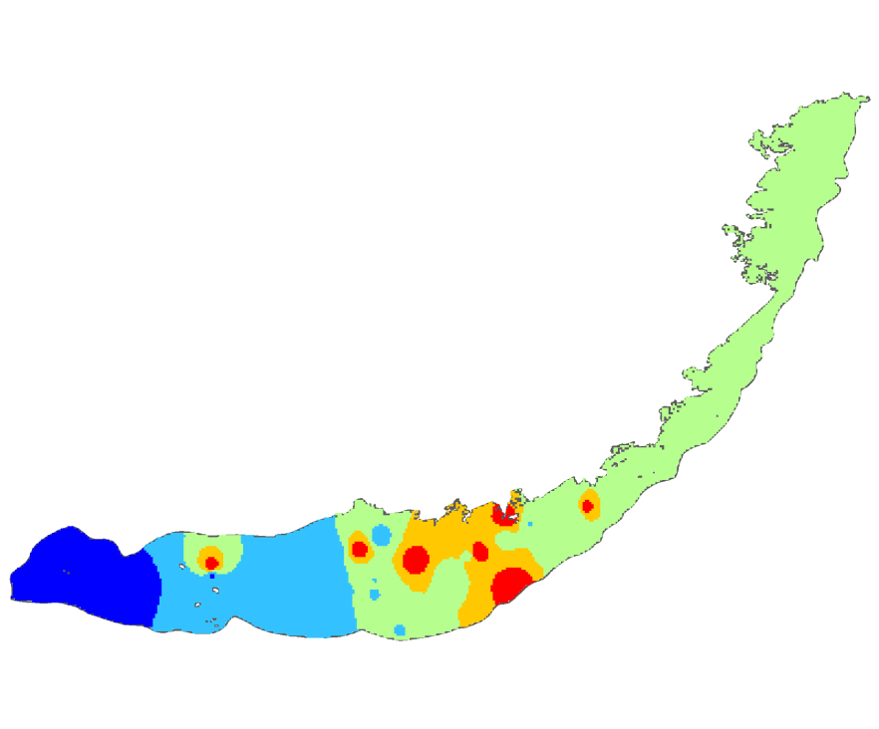
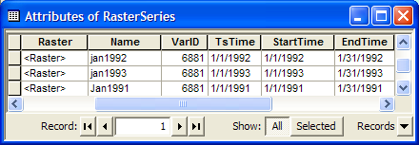

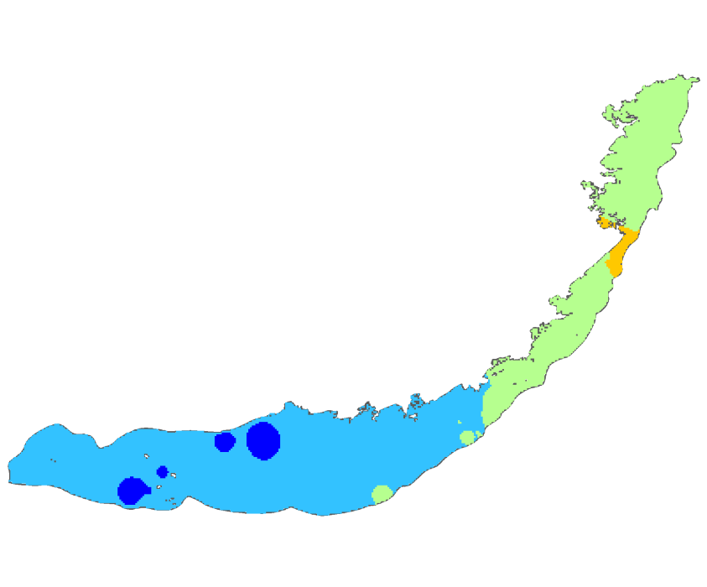
Raster Series
Raster datasets indexed by time
Each raster represents a continuous surface describing a variable for a given time
January 1991
January 1992
January 1993

Slide 14
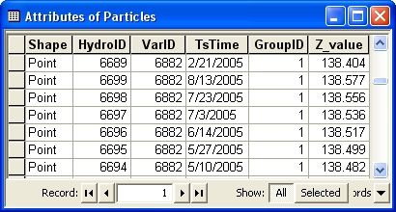
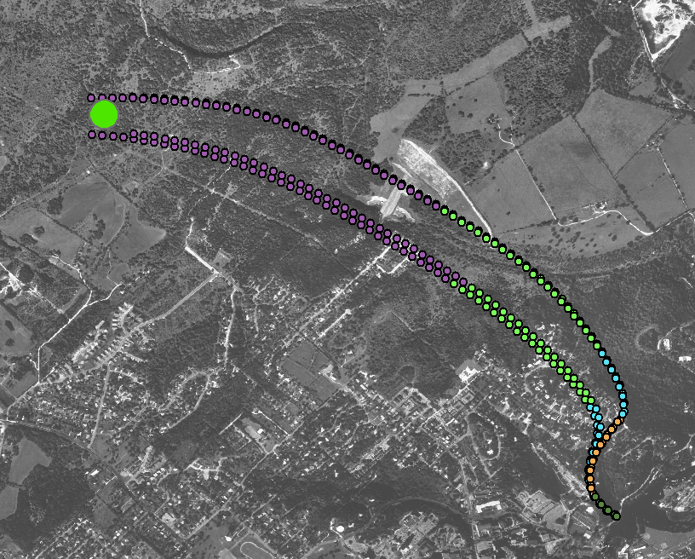

Feature Series
A collection of features indexed by time
Example of particle tracks
Features are indexed by VarID, TsTime, and GroupID
Each group of features creates a track over time

Slide 15
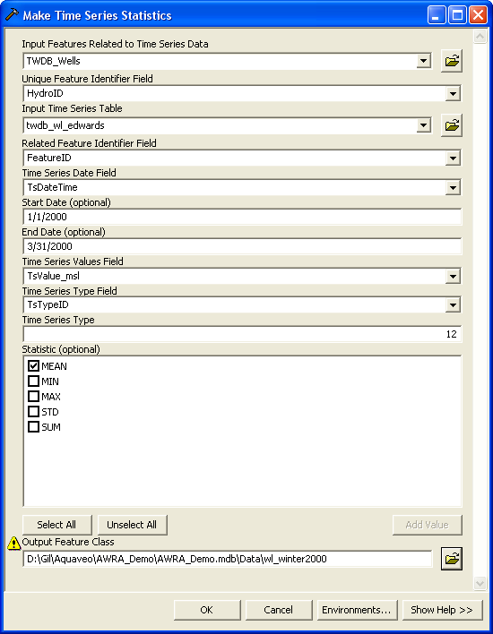
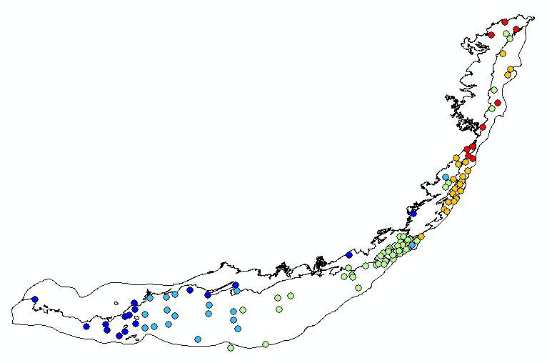

Time series statistics
Summarize values over a given time
Custom tool - part of Groundwater Analyst

Slide 16
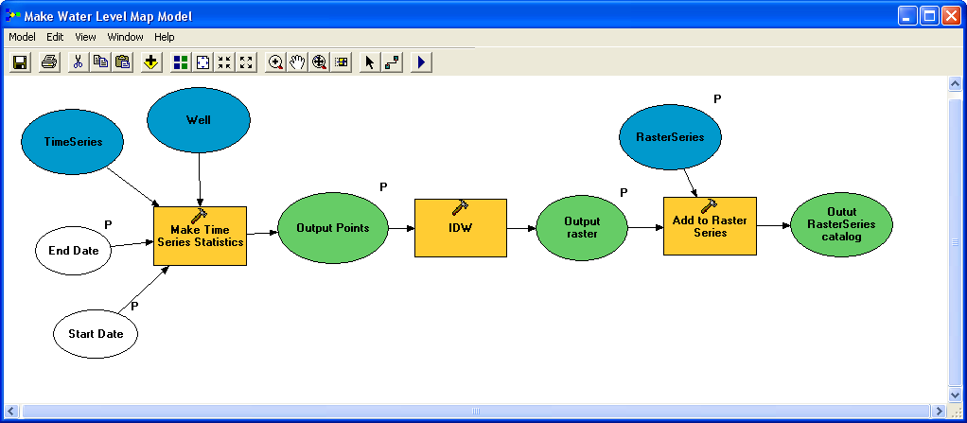
Workflow
Workflow
Import time series data into AHGW table format
Create time series views – Time Series Statistics tool
Interpolate to create rasters
Load and index rasters in the RasterSeries raster catalog
Animate data
Automate workflows with custom models/scripts

