Slide 1
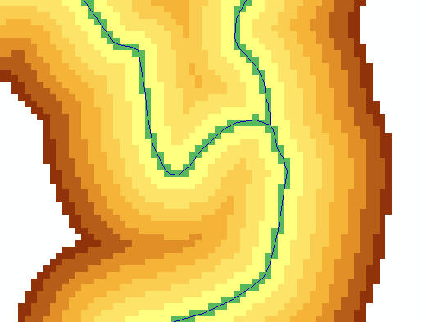
Key Concepts from Exercise 4
DEM Reconditioning as an example of quantitative raster analysis
  Vector to Raster
  Distance
  Raster Calculation
  Volume removed analysis
Subtract 10 at all stream grid cells
"smdem" - 10 * “flowLineReclas" - 0.02 * (500 - "distance") * ("distance" < 500)
500
500
Subtract an amount that tapers from 0.02*500=10 when distance is 0, to 0 when distance is 500 from stream
Only do taper when distance is less than 500, otherwise this is 0 and nothing is subtracted
10
10

Slide 2
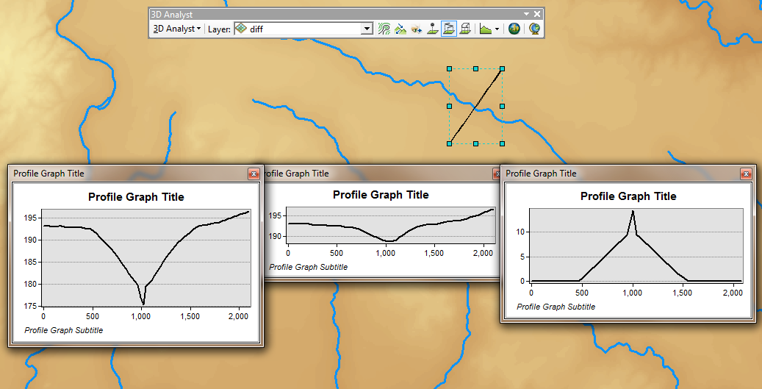
3D Analyst Profiles
smdem
diff
smrecon

Slide 3
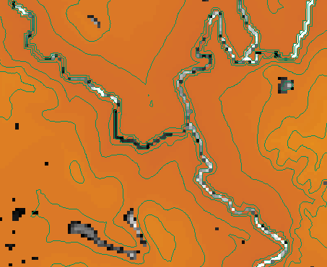
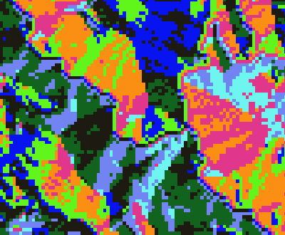
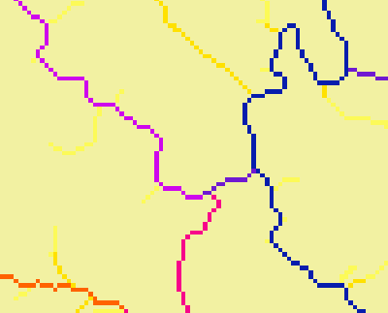
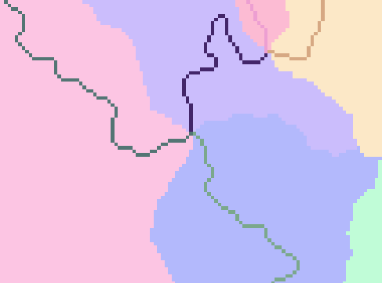
Construct the Analysis Layer
Fill
Flow Direction
Flow Accumulation
Stream Definition
Stream Links
Catchments

Slide 4
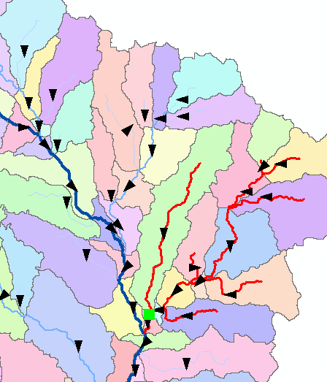
Convert to Vector
Vector streams
Vector catchments
Attribute feature with raster zonal statistics
Geometric Network
Tracing
Selection statistics

Slide 5
and, correction of an error
Pages 16, 20 – references to “ThinRaster” should be changed to “FlowLineReclas”
To turn in:
  2. Number of stream grid cells in FlowLineReclas and estimates of channel length and drainage density.

Slide 6
Hydro Networks in GIS
Network model
Flow on Networks
Hydrologic networks
Linear referencing on networks
Some slides in this presentation were prepared by
Dr Francisco Olivera

Slide 7
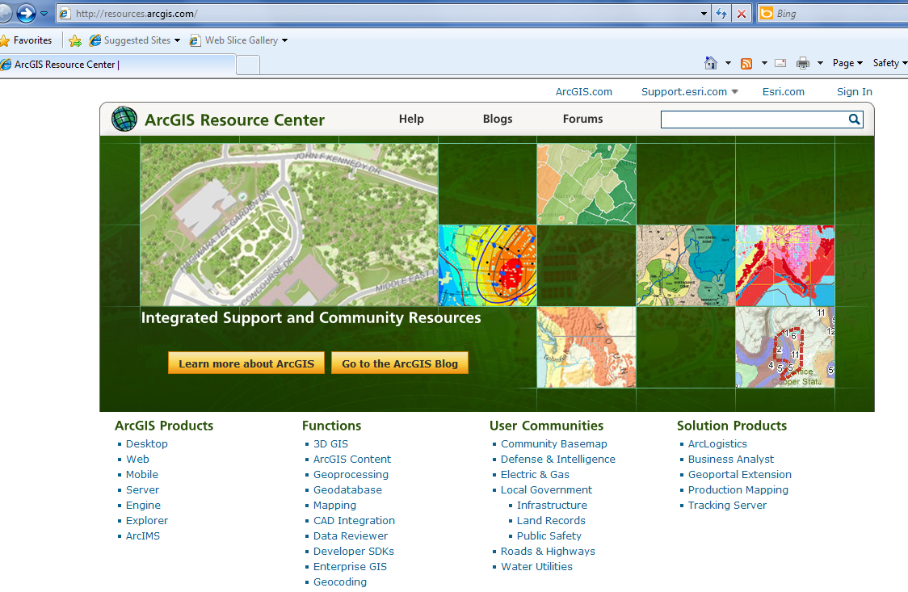
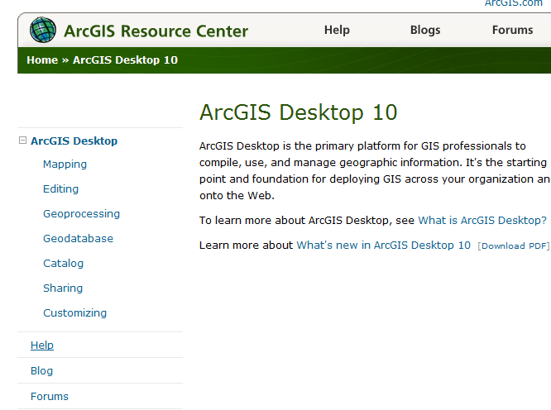
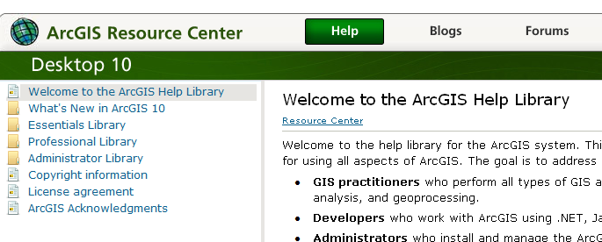
ArcGIS Resource Centers http://resources.arcgis/com
Getting to Readings in ArcGIS Resource Center Help for Desktop 10
Desktop
Help

Slide 8
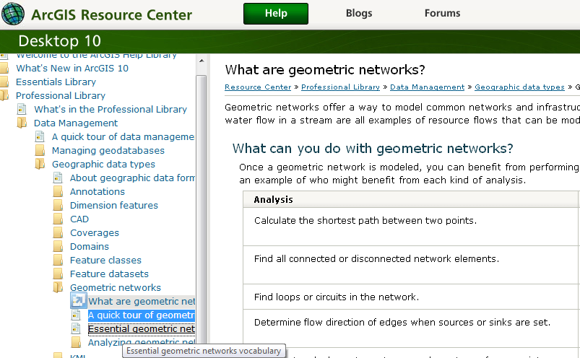
Reading (1)
ArcGIS Resource Center/Desktop 10/Help/Professional Library/Data Management/Geographic Data Types/Geometric Networks – What are geometric networks, A quick tour of geometric networks, Essential geometric networks

Slide 9
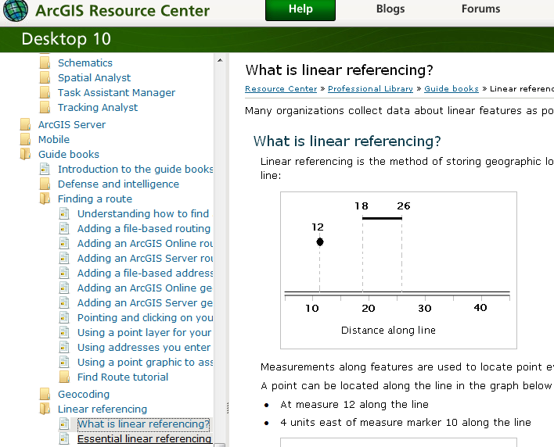
Reading (2)
ArcGIS Resource Center/ Desktop 10/Help/Professional Library/Guide books/Linear Referencing
- What is linear referencing; Essential linear referencing

Slide 10
Raster to Vector Transition
During the last week, you have been dealing with the flow of water through the landscape based on the raster data structures
Today we are making a transition in which we are going to use vector network data to describe water pathways.
We will connect the land and water flow systems by attaching the catchments and watersheds derived from raster data processing to our vector networks

Slide 11
Some terminology
Hydrography – the mapping of water features
    Blue line features on topographic maps (streams, rivers, lakes,…)
    More generally, hydrography also includes the mapping of bathymetry and extent of estuaries and coastal waters
National Hydrography Dataset (NHD) – a data model for storing topographic map hydrography
  Medium resolution (1:100K) is complete for US
  High resolution (1:24K) is complete for most of the US
NHDPlus – a new data model integrating 1:100K resolution NHD with catchments and derived attributes from the National Elevation Dataset

Slide 12
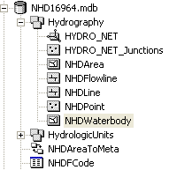
National Hydrography Dataset
Key feature classes
Five feature classes with
NHDFLowline built into
A geometric network
NHDPoint, NHDLine,
NHDArea are point, line
and area water features
on map apart from flowlines
and waterbodies

Slide 13
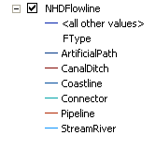
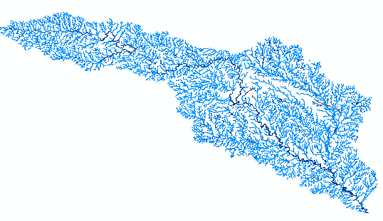
National Hydrography Dataset

Slide 14
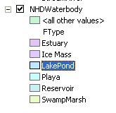
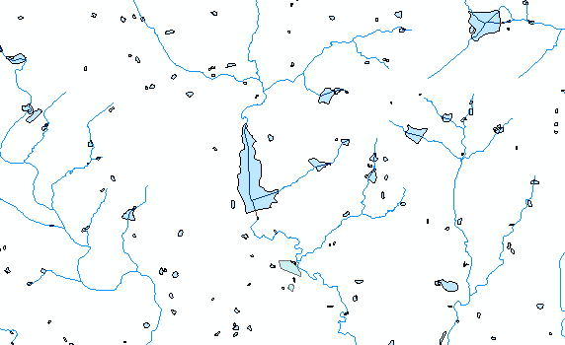
NHD Waterbody

Slide 15
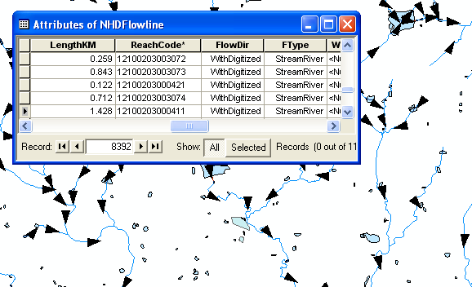
NHD Geometric Network

Slide 16
Arc Hydro Framework Input Data
Watersheds
Waterbody
Streams
Hydro Points
Notes:
The Arc Hydro Framework is a simplified version of the full Arc Hydro data model designed for an entry level user who just wants to put together a basic data set for streams, watersheds, waterbodies and hydro points like stream gages and water quality monitoring points

Slide 17
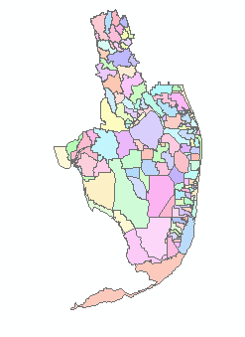
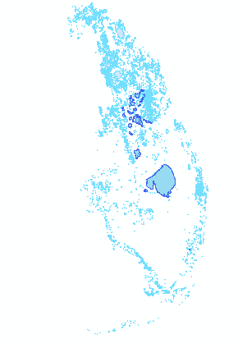
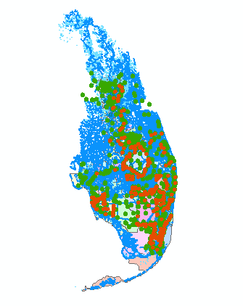
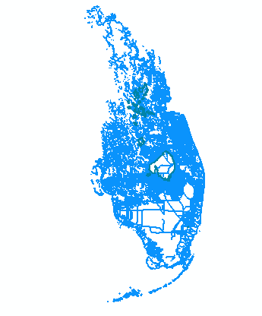
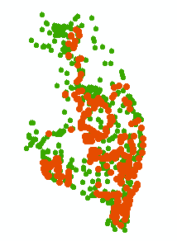

Arc Hydro Framework For South Florida
Basins
Waterbody
(NHD)
Hydro Points
Hydro Network
(NHD)
Notes:
The Arc Hydro Framework is a simplified version of the full Arc Hydro data model designed for an entry level user who just wants to put together a basic data set for streams, watersheds, waterbodies and hydro points like stream gages and water quality monitoring points

Slide 18

Network Definition
A network is a set of edges and junctions that are topologically connected to each other.

Slide 19
Network Model in GIS
Three components
  Geometric model: (x,y,z,m) coordinates of edges and junctions
  Logical model: which edges are connected to what junctions
  Addressing model: location on the network using measure

Slide 20
Edges and Junctions
Simple feature classes: points and lines
Network feature classes: junctions and edges
Edges can be
  Simple: one attribute record for a single edge
  Complex: one attribute record for several edges in a linear sequence
A single edge cannot be branched
No!!

Slide 21
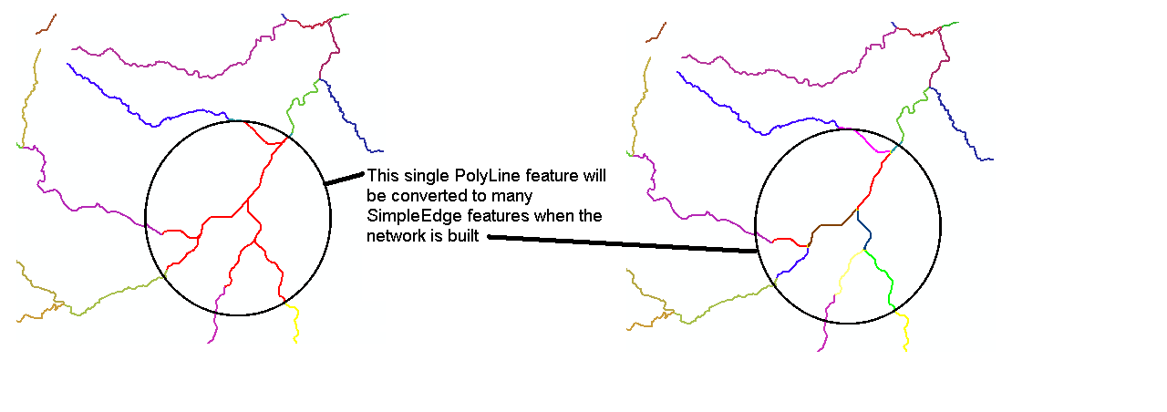
Polylines and Edges

Slide 22
Junctions
Junctions exist at all points where edges join
  If necessary they are added during network building (generic junctions)
Junctions can be placed on the interior of an edge e.g. stream gage
Any number of point feature classes can be built into junctions on a single network

Slide 23
Connectivity Table
p. 132 of Modeling our World
J125
Junction
Adjacent Junction and Edge
J123 | J124, E1
J124 | J123, E1 | J125, E2 | J126, E3
J125 | J124, E2
J126 | J124, E3
E2
J124
E1
E3
J123
J126
This is the “Logical Network”

Slide 24
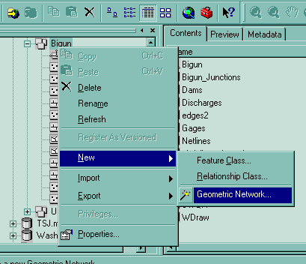
Build Network Tables
Establishes connectivity of Edge and Junction features
Enables tracing
Generates Generic Junctions
Geometric Network Wizard in ArcCatalog

Slide 25
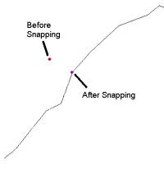
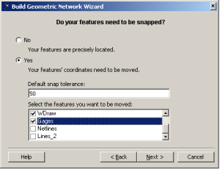
Snapping Features

Slide 26
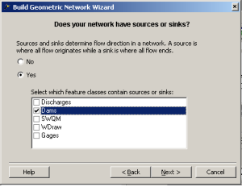
Network Sources and Sinks
Each junction
feature class
in a network can
have junctions
which are sources
or sinks for flow

Slide 27
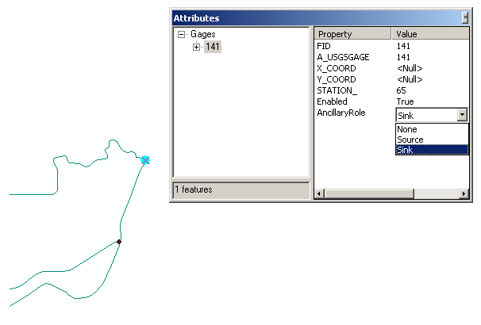
Ancillary Role of Sink

Slide 28
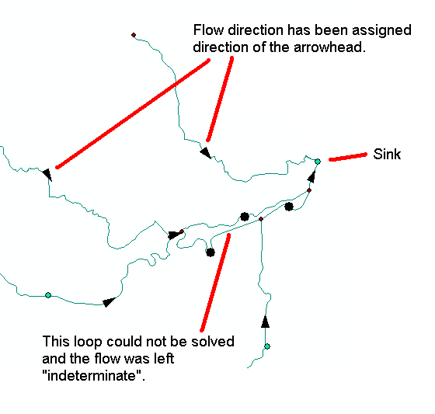
Flow to a sink

Slide 29
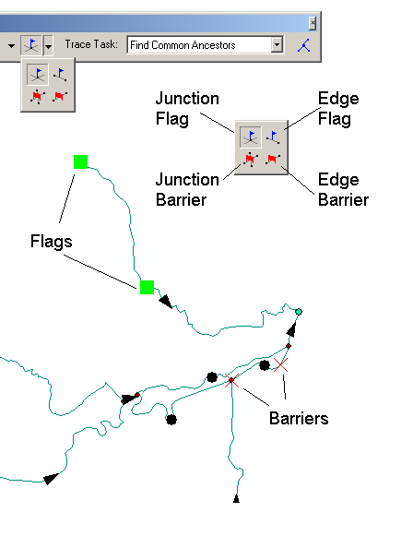
Flags

Slide 30
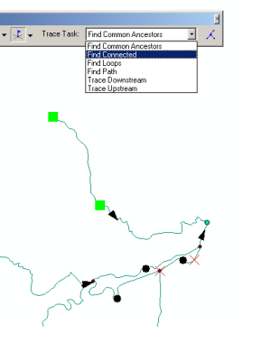
Trace Solvers

Slide 31
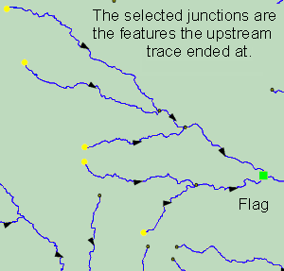
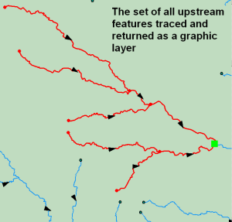
Upstream Trace Solvers

Slide 32
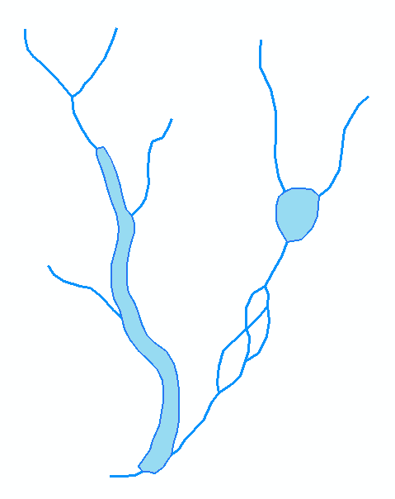
Hydrologic Networks
Hydrologic data includes:
  Single-line streams
  Double-line streams
  Braided streams
  Manmade channel systems
  Waterbodies

Slide 33
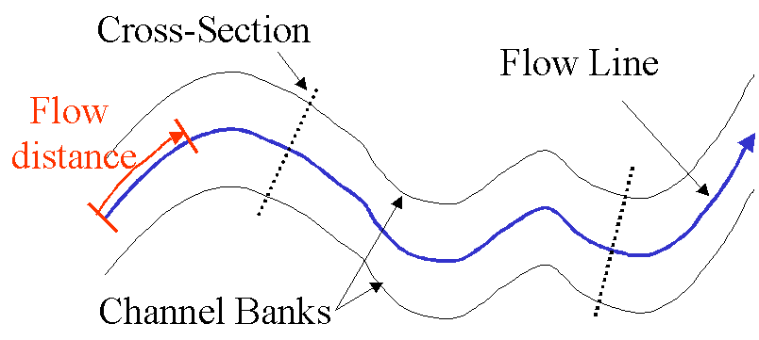
Flow Line
Traces movement of water in a one-dimensional flow system

Slide 34
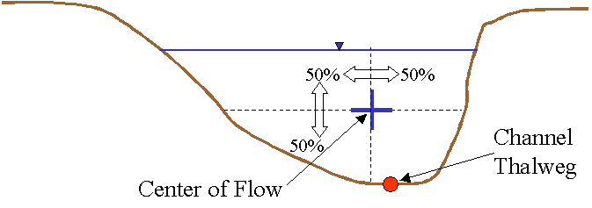
Location of the Flowline

Slide 35
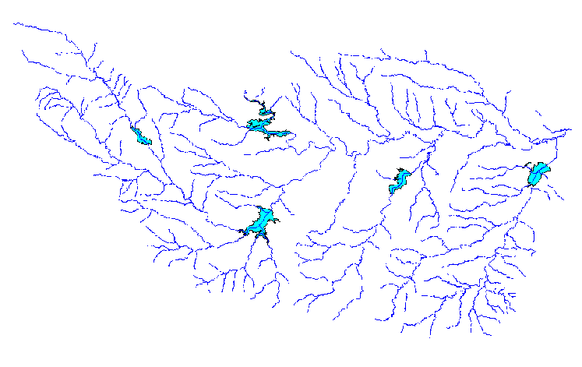
Introduction to the Hydro Network
Hydro Edge – think of Arc
Hydro Junction – think of Node
Waterbody – think of Polygon

Slide 36
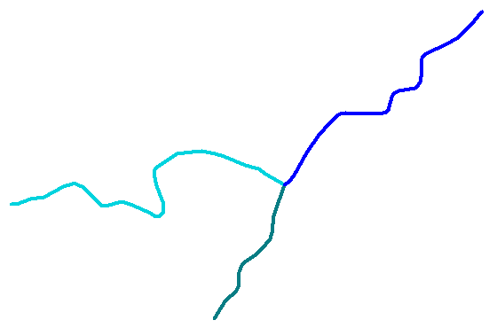
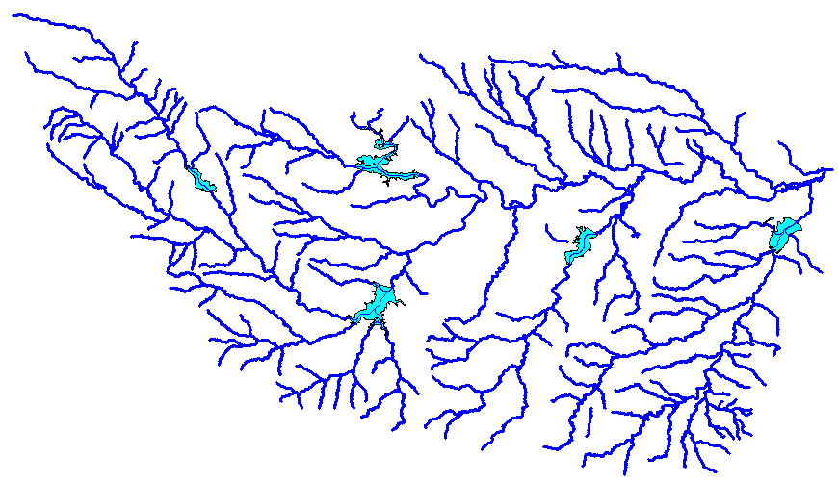
Flow Network
Edge
A connected set of flow edges
Junction

Slide 37
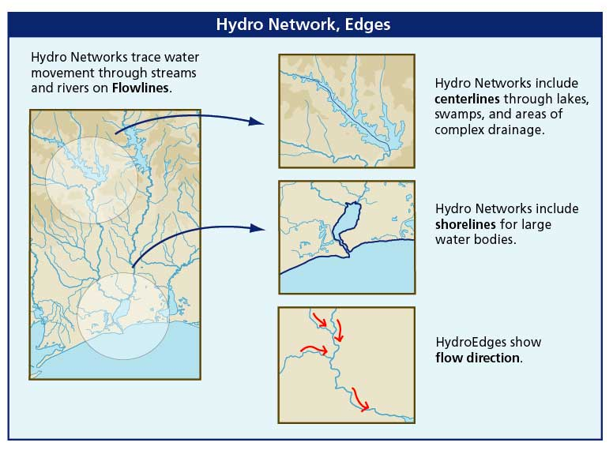
Flowlines and Shorelines

Slide 38
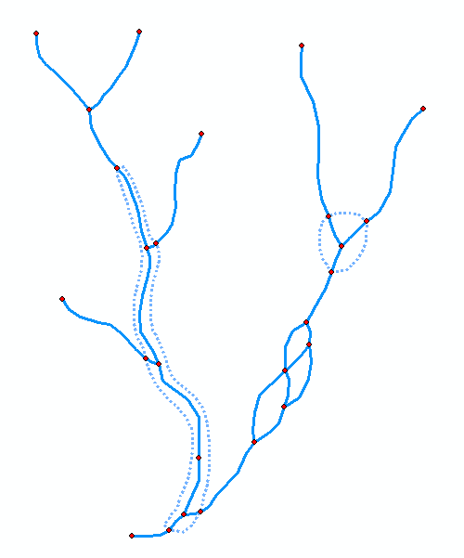
Network Building
Define flow-paths within double-line streams and waterbodies.
Define network sinks and sources.

Slide 39
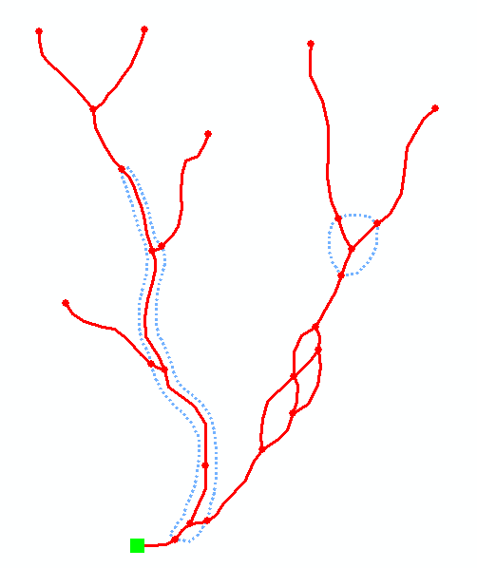
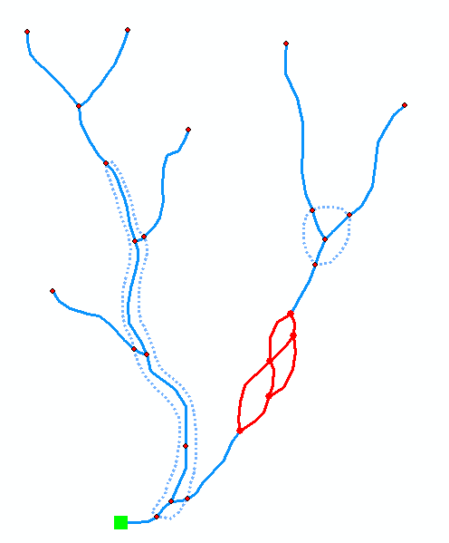
Network Connectivity
Find connected
Find loops

Slide 40
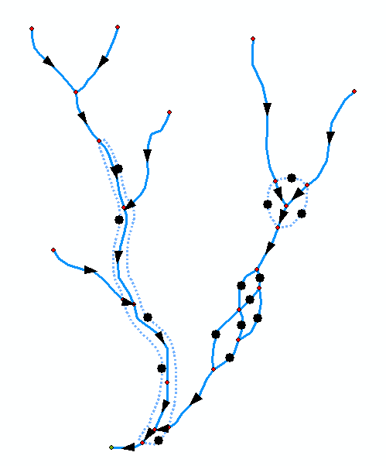
Network Flow Direction
Enable flow in flow-paths.
Disable flow in shorelines
Sink
Flow direction is unknown

Slide 41
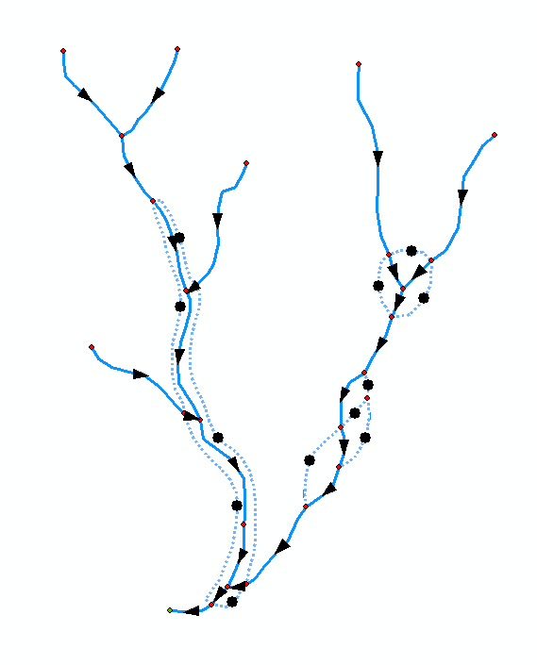
Network Flow Direction
Enable flow in flow-paths.
Disable flow in shorelines
Sink
Flow direction is known

Slide 42
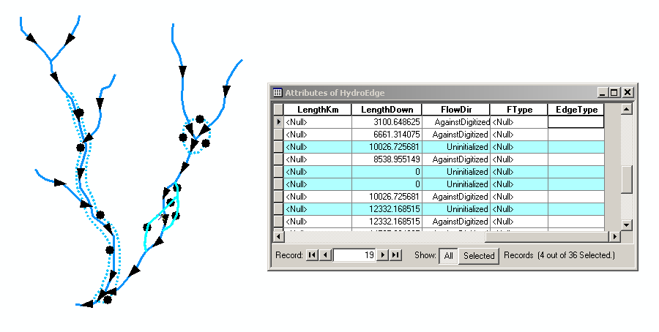
Uninitialized Flow Direction

Slide 43
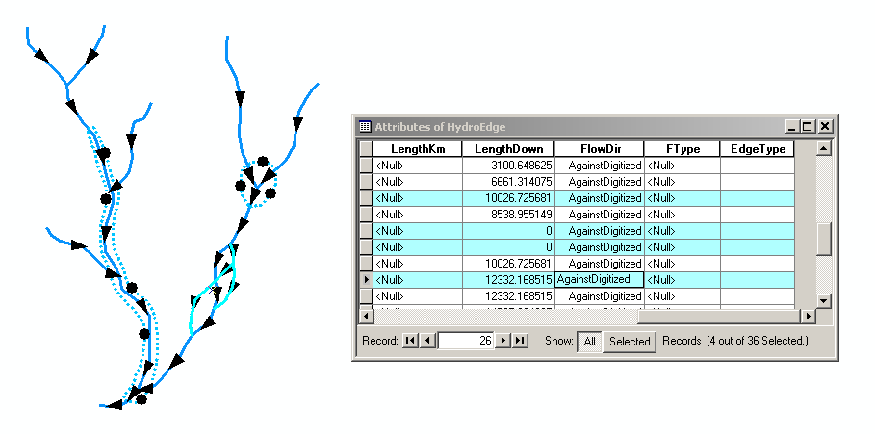
Assigned Flow Direction

Slide 44
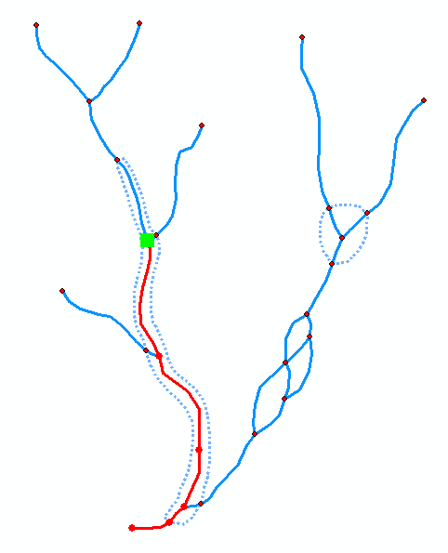
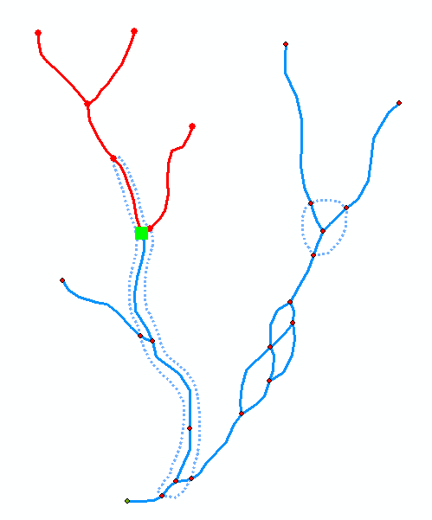
Network Tracing
Trace Upstream
Trace Downstream

Slide 45

Trace Path
Find the shortest path
between two points on
the network

Slide 46

Hydro Network for Holland

Slide 47

Hydro Network for Colorado River Basin around Lake Travis

Slide 48

Guadalupe Basin Framework Dataset

Slide 49

Network Tracing on the Guadalupe Basin

Slide 50

Schematic Network

Slide 51

Hydro Network Junctions

Slide 52

Connecting Waterbodies using Relationships

Slide 53

Hydro Network through Canyon Lake

Slide 54

Linking Canyon Lake to the Network

Slide 55

Connecting Drainage Areas
using Relationships

Slide 56

Connecting Drainage Areas to the Network
Area goes to
point on line

Slide 57


NHDPlus Reach Catchments ~ 3km²
Average reach length = 2km
2.3 million reaches for continental US
About 1000 reach catchments in each 8-digit HUC

Slide 58

Reach Attributes
Slope
Elevation
Mean annual flow
  Corresponding velocity
Drainage area
% of upstream drainage area in different land uses
Stream order

Slide 59

Linear Referencing
Where are we on a line?

Slide 60
Addressing

Slide 61


Coordinates of a 2-D Polyline

Slide 62


Coordinates of a 2-D Polyline M

Slide 63


Setting Line Measure

Slide 64

Proportional Aliasing
Distance is measured
Relative to the length
of the line as a percentage
0% – 100%

Slide 65


Setting Percent Measure
pMSeg.SetAndInterpolate
MsBetween 0, 100
pMSeg.SetAndInterpolate
MsBetween 100, 0
0 – 100 going upstream
0 – 100 going downstream

Slide 66

Point and Line Events

Slide 67
Summary Concepts
A network is a connected set of points (junctions) and lines (edges) that supports tracing functions
  Three data model components
    Geographic (x,y,z)
    Logical (point-line topology connections)
    Addressing (position m along the line)
Features can be geometrically connected (network) or relationally connected (HydroID)

Slide 68
Summary Concepts (2)
Land-water connections
  Area flows to a line model (one Catchment is connected to one flowline) – used in NHDPlus and by Arc Hydro DrainID connections
  Area flows to line at a point model (one Watershed contains many streams that drain to a Junction at the outlet) – used in Arc Hydro where HydroID of the HydroJunction is JunctionID of the Watershed

Slide 69
Summary Concepts (3)
Linear referencing can be used to locate point and line “events” on a network
This is like (x,y) event themes that you used earlier to map stream gage locations in geographic space
With linear referencing the locations are in “network space” but can be converted to regular features if necessary

