Slide 1


HydroServer
A Platform for Sharing Hydrologic Data
CUAHSI
HIS
Sharing hydrologic data
http://his.cuahsi.org/
Jeffery S. Horsburgh, David G. Tarboton, Kimberly A. T. Schreuders, David R. Maidment, Ilya Zaslavsky, and David Valentine
And the rest of the CUAHSI HIS Team
Support
EAR 0622374

Slide 2
Outline
Data Models
Observations Data Model
HydroServer
Next Steps

Slide 3
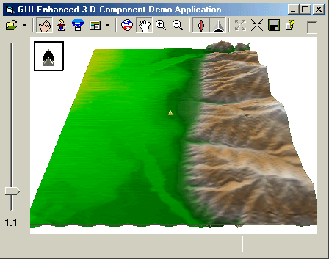

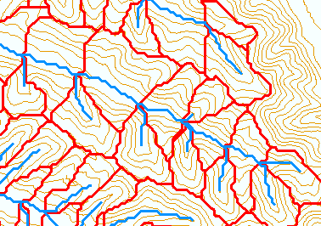
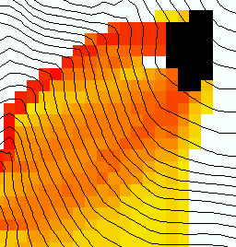
Terrain flow information model.
The way that data is organized can enhance or inhibit the analysis that can be done
Raw DEM
Pit Removal (Filling)
Channels, Watersheds, Flow Related Terrain Information
Flow Field
Notes:
This slide shows the general model for deriving flow field related derivative surfaces from digital elevation data. The input is a raw digital elevation model, generally elevation values on a grid. This is basic information used to derive further hydrology related spatial fields that enrich the information content of this basic data. The first step is to remove sinks, either by filling, or carving. Then a flow field is defined. This enables the calculation of flow related terrain information. My focus has been on flow related information working within this framework. I try to leave other GIS functionality, like radiation exposure, line of sight analyses and visualization to others. I have distributed my software in ways that it easily plugs in to mainstream systems, such as ArcGIS to enhance ease of use.

Slide 4
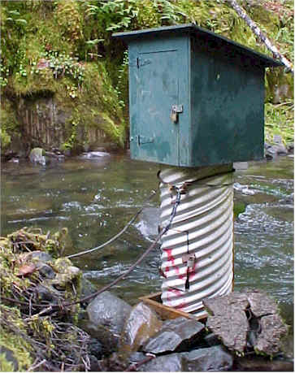
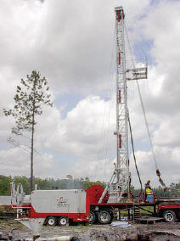
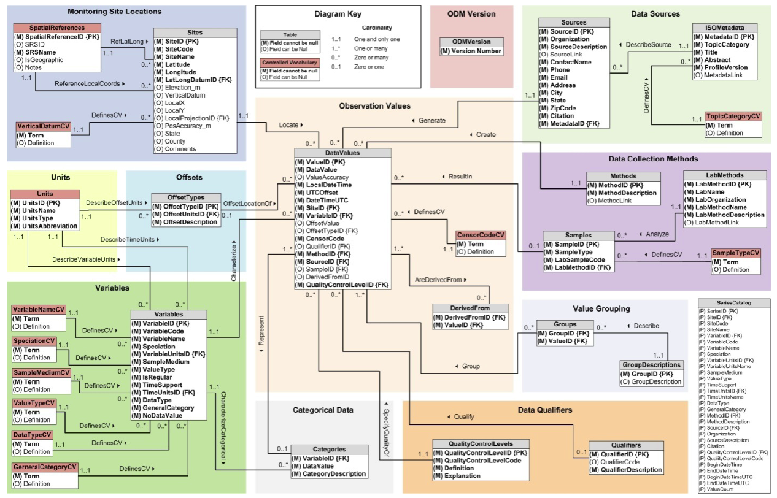
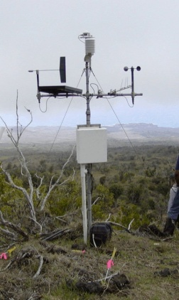
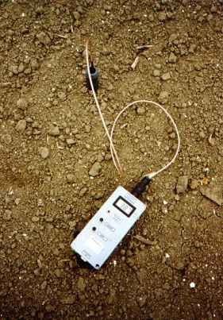
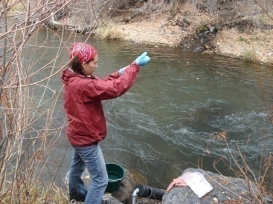
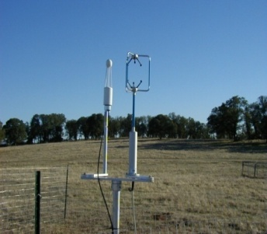
Observation Data Model for hydrologic and environmental measurements
The way that data is organized can enhance or inhibit the analysis that can be done
Groundwater
levels
Streamflow
Precipitation
& Climate
Soil
moisture
data
Water Quality
Flux tower data

Slide 5
Why an Observations Data Model
Provides a common persistence model for observations data
Syntactic heterogeneity (File types and formats)
Semantic heterogeneity
  Language for observation attributes (structural)
  Language to encode observation attribute values (contextual)
Publishing and sharing research data
Metadata to facilitate unambiguous interpretation
Enhance analysis capability

Slide 6
Scope
Focus on Hydrologic Observations made at a point
Exclude Remote sensing or grid data.
Primarily store raw observations and simple derived information to get data into its most usable form.
Limit inclusion of extensively synthesized information and model outputs at this stage.

Slide 7
What are the basic attributes to be associated with each single data value and how can these best be organized?
Value
DateTime
Variable
Location
Units
Interval (support)
Accuracy
Offset
OffsetType/ Reference Point
Source/Organization
Censoring
Data Qualifying Comments
Method
Quality Control Level
Sample Medium
Value Type
Data Type

Slide 8
CUAHSI Observations Data Model
Streamflow
Groundwater
levels
A relational database at the single observation level (atomic model)
Stores observation data made at points
Metadata for unambiguous interpretation
Traceable heritage from raw measurements to usable information
Standard format for data sharing
Cross dimension retrieval and analysis
Precipitation
& Climate
Soil
moisture
data
Water Quality
Flux tower
data
“When”
Time, T
t
A data value
v_{i} (s,t)
s
“Where”
Space, S
V_{i}
“What”
Variables, V

Slide 9
Data Storage – Relational Database
Values
Sites
Value
Date
Site
Variable
Site
Name
Latitude
Longitude
Value | Date | Site | Variable
4.5 | 3/3/2007 | 1 | Streamflow
4.2 | 3/4/2007 | 1 | Streamflow
33 | 3/3/2007 | 2 | Temperature
34 | 3/4/2007 | 2 | Temperature
Name | Latitude | Longitude
Cane Creek | 41.1 | -103.2
Cane Creek | 41.1 | -103.2
Town Lake | 40.3 | -103.3
Town Lake | 40.3 | -103.3
Site | Name | Latitude | Longitude
1 | Cane Creek | 41.1 | -103.2
2 | Town Lake | 40.3 | -103.3
Simple Intro to “What Is a Relational Database”
Notes:
HIS uses a relational database for data storage. If you’re unfamiliar with databases, here’s a quick intro. Suppose I have time series values for streamflow and temperature. I can store these in a table where I record the value, the date, the site where the measurement occurred, and the variable being measured. Now suppose I want to store more information about the site, such as its name and location. I could add some fields to the Values table, but if I have a million values, then I’m storing that same site information over and over again. A more efficient approach is to create a separate table with the site info, and relate one table to the other based on the Site number. A relational database is a set of tables with relationships like this.

Slide 10
Why Use a RDBMS
Mature and stable technology
Structured Query Language (SQL)
Sharing of data among multiple applications
  Data integrity and security
  Access by multiple users at the same time
  Tools for backup and recovery
Reduced application development time

Slide 11
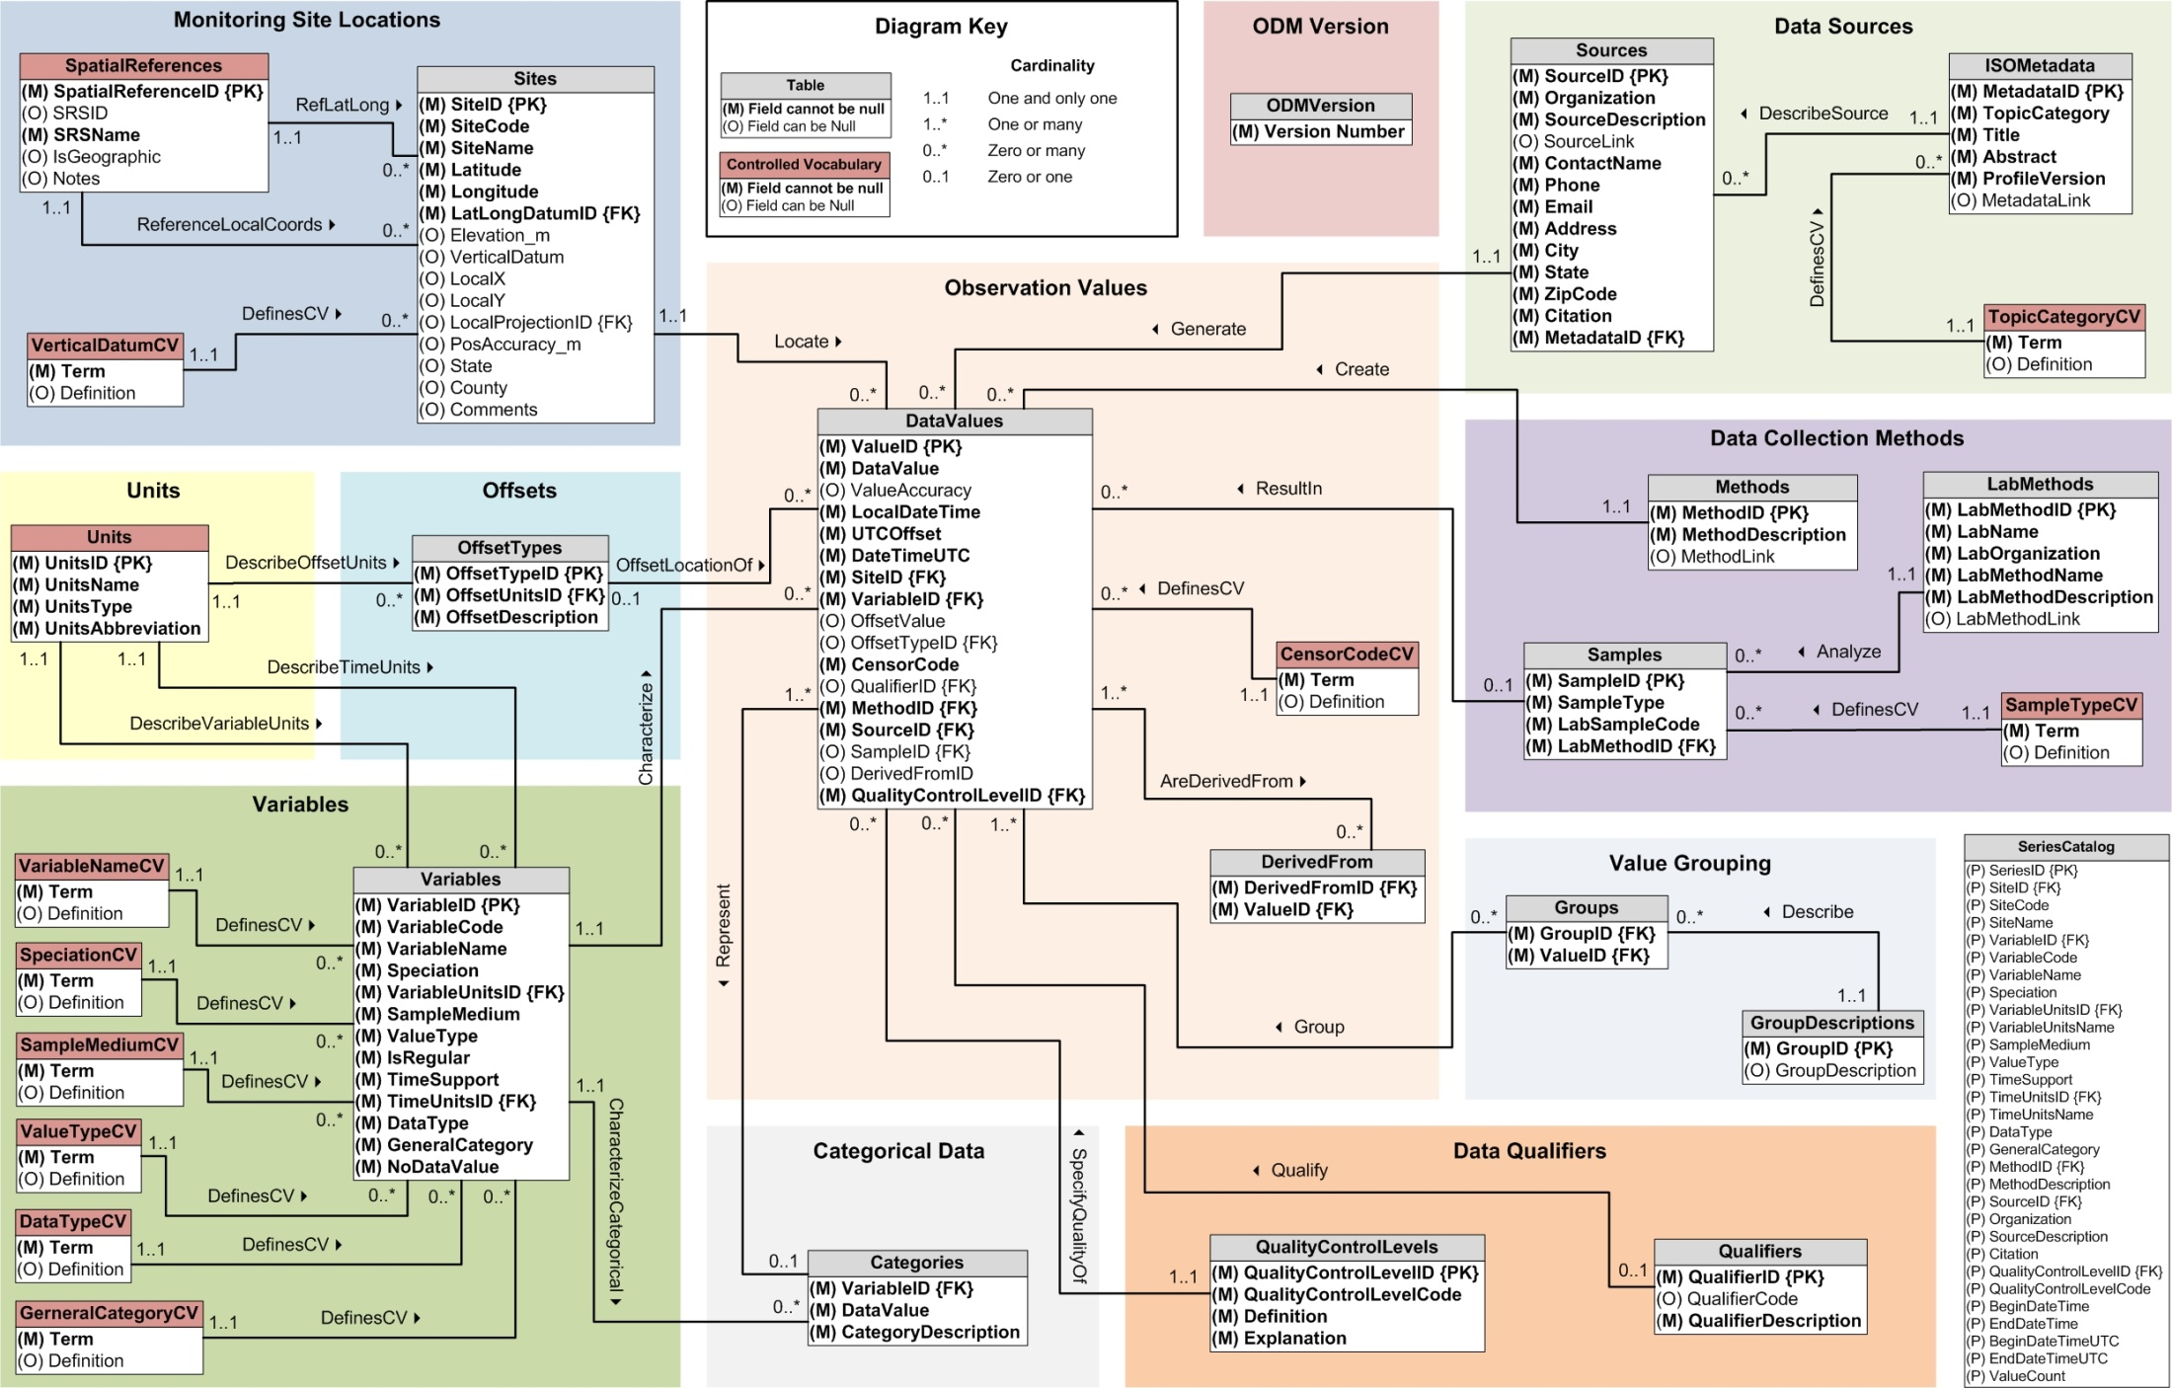
CUAHSI Observations Data Model http://his.cuahsi.org/odmdatabases.html
Horsburgh, J. S., D. G. Tarboton, D. R. Maidment and I. Zaslavsky, (2008), A Relational Model for Environmental and Water Resources Data, Water Resour. Res., 44: W05406, doi:10.1029/2007WR006392.
Notes:
In designing ODM we asked: What are the basic attributes to be associated with each single data value and how can these best be organized? This involved community survey at a workshop and by email and based on the feedback received we came up with the ODM schema illustrated, published last year in WRR
This is quite a detailed slide, but it is the entire schema. Few database designs are simple enough to fit the entire schema on one slide. This shows at the center the data values table and off to the sides, the ancillary or metadata tables that record.

Slide 12
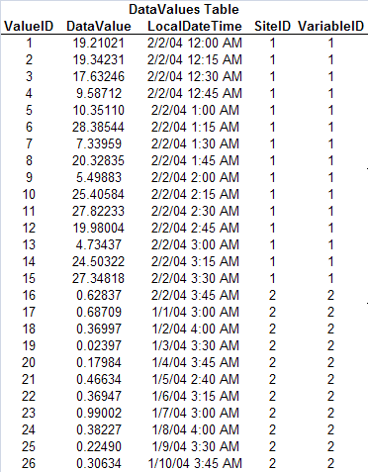

Simplified ODM Structure
Units Table
UnitsID | UnitsName | UnitsAbbreviation
12 | parts per million | ppm
23 | cubic feet per second | cfs
Sites Table
SiteID | SiteCode | SiteName | Latitude | Longitude | LatLongID
1 | AcmeP1 | Backyard Pond | 34.565 | -93.232 | 1
2 | AcmePR2 | Mill River gage Station | 34.2 | -93.4 | 1
Spatial References Table
SpatialReferenceID | SRSID | SRSName
0 |  | Unknown
1 | 4267 | NAD27
2 | 4269 | NAD83
Notes:
This slide shows a simplified view of relationships between tables in ODM.

Slide 13
What are the basic attributes to be associated with each single data value and how can these best be organized?
Value
DateTime
Variable
Location
Units
Interval (support)
Accuracy
Offset
OffsetType/ Reference Point
Source/Organization
Censoring
Data Qualifying Comments
Method
Quality Control Level
Sample Medium
Value Type
Data Type

Slide 14
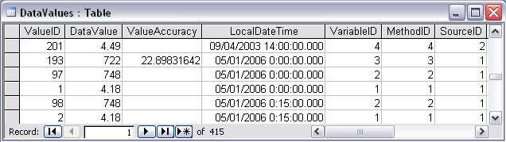
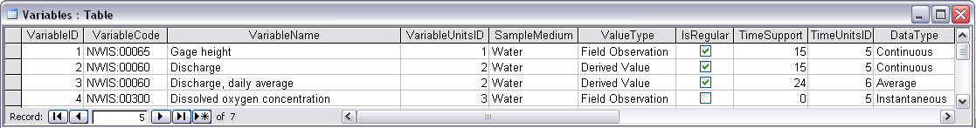
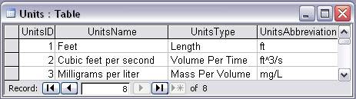
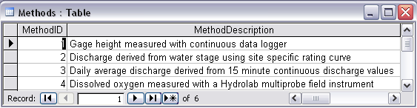
Discharge, Stage, Concentration and Daily Average Example

Slide 15
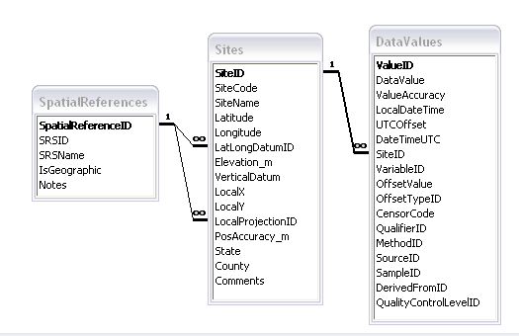
Site Attributes
SiteCode, e.g. NWIS:10109000
SiteName, e.g. Logan River Near Logan, UT
Latitude, Longitude Geographic coordinates of site
LatLongDatum Spatial reference system of latitude and longitude
Elevation_m Elevation of the site
VerticalDatum Datum of the site elevation
Local X, Local Y Local coordinates of site
LocalProjection Spatial reference system of local coordinates
PosAccuracy_m Positional Accuracy
State, e.g. Utah
County, e.g. Cache

Slide 16
Independent of, but can be coupled to Geographic Representation
ODM
Arc Hydro
Feature
Observations Data Model
1
HydroPoint
Waterbody
Watershed
Sites
1
HydroID
HydroID
HydroID
SiteID
HydroCode
*
HydroCode
HydroCode
SiteCode
FType
FType
DrainID
SiteName
OR
Name
Name
AreaSqKm
Latitude
JunctionID
AreaSqKm
JunctionID
Longitude
JunctionID
NextDownID
…
ComplexEdgeFeature
*
SimpleJunctionFeature
*
CouplingTable
1
SiteID
HydroID
1
HydroEdge
HydroJunction
HydroJunction
HydroID
1
HydroJunction
1
HydroID
HydroID
HydroCode
HydroID
HydroCode
HydroCode
ReachCode
HydroCode
NextDownID
NextDownID
Name
NextDownID
LengthDown
LengthDown
LengthKm
HydroNetwork
LengthDown
DrainArea
DrainArea
LengthDown
DrainArea
FType
FType
FlowDir
FType
Enabled
Enabled
FType
Enabled
AncillaryRole
AncillaryRole
EdgeType
AncillaryRole
Enabled
EdgeType
Flowline
Shoreline

Slide 17
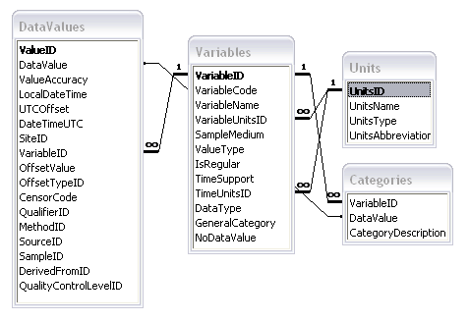
Variable attributes
Cubic meters per second
Flow
m³/s
VariableName, e.g. discharge
VariableCode, e.g. NWIS:0060
SampleMedium, e.g. water
ValueType, e.g. field observation, laboratory sample
IsRegular, e.g. Yes for regular or No for intermittent
TimeSupport (averaging interval for observation)
DataType, e.g. Continuous, Instantaneous, Categorical
GeneralCategory, e.g. Climate, Water Quality
NoDataValue, e.g. -9999

Slide 18
Scale issues in the interpretation of data
The scale triplet
a) Extent
b) Spacing
c) Support
quantity
quantity
quantity
length or time
length or time
length or time
From: Blöschl, G., (1996), Scale and Scaling in Hydrology, Habilitationsschrift, Weiner Mitteilungen Wasser Abwasser Gewasser, Wien, 346 p.

Slide 19
The effect of sampling for measurement scales not commensurate with the process scale
(a) spacing too large – noise (aliasing)
(b) extent too small – trend
(c) support too large – smoothing out
From: Blöschl, G., (1996), Scale and Scaling in Hydrology, Habilitationsschrift, Weiner Mitteilungen Wasser Abwasser Gewasser, Wien, 346 p.

Slide 20
Data Types
Continuous (Frequent sampling - fine spacing)
Sporadic (Spot sampling - coarse spacing)
Cumulative
Incremental
Average
Maximum
Minimum
Constant over Interval
Categorical

Slide 21
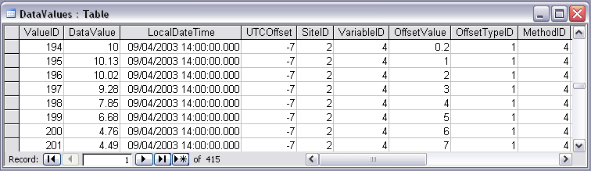

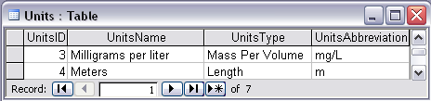
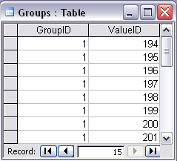


Water Chemistry from a profile in a lake
Notes:
Water Chemistry From a Lake Profile
Concepts:
Grouped observations (all observations in one reservoir profile)
Observations made using an offset (observations made at multiple depths below the surface of a reservoir)
Observations made using a specific method (observations made using a particular field instrument)
Relationships:
Relationship between Values table and the Variables table on VariableID
Relationship between Values table and OffestTypes table on OffsetTypeID
Relationship between Values table and Methods table on MethodID
Relationship between Variables table and Units table on UnitID
Relationship between GroupDescriptions table and Groups table on GroupID
Relationship between OffsetTypes table and Units table on UnitID and OffsetUnitID

Slide 22
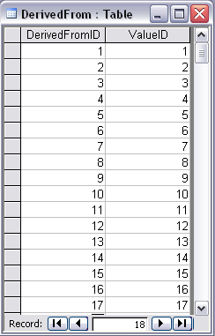
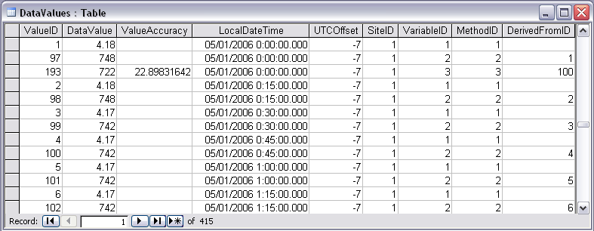
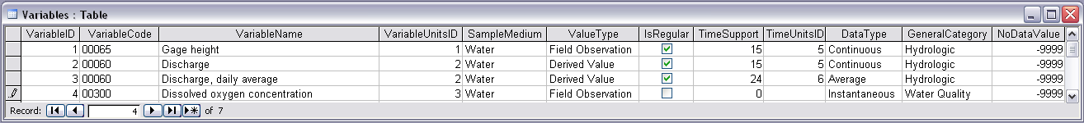
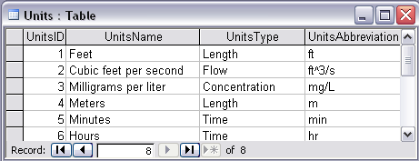
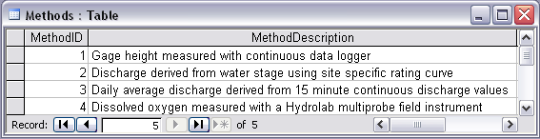
Stage and Streamflow Example
Notes:
Discharge Derived from Gage Height
Concepts:
Data derived from other data – single data point derived from a single observation (discharge from stage)
Data derived using a specific method (discharge from stage using rating curve)
Relationships:
Relationships between Values table and DerivedFrom table on DerivedFromID and ValueID
Relationship between Values table and Variables table on VariableID
Relationship between Values table and Methods table on MethodID
Relationship between Variables table and Units table on UnitID

Slide 23
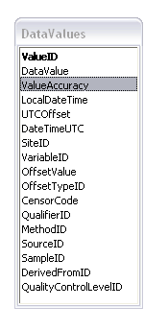
ValueAccuracy
A numeric value that quantifies measurement accuracy defined as the nearness of a measurement to the standard or true value. This may be quantified as an average or root mean square error relative to the true value. Since the true value is not known this may should be estimated based on knowledge of the method and measurement instrument. Accuracy is distinct from precision which quantifies reproducibility, but does not refer to the standard or true value.
ValueAccuracy
Accurate
Low Accuracy
Low Accuracy, but precise

Slide 24
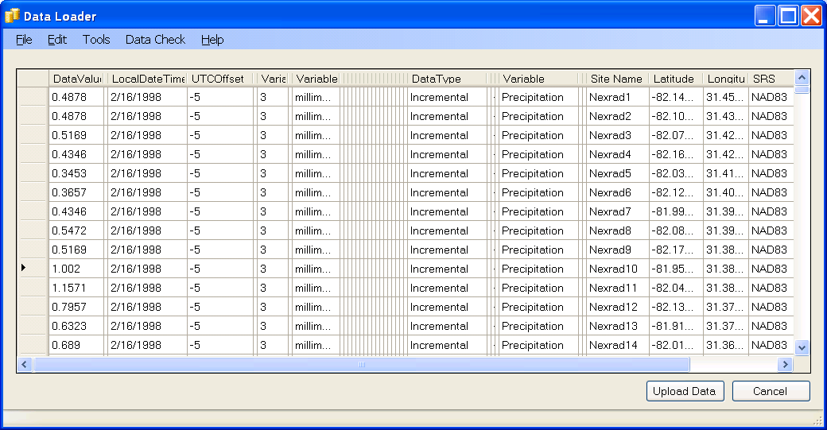
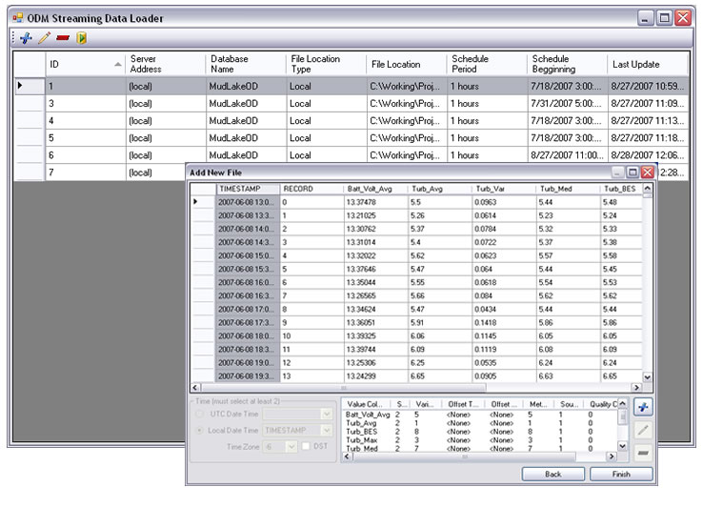
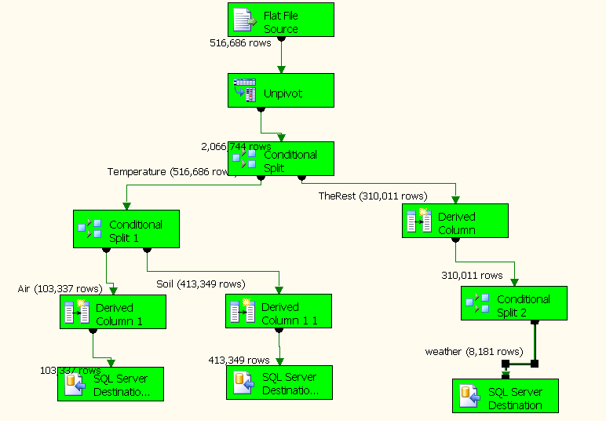
Loading data into ODM
OD Data Loader
Interactive OD Data Loader (OD Loader)
  Loads data from spreadsheets and comma separated tables in simple format
Scheduled Data Loader (SDL)
  Loads data from datalogger files on a prescribed schedule.
  Interactive configuration
SQL Server Integration Services (SSIS)
  Microsoft application accompanying SQL Server useful for programming complex loading or data management functions
SDL
SSIS

Slide 25
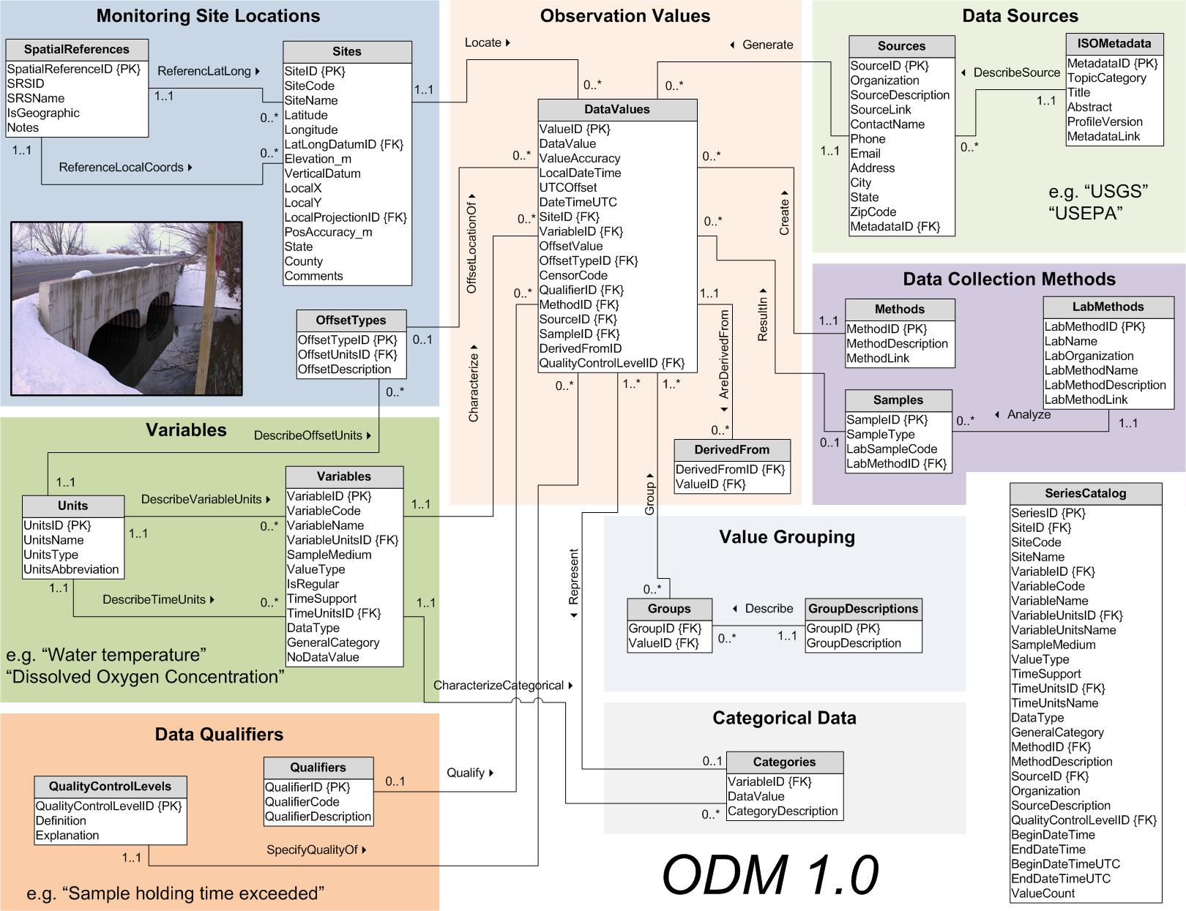
3
2
1
At last …
Work from Out to In
6
5
And don’t forget …
7
4
CUAHSI Observations Data Model
http://www.cuahsi.org/his/odm.html

Slide 26
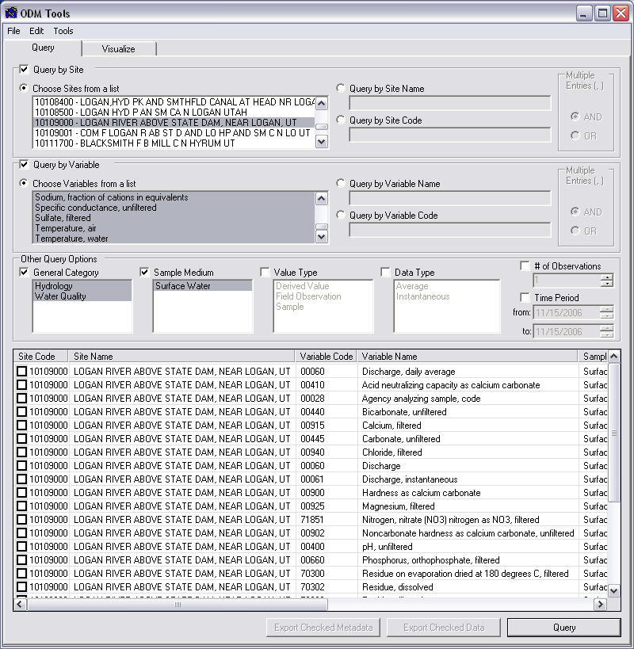
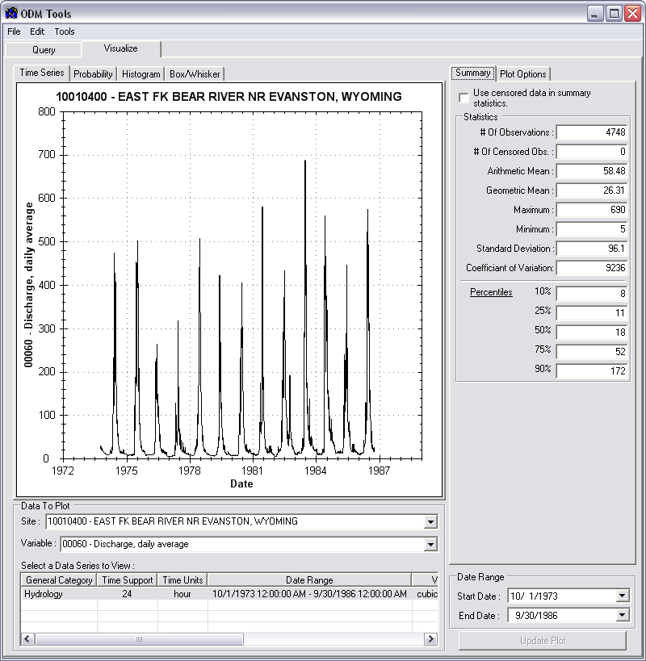
Managing Data Within ODM
ODM Tools
Query and export – export data series and metadata
Visualize – plot and summarize data series
Edit – delete, modify, adjust, interpolate, average, etc.

Slide 27
HydroServer Goals
A platform for publishing space-time hydrologic datasets that is:
  Self contained fully documented with local control of data
  Makes data universally available
  Combine spatial data and observational data
  Autonomous – e.g., functional independent of the rest of HIS

Slide 28
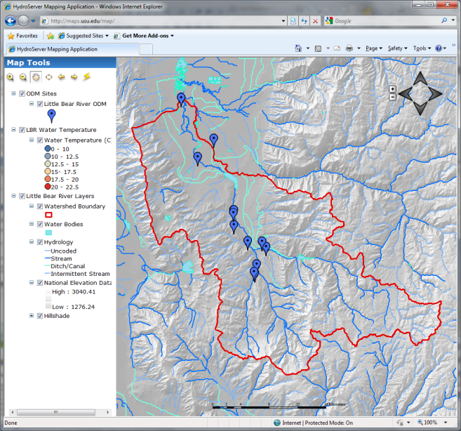

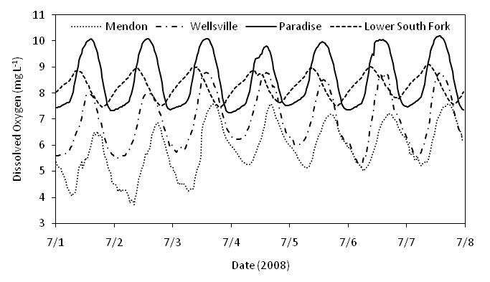

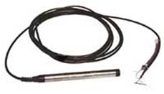
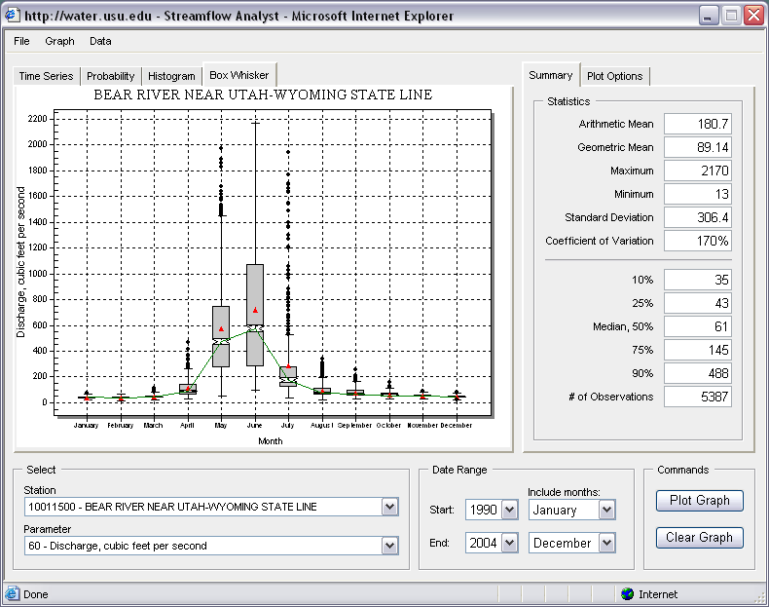
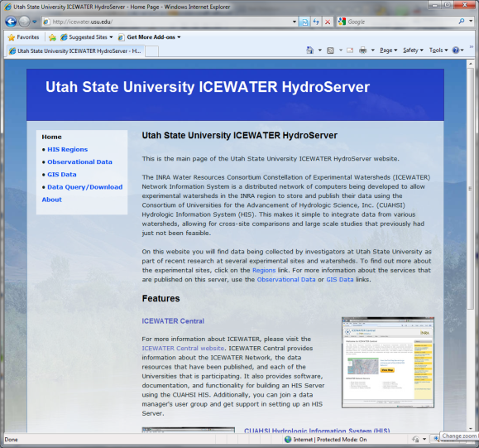

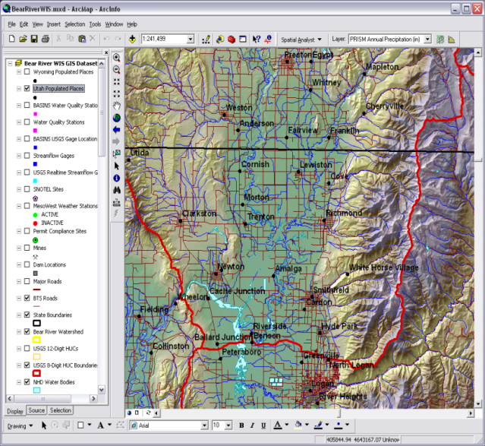
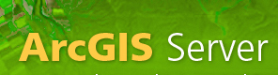
Point Observations Data
Internet Applications
Ongoing Data Collection
Historical Data Files
ODM Database
GetSites
GetSiteInfo
GetVariableInfo
GetValues
GIS Data
WaterML
WaterOneFlow
Web Service
Data presentation, visualization,
and analysis through Internet enabled applications
HydroServer

Slide 29

http://hydroserver.codeplex.com http://icewater.usu.edu/map http://littlebearriver.usu.edu/

Slide 30
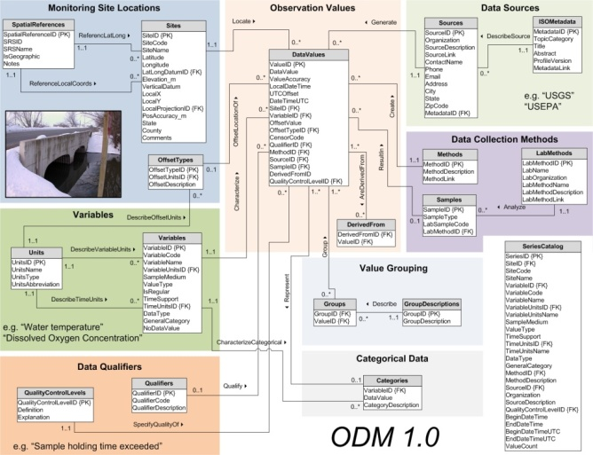
Syntactic Heterogeneity
Multiple Data Sources
With Multiple Formats
Excel
Files
Text
Files
Access
Files
Data Logger
Files
ODM Observations
Database
From Jeff Horsburgh

Slide 31
Semantic Heterogeneity
General Description of Attribute | USGS NWISª | EPA STORET^{b}
Structural Heterogeneity
Code for location at which data are collected | "site_no" | "Station ID"
Name of location at which data are collected | "Site" OR "Gage" | "Station Name"
Code for measured variable | "Parameter" | ?^{c}
Name of measured variable | "Description" | "Characteristic Name"
Time at which the observation was made | "datetime" | "Activity Start"
Code that identifies the agency that collected the data | "agency_cd" | "Org ID"
Contextual Semantic Heterogeneity
Name of measured variable | "Discharge" | "Flow"
Units of measured variable | "cubic feet per second" | "cfs"
Time at which the observation was made | "2008-01-01" | "2006-04-04 00:00:00"
Latitude of location at which data are collected | "41°44'36" | "41.7188889"
Type of monitoring site | "Spring, Estuary, Lake, Surface Water" | "River/Stream"
ª United States Geological Survey National Water Information System (http://waterdata.usgs.gov/nwis/).
^{b} United States Environmental Protection Agency Storage and Retrieval System (http://www.epa.gov/storet/).
^{c} An equivalent to the USGS parameter code does not exist in data retrieved from EPA STORET.
From Jeff Horsburgh

Slide 32
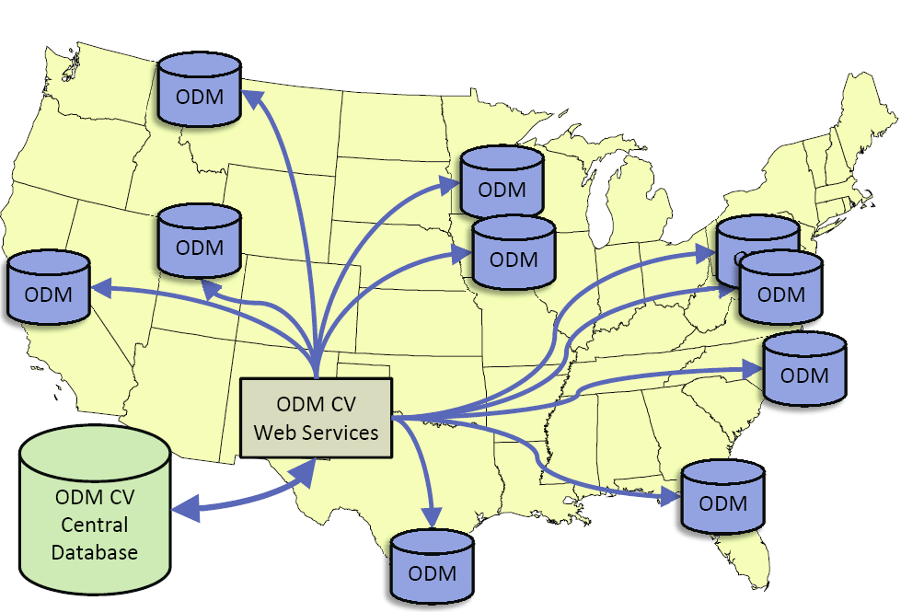
Overcoming Semantic Heterogeneity
ODM Controlled Vocabulary System
  ODM CV central database
  Online submission and editing of CV terms
  Web services for broadcasting CVs
ODM VariableNameCV
Variable Name
Term
…
Sunshine duration
Temperature
Turbidity
…
Investigator 1: | “Temperature, water”
Investigator 2: | “Water Temperature”
Investigator 3: | “Temperature”
Investigator 4: | “Temp.”
From Jeff Horsburgh

Slide 33

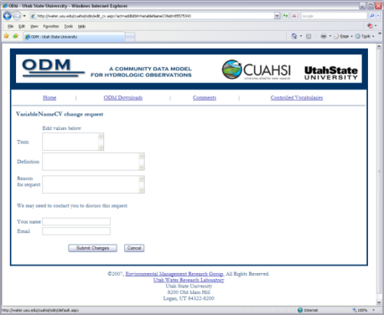

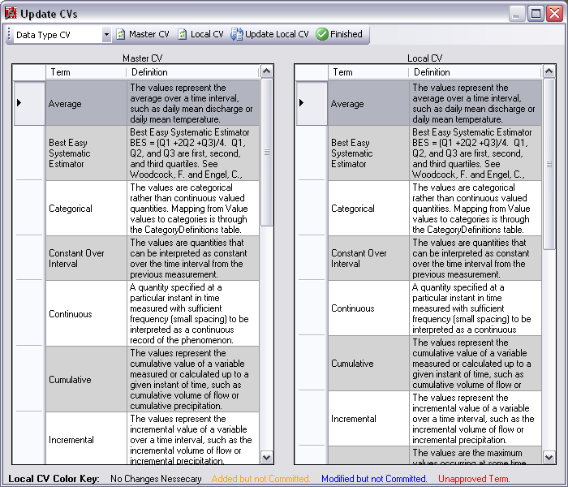
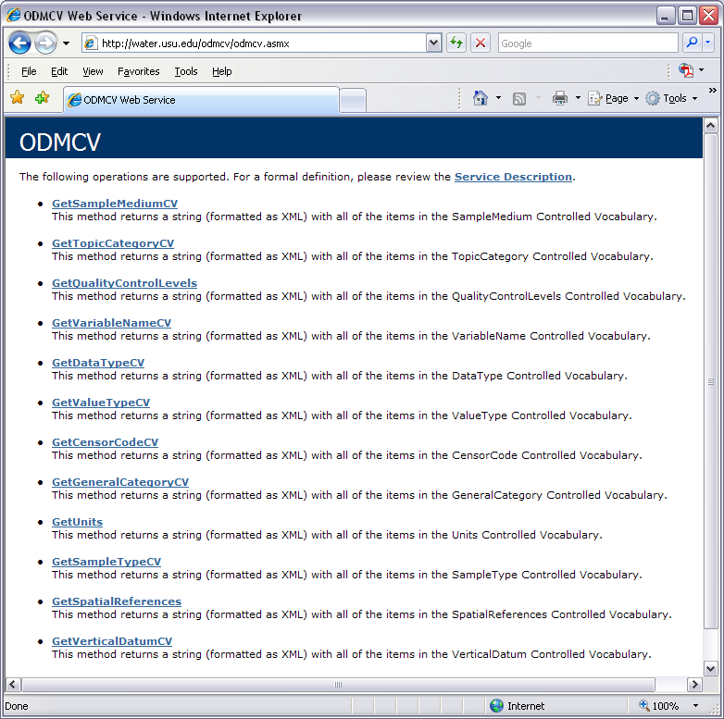
Dynamic controlled vocabulary moderation system
ODM Data Manager
ODM Website
ODM
Tools
ODM Controlled
Vocabulary Moderator
XML
Master ODM Controlled Vocabulary
Local ODM
Database
ODM
Controlled Vocabulary
Web Services
Local
Server
http://his.cuahsi.org/mastercvreg.html
From Jeff Horsburgh

Slide 34
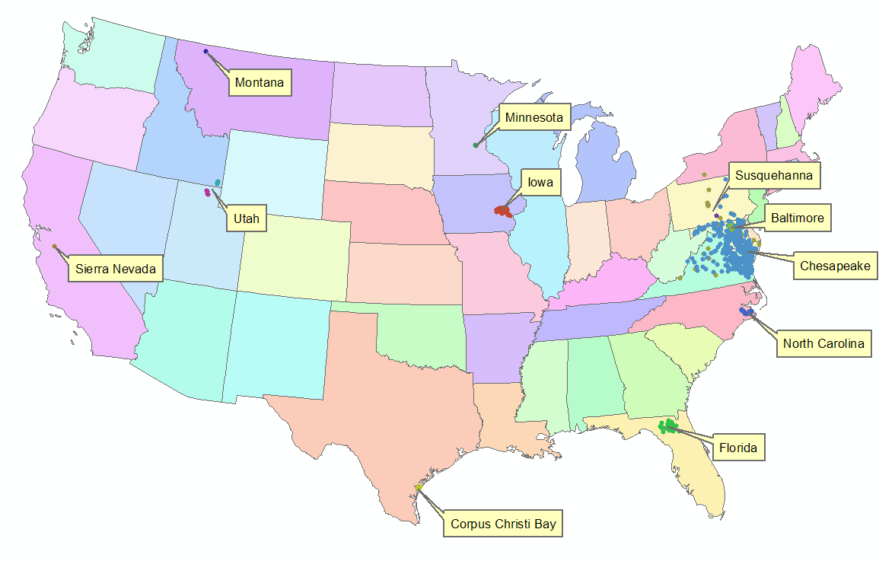




HydroServer Implementation in WATERS Network Information System
National Hydrologic Information Server
San Diego Supercomputer Center
11 WATERS Network test bed projects
16 ODM instances (some test beds have more than one ODM instance)
Data from 1246 sites, of these, 167 sites are operated by WATERS investigators

Slide 35
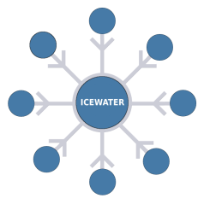

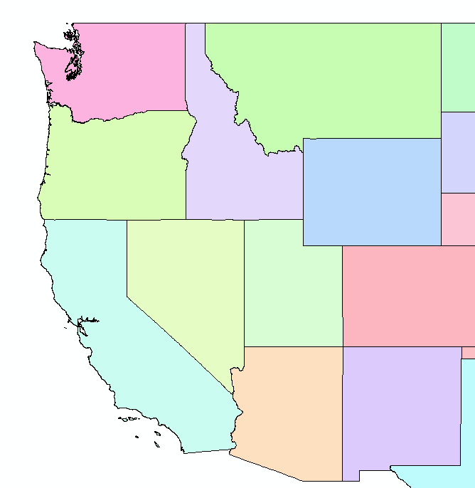

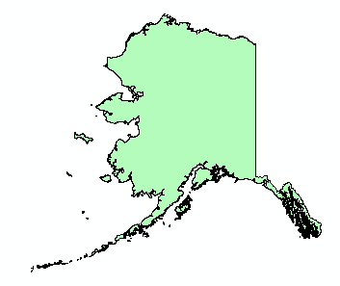
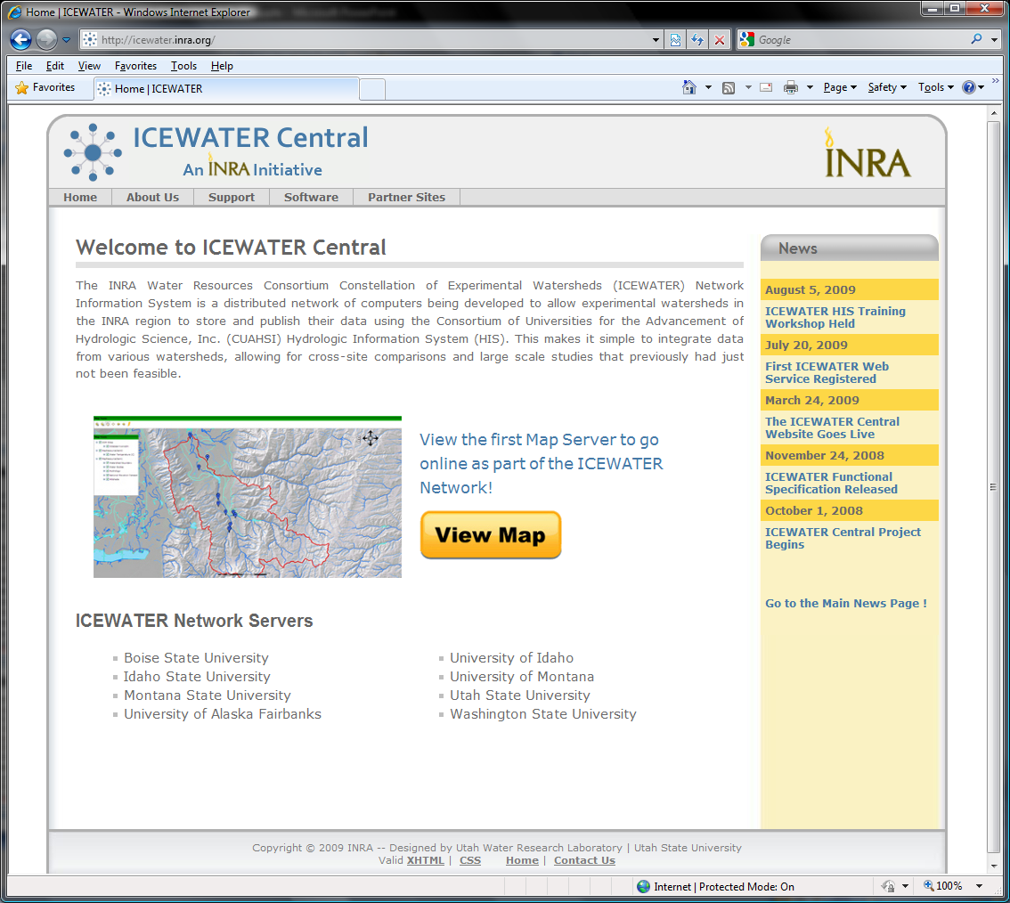










ICEWATER – A Regional HIS
ICEWATER – INRA Constellation of
Experimental WATERsheds
Coalition of 8 universities
Point Observations
  Stream gages
  Water quality sampling
  Weather stations
  Soil moisture
  Snow monitoring
  Groundwater level/quality
Spatially Distributed Data
  Land use/cover
  Terrain
  Hydrography
WA
MT
OR
ID
WY
AK
NV
UT
CO
CA
AZ
NM
http://icewater.inra.org

Slide 36
Sustainability Principles
Servers maintain their own complete data and metadata. Local control of data that is complete and self describing
Adherence to standards
Open Source
Minimize custom programming
Maintain syntactic and semantic consistency
Data repositories are required

Slide 37
What’s next for HydroServer
Security and Data Access Control
Web based data loader
Data model enhancements
  Flexibility in attributes
  Moving platforms
  Additional data types
Tighter integration with Hydrologic Ontology
Enhanced spatial data sharing

Slide 38
Proposed HydroServer Access Control
HydroServer Services
Security
Service
WaterOneFlow Web Service
Data Store (ODM)
Data consumer provides credentials
User
Authentication
Security service returns a token
Data consumer calls GetValues using the token
The token is evaluated to see if the consumer is authentic and authorized
True (Authorized), False (Not Authorized), or Error (Token Not Found)
User Authorization and
Data Access
True – Get DataValues from the data store
Returns DataValues
Data Access Logged
Data returned to consumer

Slide 39
Why Access Control
Significant feedback from academic users:
  Control who can download data
  How, when, and if data go from private to public
  Publish papers before data are released
  Track who is downloading their data
  Have and use a data use/access agreement
  Only expose the best or highest quality data
  Integrate data organization, management, and publication
Some say that they will not publish their data using the CUAHSI HIS until they have access control

Slide 40

An online collaborative environment centered on the sharing of hydrologic data and models
  Simple and easy to use
  Find, create, share, connect, integrate, work together online
  Leverage existing online sharing and collaboration platforms
  Hydro value added

Slide 41
Purpose
Facilitate collaboration
Provide a place for HydroDesktop users to simply upload and publish data
Support immutable archive data collections as well as transient “work in progress” data sharing
Support seeing inside data collections to facilitate integration and synthesis across datasets

Slide 42

An example
From Tim Whiteaker
Notes:
http://www.arcgisonline.com/, soon to be http://www.arcgis.com/

Slide 43

CUAHSI Online Data analysis and publication use case
1
6
HydroDesktop
Web Interface (HUBzero)
11
Observer or instrument
5
4
10
Web Services (WaterML)
2
8
7
3
9
HydroServer
HIS Central
Data Storage (iRODS)
Present HIS
CUAHSI Online

Slide 44
Summary
HydroServer provides a self contained autonomous data publication system
Local control of data, but universally accessible
Downloadable user (data publisher) configurable software stack that contains:
  ODM and associated tools
  WaterOneFlow web services
  Geographic data sharing using WFS, WCS, WMS from ArcGIS server
  Time Series Analyst
  ArcGIS server based web map application
  HydroServer Capabilities web service that publishes metadata about regions and services (observational and spatial)
Registering with HIS Central makes your data searchable

Slide 45
Questions?
CUAHSI
HIS
Sharing hydrologic data
http://his.cuahsi.org/
Support
EAR 0622374

