Slide 1
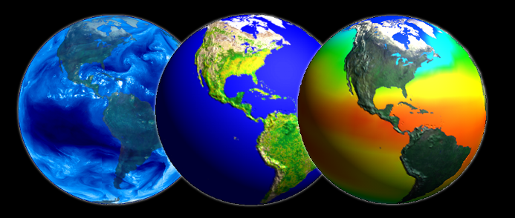
An Introduction to Remote Sensing
Presented by Dr Ayse Irmak
University of Nebraska, Lincoln

Slide 2
Remote Sensing and GIS
Remotely sensed images have a number of features which make them ideal GIS data sources
Remote sensing provides a regional view
Remote sensing provides repetitive looks at the same area
Remote sensors "see" over a broader portion of the spectrum than the human eye

Slide 3
Remote Sensing and GIS
Sensors can focus in on a very specific bandwidth in an image
They can also look at a number of bandwidths simultaneously
Remote sensors often record signals electronically and provide geo-referenced, digital, data
Some remote sensors operate in all seasons, at night, and in bad weather
Permanent record (Image is fixed in time). Accurate source of historical information

Slide 4
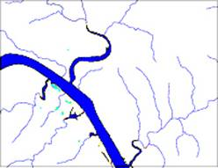
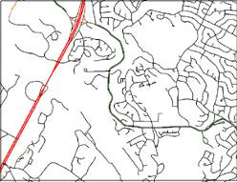
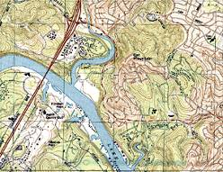
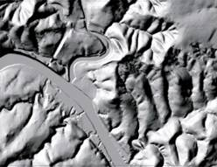
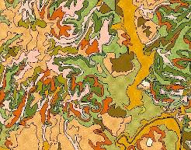
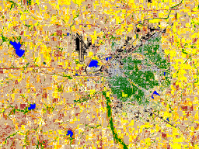
Geospatial Data
Hydrography
Transportation
Digitized Quads
Elevation
Soils
Land Use
Aerial and satellite images are valuable source of spatial data in GIS!
Notes:
Aerial images are used as a basis for surveying and topographic mapping to measure and identify horizontal and vertical locations of objects.
1:24,000 –scale quadrangle maps by USGS
Digital orthophotographs

Slide 5
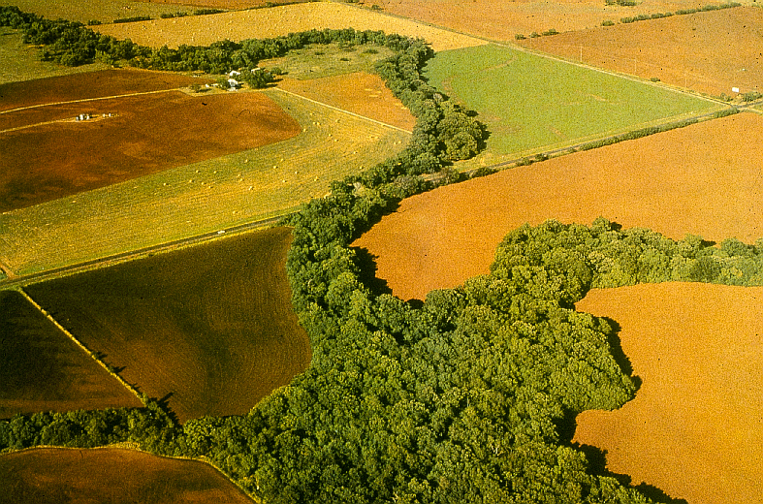
Remote Sensing: A Definition
The art and science of acquiring information about the earth and its environment using sensors mounted in aircraft and spacecraft

Slide 6
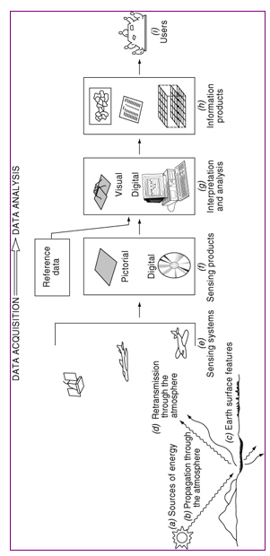
Processes involved in electromagnetic remote sensing of earth features
Notes:
Camera tilt and terrain variations may cause large errors in aerial photos – stereophotoraphic determination of elevations removes terrain caused image displacement.

Slide 7
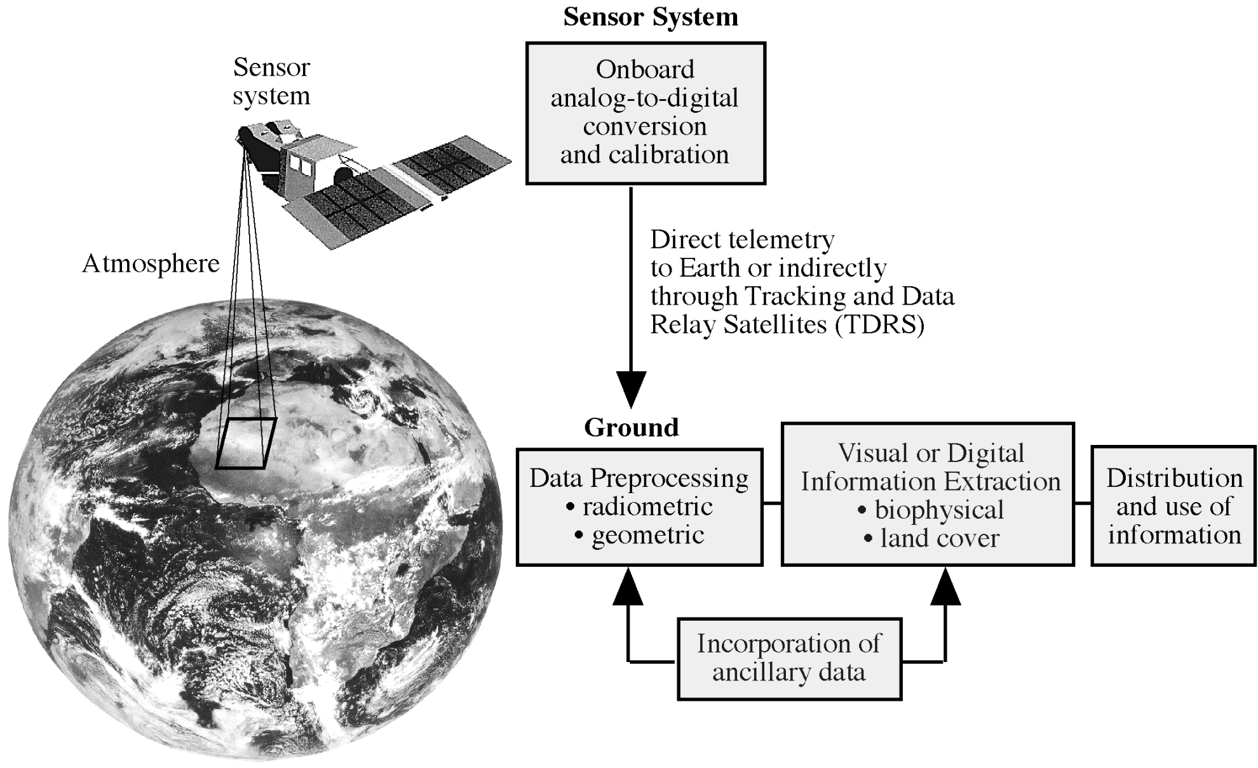
Overview of data acquisition by satellites
Notes:
Overview of data acquisition
Data recorded by the sensor system are converted from an analog electrical signal to a digital values. It takes places on-board. Sensor system creates pixels with a brightness value of 8 bit to 12 bits
Data is transmitted to ground control stations
Radiometric correction: for sensor performance. Some sensor is not performing well over time
Geometric correction. Satellite is not always going up and down. There might be some tilting.
Ground processing removes geometric and radiometric distortions.
The data are then ready for visual or digital analysis to extract information on biophysical and landcove

Slide 8
Energy Sources and Radiation Principles
Light energy is the principal form detected
Common forms of RS is based on reflected electromagnetic energy. i.e. Sensing Electromagnetic Radiation
Different materials reflect different amounts of incoming energy. This differential reflectance gives objects a distinct appearance
Light energy is characterized by its wavelenghts

Slide 9
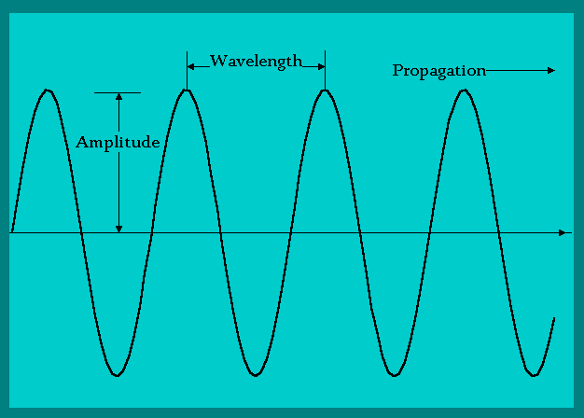
Electromagnetic Radiation
The distance between peaks in the electromagnetic stream is the wavelength
Each color of light has a distinctive wavelengths

Slide 10
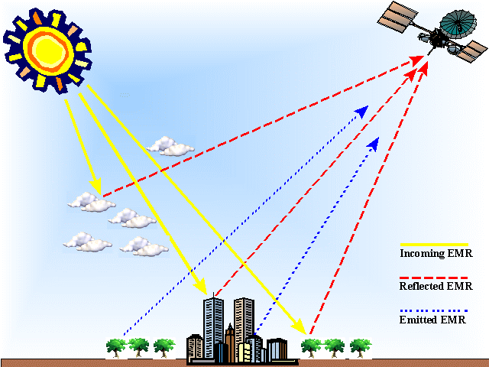
Energy pathways from source to sensor
Incident radiation = reflected + absorbed + transmitted
Notes:
Light reflected from the surface and transmitted to the sensor is used to create an image
Light energy may be absorbed, transmitted or reflected, by the atmosphere
Light reflected from the surface and transmitted to the sensor is used to create an image
The image may be degraded by atmospheric scattering due to water vapor, dust, smoke, ant others
Absorbed energy may be re-radiated at longer wavelenghts, forming the basis for thermal remote sensing.

Slide 11
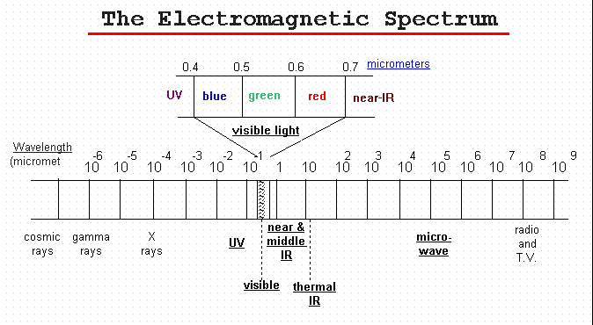
Categorize electromagnetic waves by their wavelenght location in electromagnetic spectrum.
Unit- - micrometer
Notes:
USGS defines the electromagnetic spectrum as: Electromagnetic radiation is energy propagated through space between electric and magnetic fields. The electromagnetic spectrum is the extent of that energy ranging from cosmic rays, gamma rays, X-rays to ultraviolet, visible, and infrared radiation including microwave energy."

Slide 12
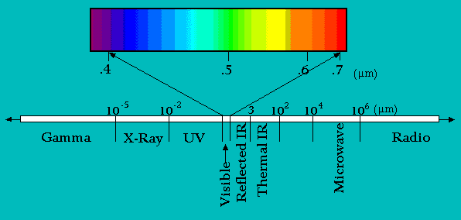
The Electromagnetic Spectrum
spectral bands (channels)
Our eyes perceive light in the visible portion of spectrum
Satellites can operationally measure panchromatic imagery (variations in a waveband from 400 to 700nm as shades of grey) at a 1 m. Panchromatic sensors.
Satellites can operationally measure multi-spectral imagery (the simultaneous sensing of two or more wavebands) at 20 to 30 m. Multispectral sensors.
Hyperspectral sensors cover spectral bands narrower than multispectral

Slide 13
Thermal Radiation Principles
Thermal infrared radiation refers to electromagnetic waves with a wavelength of between 3.5 and 20 micrometers
Most remote sensing applications make use of the 8 to 13 micrometer range
Thermal infrared is emitted energy, whereas the near infrared (photographic infrared) is reflected energy
Notes:
Thermal energy
Heat is a form of energy. Heat energy is stored in matter just like electrical energy is stored in a battery. An object that contains no heat energy is very cold, and is said to be at absolute zero (-460 F or -273 C). As heat is added to the object, its temperature rises. The more heat energy an object contains the hotter the object becomes. infrared energy is emitted as a result of atomic and molecular vibration.
The total amount of infrared energy emitted by an object is proportional to temperature to the fourth power.
Stefan-Boltzmann Law
P/A = emissivity of the object X stefan bolzman constant (5.6703 10⁻⁸ watt/m2/K⁴). X T⁴
P= new radiated power; A =radiating area

Slide 14
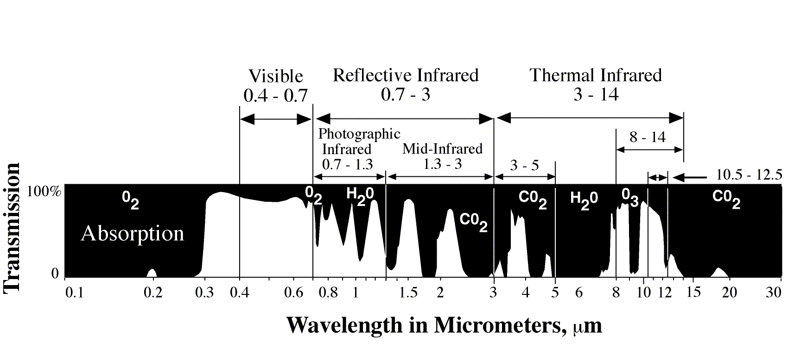
Atmospheric Windows (AW) in the Electromagnetic Spectrum
Jensen 2000
AW are caused when atmospheric gases/particles do not absorb the radiation
Only light in certain wavelength regions can penetrate the atmosphere well
Satellite are designed to operate on certain AW
Black if sensor is designed to operate on absorption bands
Notes:
Absorption results in the effective loss of energy to the atmosphere
AW are caused when atmospheric gases/particles do not absorb the radiation
Only light in certain wavelength regions can penetrate the atmosphere well
Satellite are designed to operate on certain AW
Black if sensor is designed to operate on absorption bands

Slide 15
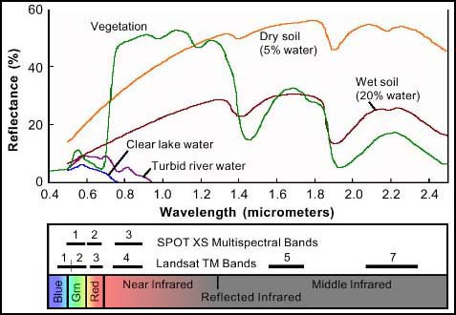
Spectral Response Curve (“signature”)
Natural objects appear to be the color they most reflect!
Notes:
Healthy green vegetation always manifest “peak and valley”
The valleys in the visible portion of spectrum are dictated by the pigments in the leaves. Chlorophyll absorbs energy centered at 0.45 and 0.67
That means high absorption of blue and red energy by plants
0.7 1.3, plant reflects as much as 50% of energy incident upon it
Dips (valleys) occur at 1.4, 1.9, and 2.7 because water in the leaves absorbs
Water: most distinctive characteristics. Absorption at near—IR and beyond
Soil shows less peak and valley because factors (moisture, texture, organic matter, surface roughness) affecting soil reflectance act less specific spectral bands

Slide 16
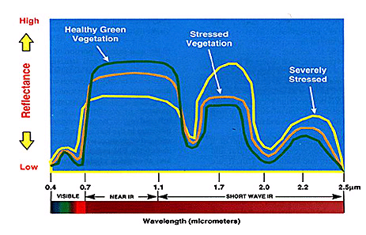
Detect crop stress generally from moisture deficiency or disease and pests
Stress is indicated by a progressive decrease in Near-IR reflectance accompanied by a reversal in Short-Wave IR reflectance
http://rst.gsfc.nasa.gov/

Slide 17
Major Components of Technology
Energy Source
  Passive System: Irradiance from earth's materials
  Active System: irradiance from artificially generated energy sources such as radar
Platforms: Vehicle to carry the sensor
Sensors: Device to detect electro-magnetic radiation
Detectors: Handling signal data (photographic, digital, etc.)
Processing: Handling signal data
Institutionalization (international and national organizations, centers, universities for execution at all stages of remote-sensing technology)
Notes:
The following are major components of Remote sensing System:
Energy Source
Passive System: sun, irradiance from earth's materials;
Active System: irradiance from artificially generated energy sources such as radar.
Platforms:(Vehicle to carry the sensor) (truck, aircraft, space shuttle, satellite, etc.)
Sensors:(Device to detect electro-magnetic radiation) (camera, scanner, etc.)
Detectors: (Handling signal data) (photographic, digital, etc.)
Processing (Handling Signal data) (photographic, digital etc.)
Institutionalisation: (Organization for execution at all stages of remote-sensing technology: international and national orrganisations, centres, universities, etc.).

Slide 18
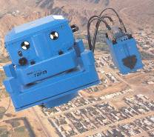
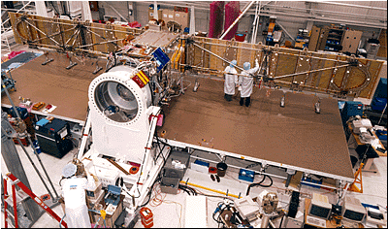
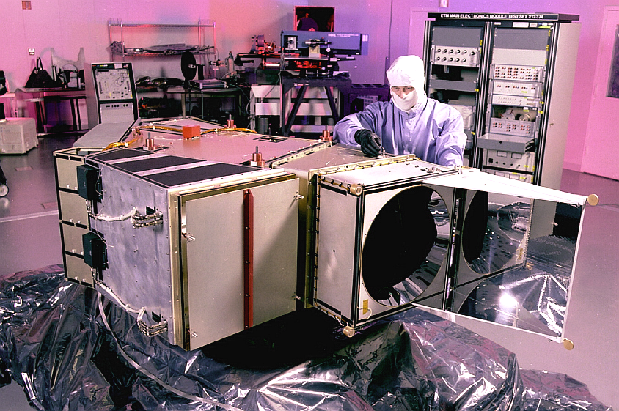
Sensors
include cameras, scanners, radar
sensors are designed to address specific problems and data requirements
sensors complement one another; image fusion
Notes:
image fusion: Process of combining relevant information from two or more images into a single image
Output: high spatial and high spectral resolution in a single image

Slide 19
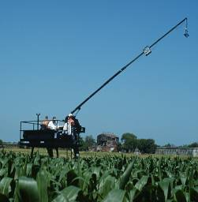
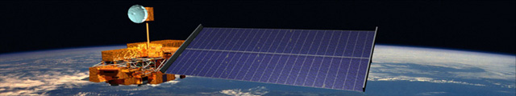
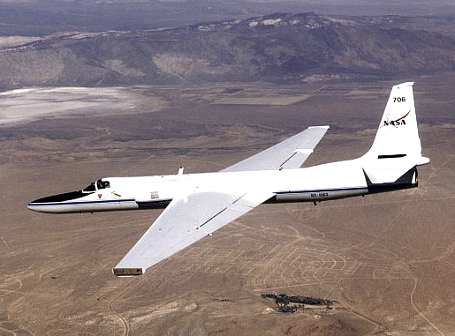
Platforms
field vehicles
light aircraft
high altitude aircraft
satellites (Landsat, SPOT, Ikonos, Terra)
space shuttle

Slide 20
Some Sensors and Platforms
Platform | Sensor(s)
Ikonos | Ikonos
Landsat-7 | Enhanced Thematic Mapper + (ETM+)
SPOT-4 | High Resolution Visible -Infrared (HRVIR); Vegetation
Terra | MODIS; ASTER
EO-1 | Advanced Land Imager (ALI); Hyperion
Radarsat | Synthetic Aperture Radar (SAR)

Slide 21
Remote Sensing Raster (Matrix) Data Format
Jensen 2000
Notes:
Digital remote sensor data are stored as matrix of numbers
Each digital value is located at a specific row and column in that matrix
Sensor systems creates pixels with a brightness value (BV) range of 8 to 12 bits. This is called “Quantization” level of remote sensor data.
8 bits have BV that range from 0 to 255
Data quantized to 12 bits range from 0 to 1023
The greater the range of values, the more precise we may able to measure the amount of radiance recorded by the sensor

Slide 22
Digital Image
25 | 22 | 19 | 47 | 44
22 | 18 | 25 | 22 | 44
19 | 21 | 22 | 23 | 42
21 | 116 | 121 | 125 | 134
118 | 125 | 123 | 135 | 126
125 | 133 | 136 | 221 | 234
244 | 243 | 212 | 232 | 178
Pixel (picture element)

Slide 23
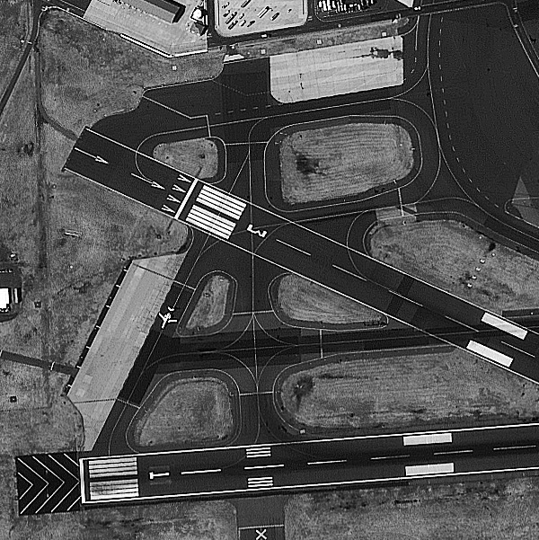
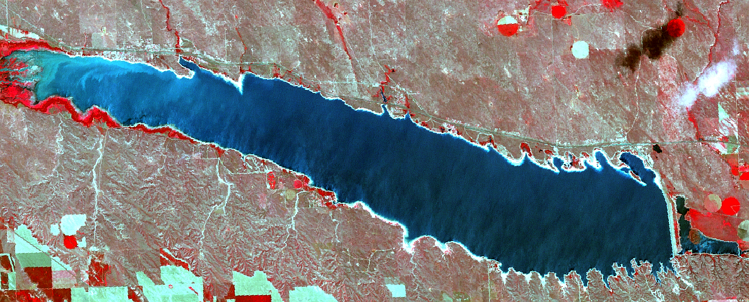
Selection of Imagery
Resolution
  spatial
  spectral
  radiometric
  temporal
Image coverage
Image availability/format
Cost

Slide 24
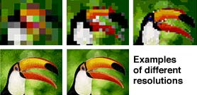
Spatial Resolution
pixel size (instantaneous field of view)
smallest object one can discern/identify
commonly 1 meter to 1100 meters

Slide 25
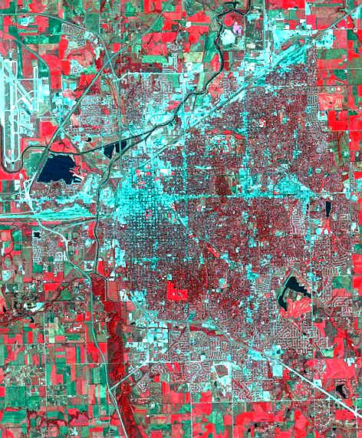
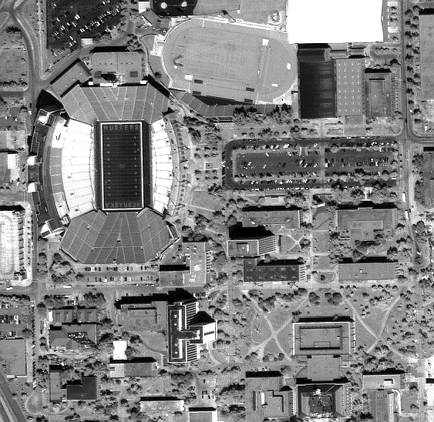
Spatial Resolution
Image of Lincoln, NE
Coarse (30 m, multispectral)
Fine (1 m, panchromatic, Ikonos)

Slide 26
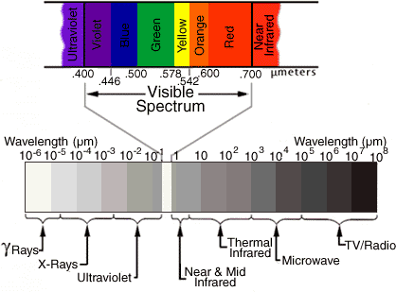
Spectral Resolution
how many spectral bands?
which bands?
band widths - narrow band vs broad band
http://geospatial.amnh.org/remote_sensing/widgets/spectral_curve/spectral.swf
Notes:
Spectral resolution refers to the number of different frequency bands recorded - usually, this is equivalent to the number of sensors carried by the platform(s).
Current Landsat collection is that of seven bands, including several in the infra-red spectrum.
The MODIS satellites are the highest resolving at 31 bands

Slide 27
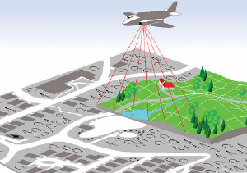
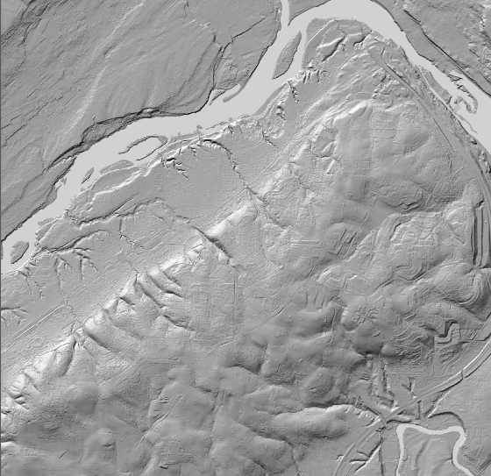
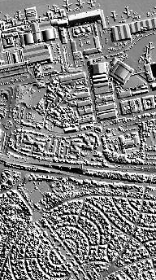
LIDAR (Light Detection and Ranging)

Slide 28
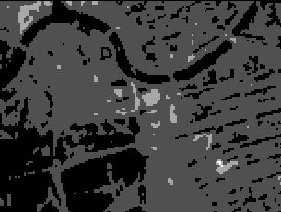
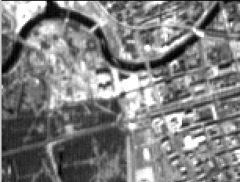
Radiometric Resolution
number of “brightness levels” (gray shades; bits)
commonly 256 - 2048 levels (8 - 11 bit)

Slide 29
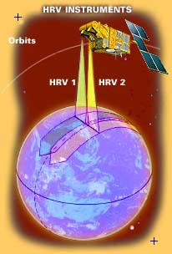
Temporal Resolution
how often is image available?
varies from 1 day to 26 days (phased?)
some sensors must be “tasked”; some are pointable
historical archive?
Notes:
The temporal resolution is simply the frequency of flyovers by the satellite or plane, and is only relevant in time-series studies or those requiring an averaged or mosaic image as in deforesting monitoring.
Cloud cover over a given area or object makes it necessary to repeat the collection of said location.
Radiometric correction gives a scale to the pixel values, e.g. the monochromatic scale of 0 to 255 will be converted to actual radiance values.
Atmospheric correction eliminates atmospheric haze by rescaling each frequency band so that its minimum value (usually realised in water bodies) corresponds to a pixel value of 0. The digitizing of data also make possible to manipulate the data by changing gray-scale values.

Slide 30
Comparing Resolution
Sensor | Spatial | Spectral | Radiometric | Temporal
Ikonos | 1-4 m | 4 + pan bands | 11 bit | 1-3 days
SPOT-5 HRG | 2.5-10 m | 4 + pan bands | 8 bit | 1-26 days
Landsat-7 ETM+ | 15-30 m | 7 + pan bands | 8 bit | 16 days
Terra MODIS | 250 m – 1000 m | 36 bands | 12 bit | 1 day

Slide 31
LANDSAT
LANDSAT refers to a series of satellites put into orbit around the earth to collect environmental data about the earth's surface.
The LANDSAT program was initiated by the U.S. Department of Interior and NASA under the name ERTS, Earth Resources Technology Satellites.
ERTS-1 was launched on July 23, 1972, and was the first unmanned satellite designed solely to acquire earth resources data on a systematic, repetitive, multispectral basis.
Over time, the sensors carried by the LANDSAT satellites have varied as technologies improved and certain types of data proved more useful than others

Slide 32
Principal applications of different wavelengths
1) 0.45-0.52. Blue. Designed for water body penetration, making it useful for coastal water mapping. Also useful for soil/vegetation discrimination, forest type mapping, and cultural feature identification.
2) 0.52-0.60. Green. Designed to measure green reflectance peak of vegetation for vegetation discrimination and vigor assessment. Also useful for cultural feature identification.
3) 0.63-0.69. Red. Designed to sense in a chlorophyll absorption region aiding in plant species differentiation. Also useful for cultural feature identification.
4) 0.76-0.90. Near-infrared. Useful for determining vegetation types, vigor, and biomass content, for delineating water bodies, and for soil moisture discrimination.
5) 1.55-1.75. Mid-infrared. Indication of vegetation moisture content and soil moisture. Also useful for differentiation of snow from clouds.
6) 10.4-12.5. Thermal infrared. Useful in vegetation stress analysis, soil moisture discrimination, and thermal mapping applications.
7) 2.08-2.35. Mid-infrared. Useful for discrimination of mineral and rock types. Also sensitive to vegetation moisture content.

Slide 33
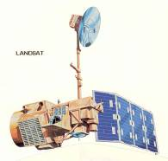
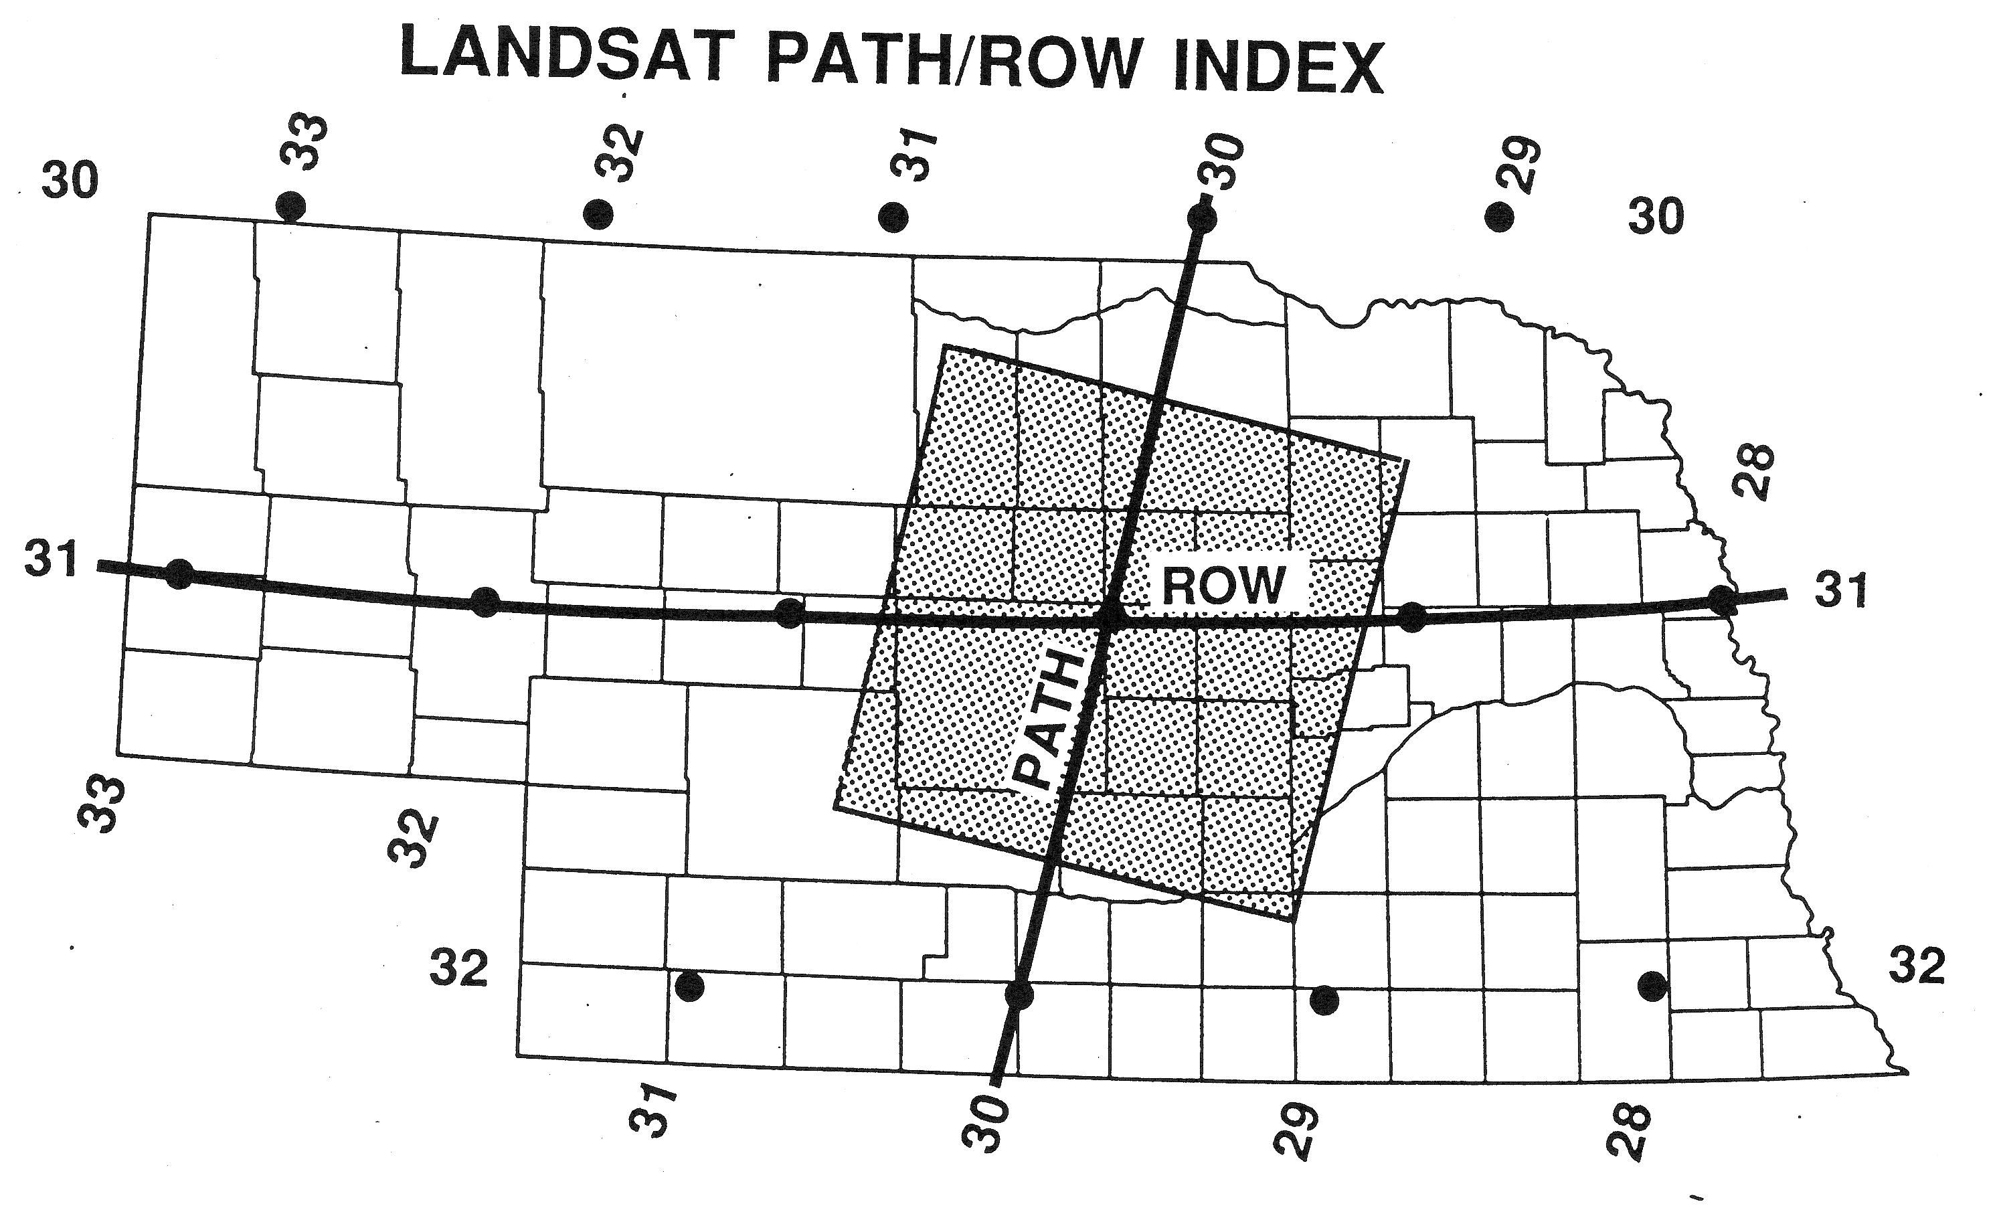
Landsat Images to Cover Nebraska
http://earthnow.usgs.gov/earthnow_app.html?sessionId=a0d0c8de12ec09f065837276c5d8ab6b4155

Slide 34
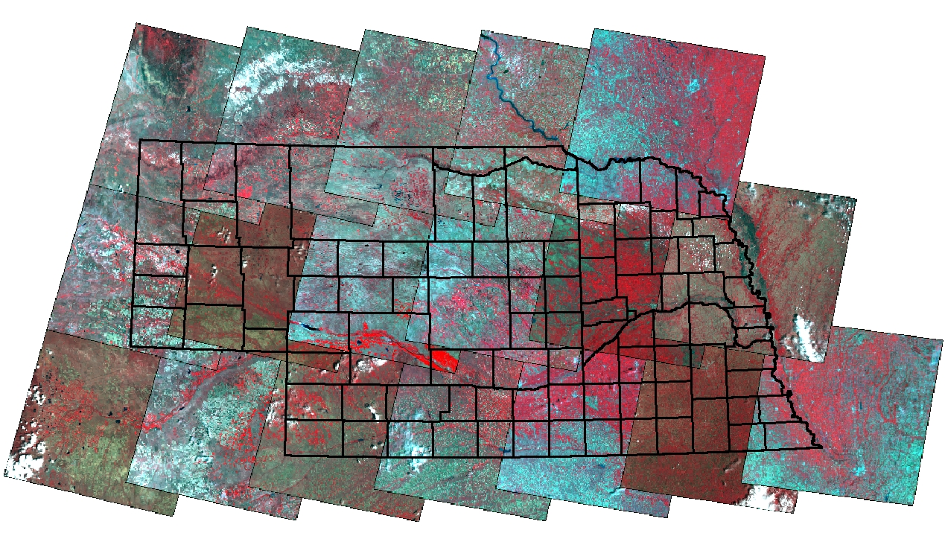
Image Coverage
2005
P33R30
10
P32R30
9
P31R30
10
P30R30
9
P29R30
10
P33R31
11
P32R31
10
P31R31
12
P30R31
9
P29R31
11
P28R31
8
P33R32
15
P32R32
8
P31R32
12
P30R32
10
P29R32
12
P28R32
10
P27R32
8
Number of images to cover study area
Generally, higher spatial resolution = smaller area coverage per frame = more scenes

Slide 35
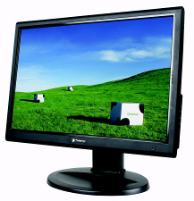
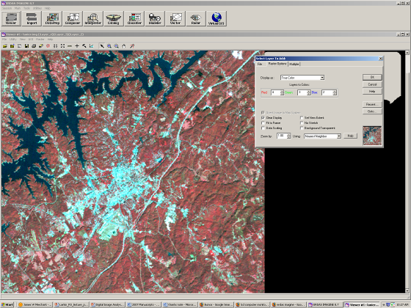
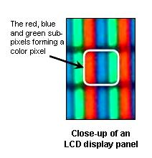
Image processing
Leica ERDAS Imagine

Slide 36
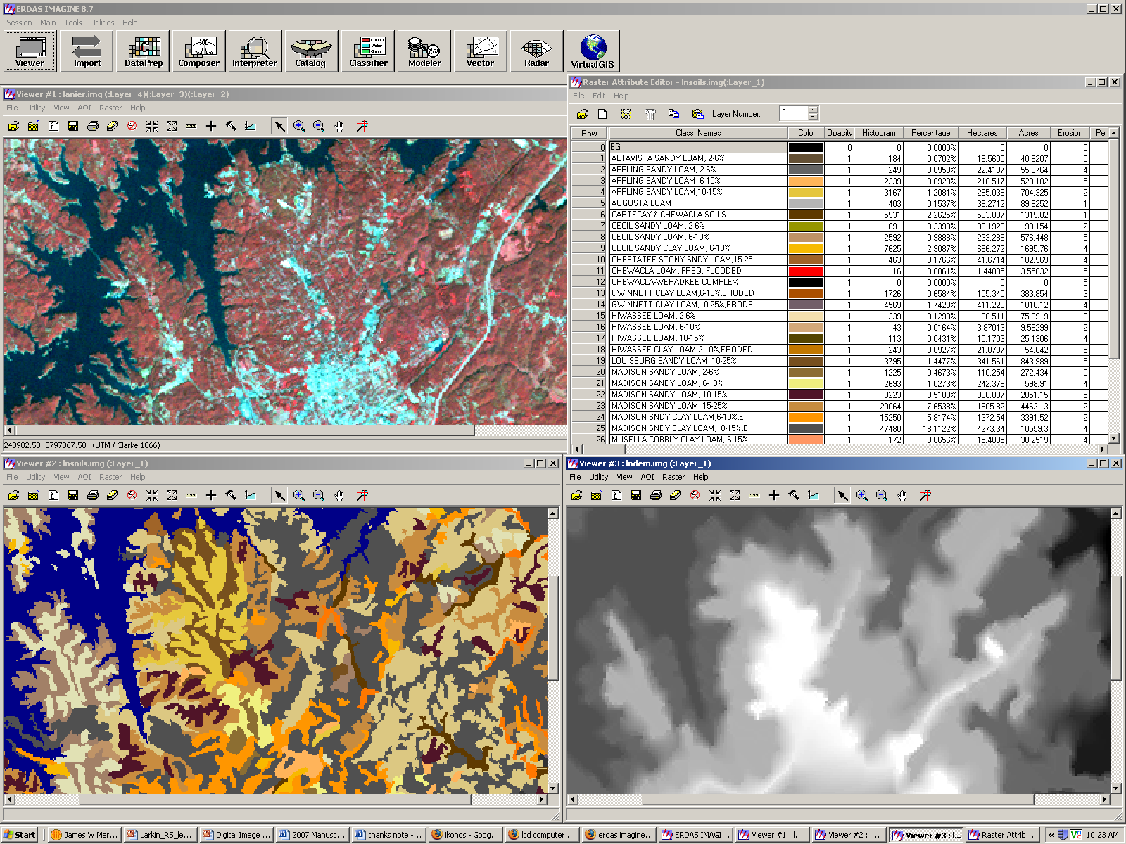

Slide 37
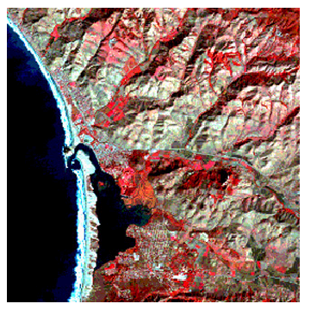
Image processing to generate color composite
Individual bands can be displayed in gray shades
Bands can be combined in color composites
False Color Composite
Spectral band | Color assignment
green (TM2) | blue
red (TM3) | green
near-infrared (TM4) | red
Reds, depicting vegetation
Medium grayish-browns, mainly along the bright sun-facing slopes
Deep blue, depicting ocean and bay
Near the shore, a bit lighter blue where thicker sediments add reflectance

Slide 38
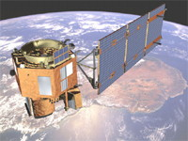
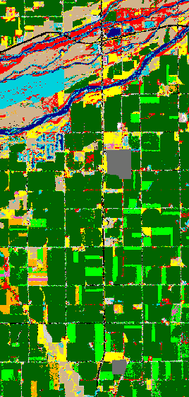
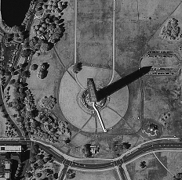
Remote Sensing
The Good News
sensors - spectral bands, higher resolution (< 1m)
lower data costs?
inexpensive, powerful software
global datasets
improved interface to GIS
biophysical analyses - biomass, soil moisture, turbidity

Slide 39
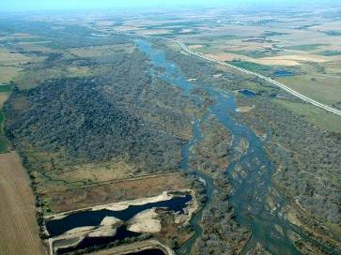
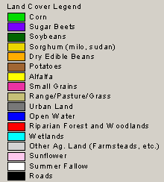
Remote Sensing
Some Typical Applications
Mapping or monitoring land cover and land use
Measuring area, volume, trajectory

Slide 40
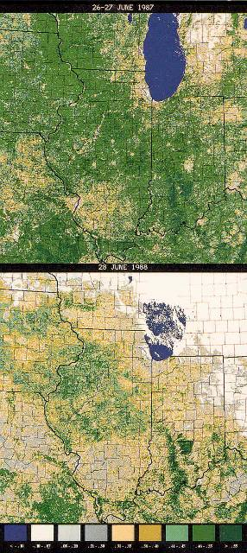
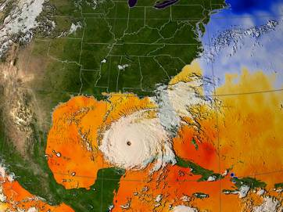

Estimating biomass, surface temperature, turbidity
Extent/impacts of natural hazards (e.g., drought, fires)

Slide 41


Mapping Invasive species (Albuquerque, NM)

Slide 42
Vegetation Index:
Infrared/Red Ratio Vegetation Index
The near-infrared (NIR) to red simple ratio (SR) is the first true vegetation index
It takes advantage of the inverse relationship between chlorophyll absorption of red radiant energy and increased reflectance of near-infrared energy for healthy plant canopies (Cohen, 1991)

Slide 43



Vegetation Index
As plants grow, canopy and biomass increase
Green leaves absorb more red and blue light –
Increase in NIR reflectance
Vegetation indices express the difference between NIR and red reflectance
“Greenness” - associated with plant photosynthetic activity, biomass, fractional cover of vegetation
Normalized vegetation index (-1, 1)

Slide 44


Slide 45

Global Normalized Difference Vegetation Index (NDVI) Image Produced Using (AVHRR) Imagery

Slide 46


Leaf Area Index
The area of green leaf per unit area of ground

Slide 47
Actual Evapotranspiration (ET) at Central Platte Natural Resources District , NE
Seasonal ET

Slide 48


Witch Wildland fire San Diego
Witch Wildland fire, burned 198,000 acres north of San Diego, destroying 1125 homes, commercial structures, and outbuildings. Over 3,000 firefighters finally contained the fire two weeks after it started on October 21. Fire started on Oct 8th 2007
This ASTER image depicts the area after the fire, on November 6; vegetation is green, burned areas are dark red, and urban areas are blue. On the burn severity index image, calculated using infrared and visible bands, red areas are the most severely burned, followed by green and blue. This information can help the US Forest Service to plan post-fire activities.
http://www.nasa.gov/vision/earth/lookingatearth/socal_wildfires_oct07.html

Slide 49

Landsat Images to study sediment deposition
Three decades of Mississippi Delta sediment deposition from the Mississippi-Missouri River system eroded debris. The left image was acquired on January 16, 1973; the middle image on March 12, 1989; and the right image on January 6, 2003.

Slide 50

Remote Sensing in Forestry
Progression of deforestation in Bolivia from 1975 to 2000 using LANDSAT 2, 4, and 7 images. The image on the left was acquired on June 17, 1975; the middle image on July 10, 1992; and the right image on August 1, 2000.
Photo credit: USGS
http://pubs.usgs.gov/fs/2010/3026/pdf/FS2010-3026.pdf

Slide 51

Airborne Remote Sensing to Support Precision Farming
Maturity Map of Brown Rice
(Red: High, Purple: Low)
Protein Map of Brown Rice
(Red: High, Purple: Low)
Detail Map
(Red: High, Purple: Low)
Hyperspectral airborne remote sensing can be used for leaf color analysis, soil classification, and monitoring the growth stage of rice in a large area.
Tokyo, Japan
By PASCO Corporation
http://www.esri.com/mapmuseum/mapbook_gallery/volume20/agriculture3.html

Slide 52


Mapping Riparian Vegetation with Lidar Data
The figure on the left is a 0.3048-meter-resolution aerial photograph of the Walker River in Nevada. The image on the right is the height-above- river map using a 300-meter kernel size and classified into 50-centimeter vertical intervals. In the upper left-hand corner is a eutrophic oxbow lake that is low lying yet disconnected from the river channel. Near the bottom of the map is a shallow river channel that periodically fills with water, cutting off the point bar. An irrigation ditch is visible on the right-hand side of the image.
http://www.esri.com/news/arcuser/0110/mapping-with-lidar.html

Slide 53



Riparian vegetation classification
Figure. Hyperspectral imagery acquired at Bartley site on June 22, 2009, showing full vegetation cover in mid summer.
Figure. Riparian vegetation classification at Bartley using Hyperspectral data on June 22, 2009.

Slide 54

Landsat 5 Image of the Oil Slick in the Gulf of Mexico
On April 20, 2010, an explosion at an oil well in the Gulf of Mexico resulted in a major oil spill. Since then, emergency response efforts have been underway to cap the leaking well system and contain the growing oil slick before it reaches wildlife refuges, fisheries, and beaches along the southern coast of the United States.
Landsat imagery, acquired by the U.S. Geological Survey on May 9 shows the extent of the oil slick. The Landsat data are being used by emergency response teams to monitor the extent and movement of the slick.
http://remotesensing.usgs.gov/feature/description.php?id=190
Notes:
On April 20, 2010, an explosion at an oil well in the Gulf of Mexico resulted in a major oil spill. Since then, emergency response efforts have been underway to cap the leaking well system and contain the growing oil slick before it reaches wildlife refuges, fisheries, and beaches along the southern coast of the United States.
Landsat imagery, acquired by the U.S. Geological Survey on May 9 shows the extent of the oil slick. The Landsat data are being used by emergency response teams to monitor the extent and movement of the slick.

Slide 55

Gulf of Mexico Oil Spill 2010
In this image the Mississippi Delta is displayed on the left and the oil spill can be seen on the right. The image colors have been enhanced to increase visibility of the oil spill. Vegetation appears green, sediment-laden effluence from the delta appears light blue, clouds are white, the Gulf of Mexico is magenta, and the oil spill is a deep to light purple.
This Landsat 7 false-color composite image was created using ETM+ bands 7,4, and 2. It was acquired on May 1, 2010. The image falls on Landsat WRS-2 Path 21 Row 40.
http://landsat.gsfc.nasa.gov/images/archive/e0024.html

Slide 56


Remote Sensing for Land Use
http://calmit.unl.edu/2005landuse/

Slide 57

The CDL Program uses medium resolution satellites. CDL products prior AWiFS to 2006 relied primarily on Landsat 4/5/7. Beginning with the 2006 CDL products, the CDL program transitioned to using the sensor on the IRS-P6 Resourcesat-1 satellite.
http://www.nass.usda.gov/research/Cropland/sarsfaqs2.html#_What_satellite_sensors
http://www.nass.usda.gov/research/Cropland/CDL09_greatplains_l.png

Slide 58

The Giza Pyramids were constructed around 2500 BC as monumental tombs. The largest and oldest pyramid was originally over 480 feet high and is made of 5.7 million tons of limestone.
QuickBird Satellite Sensor, February 2002
http://www.satimagingcorp.com/gallery/quickbird-pyramids-egypt.html

Slide 59





Slide 60

Hurricane Katrina
Notes:
Hurricane Katrina was the costliest and one of the five deadliest hurricanes in the history of the United States.
The storm surge caused severe damage along the Gulf Coast, devastating the Mississippi cities of Waveland, Bay St. Louis, Pass Christian, Long Beach, Gulfport, Biloxi, Ocean Springs, and Pascagoula

Slide 61


Landsat Change Analysis
Las Vegas
September 13, 1972
Las Vegas
June 20, 1997
Notes:
Urban development has expanded rapidly in Las Vegas, Nevada of the United States, over the last fifty years.
A major environmental change associated with this urbanization trend is the transformation of the landscape from natural cover types to increasingly anthropogenic impervious surface
--Total urban land-use increases approximately 110 percent from 1984 to 2002. Most of the increases are associated with medium-to high-density urban development.
---Places having significant increases in impervious surfaces are in the northwestern and southeastern parts of Las Vegas. Most high-density urban development, however, appears in central Las Vegas.

Slide 62


NOAA Advanced Very High Resolution Radiometer (AVHRR)
  1 km spatial resolution
  5 spectral bands
  daily revisit
  inexpensive “real-time” data capture
  Defining hydrologic, oceanographic, and meteorological parameters
Notes:
The AVHRR is a radiation-detection imager that can be used for remotely determining cloud cover and the surface temperature
The first AVHRR was a 4-channel radiometer, first carried on TIROS-N (launched October 1978). This was subsequently improved to a 5-channel instrument (AVHRR/2) that was initially carried on NOAA-7 (launched June 1981). The latest instrument version is AVHRR/3, with 6 channels, first carried on NOAA-15 launched in May 1998.
AVHRR/3 Channel Characteristics
Channel Number Resolution at Nadir Wavelength (um) Typical Use
1) 1.09 km 0.58 - 0.68 Daytime cloud and surface mapping
2) 1.09 km 0.725 - 1.00 Land-water boundaries
3A) 1.09 km 1.58 - 1.64 Snow and ice detection
3B) 1.09 km 3.55 - 3.93 Night cloud mapping, sea surface temperature
1.09 km 10.30 - 11.30 Night cloud mapping, sea surface temperature
1.09 km 11.50 - 12.50 Sea surface temperature
Measuring the same view, after processing, permits multi spectral analysis for more precisely defining hydrologic, oceanographic, and meteorological parameters. Comparison of data from two channels is often used to observe features or measure various environmental parameters. The three channels operating entirely within the infrared band are used to detect the heat radiation from and hence, the temperature of land, water, sea surfaces, and the clouds above them.

Slide 63

Worldwide Sea-surface Temperature (SST) Map
Derived From NOAA-14 AVHRR Data
Three-day composite of thermal infrared data centered on March 4, 1999.
Each pixel as allocated the highest surface temperature that occurred during the three days.
Jensen, 2000

Slide 64

Global Land Cover 1992

Slide 65

Hyperspectral Assessment of Water Quality
(Toxic algae (blue-green) alert procedure to provide early warning)
Notes:
CALMIT scientists undertook a collaborative effort with the Nebraska Department of Environmental Quality aimed at developing a tool to identify lakes where blue-green algae populations are present. The overall purpose was to incorporate those affected lakes into a toxic-algae alert procedure to provide early warnings to the public about the potential danger.
Both in-situ (close-range) and remote techniques were employed to detect and quantify in real-time the algal phytoplankton pigment concentration and composition; i.e., chlorophyll-a and phycocyanin in the water column. Two criteria were used to identify lakes and reservoirs with high probability of toxic algae: (a) chlorophyll concentration above 50 mg/m3 and (b) existence of blue green algae (the phycocyanin absorption feature has been used to indicate remotely the presence of blue-green algae).

Slide 66



Landsat 7 - Black Hills, SD
August 20, 2000
September 5, 2000
Leaf Area Index for Fire Consequences (August 24, 2000) of the Black Hills
Notes:
The 2000 wildfire season was one of the worst ever recorded in the Western United States
The Black Hills of South Dakota is dominated by ponderosa pine forest characterized by low LAI values, allowing to avoid the saturation of vegetation indices that often occurs with higher LAI values.
In three days the fire covering an area of more than 70,000 acres.

Slide 67


Monitoring Volcanic Eruptions
3,2,1
6,5,4
Mt. Etna, Sicily, Italy Bands 321 and 654. Here Band 6 is Red, Band 5 is Green, Band 4 is Blue. Notice how the thermal band 6 does not pick up the smoke, or the clouds. You can see where the hot lava flows underground in lava tubes. The hotter the signal the brighter the pixel.
Notes:
Band Wavelength (micro-m) Nominal spectral
location Principal applications
1) 0.45-0.52 Blue Designed for water body penetration, making it useful for coastal water mapping. Also useful for soil/vegetation discrimination, forest type mapping, and cultural feature identification.
2) 0.52-0.60 Green Designed to measure green reflectance peak of vegetation for vegetation discrimination and vigor assessment. Also useful for cultural feature identification.
3) 0.63-0.69 Red Designed to sense in a chlorophyll absorption region aiding in plant species differentiation. Also useful for cultural feature identification.
4) 0.76-0.90 Near-infrared Useful for determining vegetation types, vigor, and biomass content, for delineating water bodies, and for soil moisture discrimination.
5) 1.55-1.75 Mid-infrared Indication of vegetation moisture content and soil moisture. Also useful for differentiation of snow from clouds.
6) 10.4-12.5 Thermal infrared Useful in vegetation stress analysis, soil moisture discrimination, and thermal mapping applications.
7) 2.08-2.35 Mid-infrared Useful for discrimination of mineral and rock types. Also sensitive to vegetation moisture content.

