Slide 1
GIS in Water Resources
Midterm Review 2009
David Maidment, David Tarboton and Ayse Irmak

Slide 2
Readings in ArcGIS Brochures
http://www.esri.com/library/brochures/pdfs/arcgis.pdf http://www.esri.com/library/brochures/pdfs/arcgis-desktop.pdf http://www.esri.com/library/brochures/pdfs/spatialanalystbro.pdf

Slide 3
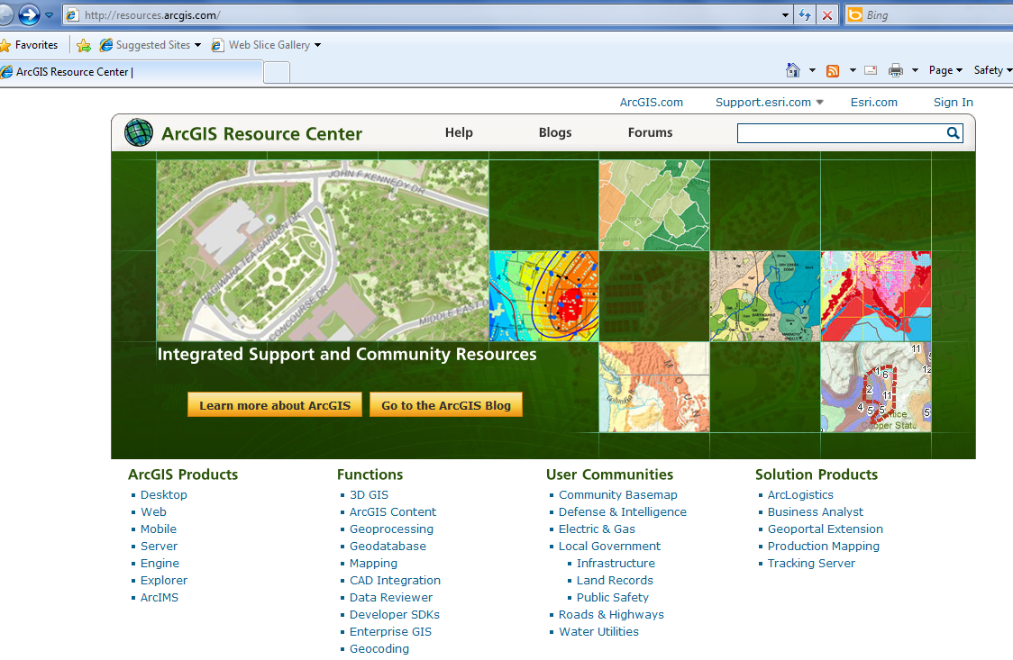
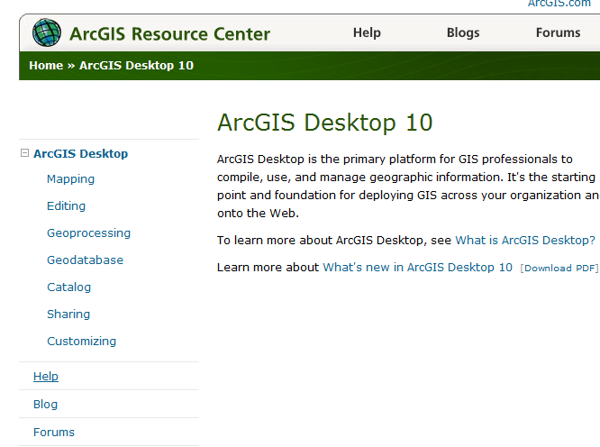

ArcGIS Resource Centers http://resources.arcgis/com
Getting to Readings in ArcGIS Resource Center Help for Desktop 10
Desktop
Help

Slide 4
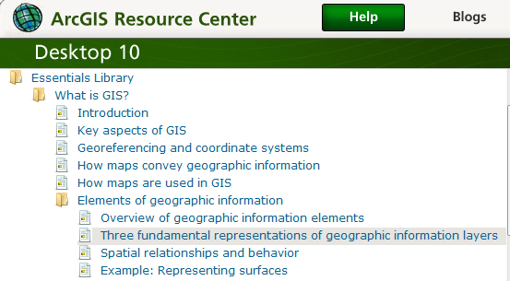
Readings – at http://help.arcgis.com
Elements of geographic information starting from “Overview of geographic information elements” http://help.arcgis.com/en/arcgisdesktop/10.0/help/00v2/00v200000003000000.htm to “Example: Representing surfaces”

Slide 5

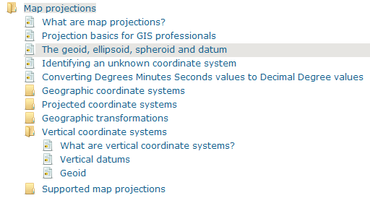
Readings:
http://resources.arcgis.com/
In ArcGIS Desktop 10 Help library/ Professional library/ Guide books/ Map projections

Slide 6
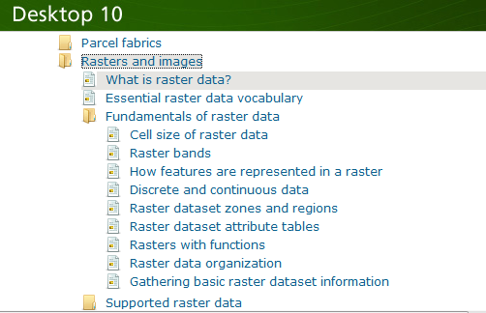
Readings – at http://help.arcgis.com
Rasters and images starting from “What is raster data” http://help.arcgis.com/en/arcgisdesktop/10.0/help/index.html#//009t00000002000000.htm to end of “Raster dataset attribute tables”

Slide 7
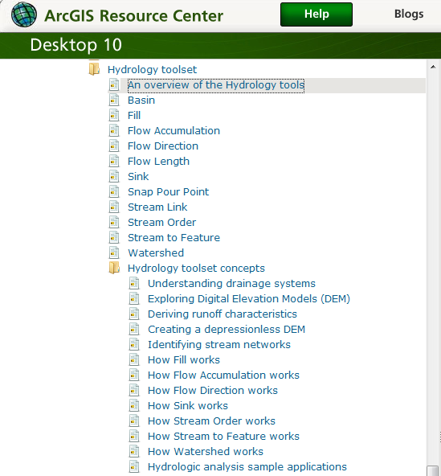
Readings
At http://help.arcgis.com, start from “An overview of the Hydrology tools” http://help.arcgis.com/en/arcgisdesktop/10.0/help/009z/009z0000004w000000.htm to end of Hydrologic analysis sample applications

Slide 8
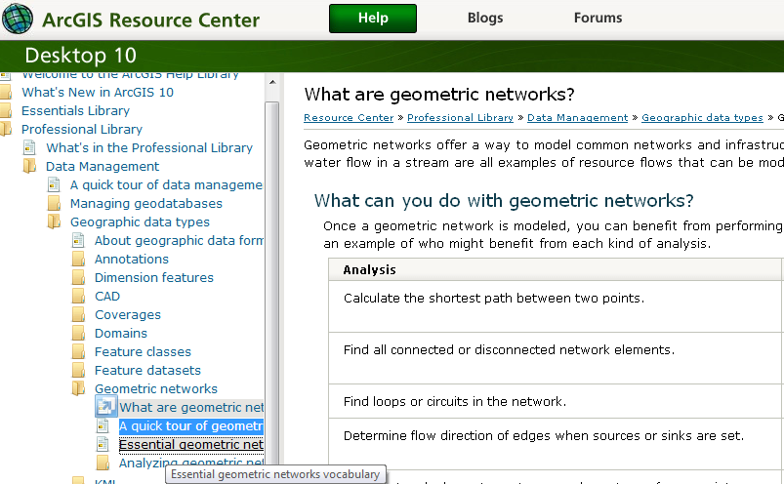
Networks Reading (1)
ArcGIS Resource Center/Desktop 10/Help/Professional Library/Data Management/Geographic Data Types/Geometric Networks – What are geometric networks, A quick tour of geometric networks, Essential geometric networks

Slide 9
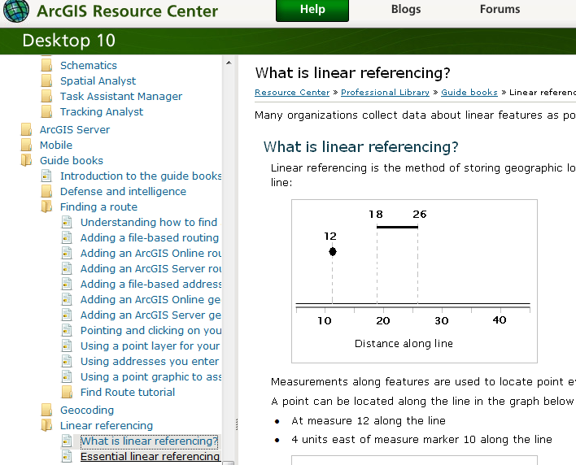
Networks Reading (2)
ArcGIS Resource Center/ Desktop 10/Help/Professional Library/Guide books/Linear Referencing
- What is linear referencing; Essential linear referencing

Slide 10
Data Model
Conceptual Model – a set of concepts that describe a subject and allow reasoning about it
Mathematical Model – a conceptual model expressed in symbols and equations
Data Model – a conceptual model expressed in a data structure (e.g. ascii files, Excel tables, …..)
Geographic Data Model – a conceptual model for describing and reasoning about the world expressed in a GIS database

Slide 11
Data Models
A geographic data model is a structure for organizing geospatial data so that it can be easily stored and retrieved.
Geographic coordinates
Tabular attributes

Slide 12
Raster and Vector Data
Raster data are described by a cell grid, one value per cell
Vector
Raster
Point
Line
Zone of cells
Polygon

Slide 13
Themes or Data Layers
Vector data: point, line or polygon features
How each of these features could be represented using vector or raster?

Slide 14
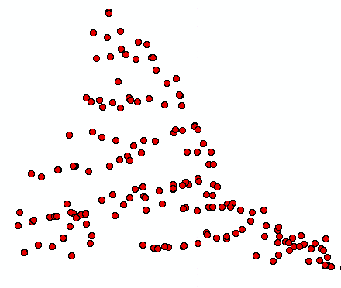
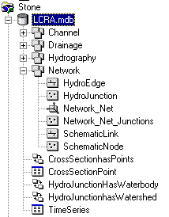
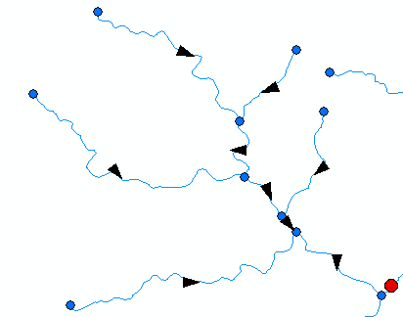
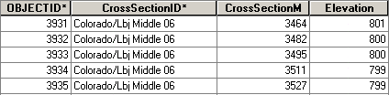
ArcGIS Geodatabase (what is in a geodatabase)
Workspace
Geodatabase
Feature Dataset
Feature Class
Geometric
Network
Relationship
Object Class

Slide 15

Geodatabase and Feature Dataset
A geodatabase is a relational database that stores geographic information.
A feature dataset is a collection of feature classes that share the same spatial reference frame.

Slide 16
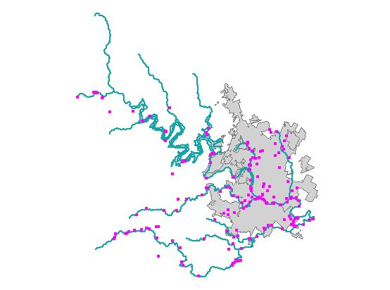
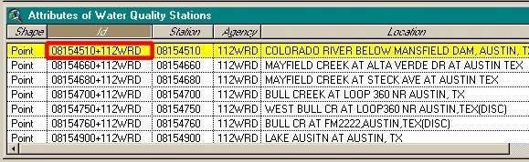
Feature Class
A feature class is a collection of geographic objects in tabular format that have the same behavior and the same attributes.
Feature Class = Object class + spatial coordinates

Slide 17
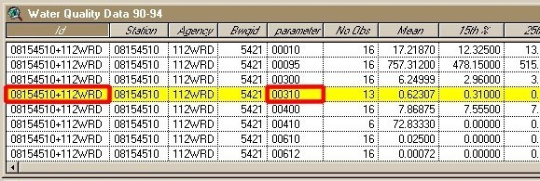
Object Class
An object class is a collection of objects in tabular format that have the same behavior and the same attributes (do not have a shape).
An object class is a table that has a unique identifier (ObjectID)
for each record

Slide 18
Relationship
Relationship between spatial and non-spatial objects
Water quality data
(non-spatial)
Measurement station
(spatial)

Slide 19
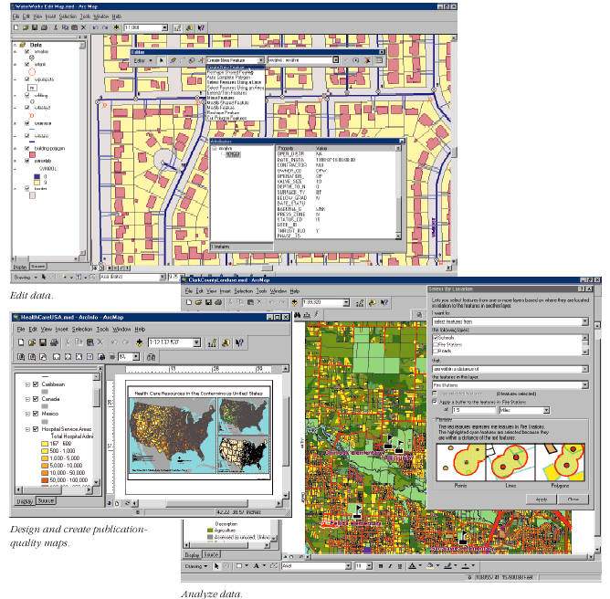
Key ArcGIS Software Components
ArcMap
ArcCatalog
ArcToolbox
Extensions
Geoprocessing

Slide 20
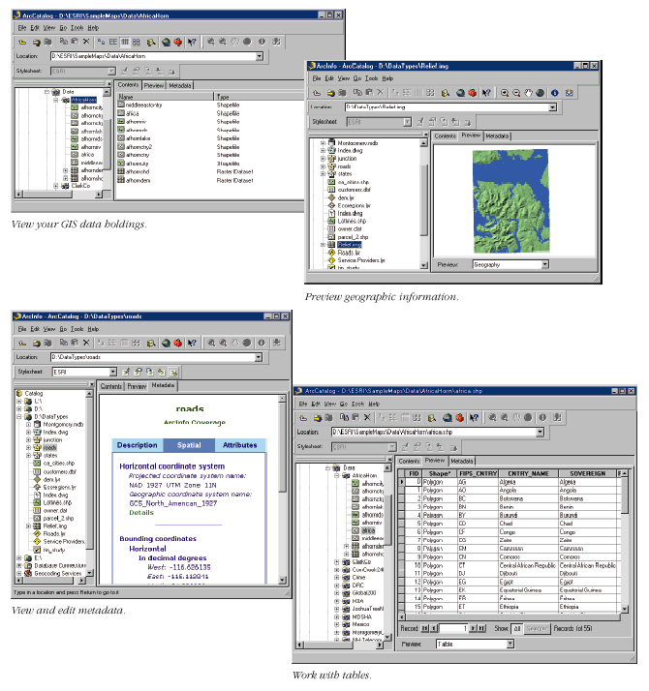
Arc Catalog
Graphical
previews
View data
(like Windows Explorer)
Tables
Metadata

Slide 21
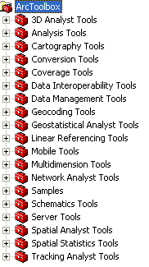
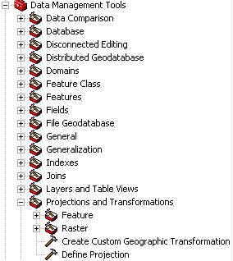
Arc Toolbox
Tools for commonly used tasks
Map Projections

Slide 22
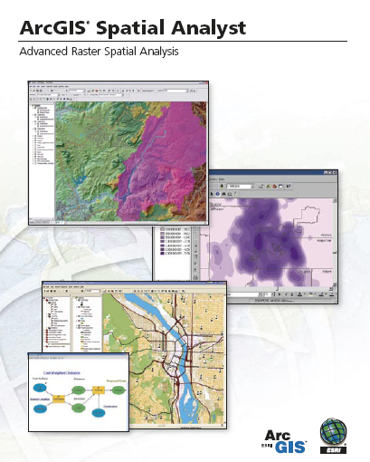
Spatial Analyst
Analysis of land surface terrain as a grid
Key means of defining drainage areas and connectivity to stream network

Slide 23
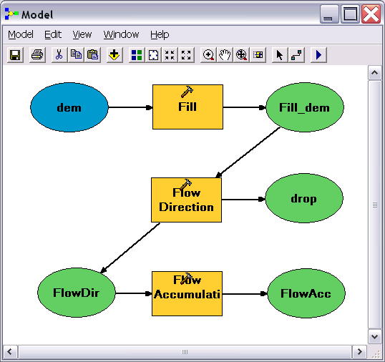
Geo-Processing
Toolbox tools linked together using the model builder to automate data processing

Slide 24
Geodesy, Map Projections and Coordinate Systems
Geodesy - the shape of the earth and definition of earth datums
Map Projection - the transformation of a curved earth to a flat map
Coordinate systems - (x,y) coordinate systems for map data
Spatial Reference = Datum +
Projection +
Coordinate system

Slide 25
Types of Coordinate Systems
(1) Global Cartesian coordinates (x,y,z) for the whole earth
(2) Geographic coordinates (φ, λ, z)
(3) Projected coordinates (x, y, z) on a local area of the earth’s surface
The z-coordinate in (1) and (3) is defined geometrically; in (2) the z-coordinate is defined gravitationally

Slide 26
Global Cartesian Coordinates (x,y,z)
Z
Greenwich
Meridian
O
•
Y
X
Equator

Slide 27
Geographic Coordinates (φ, λ, z)
Latitude (φ) and Longitude (λ) defined using an ellipsoid, an ellipse rotated about an axis
Elevation (z) defined using geoid, a surface of constant gravitational potential
Earth datums define standard values of the ellipsoid and geoid

Slide 28
Latitude and Longitude
Longitude line (Meridian)
N
W
E
S
Range: 180ºW - 0º - 180ºE
Latitude line (Parallel)
N
W
E
S
(0ºN, 0ºE)
Equator, Prime Meridian
Range: 90ºS - 0º - 90ºN

Slide 29
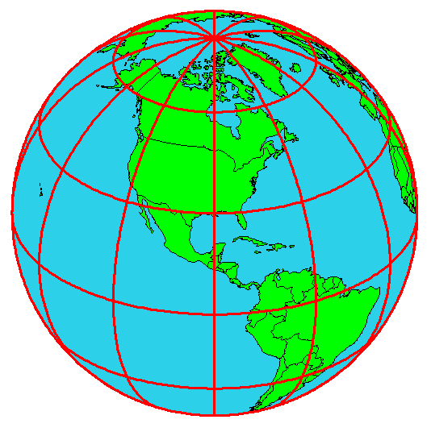
Latitude and Longitude
in North America
Austin:
(30°N, 98°W)
Logan:
(42°N, 112°W)
Lincoln:
(40°N, 96° W
60 N
30 N
120 W
60 W
90 W
0 N

Slide 30

Length on Meridians and Parallels
(Lat, Long) = (φ, λ)
Length on a Meridian:
AB = R_{e} Δφ
(same for all latitudes)
R
Δλ
D
30 N
R
C
R_{e}
Δφ
B
0 N
R_{e}
Length on a Parallel:
CD = R Δλ = R_{e} Δλ Cos φ
(varies with latitude)
A

Slide 31
Example: What is the length of a 1º increment along
on a meridian and on a parallel at 30N, 90W?
Radius of the earth = 6370 km.
Solution:
A 1º angle has first to be converted to radians
π radians = 180 º, so 1º = π/180 = 3.1416/180 = 0.0175 radians
For the meridian, ΔL = R_{e} Δφ = 6370 ∗ 0.0175 = 111 km
For the parallel, ΔL = R_{e} Δλ Cos φ
= 6370 ∗ 0.0175 ∗ Cos 30
= 96.5 km
Parallels converge as poles are approached

Slide 32
Example 2: What is the size of a 1 arc-second DEM cell when projected to (x,y) coordinates at 30º N?
Radius of the earth = 6370 km = 6,370,000m = 6.37 x 10⁶ m
Solution:
A 1” angle has first to be converted to radians
π radians = 180 º, so 1” = 1/3600 º = (1/3600)π/180 radians = 4.848 x 10⁻⁶ radians
For the left and right sides, ΔL = R_{e} Δφ = 6.37 x 10⁶ * 4.848 x 10⁻⁶ = 30.88m
For the top and bottom sides, ΔL = R_{e} Δλ Cos φ = 6.37 x 10⁶ * 4.848 x 10⁻⁶ * Cos 30º = 30.88 x 0.8660 = 26.75m
Left and right sides of cell converge as poles are approached

Slide 33
Curved Earth Distance
(from A to B)
Shortest distance is along a “Great Circle”
A “Great Circle” is the intersection of a sphere with a plane going through its center.
1. Spherical coordinates converted to Cartesian coordinates.
2. Vector dot product used to calculate angle α from latitude and longitude
3. Great circle distance is Rα, where R=6370 km²
Z
B
A
α
•
Y
X
Longley et al. (2001)

Slide 34
Horizontal Earth Datums
An earth datum is defined by an ellipse and an axis of rotation
NAD27 (North American Datum of 1927) uses the Clarke (1866) ellipsoid on a non geocentric axis of rotation
NAD83 (NAD,1983) uses the GRS80 ellipsoid on a geocentric axis of rotation
WGS84 (World Geodetic System of 1984) uses GRS80, almost the same as NAD83

Slide 35
Vertical Earth Datums
A vertical datum defines elevation, z
NGVD29 (National Geodetic Vertical Datum of 1929)
NAVD88 (North American Vertical Datum of 1988)
takes into account a map of gravity anomalies between the ellipsoid and the geoid

Slide 36
Types of Projections
Conic (Albers Equal Area, Lambert Conformal Conic) - good for East-West land areas
Cylindrical (Transverse Mercator) - good for North-South land areas
Azimuthal (Lambert Azimuthal Equal Area) - good for global views

Slide 37
Projections Preserve Some
Earth Properties
Area - correct earth surface area (Albers Equal Area) important for mass balances
Shape - local angles are shown correctly (Lambert Conformal Conic)
Direction - all directions are shown correctly relative to the center (Lambert Azimuthal Equal Area)
Distance - preserved along particular lines
Some projections preserve two properties

Slide 38
Universal Transverse
Mercator
Uses the Transverse Mercator projection
Each zone has a Central Meridian (λ_{o}), zones are 6° wide, and go from pole to pole
60 zones cover the earth from East to West
Reference Latitude (φ_{o}), is the equator
(Xshift, Yshift) = (x_{o},y_{o}) = (500000, 0) in the Northern Hemisphere, units are meters

Slide 39
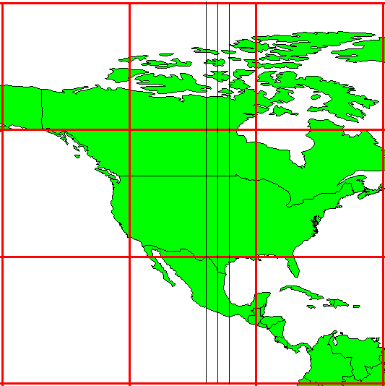
UTM Zone 14
-99°
-102°
-96°
6°
Origin
Equator
-120°
-90 °
-60 °

Slide 40
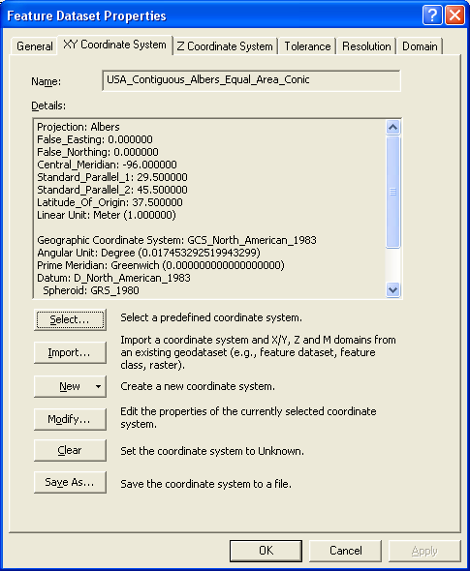
ArcGIS Reference Frames
Defined for a feature dataset in ArcCatalog
Coordinate System
  Projected
  Geographic
X/Y Coordinate system
Z Coordinate system

Slide 41
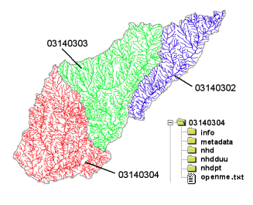
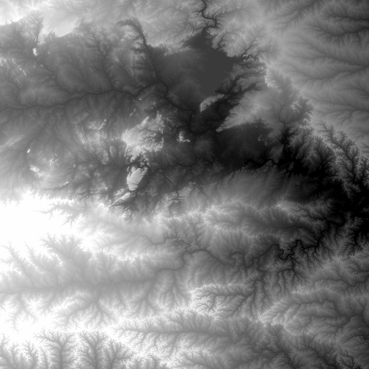
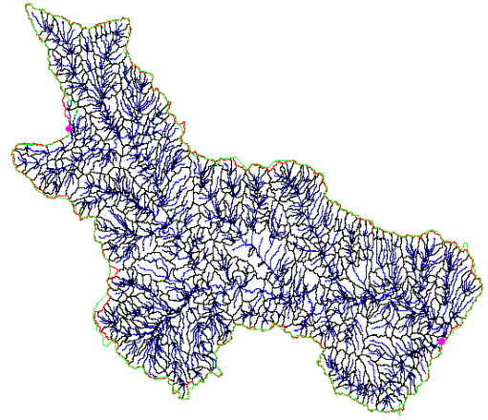
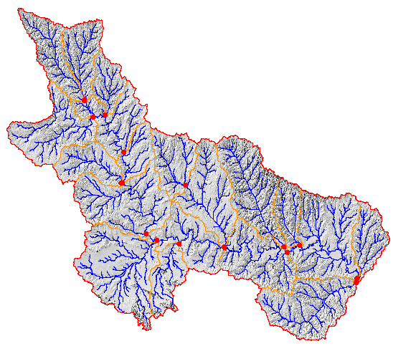
Data Sources for GIS in Water Resources
National Hydro Data Programs
National Elevation Dataset
(NED)
National Hydrography Dataset
(NHD)
What is it?
What does it contain?
What is the GIS format?
Where would it be obtained
NED-Hydrology
Watershed Boundary Dataset

Slide 42
f(x,y)
y
x

Slide 43
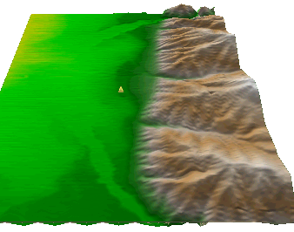
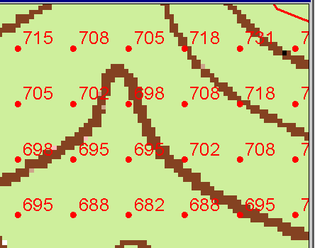
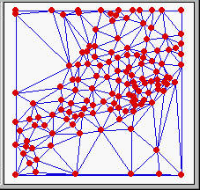
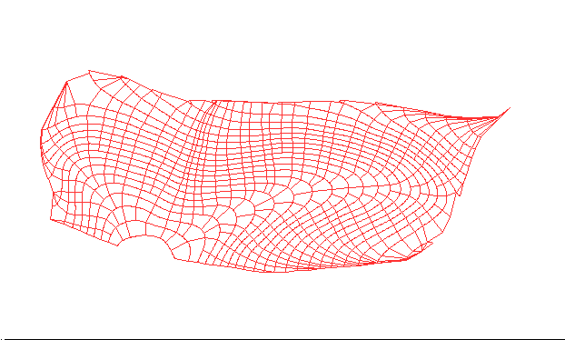
Numerical representation of a spatial surface (field)
Grid
TIN
Contour and flowline

Slide 44
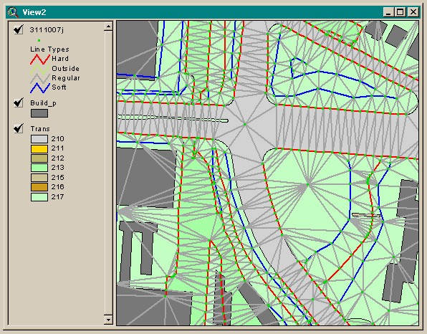
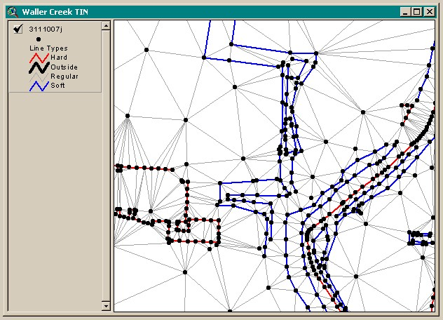
TIN Datasets
Triangle sides are constructed by connecting adjacent points so that the minimum angle of each triangle is maximized. Triangle sides cannot cross breaklines.
The TIN format is efficient to store data because the resolution adjusts to the parameter spatial variability.

Slide 45
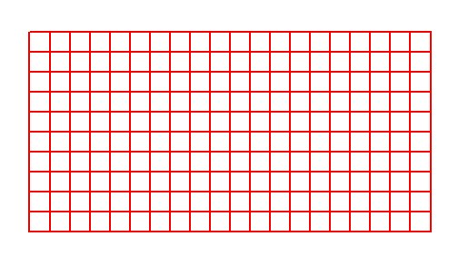
Grid Datasets
Cellular-based data structure composed of square cells of equal size arranged in rows and columns.
The grid cell size and extent (number of rows and columns), as well as the value at each cell have to be stored as part of the grid definition.
Number of columns
Cell size
Number of rows

Slide 46
Spatial Generalization
Largest share rule
Central point rule

Slide 47
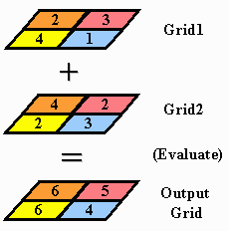
Raster Calculator
Cell by cell evaluation of mathematical functions

Slide 48
Raster calculation – some subtleties
Resampling or interpolation (and reprojection) of inputs to target extent, cell size, and projection within region defined by analysis mask
+
=
Analysis mask
Analysis cell size
Analysis extent

Slide 49

Nearest Neighbor Resampling with Cellsize Maximum of Inputs
100 m
40
50
55
40-0.5*4 = 38
42
47
43
55-0.5*6 = 52
38
52
42
44
41
42-0.5*2 = 41
41-0.5*4 = 39
41
39
150 m
4
6
2
4

Slide 50
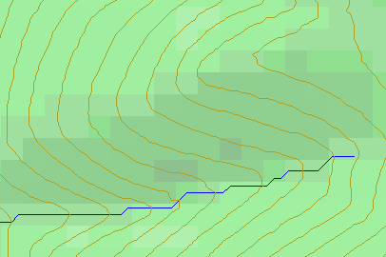
Topographic Slope
Defined or represented by one of the following
  Surface derivative ∇z
  Vector with x and y components
  Vector with magnitude (slope) and direction (aspect)

Slide 51
DEM Based Watershed and Stream Network Delineation Steps
DEM Reconditioning/Burning in Streams
Fill Sinks
Eight direction pour point model to evaluate flow directions
Flow accumulation
Threshold stream network definition
Stream segmentation
Watershed delineation
Raster to vector conversion of streams and watersheds

Slide 52
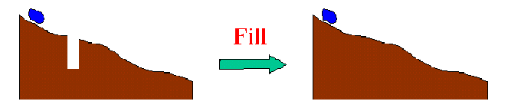
Filling in the Pits
DEM creation results in artificial pits in the landscape
A pit is a set of one or more cells which has no downstream cells around it
Unless these pits are filled they become sinks and isolate portions of the watershed
Pit filling is first thing done with a DEM

Slide 53
Identifying and Removing Pits/Sinks in a DEM
Contains pits
Filled
5 | 5 | 4 | 5 | 5 | 5 | 5 | 3 | 5 | 5
6 | 6 | 5 | 6 | 6.1 | 5 | 6 | 6 | 6 | 6
7 | 7 | 6 | 7 | 7 | 4 | 7 | 5 | 7 | 7
9 | 9 | 8 | 9 | 9 | 3.9 | 9 | 5 | 9 | 9
11 | 11 | 10 | 11 | 11 | 11 | 11 | 9 | 11 | 11
12 | 12 | 8 | 12 | 12 | 12 | 12 | 10 | 12 | 12
13 | 12 | 7 | 12 | 13 | 13 | 13 | 11 | 13 | 13
14 | 7 | 6 | 11 | 14 | 14 | 14 | 12 | 14 | 14
15 | 7 | 7 | 8 | 9 | 15 | 15 | 8 | 15 | 15
15 | 8 | 8 | 8 | 7 | 16 | 16 | 14 | 16 | 16
15 | 11 | 9 | 11 | 11 | 17 | 17 | 17 | 17 | 17
15 | 15 | 8 | 15 | 15 | 18 | 18 | 15 | 18 | 18
5 | 5 | 4 | 5 | 5 | 5 | 5 | 3 | 5 | 5
6 | 6 | 5 | 6 | 6.1 | 5 | 6 | 6 | 6 | 6
7 | 7 | 6 | 7 | 7 | 4 | 7 | 5 | 7 | 7
9 | 9 | 8 | 9 | 9 | 3.9 | 9 | 5 | 9 | 9
11 | 11 | 10 | 11 | 11 | 11 | 11 | 9 | 11 | 11
12 | 12 | 8 | 12 | 12 | 12 | 12 | 10 | 12 | 12
13 | 12 | 7 | 12 | 13 | 13 | 13 | 11 | 13 | 13
14 | 7 | 6 | 11 | 14 | 14 | 14 | 12 | 14 | 14
15 | 7 | 7 | 8 | 9 | 15 | 15 | 8 | 15 | 15
15 | 8 | 8 | 8 | 7 | 16 | 16 | 14 | 16 | 16
15 | 11 | 9 | 11 | 11 | 17 | 17 | 17 | 17 | 17
15 | 15 | 8 | 15 | 15 | 18 | 18 | 15 | 18 | 18
5 | 5 | 4 | 5 | 5 | 5 | 5 | 3 | 5 | 5
6 | 6 | 5 | 6 | 6.1 | 5 | 6 | 6 | 6 | 6
7 | 7 | 6 | 7 | 7 | 4 | 7 | 5 | 7 | 7
9 | 9 | 8 | 9 | 9 | 3.9 | 9 | 5 | 9 | 9
11 | 11 | 10 | 11 | 11 | 11 | 11 | 9 | 11 | 11
12 | 12 | 8 | 12 | 12 | 12 | 12 | 10 | 12 | 12
13 | 12 | 7 | 12 | 13 | 13 | 13 | 11 | 13 | 13
14 | 7 | 6 | 11 | 14 | 14 | 14 | 12 | 14 | 14
15 | 7 | 7 | 8 | 9 | 15 | 15 | 8 | 15 | 15
15 | 8 | 8 | 8 | 7 | 16 | 16 | 14 | 16 | 16
15 | 11 | 9 | 11 | 11 | 17 | 17 | 17 | 17 | 17
15 | 15 | 8 | 15 | 15 | 18 | 18 | 15 | 18 | 18
5 | 5 | 4 | 5 | 5 | 5 | 5 | 3 | 5 | 5
6 | 6 | 5 | 6 | 6.1 | 5 | 6 | 6 | 6 | 6
7 | 7 | 6 | 7 | 7 | 4 | 7 | 6 | 7 | 7
9 | 9 | 8 | 9 | 9 | 3.9 | 9 | 6 | 9 | 9
11 | 11 | 10 | 11 | 11 | 11 | 11 | 9 | 11 | 11
12 | 12 | 9 | 12 | 12 | 12 | 12 | 10 | 12 | 12
13 | 12 | 9 | 12 | 13 | 13 | 13 | 11 | 13 | 13
14 | 9 | 9 | 11 | 14 | 14 | 14 | 12 | 14 | 14
15 | 9 | 9 | 9 | 9 | 15 | 15 | 12 | 15 | 15
15 | 9 | 9 | 9 | 9 | 16 | 16 | 14 | 16 | 16
15 | 11 | 9 | 11 | 11 | 17 | 17 | 17 | 17 | 17
15 | 15 | 8 | 15 | 15 | 18 | 18 | 15 | 18 | 18
A pit is a set of one or more cells which has no downstream cells around it.

Slide 54
Hydrologic Slope
- Direction of Steepest Descent
30
30
67
56
49
67
56
49
52
48
37
52
48
37
58
55
22
58
55
22
Slope:

Slide 55
Eight Direction Pour Point Model
32
64
128
16
1
8
4
2
Water flows in the direction of steepest descent

Slide 56
Flow Accumulation Grid.
Area draining in to a grid cell
0
0
0
0
0
0
0
0
0
0
0
2
2
2
0
0
2
2
2
0
0
0
10
0
1
0
0
1
0
10
1
0
0
14
0
1
0
0
0
14
0
4
1
19
1
0
4
1
1
19
Flow Accumulation > Threshold
ArcHydro Page 72

Slide 57
Watershed Draining to Outlet

Slide 58
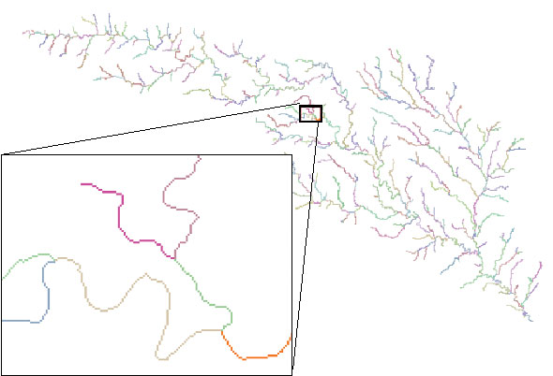
Stream links grid for the San Marcos subbasin
201
172
202
203
206
204
209
Each link has a unique identifying number
ArcHydro Page 74

Slide 59
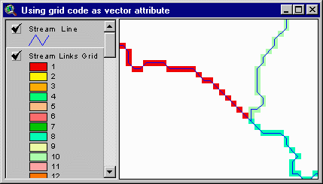
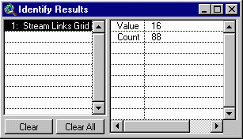
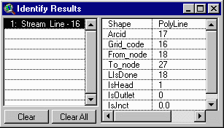
Vectorized Streams Linked Using Grid Code to Cell Equivalents
Vector
Streams
Grid
Streams
ArcHydro Page 75

Slide 60
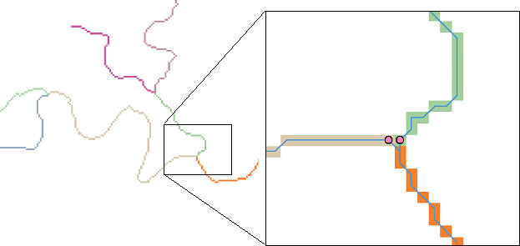
DrainageLines are drawn through the centers of cells on the stream links. DrainagePoints are located at the centers of the outlet cells of the catchments
ArcHydro Page 75

Slide 61
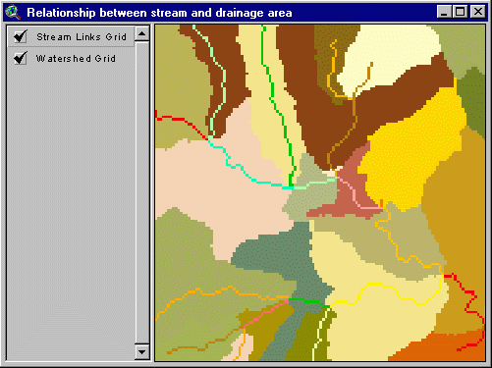
Catchments for Stream Links
Same Cell Value

Slide 62
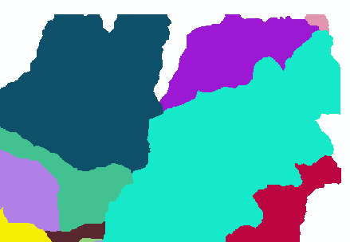
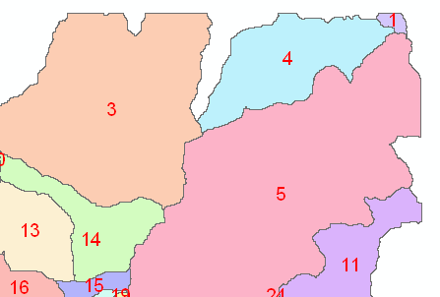
Raster Zones and Vector Polygons
One to one connection
DEM GridCode
Catchment GridID
4
3
5
Raster Zones
Vector Polygons

Slide 63
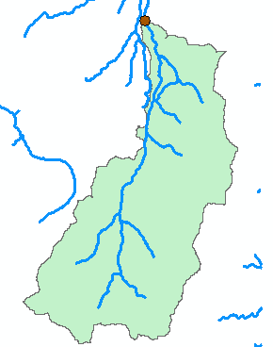
Watershed
A watershed is the area draining to any point on the stream network
A new kind of connectivity: Area flows to a point on a line

Slide 64
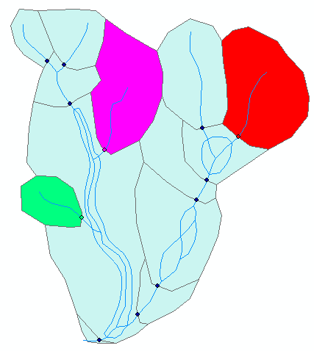
Connecting Drainage Areas to the Network
Area goes to
point on line

Slide 65
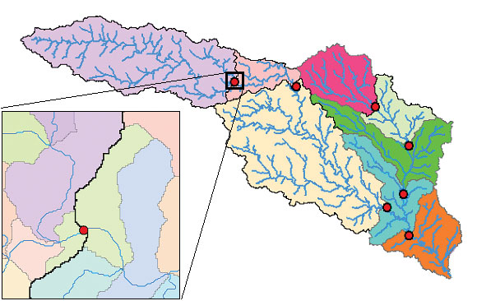
Catchment, Watershed, Subwatershed.
Subwatersheds
Catchments
Watershed
Watershed outlet points may lie within the interior of a catchment, e.g. at a USGS stream-gaging site.
ArcHydro Page 76

Slide 66
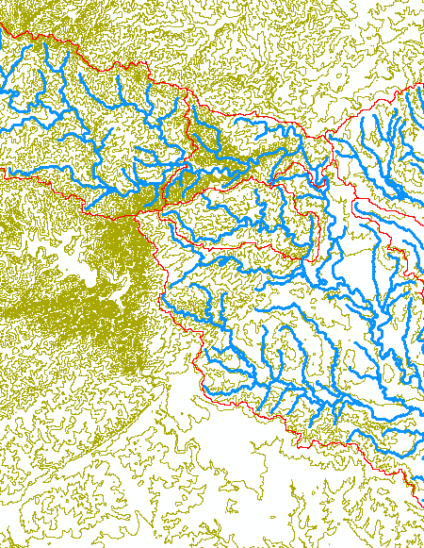

Key Spatial Analysis Concepts from Exercise 3
Contours and Hillshade to visualize topography

Slide 67


Zonal Average of Raster over Subwatershed

Slide 68


Subwatershed Precipitation by Thiessen Polygons
Thiessen Polygons
Feature to Raster (Precip field)
Zonal Statistics (Mean)
Join
Export to DBF (Excel)

Slide 69



Subwatershed Precipitation by Interpolation
Kriging (on Precip field)
Zonal Statistics (Mean)
Join
Export

Slide 70

Runoff Coefficients
Interpolated precip for each subwatershed
Convert to volume, P
Sum over upstream subwatersheds
Runoff volume, Q
Ratio of Q/P
Watershed | HydroID's
Plum Ck at Lockhart, TX | 330
Blanco Rv nr Kyle, TX | 331, 332
San Marcos Rv at Luling, TX | 331,332,333,336

Slide 71

Key Concepts from Exercise 4
DEM Reconditioning as an example of quantitative raster analysis
  Vector to Raster
  Distance
  Raster Calculation
  Volume removed analysis
Subtract 10 at all stream grid cells
"smdem" - 10 * “flowLineReclas" - 0.02 * (500 - "distance") * ("distance" < 500)
500
500
Subtract an amount that tapers from 0.02*500=10 when distance is 0, to 0 when distance is 500 from stream
Only do taper when distance is less than 500, otherwise this is 0 and nothing is subtracted
10
10

Slide 72

3D Analyst Profiles
smdem
diff
smrecon

Slide 73




Construct the Analysis Layer
Fill
Flow Direction
Flow Accumulation
Stream Definition
Stream Links
Catchments

Slide 74

Convert to Vector
Vector streams
Vector catchments
Attribute feature with raster zonal statistics
Geometric Network
Tracing
Selection statistics

Slide 75

Hydro Networks in GIS
Network Definition
A network is a set of edges and junctions that are topologically connected to each other.

Slide 76
Edges and Junctions
Simple feature classes: points and lines
Network feature classes: junctions and edges
Edges can be
  Simple: one attribute record for a single edge
  Complex: one attribute record for several edges in a linear sequence
A single edge cannot be branched
No!!

Slide 77

Polylines and Edges

Slide 78
Junctions
Junctions exist at all points where edges join
  If necessary they are added during network building (generic junctions)
Junctions can be placed on the interior of an edge e.g. stream gage
Any number of point feature classes can be built into junctions on a single network

Slide 79
Connectivity Table
p. 132 of Modeling our World
J125
Junction
Adjacent Junction and Edge
J123 | J124, E1
J124 | J123, E1 | J125, E2 | J126, E3
J125 | J124, E2
J126 | J124, E3
E2
J124
E1
E3
J123
J126
This is the “Logical Network”

Slide 80

Network Tracing on the Guadalupe Basin

Slide 81

Linear Referencing
Where are we on a line?

