Slide 1
Space and Time
By David R. Maidment
with contributions from Gil Strassberg and Tim Whiteaker

Slide 2
Linking GIS and Water Resources
Water
Resources
GIS
Water Environment
(Watersheds, gages, streams)
Water Conditions
(Flow, head, concentration)

Slide 3
Data Cube
A simple data model
Time, TsTime
“When”
D
“Where”
Space, FeatureID
Variables, VarID
“What”

Slide 4
Time Series in the Data Cube
(a)
TsTime
(b)
TsTime
(c)
TsTime
2791
FeatureID
FeatureID
2791
FeatureID
6875
6875
VarID
VarID
VarID
{FeatureID = 2791} gives all data for a feature
{VarID = 6875} gives all data for a variable
{Feature ID = 2791 and VarID = 6875} gives a time series

Slide 5
Space, Time, Variables and Observations
An observations data model archives values of variables at
particular spatial locations and points in time
Observations Data Model
Data from sensors (regular time series)
Data from field sampling (irregular time points)
Variables (VariableID)
Space (FeatureID)
Time

Slide 6
Space, Time, Variables and Visualization
A visualization is a set of maps, graphs and animations that display the variation of a phenomenon in space and time
Vizualization
Map – Spatial distribution for a time point or interval
Graph – Temporal distribution for a space point or region
Animation – Time-sequenced maps
Variables (VariableID)
Space (FeatureID)
Time

Slide 7
Space, Time, Variables and Simulation
A process simulaton model computes values of sets of variables at
particular spatial locations at regular intervals of time
Process Simulation Model
A space-time point is unique
At each point there is a set of variables
Variables (VariableID)
Space (FeatureID)
Time

Slide 8
Space, Time, Variables and Geoprocessing
Geoprocessing is the application of GIS tools to transform spatial data and create new data products
Geoprocessing
Interpolation – Create a surface from point values
Overlay – Values of a surface laid over discrete features
Temporal – Geoprocessing with time steps
Variables (VariableID)
Space (FeatureID)
Time

Slide 9
Space, Time, Variables and Statistics
A statistical distribution is defined for a particular variable defined over a particular space and time domain
Statistical distribution
Represented as {probability, value}
Summarized by statistics (mean, variance, standard deviation)
Variables (VariableID)
Space (FeatureID)
Time

Slide 10
Space, Time, Variables and Statistical Analysis
A statistical analysis summarizes the variation of a set of variables over a particular domain of space and time
Statistical analysis
Multivariate analysis – correlation of a set of variables
Geostatistics – correlation space
Time Series Analysis – correlation in time
Variables (VariableID)
Space (FeatureID)
Time

Slide 11
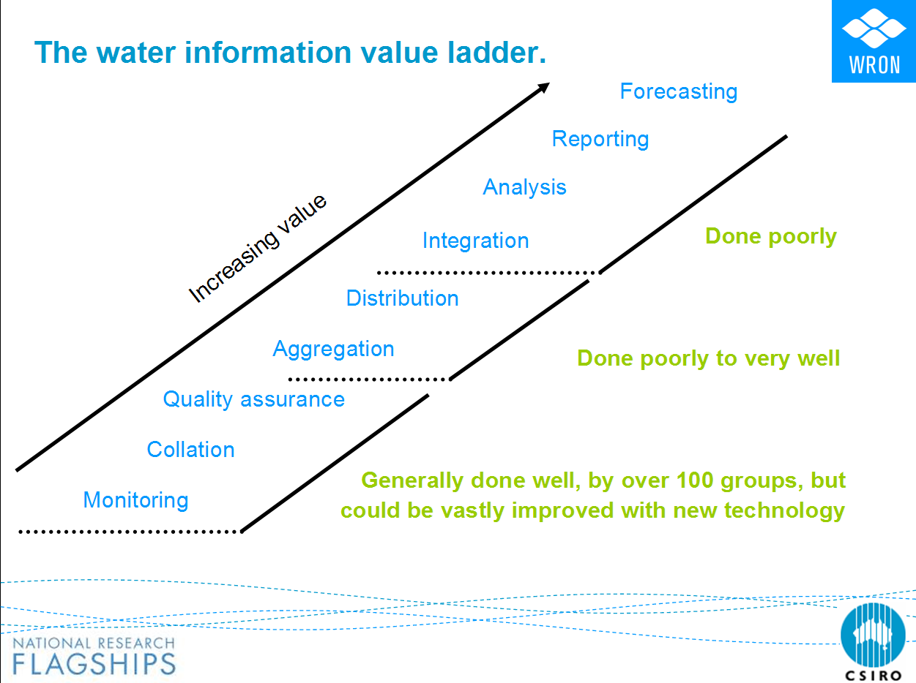
Space-Time Datasets
CUAHSI Observations Data Model
Sensor and laboratory databases
From Robert Vertessy, CSIRO, Australia

Slide 12
Geospatial time series
Time series = {value, time}
Attribute series = {featureID, value, time}
  Fixed geometry, only attributes change with time
Raster series = {raster, time}
Feature series = {shape, value, time}
  Both shape and attributes vary in time
Notes:
Layers give you the view on the data that you need to perform your analyses.

Slide 13
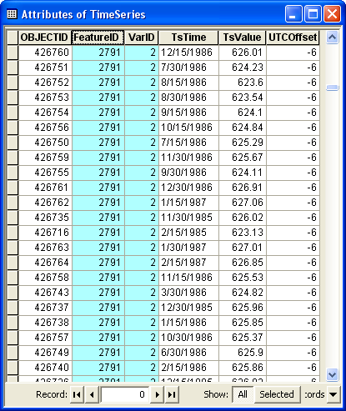
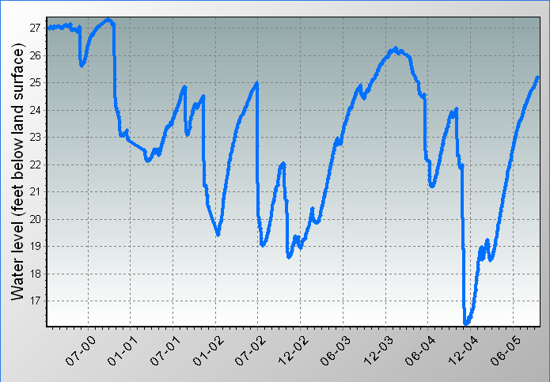
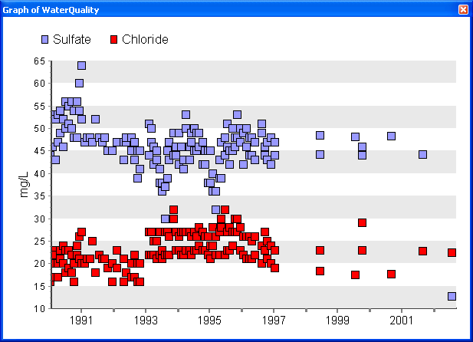
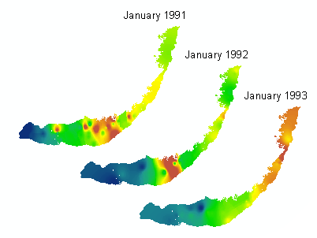
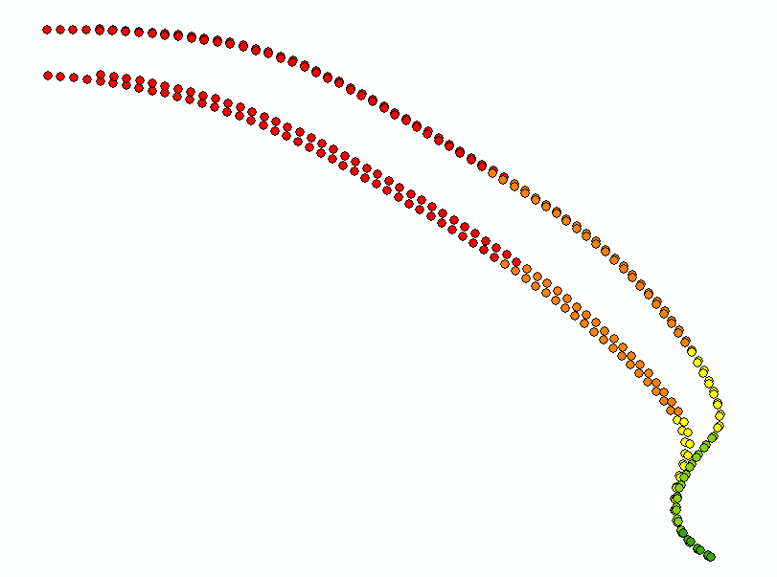
Geospatial time series
TimeSeries
AttributeSeries
RasterSeries
FeatureSeries

Slide 14
Arc Hydro II: Dataset Overview
Variables
associations
associations
[AttributeSeries]
workflows
workflows
[TimeSeries]
[FeatureSeries]
[RasterSeries]
indexes
indexes
SeriesCatalog
DatasetCatalog
Framework
Extended
Notes:
The brackets indicate that the name of this table can be whatever a user wants. So, the user can have a feature series called “Hurricanes”, and another one called “InundationPolygons”. I’m allowing the TimeSeries table to have multiple names for flexibility. The Variables, FeatureVariableIndex, and DatasetVariableIndex tables have predefined names that must be used.

Slide 15
Framework Schema
Variables
TimeSeries
SeriesCatalog
Variables
associations
[TimeSeries]
indexes
SeriesCatalog

Slide 16
Variables
A variable has a name, plus other properties
A variable can be represented by many time series datasets
Indexed by VariableID, or VarKey when a String is required
Variables
VariableID
VarName
VarDesc
VarUnits
SmplMedium
VarCode
Vocabulary
VarKey
IsRegular
TimeUnits
TimeStep
DataType
NoDataVal

Slide 17
TimeSeries
Variables
VariableID
VarName
VarUnits
VarDesc
Etc…
Data values indexed by Location, Variable, Time
Time
TsTime
[TimeSeries]
Data value
VariableID
FeatureID
TsTime
UTCOffset
TsValue
TsValue
Space
FeatureID
[FeatureClass]
Variables
HydroID
Shape
VariableID
Notes:
Time series for Arc Hydro II is an atomic representation of the data cube. In other words, each data value has a row in a TimeSeries table. This design is very flexible. Time is subordinate to Space and Variables here. In the TimeSeries table, time is just another piece of metadata for the data value.

Slide 18
SeriesCatalog
Indexes time series for a given feature and variable
Supports fast queries to identify data series
Time
SeriesCatalog
SeriesID
1
SeriesID
FeatureID
FeatClass
VariableID
TsTable
StartTime
EndTime
ValueCount
2
Where
3
4
What
Space
When
Variables
Notes:
This table summarizes time series. It enables faster searches for data series to figure out what you have in the database (but to retrieve the data values themselves, you still have to query the TimeSeries table).

Slide 19
Extended Schema Adds Items
Typically derived from models or observations
Contains
  TsTime
  UTCOffset
  Location Index or Shape
DatasetCatalog indexes
entire datasets for a variable
[AttributeSeries]
workflows
[FeatureSeries]
[RasterSeries]
indexes
DatasetCatalog

Slide 20
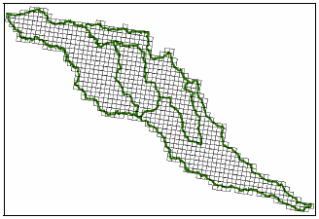
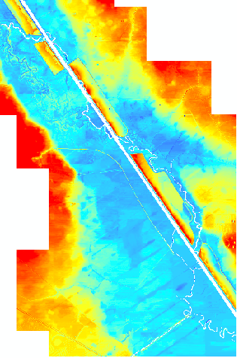
DatasetCatalog
Attribute Series, e.g., NEXRAD
DatasetCatalog
VariableID
DsType
DsSource
TsTable
StartTime
EndTime
StepCount
Feature Series
Raster Series
Notes:
The NEXRAD example might be confused with a feature series. Actually, no time stamps are associated with the HRAP features. Each feature has a unique ID, which relates to rainfall data in an attribute series table. This dataset should be indexed in the DatasetVariableIndex table, and not the FeatureVariableIndex table, because we don’t care about rainfall in an individual HRAP cell. We tend to view the dataset as a whole, and do spatial/temporal interpolation to extract that the data that we need for other purposes. An example of this is interpolating rainfall onto catchments.
The NEXRAD images was obtained from http://www.idswater.com/Common/Paper/Paper_176/z7.jpg.

Slide 21
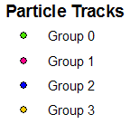
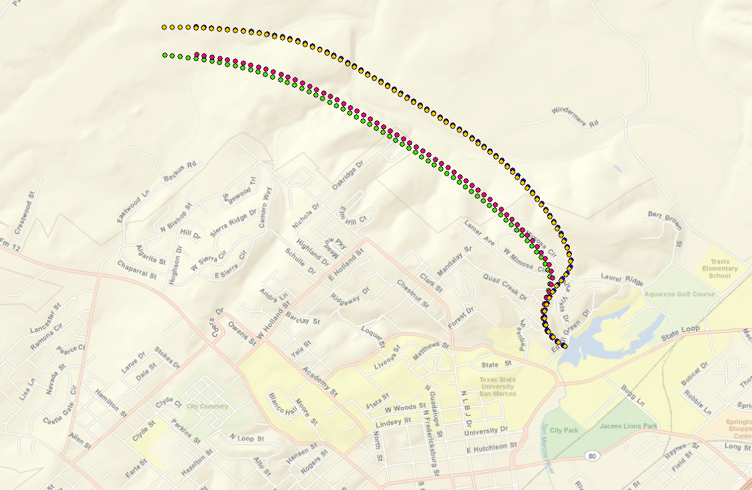
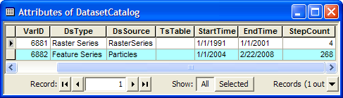
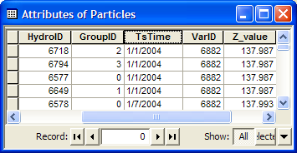
A Feature Series – Particle Tracking

