Slide 1
Spatial Analysis Using Grids
Learning Objectives
The concepts of spatial fields as a way to represent geographical information
Raster and vector representations of spatial fields
Perform raster calculations using spatial analyst
Raster calculation concepts and their use in hydrology
Calculate slope on a raster using
  ESRI polynomial surface method
  Eight direction pour point model
  [D∞ method]

Slide 2
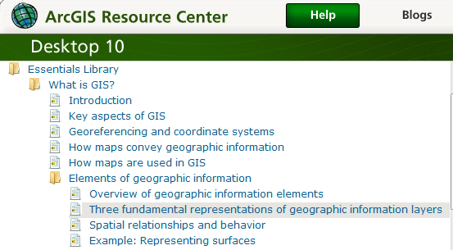
Readings – at http://help.arcgis.com
Elements of geographic information starting from “Overview of geographic information elements” http://help.arcgis.com/en/arcgisdesktop/10.0/help/00v2/00v200000003000000.htm to “Example: Representing surfaces”

Slide 3
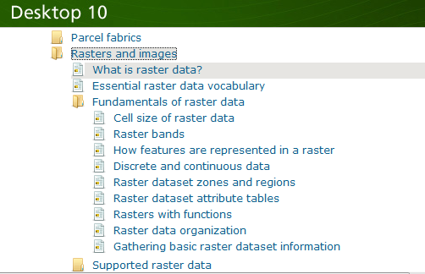
Readings – at http://help.arcgis.com
Rasters and images starting from “What is raster data” http://help.arcgis.com/en/arcgisdesktop/10.0/help/index.html#//009t00000002000000.htm to end of “Raster dataset attribute tables”

Slide 4
f(x,y)
y
x
Notes:
DRM

Slide 5
Raster and Vector Data
Raster data are described by a cell grid, one value per cell
Vector
Raster
Point
Line
Zone of cells
Polygon
Notes:
DRM

Slide 6
Raster and Vector are two methods of representing geographic data in GIS
Both represent different ways to encode and generalize geographic phenomena
Both can be used to code both fields and discrete objects
In practice a strong association between raster and fields and vector and discrete objects
Notes:
DRM

Slide 7
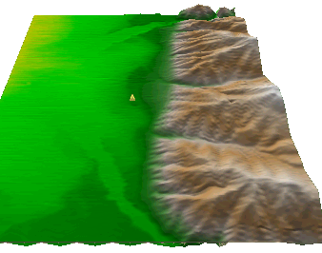
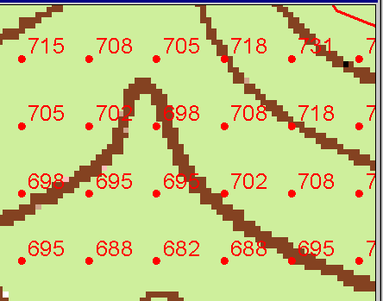
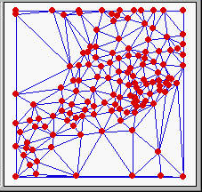
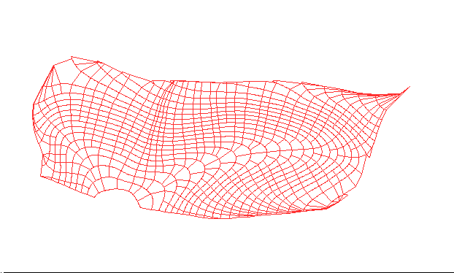
Numerical representation of a spatial surface (field)
Grid
TIN
Contour and flowline

Slide 8
Six approximate representations of a field used in GIS
Regularly spaced sample points
Irregularly spaced sample points
Rectangular Cells
Irregularly shaped polygons
Triangulated Irregular Network (TIN)
Polylines/Contours
from Longley, P. A., M. F. Goodchild, D. J. Maguire and D. W. Rind, (2001), Geographic Information Systems and Science, Wiley, 454 p.

Slide 9
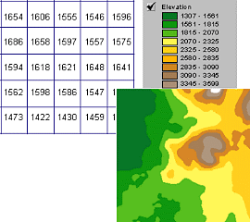
A grid defines geographic space as a matrix of identically-sized square cells. Each cell holds a numeric value that measures a geographic attribute (like elevation) for that unit of space.

Slide 10
The grid data structure
Grid size is defined by extent, spacing and no data value information
  Number of rows, number of column
  Cell sizes (X and Y)
  Top, left , bottom and right coordinates
Grid values
  Real (floating decimal point)
  Integer (may have associated attribute table)

Slide 11
Definition of a Grid
Cell size
Number
of
rows
NODATA cell
(X,Y)
Number of Columns

Slide 12
Points as Cells

Slide 13
Line as a Sequence of Cells

Slide 14
Polygon as a Zone of Cells

Slide 15
NODATA Cells

Slide 16
Cell Networks

Slide 17
Grid Zones

Slide 18
Floating Point Grids
Continuous data surfaces using floating point or decimal numbers

Slide 19
Value attribute table for categorical (integer) grid data
Attributes of grid zones

Slide 20
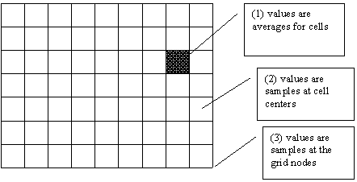
Raster Sampling
from Michael F. Goodchild. (1997) Rasters, NCGIA Core Curriculum in GIScience, http://www.ncgia.ucsb.edu/giscc/units/u055/u055.html, posted October 23, 1997

Slide 21
Raster Generalization
Largest share rule
Central point rule

Slide 22
Raster Calculator
Example
5
6
Precipitation
-
Losses (Evaporation, Infiltration)
=
Runoff
Cell by cell evaluation of mathematical functions
7
6
-
3
3
2
4
=
2
3
5
2

Slide 23
Runoff generation processes
P
Infiltration excess overland flow
aka Horton overland flow
P
f
P
q_{o}
f
Partial area infiltration excess overland flow
P
P
P
q_{o}
f
Saturation excess overland flow
P
P
P
q_{o}
q_{r}
q_{s}

Slide 24
Runoff generation at a point depends on
Rainfall intensity or amount
Antecedent conditions
Soils and vegetation
Depth to water table (topography)
Time scale of interest
These vary spatially which suggests a spatial geographic approach to runoff estimation

Slide 25
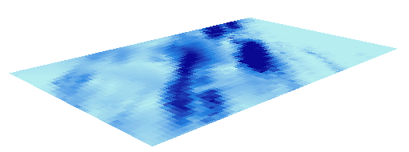
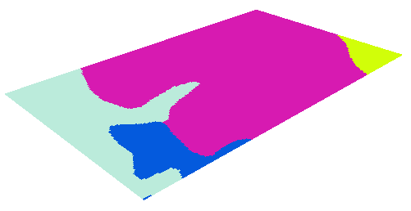
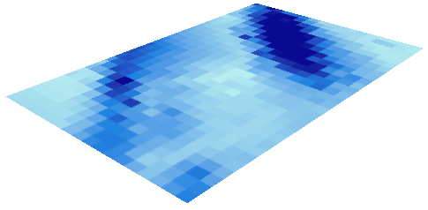
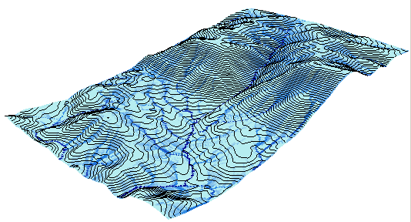
Cell based discharge mapping flow accumulation of generated runoff
Radar Precipitation grid
Soil and land use grid
Runoff grid from raster calculator operations implementing runoff generation formula’s
Accumulation of runoff within watersheds

Slide 26
Raster calculation – some subtleties
Resampling or interpolation (and reprojection) of inputs to target extent, cell size, and projection within region defined by analysis mask
+
=
Analysis mask
Analysis cell size
Analysis extent

Slide 27
Spatial Snowmelt Raster Calculation Example
100 m
150 m
100 m
40
50
55
150 m
4
6
42
47
43
2
4
42
44
41

Slide 28
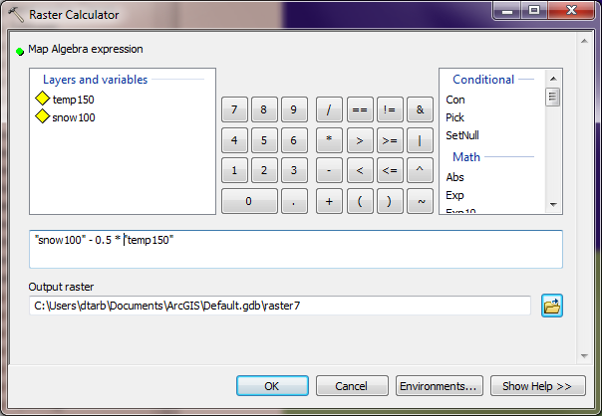
New depth calculation using Raster Calculator
“snow100” - 0.5 * “temp150”

Slide 29
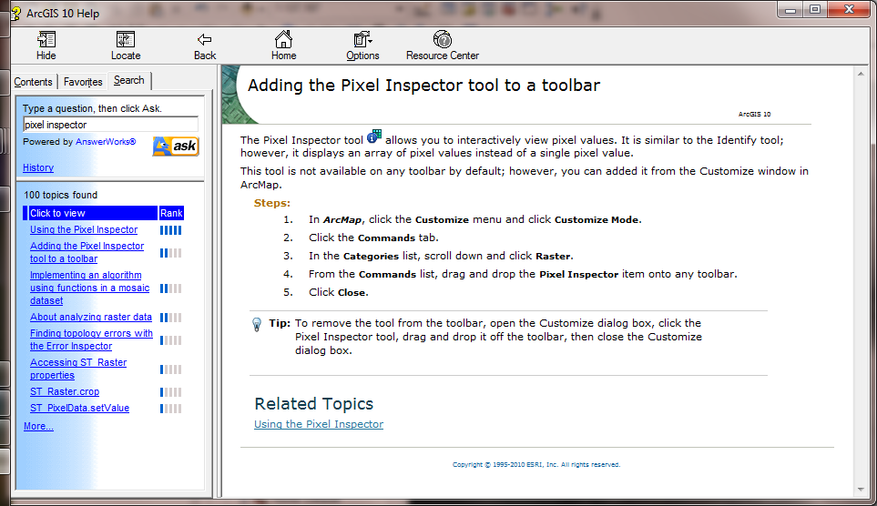
Example and Pixel Inspector

Slide 30
The Result
Outputs are on 150 m grid.
How were values obtained ?
38
52
41
39

Slide 31
Nearest Neighbor Resampling with Cellsize Maximum of Inputs
100 m
40
50
55
40-0.5*4 = 38
42
47
43
55-0.5*6 = 52
38
52
42
44
41
42-0.5*2 = 41
41-0.5*4 = 39
41
39
150 m
4
6
2
4

Slide 32
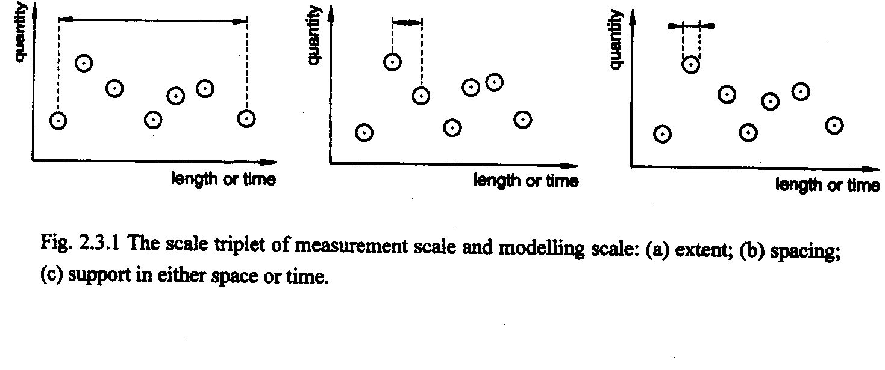
Scale issues in interpretation of measurements and modeling results
The scale triplet
a) Extent
b) Spacing
c) Support
From: Blöschl, G., (1996), Scale and Scaling in Hydrology, Habilitationsschrift, Weiner Mitteilungen Wasser Abwasser Gewasser, Wien, 346 p.

Slide 33
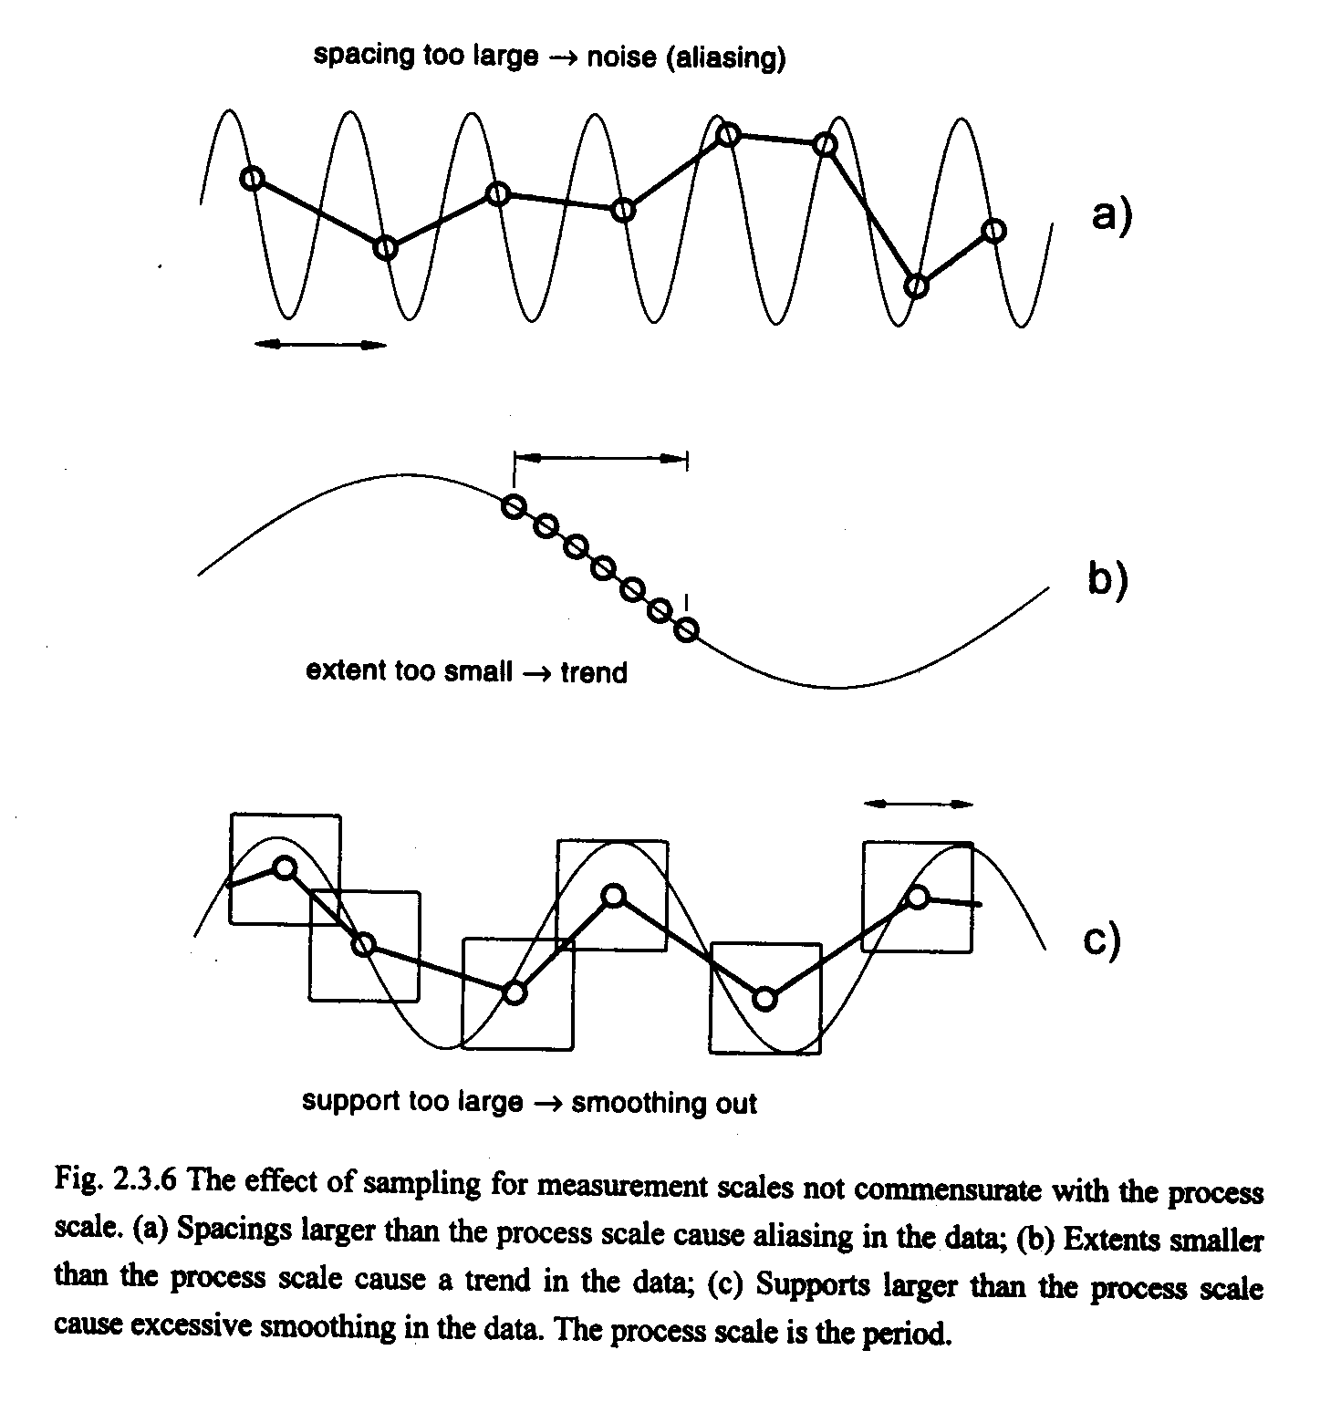
From: Blöschl, G., (1996), Scale and Scaling in Hydrology, Habilitationsschrift, Weiner Mitteilungen Wasser Abwasser Gewasser, Wien, 346 p.

Slide 34
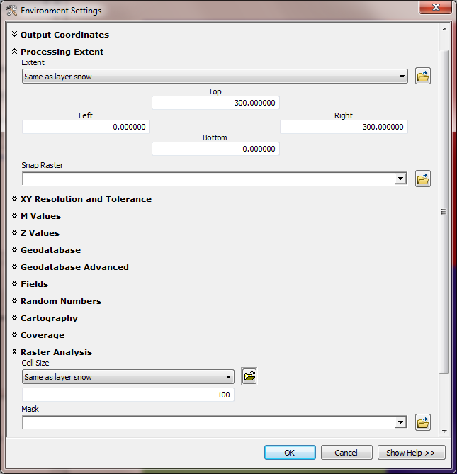
Use Environment Settings to control the scale of the output
Extent
Spacing & Support

Slide 35
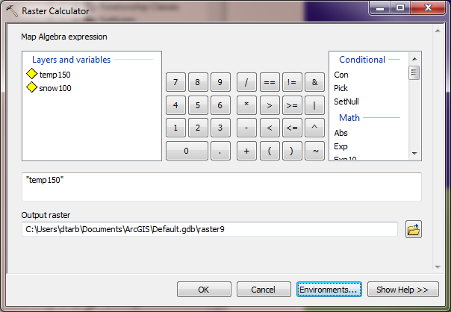
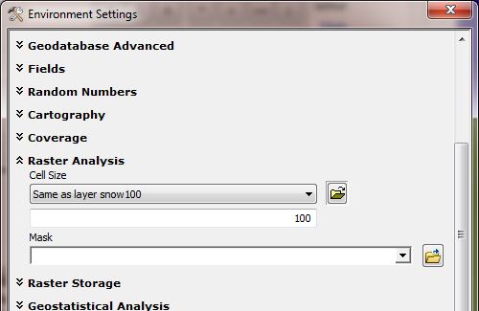
Raster Calculator “Evaluation” of “temp150”
4
4
6
6
6
2
4
4
2
4
2
4
4
Nearest neighbor to the E and S has been resampled to obtain a 100 m temperature grid.

Slide 36
Calculation with cell size set to 100 m grid
“snow100” - 0.5 * “temp150”
Outputs are on 100 m grid as desired.
How were these values obtained ?
38
47
52
41
45
41
41
42
39

Slide 37
100 m cell size raster calculation
40-0.5*4 = 38
100 m
40
50
55
50-0.5*6 = 47
55-0.5*6 = 52
42
47
43
42-0.5*2 = 41
47-0.5*4 = 45
38
47
52
42
44
41
43-0.5*4 = 41
41
45
41
42-0.5*2 = 41
4
6
6
44-0.5*4 = 42
150 m
41
42
39
4
6
41-0.5*4 = 39
2
4
4
2
4
Nearest neighbor values resampled to 100 m grid used in raster calculation
2
4
4

Slide 38
What did we learn?
Raster calculator automatically uses nearest neighbor resampling
The scale (extent and cell size) can be set under options
What if we want to use some other form of interpolation?
From Point
  Natural Neighbor, IDW, Kriging, Spline, …
From Raster
  Project Raster (Nearest, Bilinear, Cubic)

Slide 39
Interpolation
Estimate values between known values.
A set of spatial analyst functions that predict values for a surface from a limited number of sample points creating a continuous raster.
Apparent improvement in resolution may not be justified

Slide 40
Interpolation methods
Nearest neighbor
Inverse distance weight
Bilinear interpolation
Kriging (best linear unbiased estimator)
Spline

Slide 41
Nearest Neighbor “Thiessen” Polygon Interpolation
Spline Interpolation

Slide 42
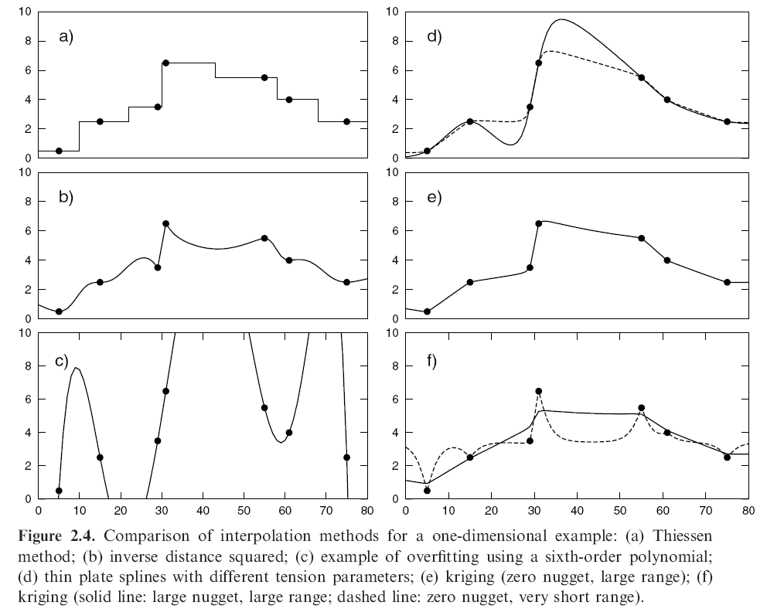
Interpolation Comparison
Grayson, R. and G. Blöschl, ed. (2000)

Slide 43
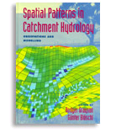
Further Reading
Grayson, R. and G. Blöschl, ed. (2000), Spatial Patterns in Catchment Hydrology: Observations and Modelling, Cambridge University Press, Cambridge, 432 p.
Chapter 2. Spatial Observations and Interpolation
Full text online at:
http://www.catchment.crc.org.au/special_publications1.html

Slide 44
Spatial Surfaces used in Hydrology
Elevation Surface — the ground surface elevation at each point

Slide 45
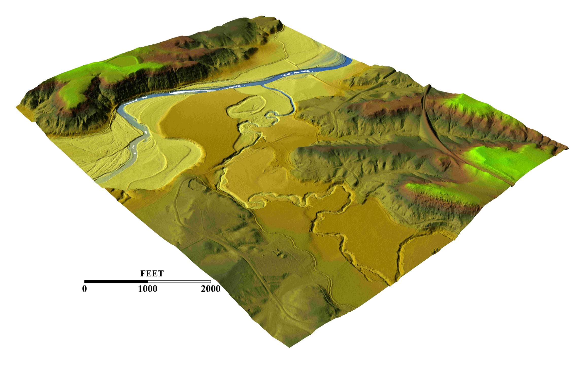
3-D detail of the Tongue river at the WY/Mont border from LIDAR.
Roberto Gutierrez
University of Texas at Austin

Slide 46
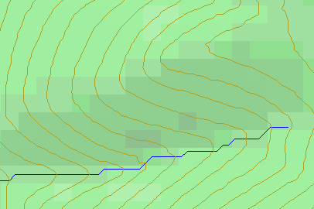
Topographic Slope
Defined or represented by one of the following
  Surface derivative ∇z (dz/dx, dz/dy)
  Vector with x and y components (S_{x}, S_{y})
  Vector with magnitude (slope) and direction (aspect) (S, α)

Slide 47
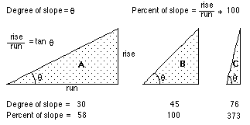
ArcGIS “Slope” tool
a
b
c
d
e
f
g
h
i

Slide 48
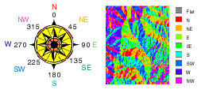
ArcGIS Aspect – the steepest downslope direction

Slide 49
Example
30
a
b
c
80
74
63
d
e
f
145.2º
69
67
56
g
h
i
60
52
48

Slide 50
Hydrologic Slope (Flow Direction Tool)
- Direction of Steepest Descent
30
30
80
74
63
80
74
63
69
67
56
69
67
56
60
52
48
60
52
48
Slope:

Slide 51
Eight Direction Pour Point Model
32
64
128
16
1
8
4
2
ESRI Direction encoding

Slide 52
Limitation due to 8 grid directions.
?

Slide 53
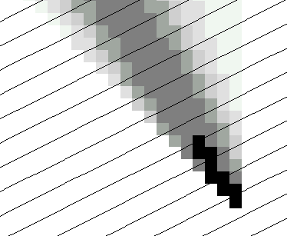
The D∞ Algorithm
Tarboton, D. G., (1997), "A New Method for the Determination of Flow Directions and Contributing Areas in Grid Digital Elevation Models," Water Resources Research, 33(2): 309-319.) (http://www.engineering.usu.edu/cee/faculty/dtarb/dinf.pdf)

Slide 54
The D∞ Algorithm
Δ
If α₁ does not fit within the triangle the angle is chosen along the steepest edge or diagonal resulting in a slope and direction equivalent to D8

Slide 55
D∞ Example
30
80
74
63
69
e_{o}
67
56
60
e₇
e₈
52
48
284.9º
14.9º

Slide 56
Summary Concepts
Grid (raster) data structures represent surfaces as an array of grid cells
Raster calculation involves algebraic like operations on grids
Interpolation and Generalization is an inherent part of the raster data representation

Slide 57
Summary Concepts (2)
The elevation surface represented by a grid digital elevation model is used to derive surfaces representing other hydrologic variables of interest such as
  Slope
  Drainage area (more details in later classes)
  Watersheds and channel networks (more details in later classes)

Slide 58
Summary Concepts (3)
The eight direction pour point model approximates the surface flow using eight discrete grid directions.
The D∞ vector surface flow model approximates the surface flow as a flow vector from each grid cell apportioned between down slope grid cells.

