Slide 1
GIS in Water Resources: Lecture 1
In-class and distance learning
Geospatial database of hydrologic features
GIS and HIS
Curved earth and a flat map

Slide 2
Six Basic Course Elements
Lectures
  Powerpoint slides
  Video streaming
Readings
  “Arc Hydro: GIS in Water Resources” and other materials
Homework
  Computer exercises
  Hand exercises
Term Project
  Oral presentation
  HTML report
Class Interaction
  Email
  Discussion
Examinations
  Midterm, final

Slide 3
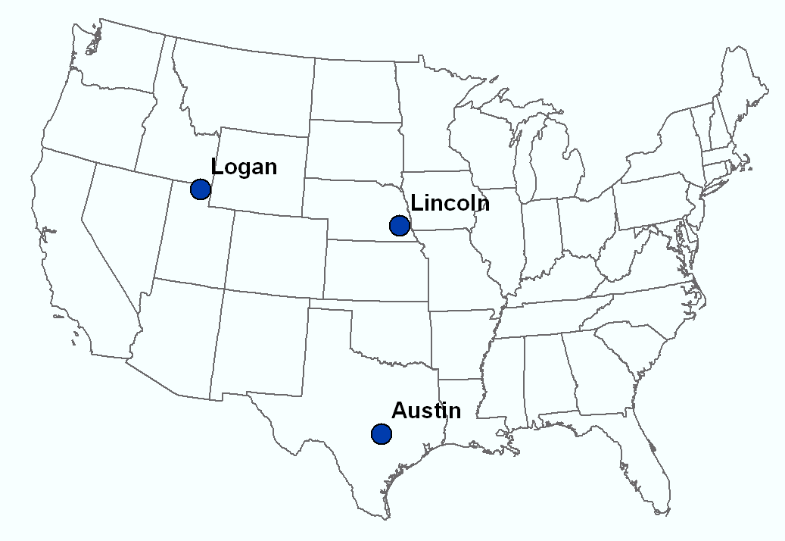
Our Classroom
Dr David Tarboton
Students at Utah State University
Dr Ayse Irmak Students at University of Nebraska - Lincoln
Dr David Maidment Students at UT Austin

Slide 4
University Without Walls
Traditional Classroom
Community
Inside and Outside
The Classroom

Slide 5
Learning Styles
Instructor-Centered Presentation
Community-Centered Presentation
Instructor
Student
We learn from the instructors and each other

Slide 6
GIS in Water Resources: Lecture 1
In-class and distance learning
Geospatial database of hydrologic features
GIS and HIS
Curved earth and a flat map

Slide 7
Geographic Data Model
Conceptual Model – a set of concepts that describe a subject and allow reasoning about it
Mathematical Model – a conceptual model expressed in symbols and equations
Data Model – a conceptual model expressed in a data structure (e.g. ascii files, Excel tables, …..)
Geographic Data Model – a conceptual model for describing and reasoning about the world expressed in a GIS database

Slide 8
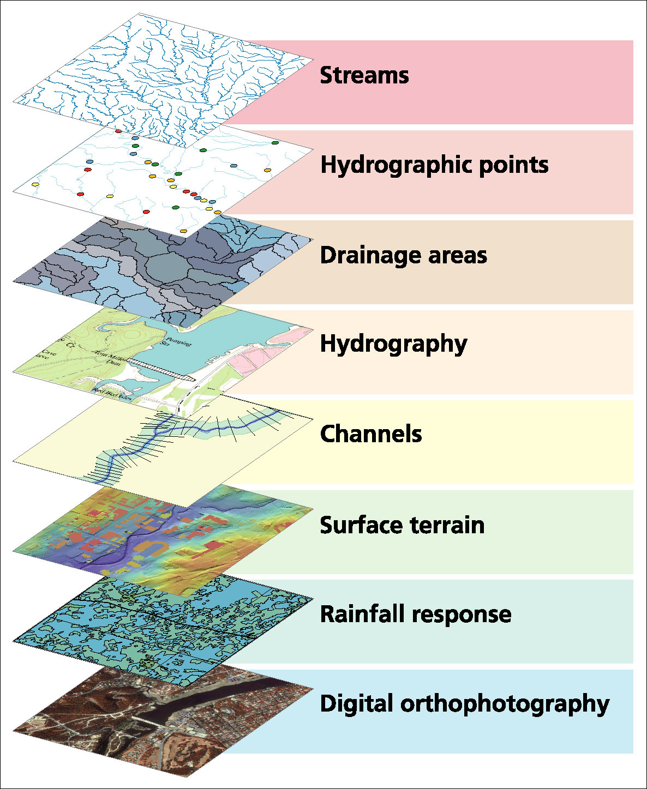
Data Model based on Inventory of data layers

Slide 9
Spatial Data: Vector format
Vector data are defined spatially:
(x₁,y₁)
Point - a pair of x and y coordinates
vertex
Line - a sequence of points
Node
Polygon - a closed set of lines
Notes:
DRM

Slide 10
Themes or Data Layers
Vector data: point, line or polygon features

Slide 11
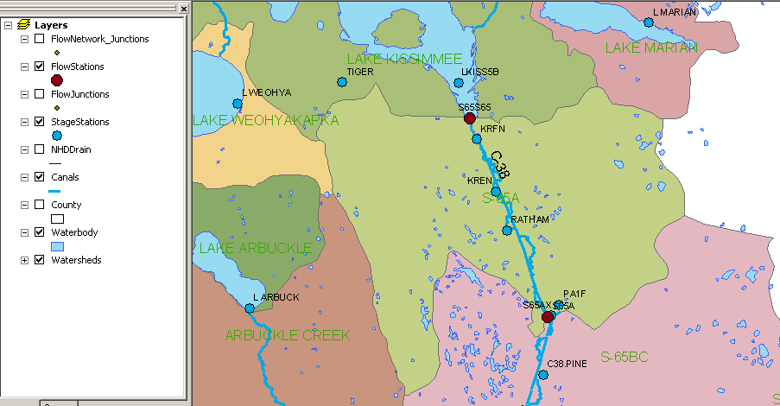
Kissimmee watershed, Florida
Themes

Slide 12
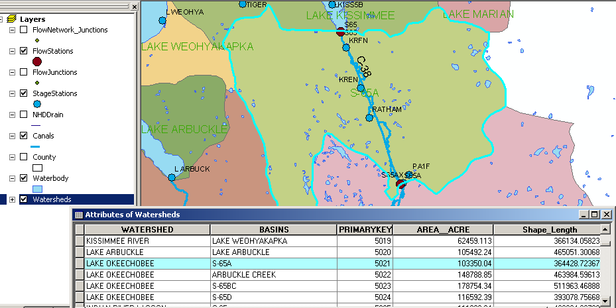
Attributes of a Selected Feature

Slide 13
Raster and Vector Data
Raster data are described by a cell grid, one value per cell
Vector
Raster
Point
Line
Zone of cells
Polygon
Notes:
DRM

Slide 14

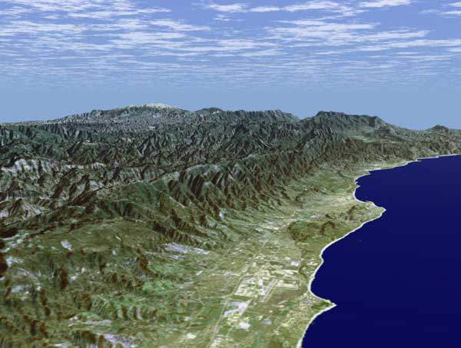
Santa Barbara, California
http://srtm.usgs.gov/srtmimagegallery/index.html

Slide 15
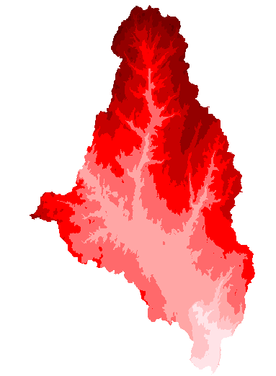
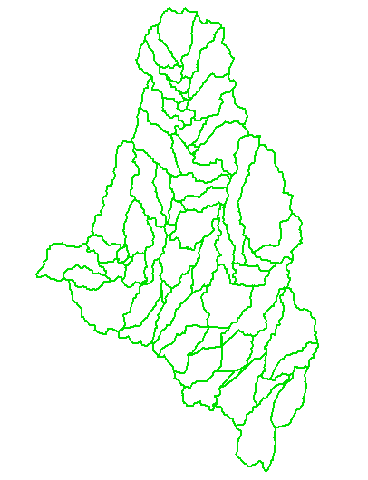
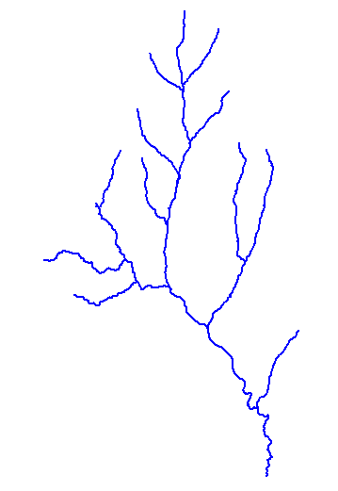
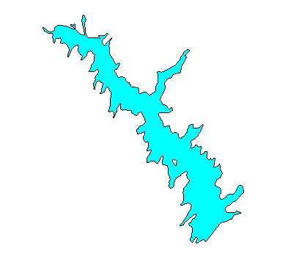
How do we combine these data?
Digital Elevation
Models
Watersheds
Streams
Waterbodies

Slide 16
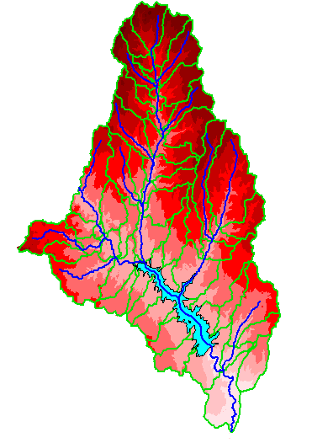
An integrated raster-vector database

Slide 17
GIS in Water Resources: Lecture 1
In-class and distance learning
Geospatial database of hydrologic features
GIS and HIS
Curved earth and a flat map

Slide 18
Linking Geographic Information Systems and Water Resources
Water
Resources
GIS

Slide 19
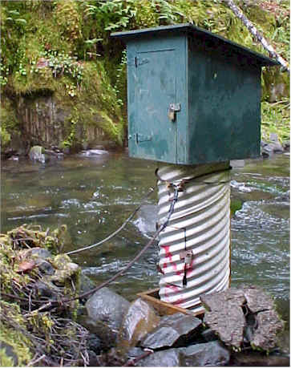
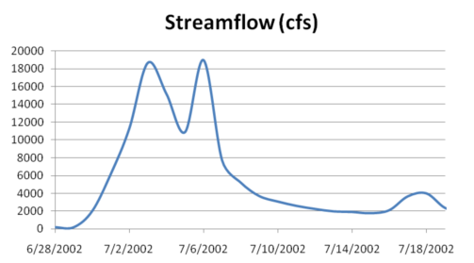
Point Water Observations Time Series
A point location in space
A series of values in time

Slide 20
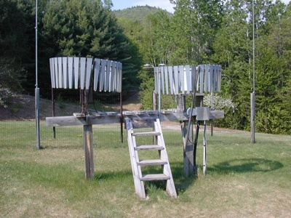
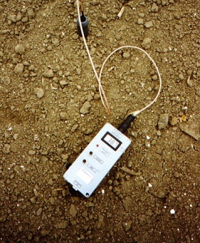
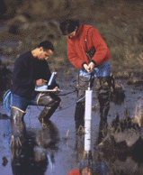
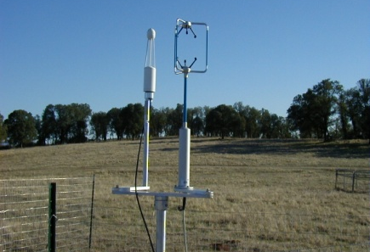
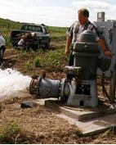
This System Integrates
Many Types of Water Observations Data
Water quantity
Rainfall
Soil water
Water quality
Meteorology
Groundwater

Slide 21

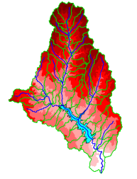

A Key Challenge
How to connect water environment with water observations
GIS
Water Environment
(Watersheds, streams,
gages, sampling points)
Time Series Data
Water Observations
(Flow, water level
concentration)

Slide 22
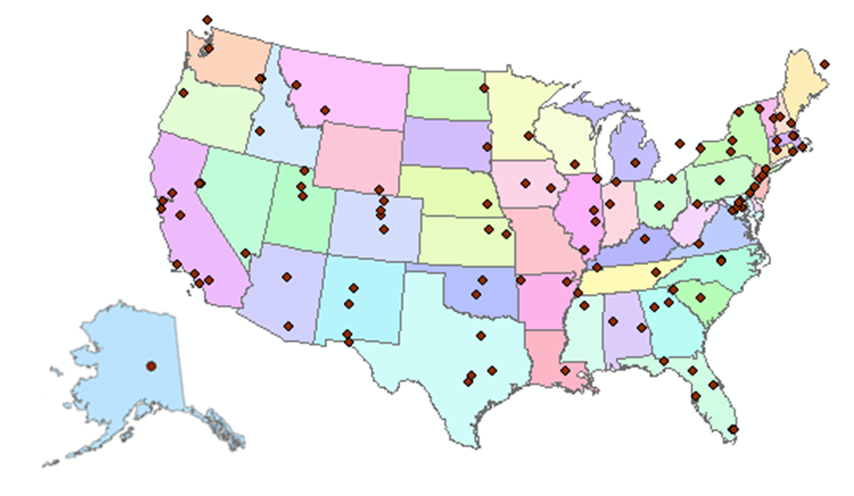
CUAHSI Member Institutions
122 Universities as of August 2009

Slide 23
Hydrologic Information System Goals
Data Access – providing better access to a large volume of high quality hydrologic data;
Hydrologic Observatories – storing and synthesizing hydrologic data for a region;
Hydrologic Science – providing a stronger hydrologic information infrastructure;
Hydrologic Education – bringing more hydrologic data into the classroom.

Slide 24
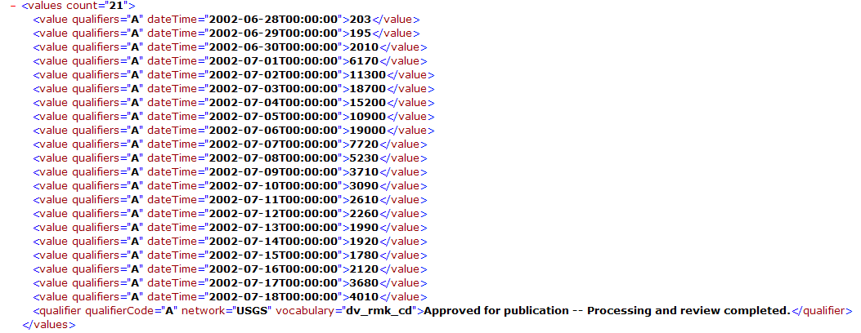
This is Enabled by WaterML
A Web Language for Water Observations Data
GetValues Response in WaterML
. . .Adopted by USGS, and other agencies for Publishing Some of their Data

Slide 25
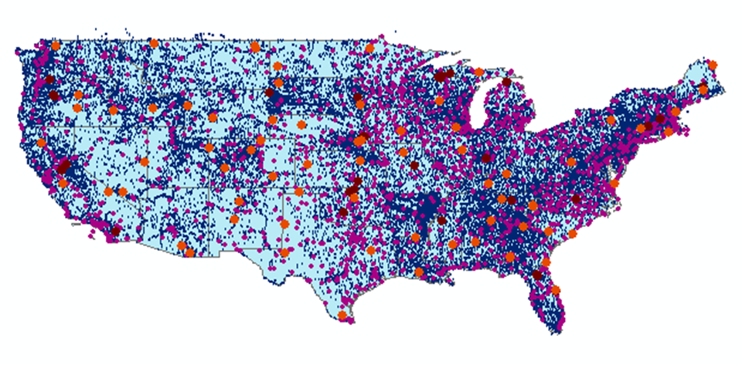
The CUAHSI Data Catalog Integrates
Multi Source Water Data Services
Map Integrating NWIS, STORET, & Climatic Sites
47 services
15,000 variables
1.8 million sites
9 million series
4.3 billion data Values
. . . The Worlds Largest Water Data Catalog

Slide 26
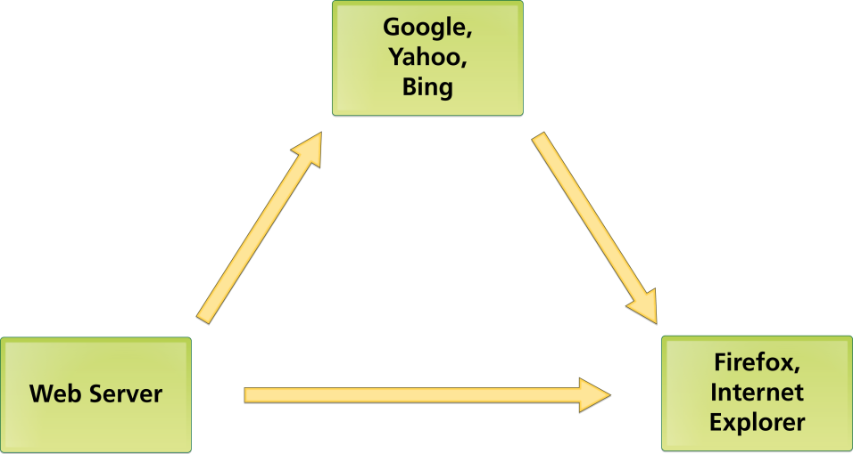
Three Basic Internet Components: Catalog, Server, User Linked by HTML
Catalog
HTML
Server
User

Slide 27
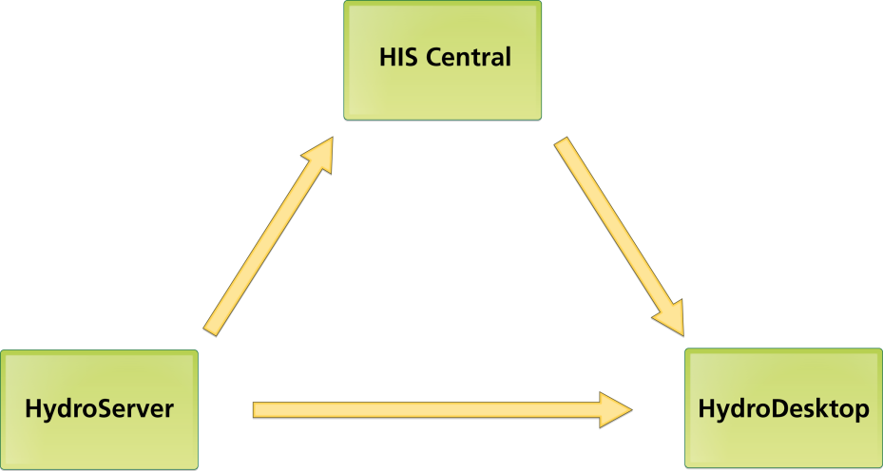
CUAHSI HIS Components Linked by WaterML
Catalog
WaterML
Server
User

Slide 28
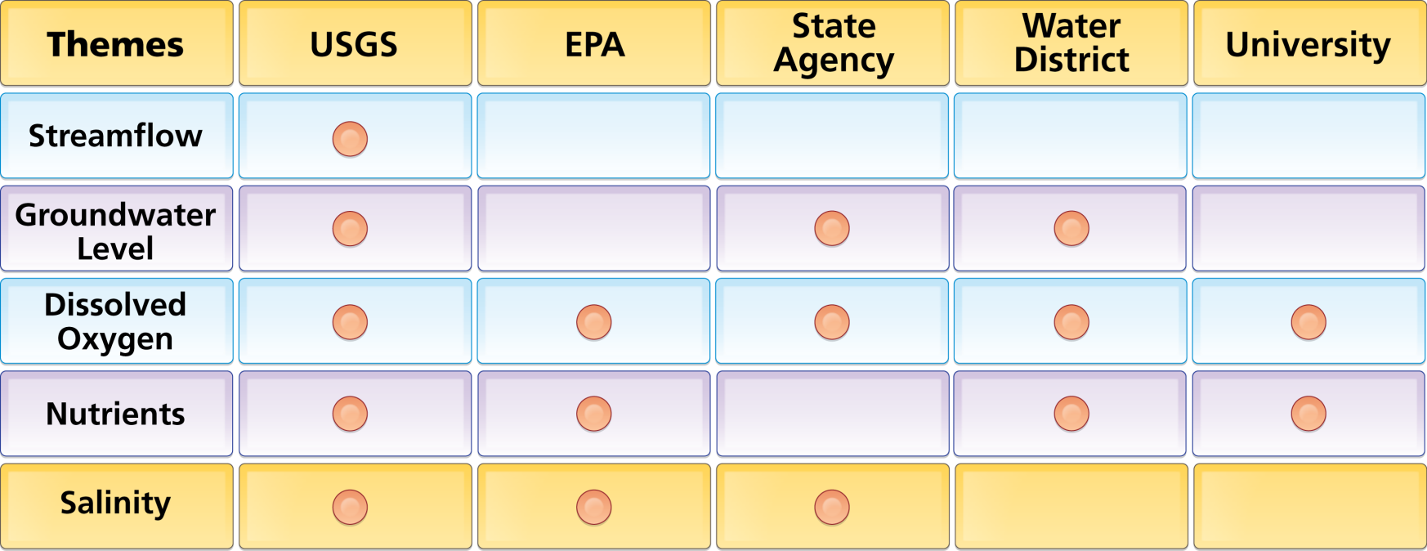
Organize Water Data Into “Themes”
Integrating Water Data Services From Multiple Agencies
. . . Across Groups of Organizations

Slide 29
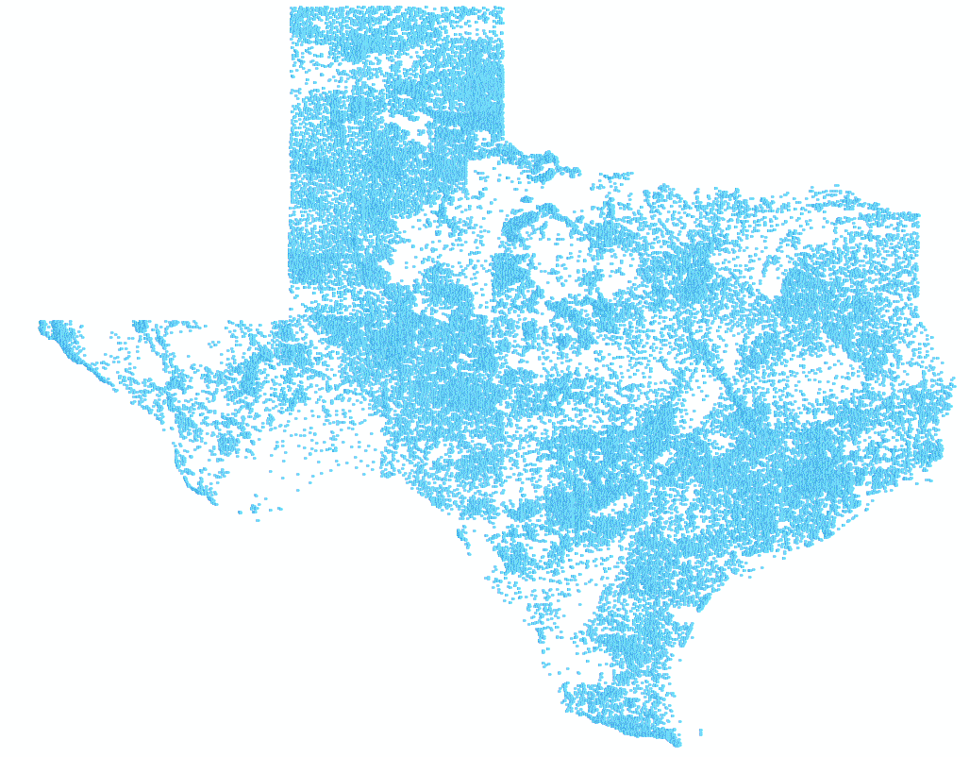
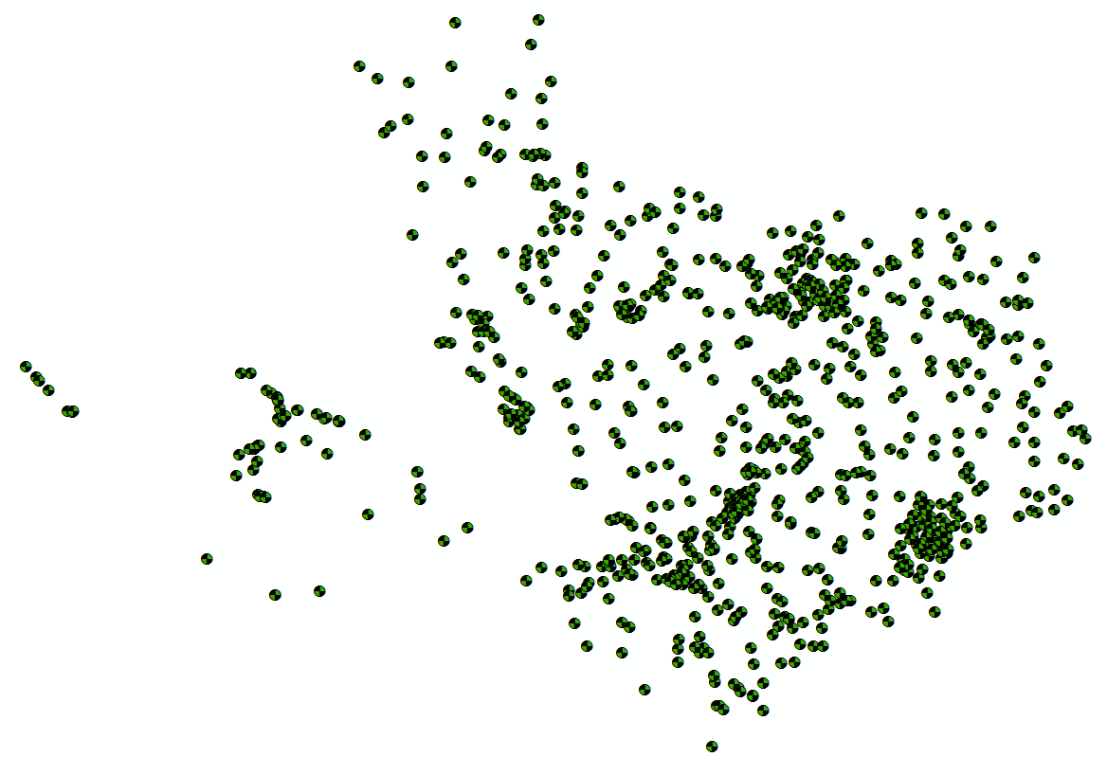
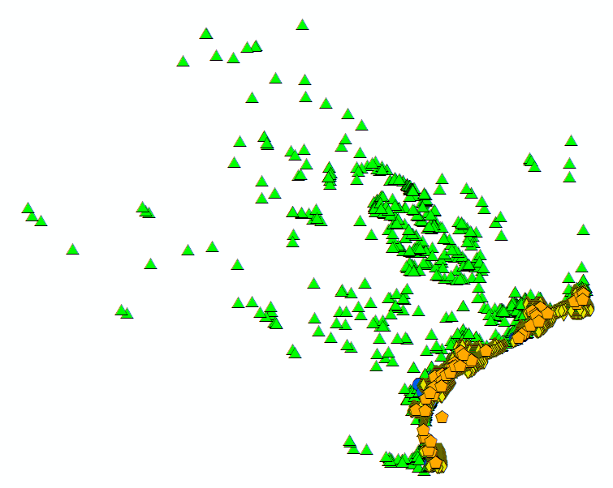
Bringing Water Into GIS
Thematic Maps of Water Observations as GIS Layers
Groundwater
Streamflow
Salinity
Unified access to water data in Texas ….

Slide 30
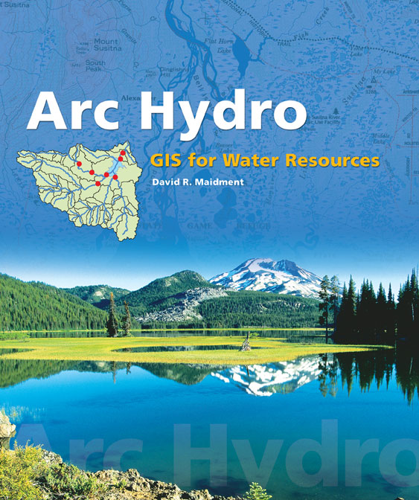
Arc Hydro: GIS for Water Resources
Published in 2002, now in revision for Arc Hydro II
Arc Hydro
  An ArcGIS data model for water resources
  Arc Hydro toolset for implementation
  Framework for linking hydrologic simulation models
The Arc Hydro data model and
application tools are in the public
Domain.

Slide 31
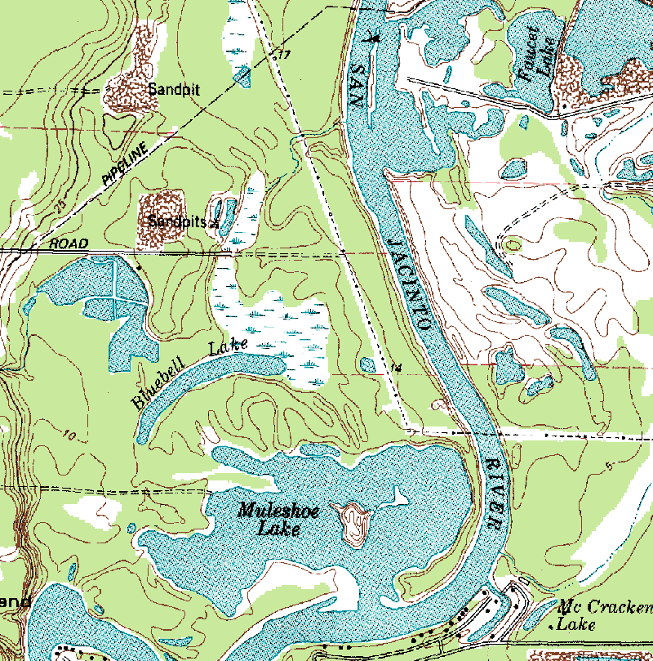
Arc Hydro — Hydrography
The blue lines on maps

Slide 32
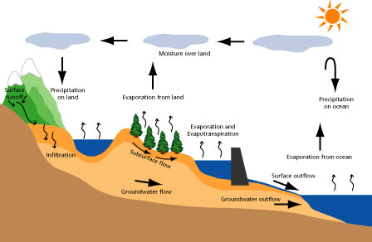
Arc Hydro — Hydrology
The movement of water through the hydrologic system

Slide 33
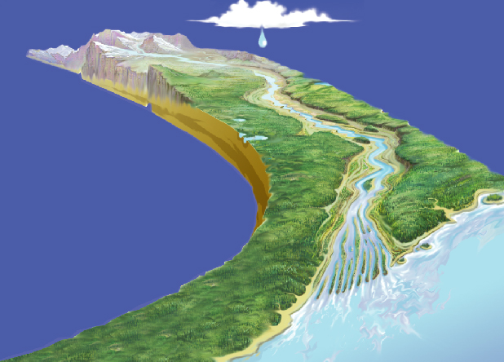
Integrating Data Inventory using a Behavioral Model
Relationships between
objects linked by tracing path
of water movement

Slide 34
Arc Hydro Components
Drainage System
Hydro Network
Flow
Time
Time Series
Hydrography
Channel System

Slide 35
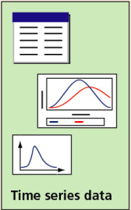
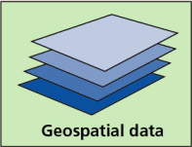
Hydrologic Information System
Analysis, Modeling,
Decision Making
Arc Hydro
Geodatabase
A synthesis of geospatial and temporal data supporting hydrologic analysis and modeling

Slide 36
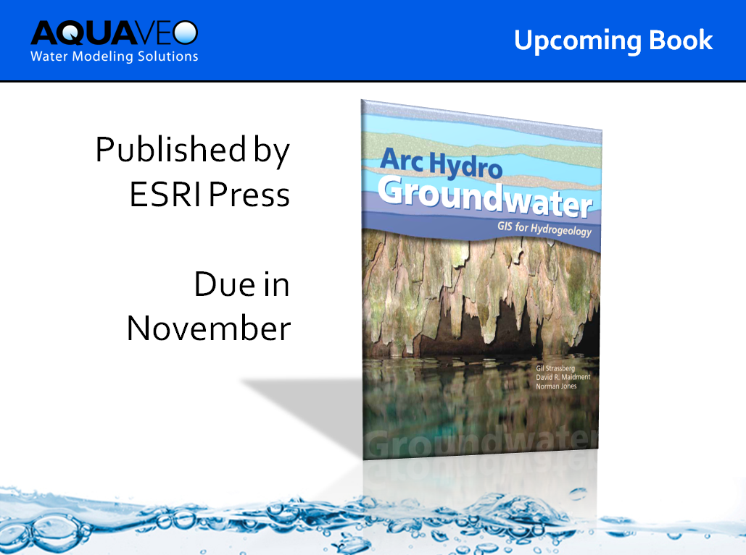

Slide 37
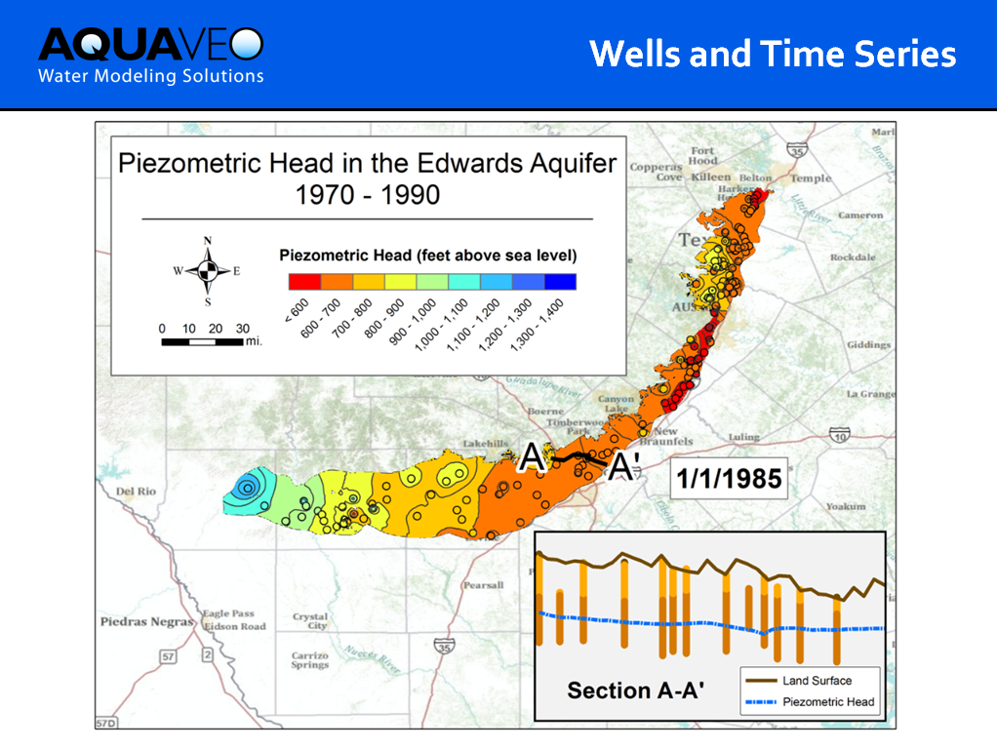

Slide 38
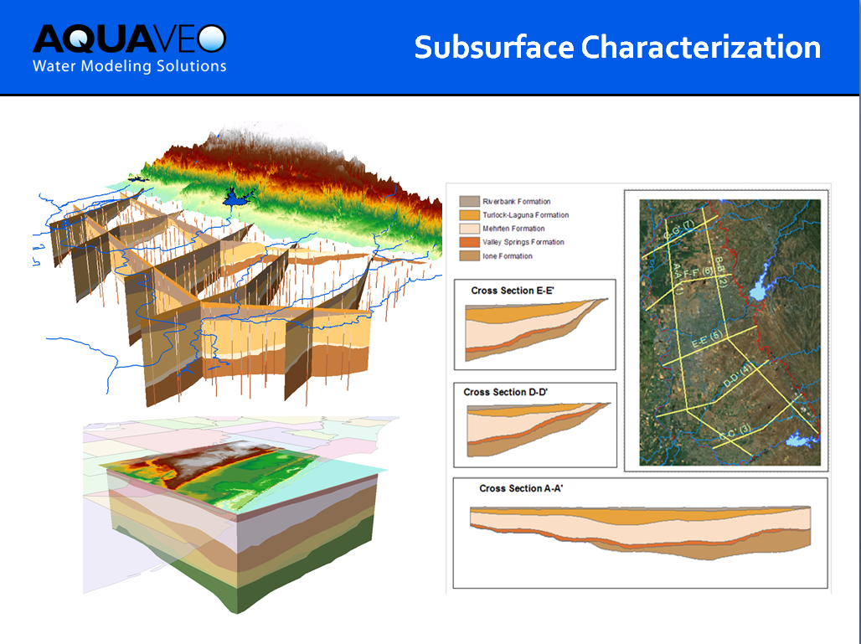

Slide 39
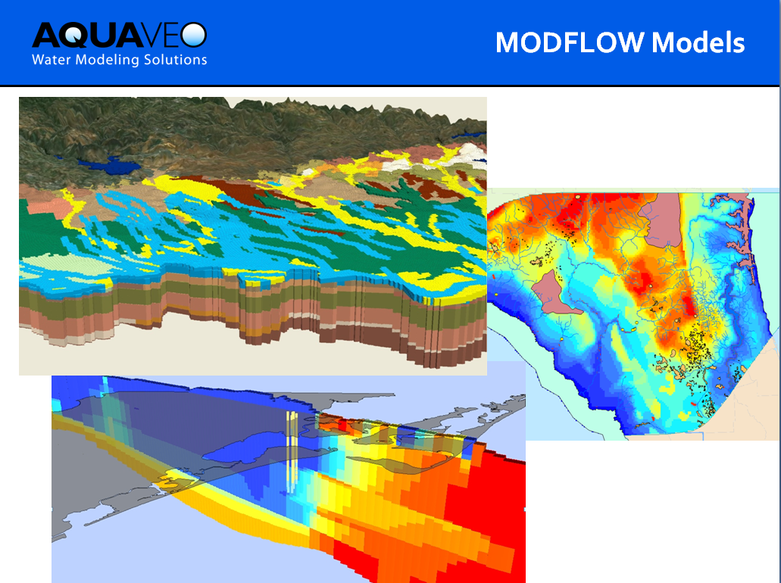

Slide 40
GIS in Water Resources: Lecture 1
In-class and distance learning
Geospatial database of hydrologic features
GIS and HIS
Curved earth and a flat map

Slide 41
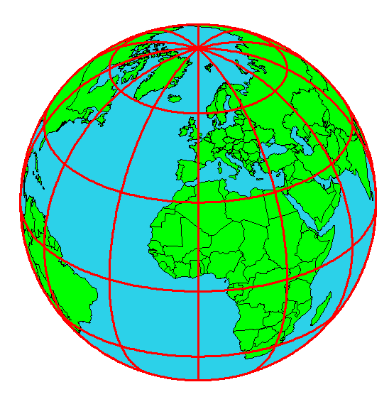
Origin of Geographic Coordinates
Equator
(0,0)
Prime Meridian

Slide 42
Latitude and Longitude
Longitude line (Meridian)
N
W
E
S
Range: 180ºW - 0º - 180ºE
Latitude line (Parallel)
N
W
E
S
(0ºN, 0ºE)
Equator, Prime Meridian
Range: 90ºS - 0º - 90ºN

Slide 43
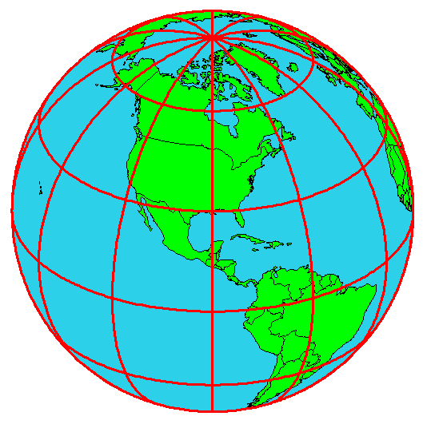
Latitude and Longitude in North America
40 50 59 96 45 0
Austin:
Logan:
Lincoln:
(30°18' 22" N, 97°45' 3" W)
60 N
30 N
(41°44' 24" N, 111°50' 9" W)
120 W
60 W
90 W
0 N
(40°50' 59" N, 96°45' 0" W)

Slide 44
Map Projection
Flat Map
Cartesian coordinates: x,y
(Easting & Northing)
Curved Earth
Geographic coordinates: φ, λ
(Latitude & Longitude)
Notes:
DRM

Slide 45
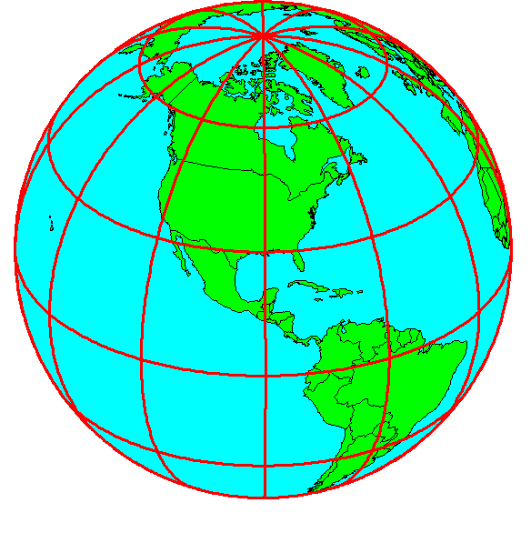
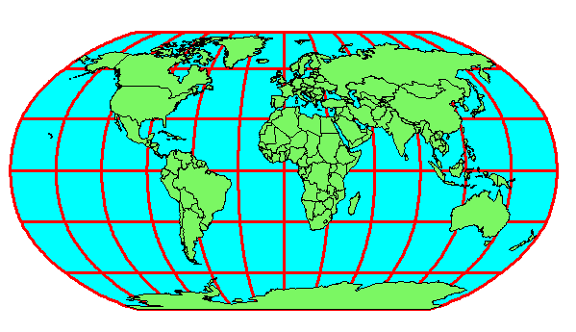
Earth to Globe to Map
Map Scale:
Map Projection:
Representative Fraction
Globe distance
Earth distance
Scale Factor
Map distance
Globe distance
=
=
(e.g. 1:24,000)
(e.g. 0.9996)

Slide 46
Coordinate Systems
A planar coordinate system is defined by a pair
of orthogonal (x,y) axes drawn through an origin
Y
Origin
X
(x_{o},y_{o})
(φ_{o},λ_{o})

Slide 47
Summary (1)
GIS in Water Resources is about empowerment through use of information technology – helping you to understand the world around you and to investigate problems of interest to you
This is an “open class” in every sense where we learn from one another as well as from the instructors

Slide 48
Summary (2)
GIS offers a structured information model for working with geospatial data that describe the “water environment” (watersheds, streams, lakes, land use, ….)
Water resources also needs observations and modeling to describe “the water” (discharge, water quality, water level, precipitation)

Slide 49
Summary (3)
A Hydrologic Information System depends on water web services and integrates spatial and temporal water resources data
Geography “brings things together” through georeferencing on the earth’s surface
Understanding geolocation on the earth and working with geospatial coordinate systems is fundamental to this field

