Slide 1
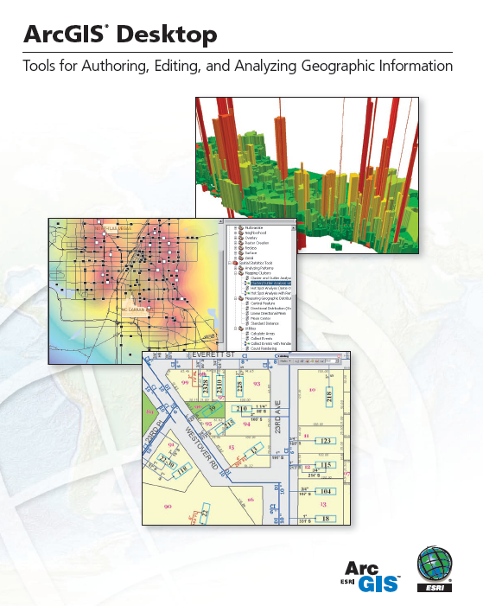
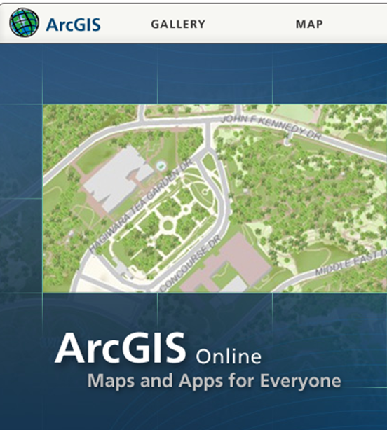
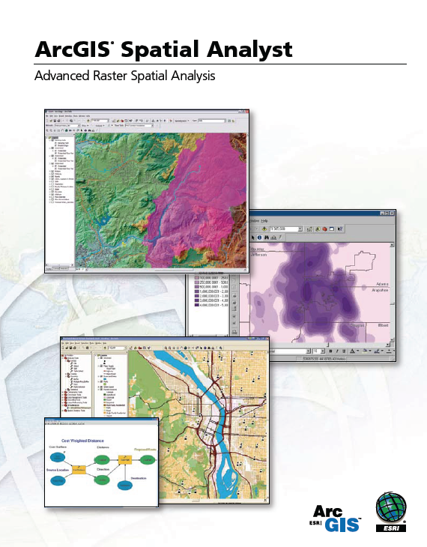
Introduction to ArcGIS Software

Slide 2
ESRI Online Reference Materials
ArcGIS summary: http://www.esri.com/library/brochures/pdfs/arcgis.pdf
ArcGIS Desktop summary: http://www.esri.com/library/brochures/pdfs/arcgis-desktop.pdf
Spatial Analyst summary: http://www.esri.com/library/brochures/pdfs/spatialanalystbro.pdf
ESRI Virtual Campus – provides online training http://campus.esri.com/
The first three items are readings for this class

Slide 3
ArcGIS Online http://www.argis.com
Description: http://www.esri.com/software/arcgis/arcgisonline/index.html
Videos: http://www.esri.com/software/arcgis/arcgisonline/demos.html
Please familiarize yourself with this information

Slide 4
Introduction to GIS Software
How data are stored in ArcGIS
Components of ArcGIS – ArcMap, ArcCatalog and ArcToolbox
GIS on the Web – ArcGIS Server, ArcGIS Online, Google Earth.
Extensions of ArcGIS – spatial analyst, geostatistical analyst and 3D analyst

Slide 5
ESRI GIS Development
Arc/Info (coverage model)
Versions 1-7 from 1980 – 1999
Arc Macro Language (AML)
160,000 licenses
1,200,000 users as of 2009
ArcGIS (geodatabase model)
Version 8.0, …, 10.0 from 2000 – Python scripting
ArcView (shapefile model)
Versions 1-3 from 1994 – 1999
Avenue scripting language

Slide 6
Geographic Data Models
All geographic information systems are built using formal models that describe how things are located in space. A formal model is an abstract and well-defined system of concepts. A geographic data model defines the vocabulary for describing and reasoning about the things that are located on the earth. Geographic data models serve as the foundation on which all geographic information systems are built.
Scott Morehouse, Preface to “Modeling our World”

Slide 7
Data Models
A geographic data model is a structure for organizing geospatial data so that it can be easily stored and retrieved.
Geographic coordinates
Tabular attributes

Slide 8
File-based Data Models
Geographic coordinates and attributes
are stored in separate but linked files
Arc
Info
Coverages
  Developed for workstation Arc/Info ~ 1980
  Complex structure, proprietary format
  Attributes in Info tables
Shapefiles
  Developed for ArcView ~ 1993
  Simpler structure in public domain
  Attributes in dBase (.dbf) tables

Slide 9
Storing Data
Coverages
Shapefiles
Texas
Texas
Counties
Counties.shp
Counties.shx
Counties.dbf
Evap
Evap.shp
Evap.shx
Evap.dbf
Info

Slide 10
Storing Data
Coverages and Shapefiles
  Coverages are stored partially in their own folder (ARC) and partially in the common INFO folder. Shapefiles are stored in three to five files (with extensions .shp, .shx, .dbf, .sbx and .sbn).
  Coverages store common boundaries between polygons only once, to avoid redundancy. Shapefiles store all the geometry of each polygon regardless of redundancy.
  Coverage features are single lines or single polygons. Shapefiles allow features to have multiple, disconnected, intersecting and overlapping components.

Slide 11

Geodatabase and Feature Dataset
A geodatabase is a relational database that stores geographic information.
A feature dataset is a collection of feature classes that share the same spatial reference frame.

Slide 12
Geodatabase model
Stores geographic coordinates as one attribute (shape) in a relational database table
Uses MS Access for “Personal Geodatabase” (single user)
Uses Oracle, SQL/Server, dB2 or other commercial relational databases for “Enterprise Geodatabases” (many simultaneous users)
Uses files in “File Geodatabase”
Shape

Slide 13
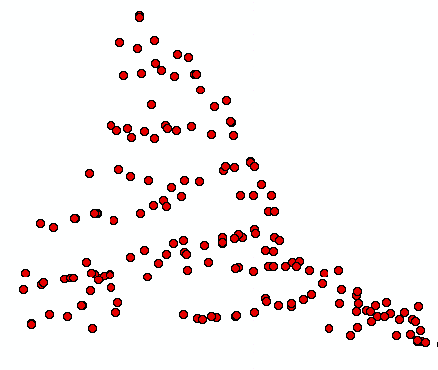
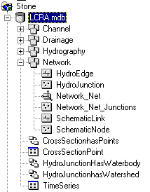
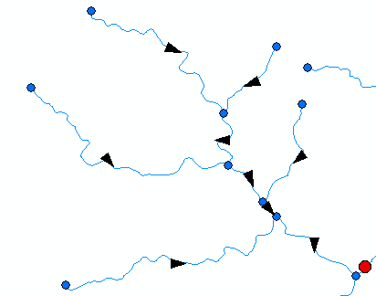
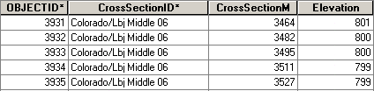
ArcGIS Geodatabase
Workspace
Geodatabase
Feature Dataset
Feature Class
Geometric
Network
Relationship
Object Class

Slide 14
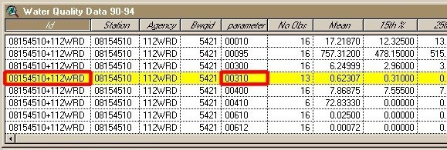
Object Class
An object class is a collection of objects in tabular format that have the same behavior and the same attributes.
An object class is a table that has a unique identifier (ObjectID)
for each record

Slide 15
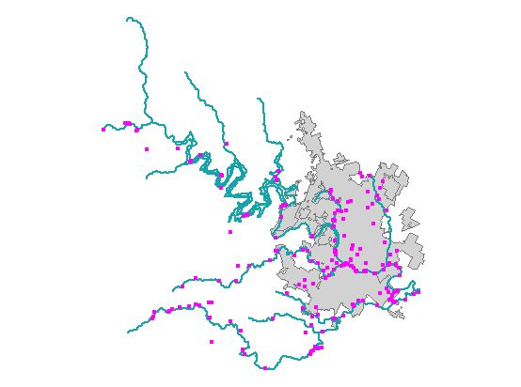
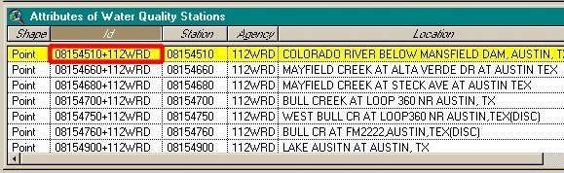
Feature Class
A feature class is a collection of geographic objects in tabular format that have the same behavior and the same attributes.
Feature Class = Object class + spatial coordinates

Slide 16
Relationship
A relationship is an association or link between two objects in a database.
A relationship can exist between spatial objects (features in feature classes), non-spatial objects (objects in object classes), or between spatial and non-spatial objects.

Slide 17
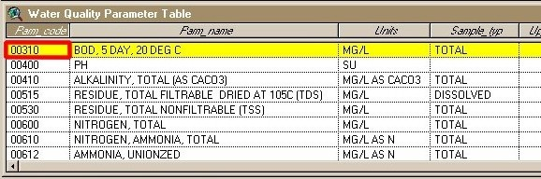
Relationship
Relationship between non-spatial objects
Water
Quality
Data
Water
Quality
Parameters

Slide 18
Relationship
Relationship between spatial and non-spatial objects
Water quality data
(non-spatial)
Measurement station
(spatial)

Slide 19
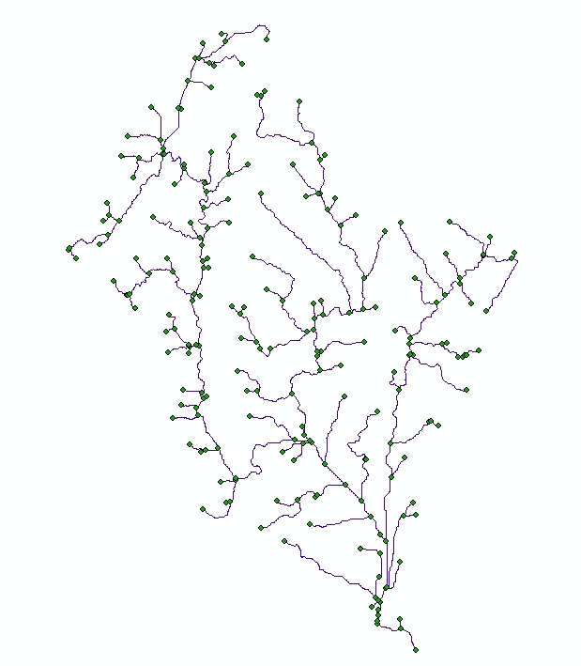
Network
A network is a set of edges (lines) and junctions (points) that are topologically connected to each other.
Each edge knows which junctions are at its endpoints
Each junction knows which edges it connects to

Slide 20
Introduction to GIS Software
How data are stored in ArcGIS
Components of ArcGIS – ArcMap, ArcCatalog and ArcToolbox
GIS on the Web – ArcGIS Server, ArcGIS Online.
Extensions of ArcGIS – spatial analyst, geostatistical analyst and 3D analyst

Slide 21
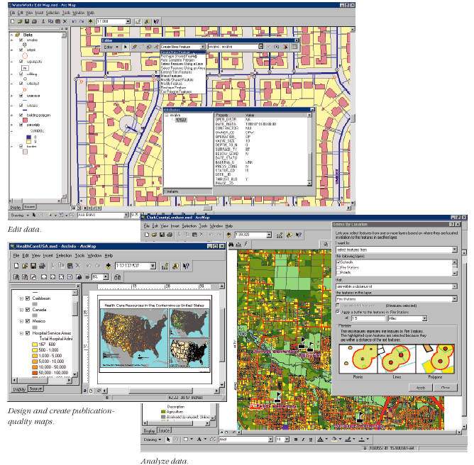
Arc Map
View
and
edit
data
Analyze data
(Geoprocessing)
Create maps

Slide 22
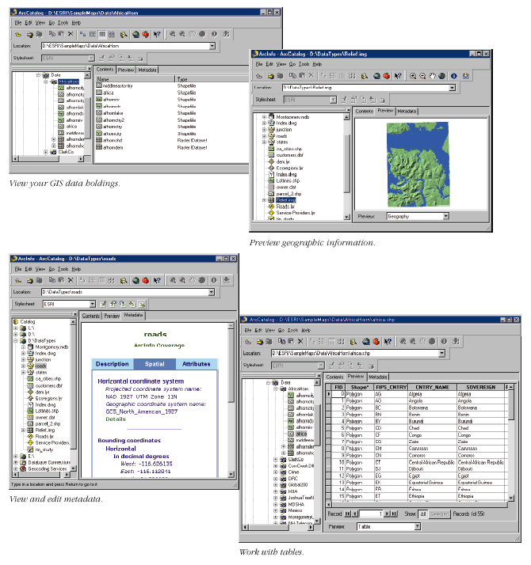
Arc Catalog
Graphical
previews
View data
(like Windows Explorer)
Tables
Metadata

Slide 23
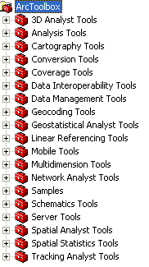
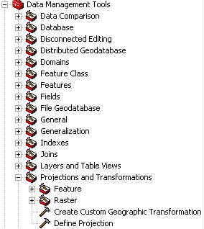
Arc Toolbox
Tools for commonly used tasks
Map Projections

Slide 24
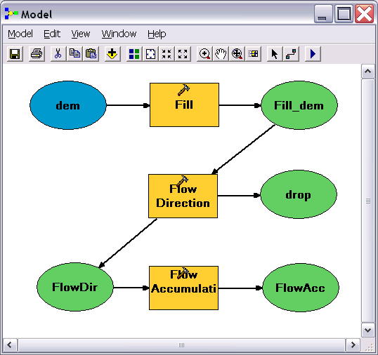
Geo-Processing
Toolbox tools linked together using the model builder to automate data processing

Slide 25
Levels of ArcGIS
ArcView – View data and do edits on shape files and simple personal geodatabases
ArcEditor – do more complex edits on enterprise geodatabases
ArcInfo – the full system, with access to workstation ArcInfo (i.e. ArcInfo version 7) as well

Slide 26
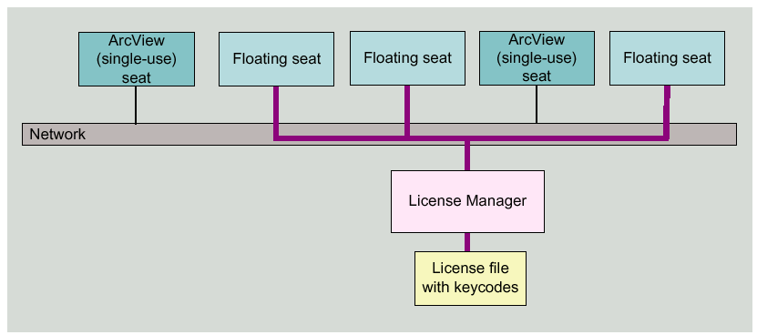
License manager
The license manager keeps track of number of simultaneous users and limits them to allowable number. If you can’t get an available license in LRC, ask the proctor to restart the ArcGIS license manager. At USU contact Paul Rew to get the license manager restarted paul.rew@usu.edu. At UNL Jim Hines (472-6708, jhines2@unl.edu ) or Gregg Hutchison (472-5436) at room 226 is the contact person to restart the ArcGIS license manager.

Slide 27
Introduction to GIS Software
How data are stored in ArcGIS
Components of ArcGIS – ArcMap, ArcCatalog and ArcToolbox
GIS on the Web – ArcGIS Server, ArcGIS Online, Google Earth.
Extensions of ArcGIS – spatial analyst, geostatistical analyst and 3D analyst

Slide 28
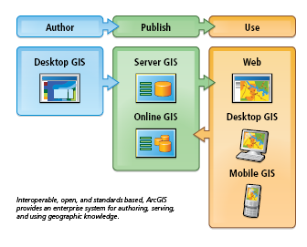
Desktop, Server, Web
Desktop GIS

Slide 29
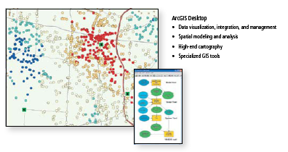
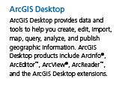
ArcGIS Desktop

Slide 30
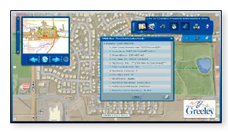
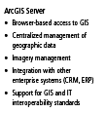
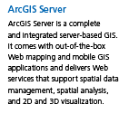
ArcGIS Server

Slide 31
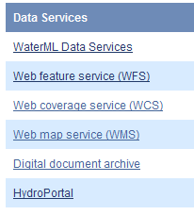

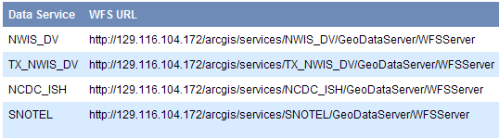
CRWR Data Services http://data.crwr.utexas.edu
Receiving Service in ArcCatalog
Publishing Service in ArcGIS Server

Slide 32







Workstation-centered GIS
Web
ArcGIS
Desktop
Local
Enterprise
Next 4 slides from Scott Morehouse, ESRI

Slide 33
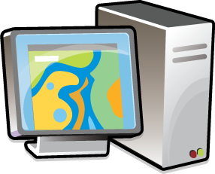
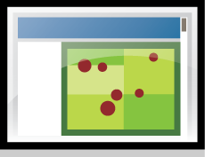


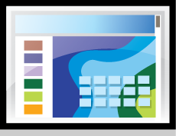




Enterprise-centered GIS
ArcGIS
Server

Slide 34





Web-centered GIS
ArcGIS
Online

Slide 35






An Integrated Systems Approach
ArcGIS
Online
ArcGIS
Desktop
ArcGIS
Server

Slide 36
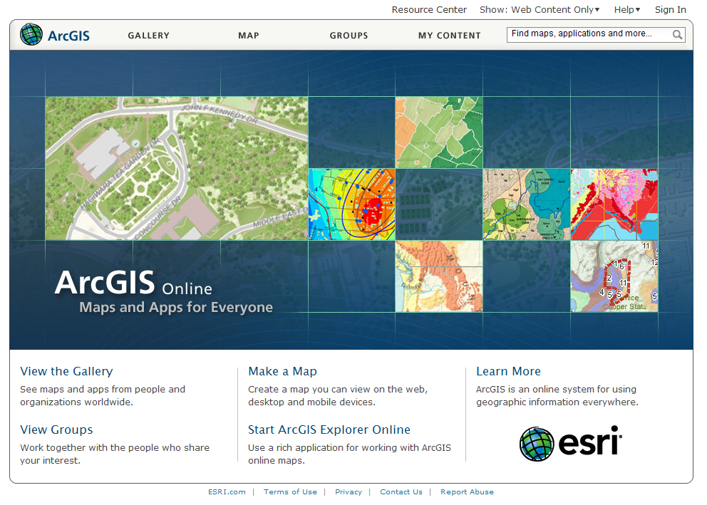

Slide 37
Multiscale Tiled Images
Small Scale: Little detail, broad coverage
1:1,000,000
Large Scale: Great detail, narrow coverage
1:1,000

Slide 38
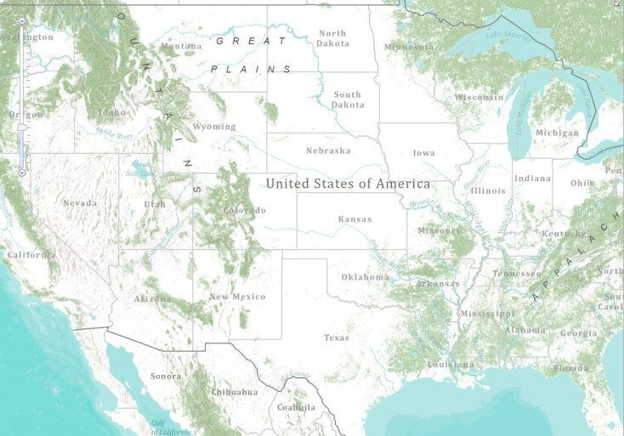
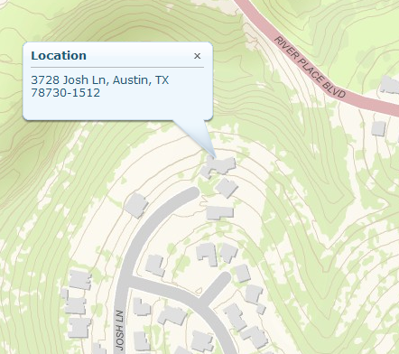
World Topographic Base Map
Cartographic map built from GIS data
With content added by the City of Austin

Slide 39
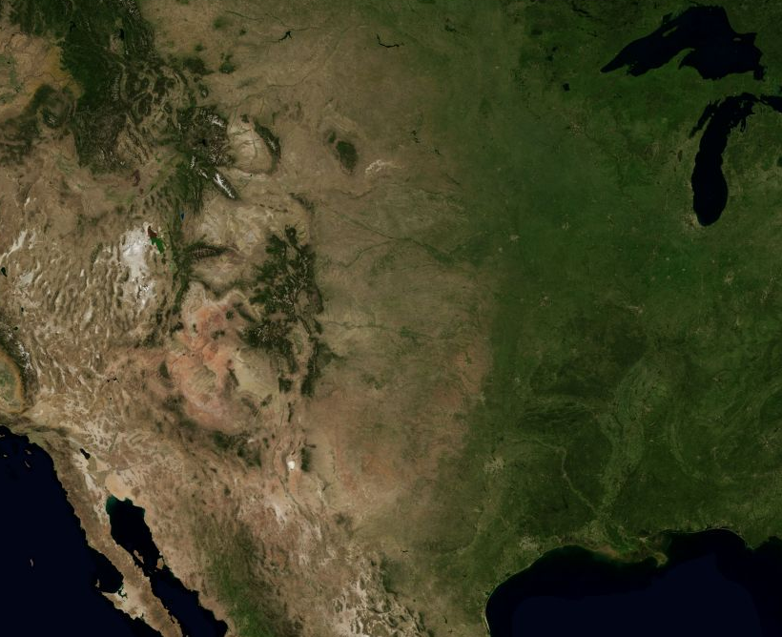
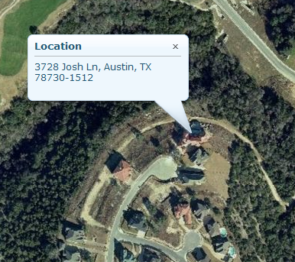
Bing Maps in ArcGIS.com

Slide 40
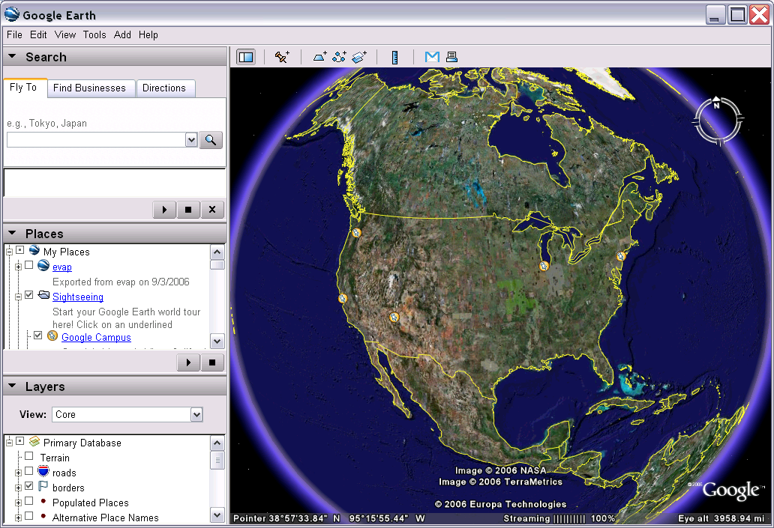
Google Earth Geographic Web Browser
http://earth.google.com/

Slide 41
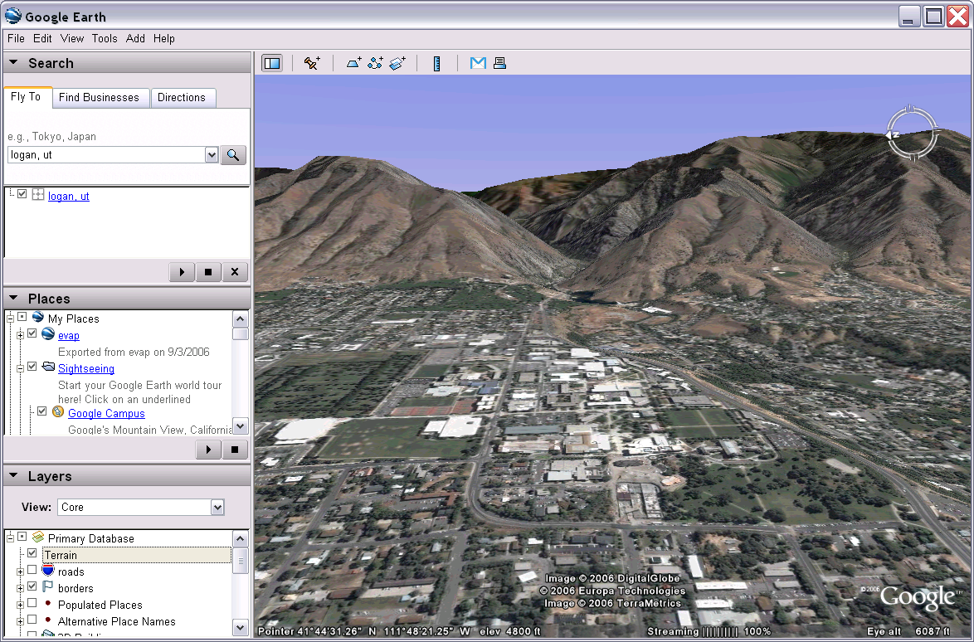
Google Earth 3D With Terrain

Slide 42
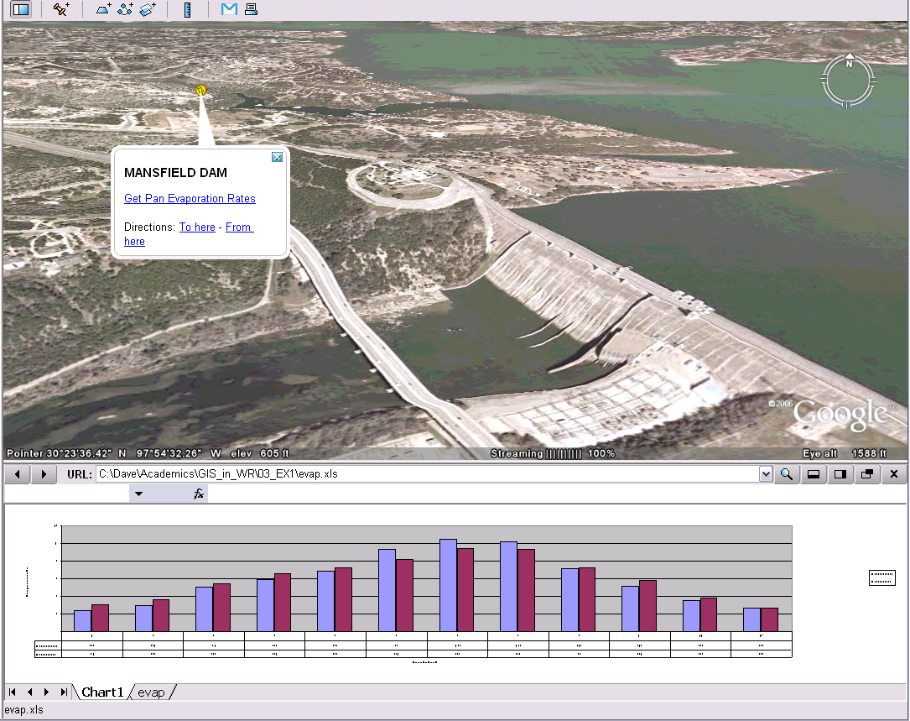
Adding data to Google Earth

Slide 43
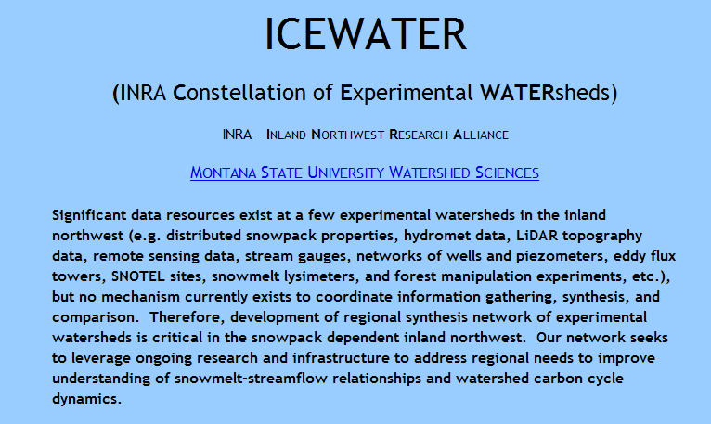
Experimental Watershed Data
http://watershed.montana.edu/ICEWATER/

Slide 44
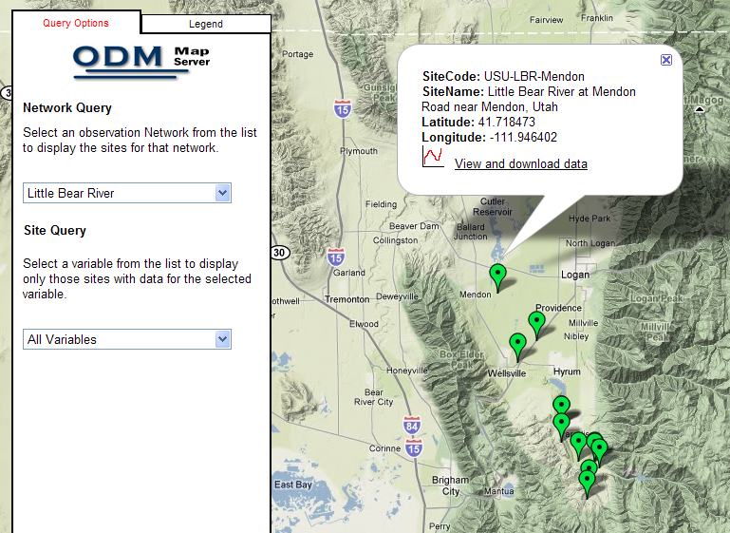
Observations Data and Google Earth
http://odm.usu.edu/odmmap/default.aspx?NetworkName=Little Bear River

Slide 45
Introduction to GIS Software
How data are stored in ArcGIS
Components of ArcGIS – ArcMap, ArcCatalog and ArcToolbox
GIS on the Web – ArcGIS Server, ArcGIS Online, Google Earth.
Extensions of ArcGIS – spatial analyst, geostatistical analyst and 3D analyst

Slide 46
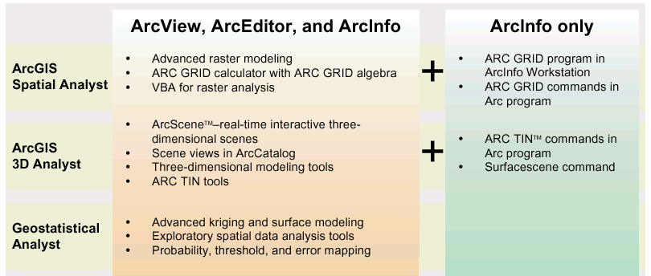
ArcGIS Extensions

Slide 47
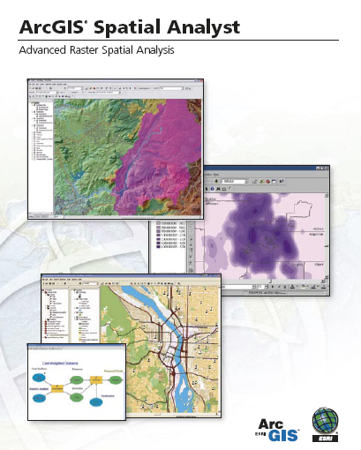
Spatial Analyst
Analysis of land surface terrain as a grid
Key means of defining drainage areas and connectivity to stream network

Slide 48

Grid Datasets
Cellular-based data structure composed of square cells of equal size arranged in rows and columns.
The grid cell size and extension (number of rows and columns), as well as the value at each cell have to be stored as part of the grid definition.
Number of columns
Cell size
Number of rows

Slide 49
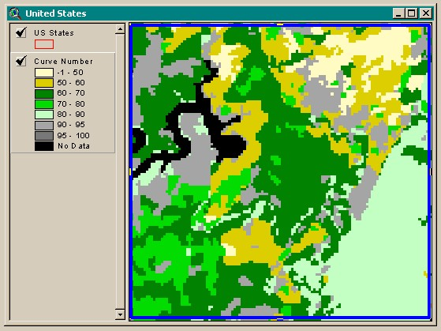
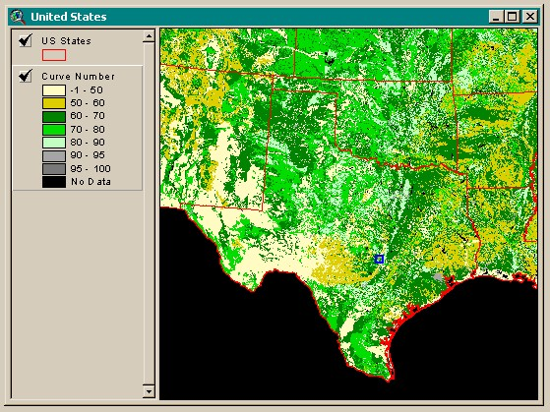
Grid Datasets
Grid datasets

Slide 50
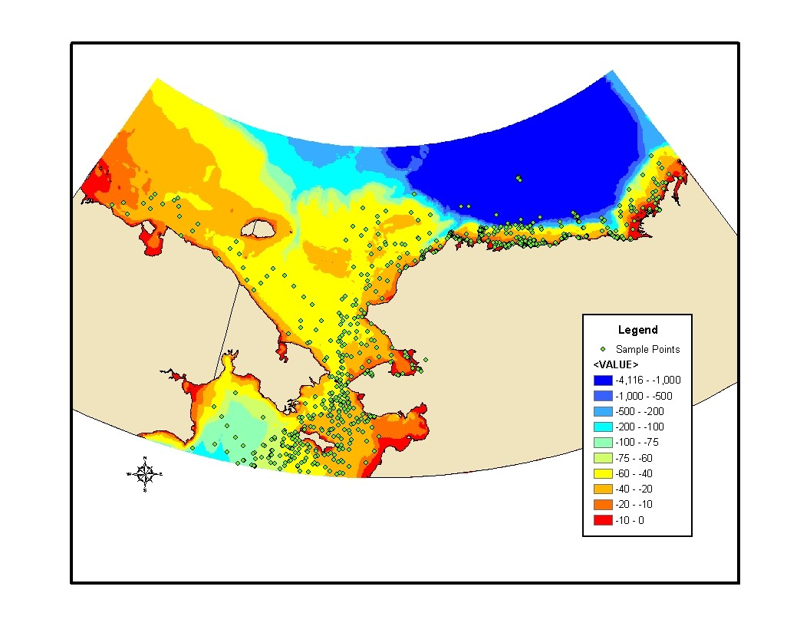
Geostatistical Analyst
Interpolation of points to a grid using statistical correlation
Produces a standard error of estimate of each map location
Siberia
Alaska
Biomass in the Arctic Ocean

Slide 51
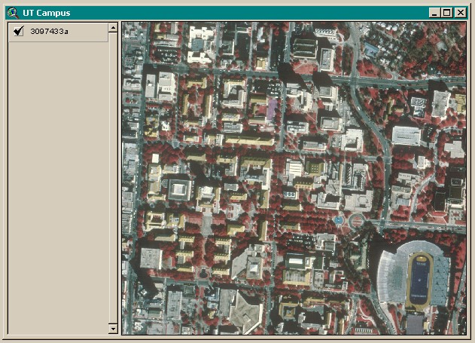
Image Datasets
Digital Orthophotos and satellite imagery
Image datasets

Slide 52
Image Datasets
Supported image formats:
  ARC Digitized Raster Graphics (ADRG)
  Windows bitmap images (BMP) [.bmp]
  Multiband (BSQ, BIL and BIP) and single band images [.bsq, .bil and .bip]
  ERDAS [.lan and .gis]
  ESRI Grid datasets
  IMAGINE [.img]
  IMPELL Bitmaps [.rlc]
  Image catalogs
  JPEG [.jpg]
  MrSID [.sid]
  National Image Transfer Format (NITF)
  Sun rasterfiles [.rs, .ras and .sun]
  Tag Image File Format (TIFF) [.tiff, .tif and .tff]
  TIFF/LZW

Slide 53
3-D Analyst
Analysis of land surface terrain as triangulated irregular network (TIN)
Visualization in 3-D using Arc Scene
Stream channel of Pecan Bayou, TX

Slide 54
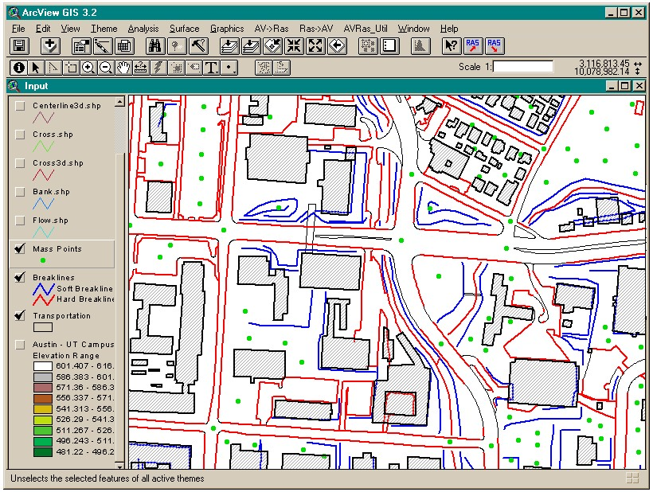
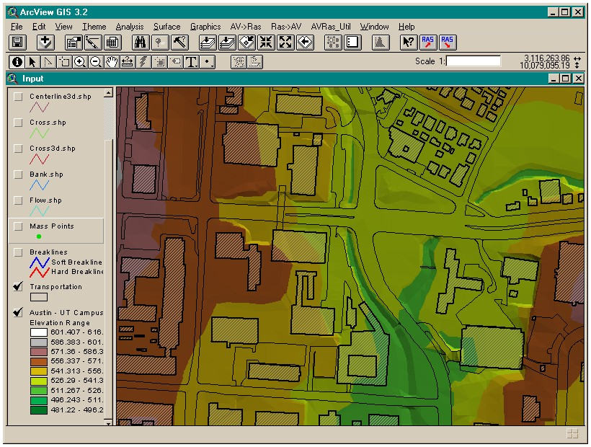
TIN Datasets
TIN datasets
Points and breaklines from which a TIN is constructed.

Slide 55
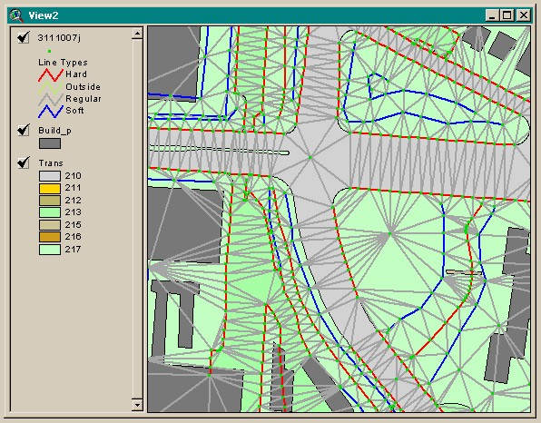
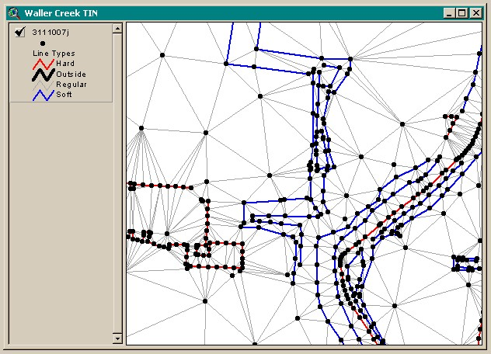
TIN Datasets
Triangle sides are constructed by connecting adjacent points so that the minimum angle of each triangle is maximized. Triangle sides cannot cross breaklines.
The TIN format is efficient to store data because the resolution adjusts to the parameter spatial variability.

Slide 56
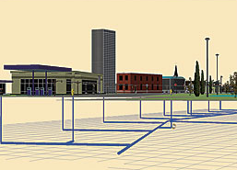

Multipatch features
3D surfaces as collections of triangles

Slide 57
Tracking Analyst
Produces animated maps and display files for space-time data

Slide 58
Summary (1)
Three core data representations for vector data: coverage (ArcInfo), shapefile (ArcView) and geodatabase (ArcGIS). We will emphasize geodatabase in this class
Relationships based on attributes (table fields) or on geometry (networks) are used to connect related geographic features

Slide 59
Summary (2)
ArcGIS Components: ArcMap, ArcCatalog, ArcToolbox
ArcGIS levels: ArcInfo, ArcEditor, ArcView
Desktop, Server and Web-based sources of maps and data
ArcGIS Online – image maps and shared data content

Slide 60
Summary (3)
Google Earth – web-based GIS and KML addons
ArcGIS Extensions: Spatial Analyst, 3D Analyst, Geostatistical Analyst, Tracking Analyst

