Slide 1
Blockhouse Ranch:
A Dam Feasibility Study
Haley Born
November 17, 2011
Notes:
Hi, as Dr. Maidment said my name is Haley Born and today I am going to tell you a little about how I used ArcGIS to esimate the amount of water that could be collected by a dam on Calf Creek.

Slide 2
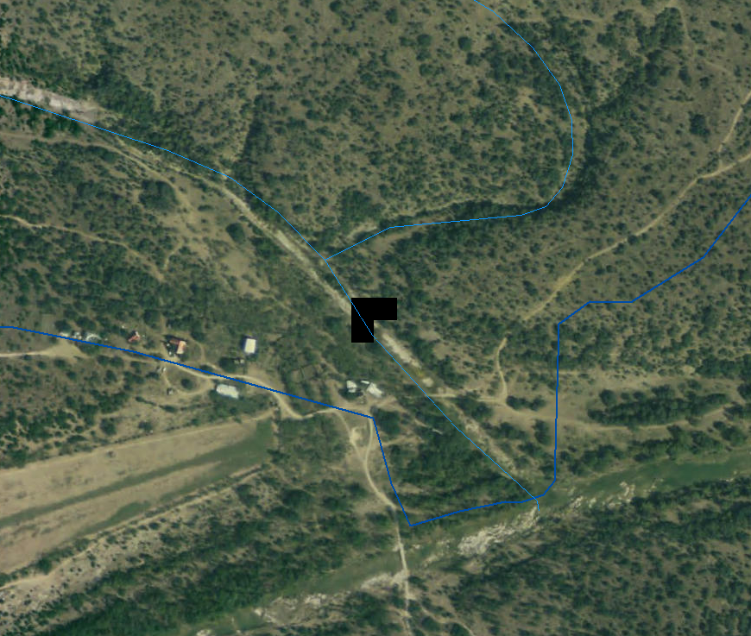
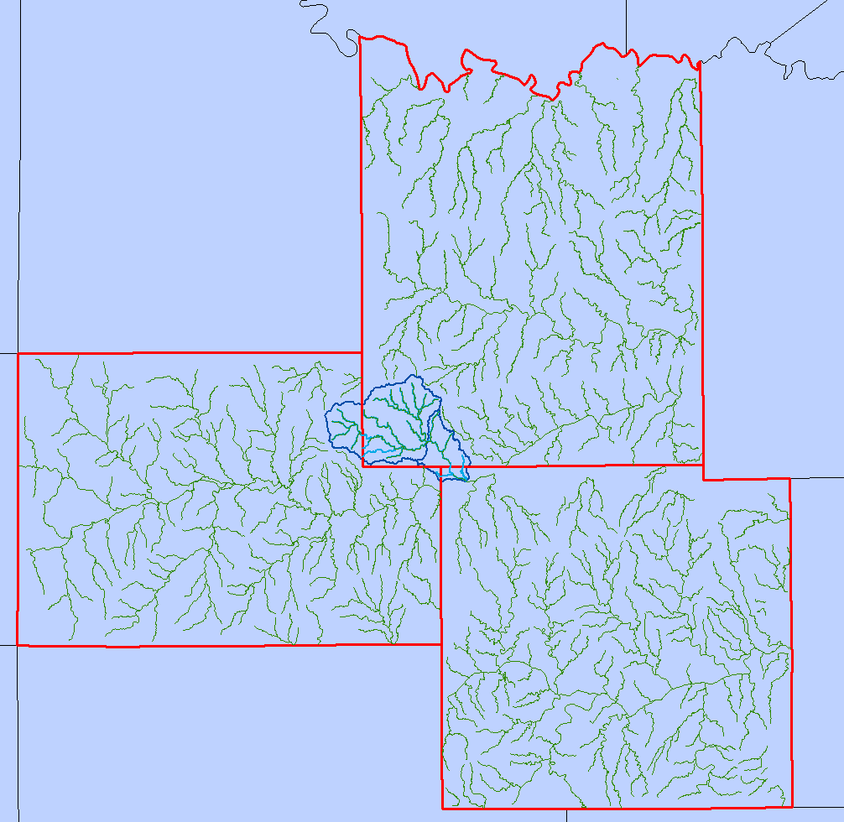
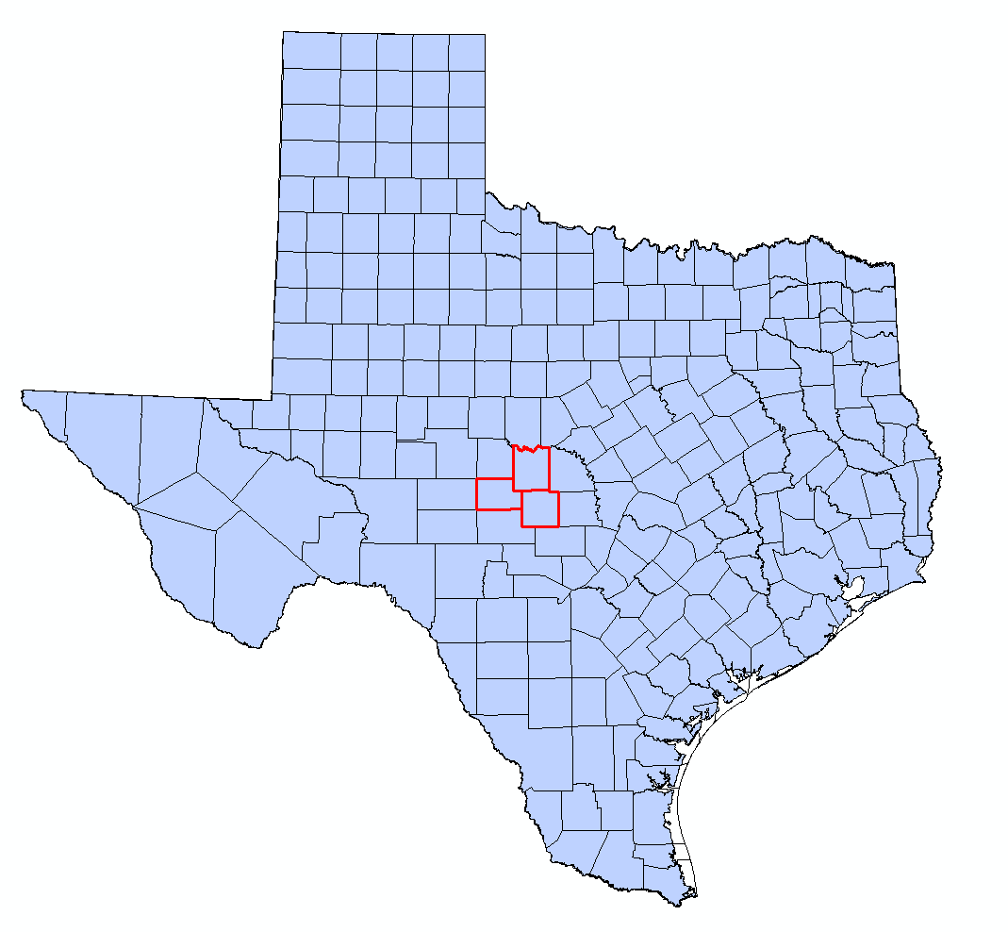
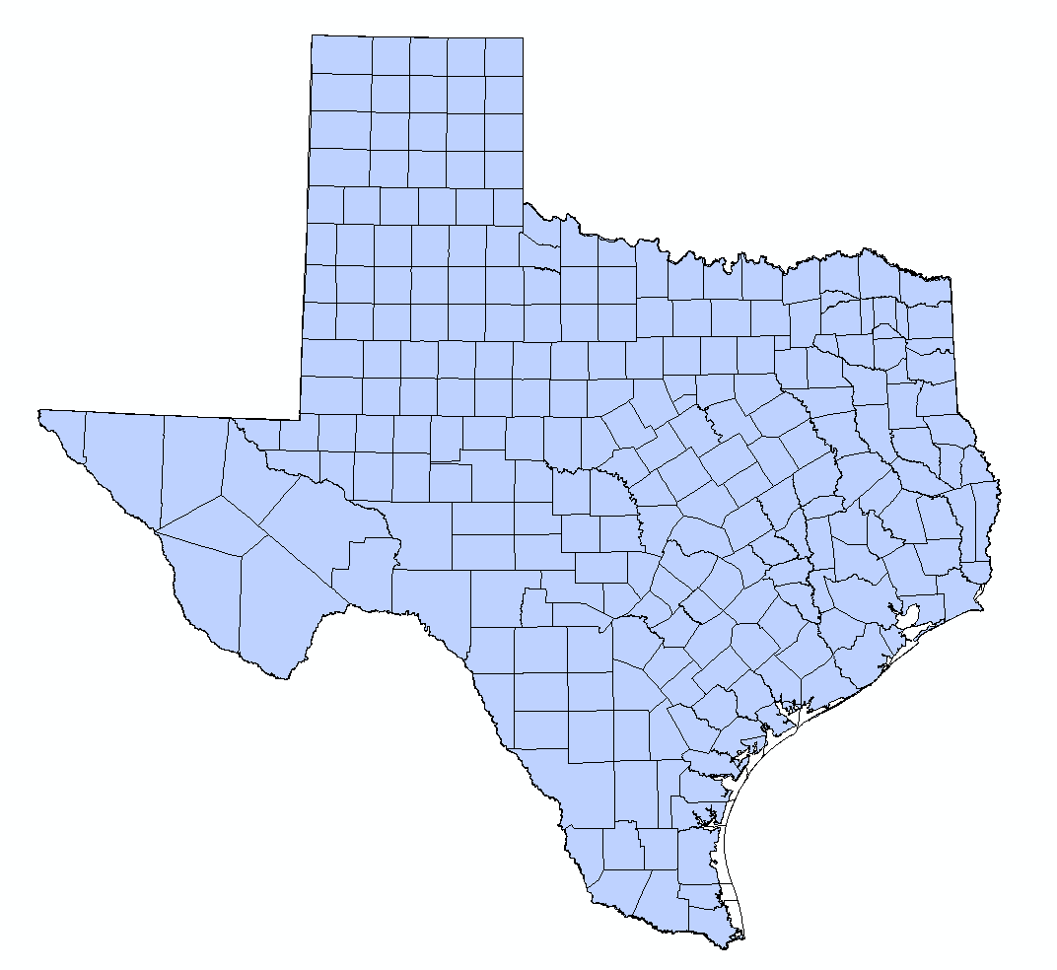
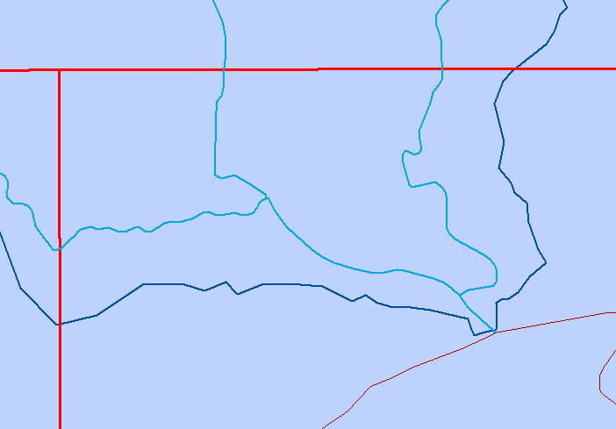
The Location
Calf Creek
Location of
Potential Dam
San Saba River
December 1, 2011
Notes:
You are probably wondering where Calf Creek is. It is located in West Texas in the Northwest corner of Mason County.
The Calf Creek watershed is actually quite large and covers parts of adjacent Menard and McCulloch counties.

Slide 3
The Problem
Not enough water to sustain
livestock and wildlife
Proposed Solution
Construct a dam to create small reservoir
December 1, 2011
Notes:
Why do we care? Blockhouse Ranch is a large expanse of ranchland, home to lots of wildlife as well as private livestock.
Calf Creek is currently dry due to the drought plaguing Texas that we have heard so much about already in other presentations this semester.
The owners of Blockhouse Ranch would like to construct a dam in order to create a small reservoir to supply water for their livestock.

Slide 4
Legal Considerations
Texas Administrative Code
  Chapter 297, Rule 21, Part (b)
Dam or Reservoir
Maximum storage allowed
(No permit required)
  200 acre-feet
December 1, 2011
Notes:
The state of Texas regulates the construction of dams and reservoirs, even on private property.
According to TAC 30, Chap 297 no permit is required for a reservoir with up to 200 acre-ft of storage. That’s almost 250,000 cubic meters of storage!

Slide 5
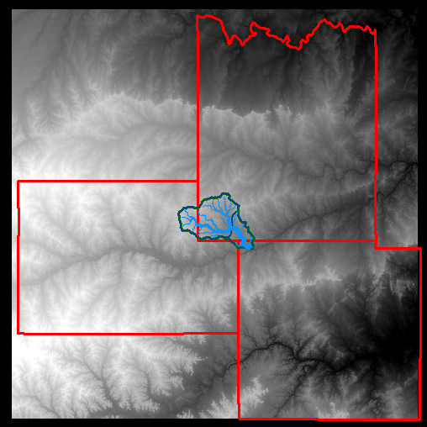
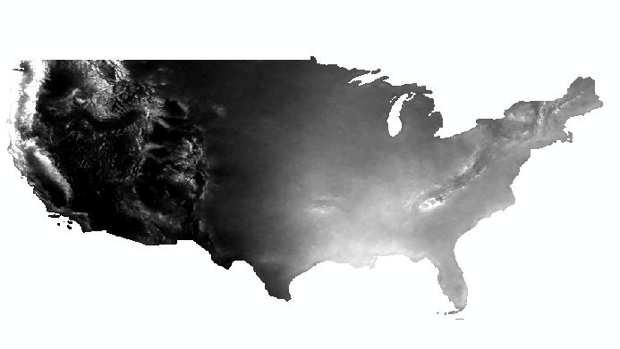
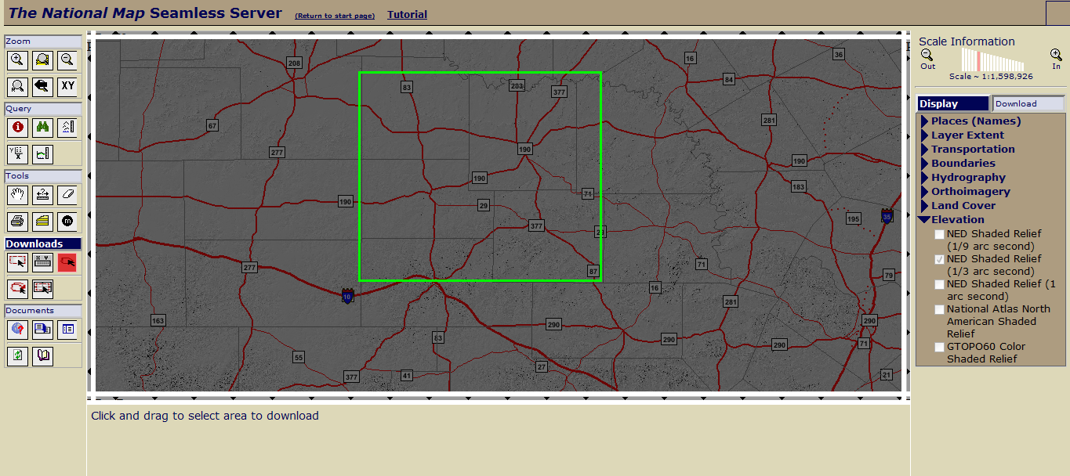
Data
Precipitation Data
  Source:PRISM
  Convert to Runoff
Elevation Data
Fill
Obtain Flow Direction and
Flow Accumulation
December 1, 2011
Notes:
Precipitation Data
No stream gauge data available (since this is in the middle of no where West Texas)
So to figure out how much flow there might be in Calf Creek, I needed rainfall data!
PRISM = Parameter-elevation Regressions on Independent Slopes Model (run by the Oregon State University)
They produce spatially distributed rainfall data interpolated from point sources. Point sources from areas such as NWS, NRCS, and USFS.
Elevation Data
Elevation data obtained from USGS seamless data map
Given in NAD 1983 GCS
Converted to Albers Equal Area to make sure area was correct

Slide 6
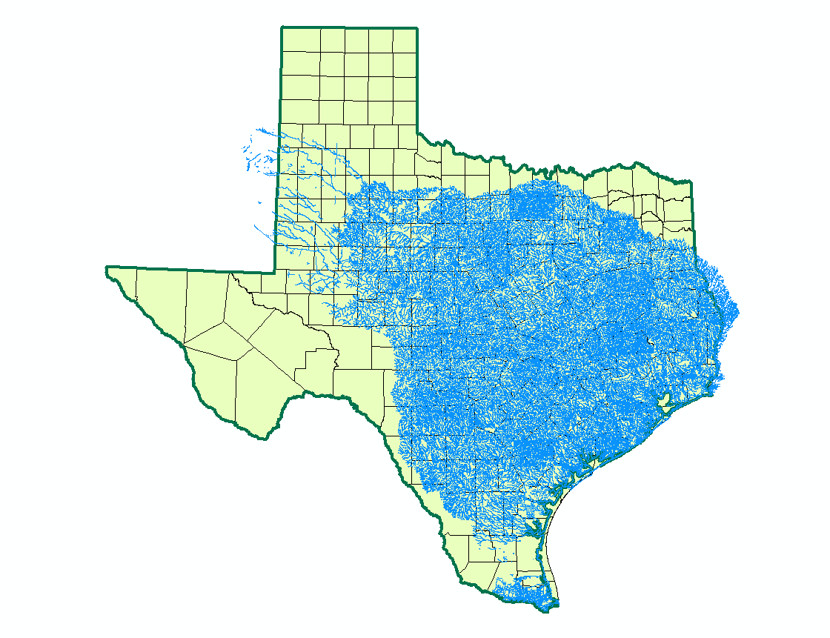
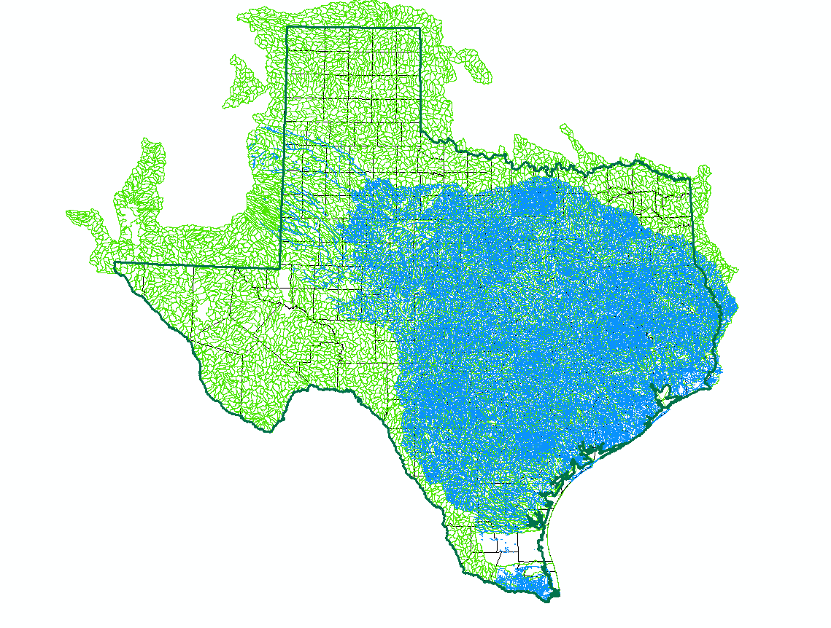
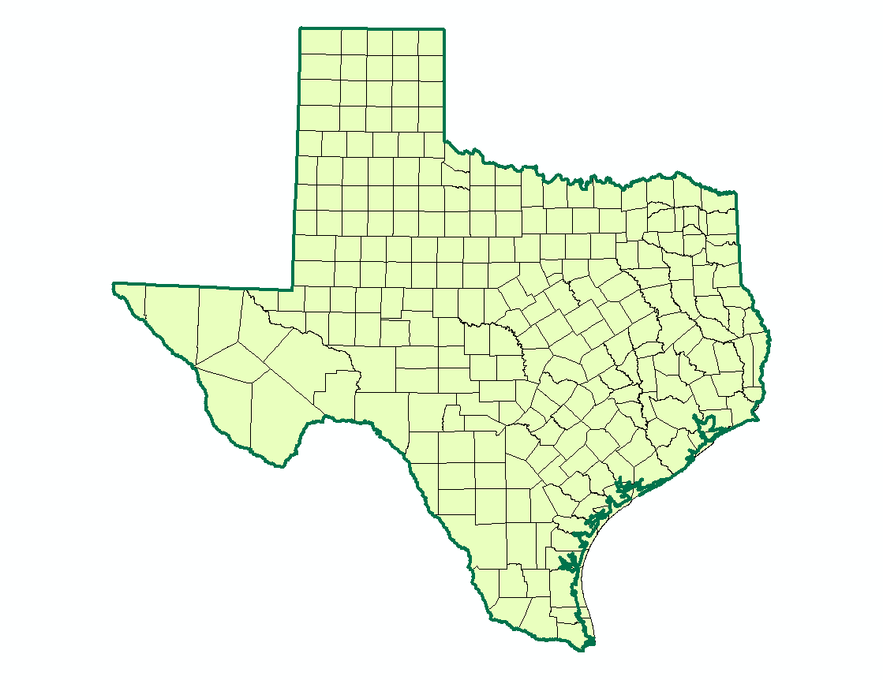
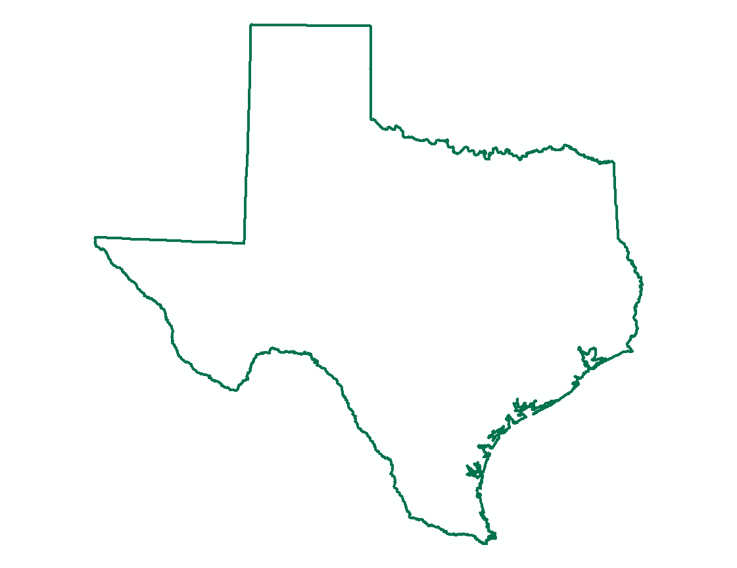
Data
Shapefiles
  NHD Flowlines
  Watershed Boundaries
  Texas
  Counties
Notes:
Shapefiles!
I obtained shapefiles for the state of Texas, Texas counties, NHD flowlines, and the HUC 12 watershed boundaries. (USDA GSDG)
The study area was composed of 2 HUC 12 watersheds.
Pretty much everything had to be converted into projected coordinates to ensure area was correct.

Slide 7
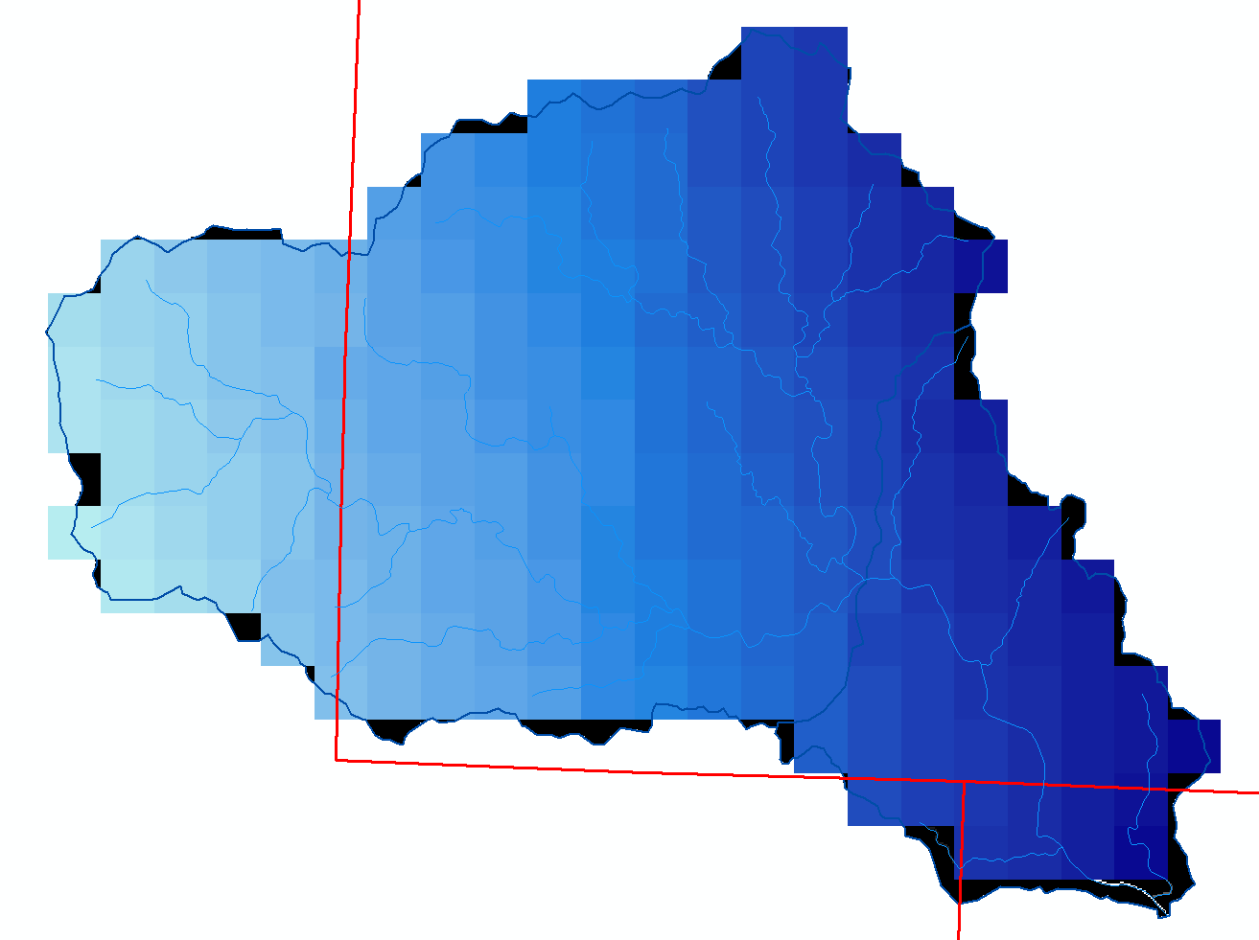

Rainfall Runoff Function
  $$Q=0.00064Pe^{0.0061P}$$
      Q = runoff (mm year⁻¹)
      P = rainfall (mm year⁻¹)
December 1, 2011
Notes:
Created a watershed raster (feature to raster)
Then extracted relevant data using extract by mask
The annual rainfall data was a thirty year average since theoretically this will be a long-term solution
Rainfall runoff function from CRWR used predict “expected” runoff as a function of rainfall
This equation is specifically designed for drier (low precipitation) areas
Applied to the map using Raster Calculator

Slide 8
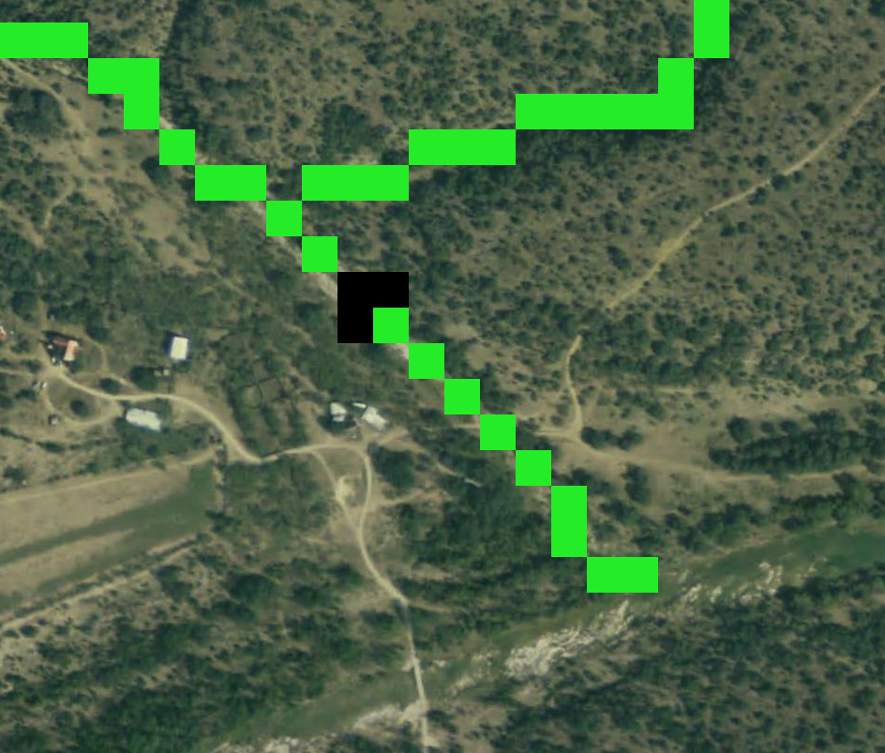
Adding a Dam
New Feature Class
  Polyline
Feature to Raster
Mosaic
  Used to merge
  layers
Notes:
First I created a new Feature Class to contain polylines.
Then I converted the line feature to a raster.
Next I tried to use the Raster Calculator to combine these two… (next slide)

Slide 9
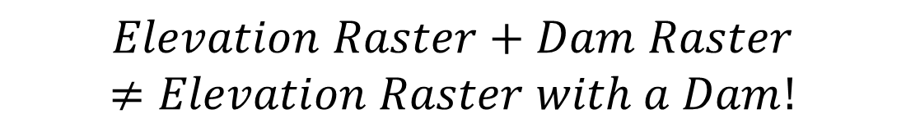
Mosaic Dataset
Problem
Cannot add 2 Rasters of different sizes
GIS will not add “No Data” cells
Solution
Create Mosaic Dataset to merge the 2 Rasters
Raster Datasets
  Dam Raster
Calf Creek DEM
  Already filled
$$Elevation Raster+Dam Raster$$
$$≠Elevation Raster with a Dam!$$
Notes:
I tried to use the raster calculator to combine the dam raster and elevation rasters, but learned that GIS will not add no data cells as zero value cells.
Instead, I created a new mosaic dataset and added both rasters to this new dataset to merge them.

Slide 10
Weighted Flow Accumulation
Water Volume Accumulated
Flow Direction
Runoff Raster
4,991,483.5 mm/yr
3,641,995 acre-ft/year
Notes:
Finally I was able to begin a flow analysis. I filled my DEM to make sure there were no pits and the calculated the Flow Direction Raster using this filled DEM.
A typical flow accumulation grid produces a grid with the cumulative number of cells flowing into each cell, but I was also interested in the amount of water in each cell.
The other input I needed to run the weighted flow accumulation tool was a runoff raster.
Once that was completed I obtained a raster with the average accumulation of runoff based on thirty year average rainfall data. (in mm/year)
I also ran an unweighted flow accumulation raster to find the area that runoff was coming from.
I then converted the number of cells accumulated to m² and multiplied by the depth of runoff accumulated to get the volume of flow per year.

Slide 11
The Result
3,641,995 acre-ft/year accumulated at dam
Much larger than the allowed 200 acre/ft
Dam would have to be designed to overflow when storage exceeds this maximum
December 1, 2011

Slide 12
Limitations
Use HEC-RAS to analyze channel hydrology and dam designs
Runoff Equation could possibly underestimate losses
Doesn’t account for upstream consumers
December 1, 2011
Notes:
Obviously this is a very rough estimate…
If there is another ranch or something else upstream this could potentially dampen the flows.

Slide 13

Questions?

