Slide 1
Evaluation of Water Resources for Hydraulic Fracturing in the Barnett Shale
Mary Hingst
GISWR Fall 2011

Slide 2


Answering the ultimate question of geology….
Where to dig a hole?

Slide 3
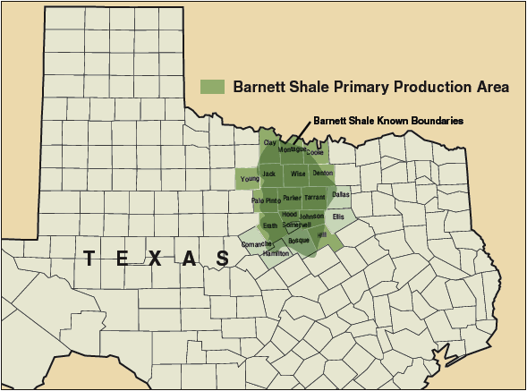
The Barnett Shale
Taken from the AAPG website

Slide 4
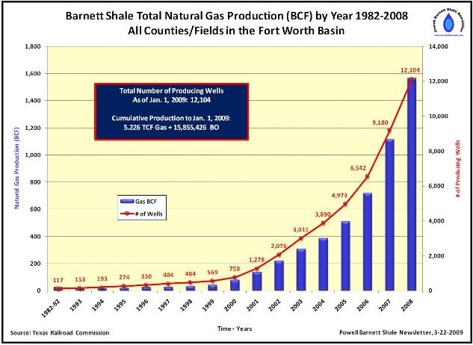
Gas Production in the Barnett Shale
5,000 mi²
Total NG volume estimated around 250 TCF
  Recoverable 43 TCF
    About 1.315E15 kWh

Slide 5
Hydraulic Fracturing
“Fracking”
Increase permeability (“flow”) of formations containing resources
  Shales and mudrocks often contain a lot of compartmentalized gas and oil in their pores
Fluids (primarily water) is pumped into an injection well to increase pressure beyond rock strength
Propping agent then injected to keep fractures open
Once gas or other resource is extracted, the fracturing fluid rises towards surface from pressure of formation
  Mismanagement of the treatment and disposal of these fluids along with the potential of methane seepage into aquifers have made ‘fracking’ controversial

Slide 6
Counties of Interest
Montague
Wise
Parker
Hood

Slide 7
How low must we go?
Need to avoid the Trinity Aquifer
Trinity

Slide 8
Well Logs
Good
Bad

Slide 9
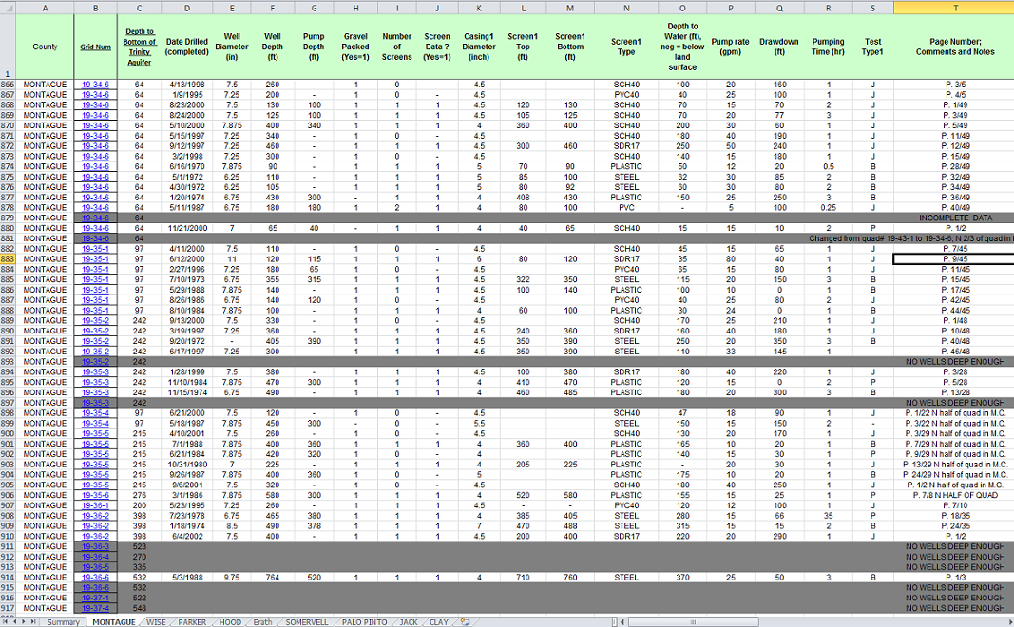
Data

Slide 10
Depth to Water

Slide 11
Specific Capacity (Pump Rate/Drawdown)

Slide 12
Best Locations (actual data)
Greater Number = Better

Slide 13
Conclusions and precautions
If you want a shallow hole dig in Montague, but if you want more water, dig in Hood.
Given the amount of missing data, well logs may not be the most accurate
Missing data may show better results in Parker
Old wells may now be dry
Water may mix with Trinity Aquifer
If you dig a hole, write down what you find!

Slide 14
Resources
TCEQ Water Well Reports
Texas Parks and Wildlife GIS Lab Map Downloads
Texas Water Development Board GIS Data
Texas Railroad Commission
US Dept. of Energy, Energy Citations Database – Mechanics of hydraulic fracturing
AAPG Website
USGS (Barnett Shale info)

