Slide 1
Groundwater Tools for GIS
GIS in Water Resources
Fall 2011

Slide 2
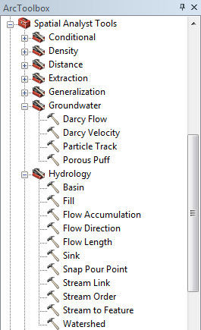
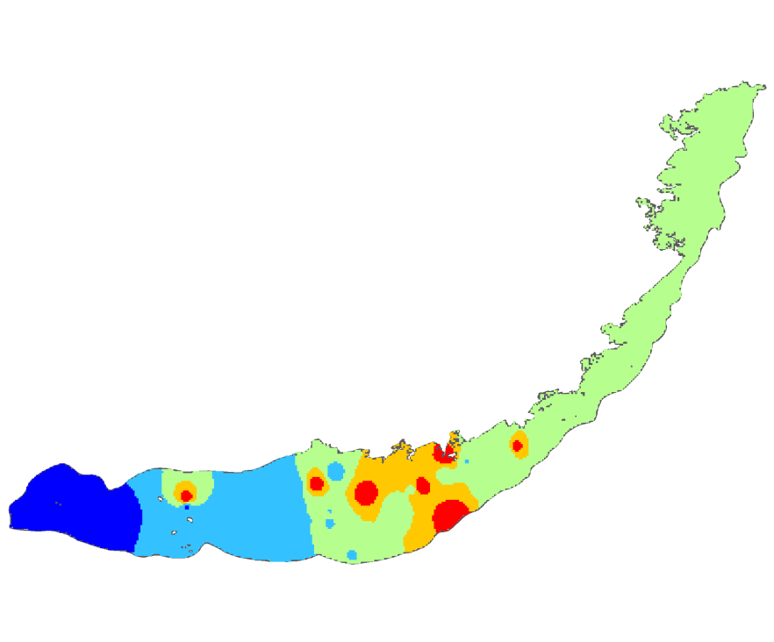

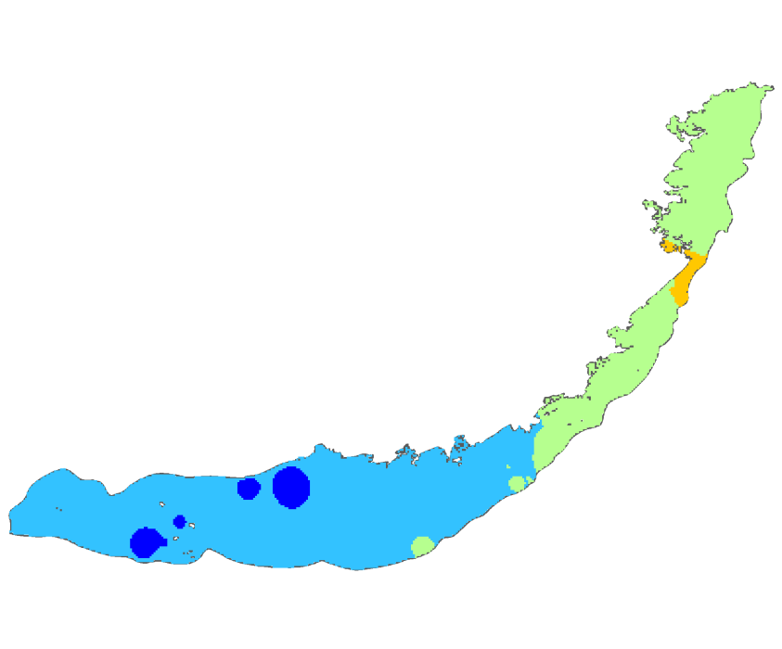
Built-in Tools
Groundwater and Hydrology Toolsets
Time-enabled Layers

Slide 3
Arc Hydro Groundwater Tools
Groundwater Analyst
MODFLOW Analyst
Subsurface Analyst
  3D Features
  2D Cross Sections

Slide 4
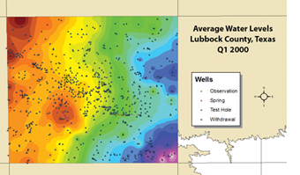
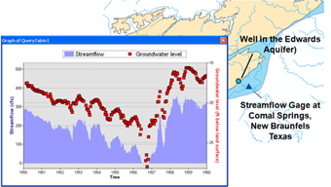
Groundwater Analyst
Import and Manage Well Data
Compute Time Series Statistics
Point and Click Graphing Tool

Slide 5
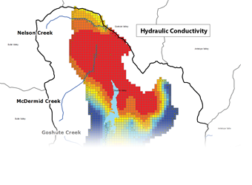
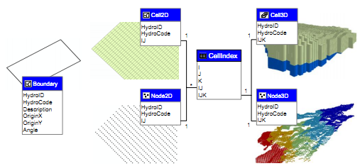
MODFLOW Analyst
Import and Export MODFLOW models
Run MODFLOW from ArcGIS

Slide 6
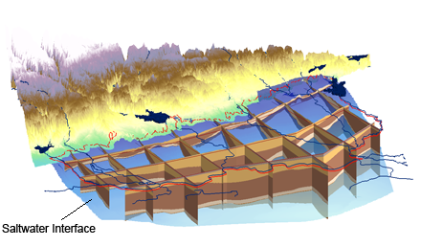
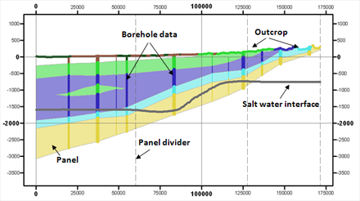
Subsurface Analyst
3D Features
2D Cross Sections

Slide 7
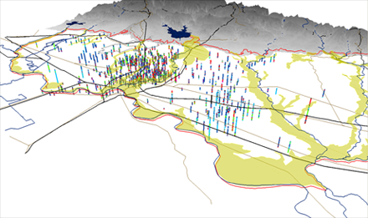
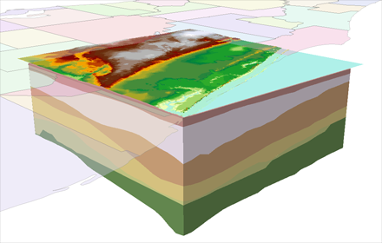
Subsurface Analyst – 3D
Create and Edit Borehole Data
Create
GeoSections
Create GeoVolumes

Slide 8
XS2D Component
Representing 2D cross sections

Slide 9
Outline
You can create 2D cross sections in ArcGIS
Cross sections are made of real GIS features
Cross sections use a (S, Z) coordinate system
Subsurface Analyst helps you create cross sections within ArcMap
Manage cross sections within a geodatabase
Notes:
You can create 2D cross sections - Arc Hydro Groundwater defines the geodatabase design to store and manage the cross section
We create the cross sections using regular GIS features – all the ArcGIS capabilities of editing, symbolizing, storing, managing.
Cross sections are created in special data frames with a transformed coordinate system along the section line.
SA helps you create the cross sections in ArcMap and storing the data inside the geodatabase.

Slide 10

Subsurface visualization
Visualizing the subsurface can be challenging
?
?
Layers of 3D volumes that are largely unseen
Notes:
Visualizing the subsurface is challenging – we can only see small sections of subsurface strata – at wells drilled into the subsurface, or as outcrops.
We need to extrapolate the data we can see to create a concept of the subsurface system.
We can use different GIS layers to help us create a model of the subsurface – DEMs, streams, geologic maps, etc.

Slide 11


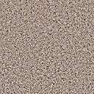
Cross sections
Cross sections help us understand local geology
We can sample the subsurface…
Wells
A
A’
Section A-A’
A’
A
Map
…And interpret the rest
Notes:
Cross sections help us visualize / conceptualize / understand the 3D structure of the subsurface.
We can sample strata at wells/boreholes drilled into the subsurface.
We then interpolate between the known points to create a continuous model of subsurface strata.

Slide 12

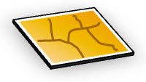


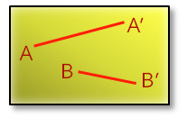
GIS datasets
You can create cross sections from GIS datasets
Spatial and attribute relationships tie features together …
Wells
Geologic features
Borehole log
Section lines
Raster surfaces
…Creating the connectivity we need to construct meaningful cross sections
Notes:
We use different GIS datasets:
Wells with related borehole logs
Geologic features – outcrops from geologic maps, faults
Surfaces - DEMs, rasters representing water levels, tops of units, etc.
Section lines
The different datasets need to be managed in a meaningful fashion.
Relationships between feature classes, manage multiple cross sections in a single geodatabase.

Slide 13
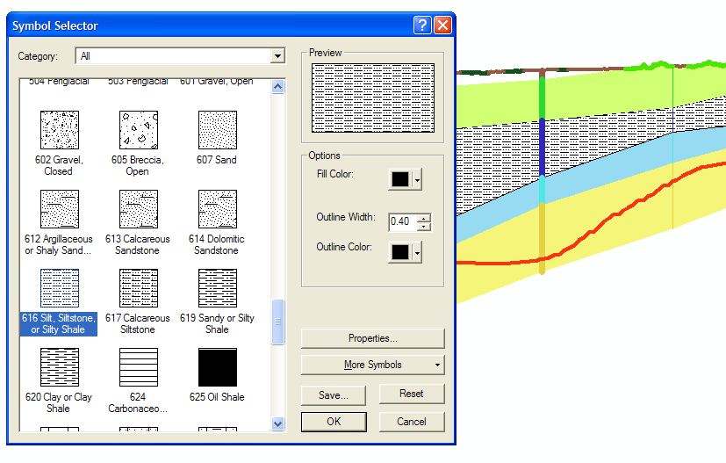
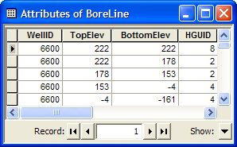
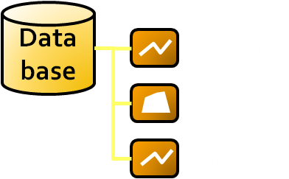
GIS features
Cross section features are real GIS features
Layer symbology, attributes, geodatabase storage, editing…
Works with your ArcGIS tools
Notes:
These are real GIS features – we can apply symbology, edit, manage within the geodatabase.
Can apply all the ArcGIS tools to edit/create data.

Slide 14
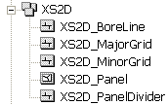
XS2D component
Part of the Arc Hydro Groundwater data model
Included in the hydrostratigraphy component
XS2D feature classes have a XS2D prefix
They exist in a special coordinate system that translates vertical coordinates so they can be viewed in ArcMap
Additional data: XS2D_Line, XS2D_Polygon, XS2D_Point…
Notes:
These are the major XS2D feature classes
We can add additional feature classes to add points/lines/polygons to the cross section.
Features are created in a special coordinate system – We need to translate X, Y, Z coordinates to a 2D coordinate system along the section line.

Slide 15
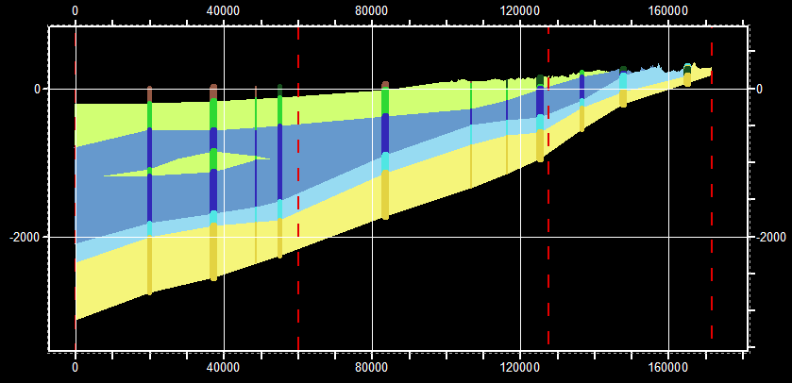
Common cross section features
Boreline
Cross Section
Panel
Panel Divider
Major Grid
Minor Grid
Notes:
Major/Minor Grids – Define the grids of the cross section. Reflect the vertical exaggeration, so one can see the “real” values in an exaggerated view.
Panel Divider - Shows locations where the section line changes direction (vertices of the SectionLine feature).
Boreline – line feature class representing data along a borehole – usually created from data stored in the BoreholeLog table.
Panel - Polygon features that represent a “panel” on the cross section – usually created by connecting the borelines and digitizing the panels.

Slide 16
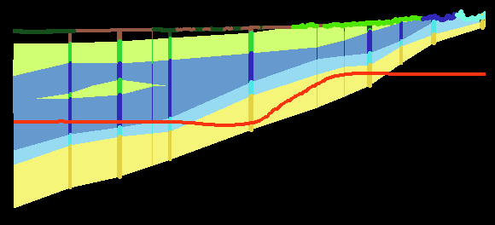
Additional features
You can add additional features using the Arc Hydro Groundwater Tools
Surficial Geology
Saltwater Interface
Or create your own features and annotation

Slide 17
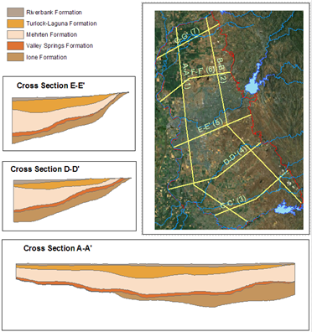
Section line features
Cross sections belong to a section line
A set of cross section feature classes per section line…
Simple 2D polylines
Define the cross section in map view
Notes:
Section lines are defined as simple polyline features in the SectionLine feature class.
They define the cross sections in plane view.
Each SectionLine feature is indexed with a HydroID.
All the XS2D feature classes are related to the HydroID of the SectionLine.
We have a XS2D catalog for managing the different feature classes and relating them back to the SectionLine to which they belong.

Slide 18
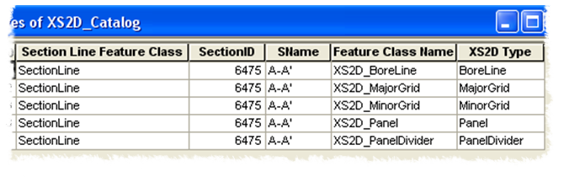
XS2D Catalog
Central part of the XS2D component
Keeps track of feature classes in all cross sections
SectionID is a key attribute = HydroID of a SectionLine feature
Notes:
This is a key part in the XS2D component – helps to manage all the related datasets.
Keep track of all the XS2D feature classes and to which SectionLine they belong
Talk about the SectionID – HydroID relationship.
Most of the Subsurface Analyst tools will require the XS2D_Catalog table as an input
If you use the tools to create new XS2D feature classes then a new row in the XS2D_Catalog table is created.

Slide 19
Cross section data
Add data by proximity to the section line
Adding Nearby Wells
A’
A
A
A’
Built from Standard GIS Operations Like ‘Select By Location’ and ‘Intersect’
Notes:
Select wells in a buffer around the section line.
Then we use the data from the wells - create borelines and add to the cross section
We can then interpolate between the borelines and create panels.

Slide 20
Cross section data
Add data by overlaying layers with the section line
Adding Outcrops
A’
A
A
A’
Notes:
Shows how we can add additional data such as outcrops from geologic maps
We intersect the section line with the outcrop polygons – then we add the vertical dimension from a DEM and add the new line to the cross section.

Slide 21
Cross section coordinates
Cross sections use a (Distance, Elevation) coordinate system
Each system is unique to the cross section…
S
y
Z
x
S
And includes vertical exaggeration…
Notes:
Cross sections have a unique coordinate system.
Data are transformed from X, Y, and Z coordinates to S and Z.
S = length along the section line
Z = vertical elevation – many times exaggerated for better visualization.
Data from nearby wells are projected to the closest point on the cross section.
Subsurface Analyst includes special tools to do these transformations.

Slide 22
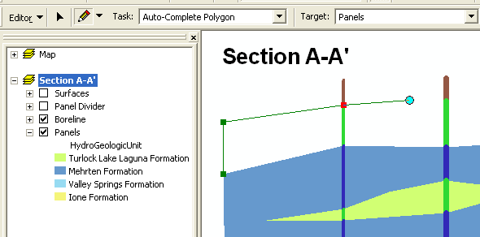
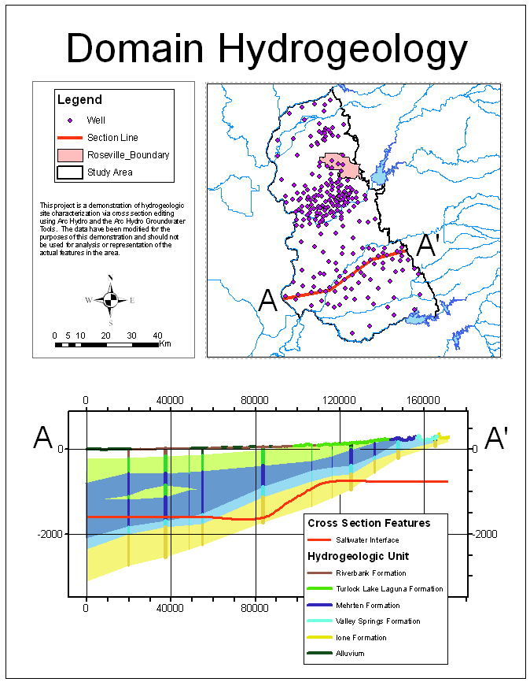
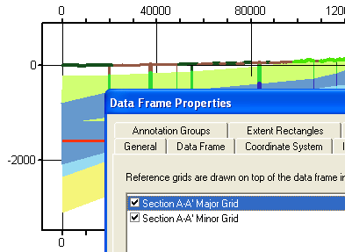
Data frame
The Data Frame is the canvas where cross sections are drawn
Edit
Print
Draft
Notes:
Each cross section has its own data frame.
Within this data frame you can add data for that cross sections and sketch cross sections using the standard ArcMap tools.
You can modify the data frame properties to set text size, grids, background, etc.
Setup the map layout, add legends, scales, etc.
Nore that you can have multiple cross sections in the same layout.
Print.

Slide 23
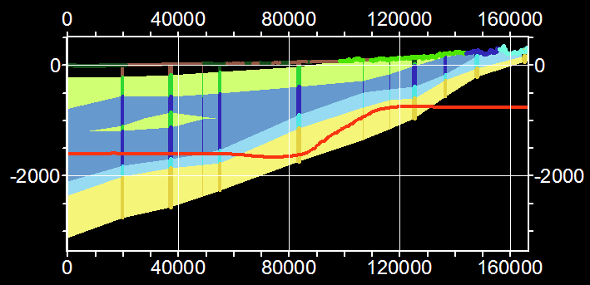
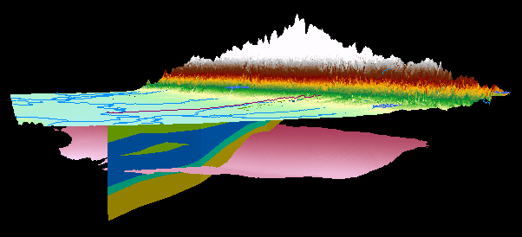
2D and 3D transformations
You can convert from 2D to 3D
and back again
Notes:
Subsurface Analyst includes tools to transform from 2D to 3D and from 3D to 2D.
You can sketch a cross section and then transform it to 3D to visualize in ArcScene.
You can also create GeoSections and then transform them to 2D and add to a cross section.
You can use this process to refine your 3D model – add data points from 2D cross sections to your m3D model and recreate your raster surfaces based on the added points.
Basically – this can be an iterative process where you keep adding data until you are satisifed with your subsrface model.

Slide 24
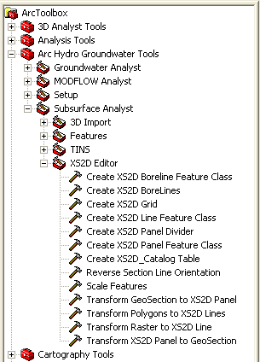
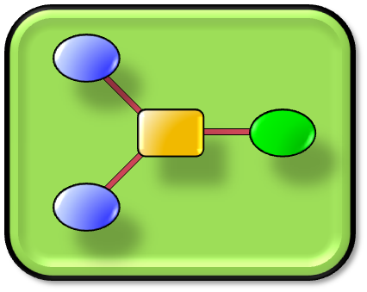
Building cross sections
You can create your own workflows for building cross sections
Notes:
There are different options for creating 2D cross sections.
You can use the basic XS2D Wizard shown on the left – this would be the easiest way to get started and then you can use additional GP tools to add different data types – Well construction, lines for outcrops, water levels etc.
You can build custom workflows using the basic GP tools provided in Subsurface Analyst – the wizard is basically a GUI for the GP tools.
If you want to use just specific parts, or maybe batch a large number of cross sections, you can apply the basic GP tools and create models/scripts to create custom workflows.

Slide 25
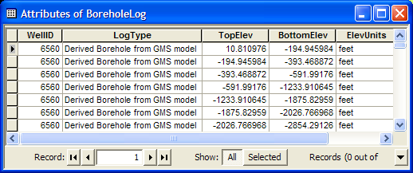
Example workflow
1. Select wells – wells are related with borehole data
Tip: Select wells within a distance of a section line
Notes:
The first step is to select wells adjacent to a selected section line.
On the right you can see that the wells are related with hydrostratigraphy recorded along boreholes.

Slide 26
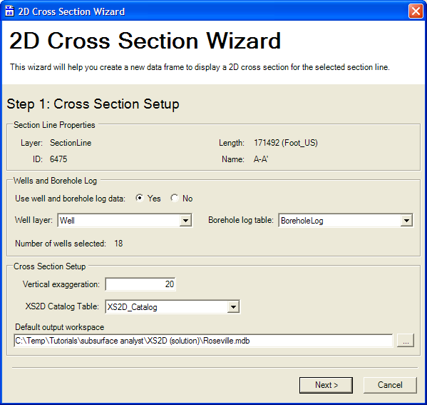
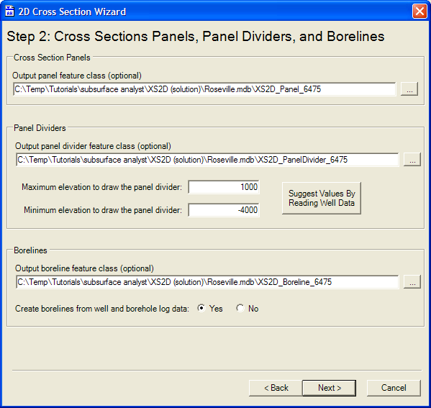
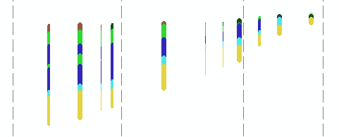
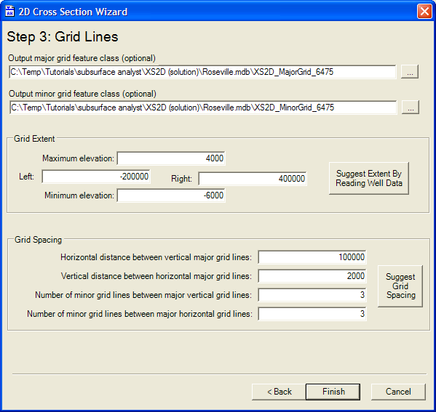
Example workflow
2. Run the cross section wizard
Click on the Section Line
Choose:
  Features to Include
  Vertical Exaggeration
  Grid Line Spacing
Output is a new cross section data frame with features created
Notes:
Second step is to run the XS2D wizard with the selected data.
You will need to provide some inputs – what feature to include/create, the vertical exaggeration, grid spacing. The Wizard will provide default values based on the borehole data and the geometry of the section line, but you have full control to modify the cross section.
The output is a new cross section data frame with the grid lines, vertical panel dividers, and borehole data as boreline features.

Slide 27

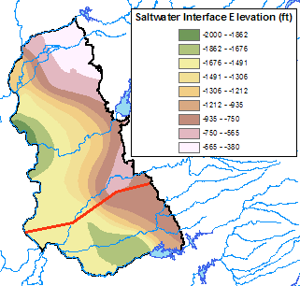
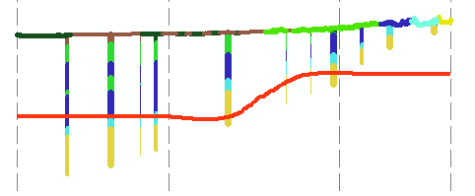
Example workflow
3. Import additional data
Notes:
If you have additional data you can add it to the cross section using Subsurface Analyst transformation tools.

Slide 28
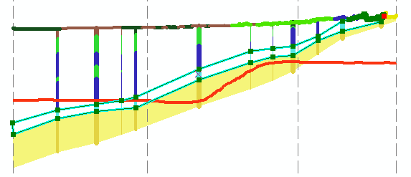
Example workflow
4. Sketch panels using standard ArcMap editing tools
Notes:
You can use the ArcMap editing tools to digitize panels.
You will need to define the snapping environment so that features are correctly created.
There are a variety of tools you can use – free digitization, trace, etc.

Slide 29
Example workflow
5. Arrange the layout
Add:
  Legends
  Annotation
  More Cross Sections
Set:
  Data Frame Properties
  Grid Line Appearance
Notes:
Once you finish editing the cross section you can arrange the layout
Add legends, other cross sections, scales, north arrow, descriptive text, etc.
You control the data frame properties - background color, grid lines, tick marks, tick labels, etc.

Slide 30
Additional workflow – image registration
Start from existing cross section images.
Load and register the images to an existing SectionLine.
Wizard helps create necessary features (grid lines, panel dividers, panels) based on the image registration process.

Slide 31
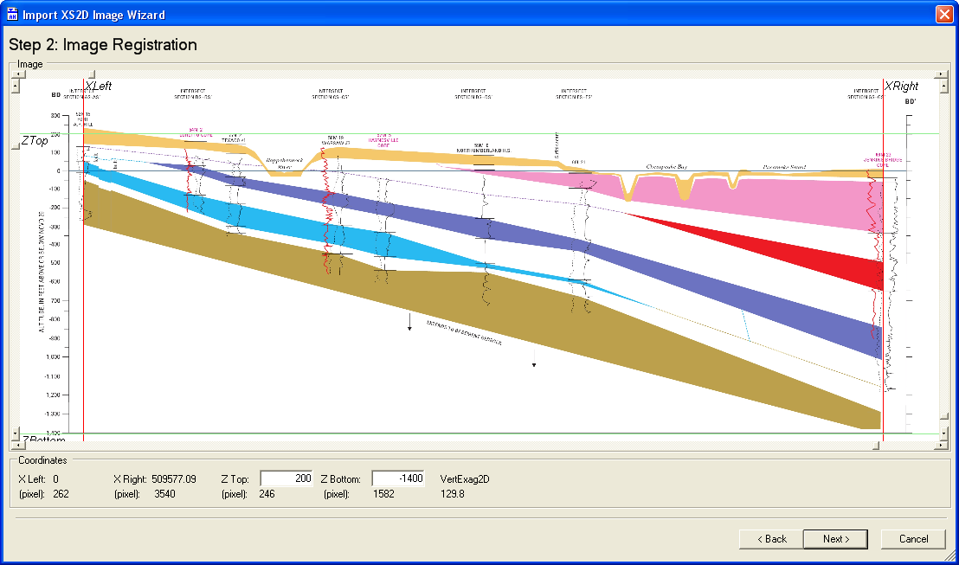
Image registration wizard
Register the image using vertical and horizontal lines

Slide 32
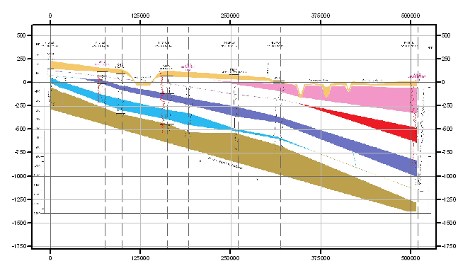
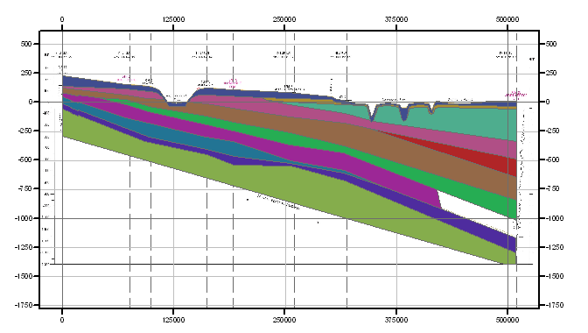
Image registration wizard
Result is a new data frame with registered image + XS2D feature classes

Slide 33
Key points
You can create 2D cross sections in ArcGIS
Cross sections are made of real GIS features - Can take advantage of all the ArcMap capabilities
Cross sections use a (S, Z) coordinate system
Subsurface Analyst helps you create cross sections – basic tools, XS2D Wizard, Image registration

Slide 34
XS2D Animation
Water levels in a cross section

Slide 35
Subsurface Analyst Demo
Creating 2D cross sections

