Slide 1
Nitrogen (N): Budgets, Estimated Loads, and Measured Exports
Lisa Helper 2011
Special Thanks to:
Ahmad Tavakoy, Tim Whiteaker (CRWR), Rich Mueller(USDA NASS Research and Development Division), and Doug Rundle (NASS Texas Office)

Slide 2
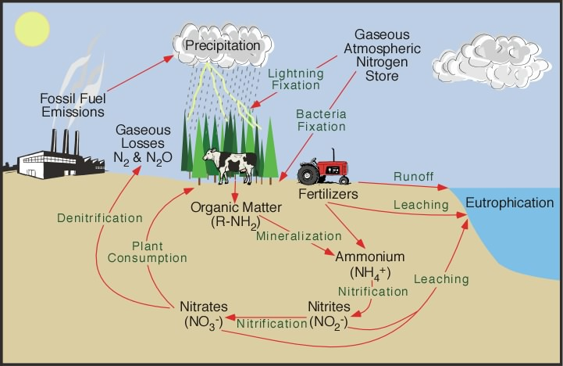
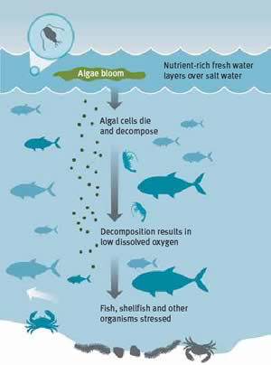
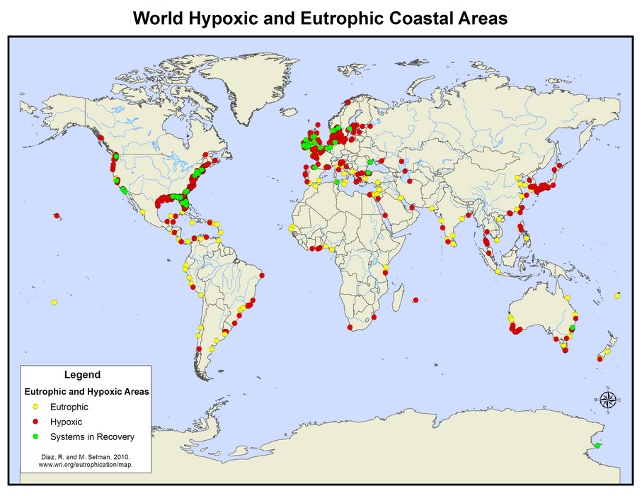
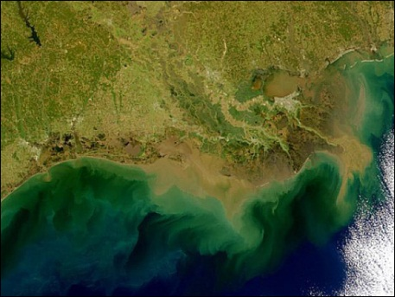
Motivation/Introduction Quickly

Slide 3
Regional Nitrogen (N) Sources
Agriculture
Atmospheric Deposition
  Fertilizer
  Livestock
  Fixation in crop & pasture lands
  NO_{y}
  NO₃
  NO₄
  NH₃
  Inorganic N deposition
Natural
Human Waste
  Forest leeching
  Animal decomposition
  Lightning
  Excretion/sewage water
  Landfill leeching

Slide 4
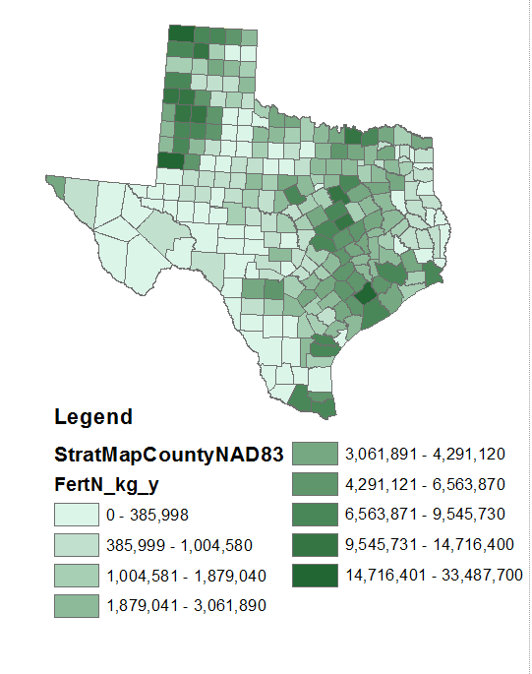
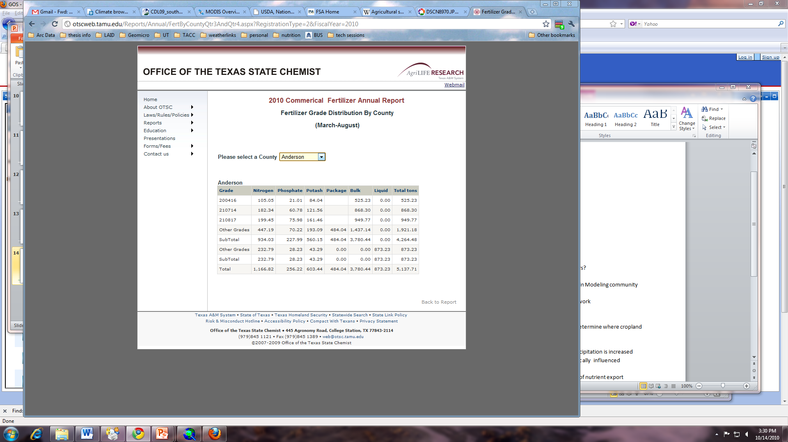
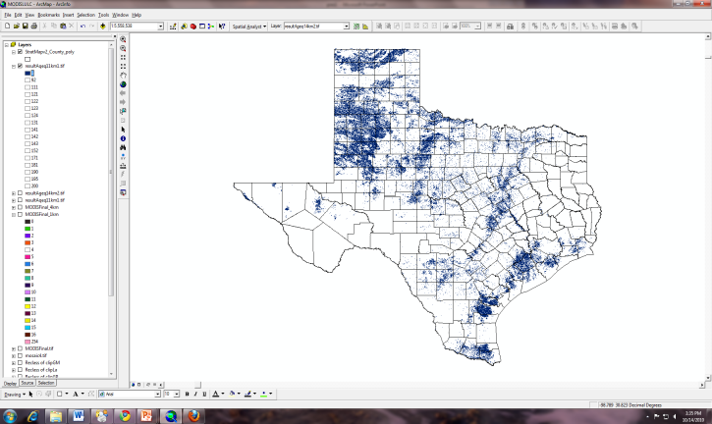
Creating Fertilizer Nitrogen Data Layer
Fertilizer Input at county level
(kg N county⁻¹ year⁻¹)

Slide 5
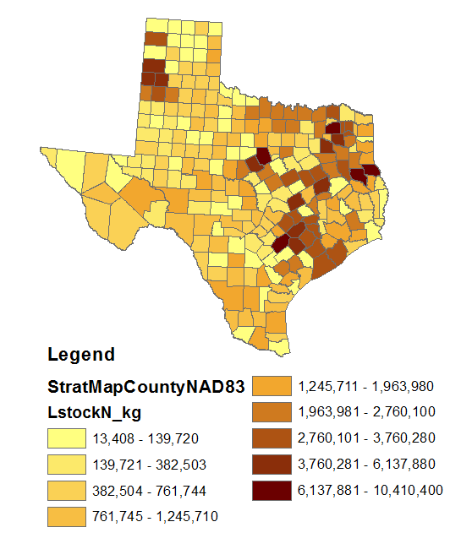
CE 394 GIS WR 2011
Lisa Helper
5
Creating Livestock N
Data Layer
Animal (number based on Census of Agriculture 2007) | N excretion rates in waste production [kg N animal⁻¹yr⁻¹]
Beef Cattle | 58.51
Dairy Cattle | 121.00
Pigs & Hogs | 5.84
Sheep | 5.00
Goats | 5.00
Horses | 40.00
Chickens (broilers-layers) | 0.07-0.55
Turkeys | 0.39
(Boyer et al. 2002)
Livestock Input at county level
(kg N county⁻¹ year⁻¹)

Slide 6
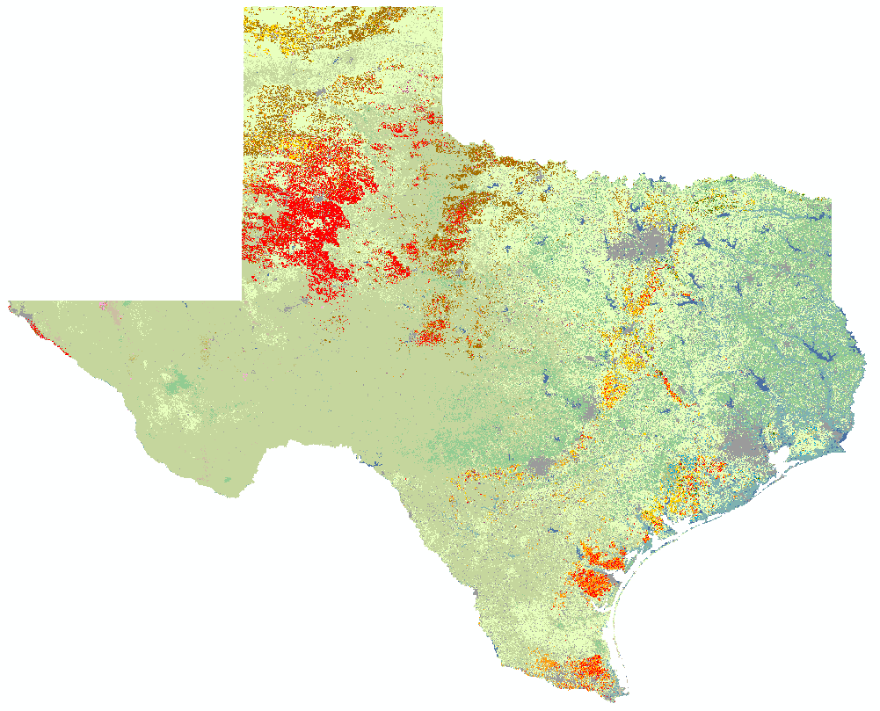
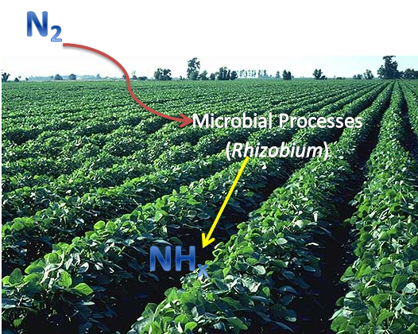
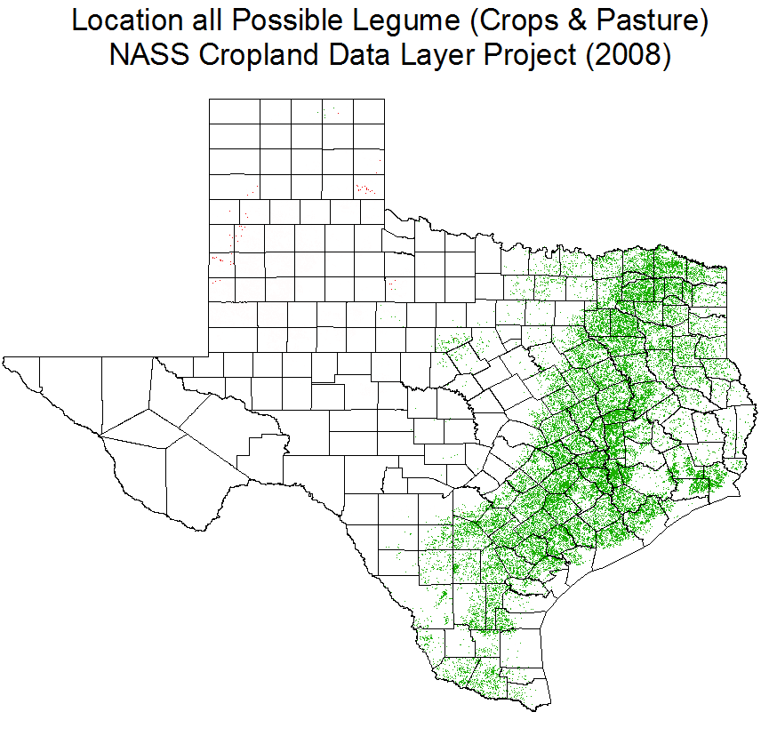
Fixation in Pastures and Cropland
USDA Cropland Data Layer Project (2008)
Certain crops and plants “fix” their own Nitrogen – result is additional inputs of N from specific plants
Using CLD, area of these lands are assessed and quantified for N input

Slide 7
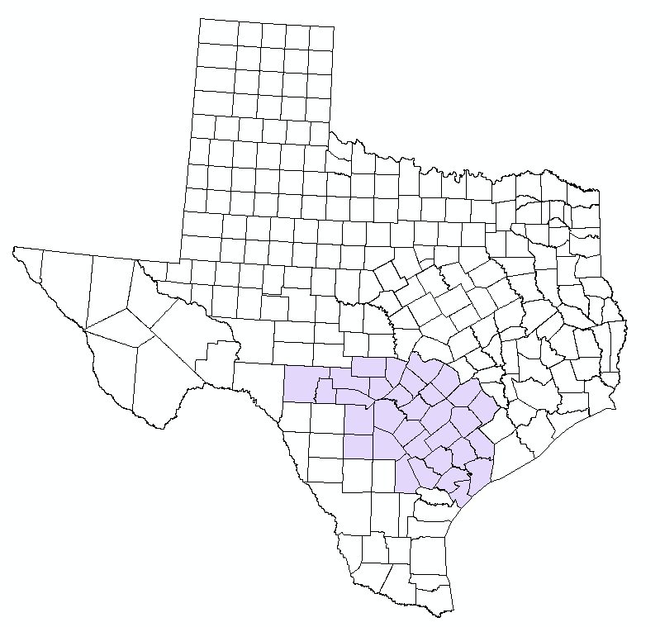
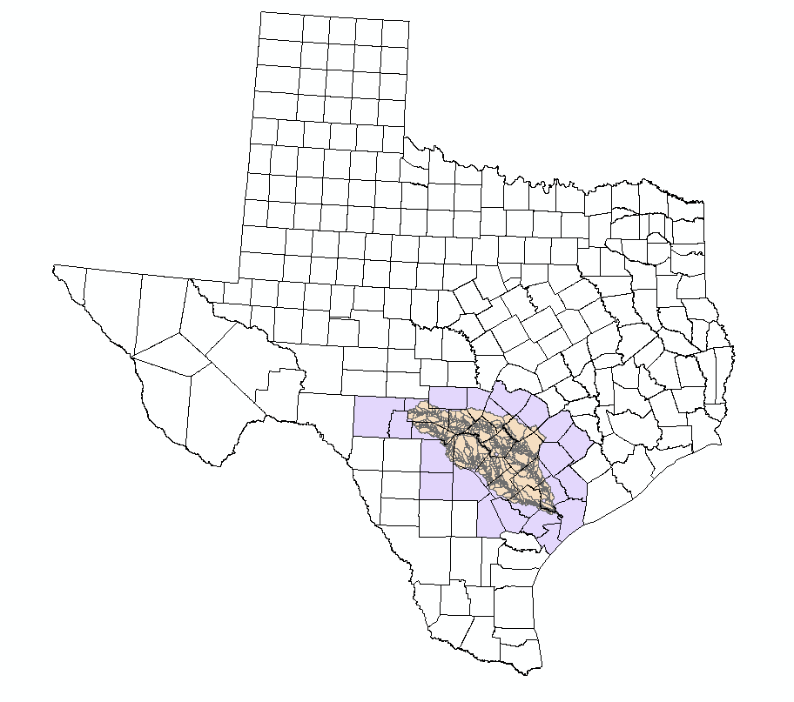
Export
Estimates
Test region:
  San Antonio
  Guadalupe
Two Methods
  RAPID
    (David et al. 2011)
  Processing with Schematic Network
    (Johnson 2009)

Slide 8
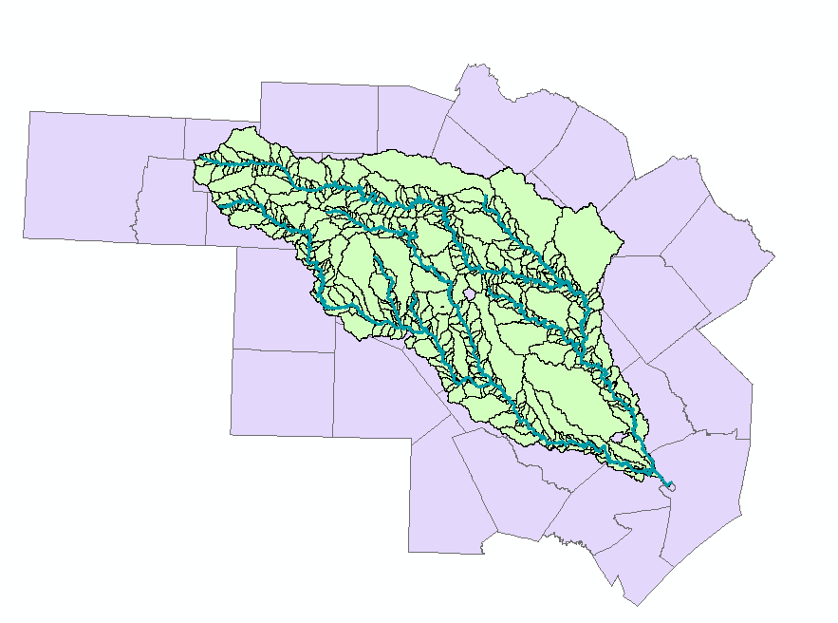
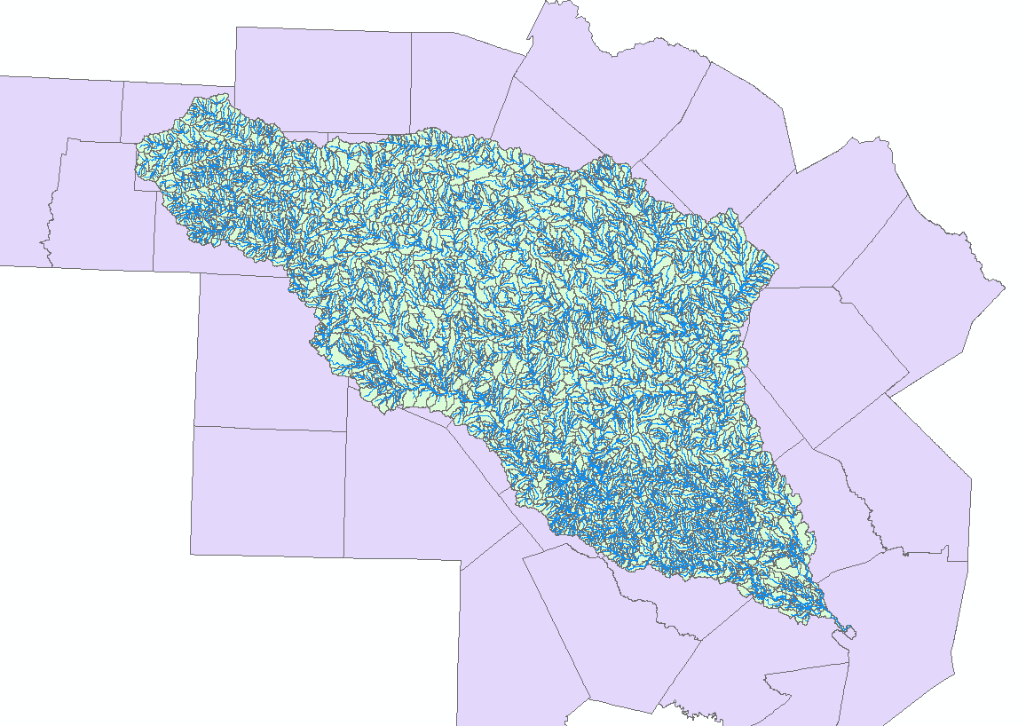
Raw NHDPlus data
NHDplus has many catchments
and rivers
Ahmad Tavakoly developed a way to downscale these catchments and rivers using the thinner code attribute provided in NHDplus data
Thinnercode = 1

Slide 9
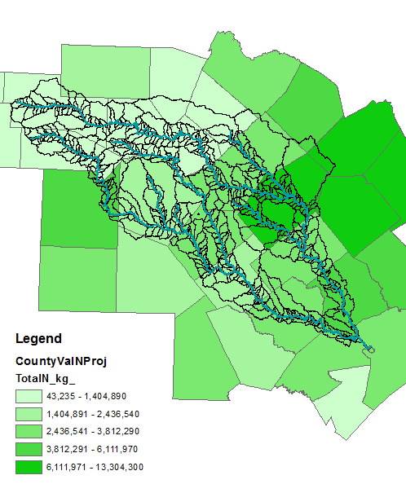
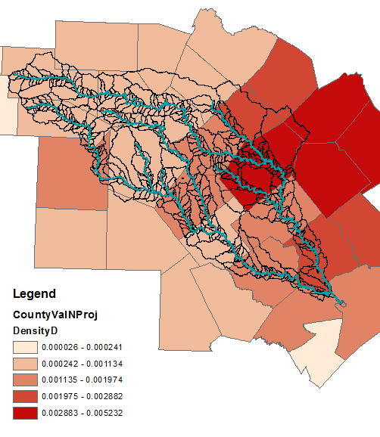
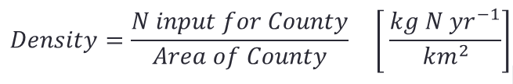
County to Catchment Level
Livestock and
Fertilizer Inputs
(kg N km⁻¹ year⁻¹)
Density of Livestock
and Fertilizer N Inputs
(kg N yr⁻¹/ km²)

Slide 10
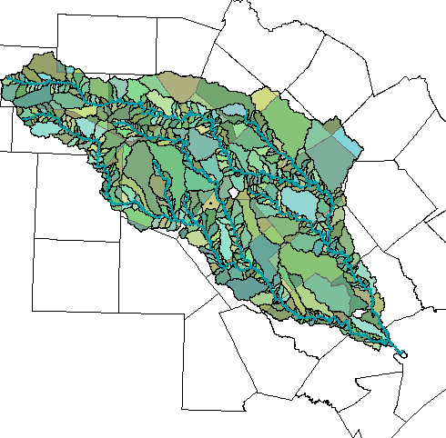
Density to Catchment Level
CE 394 GIS WR 2011
Lisa Helper
10
Identity function in Arc Toolbox's Analysis Overlay tools → developed joined attributes from counties and catchments
Summary Statistics
to get total N density per
catchment in attributes
  Multiply N density by
  catchment area

Slide 11
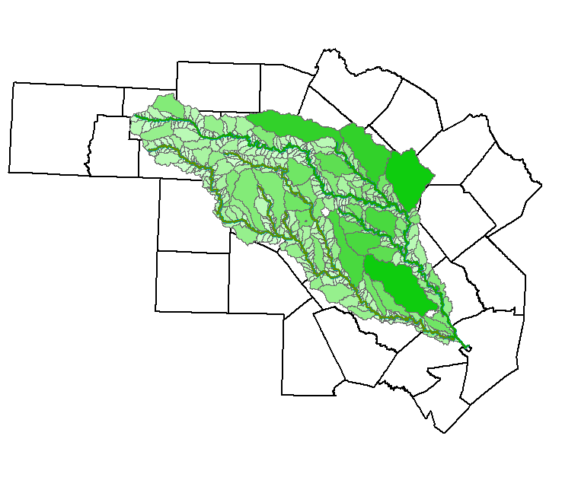
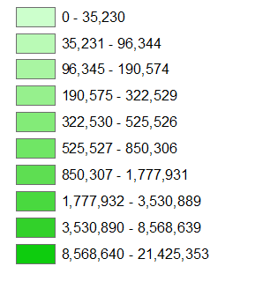
Result: Inputs at Catchment Level
Livestock and Fertilizer N
Inputs for each up-scaled
catchment
(kg N yr⁻¹)

Slide 12
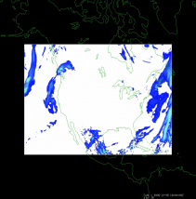
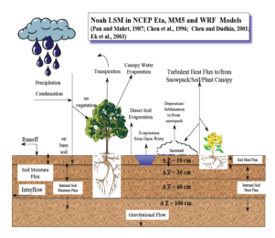
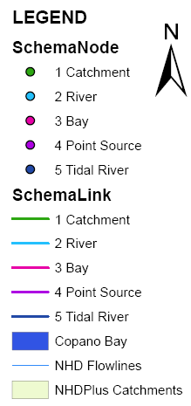
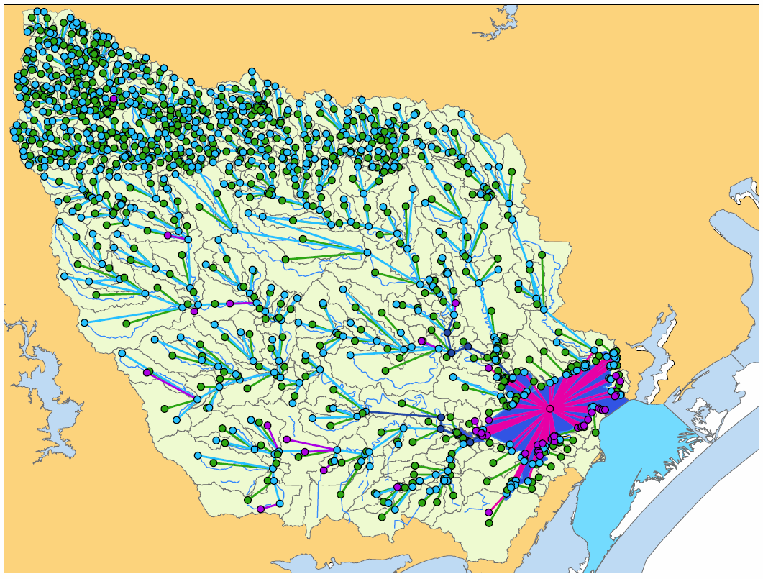
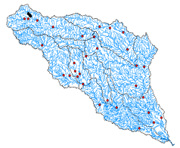
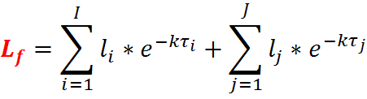


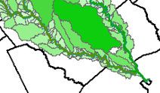



Modeling Nutrients
RAPID
Schematic Network
(From Dr. Tim Whiteaker’s Lecture)
Atmospheric Model or Dataset
Land Surface Model
Vector River Network -
High-Performance Computing River Network Model
Nutrients?
Nonpoint Sources
Decay
Will divide N attribute by 365 to get time series
$$C=\frac{L_{w}+Q_{a}C_{a}}{(Q_{net}+Q_{a})+kV}$$
A = cross sectional area = hydrolysis rate of organic N
= ammonia oxidation rate = cross sectional avg of
t = time (days) organic N concentration

Slide 13
Land Use vs. Inputs
Less Urban
Urban/developed
Less Urban
Urban/developed
How large of an effect does Land Use Land Cover (LULC) have on N inputs?

Slide 14
How Much is Input from Agriculture for Both Basins?
Less Urban
Urban/developed

Slide 15
N Input Estimates vs. Measured Output
Less Urban
Urban/developed
Less Urban
Urban/developed
Measured Data from James McClelland’s Group at University of Texas Marine Science Institute.

Slide 16
Summary
Collected and Compiled all Agriculture nitrogen non-point sources
Reduced the number of catchments and stream segments by using dissolve function and Fortran-based script
Reduced N inputs from county to catchment level
Use RAPID to model Nutrient flow from catchment to stream to the Gulf of Mexico
Develop and use Schematic Network tool in ArcGIS to model nutrient flow to the Gulf of Mexico
Compare with observations of NH₄ fluxes and note LULC types
Future Work

Slide 17
References
CE 394 GIS WR 2011
Boyer, E. W., C. L. Goodale, N. A. Jaworski, and R. W. Howarth. 2002. Anthropogenic nitrogen sources and relationships to riverine nitrogen export in the northeastern USA. Biogeochemistry, 57/58: 137-169.
David, Cédric H., David R. Maidment, Guo-Yue Niu, Zong-Liang Yang, Florence Habets and Victor Eijkhout. 2011. River network routing on the NHDPlus dataset. Journal of Hydrometeorology, 12(5): 913-934.
Han, H. J. and J. D. Allan. 2008. Estimation of nitrogen inputs to catchments: comparison of methods and consequences for riverine export prediction. Biogeochemistry, 91(2-3): 177-199.
Howarth, R.W., G. Billen, D. P. Swaney, A. Townsend, N. Jaworski, K. Lajtha, J. A. Downing, R. Elmgren, N. Caraco, T. Jordan, F. Berendse, J. Freney, V. Kudeyarov, P. Murdoch, Zhu Zhao-liang. 1996. Riverine Inputs of Nitrogen to the North Atlantic Ocean: Fluxes and Human Influences. Biogeochemistry, 35:75-139.
Johnson, Stephanie. 2009. “A general method for modeling coastal water pollutant loadings.” Dissertation, University of Texas at Austin: Civil, Architectural, and Environmental Engineering. UT Digital Repository: http://hdl.handle.net/2152/10654, 2011.
Whiteaker, Tim. “Schematic Processor”. PowerPoint presentation. Center for Research in Water Resources, Austin, TX 18 October 2011.

Slide 18







Thank you
Questions?
Lisa Helper

Slide 19
Flow vs. Output

Slide 20
Fertilizer Input at county level
(kg N county⁻¹ year⁻¹)

Slide 21
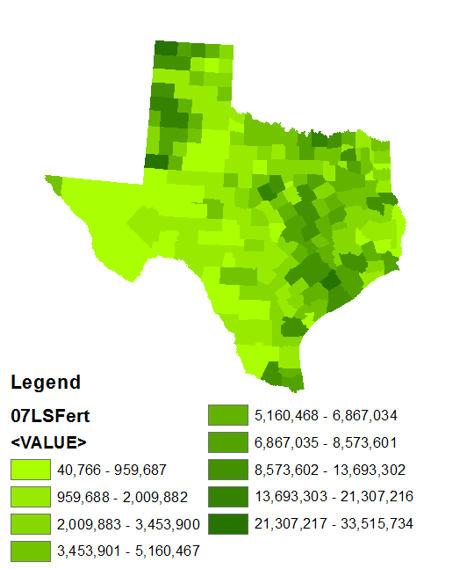
Livestock and Fertilizer Inputs
(kg N km⁻¹ year⁻¹)

Slide 22
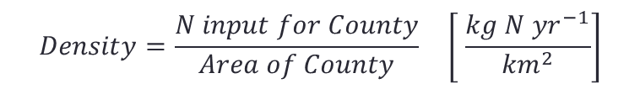
Getting the Nutrients to Catchment Level
Best Practice was to find Density of N within each county
$$Density=\frac{N input for County}{Area of County} \left[ \frac{kg N {yr}^{−1}}{{km}^{2}}\right]$$
Density of Livestock
and Fertilizer N Inputs
(kg N yr⁻¹/ km²)

Slide 23
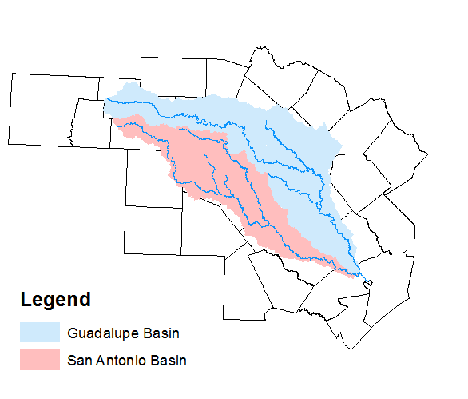
What is Measured as Export?
(McClelland Data)

