Slide 1
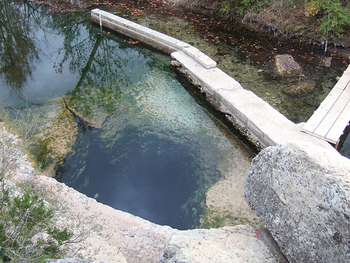
Jacob’s Well Spring
Hill Country Project

Slide 2
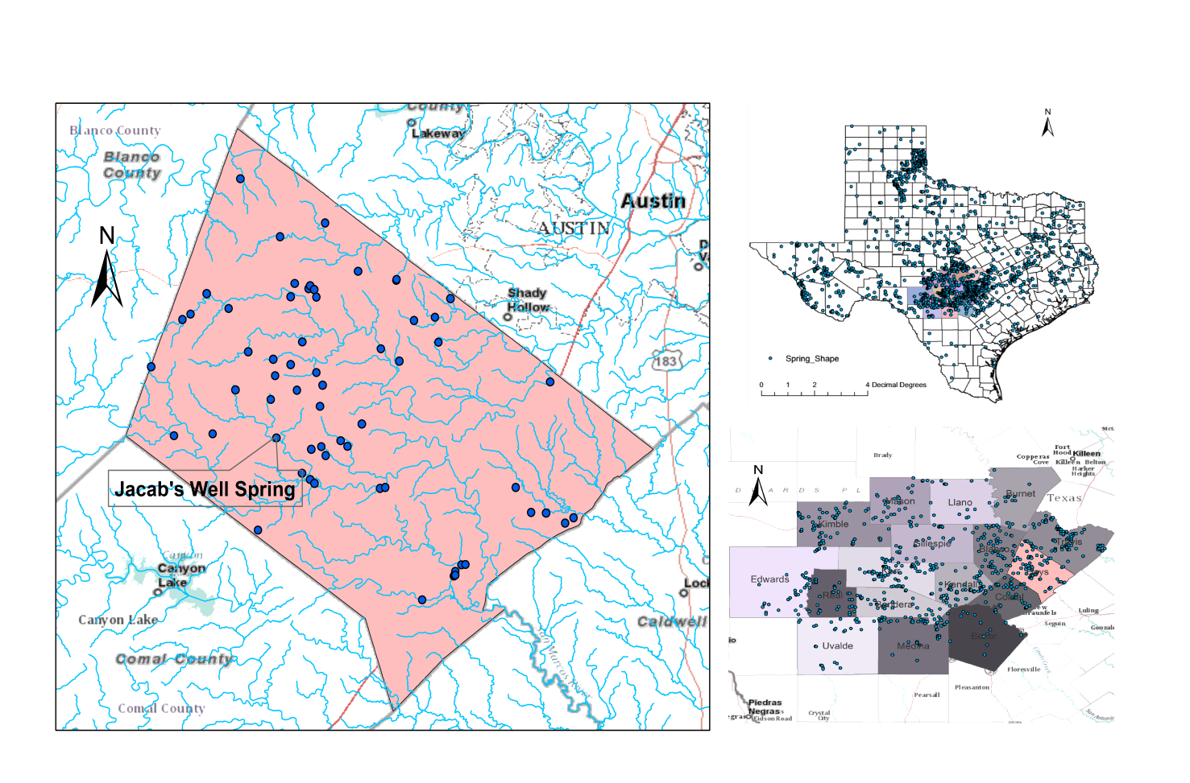
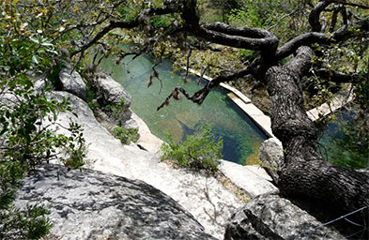
Study area

Slide 3
purpose
1
2
Time series water temperature data analysis of the Jacob’s well spring
3
Characterization of the land use and population influence on this area
Upstream watershed delineation for the Jacob’s well spring

Slide 4
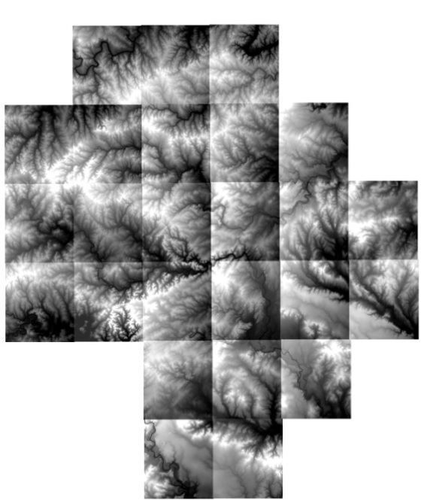
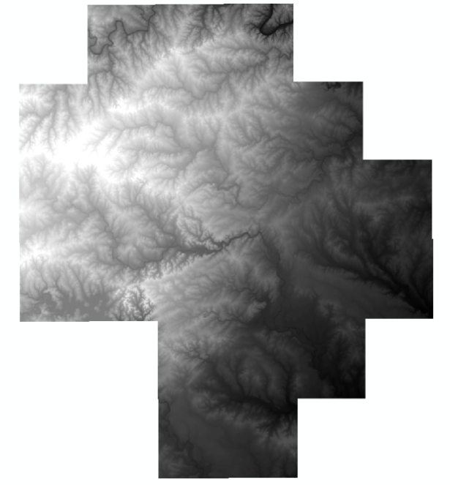
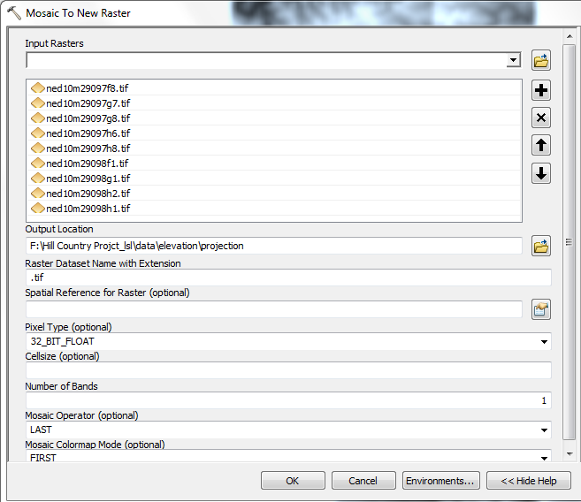
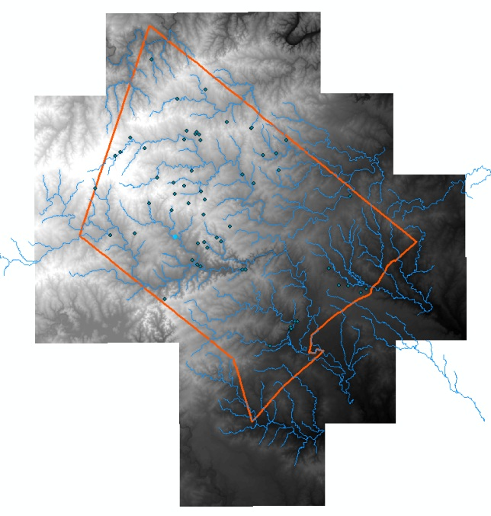
Upstream watershed delineation of the Jacob’s Well Spring
MOSAIC TO NEW RASTER
http://datagateway.nrcs.usda.gov/GDGOrder.aspx

Slide 5
Upstream watershed delineation of the Jacob’s Well Spring
DEM Reconditioning
Filling Pits
Flow Direction
Flow Accumulation
Snap Pour Point
Watershed Delineation

Slide 6
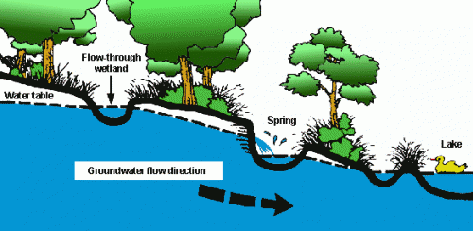
Jacob’s well spring is right located at the discharge area of the Trinity Aquifer
Ground water flows underground until it reaches a discharge zone, an area where the water is above the land surface. Springs are clearly visible discharge zones.

Slide 7
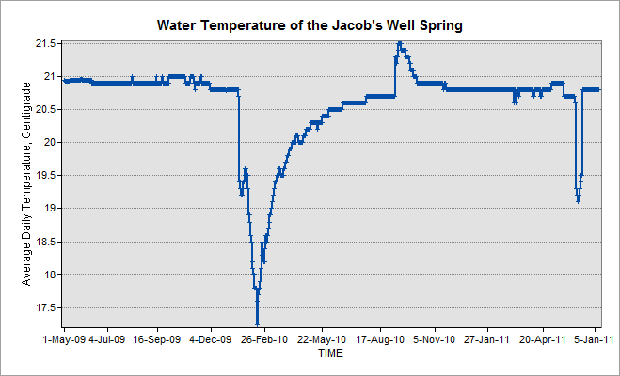
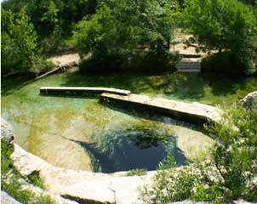
Temperature of the Jacob’s Well Spring from Jan. 2009 to Jan. 2011
Decrease in Spring
Increase in Summer
http://www.jacobswellspring.org

Slide 8
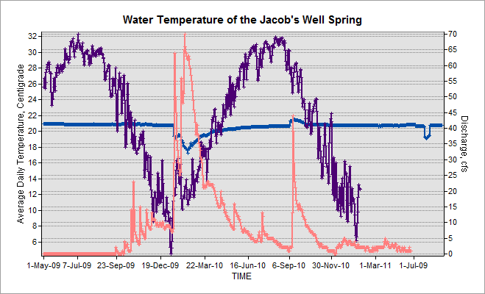
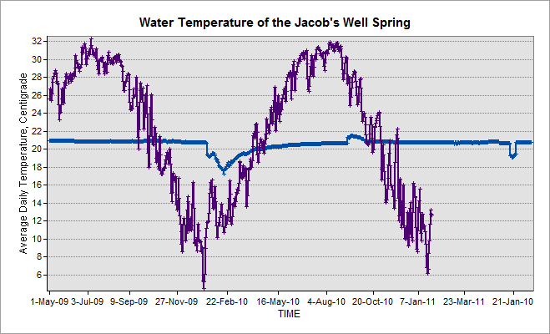
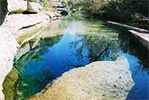
Temperature of the Surface water from Jan. 2009 to Jan. 2011
Surface water temperature fluctuates
While spring water remains almost constant, except…

Slide 9
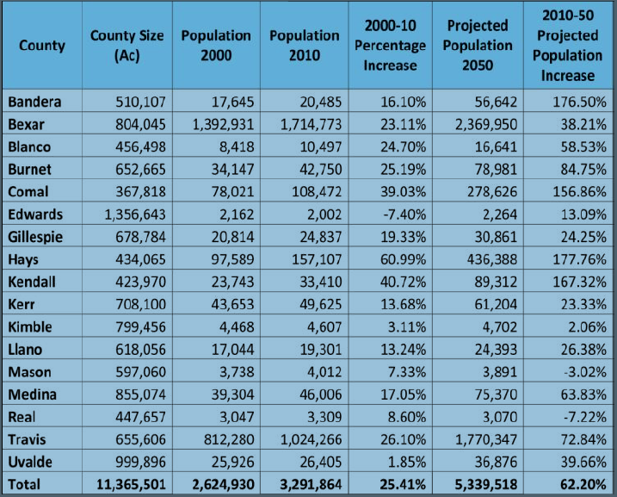
Population
Population increase plays an important role in the water quantity and quality conservation.

Slide 10
Population density now
Population density in 2050

Slide 11
Land use type
Pink part represent the developed land

Slide 12
Conclusion
Jacob’s Well Spring will be affected by the surface water during summer and spring period .
Factors affecting the surface water quality will also have an impact on the spring water.
Population is centered around the spring as well as the developed land. Thus well management of water use should be made to prevent water pollution to the spring water.
Relationship between population increase and water conservation is needed for better management.

