Slide 1
Spatial Distribution of Pulsed Environmental Flows
GIS in Water Resources, 2011
Alison Wood

Slide 2
Environmental Flow Regime
Flows to Keep Rivers Healthy
USGS Gage 08019500, Big Sandy Creek near Big Sandy
Season | Subsistence | Base | Pulse
Winter | 20 cfs | 73 cfs | 1 per season Trigger: 358 cfs Volume: 5,932 af Duration: 10 days
Spring | 9 cfs | 33 cfs | 2 per season Trigger: 313 cfs Volume: 5,062 af Duration: 13 days
Summer | 8 cfs | 15 cfs | 1 per season Trigger: 50 cfs Volume: 671 af Duration: 6 days
Fall | 8 cfs | 22 cfs | 2 per season Trigger: 130 cfs Volume: 2,189 af Duration: 9 days
cfs = cubic feet per second , af = acre-feet
www.tceq.com

Slide 3
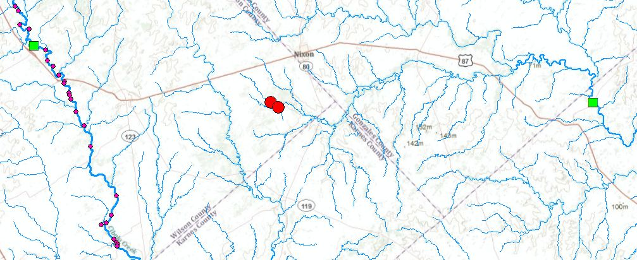
TCEQ’s Need
Water Withdrawals Not Near Gages

Slide 4
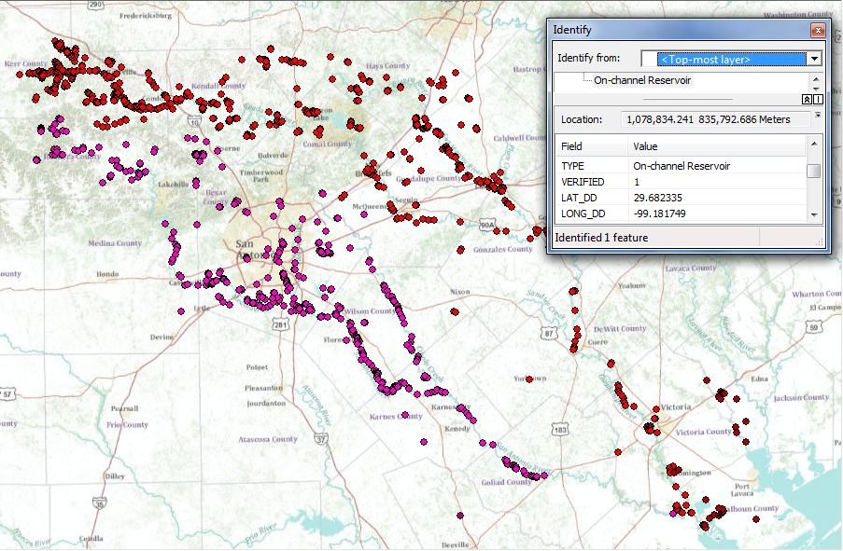
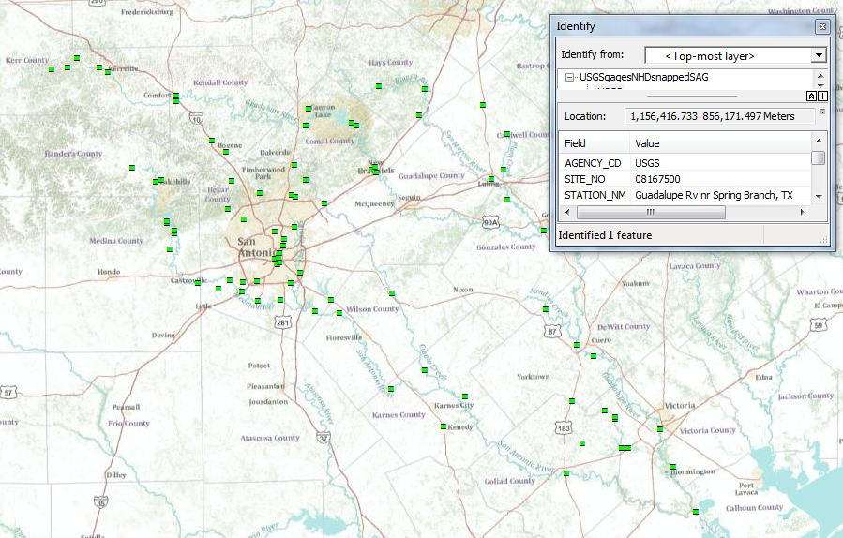
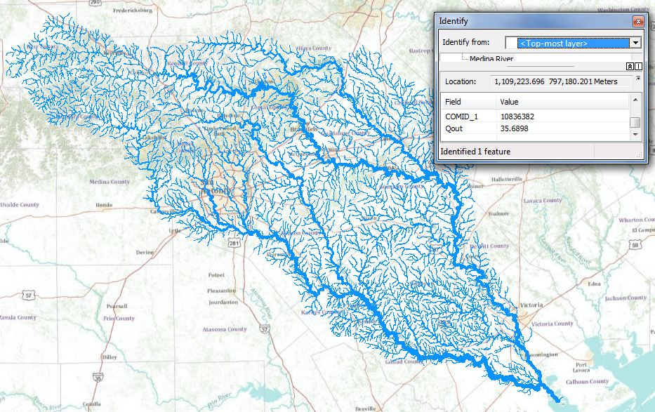
Data Sources
TCEQ Rights Points
USGS Gages
RAPID Model Output

Slide 5
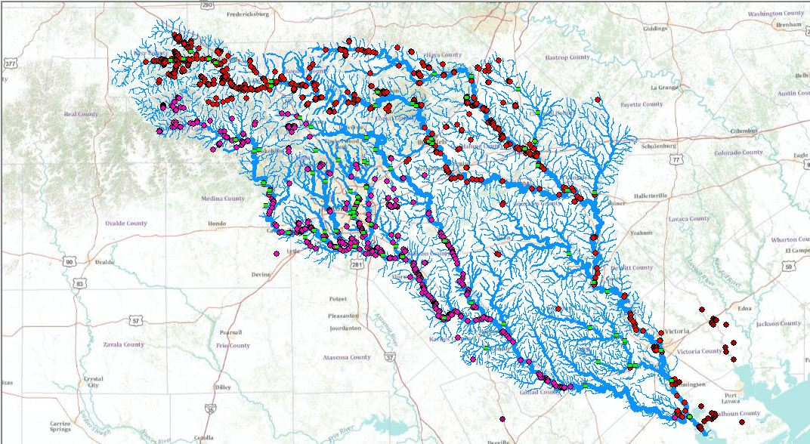
Bringing the Data Together

Slide 6
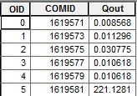
RAPID Model created by Cédric David
Routing Application for Parallel computatIon of Discharge
Input: surface and groundwater flows
Output: flow and volume of water throughout river network
Output in netCDF format
http://www.geo.utexas.edu/scientist/david/rapid.htm

Slide 7
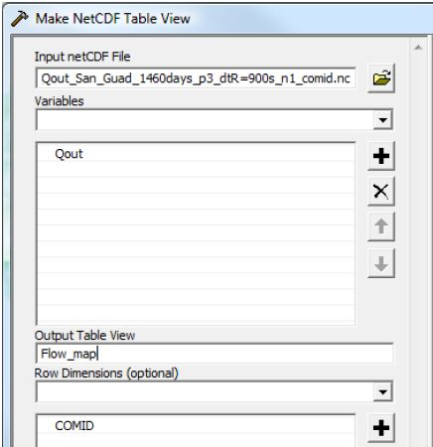
Mapping RAPID Output
Create a Table from Data
http://www.geo.utexas.edu/scientist/david/files/RAPID_in_ArcGIS.pdf

Slide 8
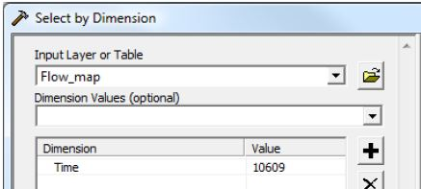
Mapping RAPID Output
Choose a Time-Step
http://www.geo.utexas.edu/scientist/david/files/RAPID_in_ArcGIS.pdf

Slide 9
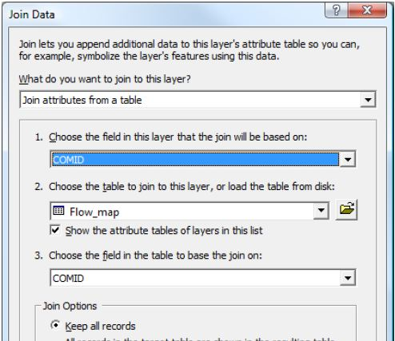
Mapping RAPID Output
Join Table to Flowline Layer
http://www.geo.utexas.edu/scientist/david/files/RAPID_in_ArcGIS.pdf

Slide 10
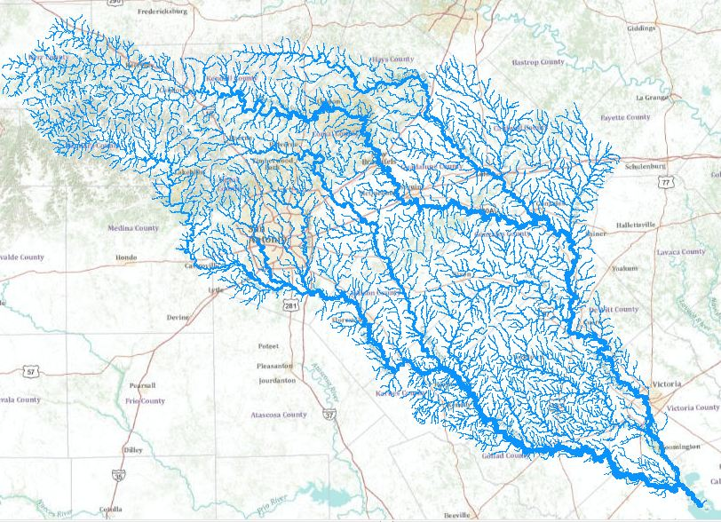
Mapping RAPID Output
Result: Map with Flow Values

Slide 11
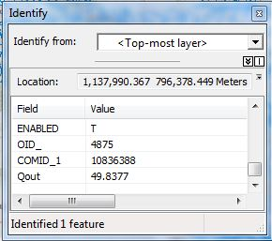
Mapping RAPID Output
Attribute: Qout = Flow

Slide 12
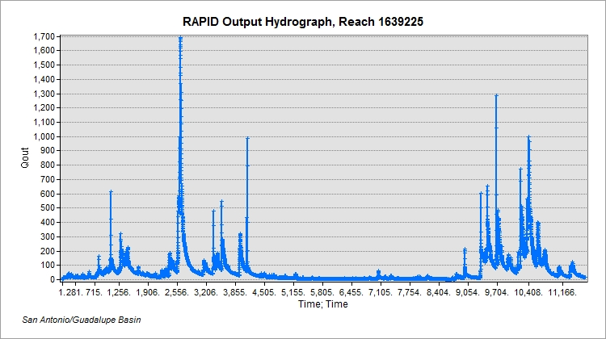
RAPID Output – Hydrograph
Model Flow Over Time

Slide 13
USGS Gage Flow– Hydrograph
Measured Flow Over Time
HydroExcel: http://his.cuahsi.org/hydroexcel.html

Slide 14
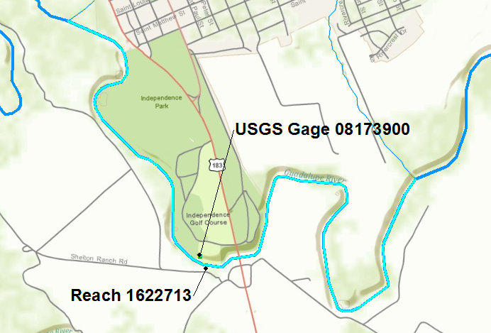
Locations of Hydrographs:
Gage 08173900 and Reach 1622713

Slide 15
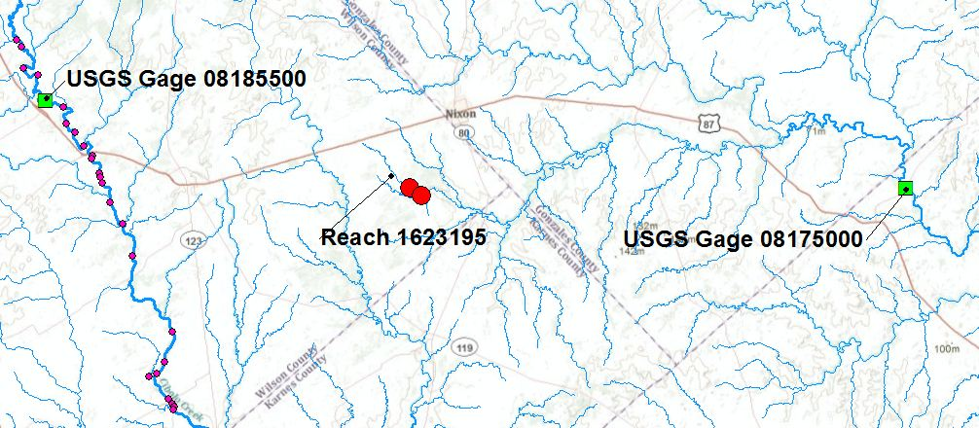
TCEQ’s Need
Water Withdrawals Not Near Gages

Slide 16
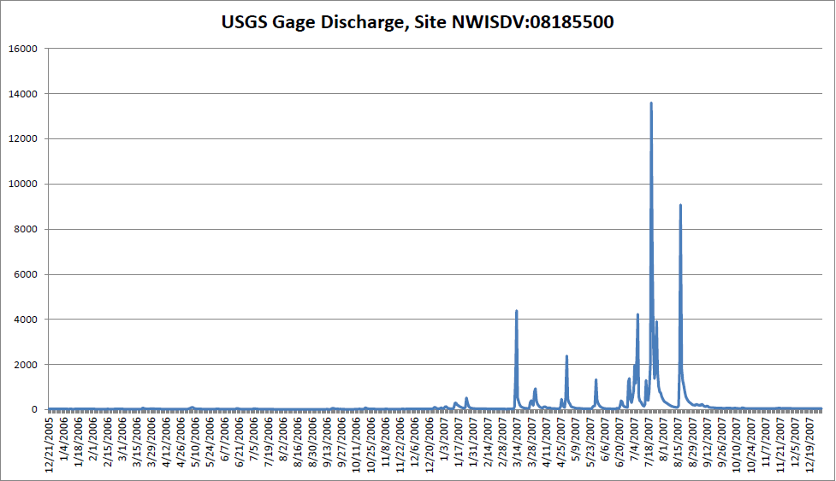
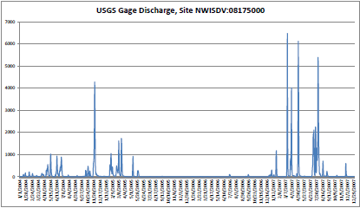
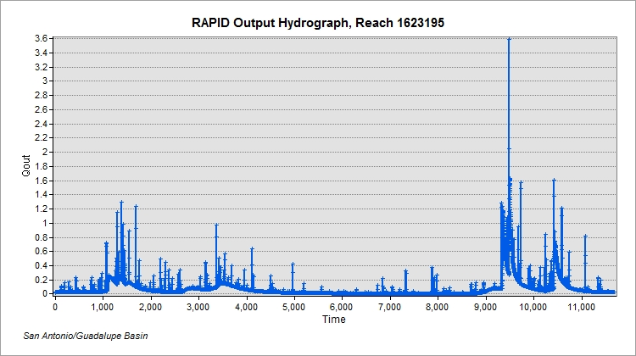

Slide 17
Next Steps:
Collect Data, Compare, Correlate
RAPID hydrographs for all chosen reaches
USGS hydrographs for all chosen gages
Compare model output with observed data
Correlate reaches with gages that reflect flows

Slide 18
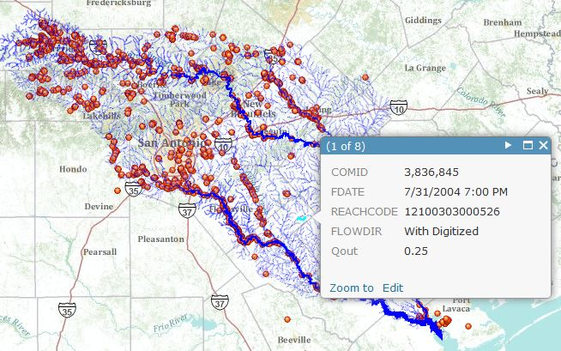
Until Real-Time Flow Maps
(Example with Historical Data)

Slide 19
Questions?

