Slide 1
Animating Observations and Model Data in ArcMap
Fengyan Yang
11/15/2011

Slide 2
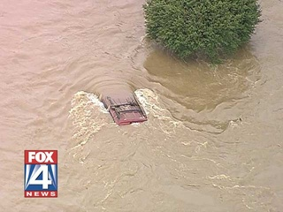
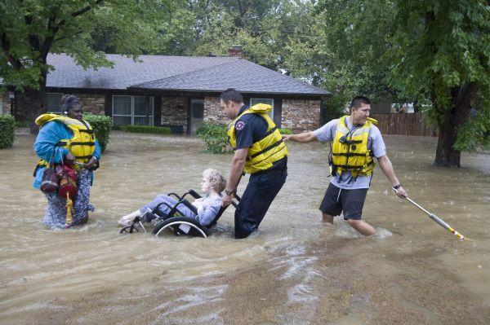
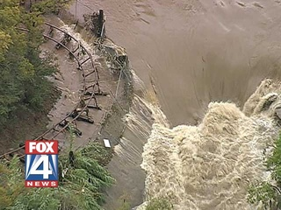
Case Study of
Hermine Flood
  Flooding caused by Tropical Storm Hermine
  9/7/2010
  The State of Texas
flooding cities
killing two people

Slide 3
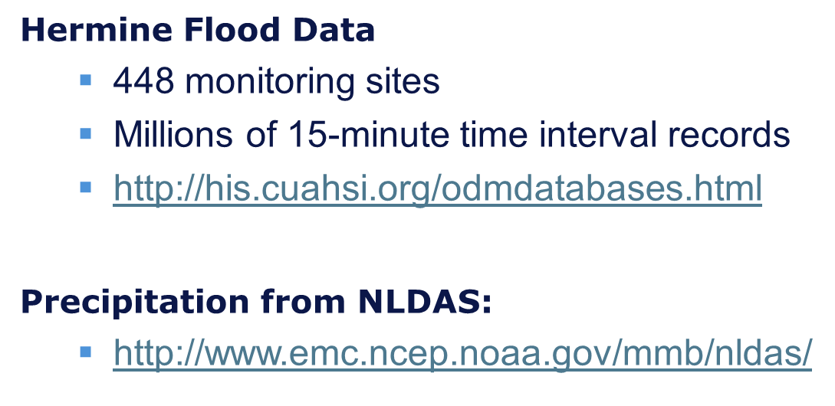
Outline
Data Animation
Data Processing
In ArcMap
Create a Time-Enabled Query Layer using views from the ODM database for flood;
Make a netCDF raster layer for precipitation.
SQL Sever
Create views to filter data
Ncar Command Language
to transform precipitation Data from GRIB to netCDF
Data Acquisition
Observations Data Model(ODM) database for Flooding
Observations and Model GRIB data for Precipitation

Slide 4
Data Animation
Data Processing
In ArcMap
Create a Time-Enabled Query Layer using views from the ODM database for flood;
Make a netCDF raster layer for precipitation.
SQL Sever
Create views to filter data
NCAR Command Language
to transform precipitation Data from GRIB to netCDF
Data Acquisition
Observations Data Model(ODM) database for Flooding
Observations and Model GRIB data for Precipitation

Slide 5
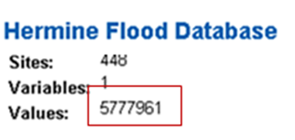
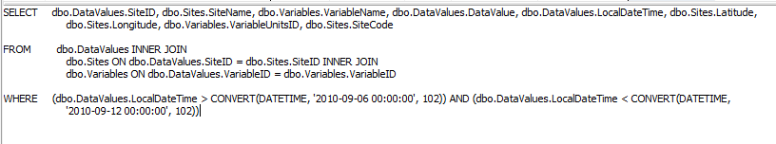
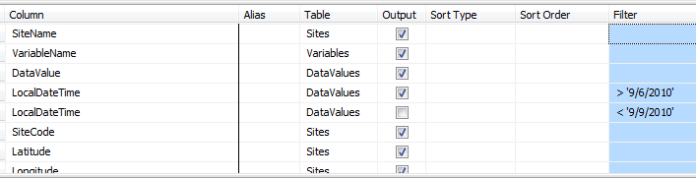
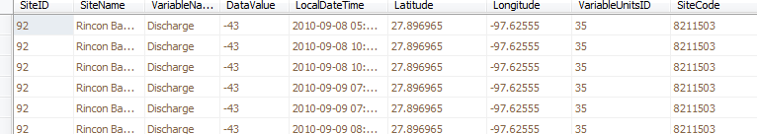
Flooding
SQL
View
Query
Hermine flood time
Results

Slide 6
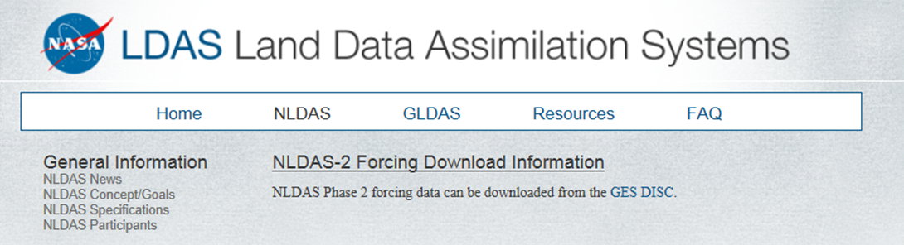
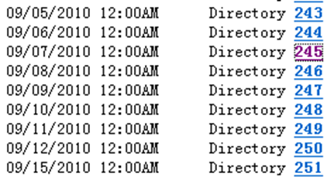
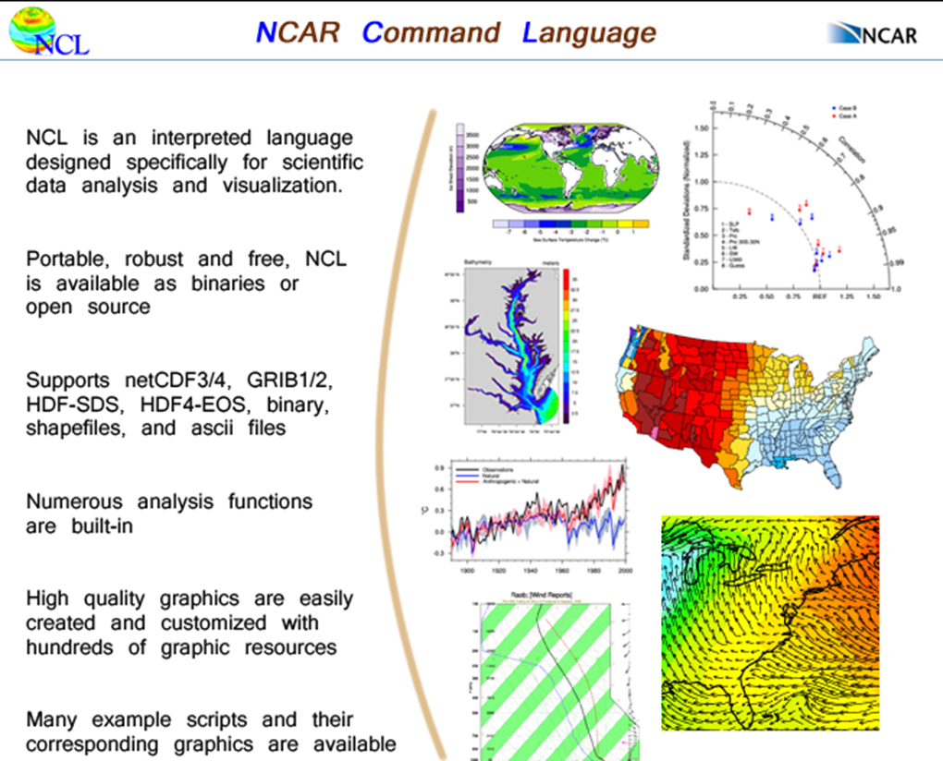
Precipitation
Hourly Precipitation data from NLDAS
Using NCAR Command Language Convert from GRIB format to netCDF (Network Common Data Form) format
Because netCDF format is easier to connect to ArcMap

Slide 7
Link Data to ArcMap
Data Animation
Data Processing
In ArcMap Create a Time-Enabled Query Layer using views from the ODM database for flood;
Make a netCDF (Network Common Data Form) raster layer for precipitation.
SQL Sever
Create views to filter data
NCAR Command Language
to transform precipitation Data from GRIB to netCDF
Data Acquisition
Observations Data Model(ODM) database for Flooding
Observations and Model GRIB data for Precipitation
Ready to go animating

Slide 8
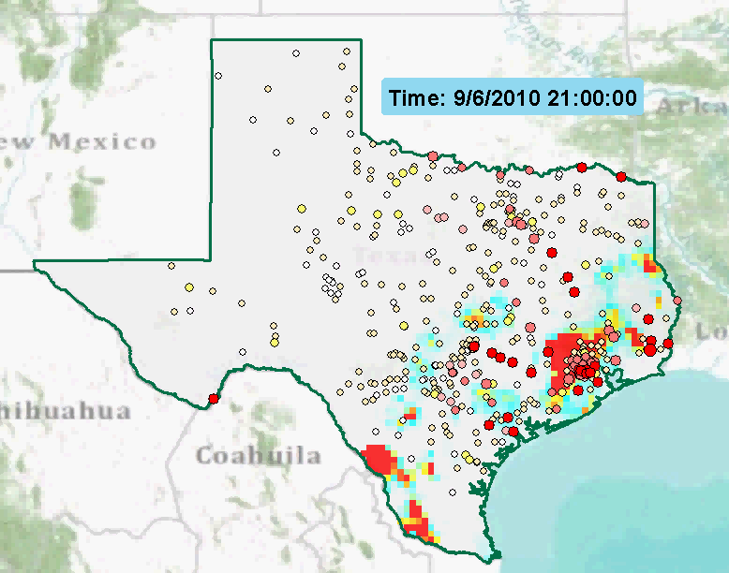
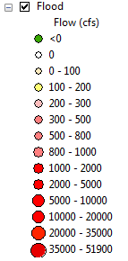

Animation for Flooding and Hermine Storm
Gulf Mexico

Slide 9
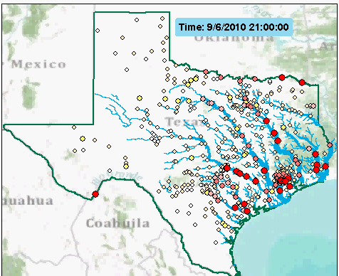
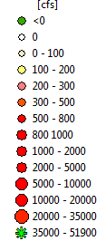
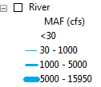

Flood Flow Animation with River Mean Annual Flow Reference
Flood flow
Red RIver
Flood pattern and trend

Slide 10
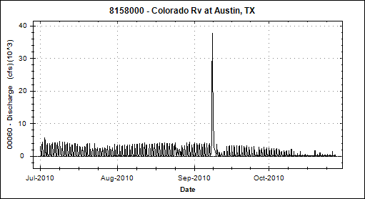
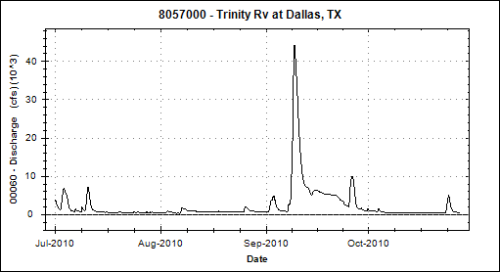


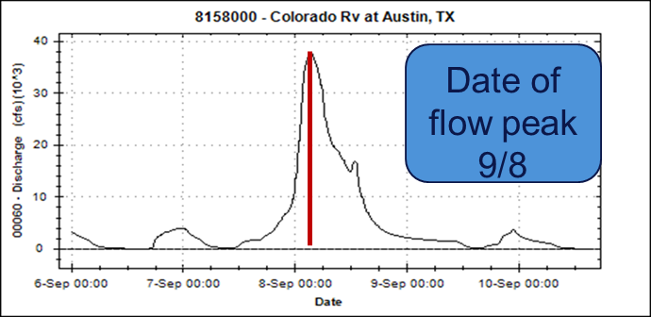
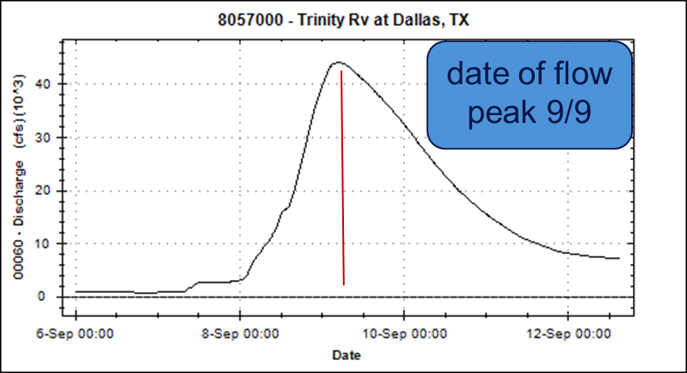
Flow discharge data analysis through ODM Tools
Fluctuation due to dams regulation to the flow discharge
One day apart to reach the flow peak, storm came to Austin one day before Dallas
Notes:
Connect with SQL sever through the same

Slide 11
Summary
Verified Query layers enable ODM database data to be viewed in ArcMap
Reviewed the patterns, trends and data changes of Flooding and Rainstorm over a period of time
This process can be applied to other time series data

Slide 12
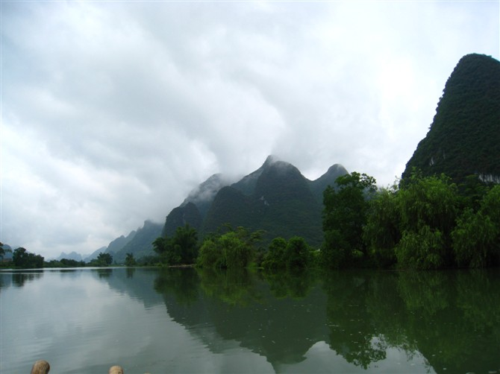

Guilin, China
July 2011

