Slide 1
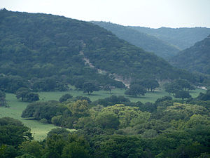
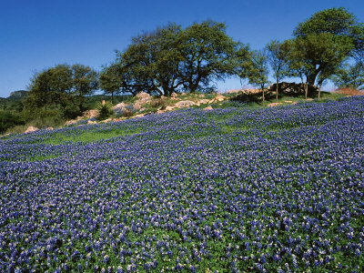
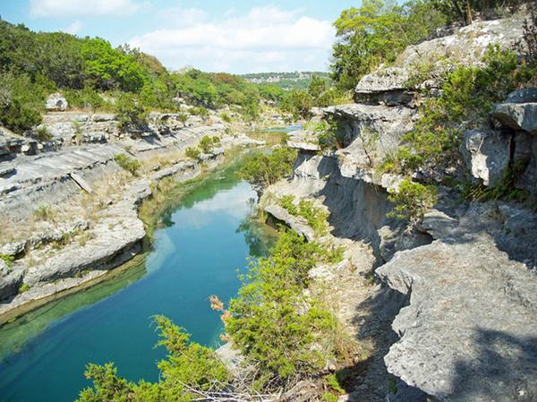
Colorado River Water Resources Vulnerability
Project for Hill Country Conservancy
Daniel Zavala Araiza

Slide 2
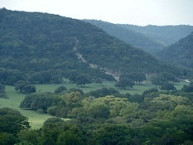
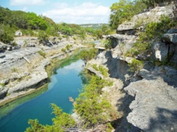
Outline
- Outline -
Hill Country Conservancy
Defining vulnerability
Mapping vulnerability
Methodology
Results
Conclusions

Slide 3
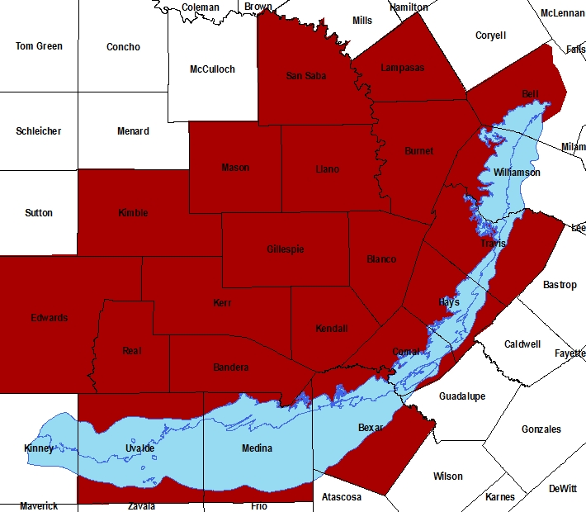
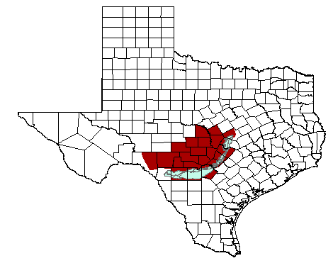
- Hill Country Conservancy -
Land preservation agreements.
Conserve a property in its natural state.
Land conservation -> impact on aquifer system.

Slide 4
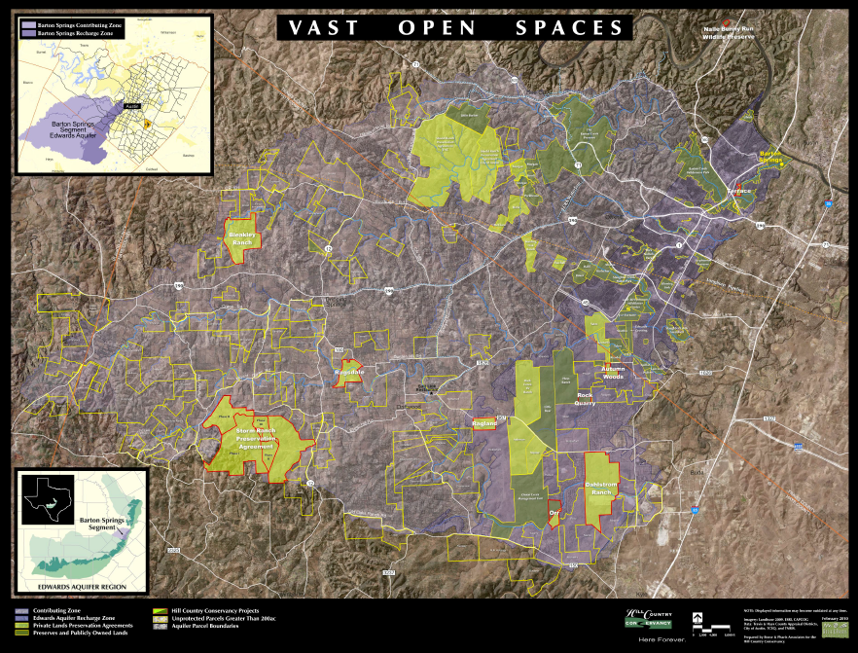

Slide 5
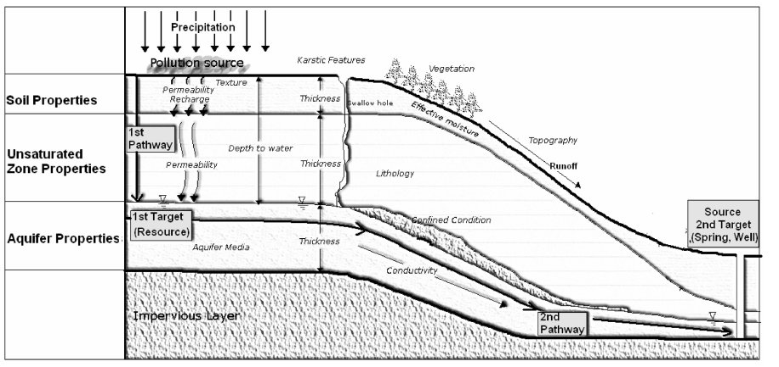
- Objective -
Development of a tool that is useful in determining which parts or parcels of land are more valuable in terms water resources vulnerability to focus on their preservation.
Yildirim, M., and Topkaya B., (2007), Groundwater Protection: A Comparative Study of Four Vulnerability Mapping Methods. Clean 35 (6), 594 – 600.

Slide 6
- Defining Vulnerability -
Intrinsic geological + hydro geological characteristics which determine sensibility of groundwater/surface water to contamination.
intrinsic vs. specific
All kinds of pollutants
Vulnerability mapping
Point sources (oil spills, leakage)
Risk mapping

Slide 7
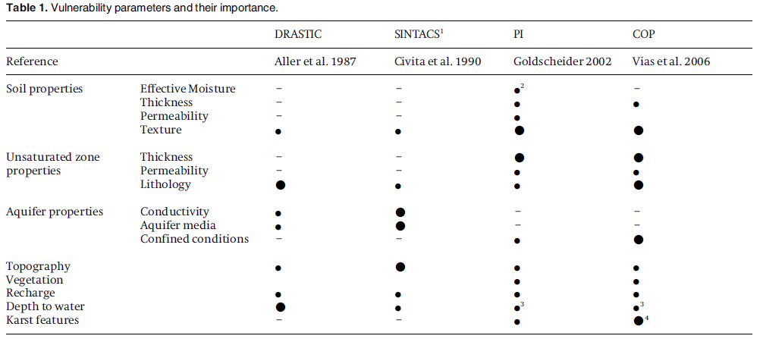
- Mapping Vulnerability -
Yildirim, M., and Topkaya B., (2007), Groundwater Protection: A Comparative Study of Four Vulnerability Mapping Methods. Clean 35 (6), 594 – 600.

Slide 8
- Selected Parameters -
Soil thickness
+
thin
Soil KSAT
+
high
How much filtration?
Amount of water that can be absorbed.
How easily water flows through the soil.
-
thick
-
low
Slope
+
Vegetation
steep
+
How likely water is to runoff?
How much water will be impeded by vegetative cover?
*ranking based on amount of ground cover
-
flat
-

Slide 9
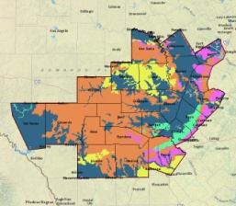
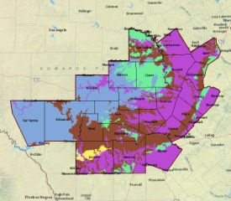
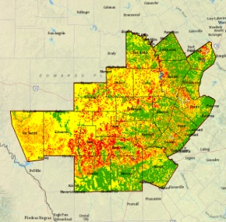
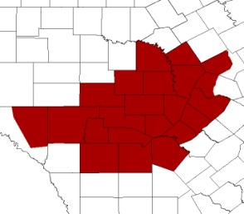
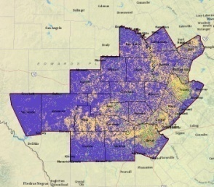
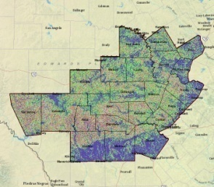
- Creating layers -
Soil thickness
Soil KSAT
SSURGO
Weighted sum
HCC study area
Vulnerability map
NED
(USGS)
Slope
Reclassify
*raster
Vegetation
NLC
(USGS)
*raster

Slide 10
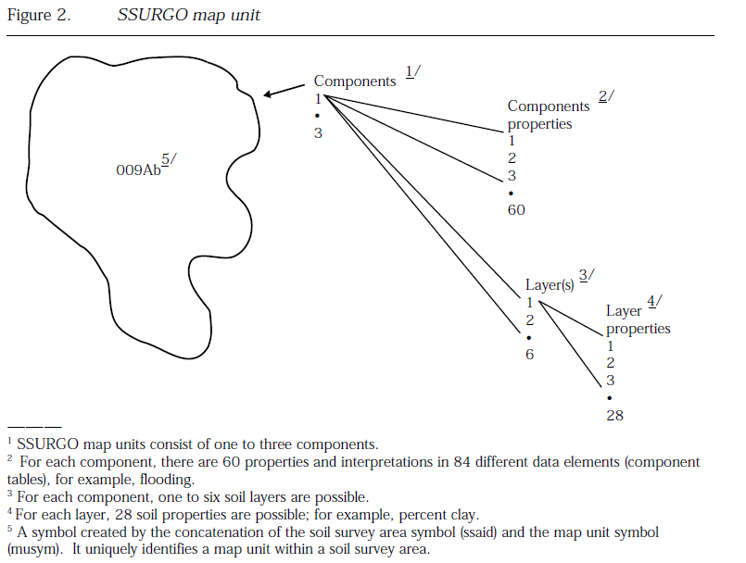
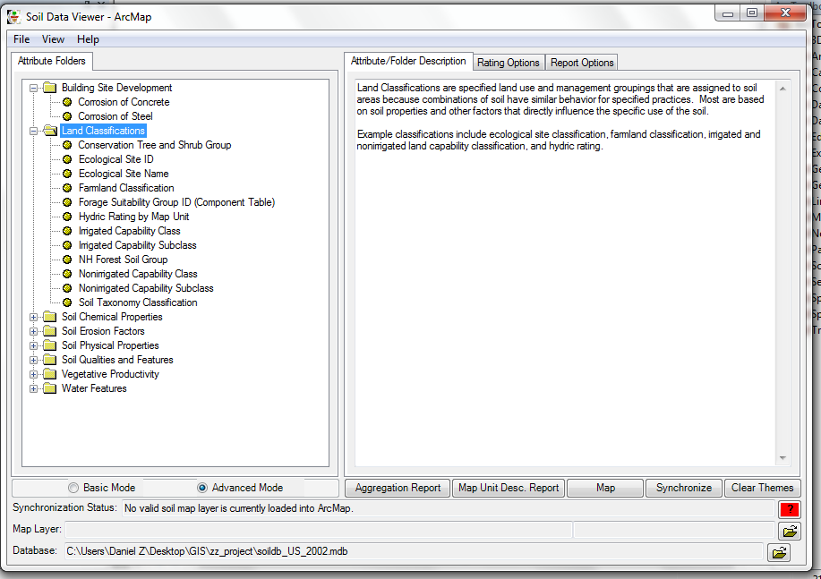
- Soil Datasets -
Soil Survey Geographic Database (SSURGO)
Soil Data Viewer for ArcMap
Soil Survey Geographic Data Base Data Use Information, USDA, 1995,pp.110

Slide 11
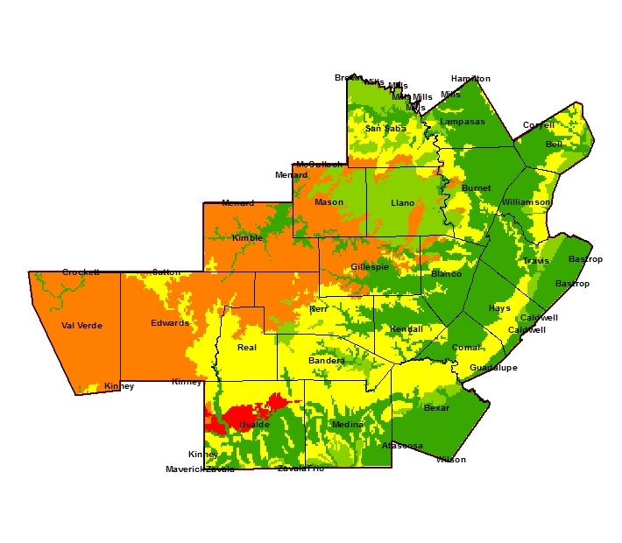
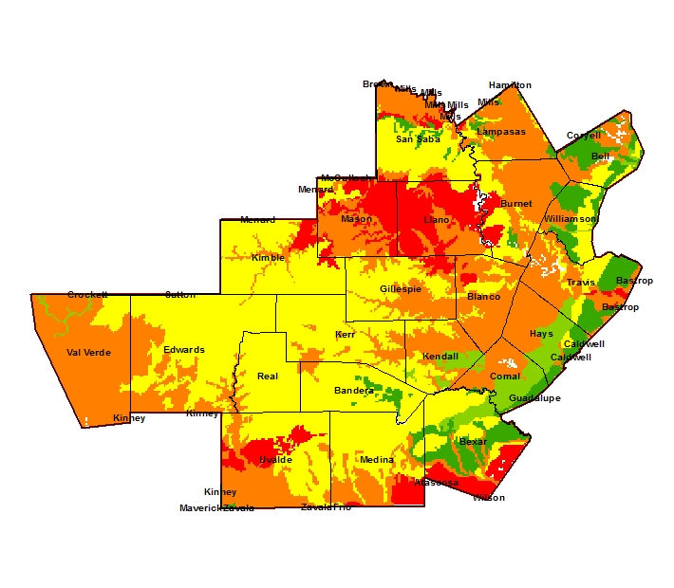
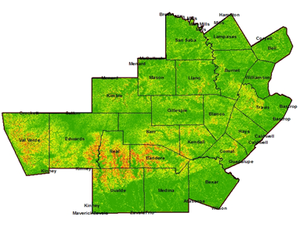
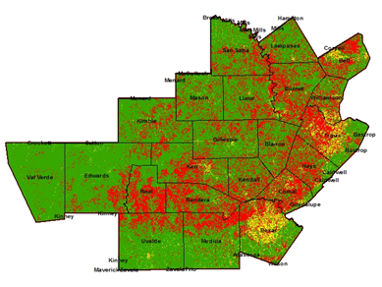
- Layers -
KSAT
Soil Thickness
Slope
Vegetation

Slide 12
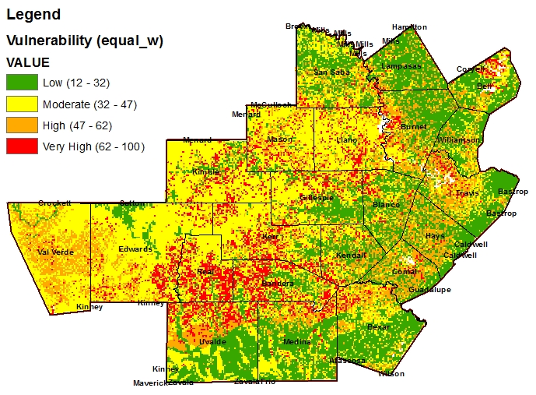
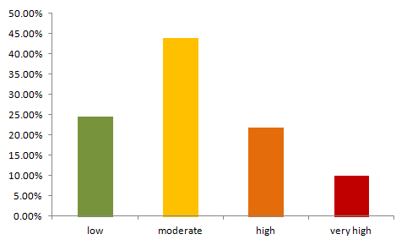
- Results -

Slide 13
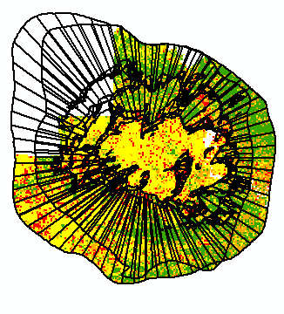
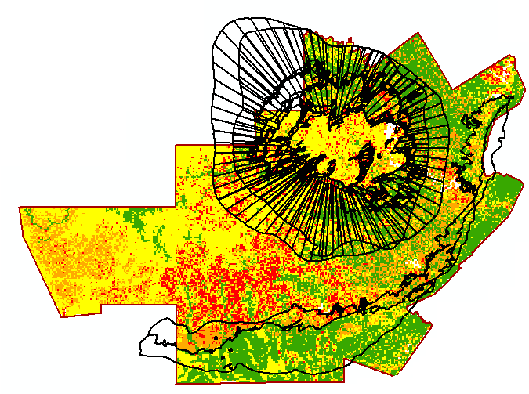
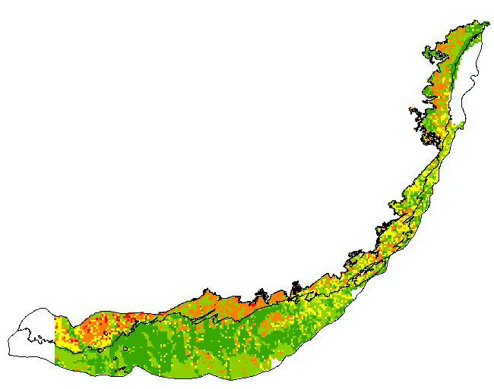
- Results -
Hickory Aquifer
Edwards Aquifer

Slide 14
- Further work -
Add Cave Density as parameter.
Compare groundwater to surface water vulnerability
Sensibility analysis for relative importance of parameters in weighted sum.

Slide 15
- Conclusions -
Vulnerability mapping as a valuable tool.
Couple their use with other methods (risk mapping).
Importance of parameters selected and their weight.

