Slide 1
An Approach to Sizing a
Rainwater Cistern
by
Russell B. Thomas
17 November 2011

Slide 2

Agenda
Motivation for Project
Methodology
The Move to Colorado
Limitations
Questions

Slide 3
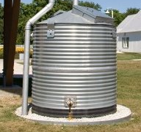
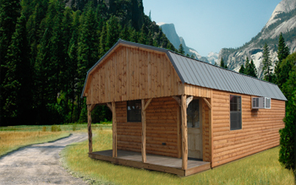
Motivation: Water Independence from above!!
Scenario:
  Newly retired
  Desire to live in a log cabin (532 ft²)
  Rainwater Harvesting to be sole water source
http://www.rain-barrel-world.com/rainwater-cisterns.html
http://www.ulrichlogcabins.com/log-cabins/texas-log-cabin.php?Rocky-Ridge-Series-4

Slide 4
Methodology
Utilize available Monthly data from PRISM
Determine catchment area and monthly water usage
Model end of Month Storage based on 30 yr average precipitation data
Model year-end Storage
Assume Limitless Tank

Slide 5
Desired End-state
A spatial representation of water available anywhere in the US based on:
  Catchment area
  Monthly Usage
Ability to quickly view when periods of low storage may occur and plan accordingly

Slide 6
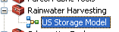
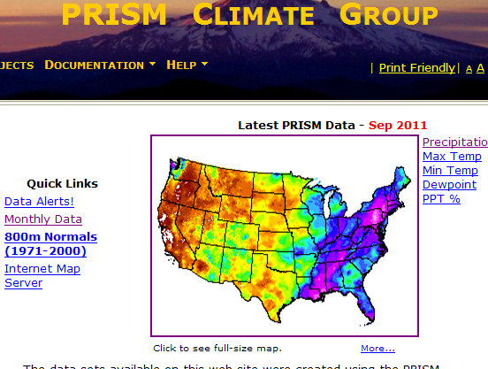
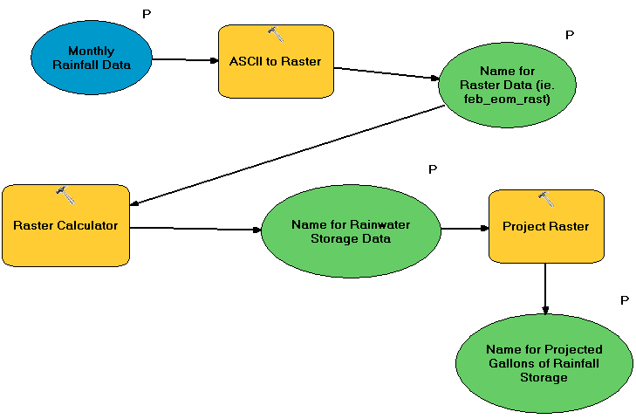
Methodology
Data Source:
GIS Model:
Monthly Avg. Data 1971-2000
Projection: GCS_North_American_1983

Slide 7
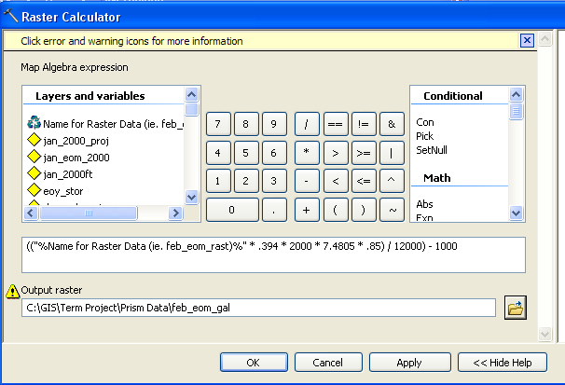

Methodology continued….
Storage Calculation:
$$S=\frac{PV(100mm)}{\frac{1000mm}{cm}}∗\frac{.394ft}{12cm}∗\frac{7.4805gal}{ft^{3}}∗η∗CA∗−M$$
Where:
S= Storage available(gal)
PV=Prism Precipitation value(100mm)
CA=Catchment Area (ft² )
M= Monthly water Usage(gal)
$η$ =efficiency factor (.85)
Result is a Raster for End of Month Storage

Slide 8
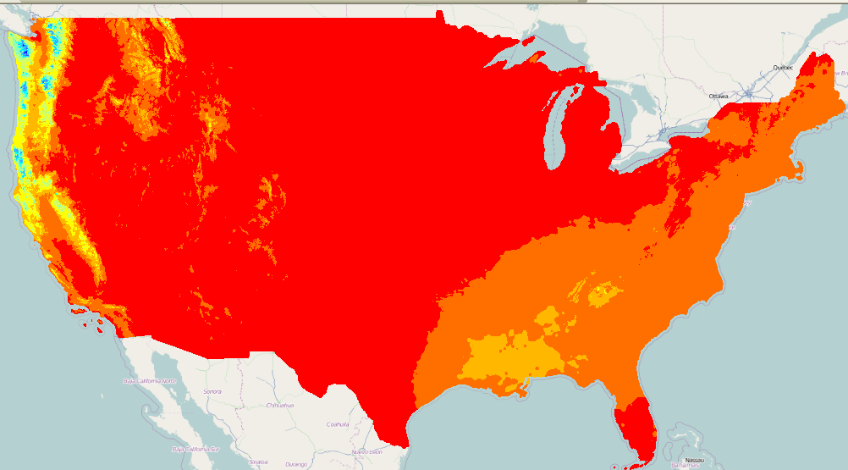
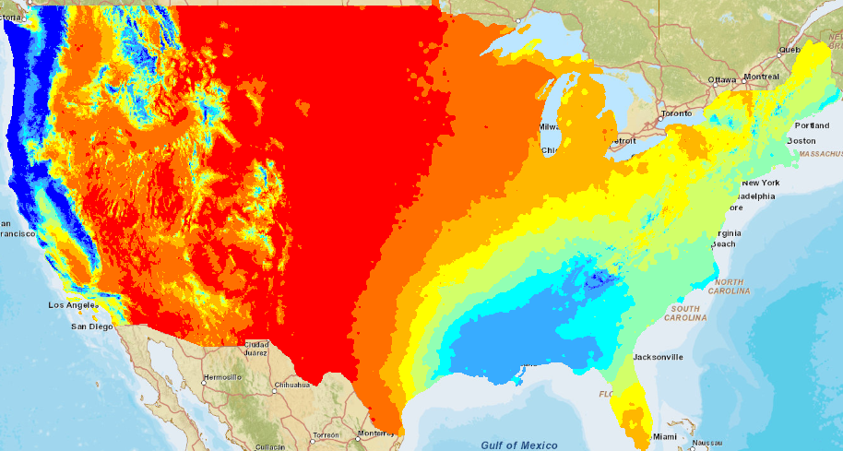
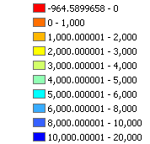

End of Month Storage Rasters (January)
532 ft² Catchment
1000 gallons/mo. usage
2000 ft² Catchment
1000 gallons/mo. usage
Gallons of Water

Slide 9
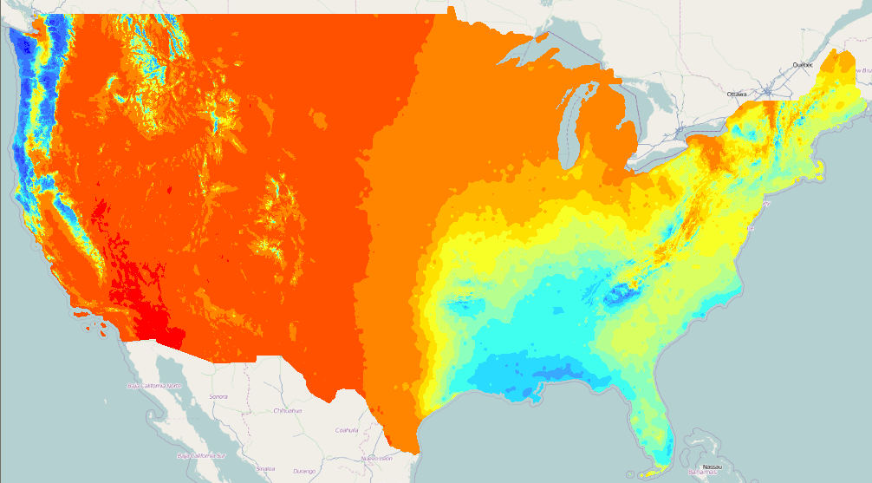

End of Year Storage Raster
Gallons of Water
Ideal for Harvesting

Slide 10
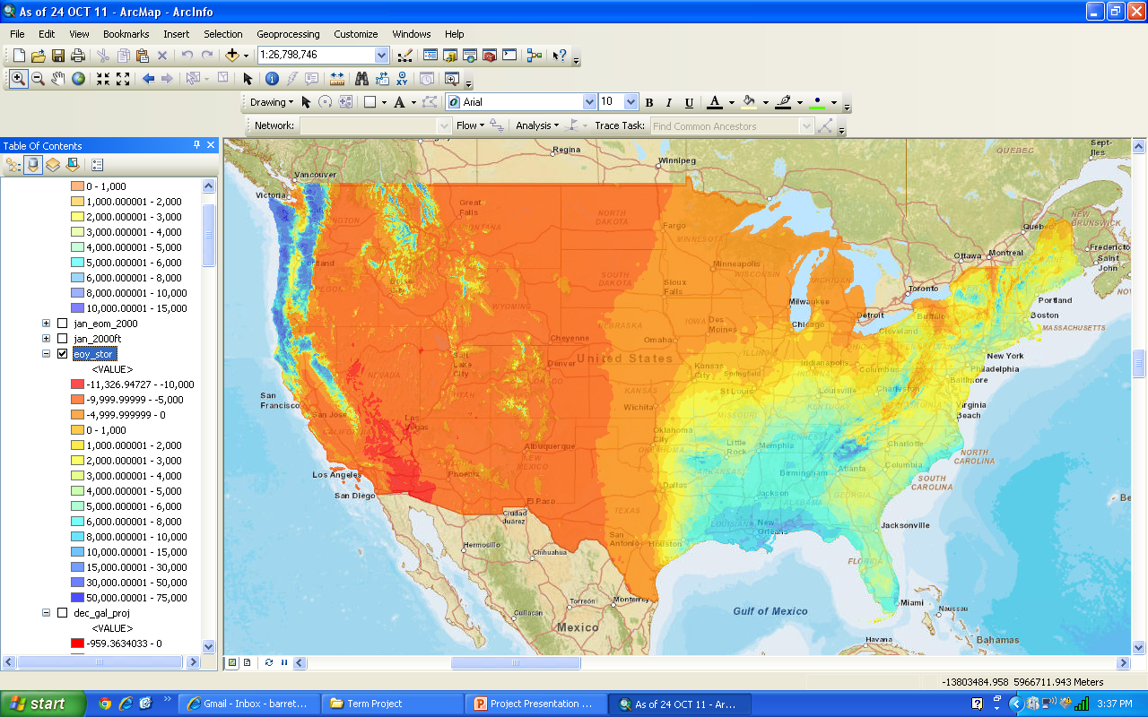
End of Year Storage Raster
Gallons of Water
Looks like a nice little hidden spot…..

Slide 11
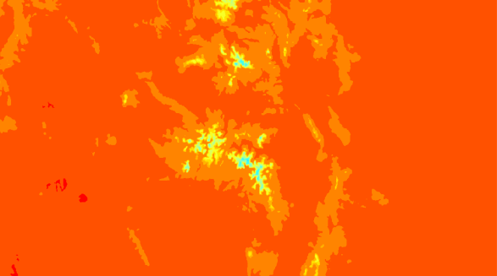
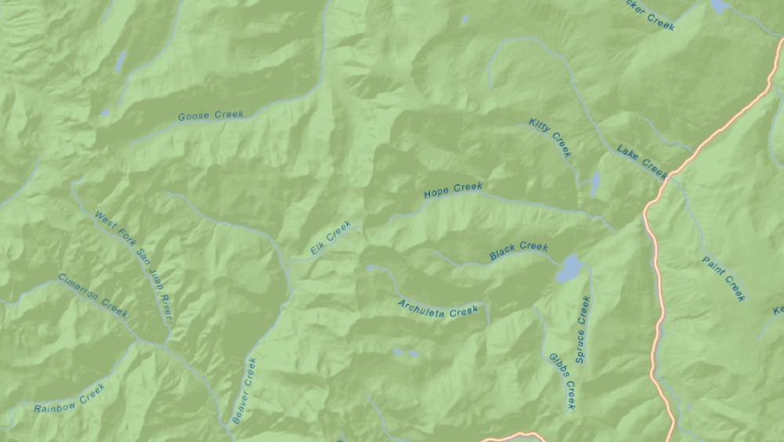
Capabilities
Can zoom down to area you would like to live
Rio Grande National Forest, Mineral County Colorado

Slide 12
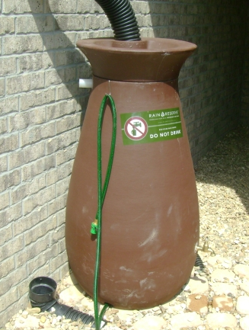
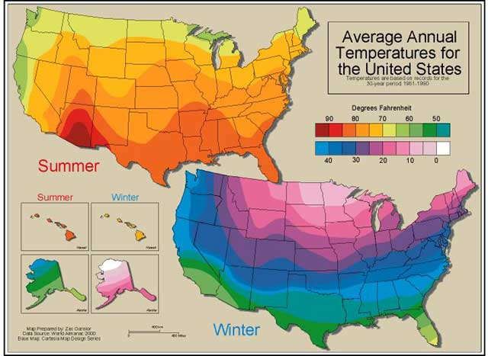
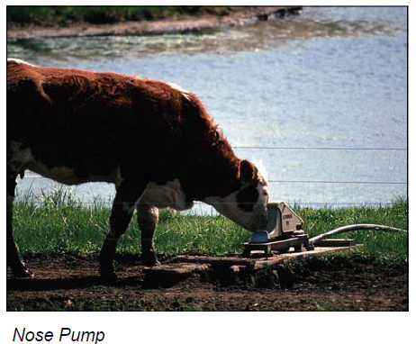
Limitations and Considerations
No Differentiation from snowfall to rainfall
Must still plan for droughts
Desired total storage
  Personal Use vs. Livestock
http://www.in.nrcs.usda.gov/smallscalefarmers
http://www.inarkansas.com/19996/woodlands-edge-shows-off-green-built-model-home

Slide 13
References
Texas Water Development Board. 2005. “The Texas Manual on Rainwater Harvesting”
Texas Commission on Environmental Quality. January 2007. “Harvesting, Sorting, and Treating Rainwater for Domestic Indoor Use”

Slide 14
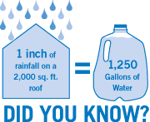
Questions?
http://www.aquascapeinc.com/why_rainwater_harvesting

