Slide 1
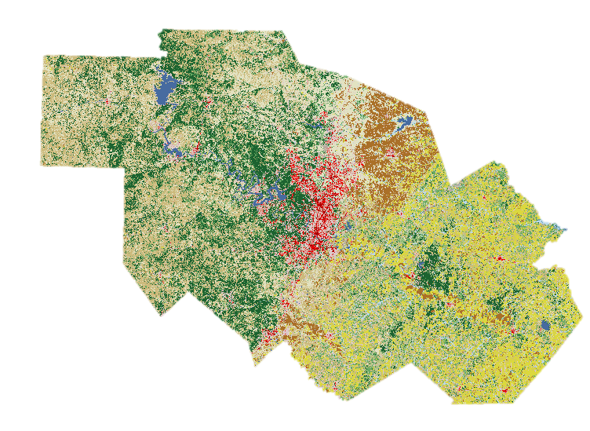
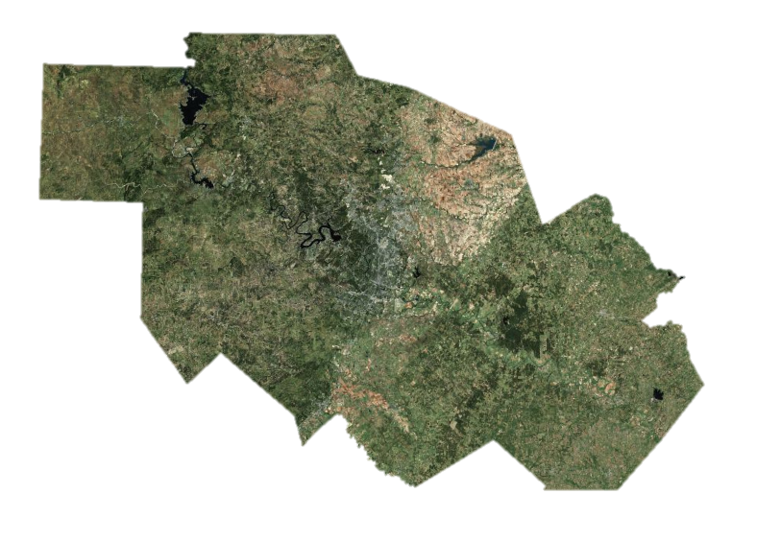
The Impact of Urbanization In Austin Texas and Surrounding Counties
An analysis of land use and development
Bryant Chambers
University of Texas, Austin
GIS in water resourcing Fall 2011

Slide 2
Objectives
Examine land use change for:
Patterns of change
How did change occur
Develop %impervious cover at the subwatershed level

Slide 3
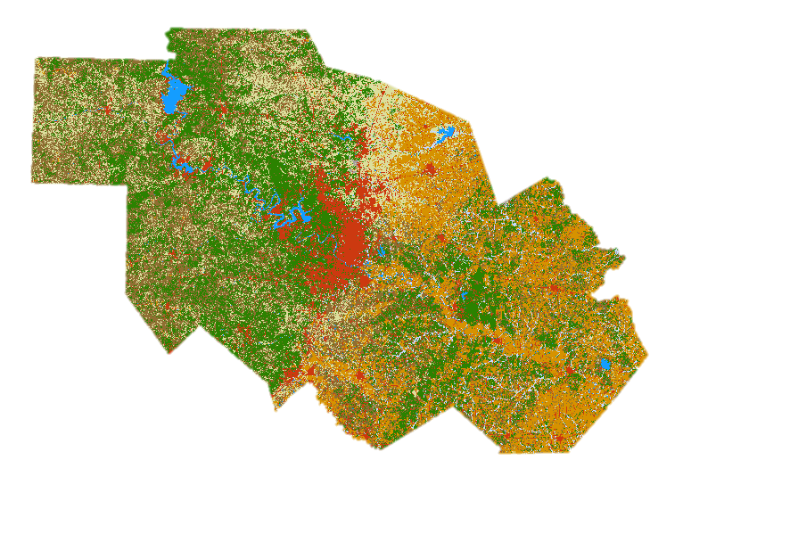
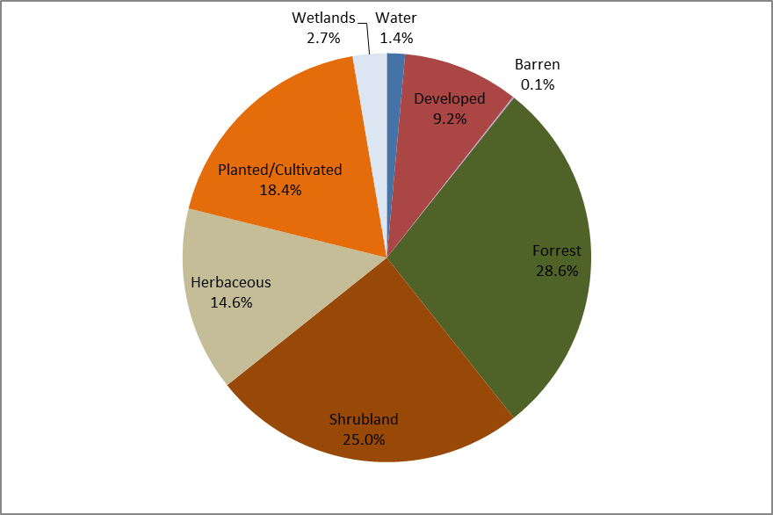
2001

Slide 4
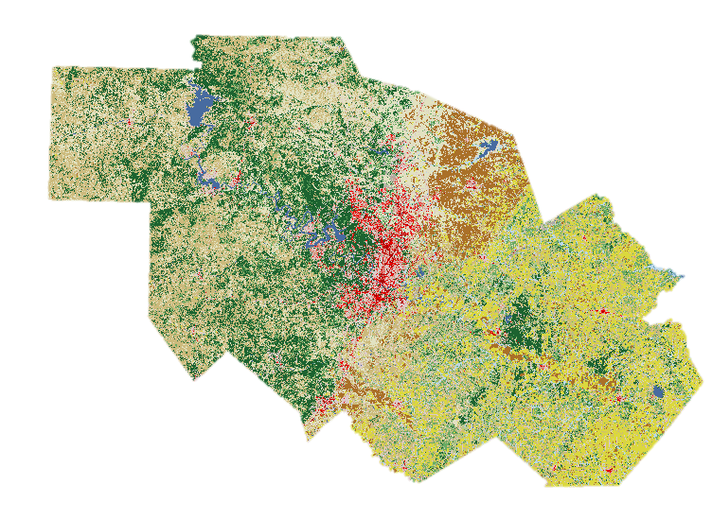
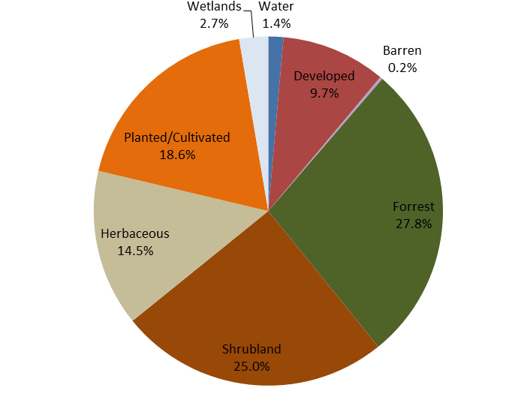
2006

Slide 5
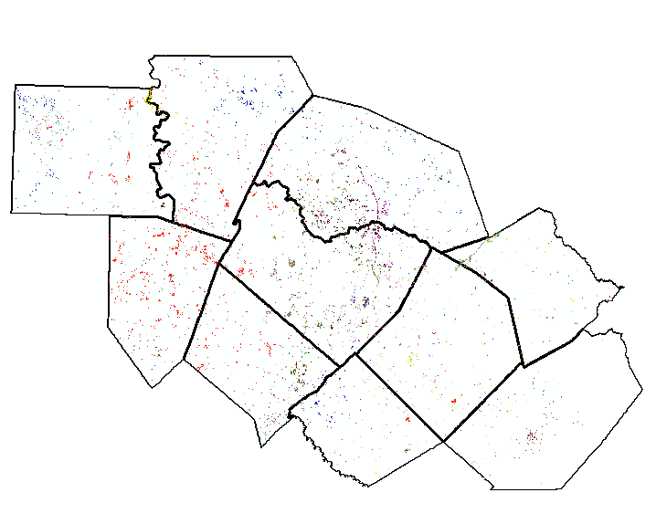
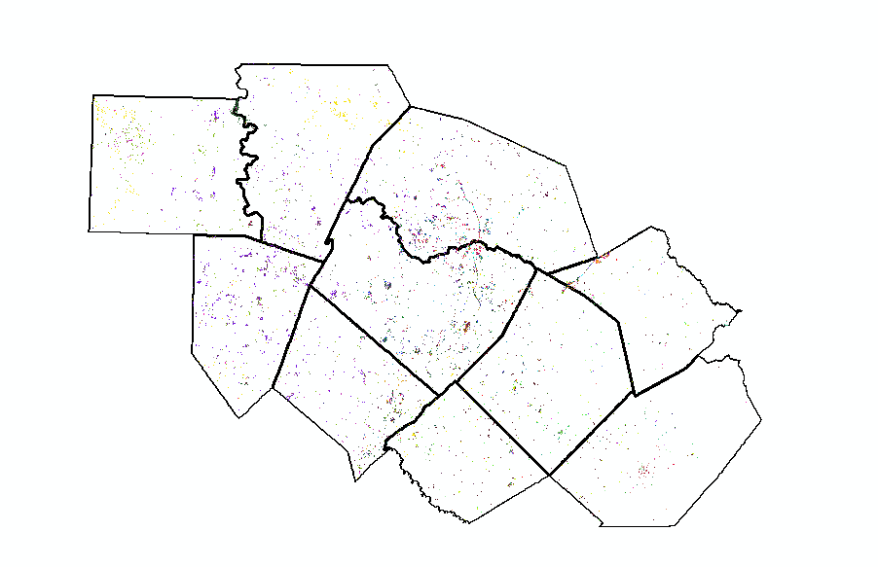
01-06 Total Change
2 digit value YX
Y is old value
X is new value
4 digit value YYXX
Y is old value
X is new value

Slide 6
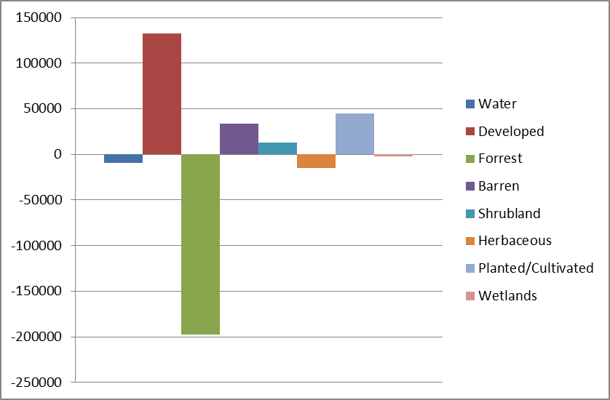
How did things change?
2.119409% was inter-category change
0.0440% was intra-category change
92% of the intra-category change was an increase in developed impermeable land
22.55% of inter-category change was an increase in developed impermeable land
Inter-category change

Slide 7
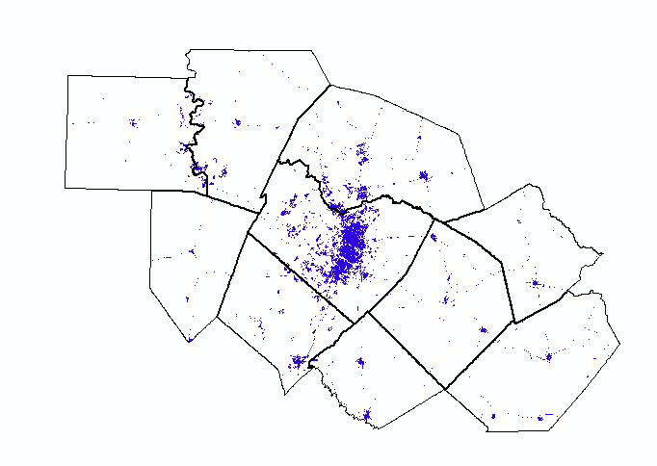
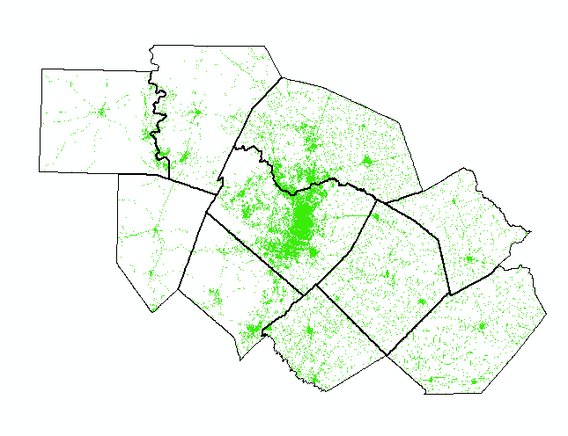
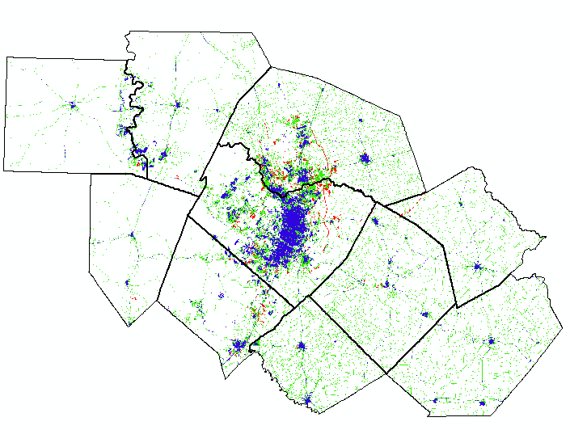
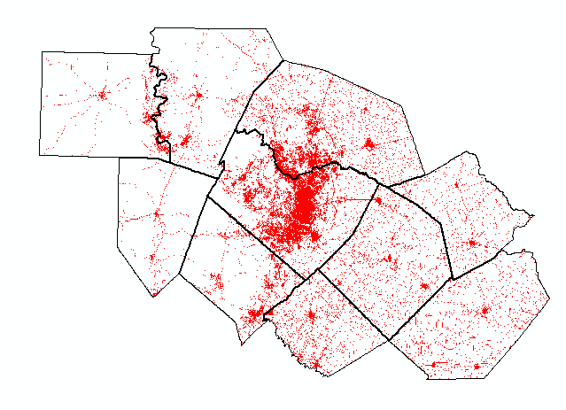
How have urban centers developed?
2001
2006
1992
Combined Map of Development
1992, 2001, and 2006

Slide 8
Remaining work
Identify percent impervious land cover in local subwatersheds
Identify subwatersheds with greater than 10% impervious cover
Identify which subwatersheds experienced largest increases over 14 year period

Slide 9
Questions?
Taken from xkcd.org by Randall Munroe 11/16/11

