Slide 1
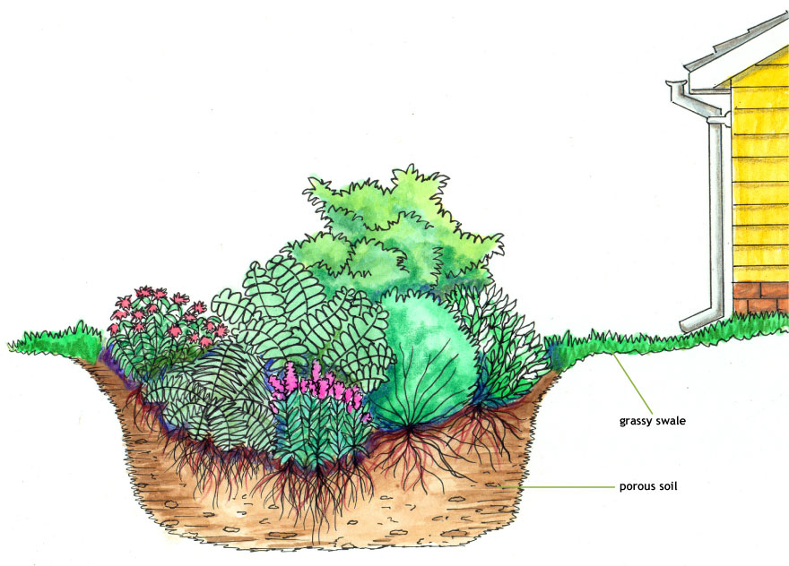
Rain Gardens as Flood Control in Austin, Texas
By Kiersten Dube
Notes:
Rain Gardens as a means of flood control in Austin
Specifically, could rain gardens at single family homes attenuate 100 year flooding
Typical cross section – water drain off roof into rain garden; typically existing soil has been replaced with more porous soil
Designed to catch and store runoff for short periods of time
Goal is to slow down water, give it more time to infiltrate or release it slowly back into the watershed through an underdrain system

Slide 2
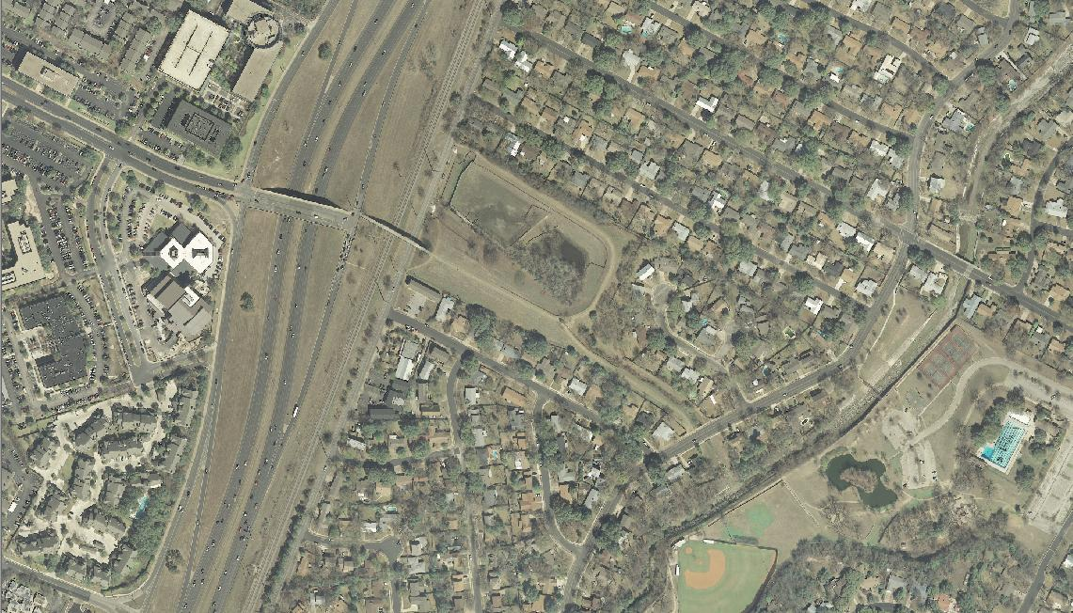
Shoal Creek Detention Pond
Q: Can rain gardens replace pond?
Far West Blvd
MOPAC
Shoal Creek
Notes:
Decided to explore topic by looking as at this detention pond.
Question: Could this pond be replaced by upstream RGs at SF homes?
Describe location
Water enters from west, flows through pond, over outflow weir and to Shoal Creek
Need to know: Pond watershed? How much water does the pond detain?

Slide 3
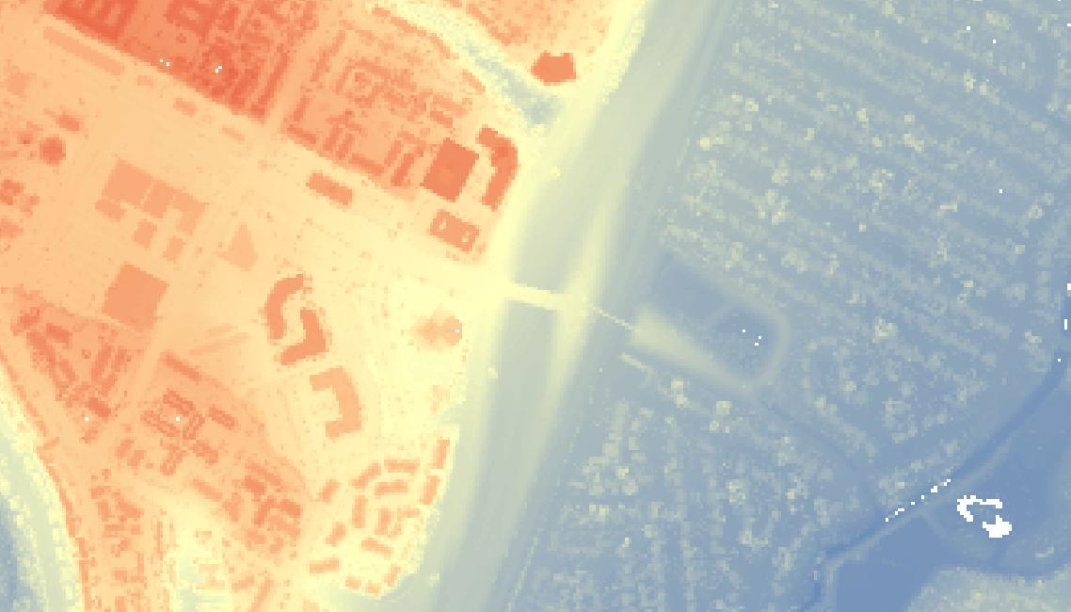
Lidar to DEM
High
Low
ArcGIS Help page “Lidar to raster”
Notes:
Acquired Lidar files from CAPCOG here in Austin
Converted Lidar to DEM using “LAS to Multipoint” then “Point to Raster” tools (ArcGIS Help page available)
Lidar resolution was 1.8 meters (~6 ft)
Convert points to raster; needed cell size of 15 ft to avoid “no data” cells (over twice resolution)
High elev is red, low is blue; pond, mopac, buildings, etc.
Clue as to where water comes from on west side of mopac

Slide 4
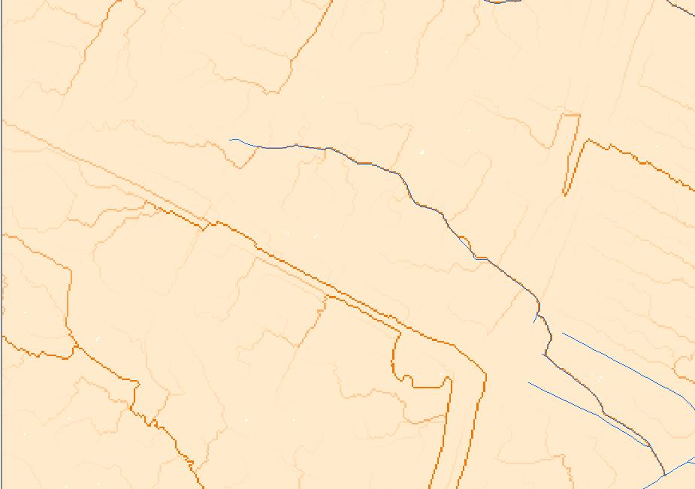
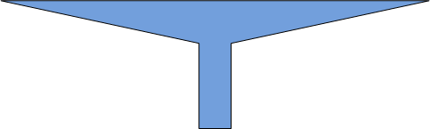
Stream Lines and
Flow Accumulation
MOPAC
Far West Blvd
AGREE
50 ft
15 ft
Notes:
Followed a process similar to Exercise 4 to generate Flow Accumulation
Start with COA stream lines (show that flow does come from west of mopac)
Recondition DEM along COA stream lines with scaled version of AGREE; chose a reasonable width for the area by looking at width of green space along COA stream line

Slide 5
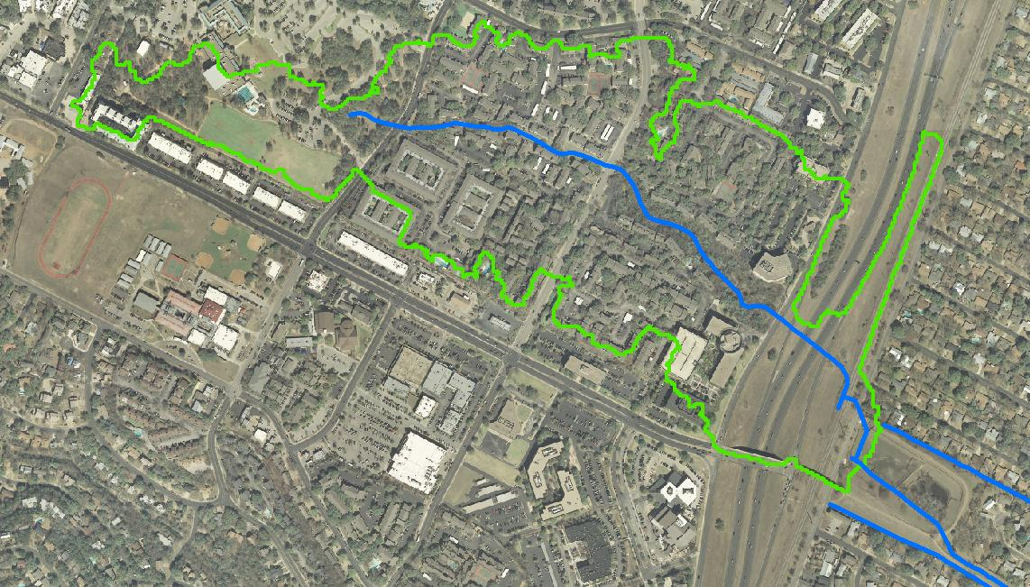
Delineate Watershed
Far West Blvd
Area = 107 acres
Notes:
Finally, delineate area flowing into pond

Slide 6
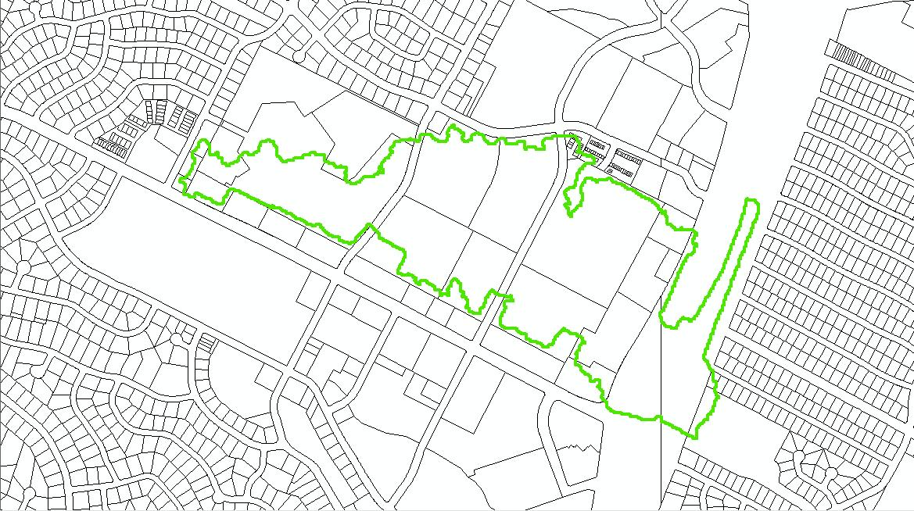
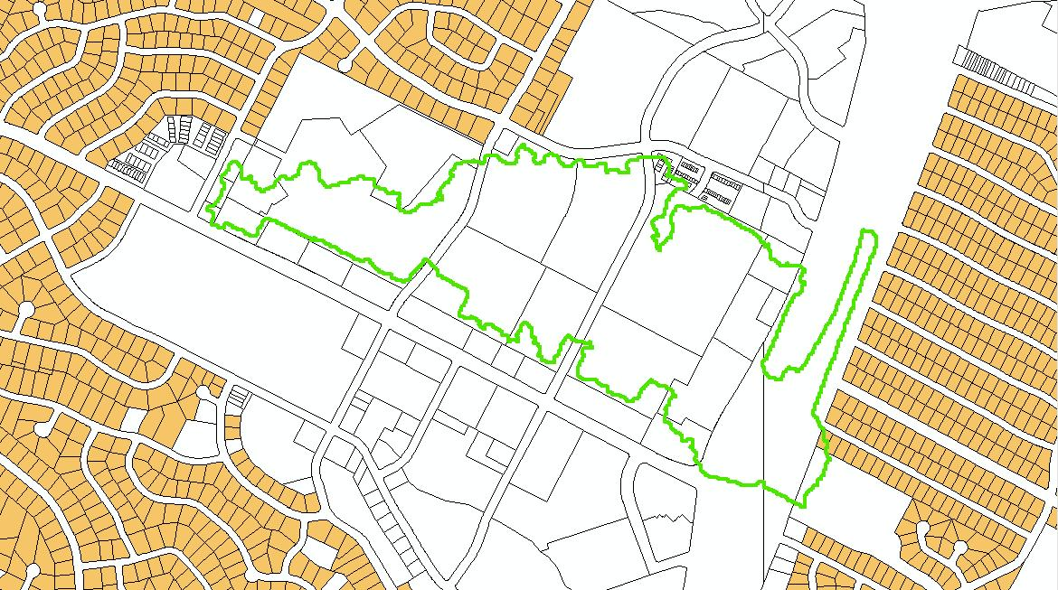
Single Family Homes
Notes:
Next, identify single family lots for potential rain gardens
Start with land use file from COA; property lot lines are shown
Fade in lot colors
No SF lots

Slide 7
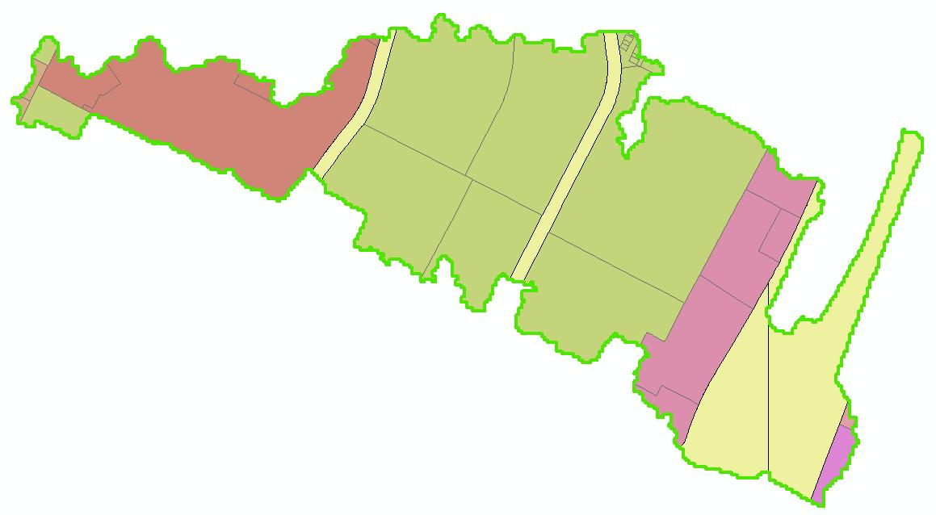
Revised Question
Can rain gardens provide flood control for commercial property?
Civic
Multi-family
Office
Roads
Notes:
Land use for watershed

Slide 8
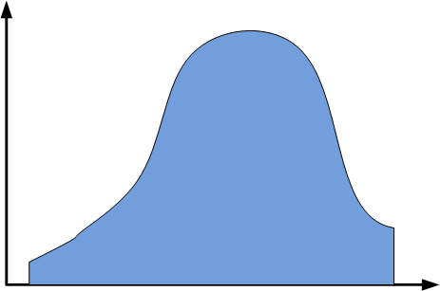
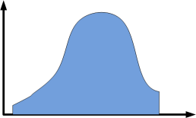
Assumption
cfs
Σ
=
time
Pond
Rain Gardens
Pond Vol = Σ (Rain Garden Vol)
Notes:
Assumption: Pond outflow hydrograph = sum of rain garden outflow hydrographs
Don’t know enough about pond to construct actual hydrograph; running design software for network of RGs exceeded scope
With this assumption, pond volume can be redistributed throughout watershed as smaller rain gardens
Assume pond is designed for 100 year storm, as required by COA drainage criteria manual 100 year flows must remain within ROW or Drainage easement
Thus, RG system will attenuate 100 year flooding

Slide 9
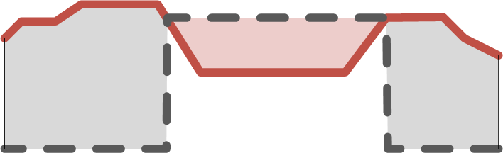
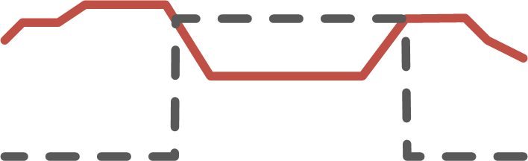

Pond Volume:
Cut and Fill Tool
Weir
DEM
Fill
Cut
Pond
Cut
Artificial DEM
Fill = Pond Vol = 2.06 x 10⁶ cubic feet
Notes:
DEM
Create artificial DEM with two elevations: pond area = top of weir elev; everything else = LOW
Cut/fill tool; Fill = Pond Vol

Slide 10
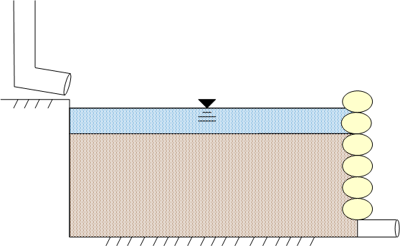
Rain Garden Design
4 in.
10 in.
30 in.
Soil Porosity = 0.2
Equivalent
Storage
Depth
1.25 in.
Notes:
Assume no infiltration; underdrain system
(30” of soil with 0.2 porosity) + (4” standing water) = 10” equivalent storage depth
Design suggested by Low Impact Development Center in Maryland

Slide 11
Feasibility Assessment
Pond Vol
Equivalent RG Depth
57
=
=
Rain Garden
Area
Acres
RG Area
Watershed Area
57
107
=
=
53%
?
Pervious Cover
Per Lot
=
56%
Notes:
Required RG area
RG area / watershed area = percent of area that required rain gardens take up to attenuate 100 year flooding
% pervious cover per lot = area available for RGs; assume Imp Cover is buildings and parking lots that can’t be easily changed
Percent pervious cover too close to percent RG
Not realistic
Note: % IMPervious cover = (WS area – buildings – parking lots – roads) / (lot area); lot area = WS area – roads;
Pervious + Impervious = 100%

Slide 12
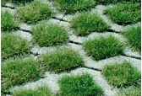
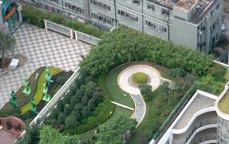
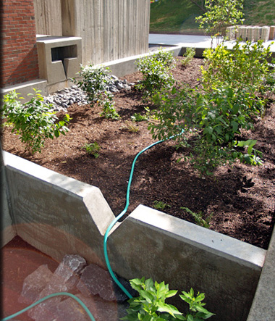
Conclusions
Can rain gardens replace pond?
  Tentative No
  Consider other options
  Pervious paving
  Roof top gardens
  More complex RG designs
Remaining questions
  Maintenance
  Water quality from roads
Notes:
Need pond info: is all of volume for detention? What is actual outflow hydrograph for pond? Run design software for actual system of RGs?
Pervious paving – convert impervious cover to pervious cover
Rooftop gardens – same thing
Example of highly engineered rain garden at SUNY
Would rain gardens at many different properties be maintained?
Need to assure residents that they will be protected from flooding; easier to do this with centralized detention facility
Water quality from roads not addressed by RGs on individual lots.

