Slide 1
Flood in Austin
- Economic losses assesment
Alexandre Martinez
November, 16th 2011

Slide 2
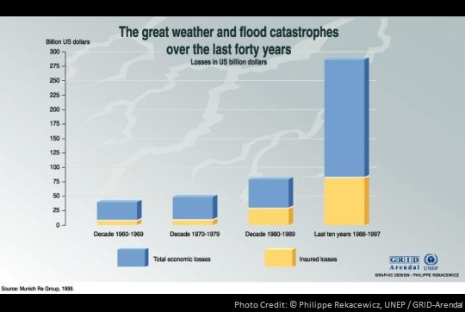
Introduction
Flood is the main cause of natural disaster losses in the USA.

Slide 3
Introduction
What would be the economic impacts of flood in Austin ?
How different zones of Austin are threatned by flow?
Which part of Austin are threatened by flow?

Slide 4
Economic assessment
Economic value Map
Land use of the city
Economic value of areas
Hazard Map
Floodplain
Vulnerability Relationships
Relationships between flood and losses

Slide 5
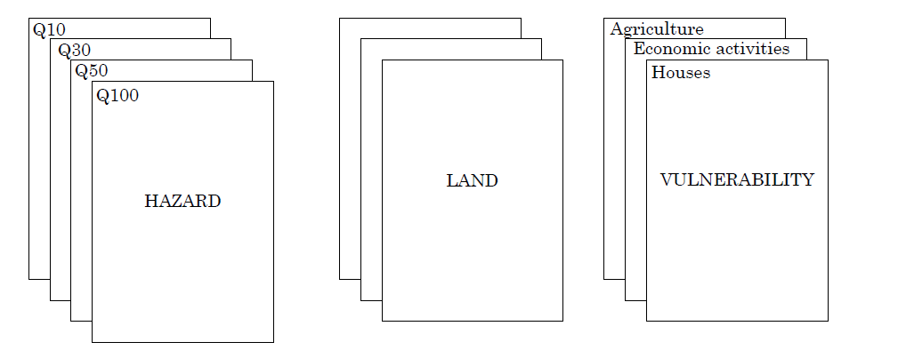
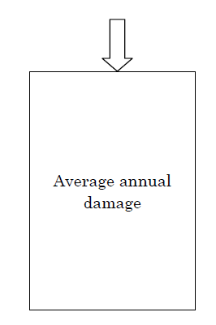
Methodology

Slide 6
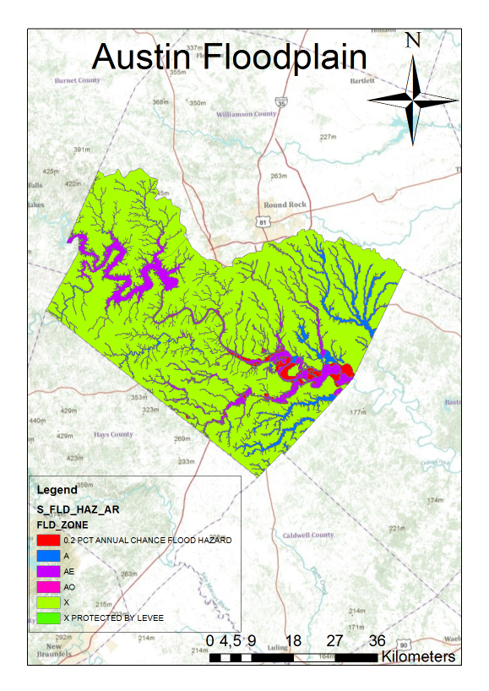
Floodplain of City of Austin

Slide 7
Floodplain of City of Austin
0.2 PCT Annual Chance Flood Hazard
A Zone
The base floodplain mapped by approximate methods, i.e., BFEs are not determined
AE Zone
X Zone
AO Zone
The base floodplain with sheet flow, ponding, or shallow flooding.
Zone X is the area determined to be outside the 500-year flood and protected by levee from 100-year flood.
Base flood depths (feet above ground) are provided
The base floodplain where base flood elevations are provided.
Areas subject to inundation by the 1-percent-annual-chance flood event.

Slide 8
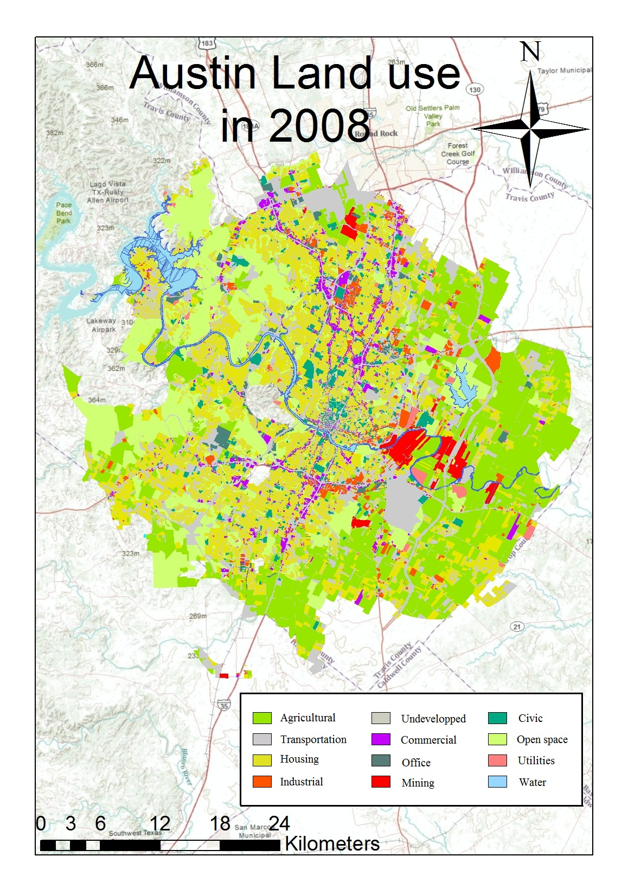
Land use of city of Austin : FIRMs

Slide 9
Land use of city of Austin

Slide 10
Vulnerability
Losses
Tangible losses
Direct
Indirect
Intangible losses
Loss of production
Clean up
Structure
Inventories

Slide 11
Vulnerability: Impact parameters
Flow velocity
For buildings
For agriculture
Flood depth
For buildings
For inventories
Flood duration
For inventories
For buildings

Slide 12
Economic analysis : Computation of EAD.
Discharge (Q)
Discharge (Q)
Stage (H)
Exceedance Probability (p)
Damage (D)
Damage (D)
Stage (H)
Exceedance Probability (p)

Slide 13
Economic analysis : Computation of EAD.
Value of the building
Value of the content
h
First Floor Elevation

Slide 14
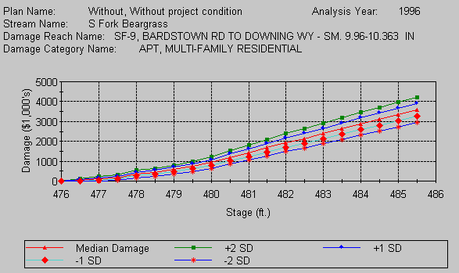
Economic analysis : Computation of EAD.

Slide 15
Conclusion
Basic evaluation of the economic losses due to floods in urban areas:
  Land Use analysis
  Flood plain analysis
  Economic value of structure, inventories analysis
To Do:
  Inegrated theses 3 analysis in order to evaluate the losses for a 2% annual chance flood in the city of Austin.

