Slide 1
Fine Particulate Matter Concentrations in the Dallas-Fort Worth Area
Adam Pacsi

Slide 2
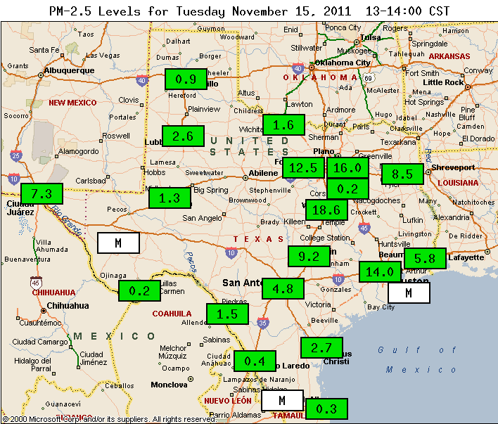
Background
Liquid/Solid Condensed Phase in Air
Fine = less than 2.5 microns in diameter
Found to trend like ozone in most US Cities
Regulation: < 15 µg/m³ for a daily average
Courtesy: TCEQ

Slide 3
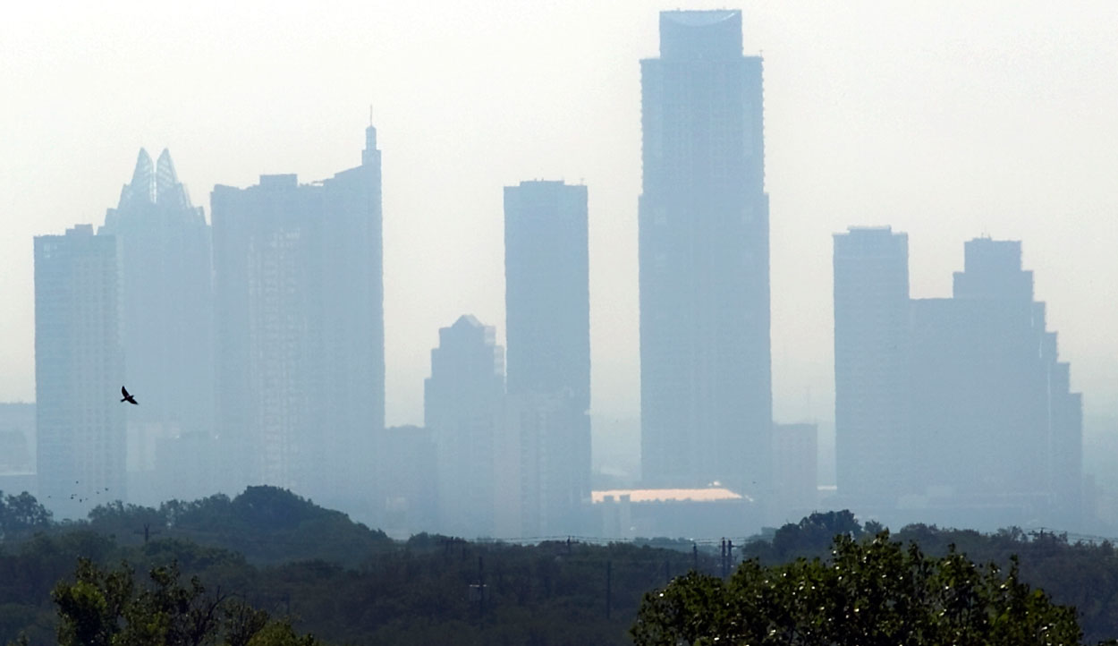
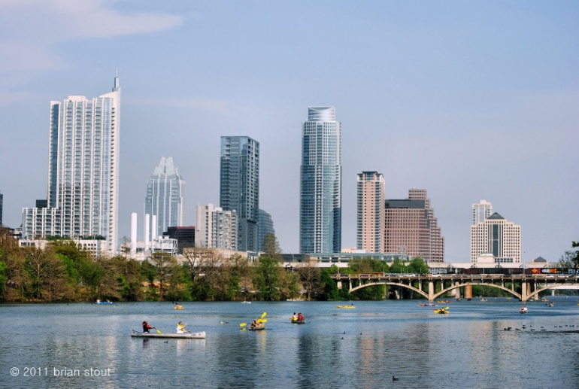
Motivation
Health Effects: asthma and overall morbidity
Overall visibility and appearance
Funding for monitoring of PM_{2.5} has been reduced since 2000
Courtesy: texasdailyphoto.com

Slide 4
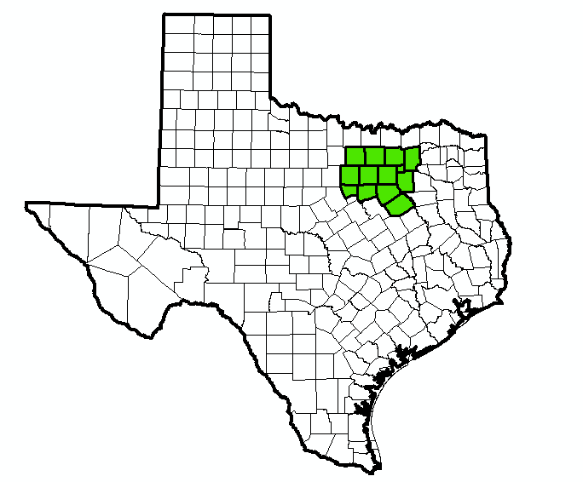
Research Problem
Determine new PM monitoring sites from current ozone sites in DFW
Criteria:
Predicted PM Concentration (from ozone levels)
The Distance from a current PM site
Local Population Density

Slide 5
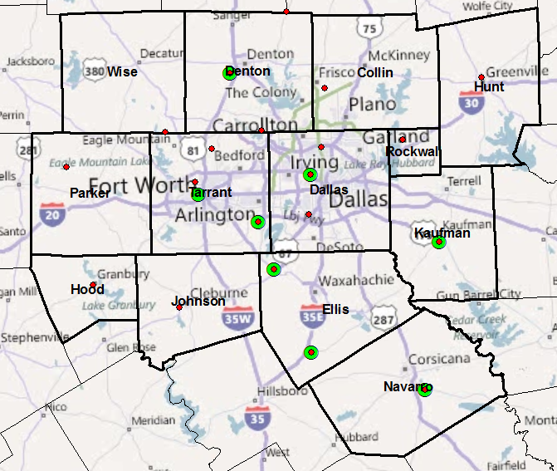
Current Monitoring Sites
Legend
Ozone
PM
Current Number of Sites
PM: 8
Ozone: 20

Slide 6
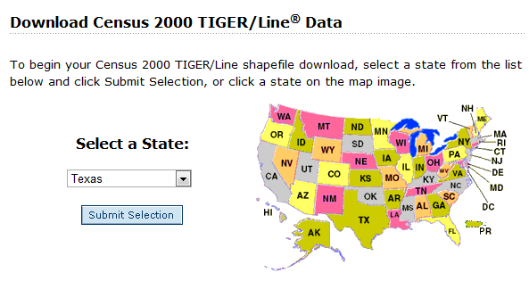
Sources of Data
TCEQ
Monitor Locations
2008-2010 Average Ozone Concentrations
ESRI 2000 TIGER/Line Data
Census tract shapefiles
Tract population data
Courtesy: ESRI
Note: All datasets were in NAD83 and needed to be converted to Albers Projection from Exercise 1.

Slide 7
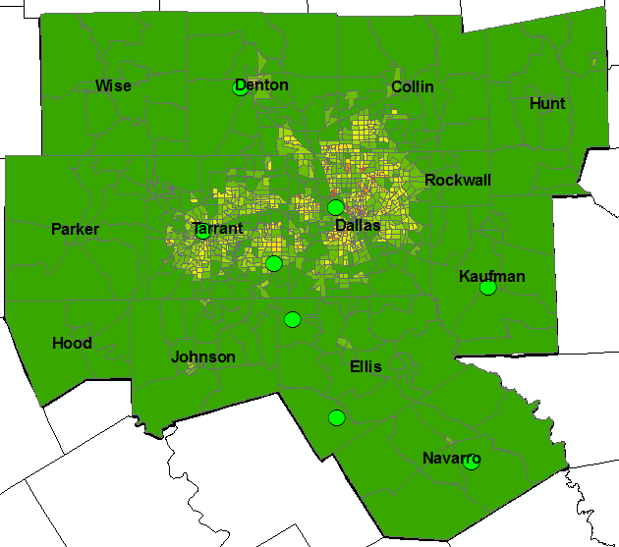
Methods: Population Density
Census Tracts
Census Tract Database File
Table Join
Population by Tract
Field Calculator
Population Density

Slide 8
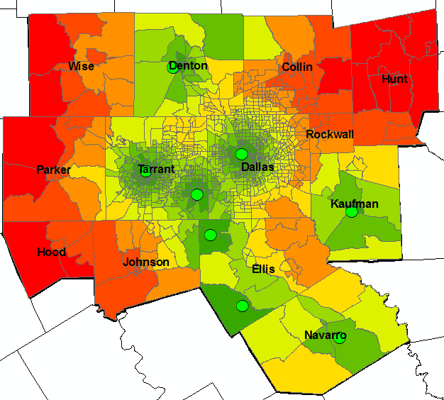
Methods: Distance
Census Tract Data
Mean Center
Tract Data as Center Point
PM Monitor Locations
Near
Distance to Current PM Site

Slide 9
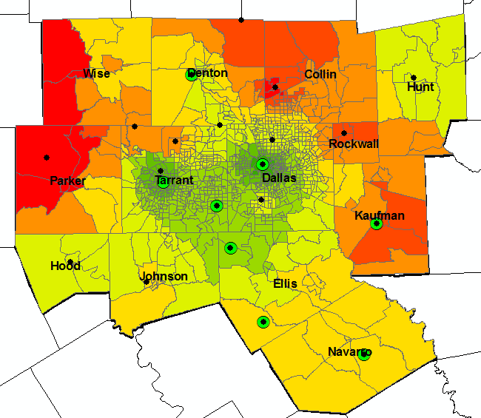
Methods: Ozone Concentration
IDW
Ozone Values at Monitoring Sites
Kriging
Interpolated Ozone Raster (float)
Int
Interpolated Ozone Raster (int)
Natural Neighbor
Raster to Point
Census Tract Center Points
Ozone Raster Values as Points
Near
Table Join
Ozone Values by Tract Center
Ozone Value
by Tract
IDW

Slide 10
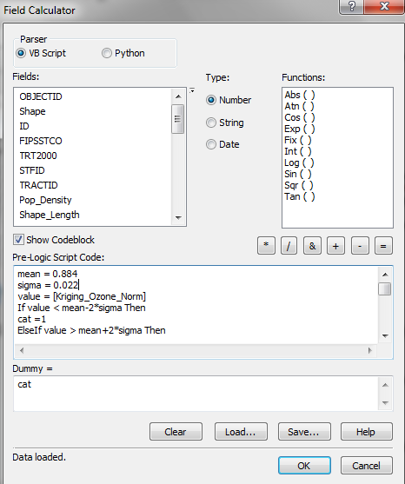
Methods: Categorizing
Problem: Differing scales for parameters even when normalized
Solution: Categorizing Data each parameter
x < Mean - 2σ
Mean-2σ < x < Mean–σ
Mean-σ < x < Mean+σ
Mean+σ < x < Mean+2σ
x > Mean+2σ
VB Script in Field Calculator

Slide 11
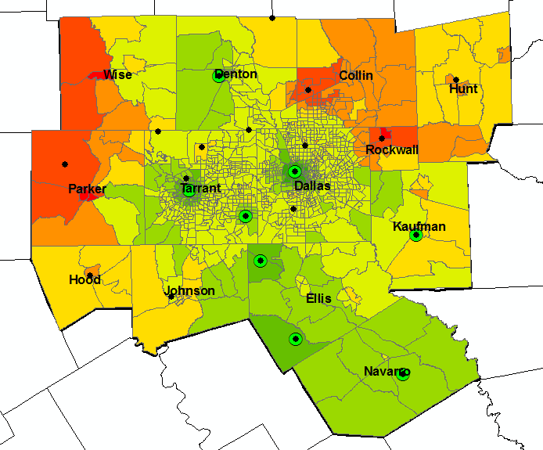
Results: Spatial Distribution
Added the categorized values to get a score out of 15.
IDW

Slide 12
Results: Which Sites?

