Slide 1
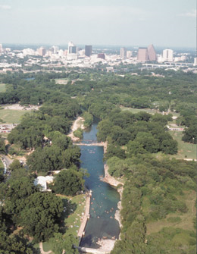
Water Quality and Flow Characteristics of Barton Springs
Abby Tomasek
http://www.ci.austin.tx.us/watershed/ordinances.htm

Slide 2
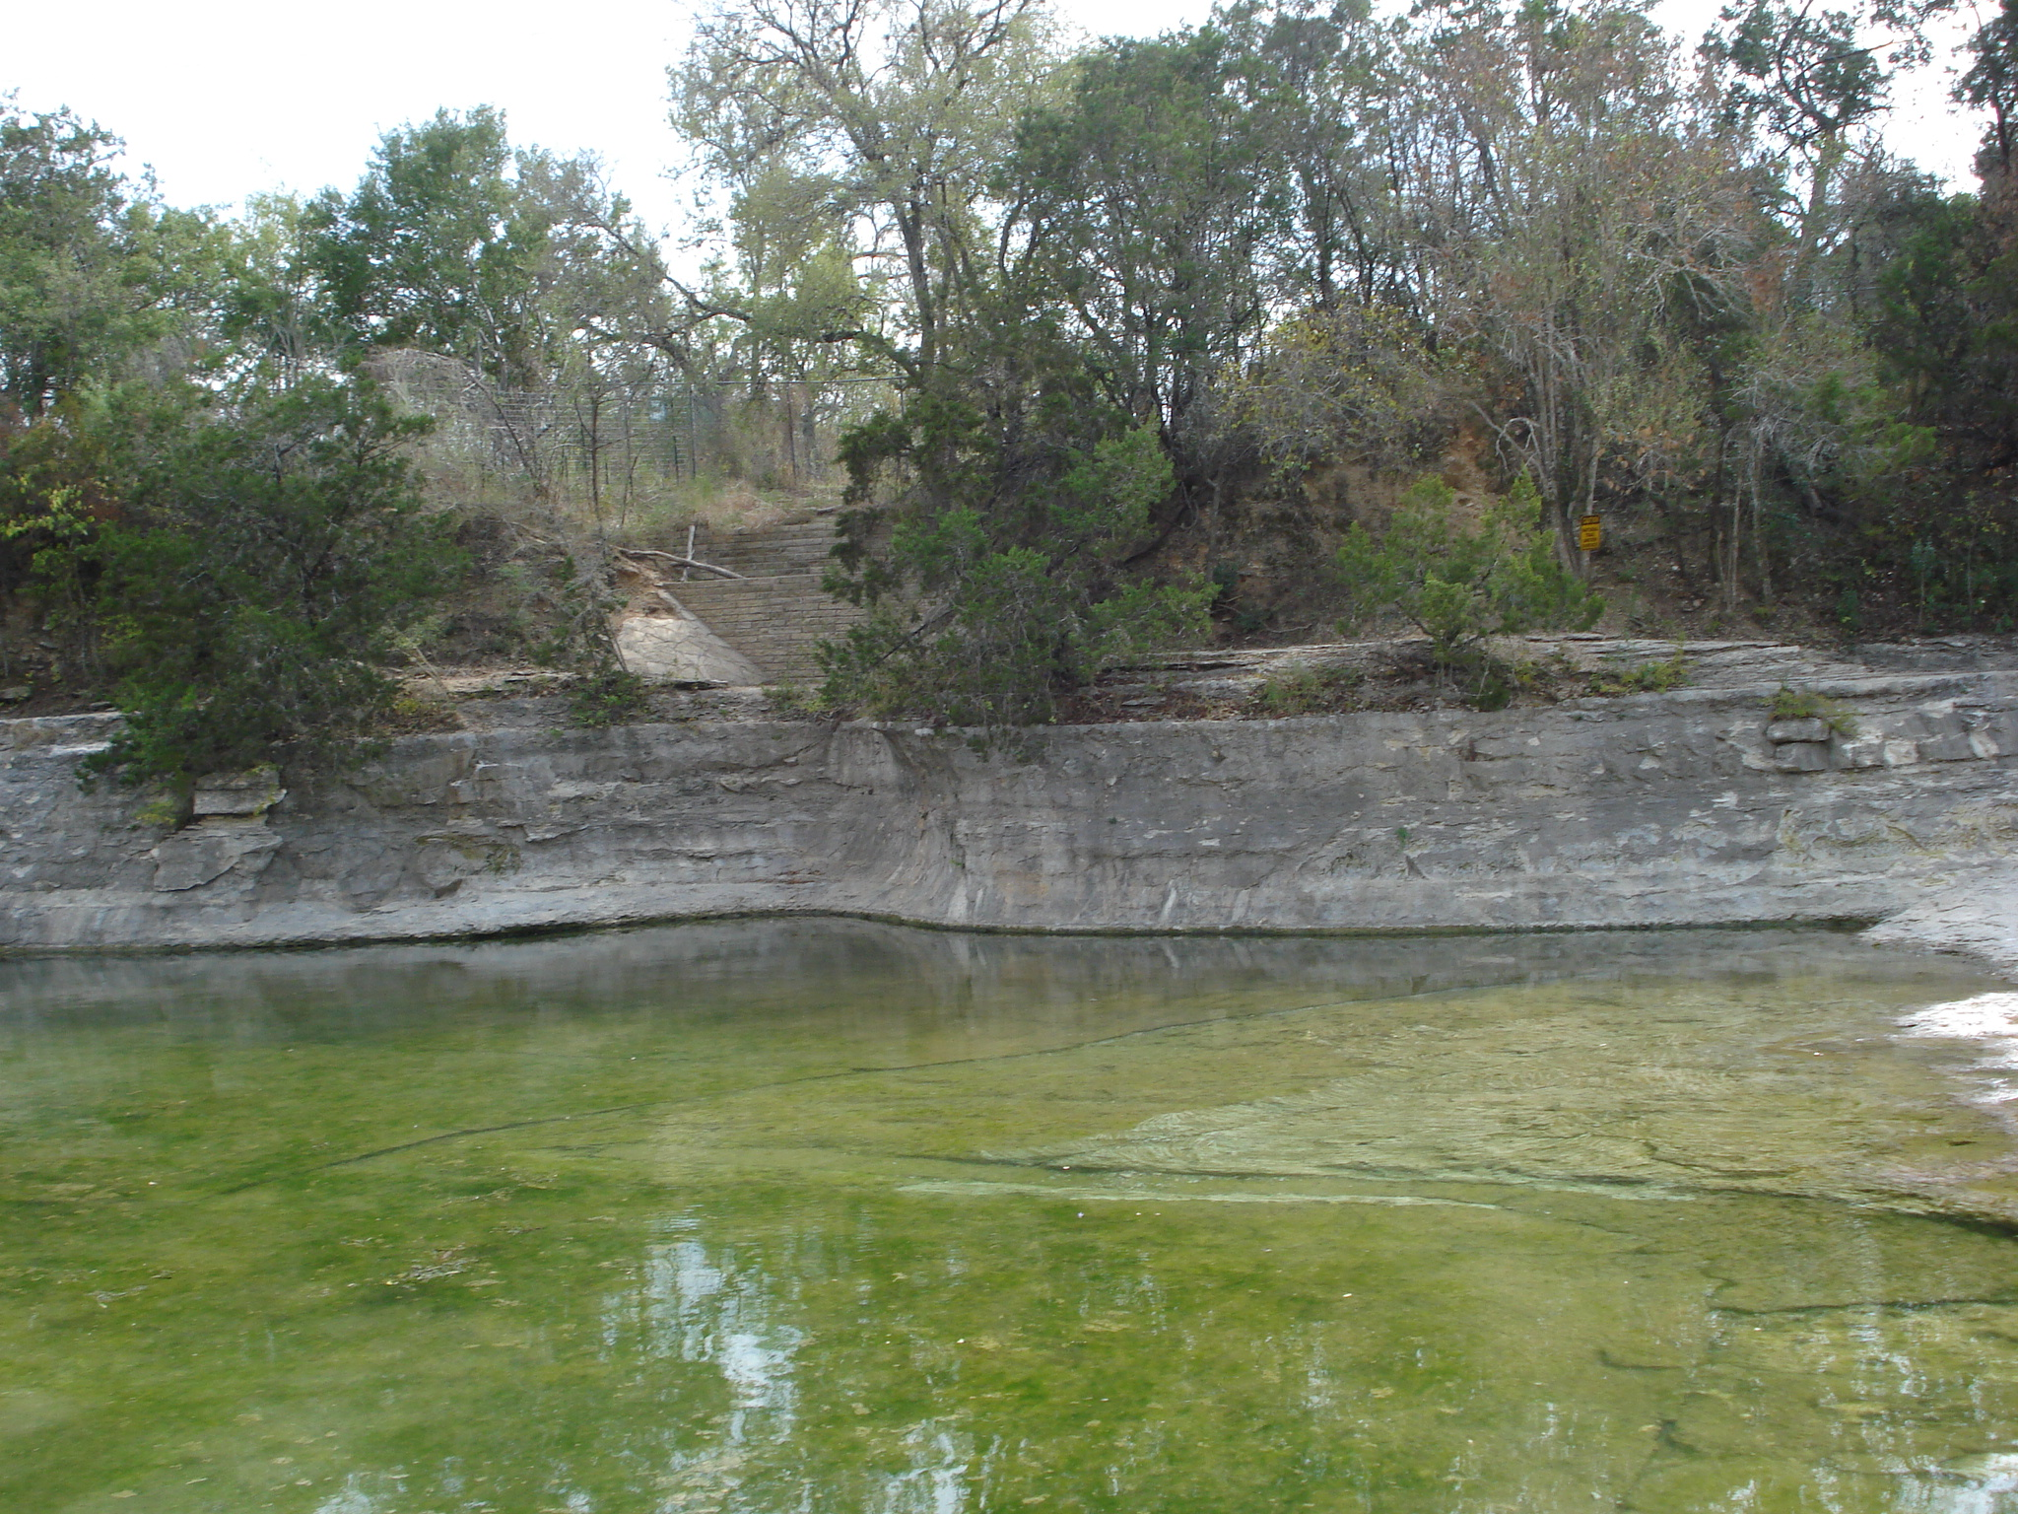
Barton Springs Pool
Main discharge point for the Barton Springs segment of the Edwards Aquifer
Main aquifer recharge comes from 6 surface streams
During dry periods, the flow is dominated by water from the aquifer matrix
During wet periods, flow is dominated by stream discharge
Implications for water quality concerns
Notes:
*For Barton Springs, about 85% of aquifer recharge comes from six major sruface streams that cross the recharge zone: Barton Creek, Onion Creek, Slaughter Creek, Bear Creek, Little Bear Creek, and Williamson Creek (Slade, Dorsey, and Steart, 1986), and Little Barton from the USGS
*During storm events, sinkholes and fractures in the stream bed can quickly provide large volumes of water to recharge
After storm events, pool can become quite cloudy and turbid
In 2006, a USGS SIR found that concentration of atrazine, chloroform, and tetrachloroethane peaked 1-2 days after storm events
Geochemical response at the springs after storm events led the authors to conclude that when there is flow in the recharge streams, water directly enters conduits and is transported straight to the springs. When there is no flow in the recharge streams, water drains from the surrounding limestone matrix into the conduits that feed the springs
In May of 2011 the USGS published a fact sheet that summarized its findings on increased nitrate concentrations in Barton Springs; nitrates are a nutrient that can cause blooms of algae when present in excessive concentrations; when algae dies and decomposes, DO in the water is used and levels of oxygen can become so low that fish and other organisms in the aquatic ecosystem cannot survive; since 2001, the tnire Barton Springs contributing zone has undergone tremendous development and the number of septic tanks and discharges of wastes have exploded
Since the pool is periodically drained for cleaning, there are times when the gage height is not in dricet relation to discharge

Slide 3
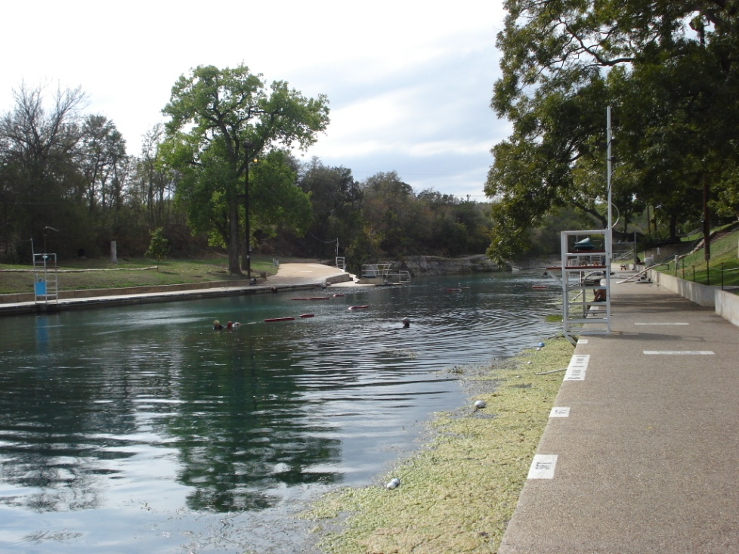
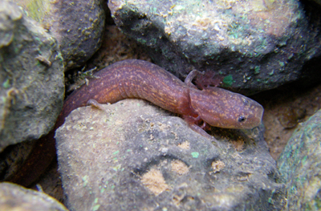
Why do we care?
The salamander!
Water quality important for the health and safety of visitors
Aesthetics (for example eutrophication and turbidity)
http://www.ci.austin.tx.us/watershed/bartonsprings_salamander.htm

Slide 4
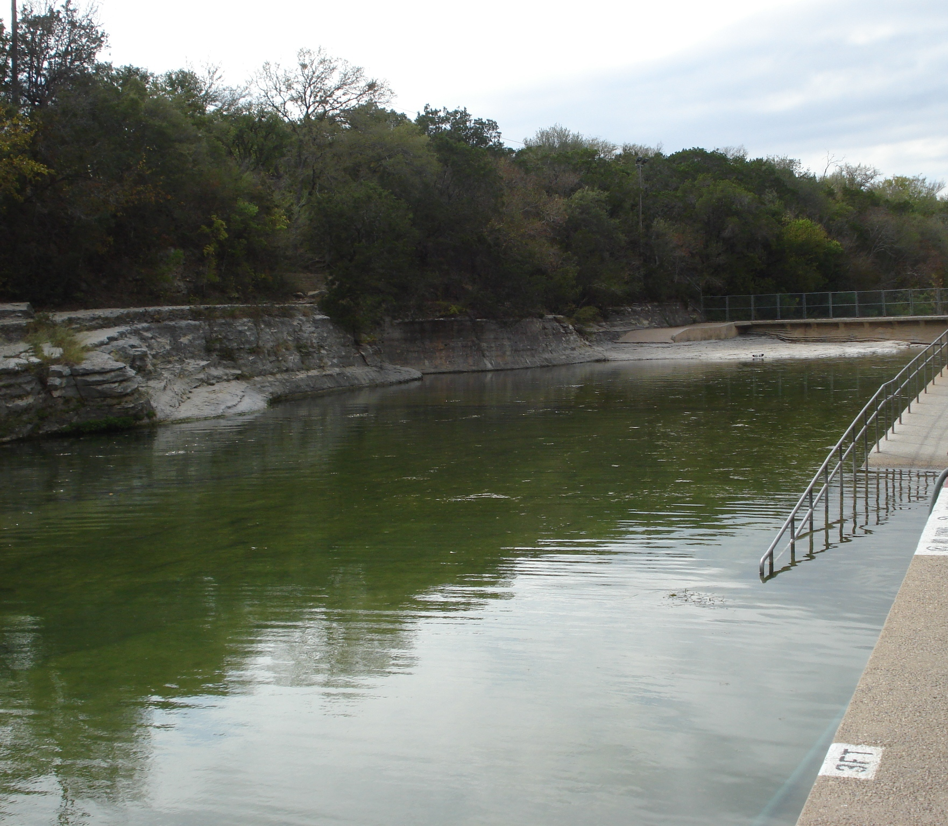
Data
Edwards aquifer and surrounding HUC-10 subwatersheds
DEM and hillshade to visualize topography for area
Added main contributing surface waters from NHD flowlines
Determined contributing area and compared to City of Austin data
Land use and population data
USGS NWIS for streamflow and water quality data

Slide 5
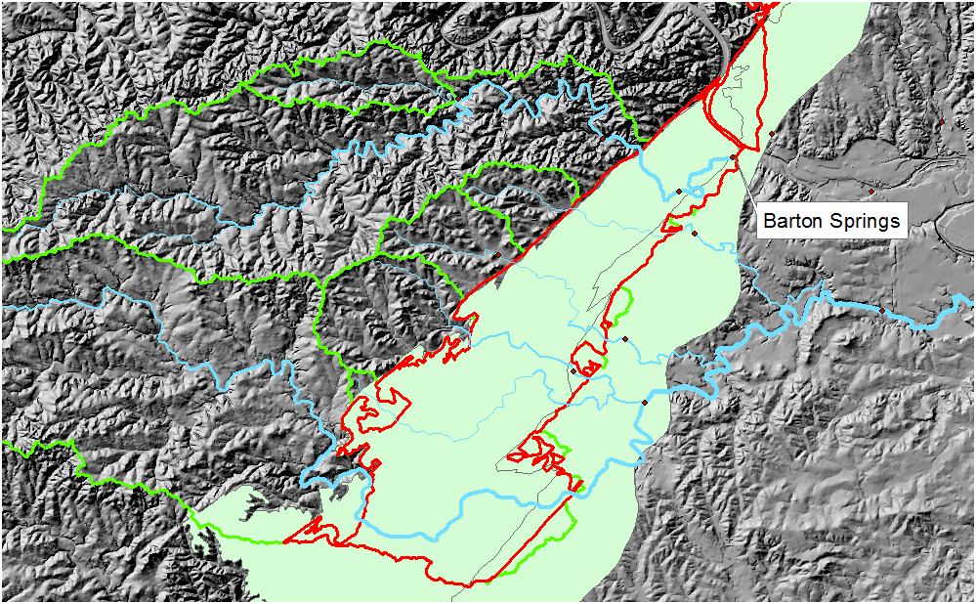
Edwards Aquifer and Contributing Areas
Notes:
Light green shaded is the Edwards aquifer
The blue lines are the major streams contributing recharge to the aquifer that discharges to Barton Springs
The light green lines is the delineated contributing watersheds to the aquifer
And the red border is the portion of the Edwards aquifer that is being recharged by the streams

Slide 6
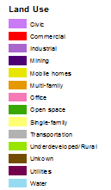
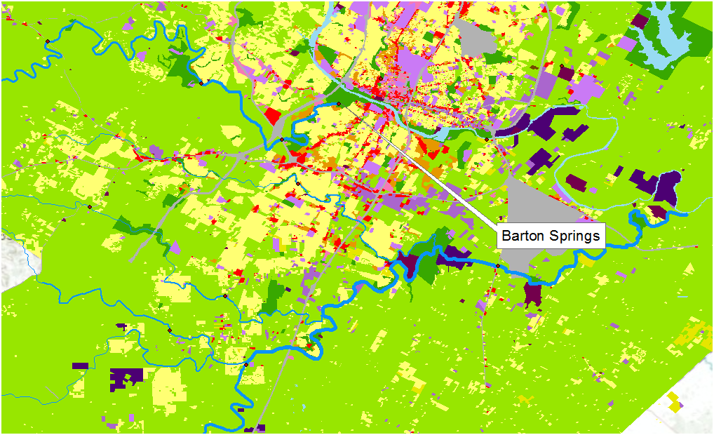
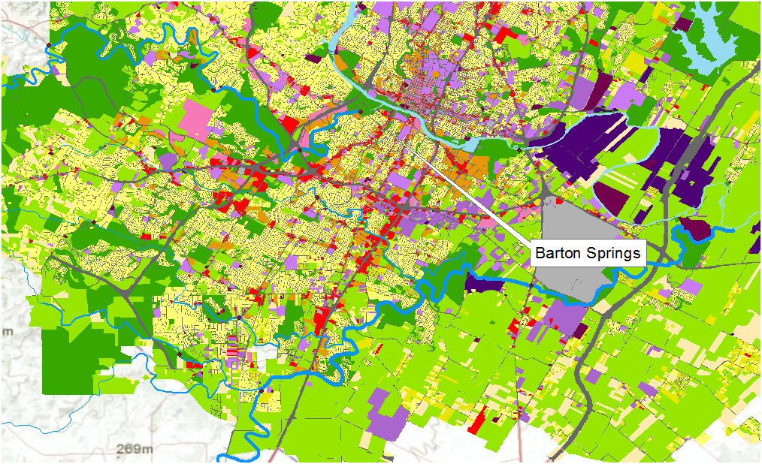
Land Use Change from 1990-2008
1990
2008
Notes:
* According to the 2010 cencus, Travis county is the 5th largest county in texas with a popullation of 1,024,266 people. Travis county grew by 26.1% between the 2000 and 2010 census

Slide 7
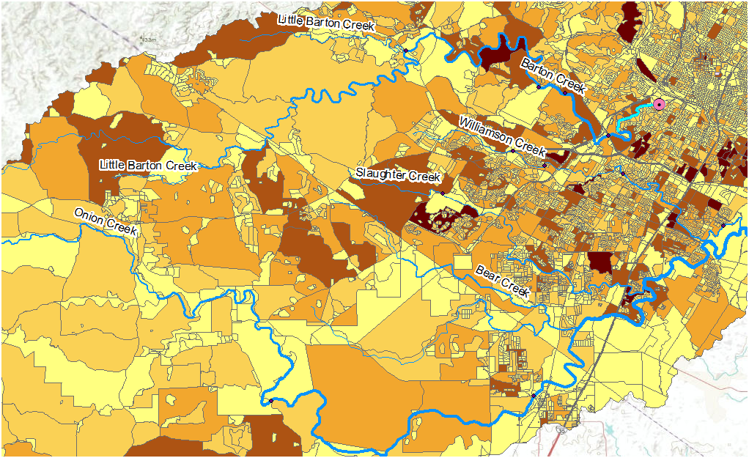
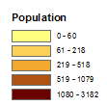
Population in Contributing Area

Slide 8
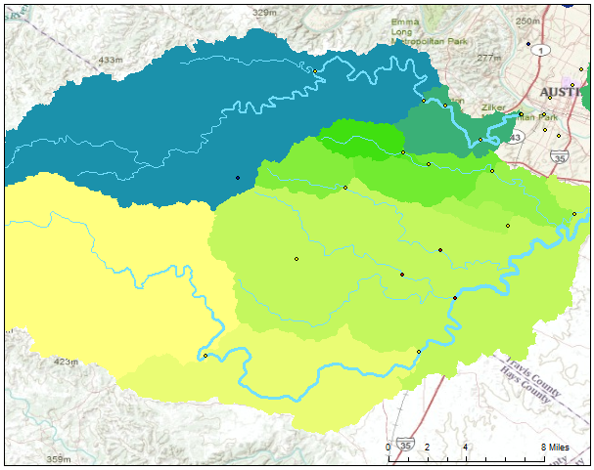
Discharge Along Barton Creek
Notes:
Creek usually has shallow waters until a heavy rainstorm, when it swells, but quickly falls as it empties into the colorado river

Slide 9
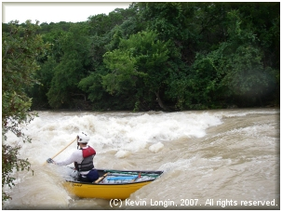
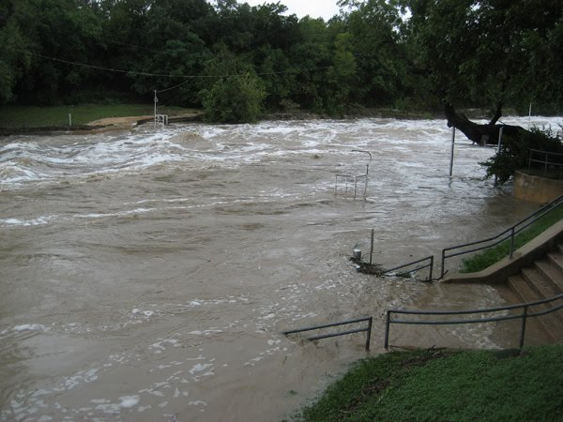
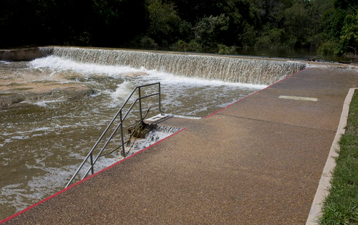
Flooding at Barton Creek and Barton Springs
Notes:
Flooding in Barton Springs Pool associated with Tropical Storm Hermine; rainfall in spots of the Barton Springs recharge and contributing area was 6-8”

Slide 10
Nitrate and Phosphorous Concentrations along Barton Creek

Slide 11
Barton Springs Continuous Water Quality Data
Notes:
Specific conductance divided by 100 to graph better (keeps same trend). Tried to find a relationship between nitrate and parameters. Nitrate almost seems to correspond with increased DO, when you’d think that increased nitrate would lead to more algal blooms and therefore lower DO. Possible explanation of some parameters- from USGS study, when discharge is low, flow mainly from aquifer matrix (groundwater). Groundwater has a higher specific conductance and lower DO than surface water. From graph above, when discharge is lower, DO is lower, and SC is higher. This could show the influx of groundwater over surface water

Slide 12
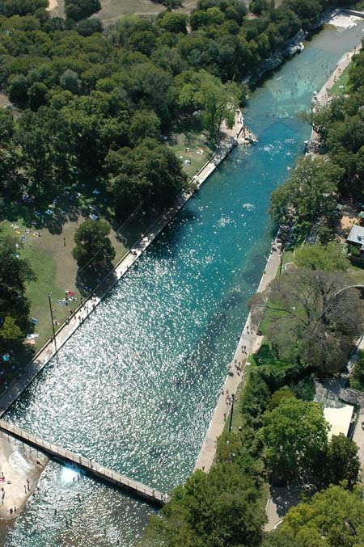
Summary and Next Steps
Area surrounding Barton Springs has experienced rapid population growth and land use change
Unique flow system of Barton Springs creates sensitivity to change
Obviously cannot stop development, but increased awareness can help preserve health of system
Investigate more nutrient parameters and contaminants (i.e. atrazine and tetrachloroethane)
Expand analysis to entire contributing area
Notes:
*USGS report found atrazine and tetrachloroethane in Barton Springs pool

