Slide 1
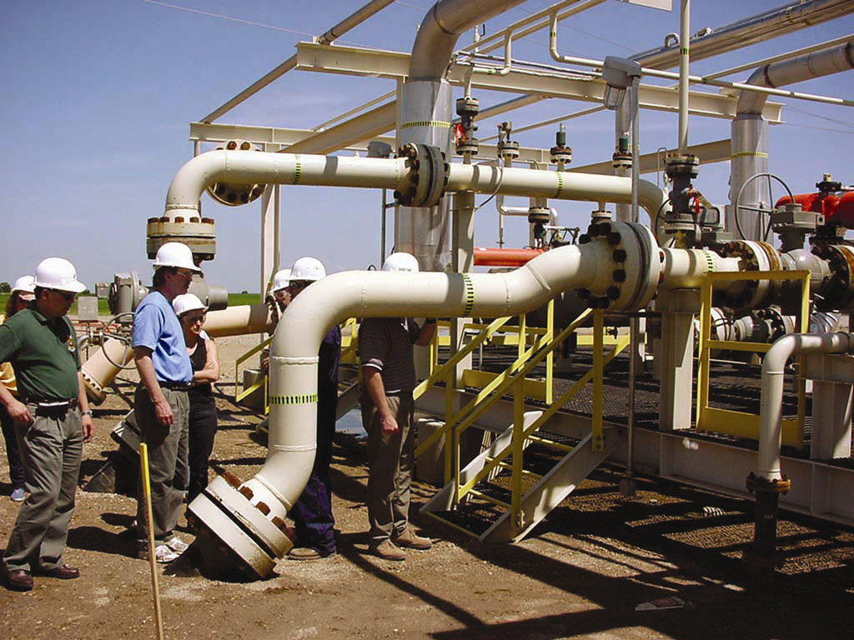
Systematic approach to source-sink matching for geological carbon capture and sequestration
Marlo Gawey
GIS for Water Resources
November 22, 2011
World Resources Institute

Slide 2
CO₂
CO₂
CO₂
CO₂
CO₂
CO₂
CO₂
CO₂
CO₂
CO₂
CO₂
CO₂
CO₂
CO₂
CO₂
CO₂
CO₂
http://indianapublicmedia.org
Motivation

Slide 3
Carbon Capture & Sequestration (CCS)
http://www.globalccsinstitute.com/ccs/how-ccs-works

Slide 4
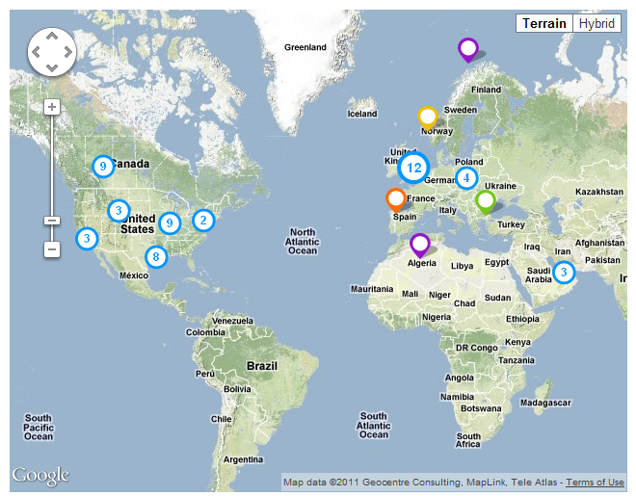
Current Carbon Capture and Sequestration Projects
http://www.globalccsinstitute.com/projects/map

Slide 5
Carbon Capture and Sequestration in Texas
http://www.globalccsinstitute.com/projects/map

Slide 6
Correct pressure and temp.
Porous
Permeable
Fluid trapping mechanism
IEA Greenhouse Gas R&D Programme

Slide 7
Subsurface Layers of Rock to Store Fluids
Biddle, K.T. and Wielchowsky, C.C., 1994, “Ch. 13: Hydrocarbon Traps,” Magoon, L.B. and W.G. Dow, eds, AAPG Memoir 60.

Slide 8
Major Enhanced Oil Recovery Fields in TX
Data from BEG Oil Atlas courtesy of C. Breton

Slide 9
IEA Greenhouse Gas R&D Programme

Slide 10
Sources
Ethylene plants
Hydrogen plants
Iron & steel refineries
Oil & gas refineries
Ammonia plants
Cement plants
Power plants (coal)

Slide 11
Major US CO₂ Producers
Data from USGS, IEA, TNRIS courtesy of C. Breton

Slide 12
Major TX CO₂ Producers

Slide 13
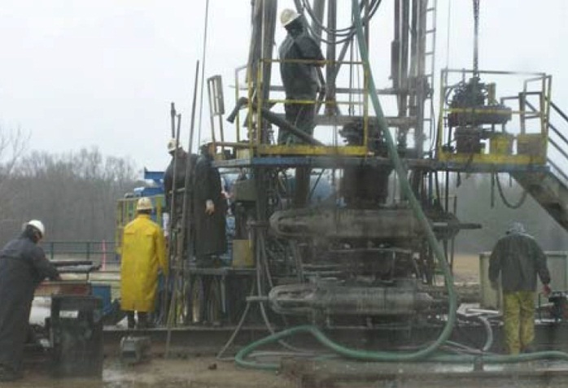
Source-Sink Matching
http://upload.wikimedia.org
Minimize distance from source to sink
Minimize distance to CO₂ pipelines, if possible
Avoid sensitive areas
Protected aquifers
State & national parks
High density population areas

Slide 14
Goals
Create unique maps for qualitative source-sink matching
Use some spatial analysis to tease out prospective source-sink matches

Slide 15
Major TX Aquifers & Reservoirs
Data from TNRIS and BEG

Slide 16
TX Aquifers & Protected Areas
Data from BEG Oil Atlas courtesy of C. Breton

Slide 17
1) Merge protected areas

Slide 18
2) Select sources & sinks within 10 km of protected areas

Slide 19
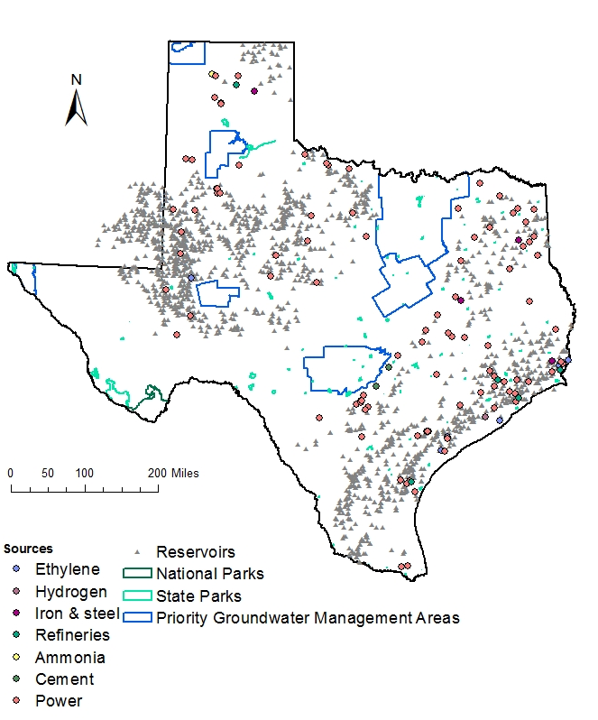
Result
296 Sources
3207 Sinks
227 Sources
2973 Sinks

Slide 20
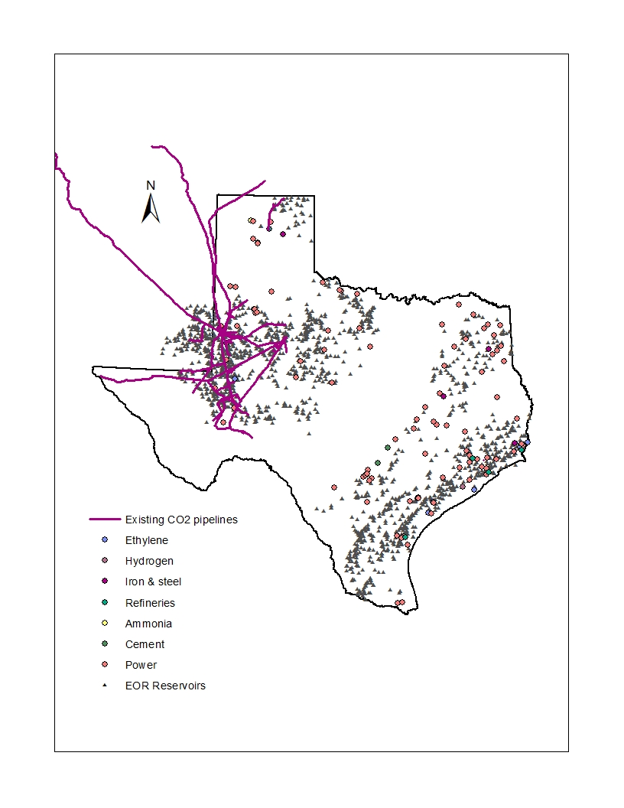
CO2 Pipelines in & around TX

Slide 21
… using the same method as before
25 km zone

Slide 22
Result
705 reservoirs
10 CO₂ producers

Slide 23
Nearest Sink to Sources

Slide 24
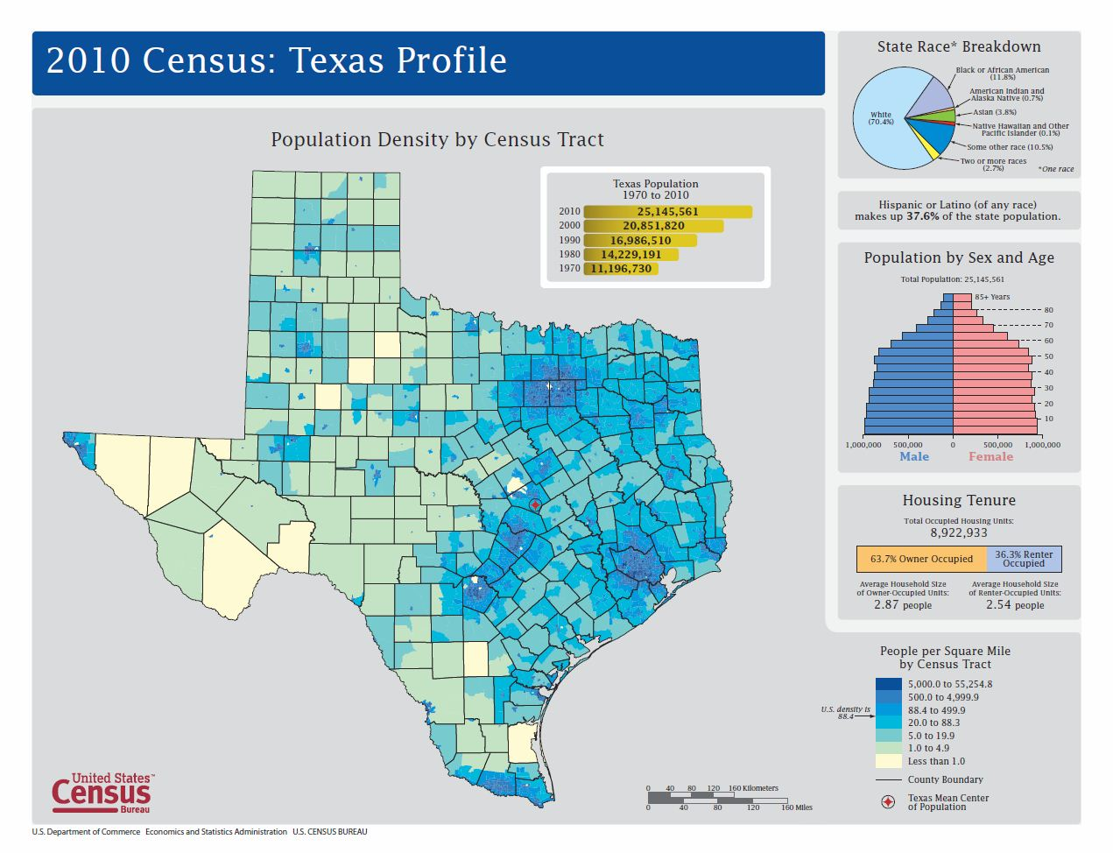
What’s Next?
Create a population density map…
…And use it to screen for Sources & Sinks

Slide 25
Steps:
Download block shapefiles with population and housing unit counts in them http://www.census.gov/geo/www/tiger/tgrshp2010/pophu.html
These polygons describe housing units
Population count in each housing unit

Slide 26
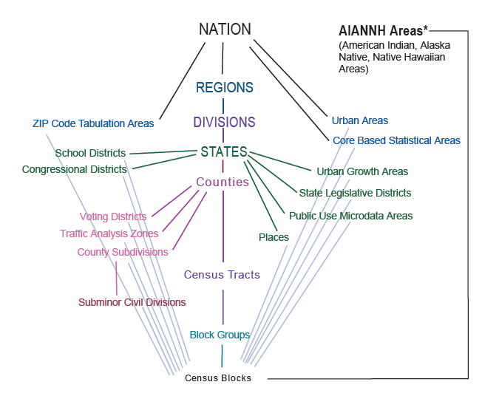
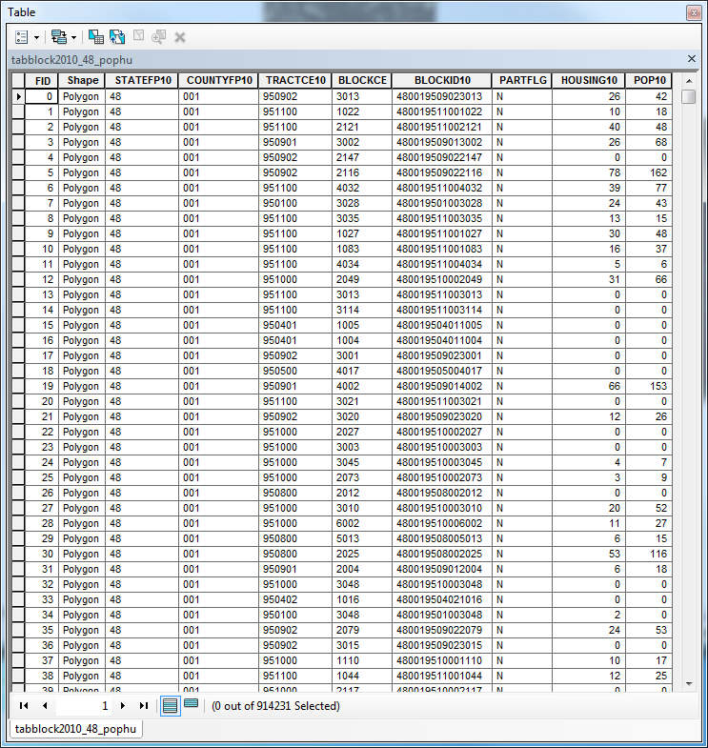
3) Consolidate data
HUGE data set:
914,231 polygons!

Slide 27
2) Calculate areas of blocks

Slide 28
3) Using “Field Calculator” in Attribute Table, calculate population density 4) Export the population density data to a new feature class and map it!

