Slide 1
Effects of the 2011 Texas Drought on Soil Moisture Capacity in the Somerville Watershed
Chris Ingenloff
22 November 2011

Slide 2
Agenda
Introduction
Background
Problem Definition
Watershed Statistics
Methodology
Required Work

Slide 3
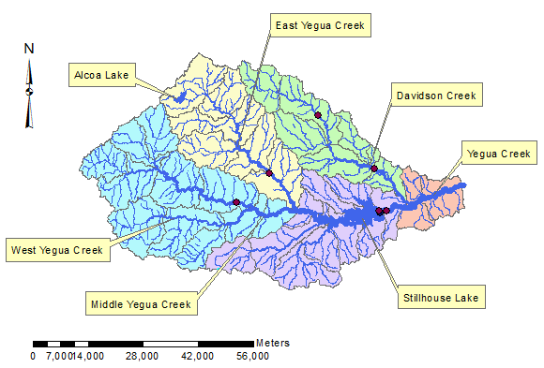
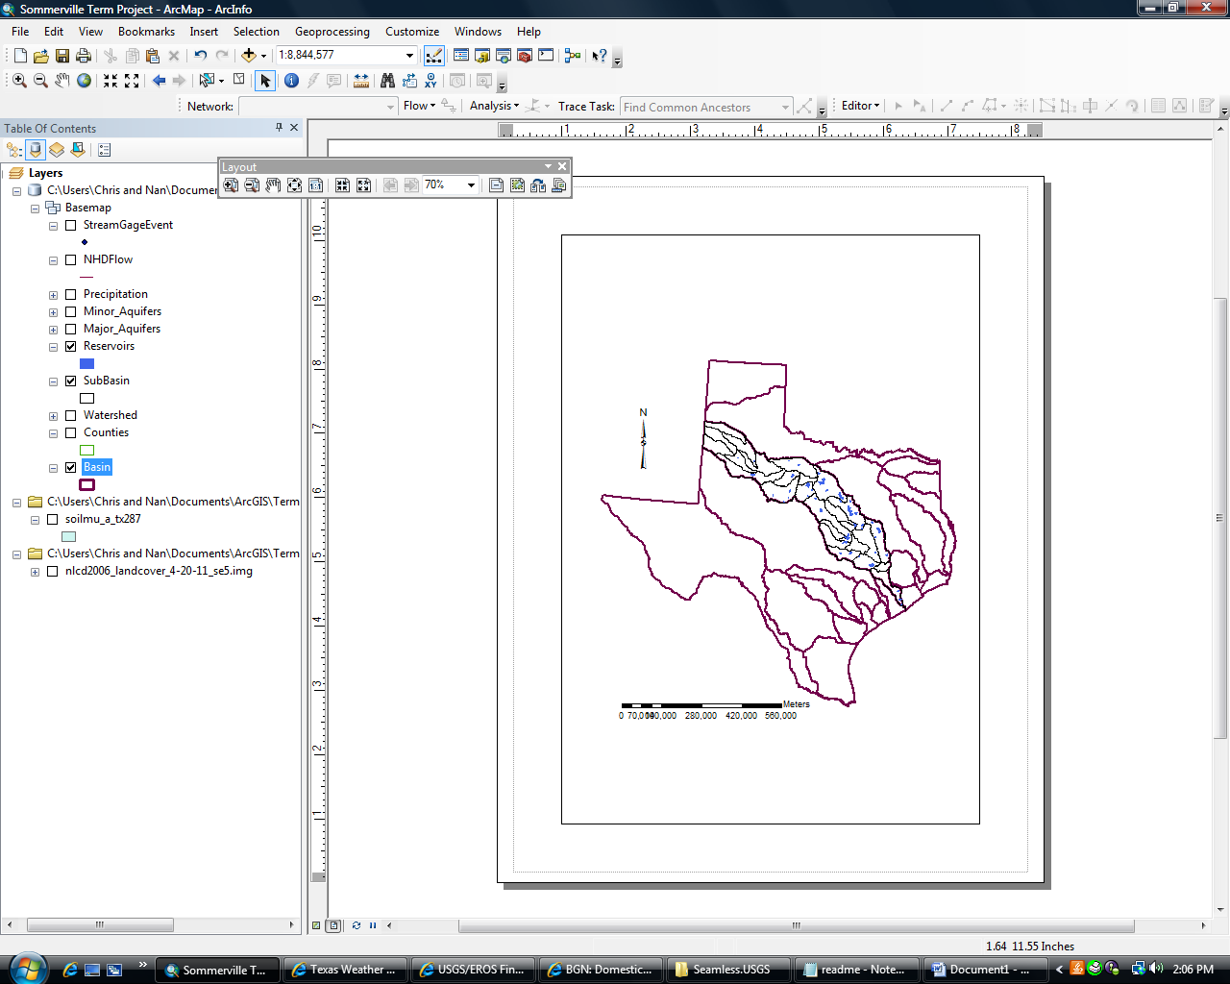
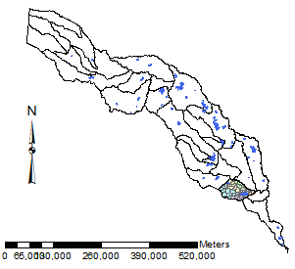
Introduction
Brazos River Basin
Lake Somerville Watershed

Slide 4
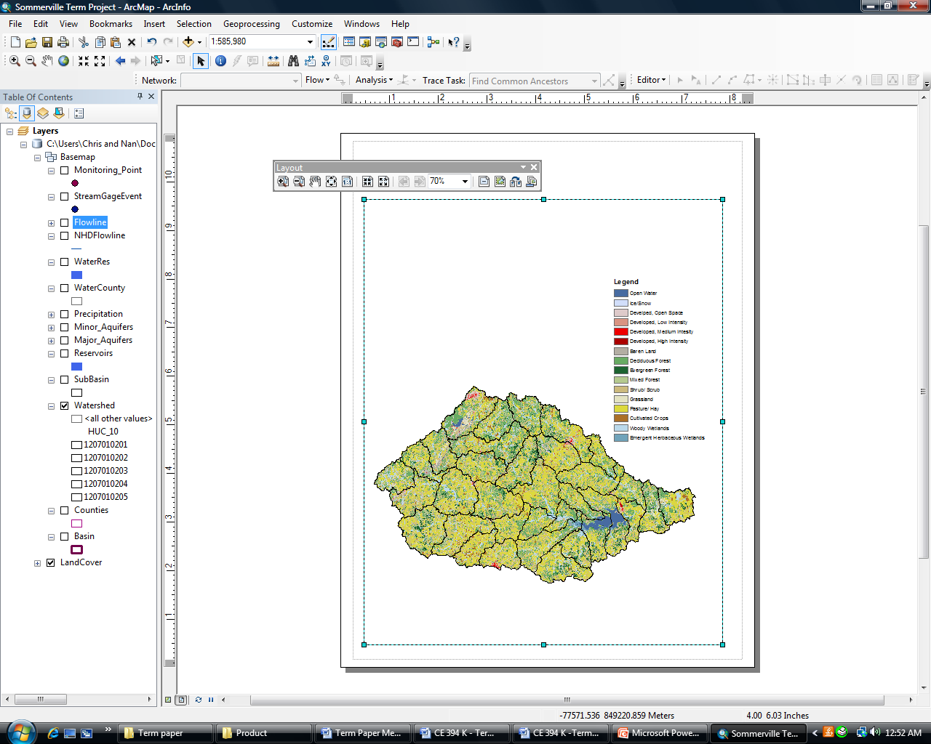
Background
Texas 2011 Drought
  High temperatures
  Low precipitation
  Record low reservoir levels
High demand for sustained soil moisture
Similar conditions expected for the next 1-2 years

Slide 5
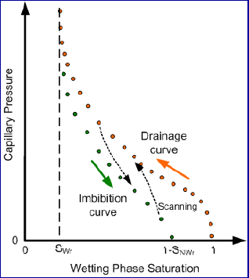
The Problem
Soil Recovery and “Memory”
  Porosity
  Field Capacity
  Wilting Point
  Residual Moisture Content

Slide 6
Watershed Statistics

Slide 7
Methodology
Water Balance
dSoil Moisture = Precipitation – Runoff – Evapotranspiration
Spatial Moisture Content Prediction
Soil Recovery Coefficient
Quantitative Impact of Critical Moisture Content
Soil Hydraulic Properties
(raster)
Statistical Precipitation Model
Runoff/Flow Correlation
(raster)
Statistical Temperature Model
Statistical ET Analysis

Slide 8
Required Work
Evapotranspiration Statistical Analysis
  MODIS Toolbox
LDAS Soil Data to Raster
Evaluate

Slide 9
Questions?

