Slide 1
Seagrass Health:
A Comprehensive Monitoring Program
Prepared by Susan Linn
University of Texas at Austin

Slide 2
Ecosystem Services
Primary production & carbon sequestration
Habitat and nursery
Fisheries and tourism
Nutrient cycling
Shoreline stabilization
Water filtration
Notes:
It is estimated that between 70 percent to 90 percent of commercial fish spend some part of their life in seagrass habitat (FDEP, 2001).
Laguna madre 225 recreational fishing
Shrimp, crab, red drum, snapper

Slide 3
Ecosystem Services
Primary production & carbon sequestration
Habitat and nursery
Fisheries & tourism
Shoreline stabilization
Water filtration
“For them it's the nursery, the roof over their heads and the grocery store all rolled into one. “- TPWD
$82,000 per acre per year
Texas = 235,000 acres
$19,270,000,000
Notes:
With inflation 33276 per hectare
Costanza et al. 1997
TPWD 1999

Slide 4
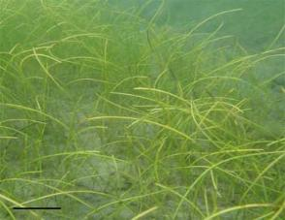
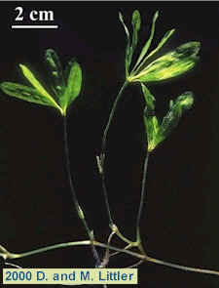
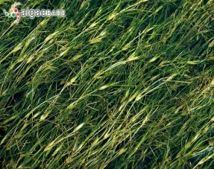
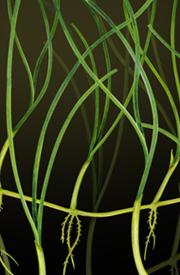
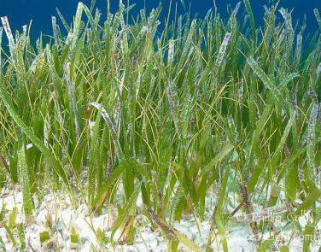
Texas Native Seagrasses
Halophila engelmannii
Star Grass
Ruppia Maritima
Widgeon Grass
Syringodium filiforme
Manatee Grass
Halodule wrightii
Shoal Grass
Thalassia tesudinum
Turtle Grass

Slide 5
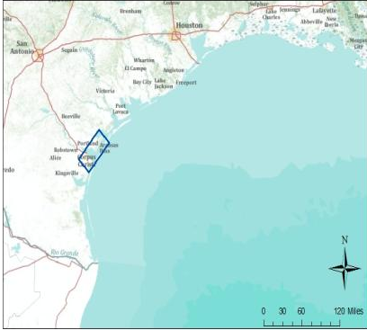
Our Study
Sampling Sites
Over 500 sites sampled
August – October 2011
4 Estuaries
  Mission Aransas
  Corpus Christi Bay
  Upper Laguna Madre
  Lower Laguna Madre
Gulf of Mexico

Slide 6
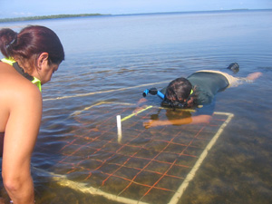
Study Parameters
Abiotic Factors
Biotic Factors
Light
Total suspended solids (TSS)
Chloropyhll a
Salinity
Temperature
pH
Dissolved oxygen
Species composition
Percent cover
Canopy height
Root/shoot ratio

Slide 7
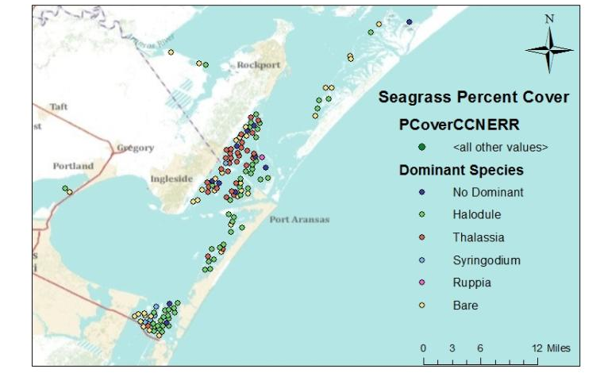
Dominant Species

Slide 8
Geoprocessing Model

Slide 9
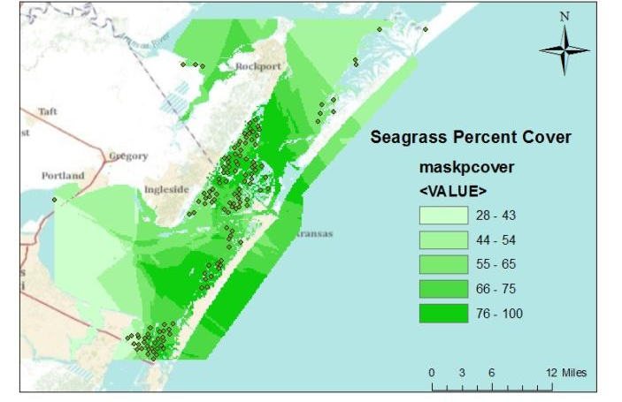
Seagrass Percent Cover

Slide 10
Chlorophyll a Concentration

Slide 11
Light Attenuation

Slide 12
Conclusions
Light appears to be limiting factor
  What about Corpus Christi Bay?
  Need more parameters
Monitoring suggestions
  Threats to light availability
    Nutrient loading: Eutrophication
      Watch Chorophyll a
    Sediment loading: Erosion
      Watch TSS

Slide 13
Next Steps
Incorporate all parameters from Mission Aransas and CC Bay
Incorporate additional 500 sites from Laguna Madre
Determine if light is the limiting growth factor in these estuaries
Assign “grades” for ecosystem health to the 4 estuaries

