Slide 1
Precipitation Analysis of Dallas County
- Poolkeshi Patel

Slide 2
Objectives
To compare the radar derived rainfall data with the actual rain gauge data.
Importance of accurate quantification of rainfall.
Is the data from the virtual rain gauges a good representation of the actual rainfall in the county?

Slide 3

Methodology :-
Data Acquisition using Hydro Desktop
Data processing using GIS
Analysis
Results

Slide 4
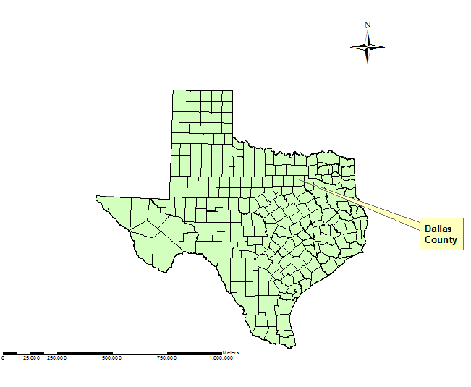

Slide 5


Rainfall Data from Virtual Gauges | Rainfall data from Actual Gauges
Source :- NWS-WGRFC NOAA’s National Weather Service | Source :- USGS – NWIS National Water Information System
Data available over the entire region. | Data available at very few locations.

Slide 6
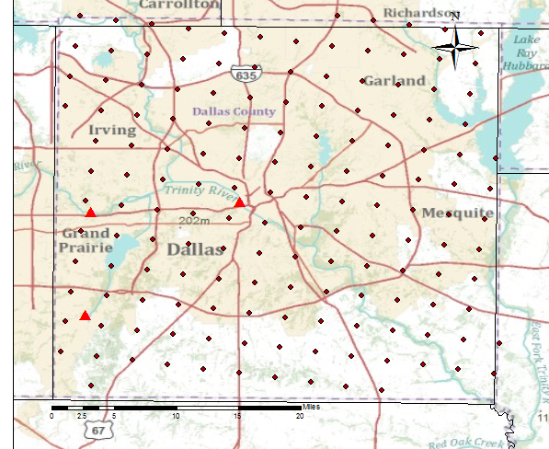
Location of the virtual & actual stations

Slide 7
 | inches
Mean | 0.377732
Standard Deviation | 0.520523
Median | 0.17
Variance | 0.270944

Slide 8
 | inches
Mean | 0.099924
Standard Deviation | 0.337801
Median | 0
Variance | 0.114109

Slide 9
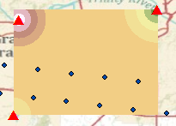
Interpolation of the actual rain gauges data

Slide 10
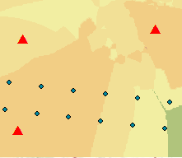
Interpolation of the virtual rain gauges data
underestimates
overestimates
overestimates

Slide 11
Analysis
Distribution of the rainfall over the county is underestimated by the virtual rain gauges.

Slide 12
Concluding Work
To look at a storm event and try to quantify the contribution of rainfall to the watershed in the county as a representative of the actual or virtual rain gauges.

