Slide 1
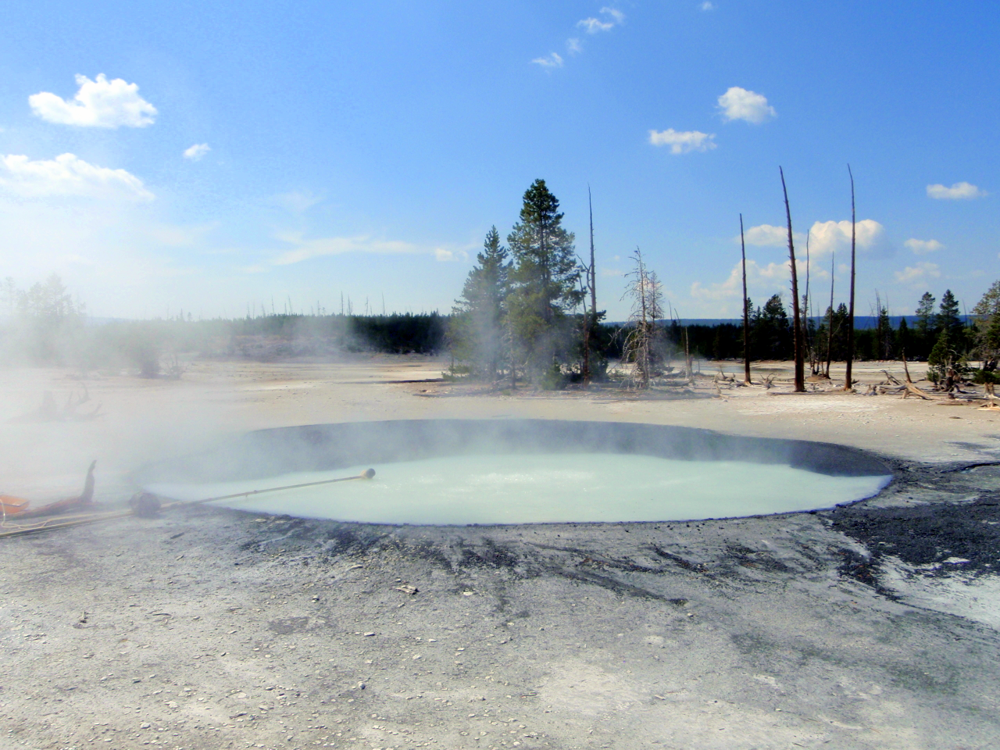
Searching for Sulfur Gases in Norris Geyser Basin
Lindsey Sydow

Slide 2
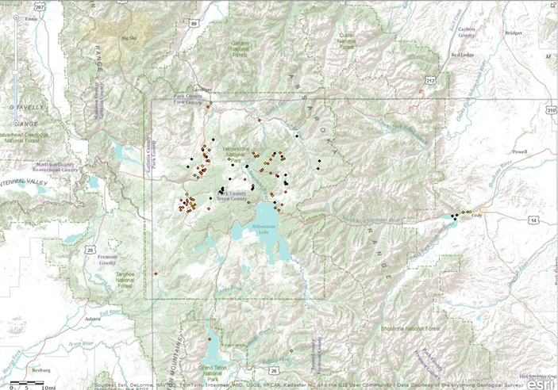
Searching ArcGIS online
Somewhat of a failure
Not enough detail for my purposes
Thermal features: too few
Geological maps: too great of scope

Slide 3
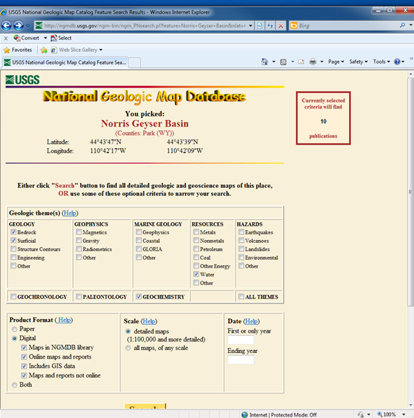
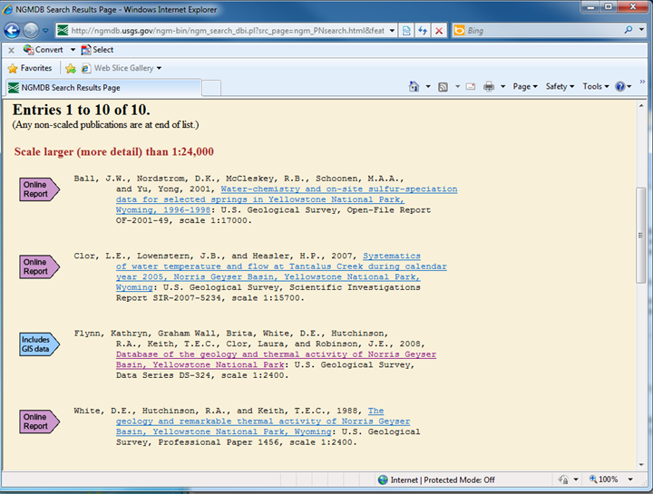
Searching USGS.gov
National Geologic Map Database
Tells you which results have GIS data!

Slide 4
Manipulating Data
Need to adjust points (flowing springs) and polygons (pools or springs) to be a single layer: “water_features”
  “Select by attributes” to separate springs from vents and other non-water point features (New layer: Springs)
  “Feature to Point” to turn pools into points (New layer: basin_centroids)
  “Merge” to join the two new layers into one: water_features.

Slide 5
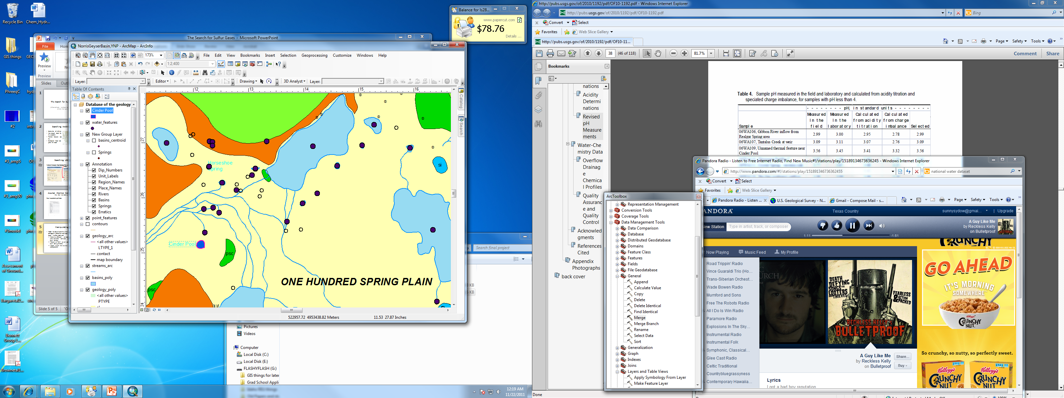
Some of the Features near Cinder Pool

Slide 6
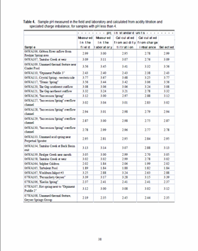
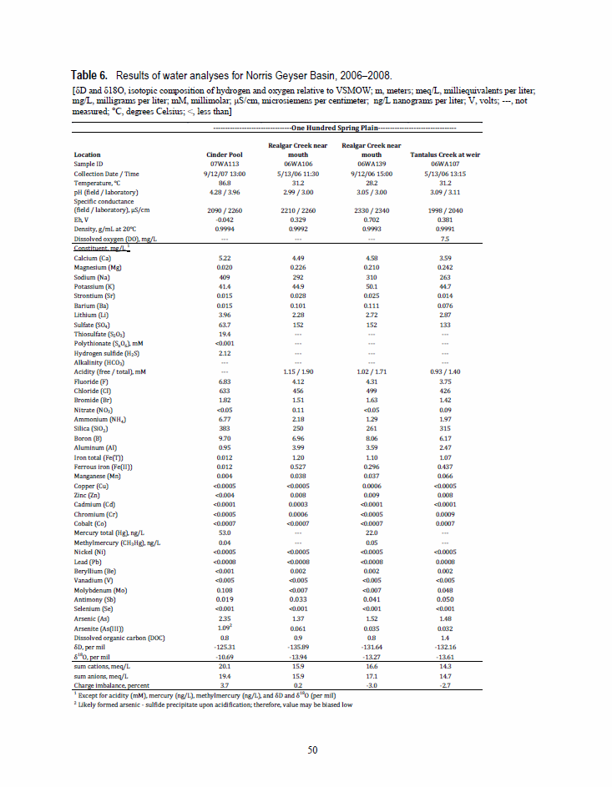
Acquired Chemical Data from PDFs
(Yes, that is as bad as it sounds)
How I acquired my pH data
What will be added

Slide 7
Major factors for identifying features of interest
Water temperature 85-110ºC
pH between 3 and 4.5
Not necessarily requirements
  Geology—fluvial deposits
  Proximity to Cinder Pool
In Cinder Pool:
Temperature is ~90ºC at the surface, but 113ºC at the bottom
pH is ~4

Slide 8
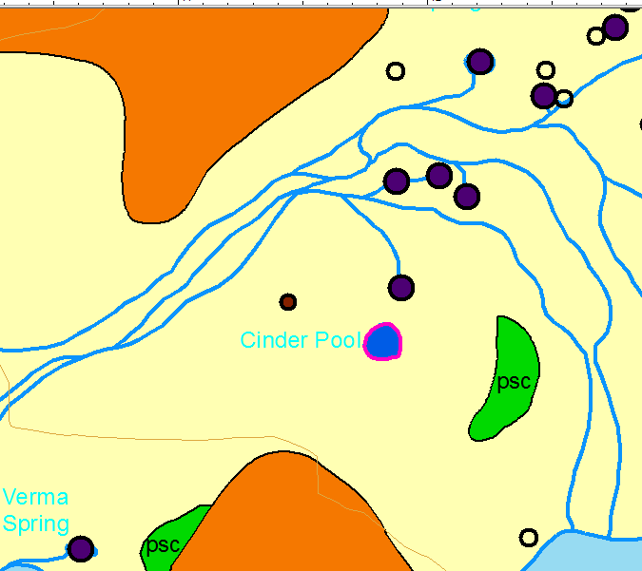

Still to be dealt with: projection issues
“events” layer
“UTM” layer

Slide 9
What remains?
  EITHER joining my point shapefiles OR projecting these same features from the USGS chemical data—rest of data is already ready to go
  Using previously mentioned criteria to select by attributes the best features to sample during next Yellowstone trip.

