Slide 1

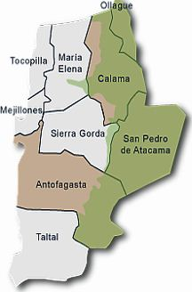
GIS Data Assessment for Region II of Chile – Implications for
Rural International Water Resource Databases
Benjamin Bass
Hydrogeology/Environmental Geology Undergraduate
November 29th, 2011
GIS in Water Resources Presentation

Slide 2
Data Collection
No Public Central Database for the nation
– No equivalent of an Open Database such as NHDPlus and USGS.
Equivalent of TWDB for Region II of Chile = SITHA
– Region II of Chile has GIS compatible files available through an organization specifically working on collecting spatial information systems for wetlands.
– However much of this data is outdated and limited.
Individual Data Request Required directly from Chilean Government
– Various Parts of the Chilean Government had to be contacted.
– Exchange of Data via request in my non-native tongue.

Slide 3
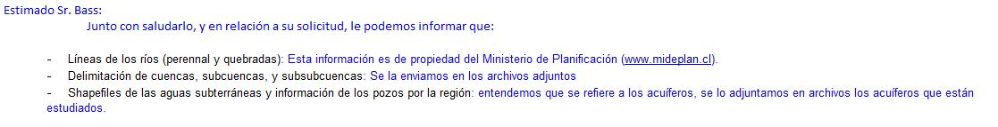

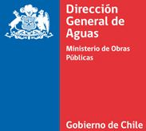
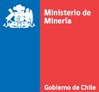

Data Request
Sitha

Slide 4
Summary of Talk
General Spatial Analysis
Trials and Tribulations of Watershed Delineation Analysis
Local Study on Copper Mines and their effects on Water Quality

Slide 5
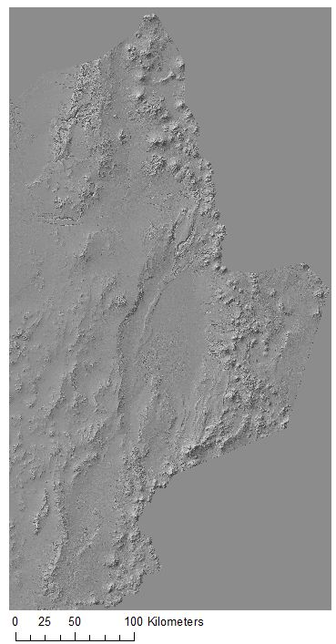
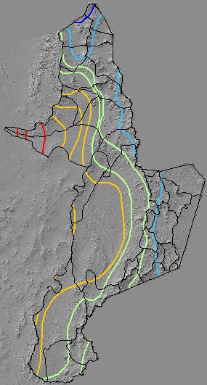
Basic Climate
Analysis of the Region

Slide 6
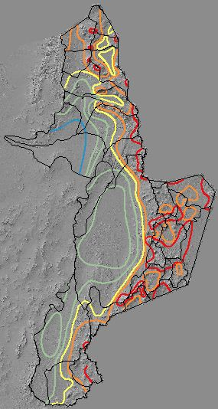
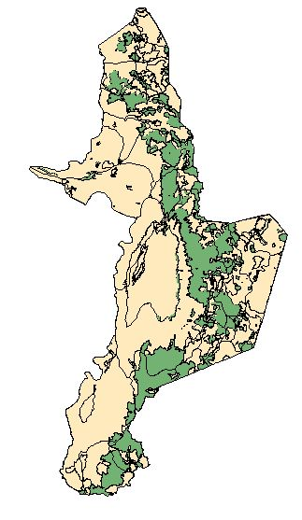

Legend
Vegetation
No Vegetation

Slide 7
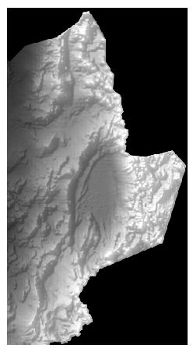
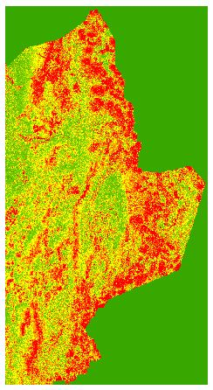
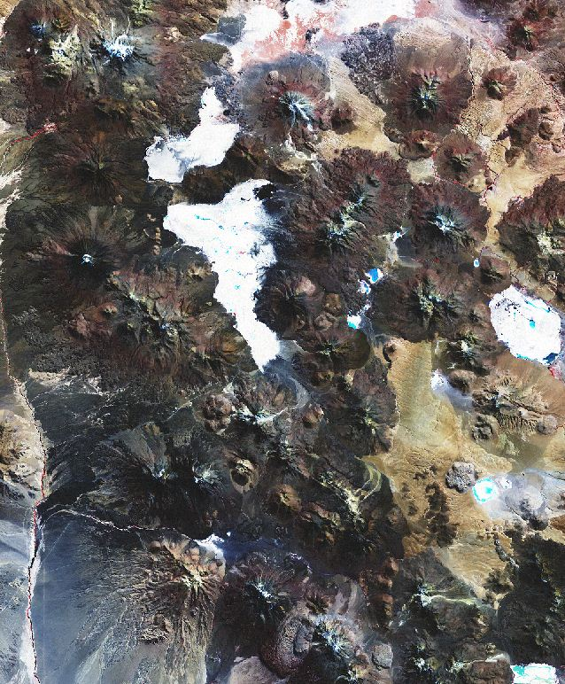

Spatial Analysis

Slide 8

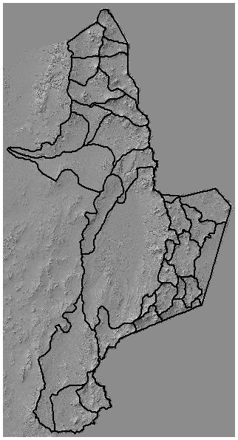
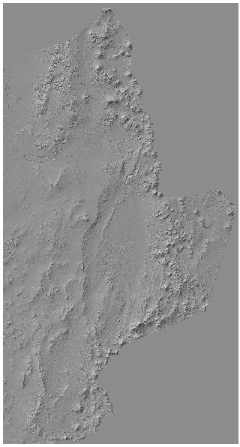
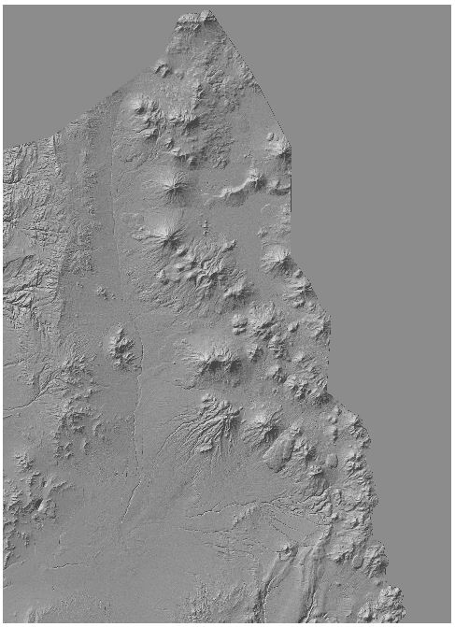
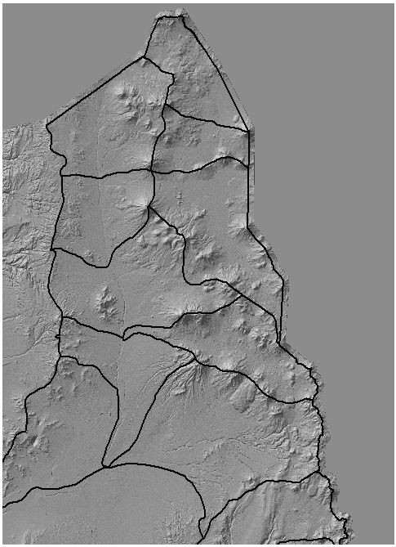
Spatial Analysis Cont…

Slide 9
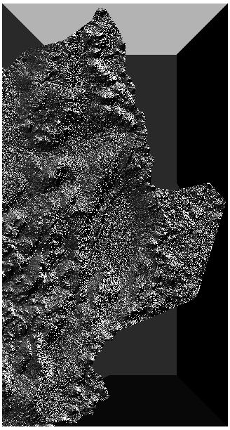
Problems with Watershed Delineation
Flow Direction
Fill Tool did not work on the DEM.
Flow Accumulation processing could not handle the size of the DEM or another problem associated with the DEM.

Slide 10
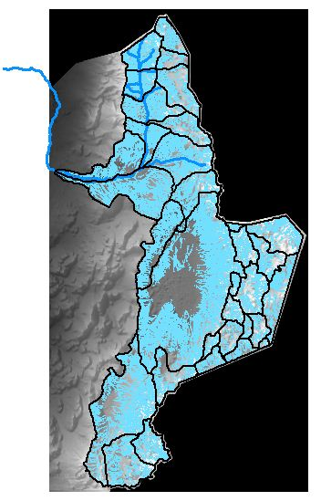

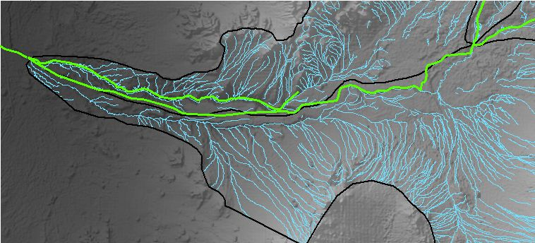

Problems with Watershed Delineation
Disconnected perennial streams non-perennial streams.
Notes:
Streams were projected, but…

Slide 11
Implications of Experiences
A centralized database with reliable data, open to the public, is necessary for Chile, particularly for rural regions such as my study area where water resources are scarce.
Further development towards a global database is necessary for this to happen, where language barriers and scattered, difficult to obtain data may not inhibit scientific analysis.
CUAHSI
ArcGIS Online
We need to continue towards developing an open
international database exchange.

Slide 12
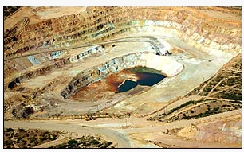
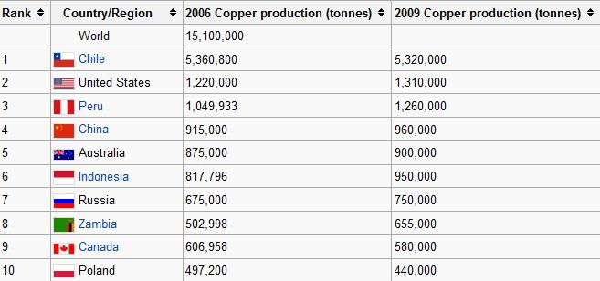
Copper Mines and Water Chemistry
Notes:
EPA:
Mining and extraction of copper by common surface or underground methods can concentrate and expose radionuclides in the waste rock (tailings). Another extraction method, known as "in-situ" leaching, can transport uranium and thorium into groundwater or surface water at the site.

Slide 13
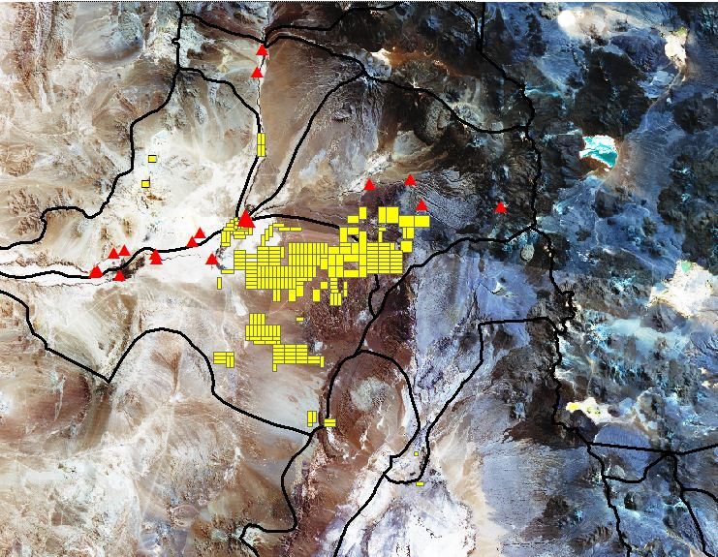
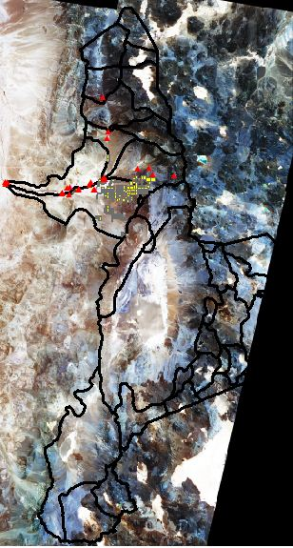


Available Data
Data Points
11 = 1999
20 = 2000

Slide 14
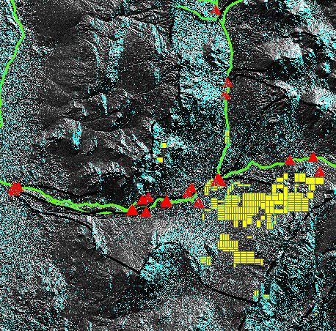
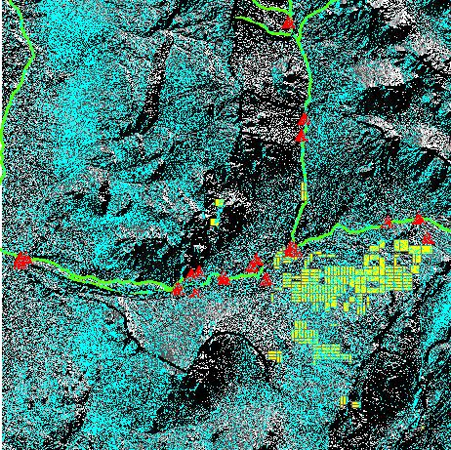

Predictions According to predominant direction of water flow
Flow Direction – East (1)
Flow Direction – West (16)

Slide 15
Water Chemistry Inspection
EPA Safe Drinking Water MCL Limits (µg/L)
pH | TDS | Nitrate | Fluoride | Al | Iron | Mn | Cu | Zn | Sulfate
6.5-8.5 | 500000 | 10000 | 4000 | 200 | 300 | 50 | 1300 | 5000 | 250000
Cd | Pb | As | Sb (Antimony) | Hg | Uranium
5 | 15 | 10 | 6 | 2 | 30

Slide 16
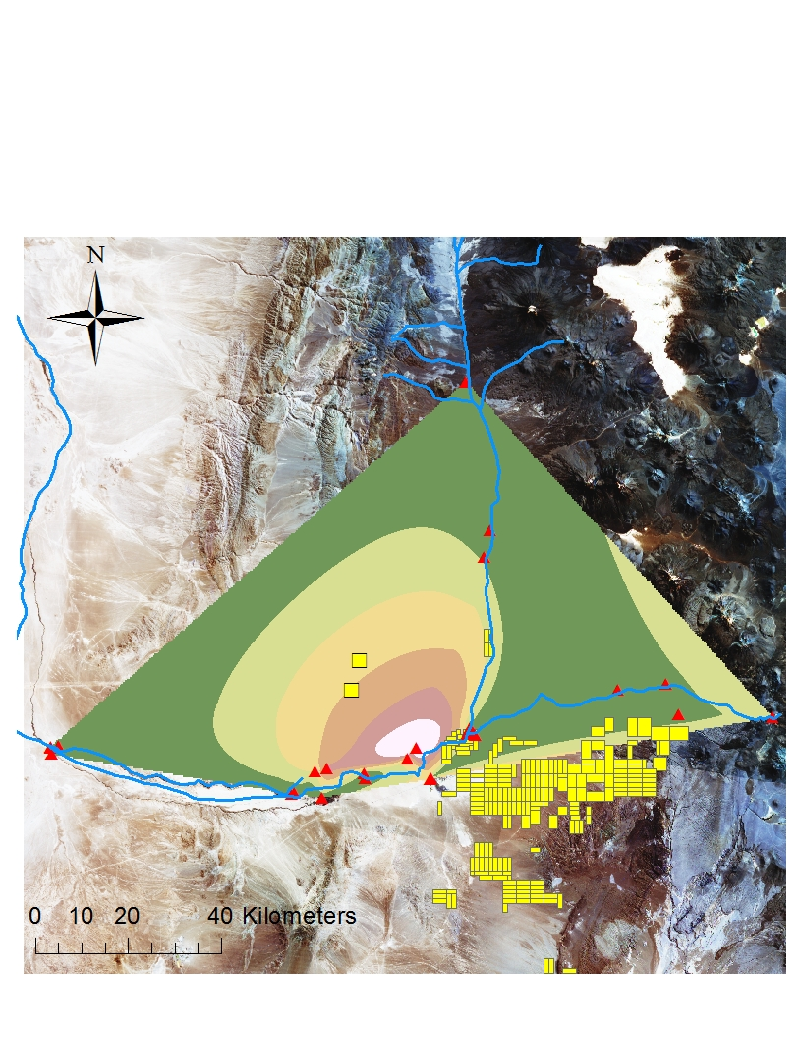
Results - Copper
EPA MCL
1,300 µg/L

Slide 17
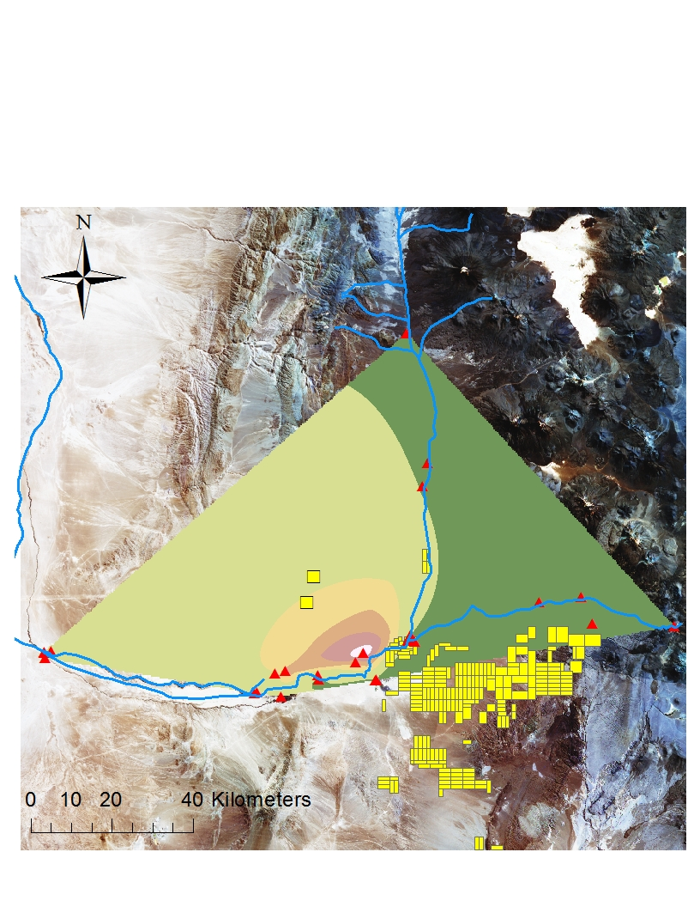
Results - Sulfate
EPA MCL
250,000 µg/L

Slide 18
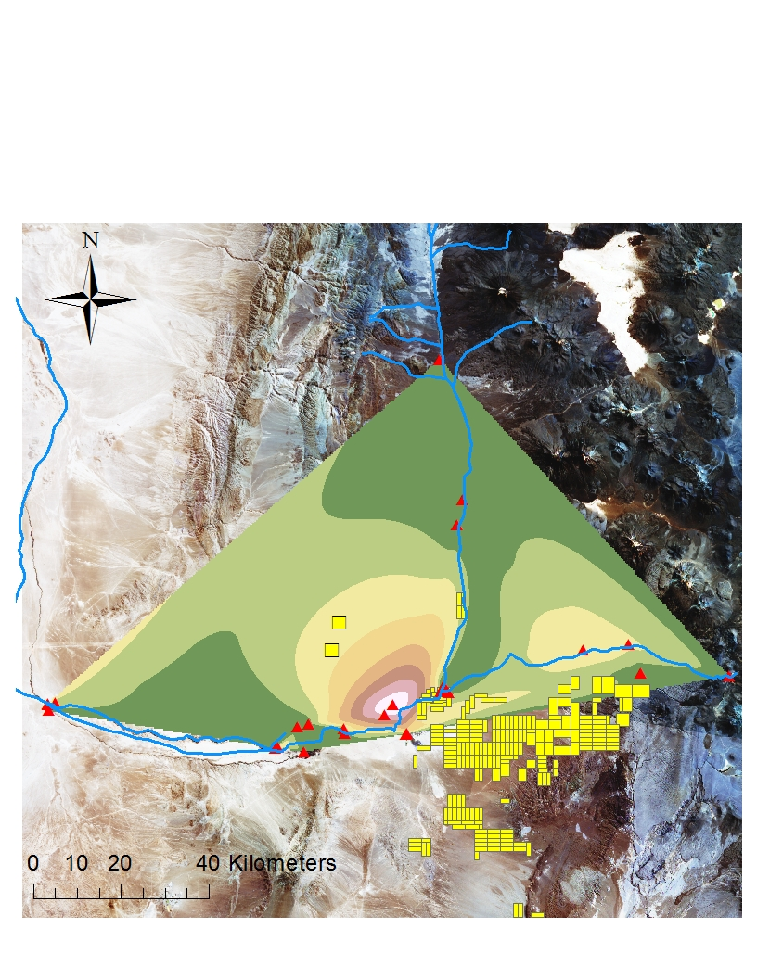
Results - Iron
EPA MCL
300 µg/L

Slide 19
Summary
Poor Water Quality inferred to be a result of copper mines.
This has implications for management of water resources.
Spatial Issues: Results makes sense for a local investigation of the area, but the surrounding region has many more mines.
Temporal Issues: Only two years of data.

Slide 20
Data Sources and References
Thank you!
Sitha.cl
Direccion General de Aguas – Gobierno de Chile
Ministerio del medio ambiente – Gobierno de Chile
Environmental Protection Agency

