Slide 1

Evaluating the Impact of Local and Global Stresses on Caribbean Coral Reefs
Presented by Courtney Thomas
My H₂O intolerance doesn’t flair up as much in the Caribbean!

Slide 2
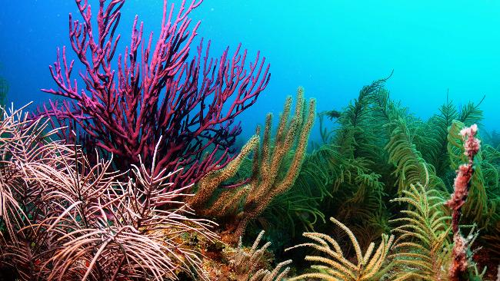
Background Information
Great things come in small packages!
  Contain 25% of all marine species in 0.1% of the world’s ocean surface
In the Caribbean:
  10% of the world’s coral reefs
  90% of the reef-building corals are unique
  75% of the reefs are threatened
Coral bleaching is loss of symbiotic algae that leaves the calcium carbonate backbone exposed
Picture source: heraldsun.com.au

Slide 3
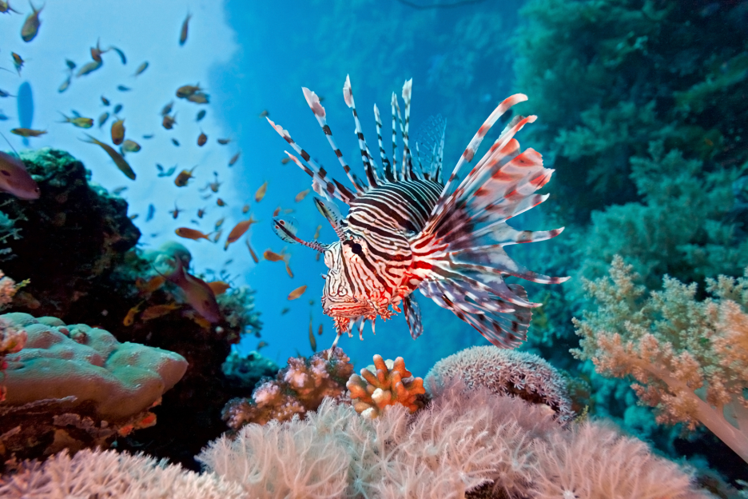
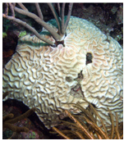
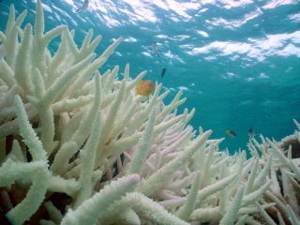
Objectives
Distinguish between Local and Global Stresses to Coral Reefs
Create and Calibrate a Threat Model based on Stresses
Model Threat Levels to Reefs for 2100

Slide 4
Global Threats to Coral Reefs
Temperature¹
Acidification²
Storms³
Coral Reefs thrive at 27°C
Post industrial levels of pCO₂ at 270 μatm
Number & intensity of tropical cyclones has increased
¹sos.noaa.gov
² ucsdnews.ucsd.edu
³geology.com

Slide 5
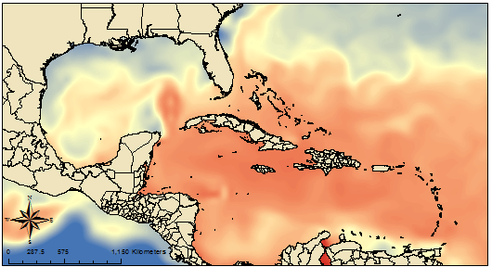

Difference between SST (50 m) and 27°C
January 1990

Slide 6
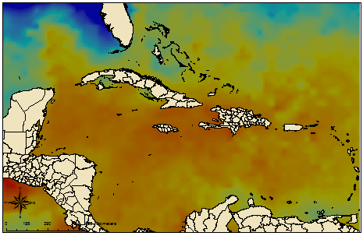

Difference between pCO₂ (50m) and 270 μatm
pCO₂ (μatm)
$$p{CO}_{2sw}=\left(10.19∗SST+0.5249∗latitude −0.2921∗longitude+52.19\right)−270$$
Olsen A., Remote Sensing of Environment. 309–325, 2004.

Slide 7
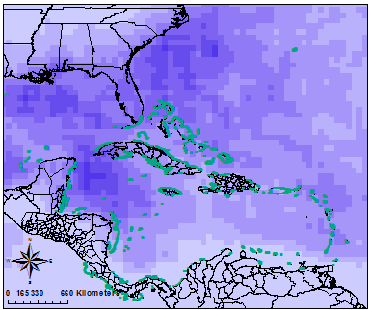

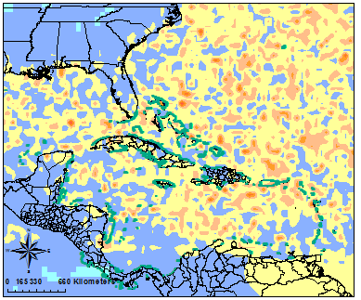

Tropical Cyclones
Percent Chance Area will be Hit by Tropical Cyclone
Storm Intensity

Slide 8
Local Threats to Coral Reefs
Watershed Pollution¹
Marine Activity²
Economics³
¹WRI.org
²shipahoy.blog.com
³duke.edu

Slide 9
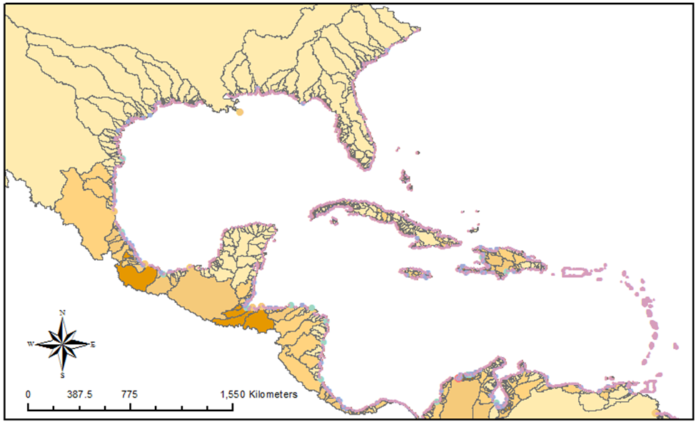
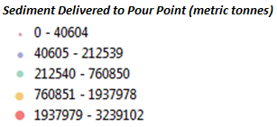

Watershed Drainage

Slide 10
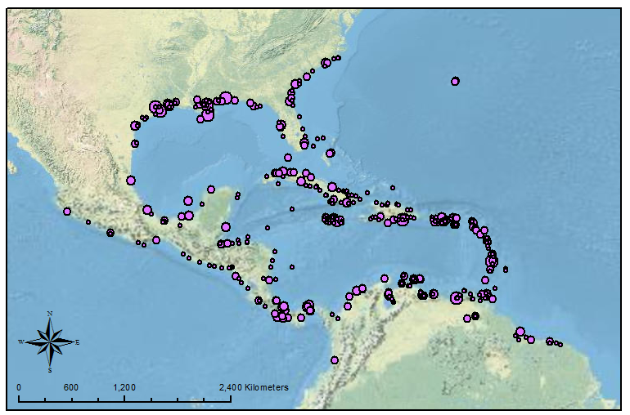
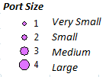
Port Size

Slide 11
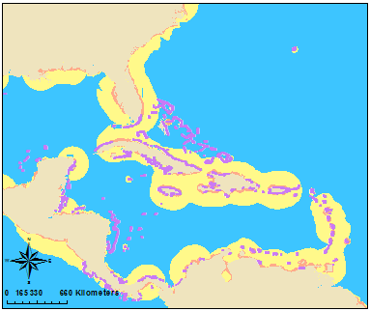
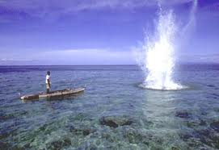

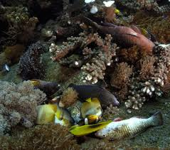
Overfishing, Destructive Fishing, & Management of Reefs
Source: umich.edu
Source: NOAA.gov

Slide 12
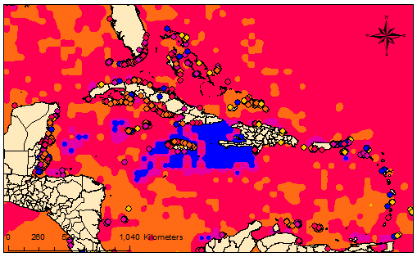
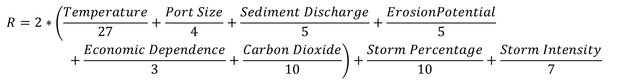
Model Calibration
$$R=2∗\left(\frac{Temperature}{27}+\frac{Port Size}{4}+\frac{Sediment Discharge}{5}+\frac{ErosionPotential}{5}+\frac{Economic Dependence}{3}+\frac{Carbon Dioxide}{10}\right)+\frac{Storm Percentage}{10}+\frac{Storm Intensity}{7}$$
Severity Level of Coral Bleaching (reefbase.org)
Unknown
No bleaching observed
Low (1-10% of corals bleached)
Medium (10-30% of corals bleached)
High (>30% of corals bleached)

Slide 13
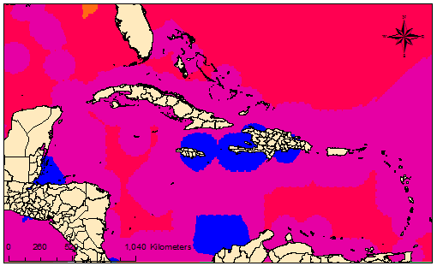
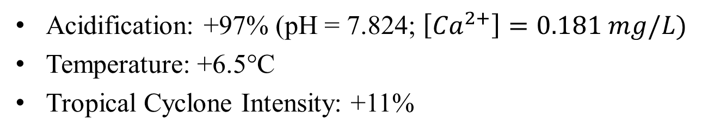
Risk Level in 2100
Acidification: +97% (pH = 7.824; $\left[{Ca}^{2+}\right]=0.181 mg/L)$
Temperature: +6.5°C
Tropical Cyclone Intensity: +11%
Risk Level

Slide 14
Conclusions
Based on investigated stresses, global stresses have a greater impact
Increase in risk level over time if “business as usual”
Need for qualitative data

