Slide 1
Assessing Subsurface Hydrology in Ntisaw, Cameroon
Colleen Lyons

Slide 2
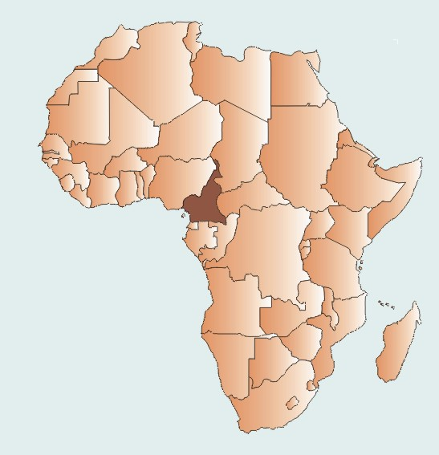
Where in the World???
Ntisaw, Cameroon
http://www.uneca.org/aisi/nici/country_profiles/cameroon/camerab.htm

Slide 3
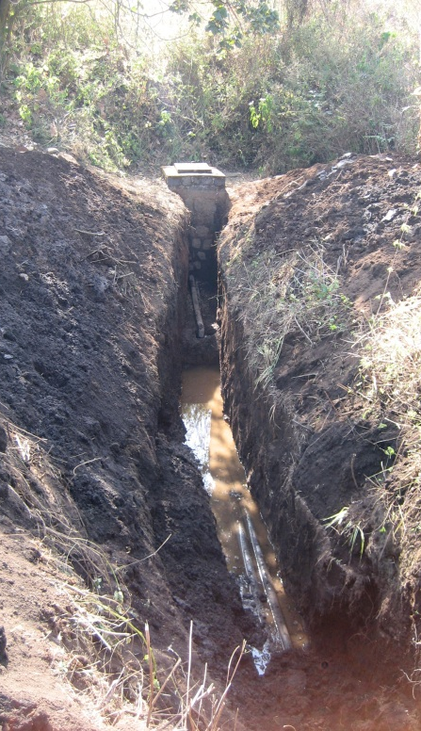
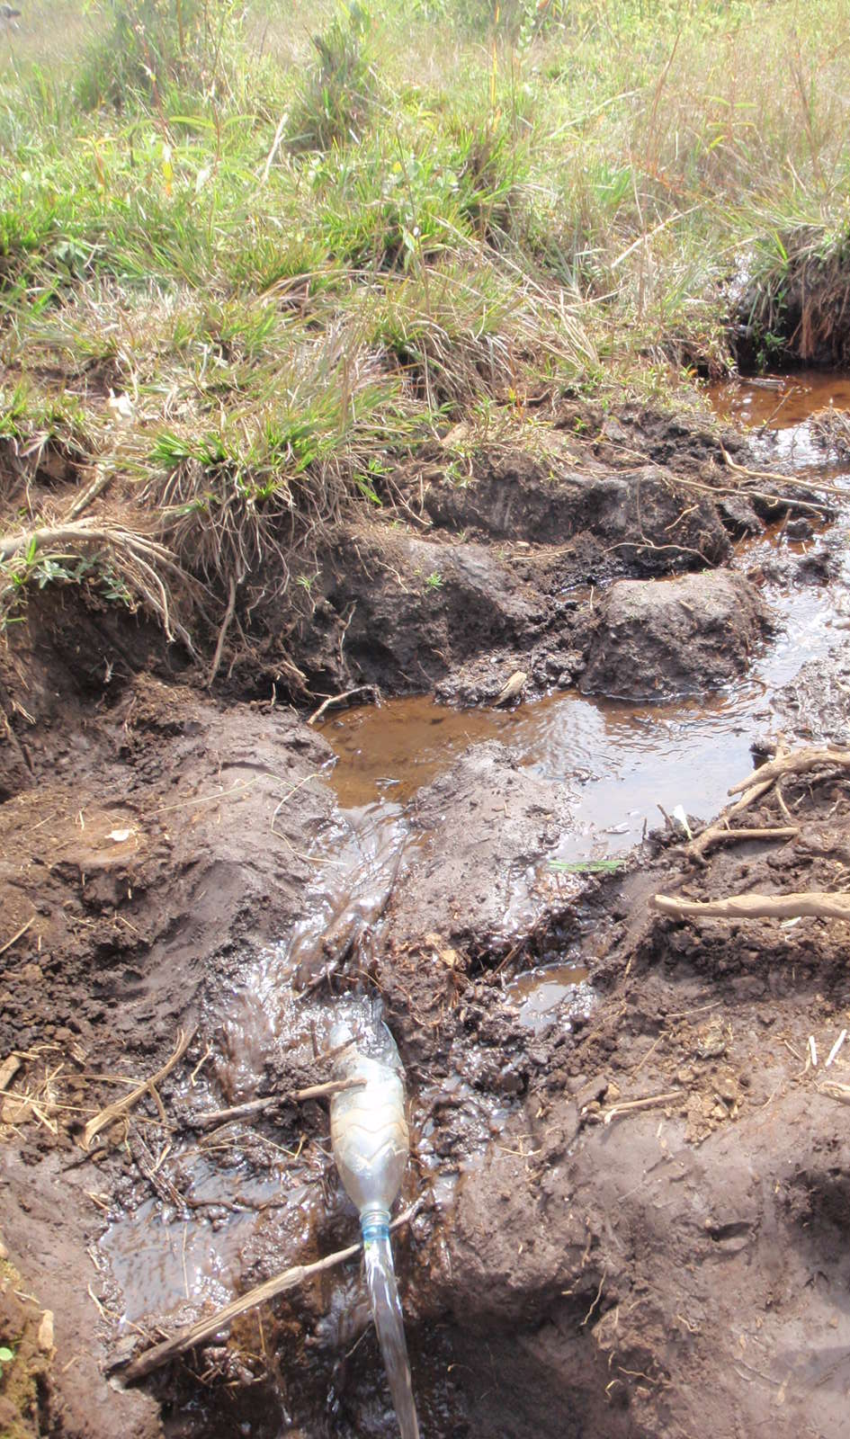
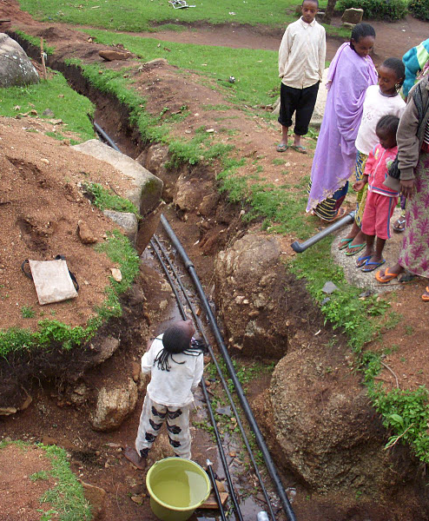
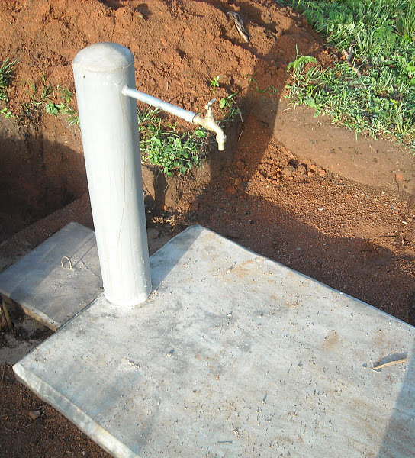
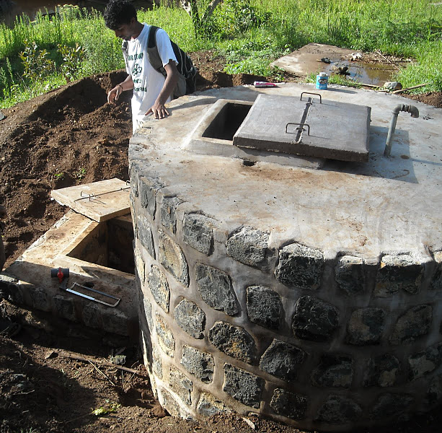
Our Goal
Engineers Without Borders at the University of Illinois at Urbana-Champaign is working to bring a rural village of ~1000 people clean drinking water
Constructed a gravity-fed water distribution system
6.5 km of pipeline
5 tanks
14 public tap stands

Slide 4
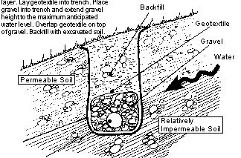
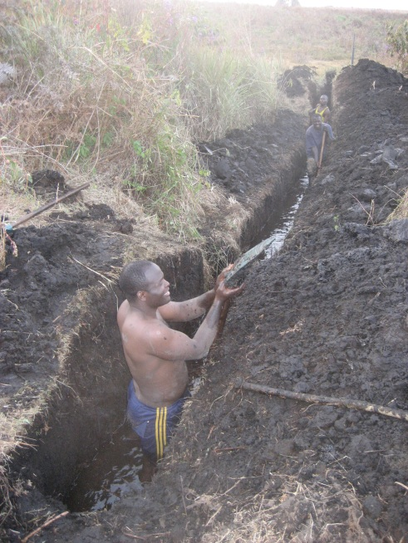
The Problem
Distinct monsoon season
During the dry season, the spring box can run dry
The spring box cannot go extended where it was built since it would no longer flow via gravity. And it is expensive.
Provide additional water via a “drain”
Typically used in Illinois to prevent crops from flooding
Disadvantage: Potentially large source of bacterial contamination
Advantage: Economically feasible and technologically simple

Slide 5
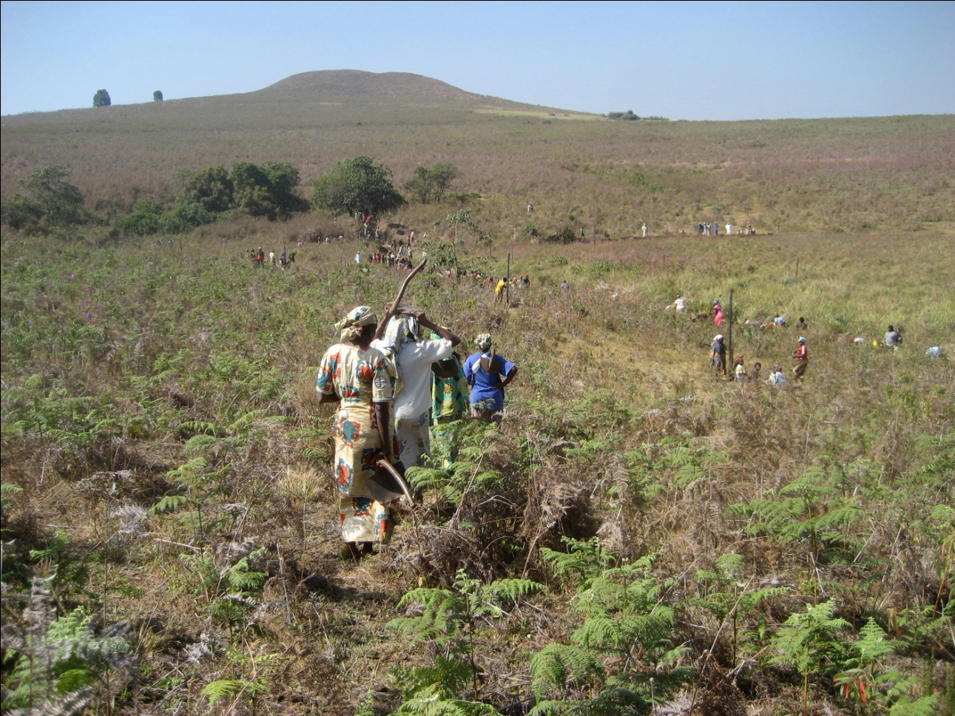
My GIS Project Goals
Determine if a berm can help prevent contamination of the water source
2. Verify that the drain can supply sufficient water when the spring box runs dry

Slide 6
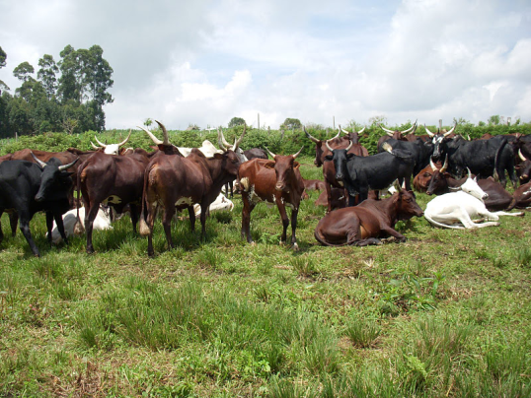
Goal #1: What is the catchment and how to protect it?
Notes:
These polygons were made using GPS data collected while in the village. The catchment is a pretty defined horseshoe shape with a relatively clear downward slope.

Slide 7
How will runoff enter the “catchment” from the “drainage area”?
* DEM data from SRTM 90 meter
Notes:
Using “fill”, “flow direction”, and finally “aspect”, we can see that our rough estimates of the drainage area are pretty spot on. Therefore using our already defined polygon and the “area calculation” function, I calculated the drainage area to be 0.38 square kilometers.

Slide 8
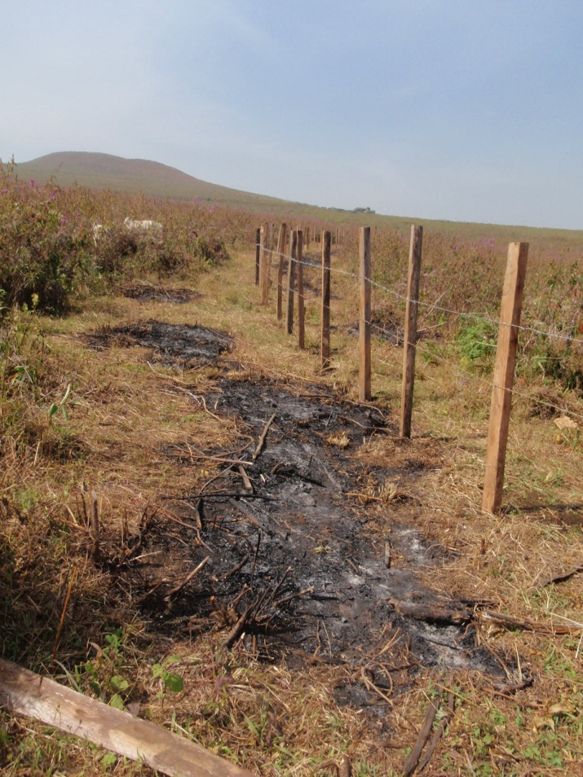
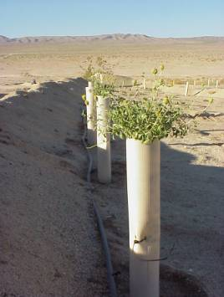
If a berm is built, how will that change flow patterns?
http://www.sci.sdsu.edu/SERG/restorationproj/mojave%20desert/ft_irwin/death760.html
Notes:
Here is a picture of a berm for those of you that do not know what I am referring to. It is essentially digging up dirt to pile it higher. This will direct run off away from the spring box and therefore the drinking water.

Slide 9
If a berm is built, how will that change flow patterns?
Using Editor, draw “berm” around fence
Convert the polyline to raster using my filled DEM for cell size and extent
Using raster calculator, give my berm the same elevation as the DEM, plus 1 extra meter to model the berm
Using a mosaic dataset, replace these new “berm” values with the previous elevation data points
Use aspect function to determine new downward slope direction with the berm incorporated
Notes:
Insert aspect picture with berm created – this is how the flow patterns change. Berm height estimated using the Rational Method and rain data from the village. While the village realistically will only make one about 1-2 feet high, this picture shows a 1 meter high berm.

Slide 10
Goal #2: Can the drain supply sufficient water?
Data Analysis Process:
Determine elevation within the catchment (data collected with an abney level)
Install monitoring wells
Process data

Slide 11
Step 1: Catchment Elevation
Upload elevation data (abney level)
Projected coordinate system: LGD2006_UTM_Zone_32N
Data interpolation
Natural neighbor
Install 31 monitoring wells
Projected coordinate system

Slide 12
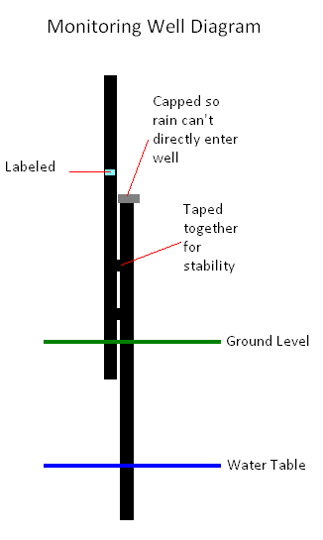
Install 31 monitoring wells in the catchment
* From Manu Kumar

Slide 13
Changing water table height
Upload well data
Projected coordinate system: LGD2006_UTM_Zone_32N
Data interpolation of ground elevation from monitoring wells
Natural neighbor

Slide 14
Changing water table height
Create Mosaic Dataset
Add rasters to mosaic dataset
Add time field using the “add field”
Enable time on the layer
Calculate cell size ranges
Time slider window

Slide 15
Can the drain supplement the spring box in the dry season?
Jan 2011
May 2011
Collected by village member
Approx 0.7 meter difference in water table height
Collected by UIUC students
Approx 1.2 meter difference
Notes:
From Jan to May, the water table fell according to this data, however the water table of the spring box fell faster than that of the drain. This is probably due to the additional spring sources supplying the drain. More precise information is needed (such as exact depth of drain, water table height at the drain and the spring box since there are not wells located immediately adjacent to them). However, this suggests that the drain has the potential to be a viable option.

Slide 16
Conclusions/Future Work
Goal 1: Determine if a berm can help prevent contamination of the water source
A berm clearly changes the flow direction and will help prevent large amounts of run-off from entering the catchment as surface water
Need to determine if bacterial contamination immediately outside of the berm, what are the chances it reaches the spring box or the french drain
Goal 2: Verify that the drain can supply sufficient water when the spring box runs dry
Need more accurate data as well as at least one years worth of measurements to truly see fluctuating water table

Slide 17
Thank you!!
Any questions?
* Please see final paper for a list of references

