Slide 1
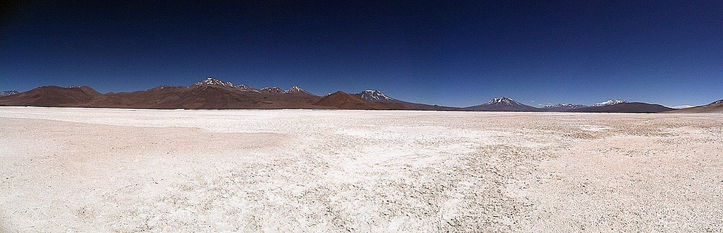
Multitemporal remote sensing analysis of a playa lake groundwater system in northern Chile
GIS in Water Resources, Fall 2011
Katherine Markovich

Slide 2
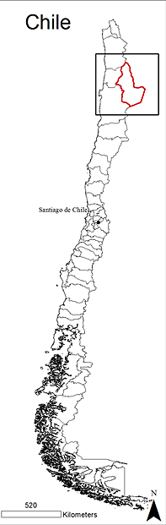
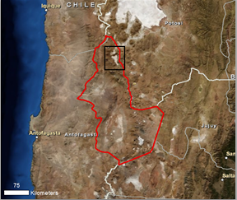
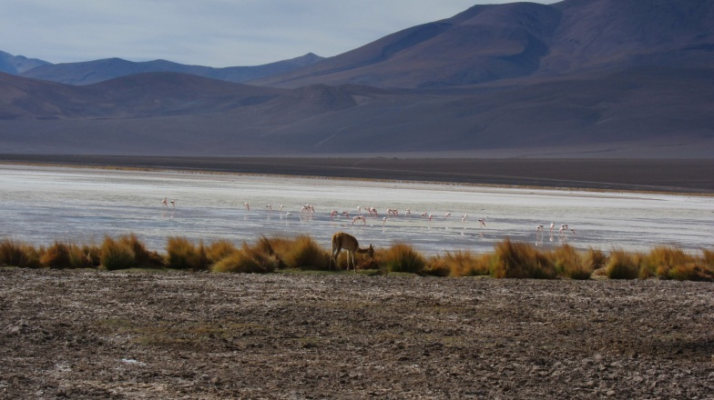
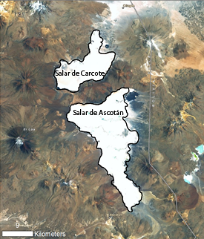
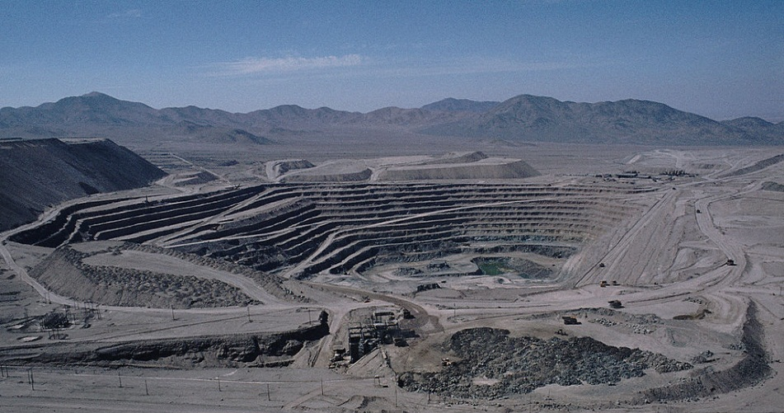
What is a playa lake or salar, and why do we care?
Playa lake: an arid zone feature that is transitional between a playa, which is completely dry most of the year, and a lake (Briere, 2000).
In this study, a salar is an internally drained evaporative basin with surface water occurring mostly from spring discharge.
Image courtesy of Wikimedia Commons
Notes:
-I will use these terms interchangeably
-study site is source of water in the atacama desert, 13,000 feet asl, VERY REMOTE
-establish the competing dependency on the salars, but also the shared interest in preserving the groundwater flow. El abra mine has been pumping in south since 97

Slide 3
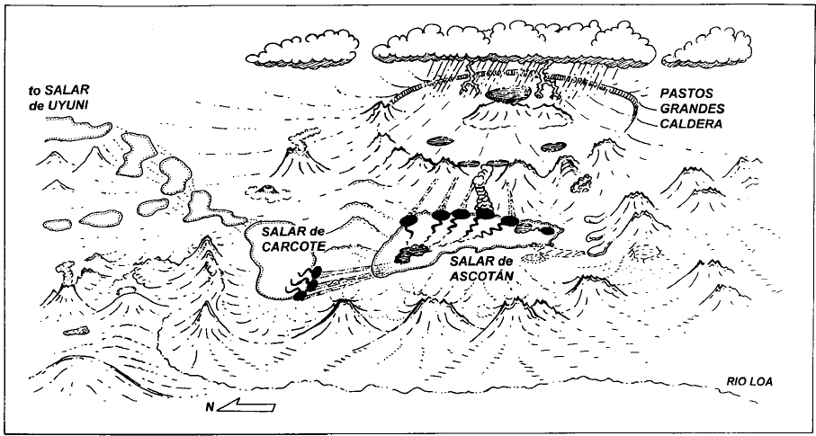
Proposed regional groundwater system:
Keller and Soto, 1998
Research Questions
Can we use remote sensing to quantify surface water extent on the salars?
Can we validate/refute Pastos Grandes as the recharge zone for Ascotán?
Can we determine if pumping has affected the northern springs and/or the springs at Carcote?
Hypothesis: Yes, remote sensing is useful for monitoring of remote areas over large spatial and temporal scales. In situ field data can supplement the remote sensing analysis.
Notes:
Precip to the east as summer convective storms known as bolivian or altiplanic winter (mild weather), caldera melts snow which recharges system. Discharges at ascotan then to carcote and ultimately uyuni.
For #3- explain how we know that pumping has affected the springs in the lower part of ascotan, but that we don’t know how if has affected the rest. This question takes into account climate, as well as utilizes hydrogeochemistry to assess inter and intra basin hydrologic connectedness.

Slide 4
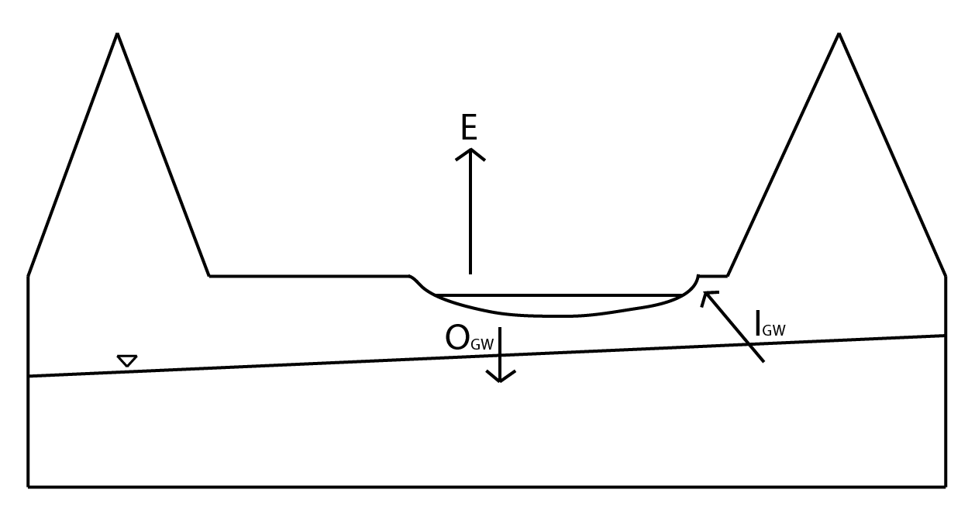
Hydrology
Background
( ) + assumptions =
ΔV= (P+I_{GW}+I_{SW}) – (ET+O_{GW}+O_{SW})
Simple water budget for salars: ΔV= (I_{GW}) – (E+O_{GW})
∆V=change in volume
P=precipitation (rain/snow)
I_{SW}=surface water inputs
I_{GW}=groundwater inputs
ET=evapotranspiration
O_{SW}=surface water outputs
O_{SW}=groundwater outputs
Remote sensing gives us ΔA, which can be related to the groundwater system!

Slide 5
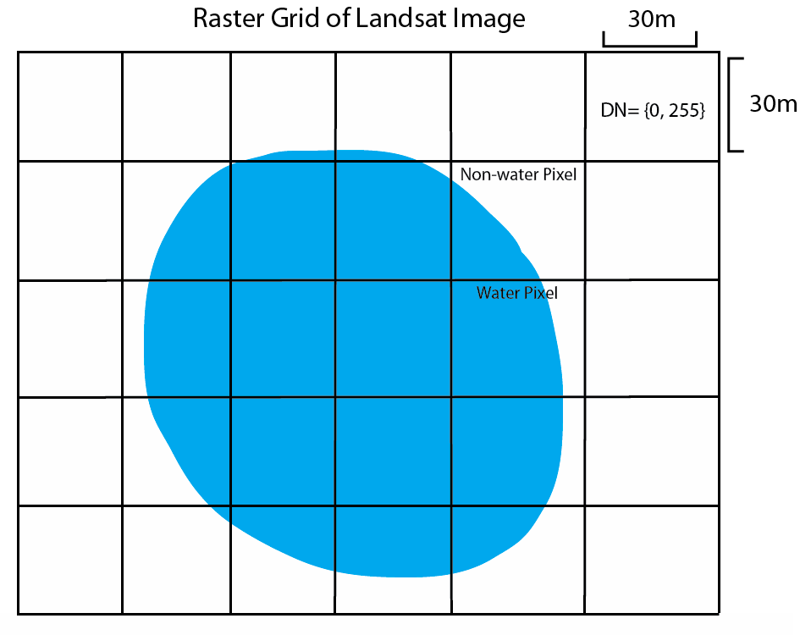
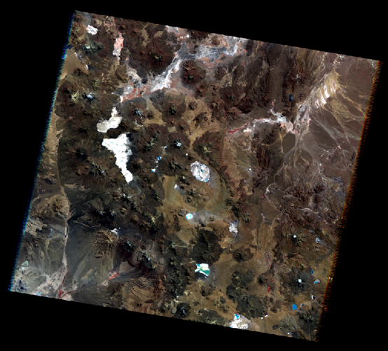
Methods
Landsat Processing
1) Download from USGS Landsat Archive
2) Stack, project, clip using ESRI ArcGIS 10
-WGS 1984 Datum
-UTM Zone 19S Projection
-Nearest Neighbor Resampling
Landsat 4-5 TM and 7 ETM+
7-9 bands
30m pixel resolution
Cloud-free
Orthorectified
Georeferenced
3) Classify water pixels using ERDAS Imagine 2011
-Convert to water extent
-Quality control
-Perform analysis with respect to climate, chemical, and pumping data

Slide 6
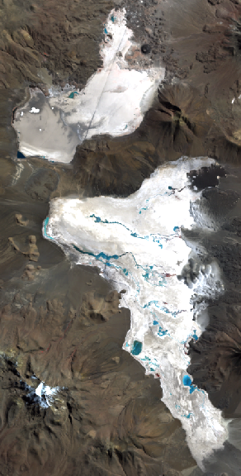
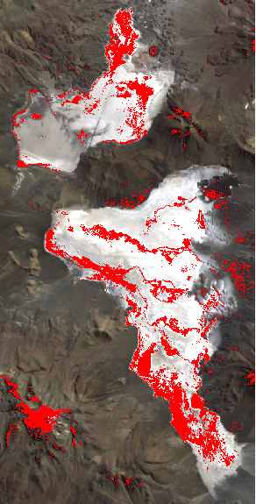
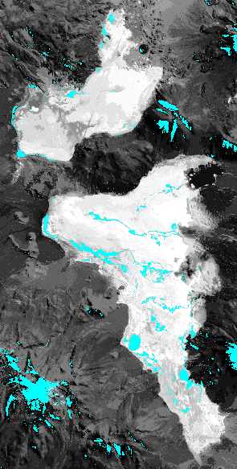
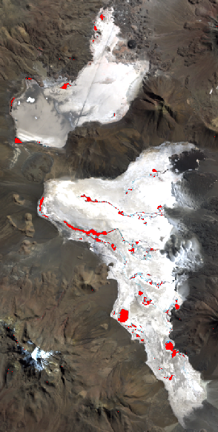

Results
1) Can we use remote sensing to quantify surface water extent as an analog to the regional groundwater system?
Optical Analysis
‘False’ image
Qualitative only
NDWI
Xu, 2006
Overestimates
Unsupervised
Classification
Casteñeda et al., 2005
Depth/salinity
Supervised
Classification
A priori knowledge
Possible Volume

Slide 7
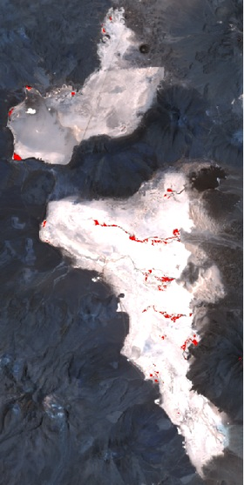
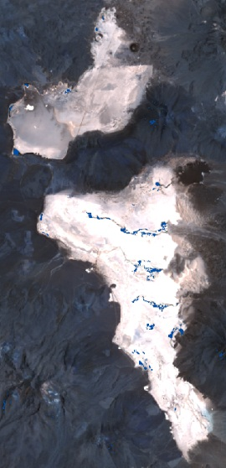


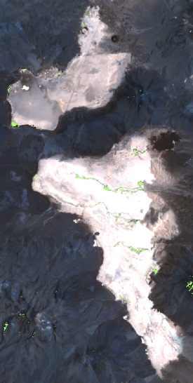
Results
Initial Multitemporal Analysis for 2009
January
March
May
July
December
Notes:
-Average rainfall 300mm/yr, with almost all of it occuring during the Bolivian or Altiplanic Winter as convective precip from the Atlantic ocean. Regional system will reflect this, with severely dampened responses. Residence time of rainfall is unknown.
-Salar images taken at same time each year (following rain recession) should reflect major climatic or anthropogenic changes.

Slide 8
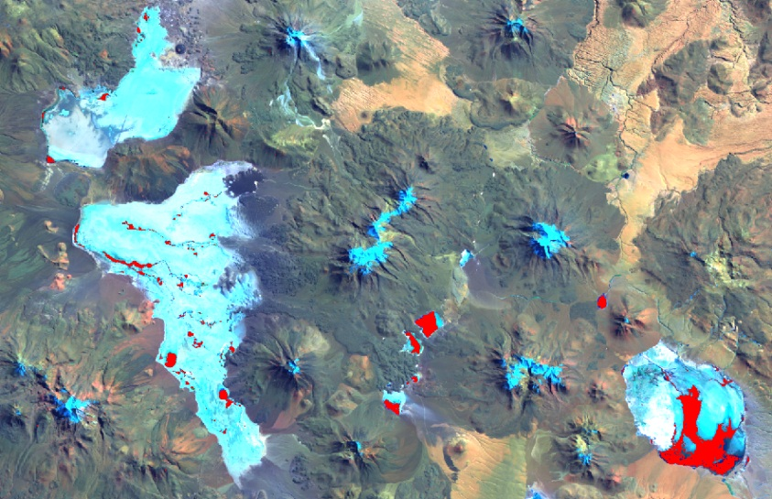
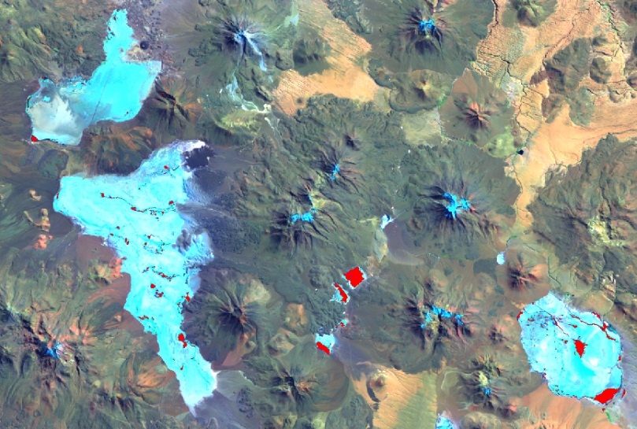
Results
2) Can we validate/refute Pastos Grandes as a recharge zone for Ascotán?
August, 1985
August, 1990
Notes:
-note false color images, but that the red pixels are WATER
-talk about outlier, but there seemed to be some sort of trend (show next graph)
-outlier can be a result of a transition due to the lag time that we see in the salars. Going to look at slightly later image to test this.

Slide 9
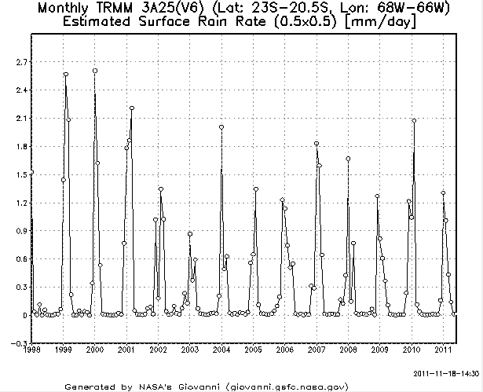
Results
3) Can we determine if pumping has affected the northern springs and ultimately the water extent at Carcote?
Notes:
Improved Analysis: Antecedent precipitation data, Pumping records, hydrochemistry

Slide 10
Summary
Developed a methodology to quantify surface water extent .
Found a positive correlation between the Pastos Grandes caldera and water extent on the salars.
Total surface water extent has decreased since 1985, but it is not certain whether the cause is predominantly anthropic or climatic.
Carcote shows a muted response to the changes at Ascotán, but the hydrologic relationship between North and South Ascotán remains a question.
Future Work:
Continue remote sensing analysis by adding images, attempting to quantify volume, and addressing uncertainty.
Further analysis of meteorological, hydrochemical, and pumping data from El Abra records and lab results.
Possible precipitation modeling using NASA TRMM data

Slide 11
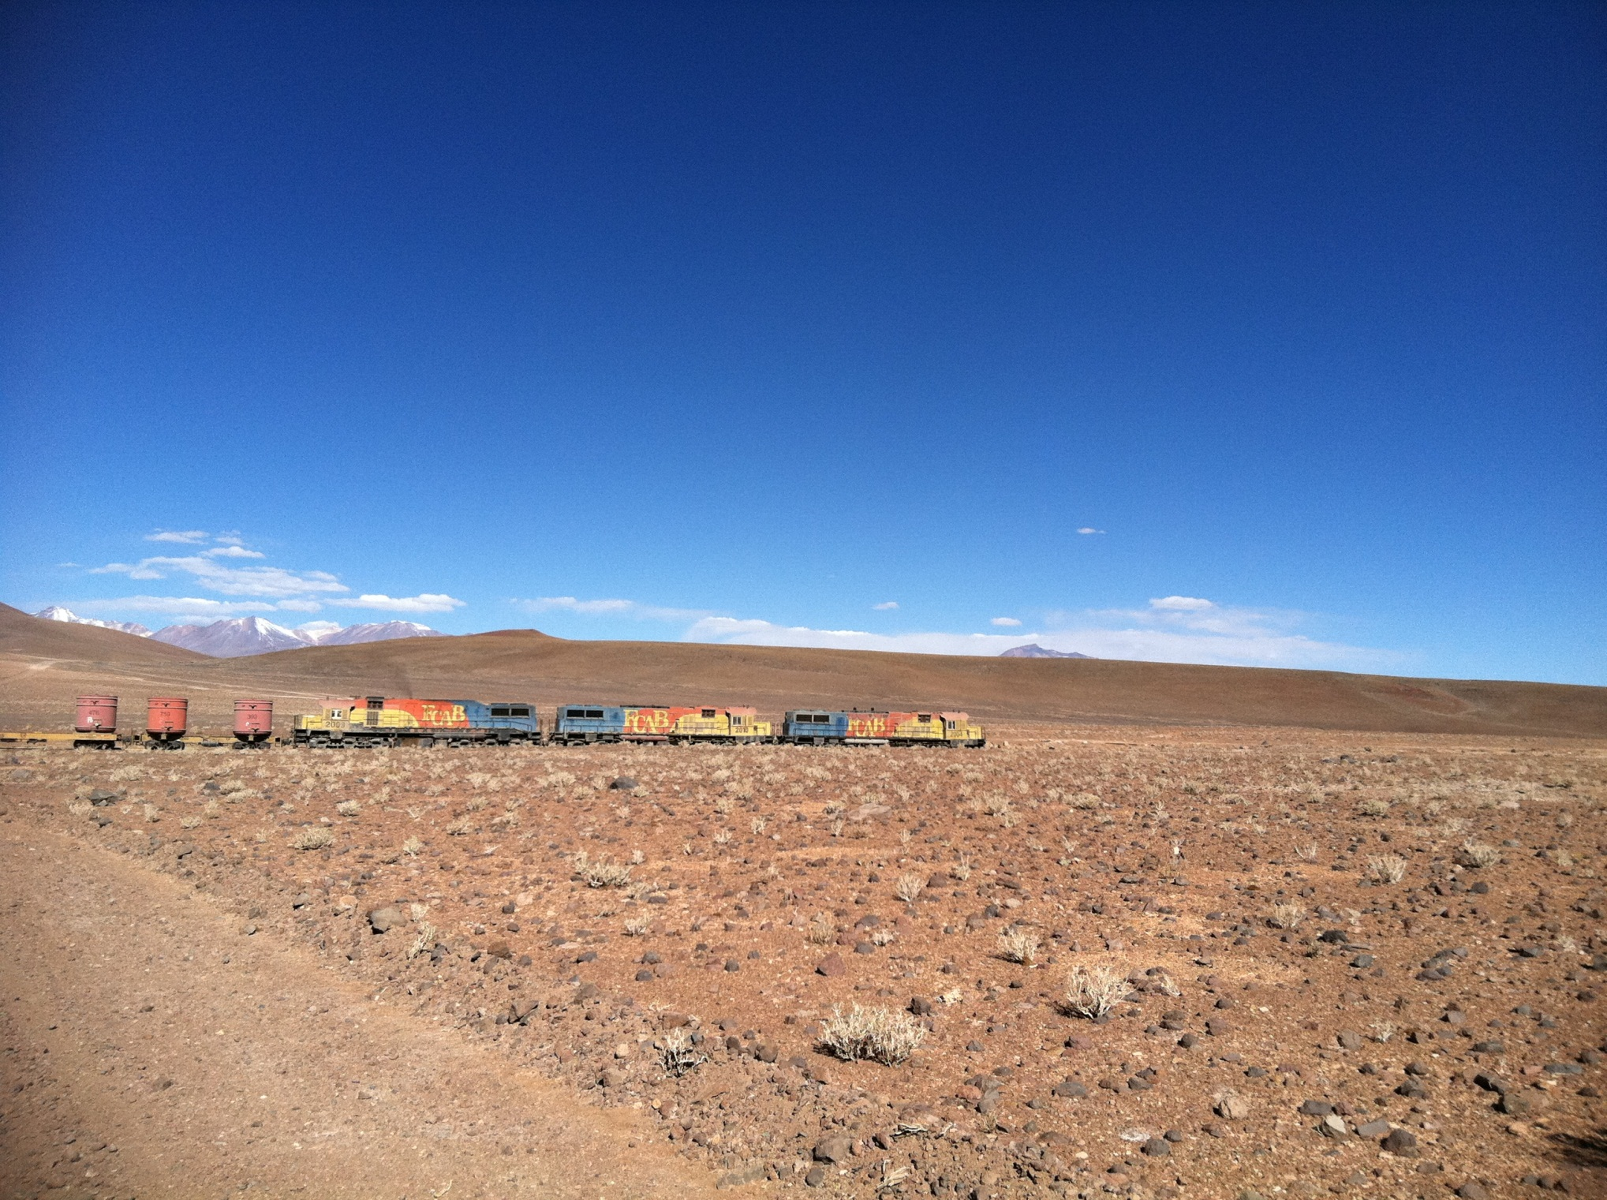
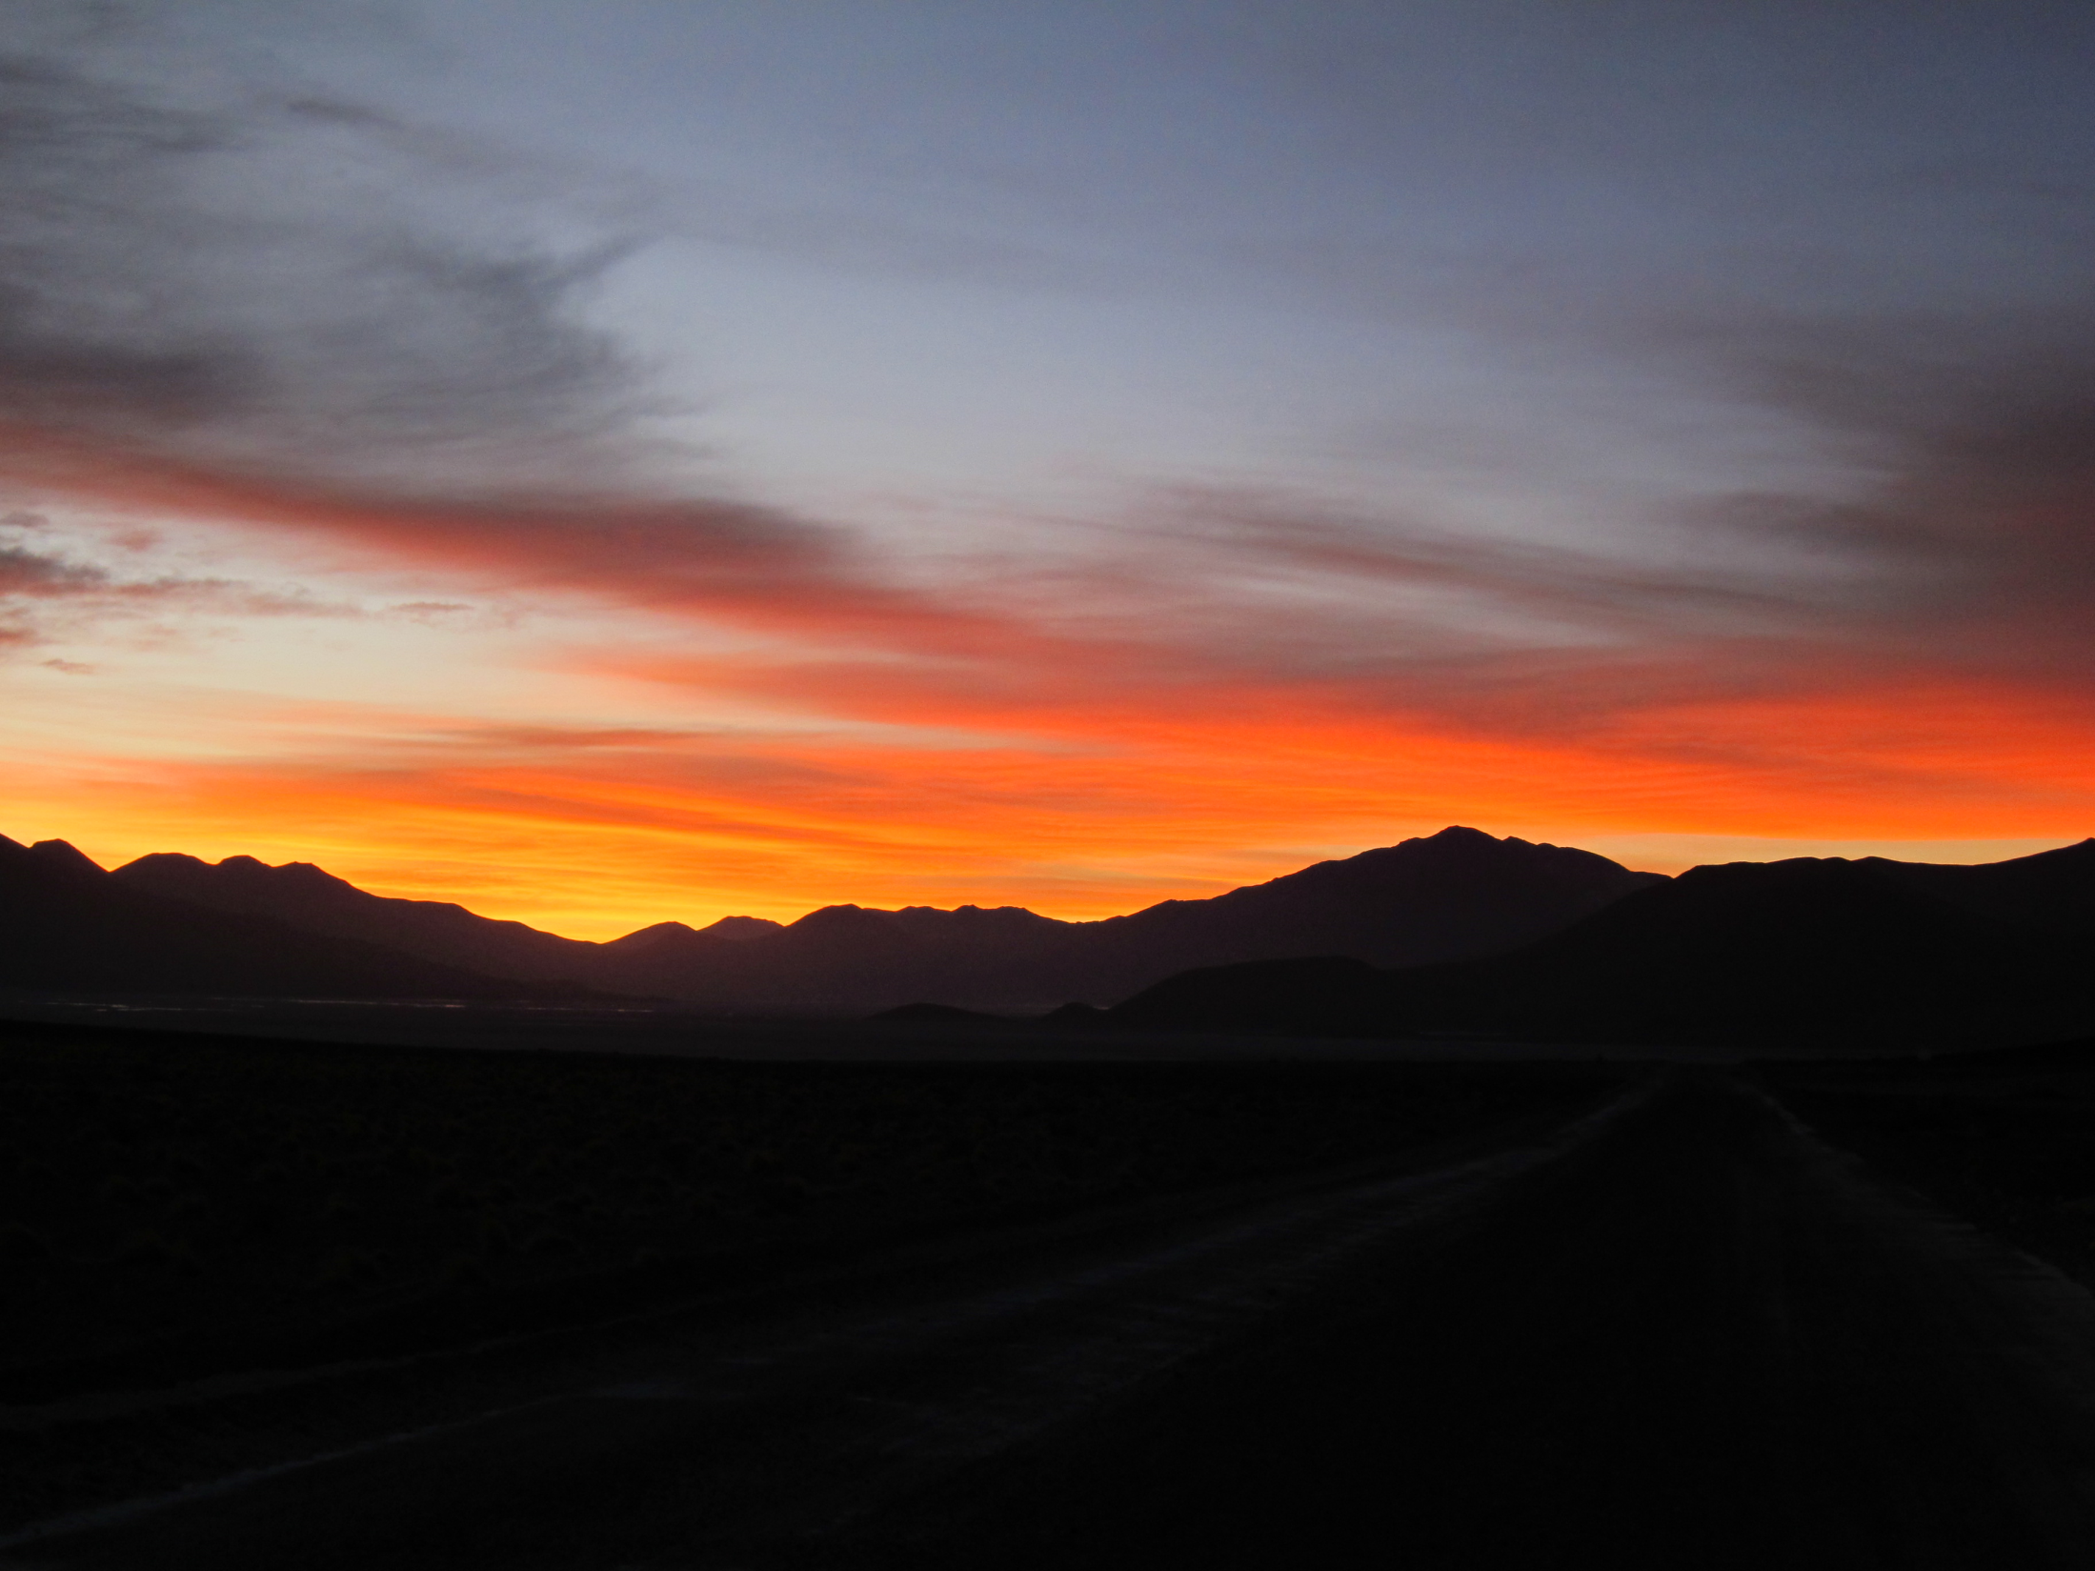
Questions?

