Slide 1
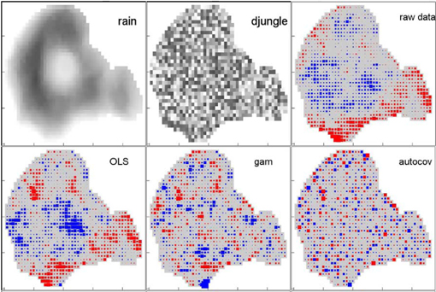
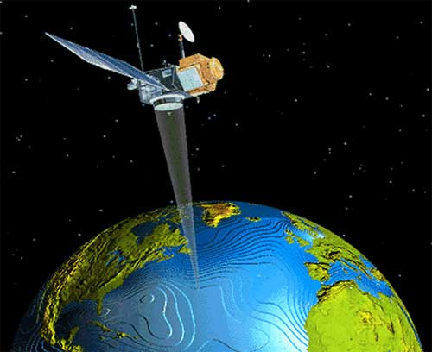
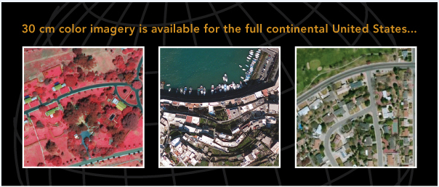
Application of spatial autocorrelation analysis in determining optimal classification method and detecting land cover change from remotely sensed data
Edward Park
SAC in MATLAB
Digital Globe inc.

Slide 2
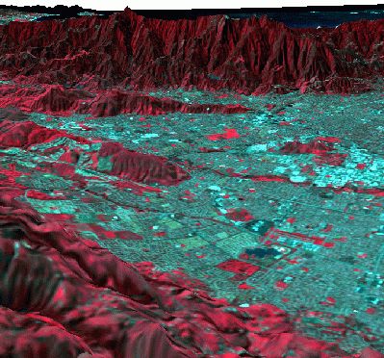
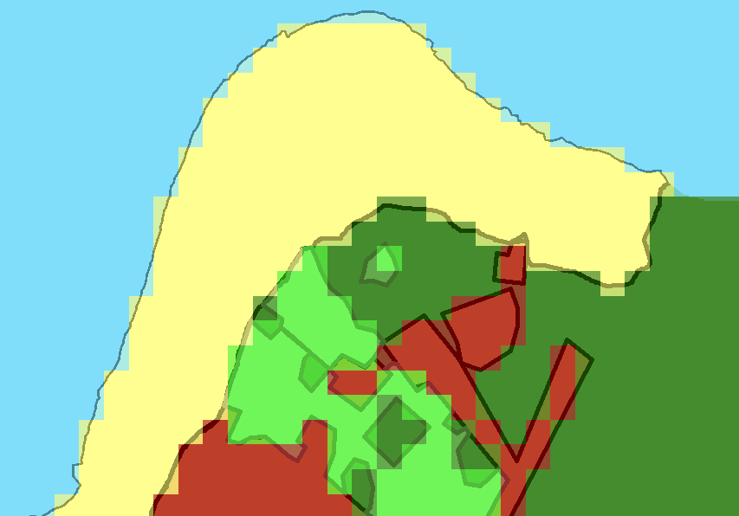
Introduction
  1.1 Objective
Spatial resolution issue
Objective:
To do the accuracy assessment of various classification of raster pixels
Why?
The ultimate goal of Geographic Information System (GIS) is to model our world. However, the modeling process is too complicated and requires elaborateness that we should not rely entirely on computer.
  How?
Comparing with hand digitized reference image and look into how the error pattern varies depending on classification methods by using spatial autocorrelation analysis.

Slide 3
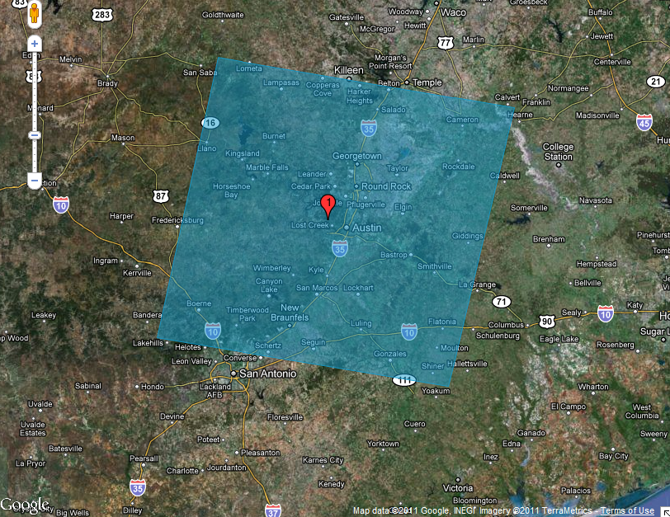
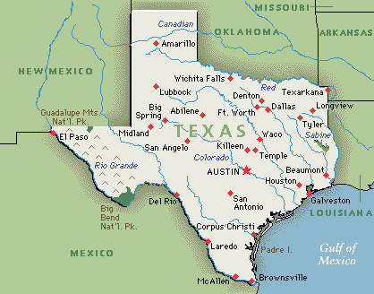
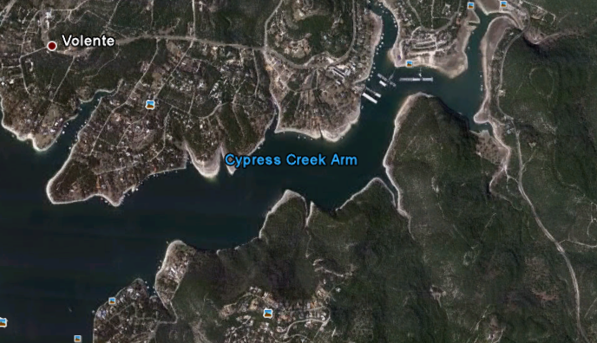
Introduction
  1.2 Study Area
Lake Travis in Austin Texas, USGS EE
Cypress Creek Arm, Google Earth (approximately 2km*1.5km)

Slide 4
Introduction
  1.3. Data Source
Scene
· 2009 Landsat 7 ETM+ Images from USGS
· LE70270392009032EDC00
· LE70270392009064EDC00
Reference data
· 2009 Aerial Photograph from Capcog (capcog.org) and Trinis (trinis.org)
· TOP0809_50cm_3097_33_4_CIR_01062008 (natural color)
· TOP0809_50cm_3097_33_4_NC_01062008 (color infrared)
· MANSFIELD_DAM (29 mrsid files stitched)
· Field Visit with GPS
· Other reference data
· Land-cover map, vegetation cover map, hydrograph map,
- Google earth (for oblique view), daily water level data of Lake Travis from 2009

Slide 5
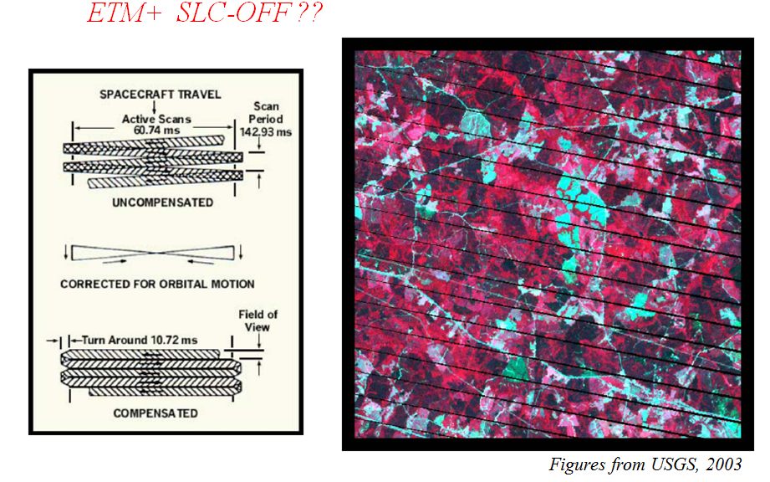
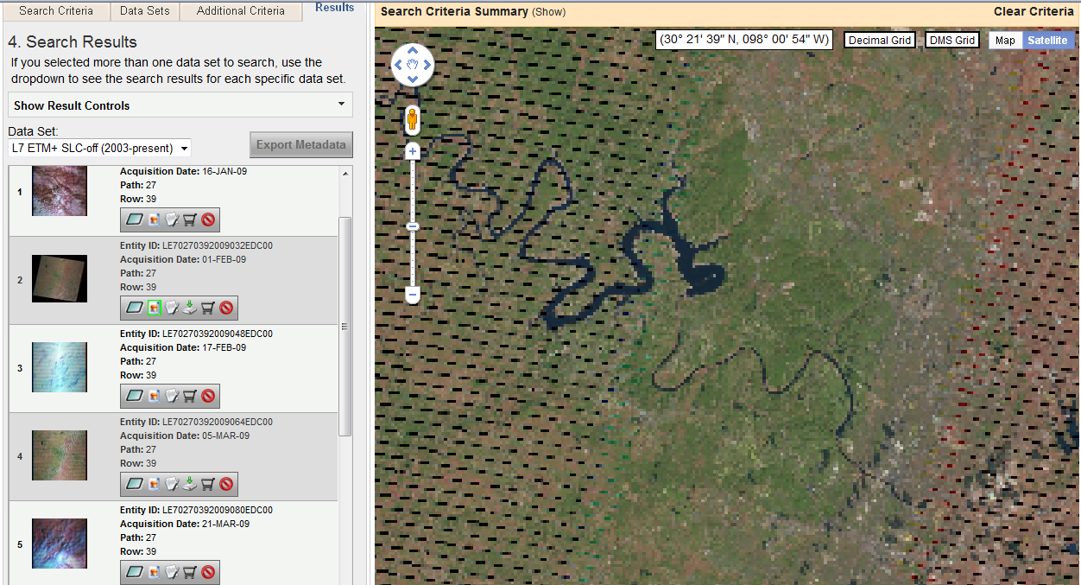
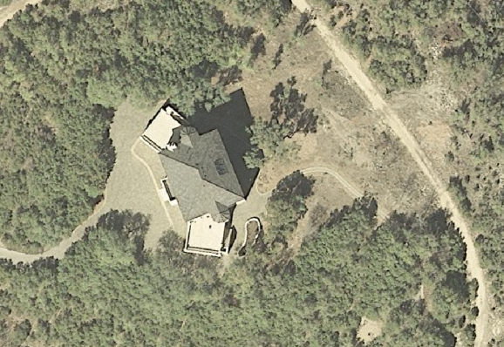
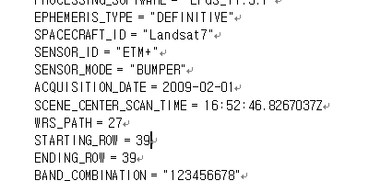
Introduction
  1.3. Data Source
  - Some Justification and Projection
VS
Aerial Orthophoto taken around…early noon!! 3? 4?
Metadata from Landsat

Slide 6
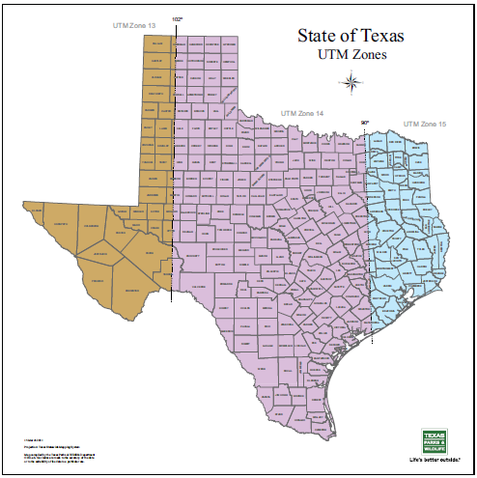
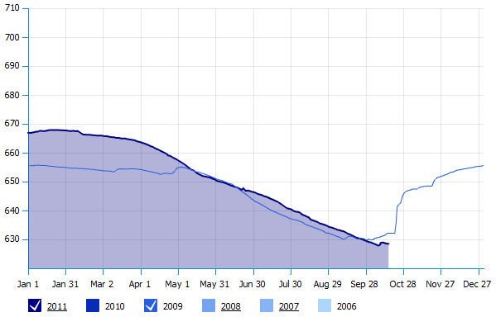
Introduction
  1.3. Data Source
  - Some Justification and Projection
Approximately same level between dates
(Feb. 1 & Feb. 3)
Lake Travis water level
- From http://travis.uslakes.info/Level.asp
UTM Zone 14
Almost through the standard line!!

Slide 7
2. Preprocessing
  - Overview
Three major analysis will be introduced in this research using spatial autocorrelation:
analysis of error produced based on different types of classification method
2) monthly change detection using spatial autocorrelation,
3) changing pattern of error depending on spatial resolution.

Slide 8

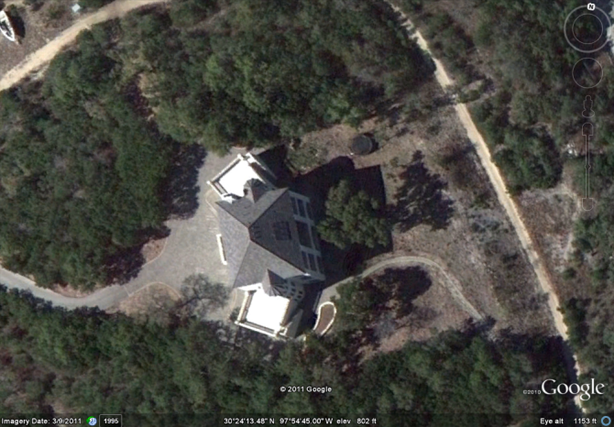
2. Preprocessing
  - Overview, 2.1 Digitizing
Hand Digitize
Reclassify
Orthohphoto O
Orthohphoto X
MANSFIELD_DAM (29 mrsid files stitched)
from CAPCOG
Difference Image
Run Spatial Autocorrelation

Slide 9
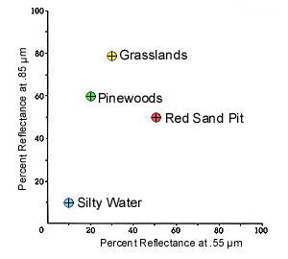
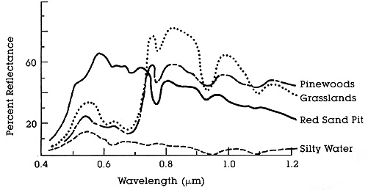
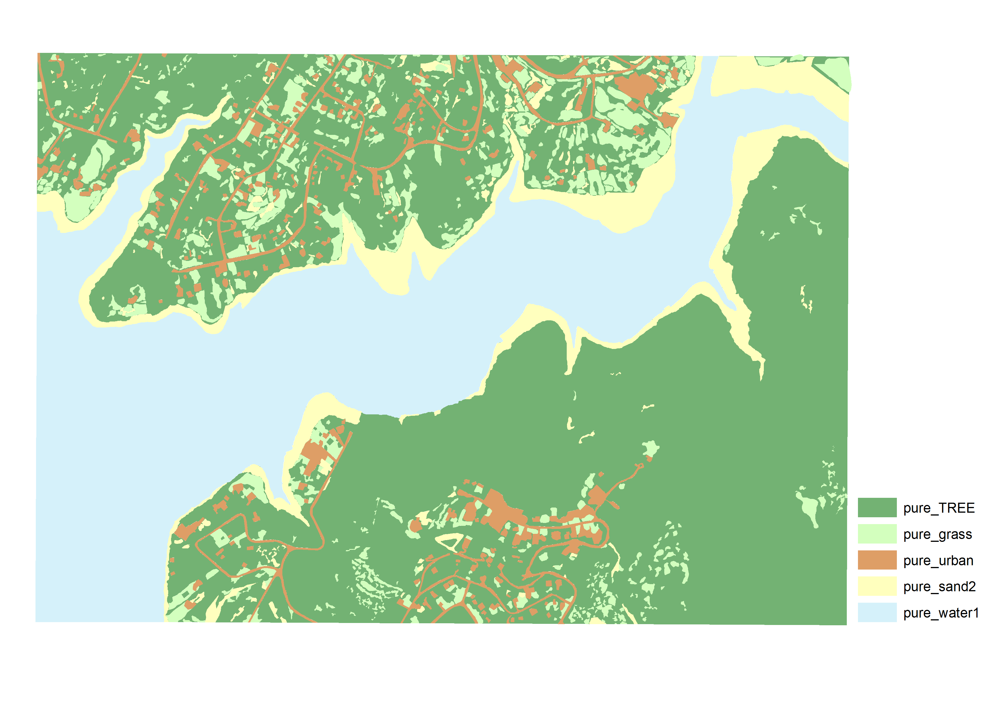
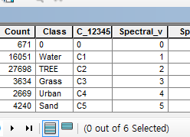
2. Method
  2.2 Preprocessing
Spectral Reflectance Curve
Feature Space Plot
Assign:
- Water to 1
- Tree to 2
- Grass to 3
- Urban to 4
Sand to 5
  Based on Spectral Value !!
Mosaic
Clip
Project
Digitize..etc
Reference Map!!
Threshold 7.5 meter

Slide 10
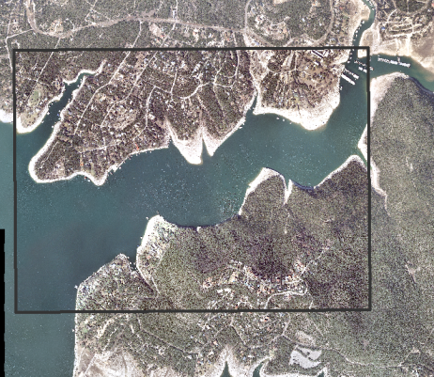
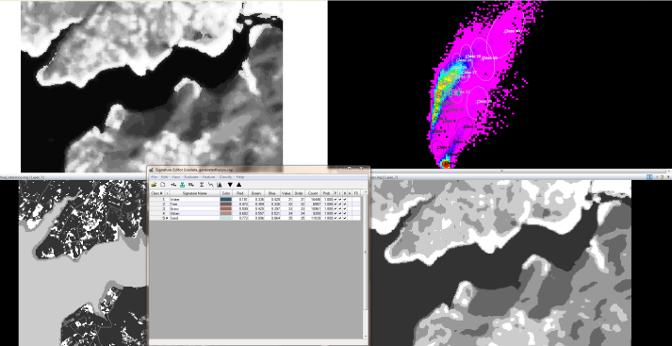
2. Method
  2.2 Preprocessing of Image ‘to be’ classified
Clip!!
Resampled (30 ->10m)
10 methods of classifications were used !
Parametric MLH (Maximum Likely Hood)
Parametric MHN (Mahalanobis)
Parametric MND (Minimum Distance)
Parallelepiped MLH
Parallelepiped MHN
Parallelepiped MND
Feature Space MLH
Feature Space MND
Mostly Supervised (8):
One Unsupervised:
ISODATA (5 classes)
MLH (but used 30 signature produced by ISODATA process)
Will add PCA (Principal Component Analysis) in final project

Slide 11
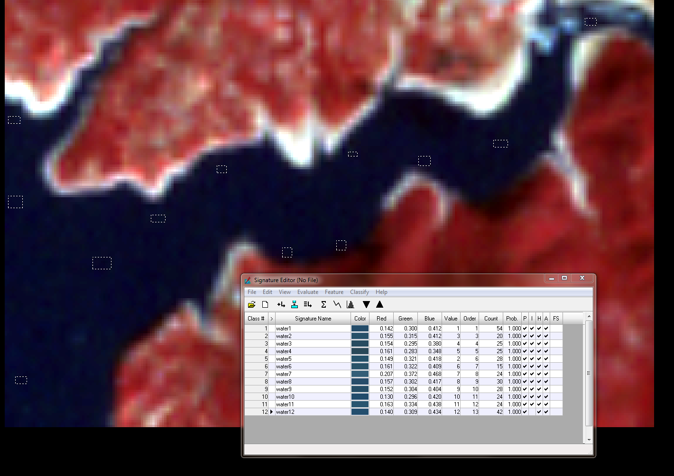
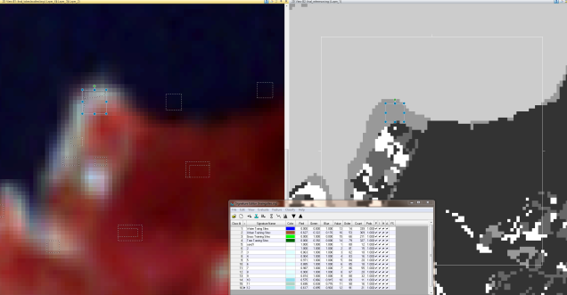
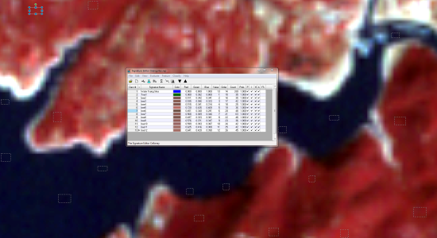
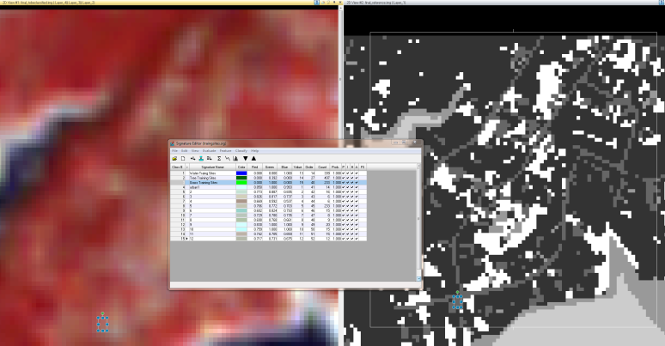
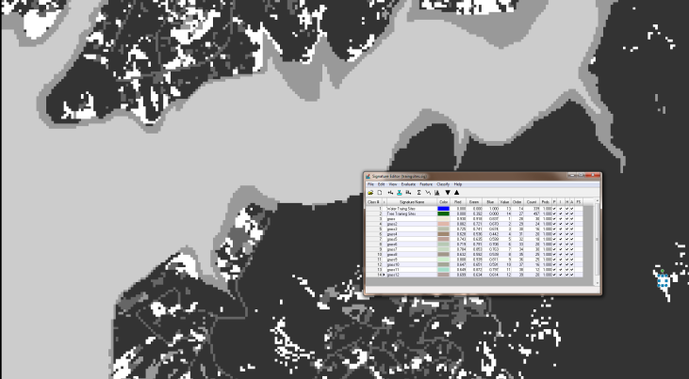
2. Method
  2.2 Preprocessing of Image ‘to be’ classified
  - Supervised Classification
Water
Sand
Tree
Training Sites Pickup in ERDAS
Imagine’s Signature Editor
Urban
Grass
the trickiest!!

Slide 12
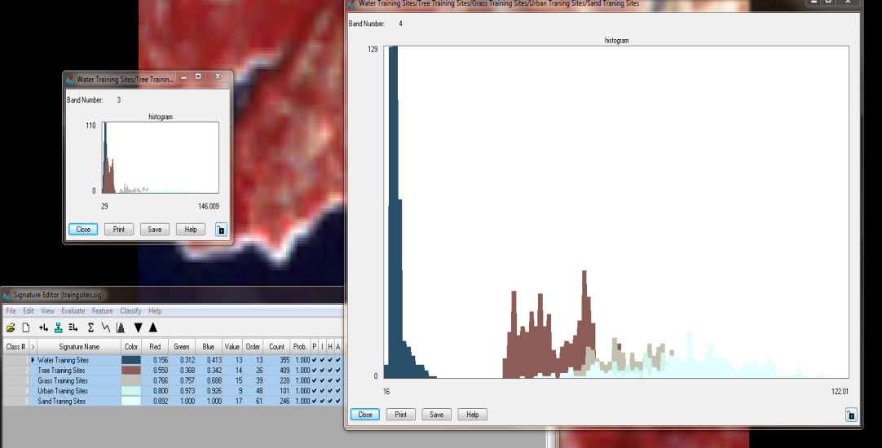
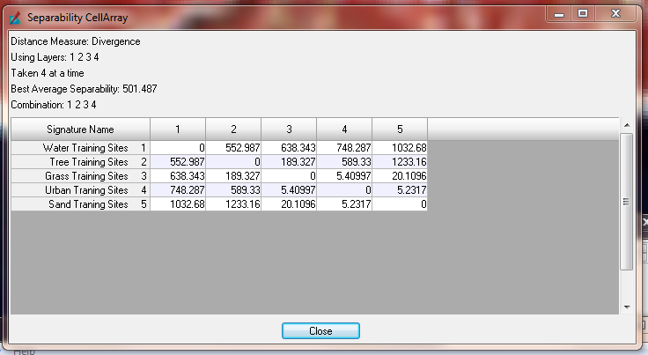
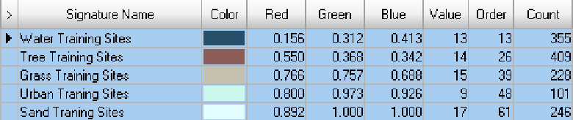
2. Method
  2.2 Preprocessing of Image ‘to be’ classified
  - Supervised Classification
TrainingSites_Separability
Plot of all training sites

Slide 13
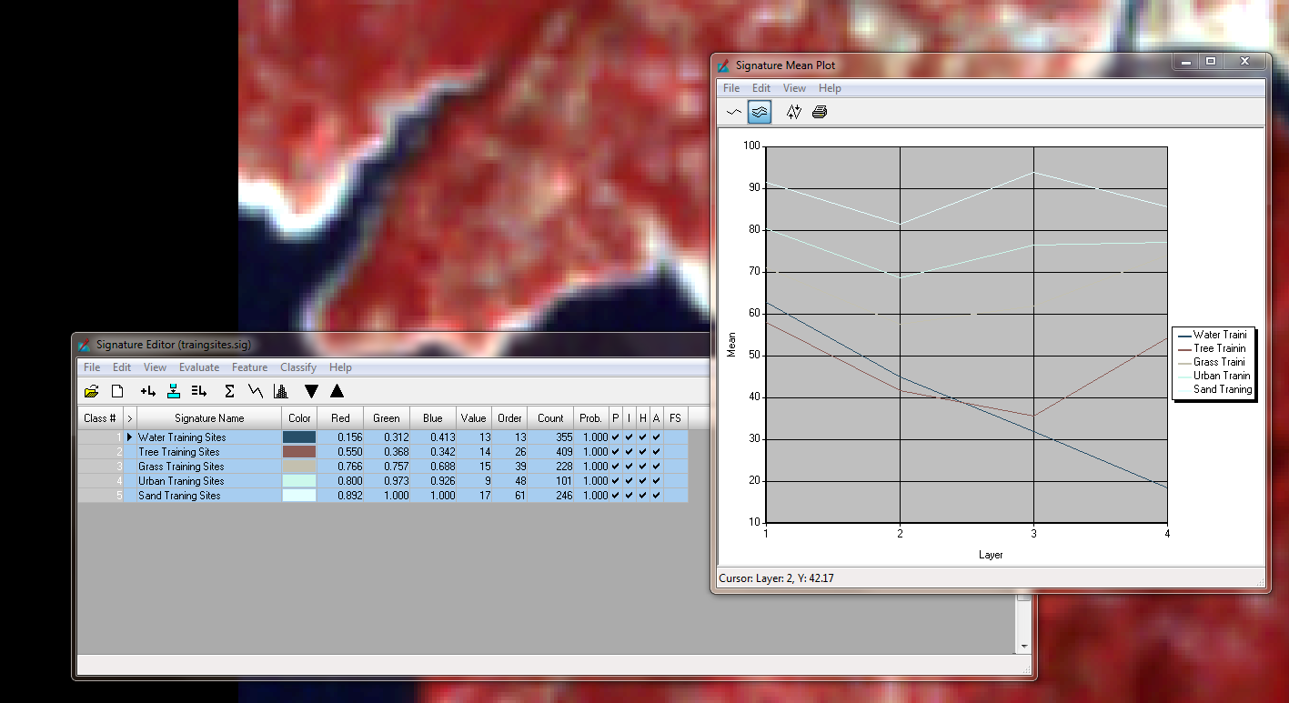
2. Method
  2.2 Preprocessing of Image ‘to be’ classified
  - Supervised Classification
=
Spectral Reflectance Curve

Slide 14
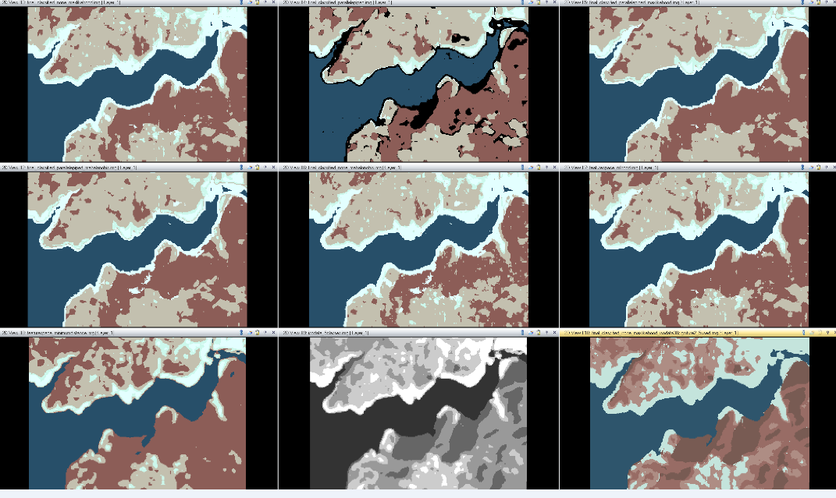
2. Method
  2.2 Preprocessing of Image ‘to be’ classified
  - Supervised Classification
Classified Images!! (half way product)

Slide 15
2. Method
  2.2 Preprocessing of Image ‘to be’ classified
  - Creating Difference Image
=
-
(Difference Image)
(Reference Image)
(Classified Image)
-
* Ranges from -4~4, reclassified into 0~4

Slide 16
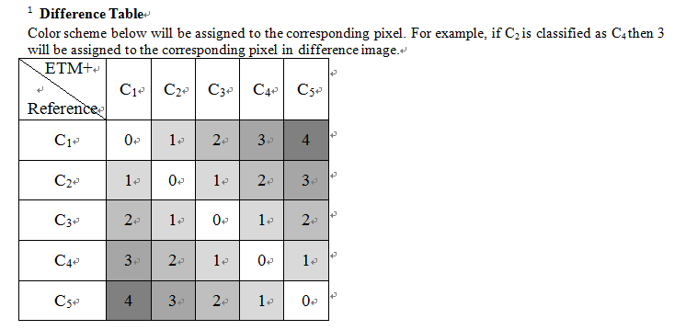
2. Method
  2.2 Preprocessing of Image ‘to be’ classified
  - Difference Image

Slide 17
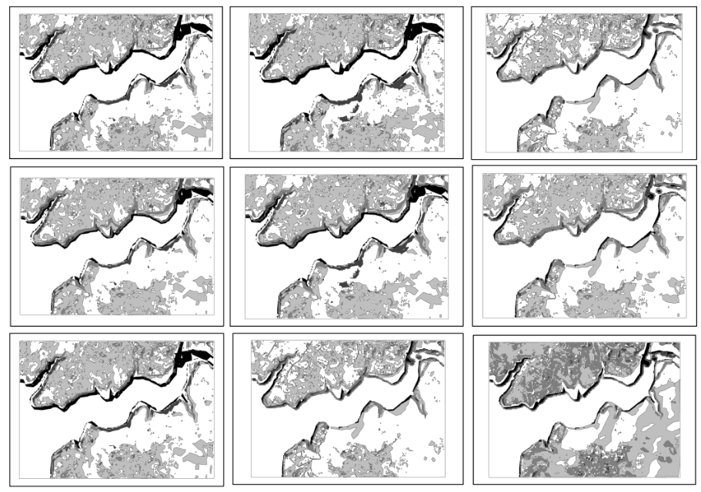

2. Method
  2.2 Preprocessing of Image ‘to be’ classified
  - Difference Image
Final Product!! (ready to start analysis)
One Unsupervised:
One Unsupervised:

Slide 18
2. Method
  2.2 Spatial Autocorrelation
Spatial Autocorrelation (SAC): 1st rule of geography,
“everything is related to everything else, but near things are more
related than distant things” – Waldo Tobler
– correlation of a variable with itself through space.
– If there is any systematic pattern in the spatial distribution of a variable, it is said to be spatially autocorrelated.
– If nearby or neighboring areas are more alike, this is positive spatial autocorrelation.
– Negative autocorrelation describes patterns in which neighboring areas are unlike.
– Random patterns exhibit no spatial autocorrelation.
A rule that makes geography so meaningful!!

Slide 19
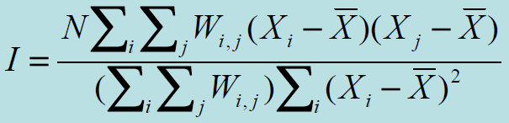
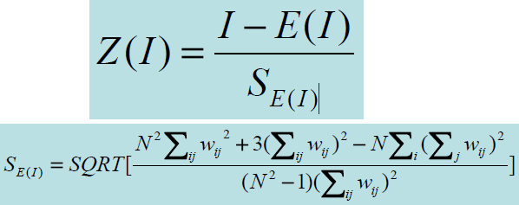
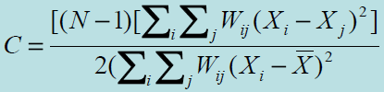

2. Method
  2.2 Spatial Autocorrelation
Moran’s I
General G
Xi is the variable value at a particular
Location, Xj is the variable value at another
Location, X is the mean of the variable
Wij is a weight applied to the comparison
between location i and location j
Global SAC
Local SAC
LISA

Slide 20
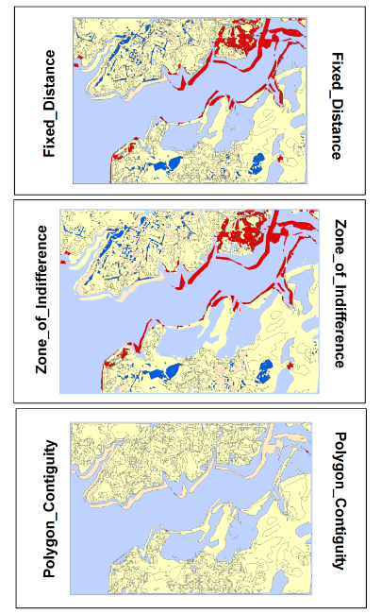
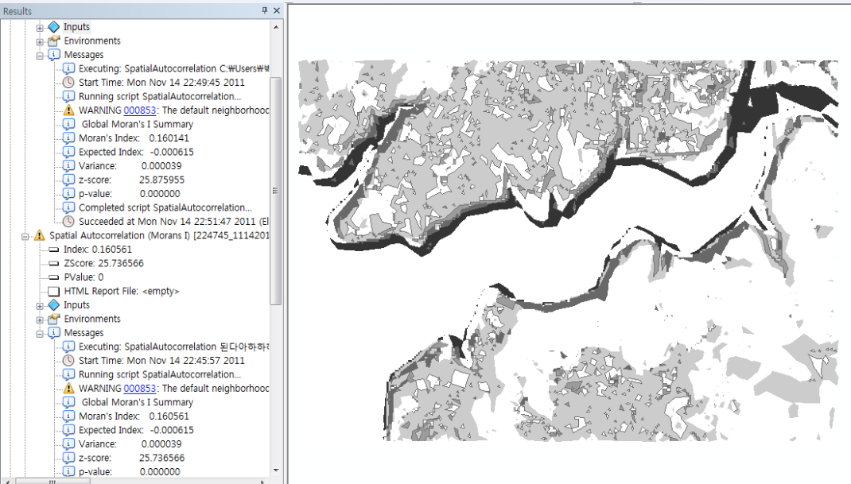
2. Method
  2.2 Spatial Autocorrelation
Conceptualization of Spatial Pattern
Again, some justifications
Simplification of line when vectorizing

Slide 21
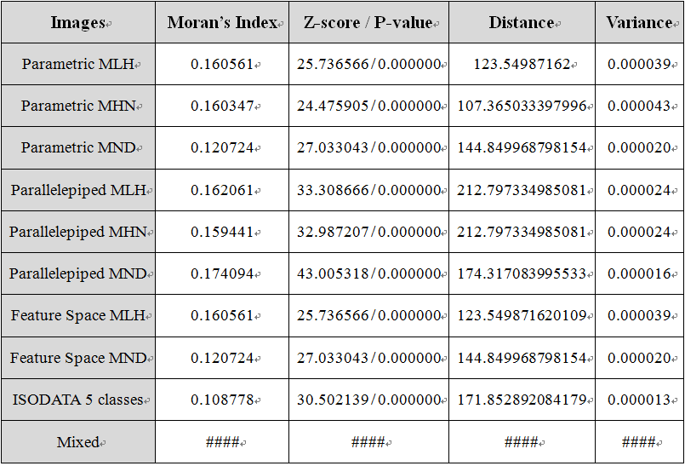
3. Result
  3.1 Global SAC
Lowest!! (looks like computer won over me)

Slide 22
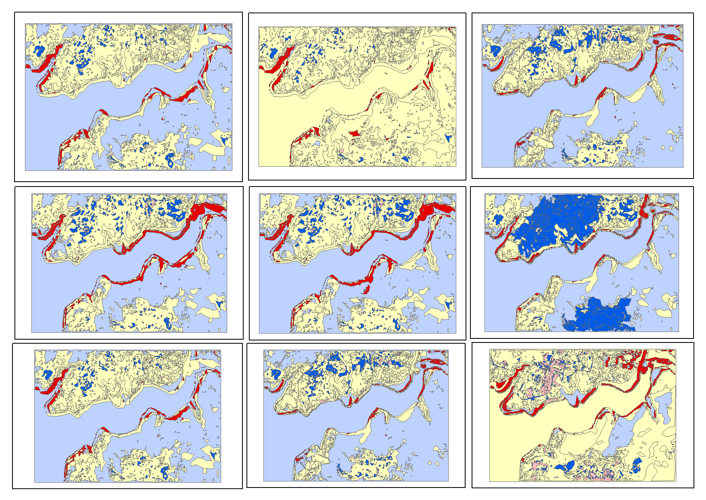

3. Result
  3.2 Local SAC

Slide 23
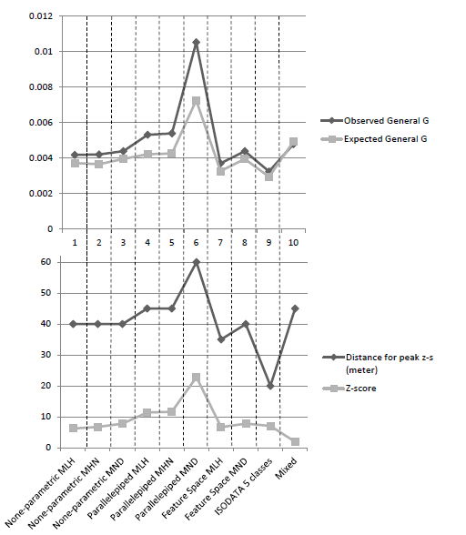
3. Result
  3.3 General G Statistics

Slide 24
3. Conclusion and Limitations
There is spatial autocorrelation pattern of errors.
Spatial resolution issue

Slide 25

- Further Plan
◆ Also perform initial statistical analysis based on number of pixels for each class
◆ Regression analysis (explanatory_var: reference image, dependent_var: classified image )
◆ Try to look for other classification method (Linear SMA, Fisher linear discriminant etc)
◆ Visualization of results (including plotting rook’s, queen’s bishop’s cases)
Questions?
Suggestions?

