Slide 1
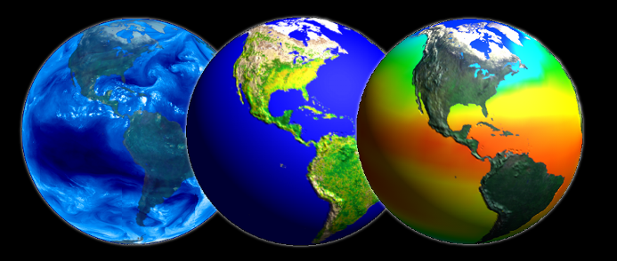
Applications of Remote Sensing in Water Resources
Ayse Irmak
University of Nebraska-Lincoln

Slide 2
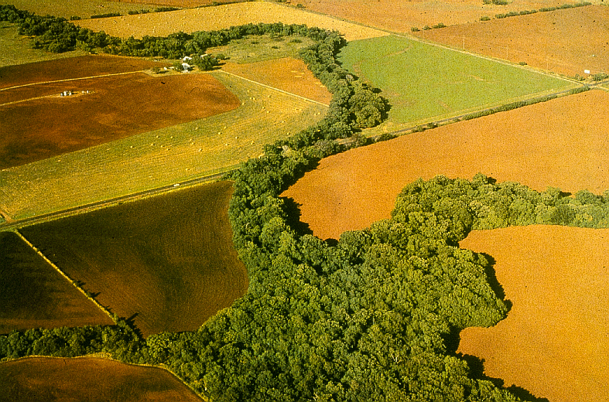
Remote Sensing: A Definition
The art and science of acquiring information about the earth and its environment using sensors mounted in aircraft and spacecraft

Slide 3
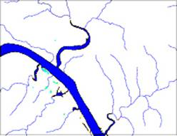
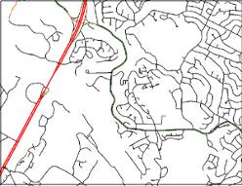
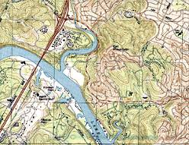
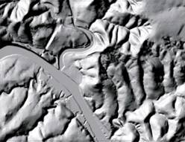
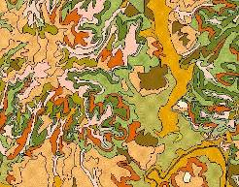
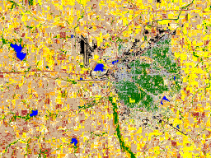
Geospatial Data
Hydrography
Transportation
Digitized Quads
Elevation
Soils
Land Use
Aerial and satellite images are valuable source of spatial data in GIS!
Notes:
Aerial images are used as a basis for surveying and topographic mapping to measure and identify horizontal and vertical locations of objects.
1:24,000 –scale quadrangle maps by USGS
Digital orthophotographs

Slide 4
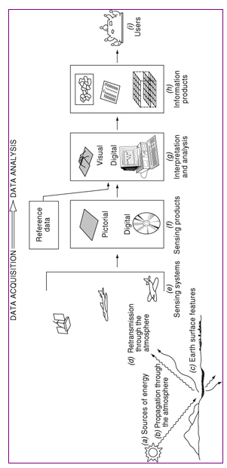
Processes involved in electromagnetic remote sensing of earth features
Notes:
Camera tilt and terrain variations may cause large errors in aerial photos – stereophogtoraphic determination of elevations removes terrain caused image displacement.

Slide 5
Energy Sources and Radiation Principles
Light energy is the principal form detected
Common forms of RS is based on reflected electromagnetic energy. i.e. Sensing Electromagnetic Radiation
Light energy is characterized by its wavelengths
Different materials reflect different amounts of incoming energy. This differential reflectance gives objects a distinct appearance

Slide 6
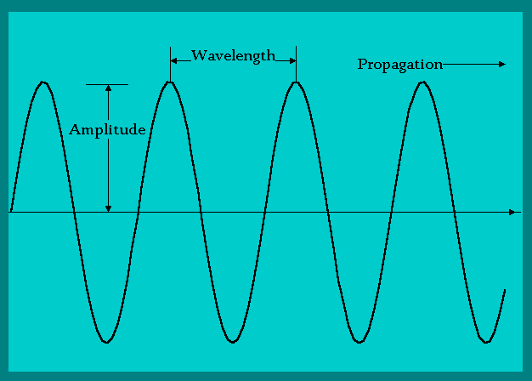
Electromagnetic Radiation
The distance between peaks in the electromagnetic stream is the wavelength
Each color of light has a distinctive wavelengths

Slide 7
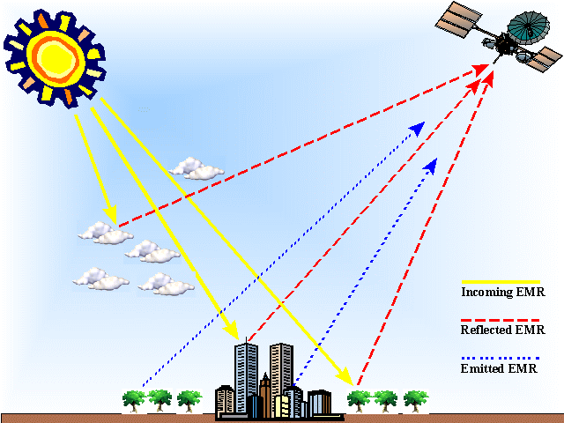
Energy pathways from source to sensor
Incident radiation = reflected + absorbed + transmitted
Notes:
Light reflected from the surface and transmitted to the sensor is used to create an image
Light energy may be absorbed, transmitted or reflected, by the atmosphere
Light reflected from the surface and transmitted to the sensor is used to create an image
The image may be degraded by atmospheric scattering due to water vapor, dust, smoke, ant others
Absorbed energy may be re-radiated at longer wavelenghts, forming the basis for thermal remote sensing.

Slide 8
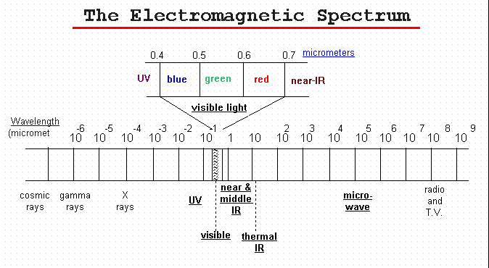
USGS definition: ” Electromagnetic radiation is energy propagated through space between electric and magnetic fields. The electromagnetic spectrum is the extent of that energy ranging from cosmic rays to infrared radiation including microwave energy."
Categorize electromagnetic waves by their wavelenght location in electromagnetic spectrum (unit is micrometer).
Notes:
USGS defines the electromagnetic spectrum as: Electromagnetic radiation is energy propagated through space between electric and magnetic fields. The electromagnetic spectrum is the extent of that energy ranging from cosmic rays, gamma rays, X-rays to ultraviolet, visible, and infrared radiation including microwave energy."

Slide 9
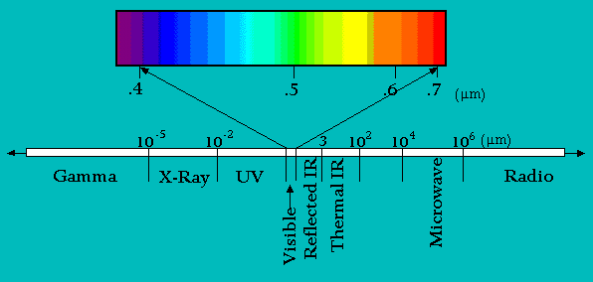
The Electromagnetic Spectrum
spectral bands (channels)
Our eyes perceive light in the visible portion of spectrum
Satellites can operationally measure panchromatic imagery (variations in a waveband from 400 to 700nm as shades of grey) at a 1 m. Panchromatic sensors.
Satellites can operationally measure multi-spectral imagery (the simultaneous sensing of two or more wavebands) at 20 to 30 m. Multispectral sensors.
Hyperspectral sensors cover spectral bands narrower than multispectral

Slide 10
Thermal Radiation Principles
Thermal infrared radiation refers to electromagnetic waves with a wavelength of between 3.5 and 20 micrometers
Most remote sensing applications make use of the 8 to 13 micrometer range
Thermal infrared is emitted energy, whereas the near infrared (photographic infrared) is reflected energy
Notes:
Thermal energy
Heat is a form of energy. Heat energy is stored in matter just like electrical energy is stored in a battery. An object that contains no heat energy is very cold, and is said to be at absolute zero (-460 F or -273 C). As heat is added to the object, its temperature rises. The more heat energy an object contains the hotter the object becomes. infrared energy is emitted as a result of atomic and molecular vibration.
The total amount of infrared energy emitted by an object is proportional to temperature to the fourth power.
Stefan-Boltzmann Law
P/A = emissivity of the object X stefan bolzman constant (5.6703 10⁻⁸ watt/m2/K⁴). X T⁴
P= new radiated power; A =radiating area

Slide 11
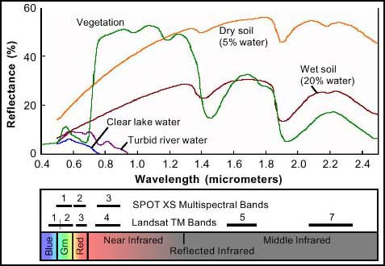
Spectral Response Curve (“signature”)
Natural objects appear to be the color they most reflect!
Notes:
Healthy green vegetation always manifest “peak and valley”
The valleys in the visible portion of spectrum are dictated by the pigments in the leaves. Chlorophyll absorbs energy centered at 0.45 and 0.67
That means high absorption of blue and red energy by plants
0.7 1.3, plant reflects as much as 50% of energy incident upon it
Dips (valleys) occur at 1.4, 1.9, and 2.7 because water in the leaves absorbs
Water: most distinctive characteristics. Absorption at near—IR and beyond
Soil shows less peak and valley because factors (moisture, texture, organic matter, surface roughness) affecting soil reflectance act less specific spectral bands

Slide 12
Remote Sensing Raster (Matrix) Data Format
Jensen 2000
Notes:
Digital remote sensor data are stored as matrix of numbers
Each digital value is located at a specific row and column in that matrix
Sensor systems creates pixels with a brightness value (BV) range of 8 to 12 bits. This is called “Quantization” level of remote sensor data.
8 bits have BV that range from 0 to 255
Data quantized to 12 bits range from 0 to 1023
The greater the range of values, the more precise we may able to measure the amount of radiance recorded by the sensor

Slide 13
Digital Image
25 | 22 | 19 | 47 | 44
22 | 18 | 25 | 22 | 44
19 | 21 | 22 | 23 | 42
21 | 116 | 121 | 125 | 134
118 | 125 | 123 | 135 | 126
125 | 133 | 136 | 221 | 234
244 | 243 | 212 | 232 | 178
Pixel (picture element)

Slide 14
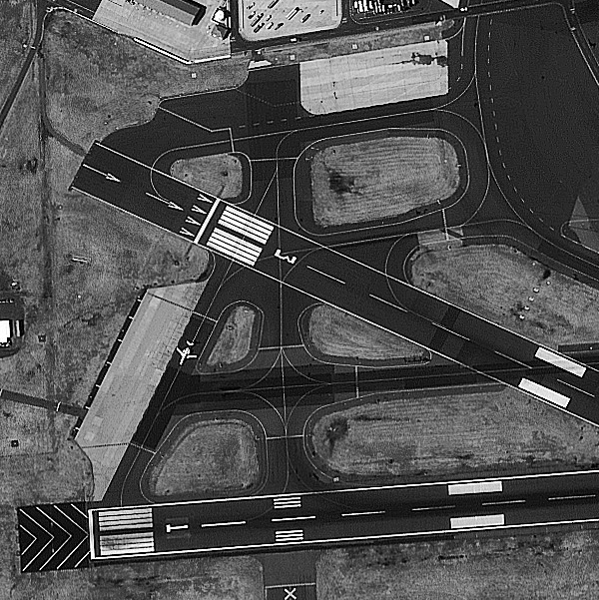
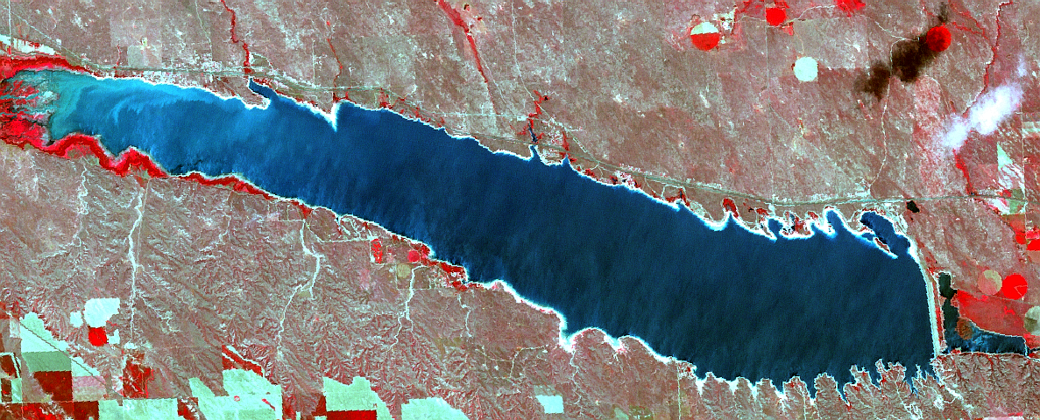
Selection of Imagery
Resolution
  spatial
  spectral
  radiometric
  temporal
Image coverage
Image availability/format
Cost

Slide 15
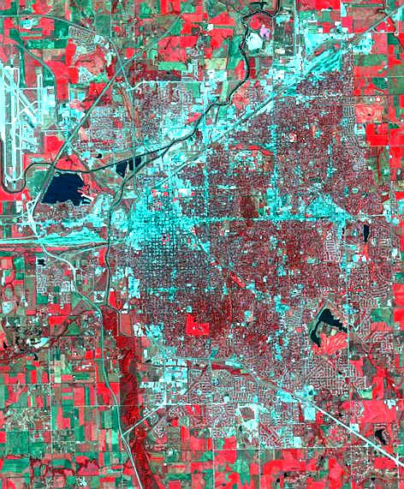
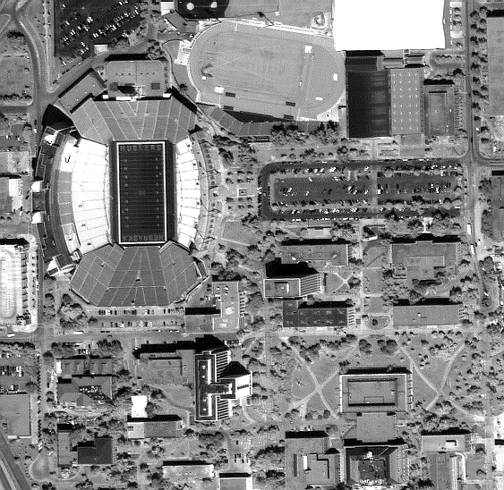
Spatial Resolution
Image of Lincoln, NE
Coarse (30 m, multispectral)
Fine (1 m, panchromatic, Ikonos)

Slide 16
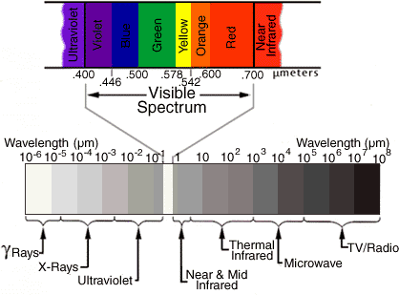
Spectral Resolution
how many spectral bands?
which bands?
band widths - narrow band vs broad band
http://geospatial.amnh.org/remote_sensing/widgets/spectral_curve/spectral.swf
Notes:
Spectral resolution refers to the number of different frequency bands recorded - usually, this is equivalent to the number of sensors carried by the platform(s).
Current Landsat collection is that of seven bands, including several in the infra-red spectrum.
The MODIS satellites are the highest resolving at 31 bands

Slide 17
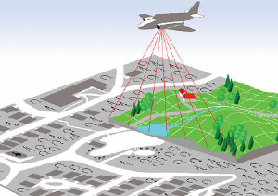
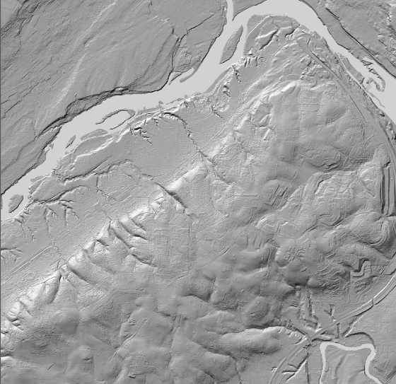
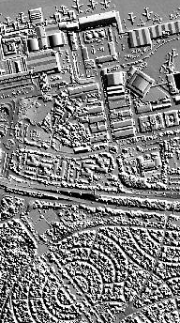
LIDAR (Light Detection and Ranging)

Slide 18
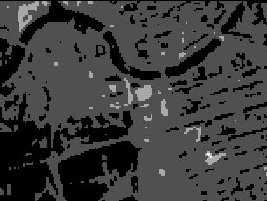
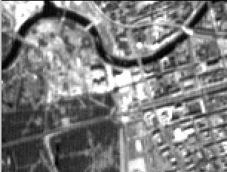
Radiometric Resolution
number of “brightness levels” (gray shades; bits)
commonly 256 - 2048 levels (8 - 11 bit)

Slide 19
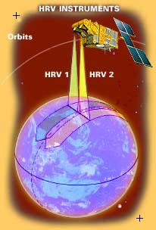
Temporal Resolution
how often is image available?
varies from 1 day to 26 days (phased?)
some sensors must be “tasked”; some are pointable
historical archive?
Notes:
The temporal resolution is simply the frequency of flyovers by the satellite or plane, and is only relevant in time-series studies or those requiring an averaged or mosaic image as in deforesting monitoring.
Cloud cover over a given area or object makes it necessary to repeat the collection of said location.
Radiometric correction gives a scale to the pixel values, e.g. the monochromatic scale of 0 to 255 will be converted to actual radiance values.
Atmospheric correction eliminates atmospheric haze by rescaling each frequency band so that its minimum value (usually realised in water bodies) corresponds to a pixel value of 0. The digitizing of data also make possible to manipulate the data by changing gray-scale values.

Slide 20
LANDSAT
LANDSAT refers to a series of satellites put into orbit around the earth to collect environmental data about the earth's surface.
The LANDSAT program was initiated by the U.S. Department of Interior and NASA under the name ERTS, Earth Resources Technology Satellites.
ERTS-1 was launched on July 23, 1972, and was the first unmanned satellite designed solely to acquire earth resources data on a systematic, repetitive, multispectral basis.
Over time, the sensors carried by the LANDSAT satellites have varied as technologies improved and certain types of data proved more useful than others

Slide 21
Principal applications of different wavelengths
1) 0.45-0.52. Blue. Designed for water body penetration, making it useful for coastal water mapping. Also useful for soil/vegetation discrimination, forest type mapping, and cultural feature identification.
2) 0.52-0.60. Green. Designed to measure green reflectance peak of vegetation for vegetation discrimination and vigor assessment. Also useful for cultural feature identification.
3) 0.63-0.69. Red. Designed to sense in a chlorophyll absorption region aiding in plant species differentiation. Also useful for cultural feature identification.
4) 0.76-0.90. Near-infrared. Useful for determining vegetation types, vigor, and biomass content, for delineating water bodies, and for soil moisture discrimination.
5) 1.55-1.75. Mid-infrared. Indication of vegetation moisture content and soil moisture. Also useful for differentiation of snow from clouds.
6) 10.4-12.5. Thermal infrared. Useful in vegetation stress analysis, soil moisture discrimination, and thermal mapping applications.
7) 2.08-2.35. Mid-infrared. Useful for discrimination of mineral and rock types. Also sensitive to vegetation moisture content.

Slide 22
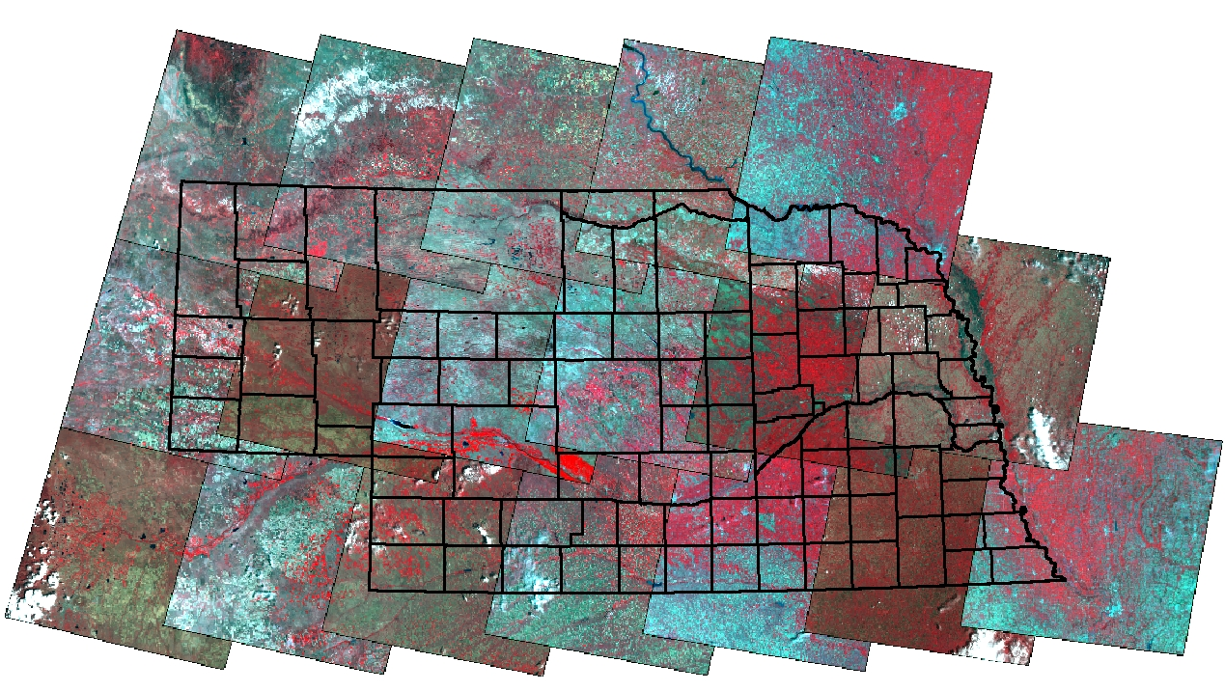
Image Coverage
2005
P33R30
10
P32R30
9
P31R30
10
P30R30
9
P29R30
10
P33R31
11
P32R31
10
P31R31
12
P30R31
9
P29R31
11
P28R31
8
P33R32
15
P32R32
8
P31R32
12
P30R32
10
P29R32
12
P28R32
10
P27R32
8
Number of images to cover study area
Generally, higher spatial resolution = smaller area coverage per frame = more scenes

Slide 23
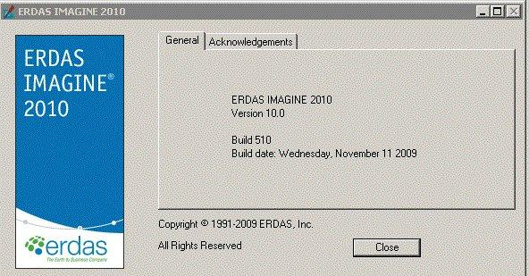
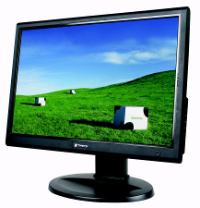
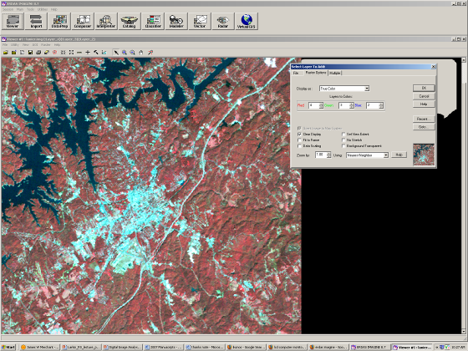
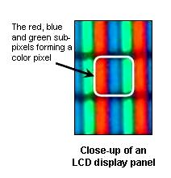
Image processing
Leica ERDAS Imagine

Slide 24
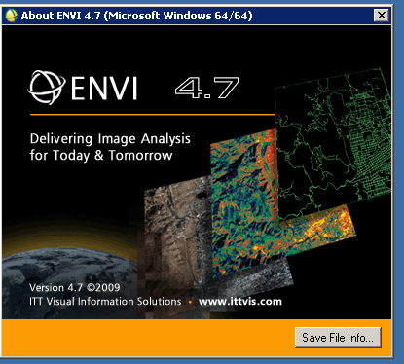

Slide 25
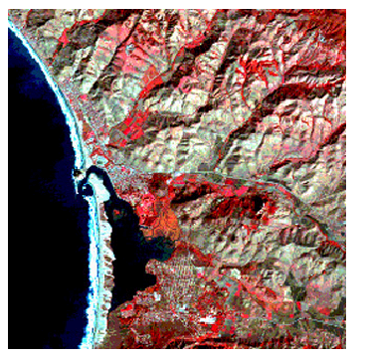
Image processing to generate color composite
Individual bands can be displayed in gray shades
Bands can be combined in color composites
False Color Composite
Spectral band | Color assignment
green (TM2) | blue
red (TM3) | green
near-infrared (TM4) | red
Reds, depicting vegetation
Medium grayish-browns, mainly along the bright sun-facing slopes
Deep blue, depicting ocean and bay
Near the shore, a bit lighter blue where thicker sediments add reflectance

Slide 26
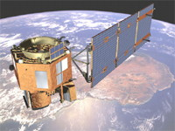
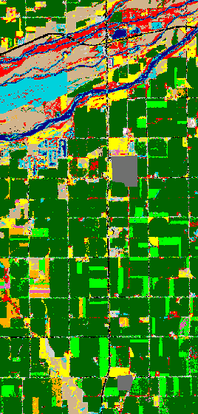
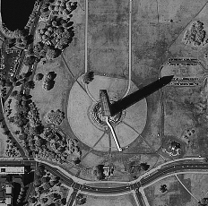
Remote Sensing
The Good News
sensors - spectral bands, higher resolution (< 1m)
lower data costs?
inexpensive, powerful software
global datasets
improved interface to GIS
biophysical analyses - biomass, soil moisture, turbidity

Slide 27
Aerial or satellite images?
A number of factors including spectral range, price, availability, reliability and flexibility are important in deciding between aerial and satellite images.
Aerial images are the main source of coordinate and attribute data, and provide more detailed information than satellite images.
National, state, and local governments are the main source of aerial images.
The National Aerial Photography Program (NAPP) provides full coverage of the lower 48 United States at 1:40,000 scale at 5 to 10 year return intervals.
Satellite systems provide a broader range of spatial, spectral and temporal data relative to aerial images, and cover large areas.
Often used to create or update landcover classification, and to detect and monitor change over large areas.

Slide 28
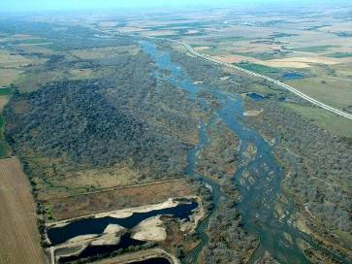
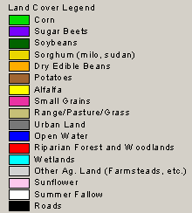
Remote Sensing
Some Typical Applications
Mapping or monitoring land cover and land use
Measuring area, volume, trajectory

Slide 29
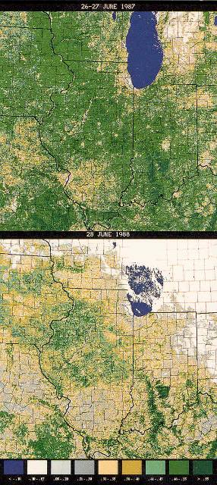
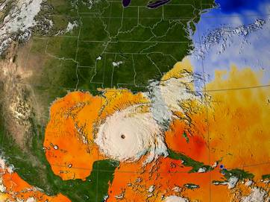
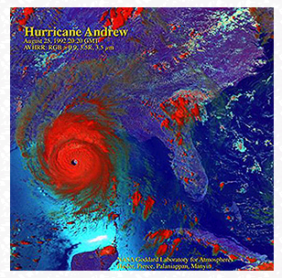
Estimating biomass, surface temperature, turbidity
Extent/impacts of natural hazards (e.g., drought, fires)

Slide 30
Vegetation Index:
Infrared/Red Ratio Vegetation Index
The near-infrared (NIR) to red simple ratio (SR) is the first true vegetation index
It takes advantage of the inverse relationship between chlorophyll absorption of red radiant energy and increased reflectance of near-infrared energy for healthy plant canopies (Cohen, 1991)

Slide 31
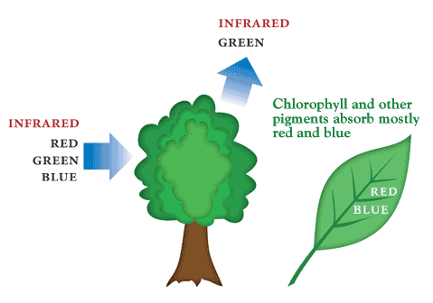
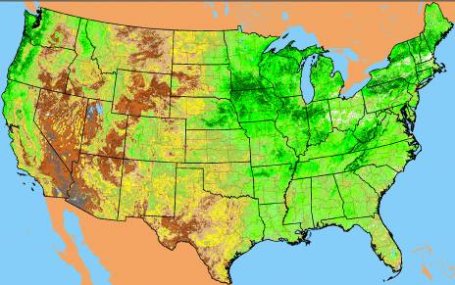

Vegetation Index
As plants grow, canopy and biomass increase
Green leaves absorb more red and blue light –
Increase in NIR reflectance
Vegetation indices express the difference between NIR and red reflectance
“Greenness” - associated with plant photosynthetic activity, biomass, fractional cover of vegetation
Normalized vegetation index (-1, 1)

Slide 32
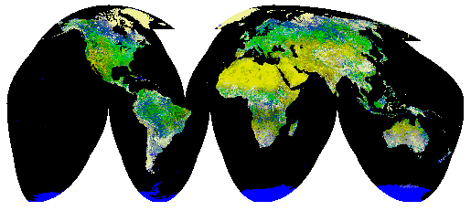
Global Normalized Difference Vegetation Index (NDVI) Image Produced Using (AVHRR) Imagery

Slide 33
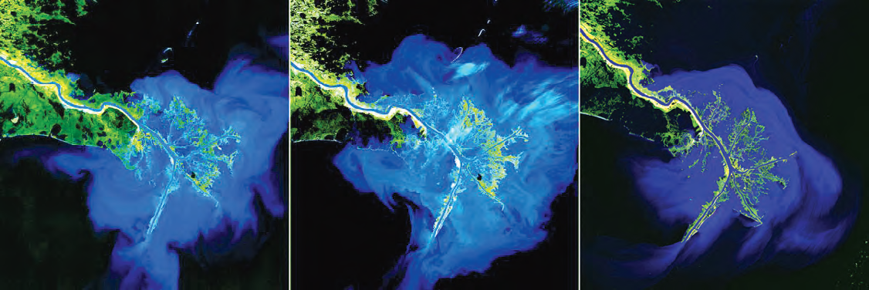
Landsat Images to study sediment deposition
Three decades of Mississippi Delta sediment deposition from the Mississippi-Missouri River system eroded debris. The left image was acquired on January 16, 1973; the middle image on March 12, 1989; and the right image on January 6, 2003.

Slide 34
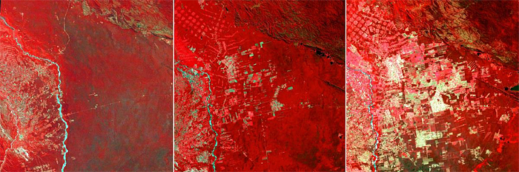
Remote Sensing in Forestry
Progression of deforestation in Bolivia from 1975 to 2000 using LANDSAT 2, 4, and 7 images. The image on the left was acquired on June 17, 1975; the middle image on July 10, 1992; and the right image on August 1, 2000.
Photo credit: USGS
http://pubs.usgs.gov/fs/2010/3026/pdf/FS2010-3026.pdf

Slide 35
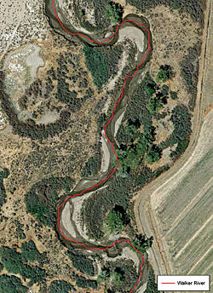
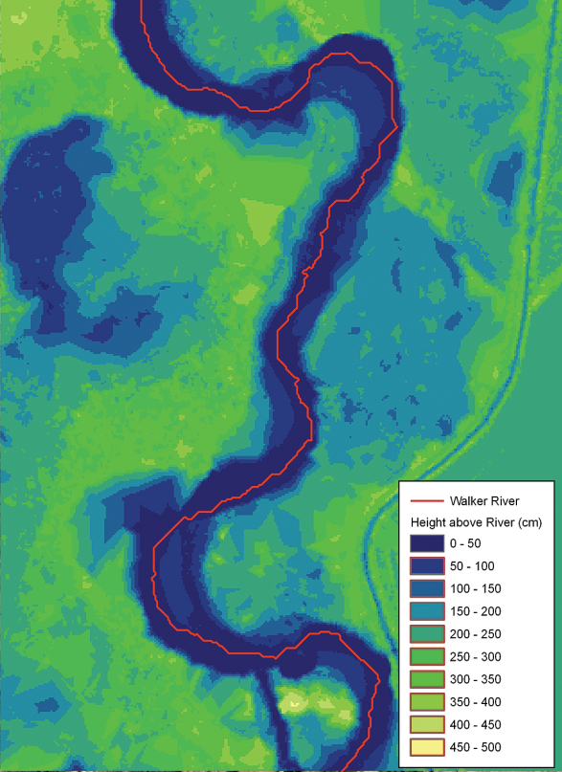
Mapping Riparian Vegetation with Lidar Data
The figure on the left is a 0.3048-meter-resolution aerial photograph of the Walker River in Nevada. The image on the right is the height-above- river map using a 300-meter kernel size and classified into 50-centimeter vertical intervals. In the upper left-hand corner is a eutrophic oxbow lake that is low lying yet disconnected from the river channel. Near the bottom of the map is a shallow river channel that periodically fills with water, cutting off the point bar. An irrigation ditch is visible on the right-hand side of the image.
http://www.esri.com/news/arcuser/0110/mapping-with-lidar.html

Slide 36
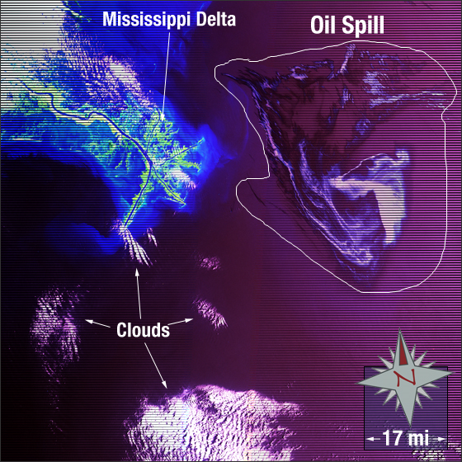
Gulf of Mexico Oil Spill 2010
In this image the Mississippi Delta is displayed on the left and the oil spill can be seen on the right. The image colors have been enhanced to increase visibility of the oil spill. Vegetation appears green, sediment-laden effluence from the delta appears light blue, clouds are white, the Gulf of Mexico is magenta, and the oil spill is a deep to light purple.
This Landsat 7 false-color composite image was created using ETM+ bands 7,4, and 2. It was acquired on May 1, 2010. The image falls on Landsat WRS-2 Path 21 Row 40.
http://landsat.gsfc.nasa.gov/images/archive/e0024.html

Slide 37
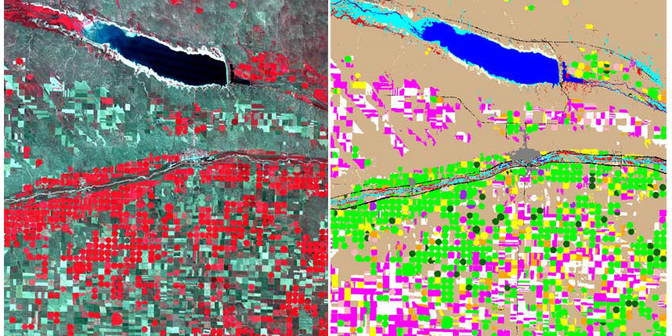

Remote Sensing for Land Use
http://calmit.unl.edu/2005landuse/

Slide 38
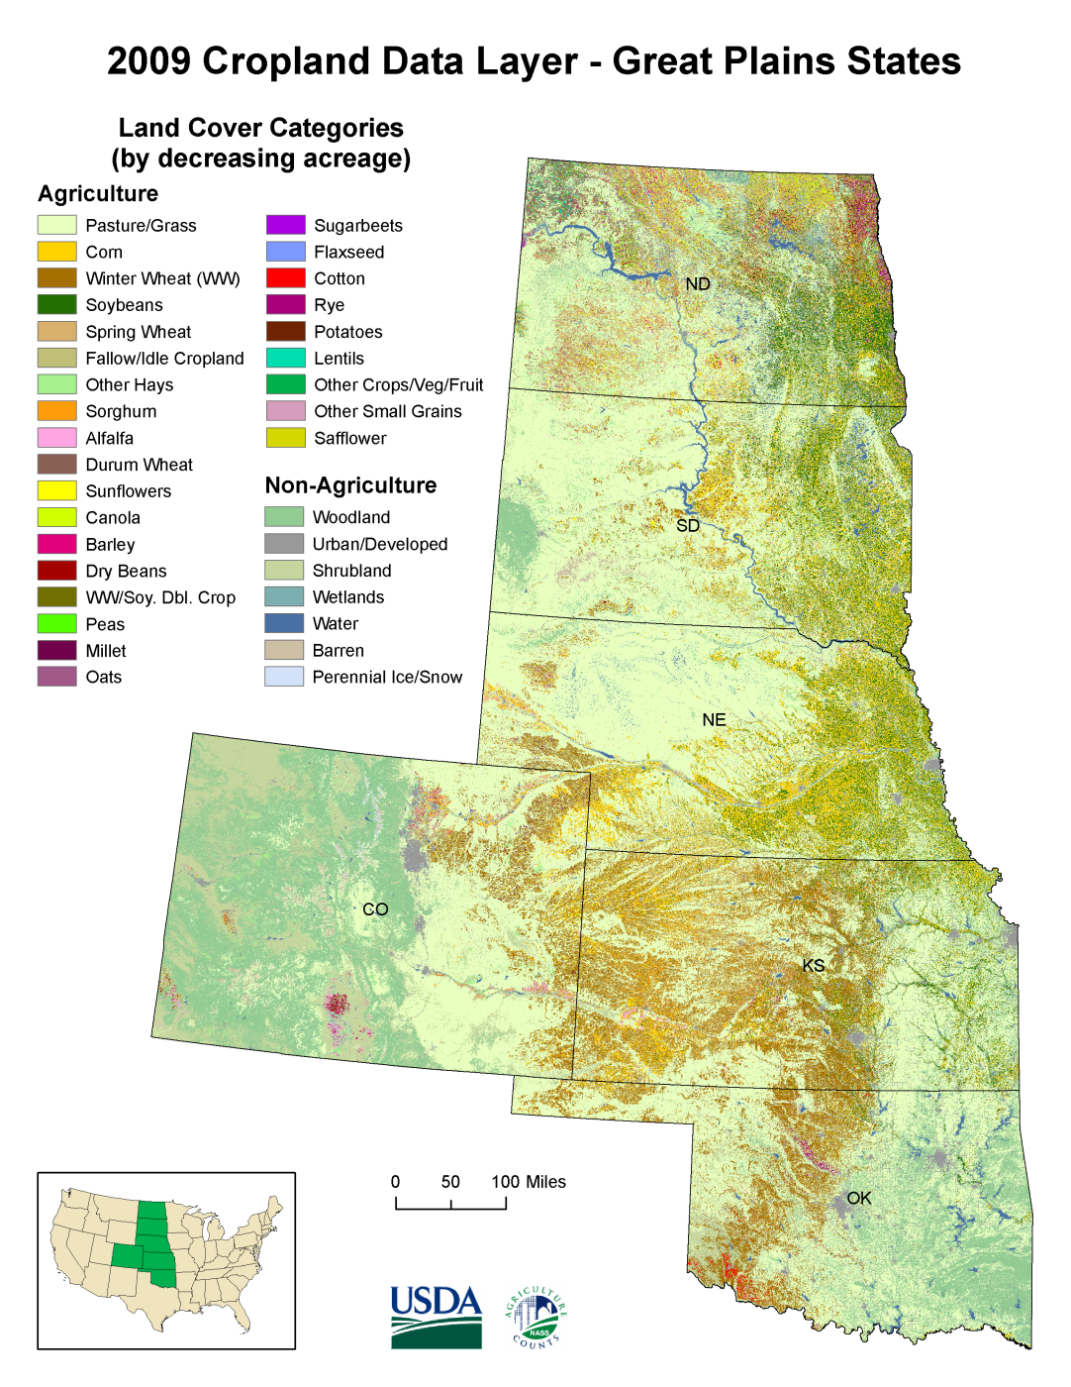
The CDL Program uses medium resolution satellites. CDL products prior AWiFS to 2006 relied primarily on Landsat 4/5/7. Beginning with the 2006 CDL products, the CDL program transitioned to using the senor on the IRS-P6 Resourcesat-1 satellite.
http://www.nass.usda.gov/research/Cropland/sarsfaqs2.html#_What_satellite_sensors
http://www.nass.usda.gov/research/Cropland/CDL09_greatplains_l.png

Slide 39

Hurricane Katrina
Notes:
Hurricane Katrina was the costliest and one of the five deadliest hurricanes in the history of the United States.
The storm surge caused severe damage along the Gulf Coast, devastating the Mississippi cities of Waveland, Bay St. Louis, Pass Christian, Long Beach, Gulfport, Biloxi, Ocean Springs, and Pascagoula

Slide 40


Landsat Change Analysis
Las Vegas
September 13, 1972
Las Vegas
June 20, 1997
Notes:
Urban development has expanded rapidly in Las Vegas, Nevada of the United States, over the last fifty years.
A major environmental change associated with this urbanization trend is the transformation of the landscape from natural cover types to increasingly anthropogenic impervious surface
--Total urban land-use increases approximately 110 percent from 1984 to 2002. Most of the increases are associated with medium-to high-density urban development.
---Places having significant increases in impervious surfaces are in the northwestern and southeastern parts of Las Vegas. Most high-density urban development, however, appears in central Las Vegas.

Slide 41


NOAA Advanced Very High Resolution Radiometer (AVHRR)
  1 km spatial resolution
  5 spectral bands
  daily revisit
  inexpensive “real-time” data capture
  Defining hydrologic, oceanographic, and meteorological parameters
Notes:
The AVHRR is a radiation-detection imager that can be used for remotely determining cloud cover and the surface temperature
The first AVHRR was a 4-channel radiometer, first carried on TIROS-N (launched October 1978). This was subsequently improved to a 5-channel instrument (AVHRR/2) that was initially carried on NOAA-7 (launched June 1981). The latest instrument version is AVHRR/3, with 6 channels, first carried on NOAA-15 launched in May 1998.
AVHRR/3 Channel Characteristics
Channel Number Resolution at Nadir Wavelength (um) Typical Use
1) 1.09 km 0.58 - 0.68 Daytime cloud and surface mapping
2) 1.09 km 0.725 - 1.00 Land-water boundaries
3A) 1.09 km 1.58 - 1.64 Snow and ice detection
3B) 1.09 km 3.55 - 3.93 Night cloud mapping, sea surface temperature
1.09 km 10.30 - 11.30 Night cloud mapping, sea surface temperature
1.09 km 11.50 - 12.50 Sea surface temperature
Measuring the same view, after processing, permits multi spectral analysis for more precisely defining hydrologic, oceanographic, and meteorological parameters. Comparison of data from two channels is often used to observe features or measure various environmental parameters. The three channels operating entirely within the infrared band are used to detect the heat radiation from and hence, the temperature of land, water, sea surfaces, and the clouds above them.

Slide 42



Seasonal Evapotranspiration Mapping Using Landsat Visible and Thermal Data with Remote Sensing

Slide 43
Methods Estimate Evaporation
Conventional class A pans
Ground-based measurements using instrumented weather stations (Bowen Ratio, Eddy covariance)
Buoys (water bodies)
Remote sensing technology
Climate models

Slide 44

METRIC Model
R_{n}-G-LE-H+L_{p}F_{p}+A_{h} +Δ= 0
LE
R_{n}
R_{n} = Net radiation
G = Soil heat flux
LE = Latent heat flux
H = Sensible heat flux
L_{p} = Fixation of CO₂ conversion factor
F_{p} = Specific flux of CO₂
A_{h} = Advection
Δ = Change in storage
H
G
Minor energy components ignored
Only vertical fluxes considered
Energy conservation
(Incoming Energy = Outgoing Energy)
LE = R_{n}- G - H
(K_{c} = ET_{act} / ET_{ref})

Slide 45
Nebraska
Differences between Actual K_{c} from METRIC and Potential K_{c} (from standard tables).
(K_{c} = ET_{act} / ET_{ref})
Corn
reduction in Kc from stress?
extra evaporation from rain
The METRIC derived curve is from year 2005 near Scottsbluff Nebraska averaged over about 100 fields (from UNL (Ayse Irmak and Ian Ratcliffe)))
K_{c actual} = K_{s} K_{cb} + K_{e total}

Slide 46



Daily ET expressed as ETrF for 06/10/2007 (left), 08/13/2007 (center) and 09/14/2007 (right) for the area north of Grand Island, NE.
06/10/2007
08/13/2007
09/14/2007
Notice the initial low ET values in the 6/10 image, followed by the dramatic
increase in ET values in the 8/13 image, then lower values in the 9/14 image.

Slide 47





Monthly ET
Nebraska
Central Platte Natural Resource District
Notes:
Evapotranspiration increases gradually from May after crop emergence and growth through July and August as the vegetation start to transpire at a potential rate for most vegetation surfaces. August is usually the peak ET month with high incoming solar radiation, high temperatures, and large vapor pressure deficit that increase ET. ET shows variation throughout the district as a function of different ET rates of various land covers, including corn, soybean, invasive species, natural vegetation, etc. With physiological maturity, leaf aging and senescence, ET starts to decrease gradually in September and is minimal in October. With harvest in October, most of the ET in this month represents the soil evaporation component of ET. As shown in monthly ET maps, mapping ET on large scales can provide vital information on the progression of ET for various vegetation surfaces over time.

Slide 48


April – October, 2006 ET from METRIC-Landsat
ET features at 30 m resolution
American Falls Reservoir
Lake Walcott
~80 km
Albion, ID
Snake River
Irrigated Fields/
Water Rights
Local Riparian

Slide 49




southcentral
Idaho 2006
Contrast between K_{c} (=ET_{r}F) from Energy Balance (left) and ETrF from NDVI (right)
  ET_{r}F from METRIC (using Thermal)
  ET_{r}F = 1.25 NDVI
  Surface Temperature
  NDVI

Slide 50

Nebraska
Use ET maps to estimate Recharge
Evapotranspiration minus Precipitation for April 1 – October 31, 1997 for Path 33, Row 31
(Nebraska Panhandle)
Notes:
This image shows April – October ET less precipitation. Therefore, negative values indicate that precipitation exceeds ET, and generally occurs in rainfed areas where there is ground water recharge. Positive values of ET – P indicate probable consumption of irrigation water or shallow ground water contributed by local sand dunes or hillslopes.

Slide 51


NEBFLUX
Nebraska Water and Energy Flux Measurement, Modeling, and Research Network
Comprehensive network that is designed to measure surface energy and water vapor fluxes, microclimatic variables, plant physiological parameters, soil water content, surface characteristics, and their interactions for various vegetation surfaces
12 BREBSs and one eddy covariance system are operating on a long-term and continuous basis

Slide 52


Measurement sites

Slide 53

http://nebhydro.com/
http://snr.unl.edu/airmak/

