Slide 1


Sharing Data Using the CUAHSI Hydrologic Information System
David Tarboton
Utah State University
CUAHSI
HIS
Sharing hydrologic data
http://his.cuahsi.org/
Support
EAR 0622374

Slide 2
The CUAHSI Hydrologic Information System Team
University of Texas at Austin – David Maidment, Tim Whiteaker, James Seppi, Fernando Salas, Jingqi Dong, Harish Sangireddy
San Diego Supercomputer Center – Ilya Zaslavsky, David Valentine, Tom Whitenack, Matt Rodriguez
Utah State University – David Tarboton, Jeff Horsburgh, Kim Schreuders, Stephanie Reeder
University of South Carolina – Jon Goodall, Anthony Castronova
Idaho State University – Dan Ames, Ted Dunsford, Jiří Kadlec, Yang Cao, Dinesh Grover
Drexel University/CUNY – Michael Piasecki
CUAHSI Program Office – Rick Hooper, Yoori Choi, Jennifer Arrigo, Conrad Matiuk
ESRI – Dean Djokic, Zichuan Ye
Users Committee – Kathleen Mckee, Jim Nelson, Stephen Brown, Lucy Marshall, Chris Graham, Marian Muste
CUAHSI
HIS
Sharing hydrologic data
http://his.cuahsi.org/
Support
EAR 0622374

Slide 3
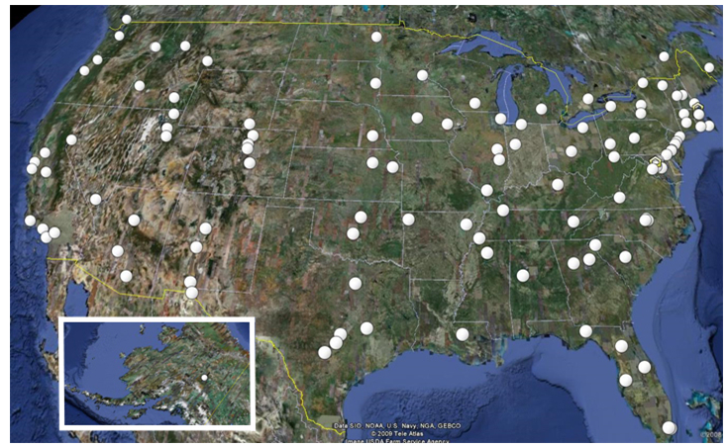
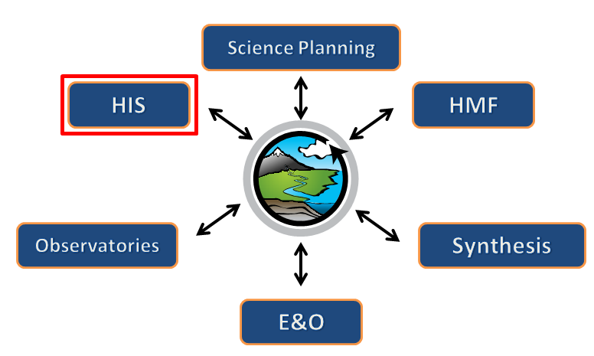

What is CUAHSI?
Consortium of Universities for the Advancement of Hydrologic Science, Inc.
111 US University members
7 affiliate members
17 International affiliate members
(as of October 2011)
Infrastructure and services for the advancement of hydrologic science and education in the U.S.
Support
EAR 0753521
http://www.cuahsi.org/

Slide 4
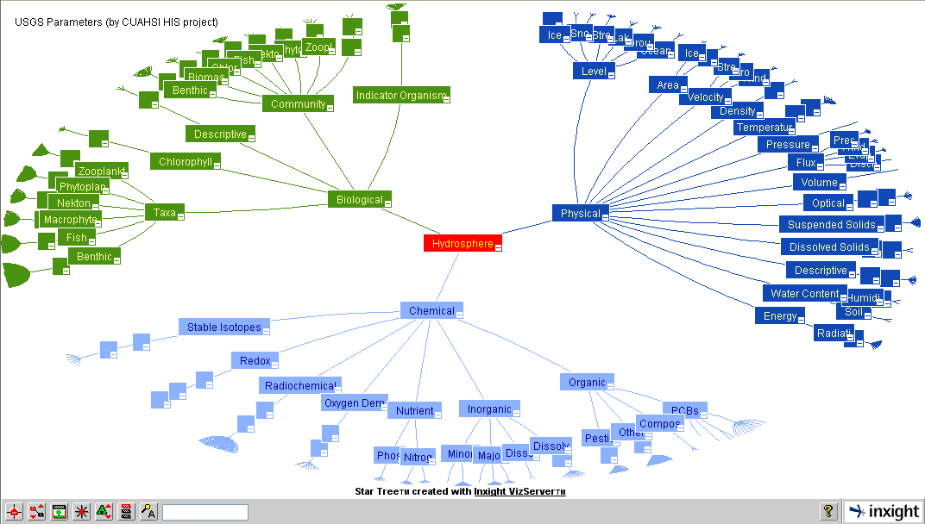
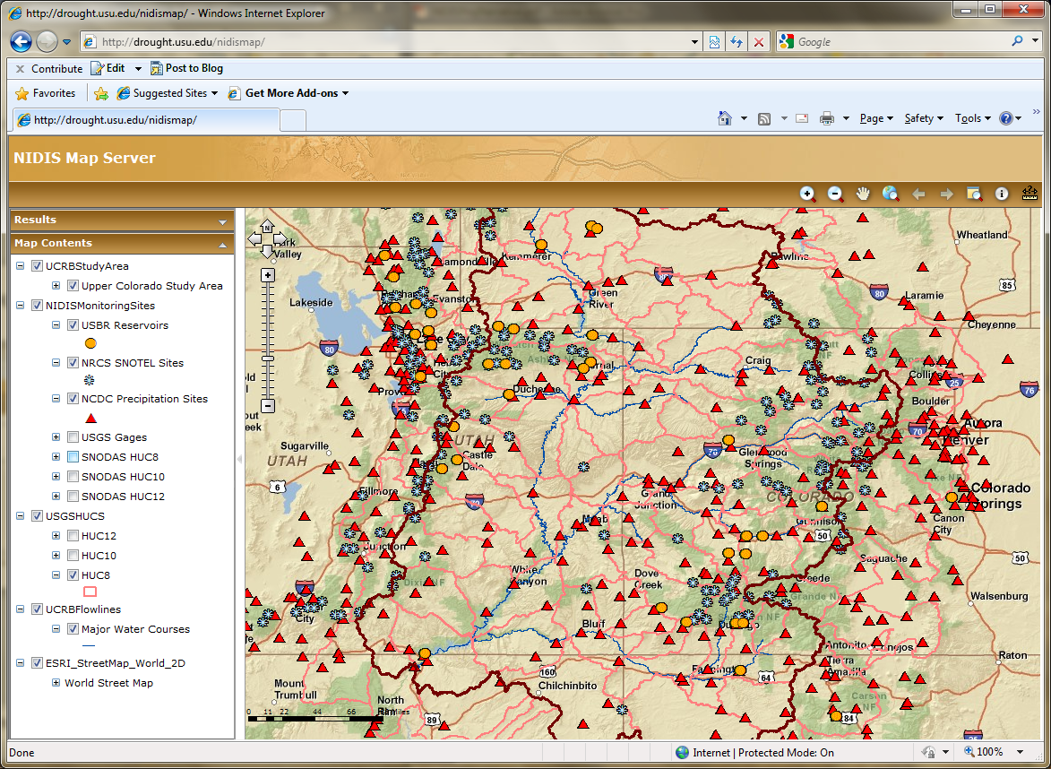
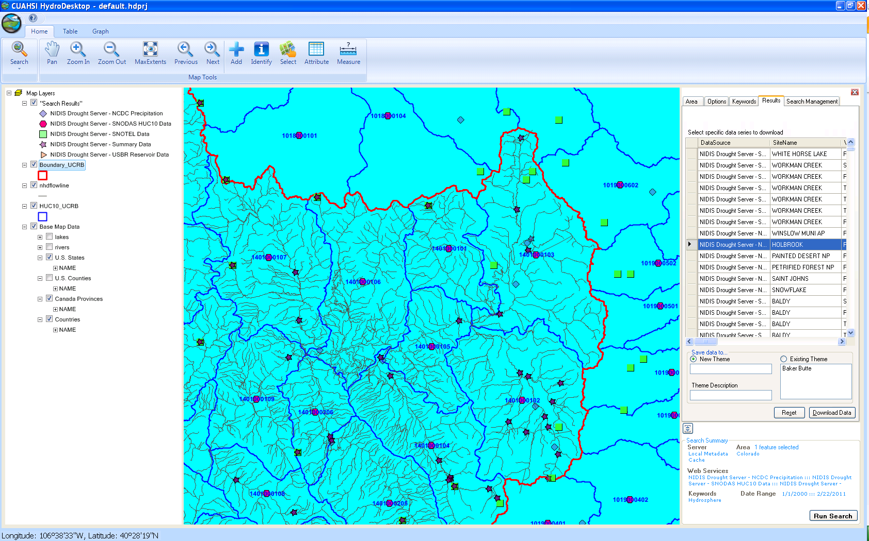
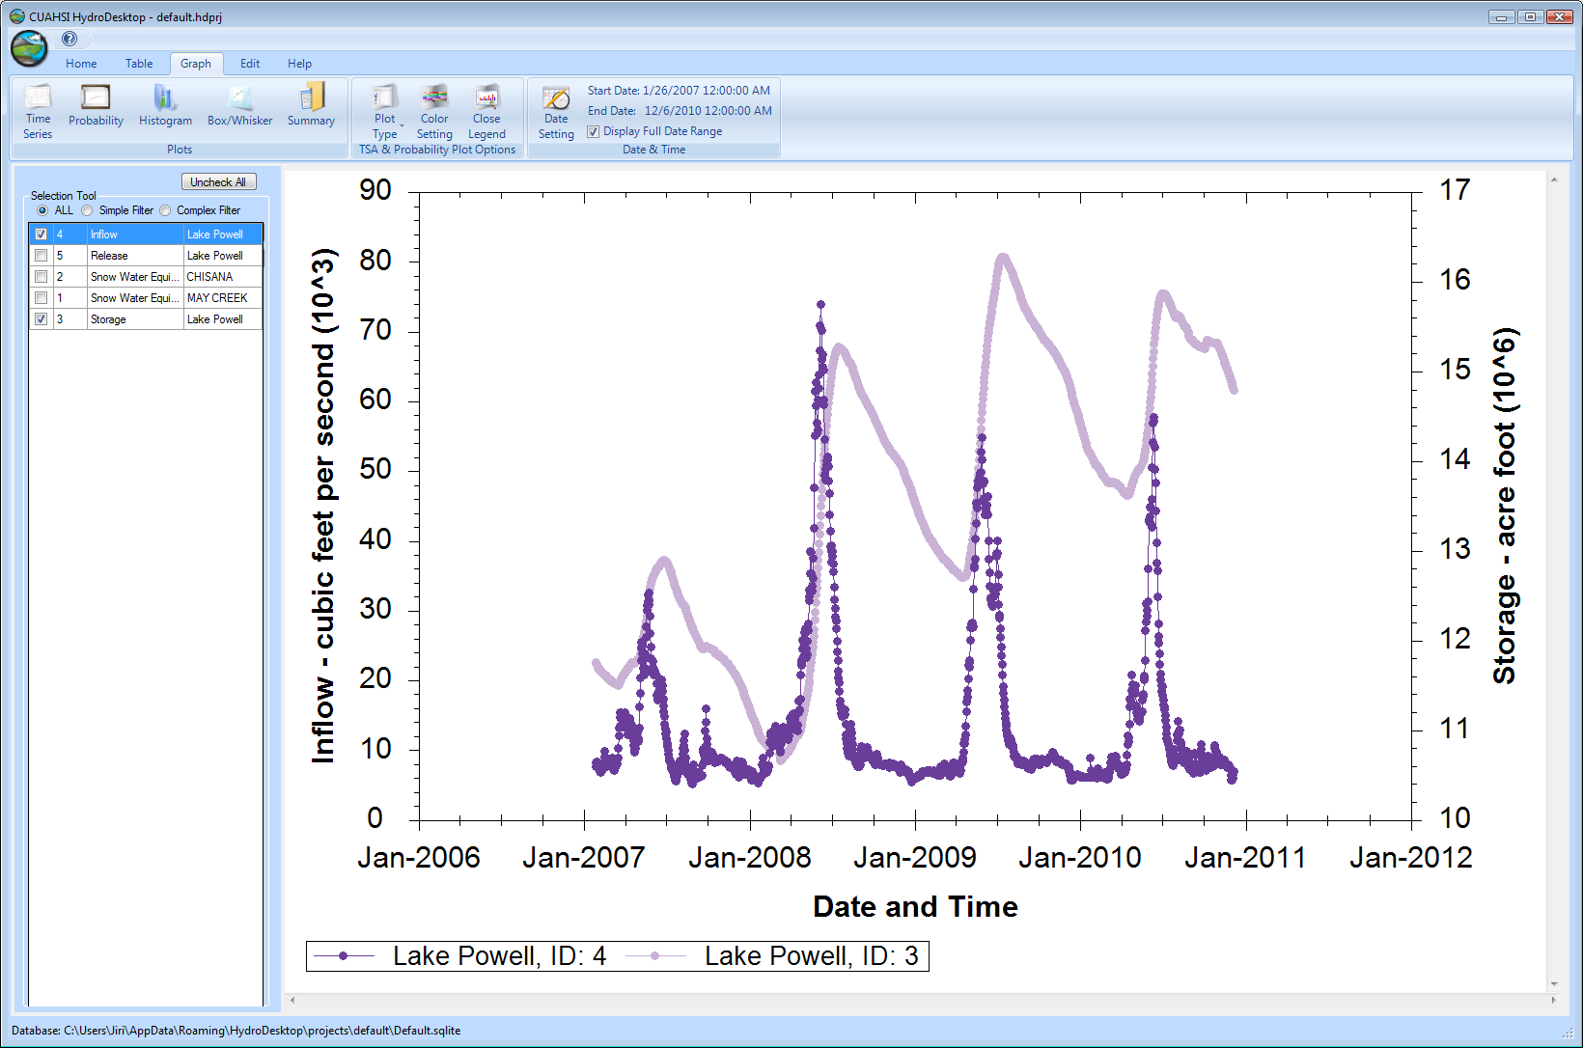
CUAHSI HIS
The CUAHSI Hydrologic Information System (HIS) is an internet based system to support the sharing of hydrologic data. It is comprised of hydrologic databases and servers connected through web services as well as software for data publication, discovery and access.
HydroServer – Data Publication
HydroCatalog
Data Discovery
Lake Powell Inflow and Storage
HydroDesktop – Data Access and Analysis
HydroDesktop – Combining multiple data sources

Slide 5
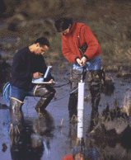
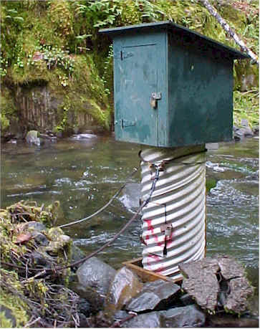
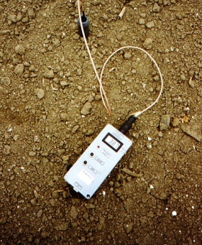
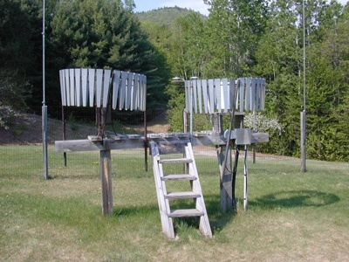
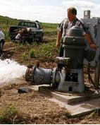
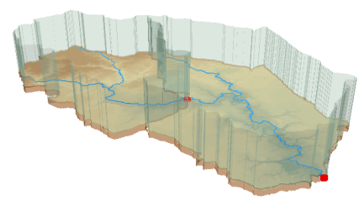
Hydrologic Data Challenges
Water quality
Water quantity
From dispersed federal agencies
From investigators collected for different purposes
Different formats
  Points
  Lines
  Polygons
  Fields
  Time Series
Rainfall and Meteorology
Soil water
Groundwater
GIS
Data Heterogeneity

Slide 6
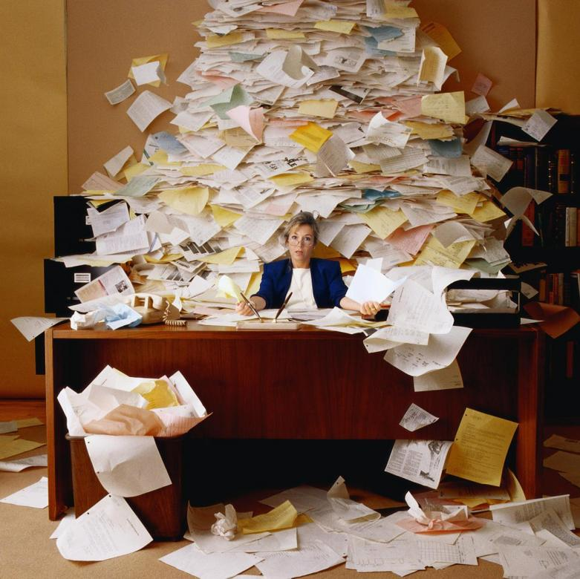
The way that data is organized can enhance or inhibit the analysis that can be done
I have your information right here …
Picture from: http://initsspace.com/

Slide 7
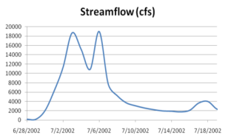
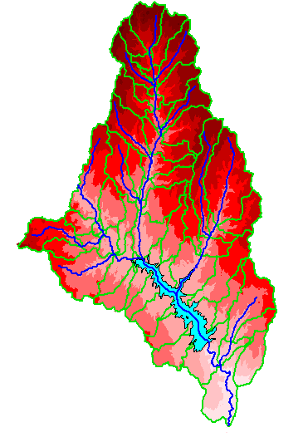
Hydrologic Science
It is as important to represent hydrologic environments precisely with
data as it is to represent hydrologic processes with equations
Physical laws and principles
(Mass, momentum, energy, chemistry)
Hydrologic Process Science
(Equations, simulation models, prediction)
Hydrologic conditions
(Fluxes, flows, concentrations)
Hydrologic Information Science
(Observations, data models, visualization
Hydrologic environment
(Physical earth)

Slide 8
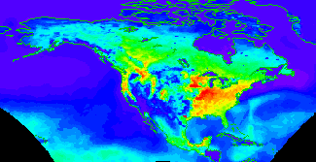


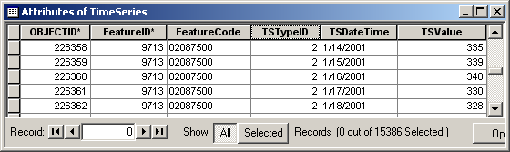
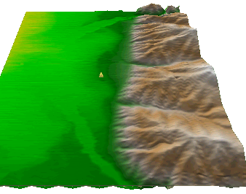
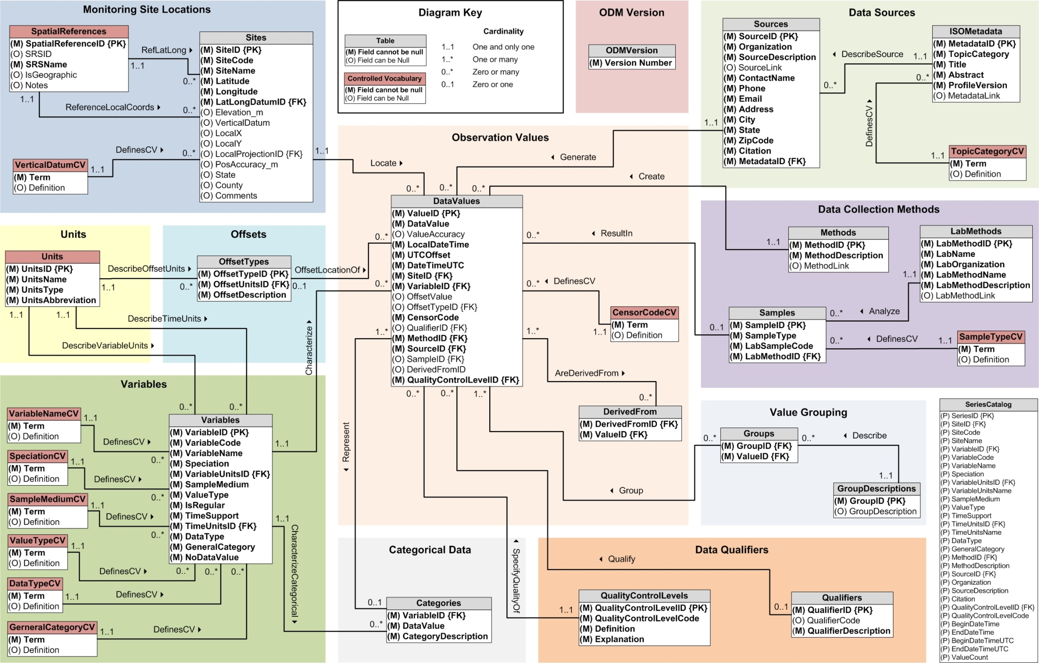
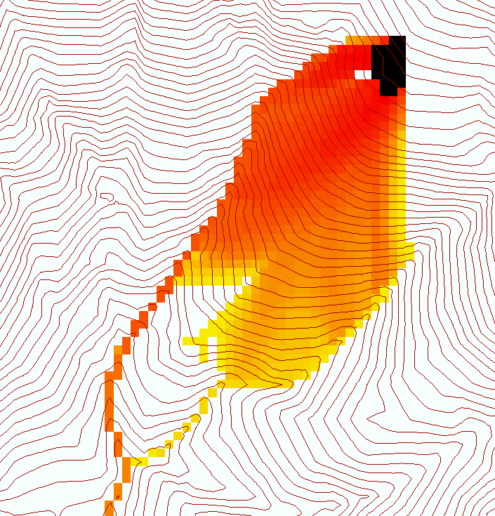
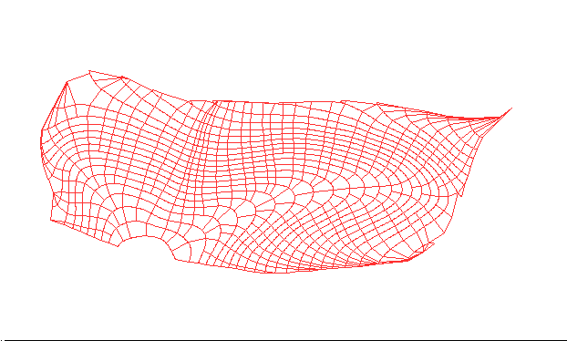
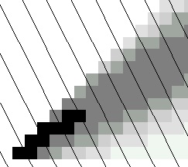
Data models capture the complexity of natural systems
NetCDF (Unidata) - A model for Continuous Space-Time data
ArcHydro – A model for Discrete Space-Time Data
Time, TSDateTime
Time, T
Coordinate
dimensions
{X}
TSValue
D
Space, FeatureID
Space, L
CUAHSI Observations Data Model: What are the basic attributes to be associated with each single data value and how can these best be organized?
Variables, TSTypeID
Variables, V
Variable dimensions
{Y}
Terrain Flow Data Model used to enrich the information content of a digital elevation model

Slide 9










Data Searching – What we used to have to do
Searching each data source separately
NWIS
request
return
request
request
return
return
NAWQA
request
return
NAM-12
request
return
request
return
request
return
request
return
NARR
Michael Piasecki
Drexel University
Notes:
9

Slide 10

What HIS enables
Searching all data sources collectively
GetValues
GetValues
NWIS
GetValues
GetValues
generic
request
GetValues
GetValues
NAWQA
Michael Piasecki
Drexel University
GetValues
NARR
GetValues
ODM
Notes:
10

Slide 11
Web Paradigm
Catalog
(Google)
Catalog harvest
Search
Web Server
(CNN.com)
Access
Browser
(Firefox)

Slide 12


CUAHSI Hydrologic Information System
Services-Oriented Architecture
Data Discovery and Integration
HydroCatalog
Metadata Services
WaterML, Other OGC Standards
Search Services
HydroServer
HydroDesktop
Data Publication
Data Services
Data Analysis and Synthesis
ODM
Geo Data
Information Model and Community Support Infrastructure

Slide 13
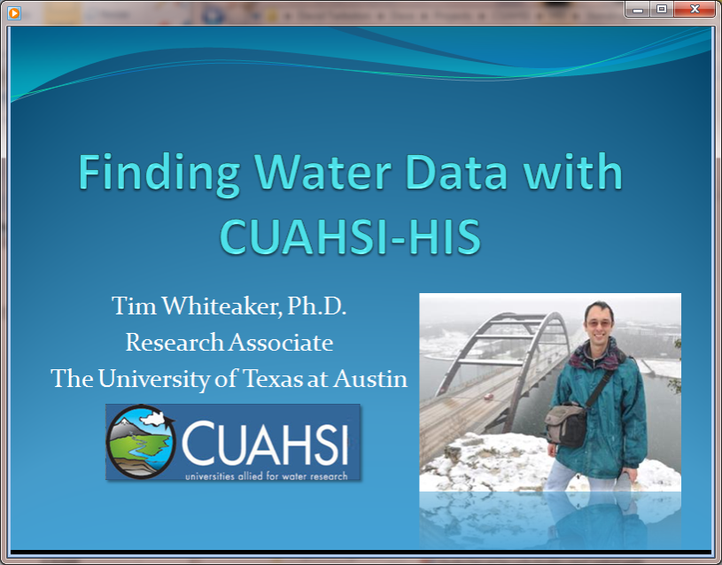
Video Demo
http://his.cuahsi.org/movies/JacobsWellSpring/JacobsWellSpring.html

Slide 14
What are the basic attributes to be associated with each single data value and how can these best be organized?
Value
DateTime
Variable
Location
Units
Interval (support)
Accuracy
Offset
OffsetType/ Reference Point
Source/Organization
Censoring
Data Qualifying Comments
Method
Quality Control Level
Sample Medium
Value Type
Data Type

Slide 15
CUAHSI Observations Data Model
Streamflow
Groundwater
levels
A relational database at the single observation level (atomic model)
Stores observation data made at points
Metadata for unambiguous interpretation
Traceable heritage from raw measurements to usable information
Standard format for data sharing
Cross dimension retrieval and analysis
Precipitation
& Climate
Soil
moisture
data
Water Quality
Flux tower
data
“When”
Time, T
t
A data value
v_{i} (s,t)
s
“Where”
Space, S
V_{i}
“What”
Variables, V

Slide 16
Data Storage – Relational Database
Values
Sites
Value
Date
Site
Variable
Site
Name
Latitude
Longitude
Value | Date | Site | Variable
4.5 | 3/3/2007 | 1 | Streamflow
4.2 | 3/4/2007 | 1 | Streamflow
33 | 3/3/2007 | 2 | Temperature
34 | 3/4/2007 | 2 | Temperature
Name | Latitude | Longitude
Cane Creek | 41.1 | -103.2
Cane Creek | 41.1 | -103.2
Town Lake | 40.3 | -103.3
Town Lake | 40.3 | -103.3
Site | Name | Latitude | Longitude
1 | Cane Creek | 41.1 | -103.2
2 | Town Lake | 40.3 | -103.3
Simple Intro to “What Is a Relational Database”
Notes:
HIS uses a relational database for data storage. If you’re unfamiliar with databases, here’s a quick intro. Suppose I have time series values for streamflow and temperature. I can store these in a table where I record the value, the date, the site where the measurement occurred, and the variable being measured. Now suppose I want to store more information about the site, such as its name and location. I could add some fields to the Values table, but if I have a million values, then I’m storing that same site information over and over again. A more efficient approach is to create a separate table with the site info, and relate one table to the other based on the Site number. A relational database is a set of tables with relationships like this.

Slide 17
CUAHSI Observations Data Model http://his.cuahsi.org/odmdatabases.html
Horsburgh, J. S., D. G. Tarboton, D. R. Maidment and I. Zaslavsky, (2008), A Relational Model for Environmental and Water Resources Data, Water Resour. Res., 44: W05406, doi:10.1029/2007WR006392.
Notes:
In designing ODM we asked: What are the basic attributes to be associated with each single data value and how can these best be organized? This involved community survey at a workshop and by email and based on the feedback received we came up with the ODM schema illustrated, published last year in WRR
This is quite a detailed slide, but it is the entire schema. Few database designs are simple enough to fit the entire schema on one slide. This shows at the center the data values table and off to the sides, the ancillary or metadata tables that record.

Slide 18
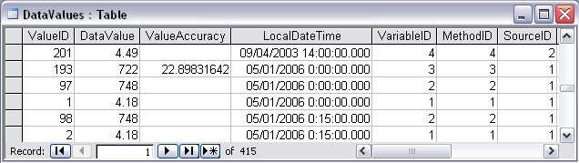
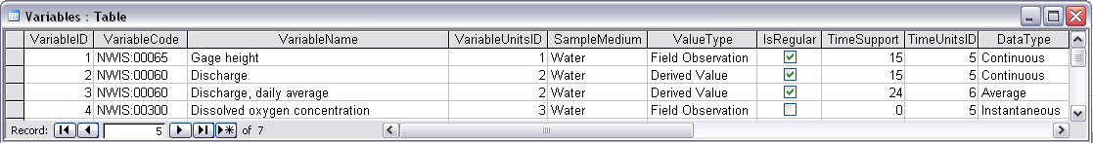
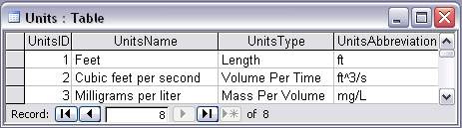
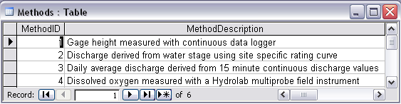
Discharge, Stage, Concentration and Daily Average Example

Slide 19
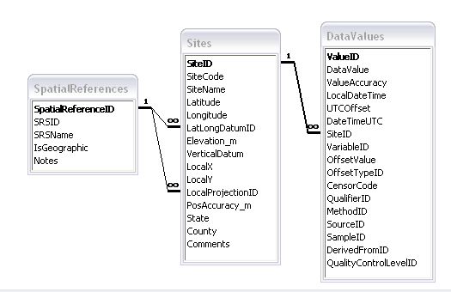
Site Attributes
SiteCode, e.g. NWIS:10109000
SiteName, e.g. Logan River Near Logan, UT
Latitude, Longitude Geographic coordinates of site
LatLongDatum Spatial reference system of latitude and longitude
Elevation_m Elevation of the site
VerticalDatum Datum of the site elevation
Local X, Local Y Local coordinates of site
LocalProjection Spatial reference system of local coordinates
PosAccuracy_m Positional Accuracy
State, e.g. Utah
County, e.g. Cache

Slide 20
Independent of, but can be coupled to Geographic Representation
ODM
e.g. Arc Hydro
Feature
Observations Data Model
1
HydroPoint
Waterbody
Watershed
Sites
1
HydroID
HydroID
HydroID
SiteID
HydroCode
*
HydroCode
HydroCode
SiteCode
FType
FType
DrainID
SiteName
OR
Name
Name
AreaSqKm
Latitude
JunctionID
AreaSqKm
JunctionID
Longitude
JunctionID
NextDownID
…
ComplexEdgeFeature
*
SimpleJunctionFeature
*
CouplingTable
1
SiteID
HydroID
1
HydroEdge
HydroJunction
HydroJunction
HydroID
1
HydroJunction
1
HydroID
HydroID
HydroCode
HydroID
HydroCode
HydroCode
ReachCode
HydroCode
NextDownID
NextDownID
Name
NextDownID
LengthDown
LengthDown
LengthKm
HydroNetwork
LengthDown
DrainArea
DrainArea
LengthDown
DrainArea
FType
FType
FlowDir
FType
Enabled
Enabled
FType
Enabled
AncillaryRole
AncillaryRole
EdgeType
AncillaryRole
Enabled
EdgeType
Flowline
Shoreline

Slide 21
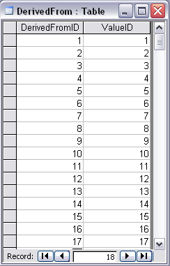
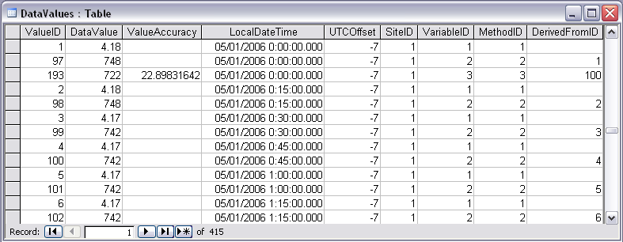
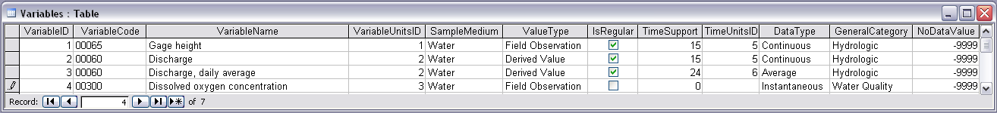
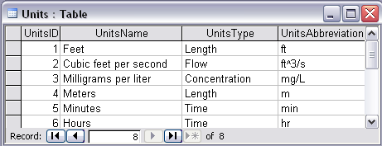
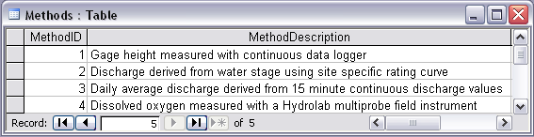
Stage and Streamflow Example
Notes:
Discharge Derived from Gage Height
Concepts:
Data derived from other data – single data point derived from a single observation (discharge from stage)
Data derived using a specific method (discharge from stage using rating curve)
Relationships:
Relationships between Values table and DerivedFrom table on DerivedFromID and ValueID
Relationship between Values table and Variables table on VariableID
Relationship between Values table and Methods table on MethodID
Relationship between Variables table and Units table on UnitID

Slide 22
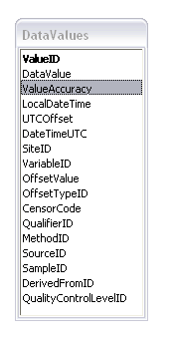
ValueAccuracy
A numeric value that quantifies measurement accuracy defined as the nearness of a measurement to the standard or true value. This may be quantified as an average or root mean square error relative to the true value. Since the true value is not known this may should be estimated based on knowledge of the method and measurement instrument. Accuracy is distinct from precision which quantifies reproducibility, but does not refer to the standard or true value.
ValueAccuracy
Accurate
Low Accuracy
Low Accuracy, but precise

Slide 23
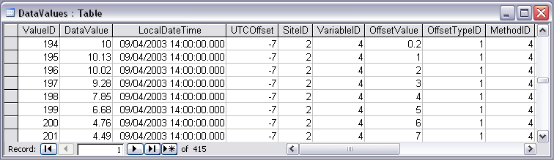

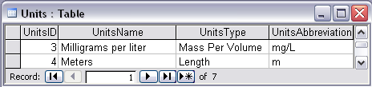
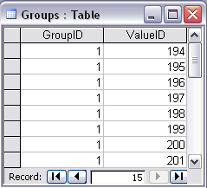


Water Chemistry from a profile in a lake
Notes:
Water Chemistry From a Lake Profile
Concepts:
Grouped observations (all observations in one reservoir profile)
Observations made using an offset (observations made at multiple depths below the surface of a reservoir)
Observations made using a specific method (observations made using a particular field instrument)
Relationships:
Relationship between Values table and the Variables table on VariableID
Relationship between Values table and OffestTypes table on OffsetTypeID
Relationship between Values table and Methods table on MethodID
Relationship between Variables table and Units table on UnitID
Relationship between GroupDescriptions table and Groups table on GroupID
Relationship between OffsetTypes table and Units table on UnitID and OffsetUnitID

Slide 24
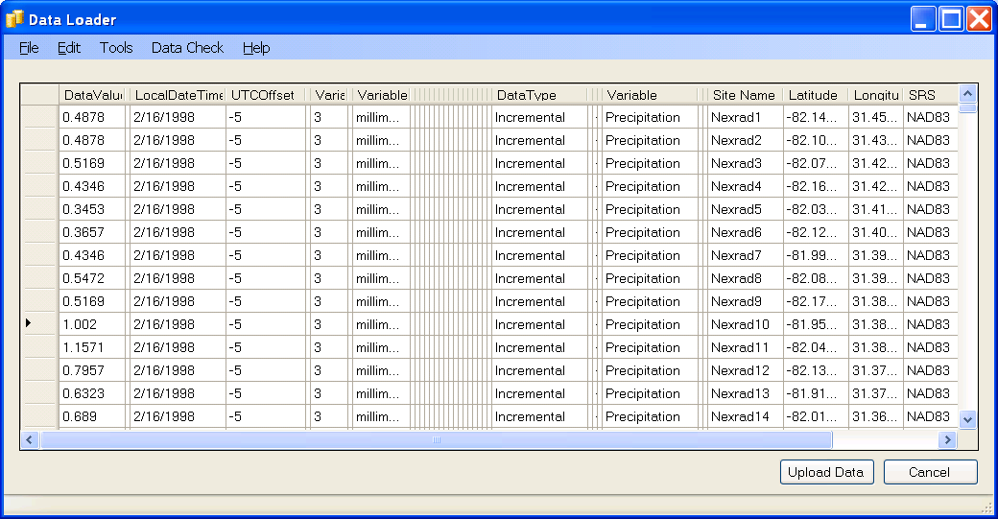
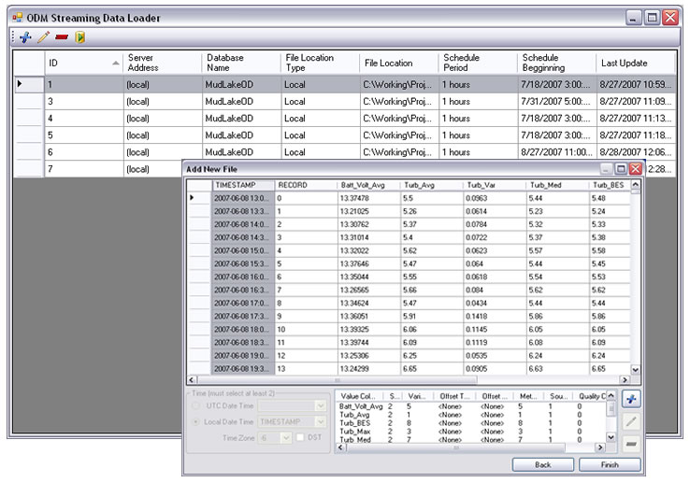
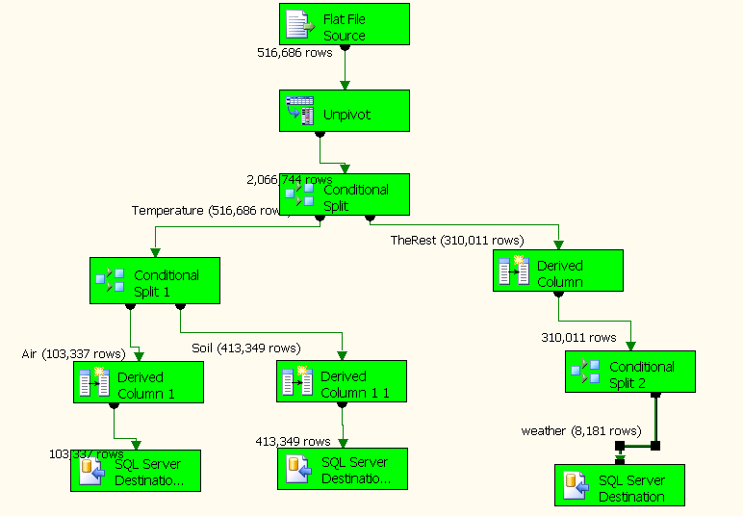
Loading data into ODM
OD Data Loader
Interactive OD Data Loader (OD Loader)
  Loads data from spreadsheets and comma separated tables in simple format
Scheduled Data Loader (SDL)
  Loads data from datalogger files on a prescribed schedule.
  Interactive configuration
SQL Server Integration Services (SSIS)
  Microsoft application accompanying SQL Server useful for programming complex loading or data management functions
SDL
SSIS

Slide 25
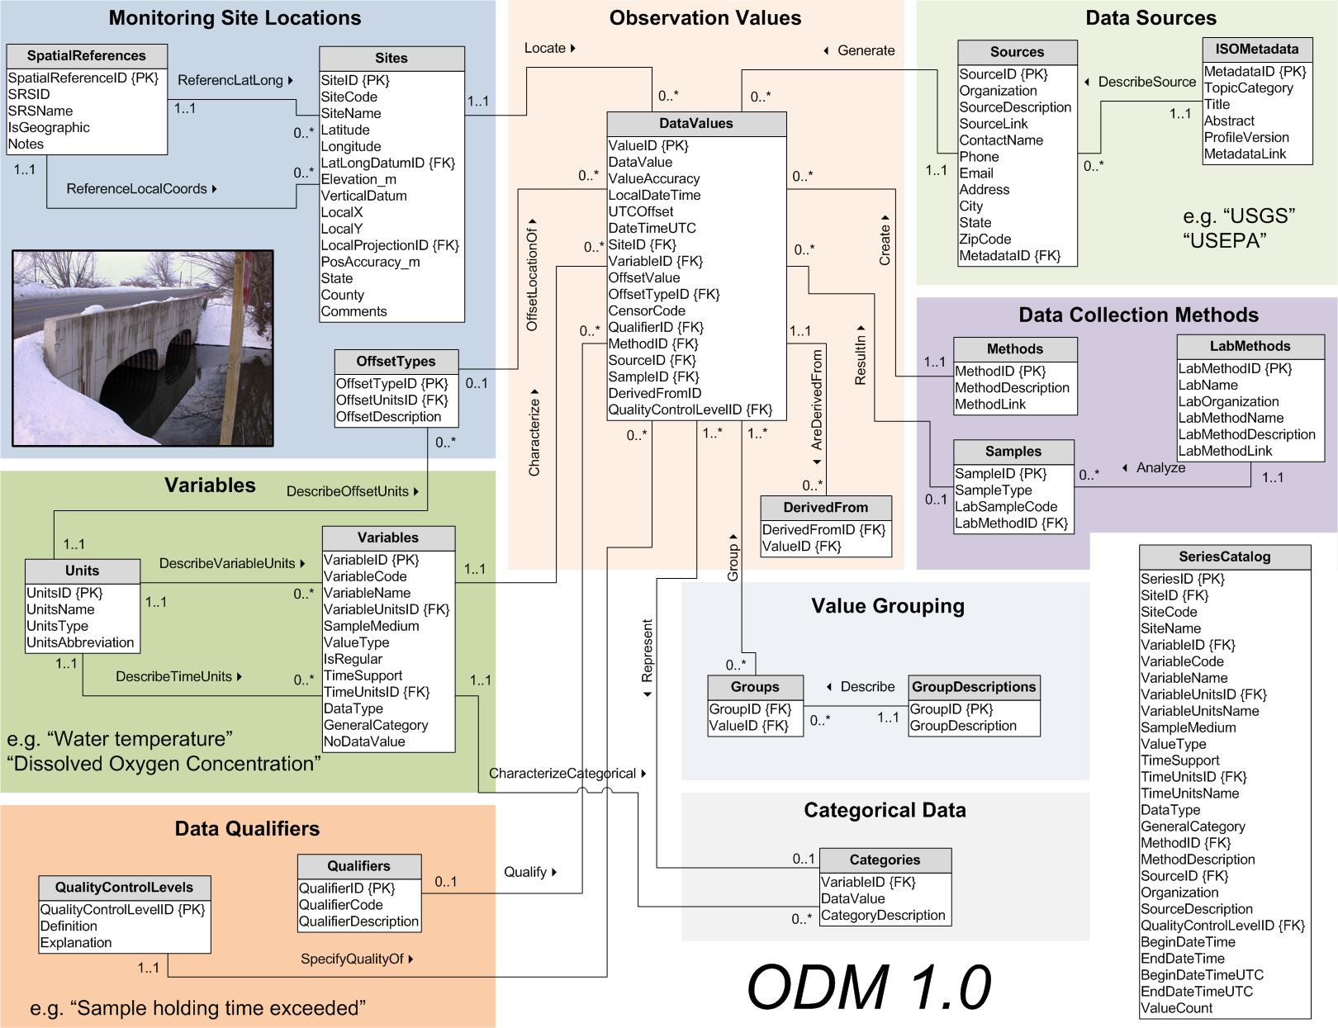
3
2
1
At last …
Work from Out to In
6
5
And don’t forget …
7
4
CUAHSI Observations Data Model
http://www.cuahsi.org/his/odm.html

Slide 26
Importance of the Observations Data Model
Provides a common persistence model for observations data
Syntactic consistency (File types and formats)
Semantic consistency
  Language for observation attributes (structural)
  Language to encode observation attribute values (contextual)
Publishing and sharing research data
Metadata to facilitate unambiguous interpretation
Enhance analysis capability

Slide 27
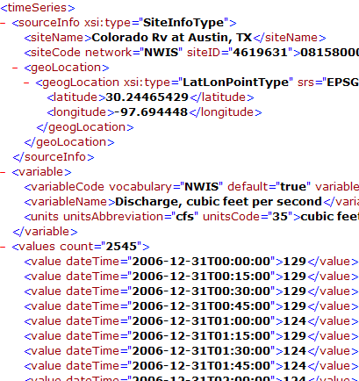
WaterML and WaterOneFlow
WaterML is an XML language for communicating water data
WaterOneFlow is a set of web services based on WaterML
Set of query functions
Returns data in WaterML
GetSites
GetSiteInfo
GetVariableInfo
GetValues
WaterOneFlow
Web Service
Notes:
27

Slide 28
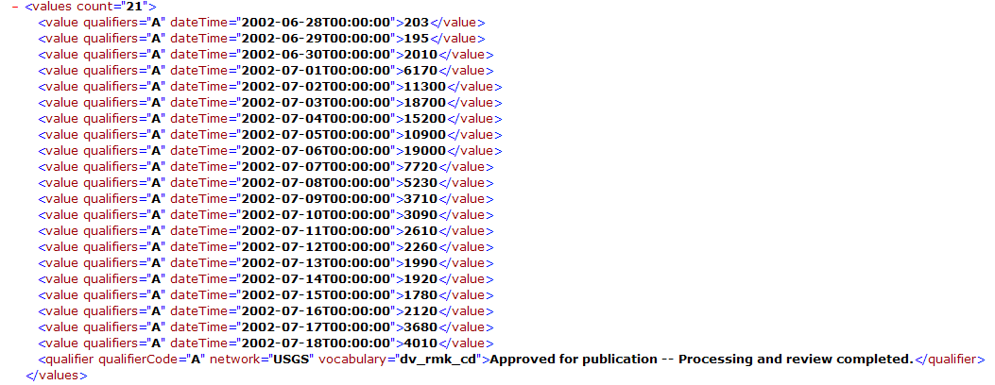
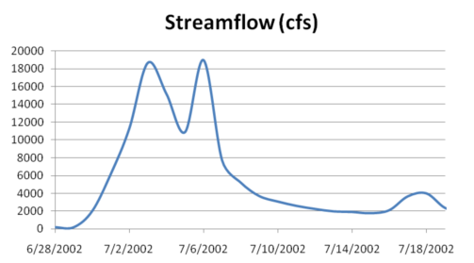
WaterML as a Web Language
Discharge of the San Marcos River at Luling, TX June 28 - July 18, 2002
USGS Streamflow data in WaterML language
This is the WaterML GetValues response from NWIS Daily Values

Slide 29
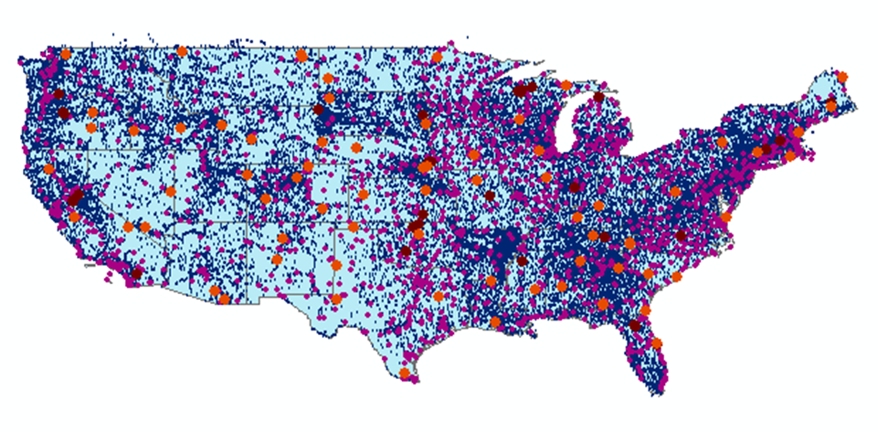
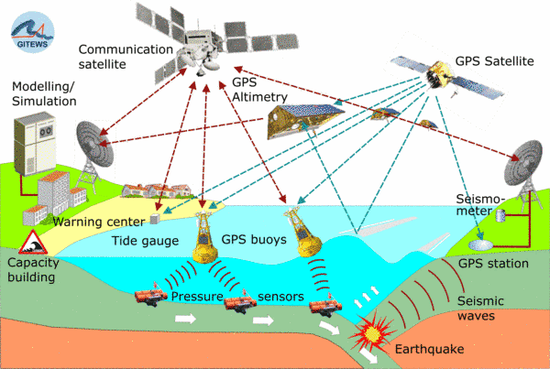
Open Geospatial Consortium
Web Service Standards
These standards have been developed over the past 10 years ….
…. by 400 companies and agencies working within the OGC
Map Services
Web Map Service (WMS)
Web Feature Service (WFS)
Web Coverage Service
(WCS)
Catalog Services for the Web (CS/W)
Observation Services
Observations and Measurements Model
Sensor Web Enablement (SWE)
Sensor Observation Service (SOS)
OGC Hydrology Domain Working Group evolving WaterML into an International Standard
http://www.opengeospatial.org/projects/groups/waterml2.0swg

Slide 30
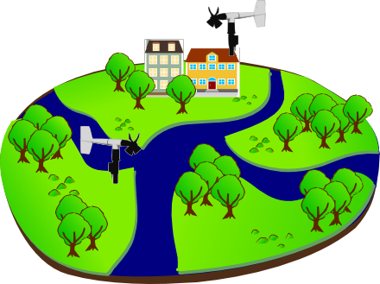
Sensor Observations Service: Get Observation
Observed Property := “Wind_Speed“
Sampling Time
Result
Feature of Interest
23 m/s 16.9.2010 13:45
uom
Procedure (ID := “DAVIS_123“)
Observation
Notes:
Basis for a standardized access to sensor data is the observation model defined in the Observations & Measurements standard. Let me briefly describe the main concepts / terms used in this model…

Slide 31
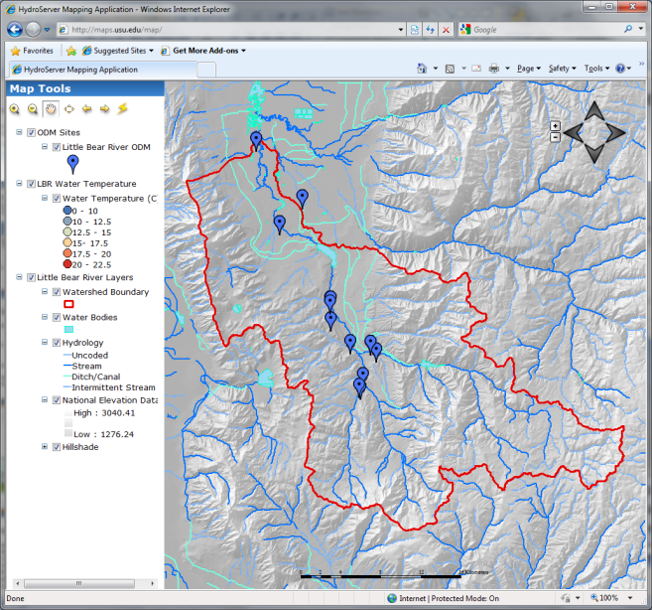

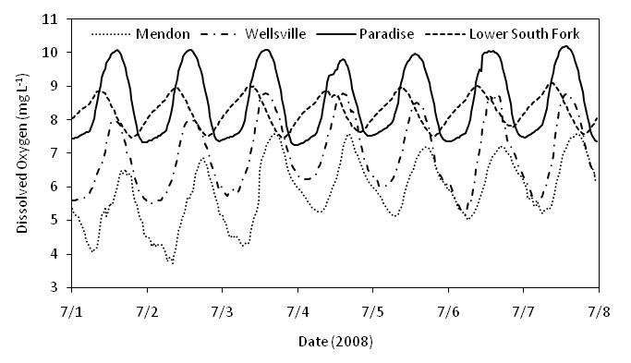

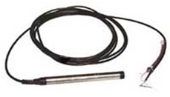





HydroServer – Data Publication
Point Observations Data
Internet Applications
Ongoing Data Collection
Historical Data Files
ODM Database
GetSites
GetSiteInfo
GetVariableInfo
GetValues
GIS Data
WaterML
WaterOneFlow
Web Service
OGC Spatial Data Service from ArcGIS Server
Data presentation, visualization,
and analysis through Internet enabled applications
Notes:
A platform for publishing space-time hydrologic datasets that:
Autonomous with local control of data
Part of a distributed system that makes data universally available
Basis for Experimental Watershed or Observatory data management system
Standards based approach to data publication
Accepted and emerging standards for data storage and transfer (OGC, WaterML)
Built on established software
MS SQL Server, ArcGIS server
Open Source Community Code Repository
Sustainability

Slide 32




HydroCatalog
Service Registry
Hydrotagger
Search over data services from multiple sources
Supports concept based data discovery
WaterML
Harvester
Water Metadata Catalog
GetSites
GetSiteInfo
GetVariableInfo
GetValues
WaterOneFlow
Web Service
Search Services
CUAHSI Data Server
3rd Party Server
e.g. USGS
Discovery and Access
Hydro
Desktop
http://hiscentral.cuahsi.org

Slide 33

Overcoming Semantic Heterogeneity
ODM Controlled Vocabulary System
  ODM CV central database
  Online submission and editing of CV terms
  Web services for broadcasting CVs
ODM VariableNameCV
Variable Name
Term
…
Sunshine duration
Temperature
Turbidity
…
Investigator 1: | “Temperature, water”
Investigator 2: | “Water Temperature”
Investigator 3: | “Temperature”
Investigator 4: | “Temp.”
From Jeff Horsburgh

Slide 34





Dynamic controlled vocabulary moderation system
ODM Data Manager
ODM Website
ODM
Tools
ODM Controlled
Vocabulary Moderator
XML
Master ODM Controlled Vocabulary
Local ODM
Database
ODM
Controlled Vocabulary
Web Services
Local
Server
http://his.cuahsi.org/mastercvreg.html
From Jeff Horsburgh

Slide 35

Thematic keyword search
HydroDesktop – Data Access and Analysis
Integration from multiple sources
Search on space and time domain

Slide 36

HydroModeler
An integrated modeling environment based on the Open Modeling Interface (OpenMI) standard and embedded within HydroDesktop
Allows for the linking of data and models as “plug-and-play” components
In development at the University of South Carolina by Jon Goodall, Tony Castronova, Mehmet Ercan, Mostafa Elag, and Shirani Fuller

Slide 37

Integration with “R” Statistics Package

Slide 38

37 Water Data Services on HIS Central from 12 Universities
University of Maryland, Baltimore County
Montana State University
University of Texas at Austin
University of Iowa
Utah State University
University of Florida
University of New Mexico
University of Idaho
Boise State University
University of Texas at Arlington
University of California, San Diego
Idaho State University
Dry Creek Experimental Watershed (DCEW)
(28 km² semi-arid steep topography, Boise Front)
68 Sites
24 Variables
4,700,000+ values
Published by Jim McNamara, Boise State University

Slide 39




Water Agencies and Industry
USGS, NCDC , Corps of Engineers publishing data using HIS WaterML
OGC Hydrology Domain Working Group evaluating WaterML as OGC standard
ESRI using CUAHSI model in ArcGIS.com GIS data collaboration portal
Kisters WISKI support for WaterML data publication
Australian Water Resources Information System Water Accounting System has adopted aspects of HIS
NWS West Gulf River Forecast Center Multi-sensor Precipitation Estimate published from ODM using WaterML

Slide 40
CUAHSI Water Data Services Catalog
69 public services
18,000 variables
1.9 million sites
23 million series
5.1 billion data values
(as of June 2011)
The largest water data
catalog in the world
maintained at the San Diego Supercomputer Center

Slide 41

Open Development Model
http://hydrodesktop.codeplex.com
http://hydroserver.codeplex.com
http://hydrocatalog.codeplex.com

Slide 42
Summary
Data Storage in an Observations Data Model (ODM) and publication through HydroServer
Data Access through internet-based Water Data Services using a consistent data language, called WaterML from HydroDesktop
Data Discovery through a National Water Metadata Catalog and thematic keyword search system at Central HydroCatalog (SDSC)
Integrated Modeling and Analysis within HydroDesktop
This approach based on standards provides a general foundation and approach for integration and sharing of hydrologic data around the world.

Slide 43
Are there any questions ?

