Slide 1
Data Sources for GIS in Water Resources by David R. Maidment, David G. Tarboton and Ayse Irmak
GIS in Water Resources
Fall 2011

Slide 2
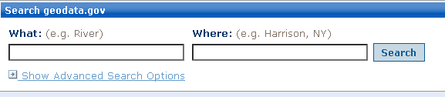
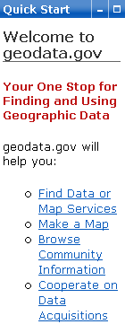
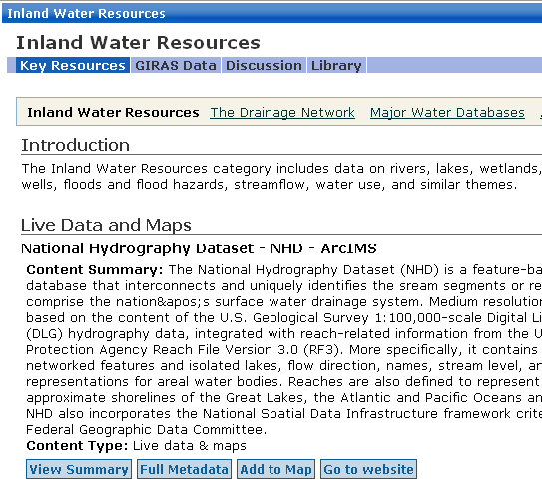
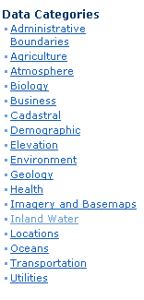
http://www.geodata.gov/
http://www.geodata.gov/

Slide 3
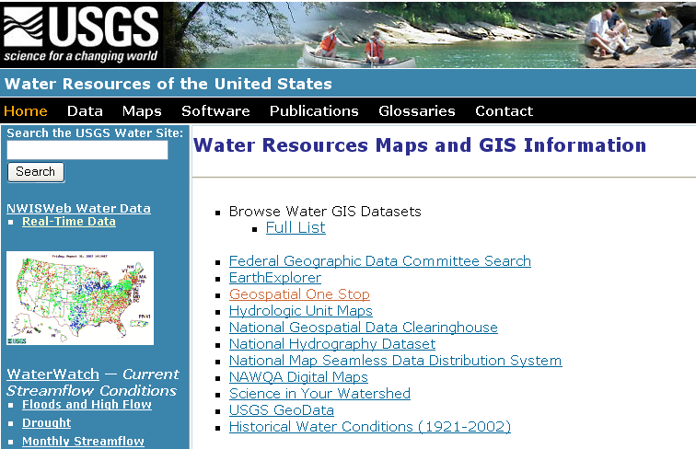
USGS GIS data for Water
http://water.usgs.gov/maps.html

Slide 4
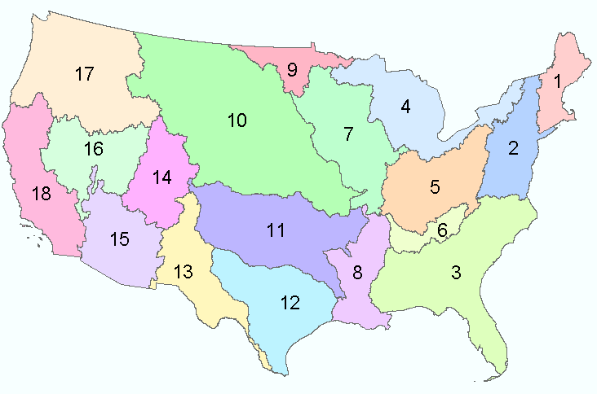
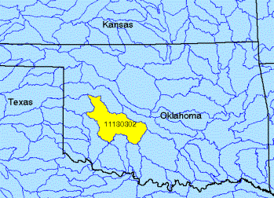
Watersheds of the US
2-digit water resource regions
8-digit HUC watersheds

Slide 5
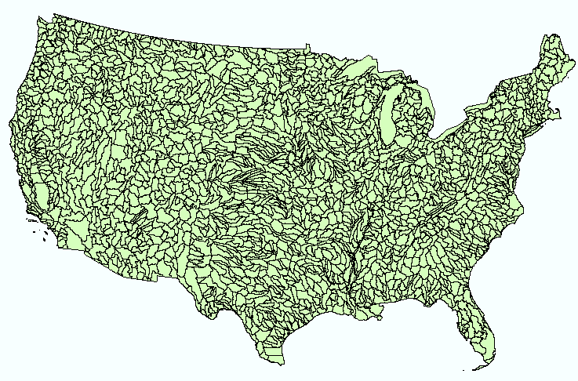
Hydrologic Unit Code Watersheds
~ 2000 for US, about the size of counties

Slide 6
Watershed Hierarchy
Digit #
2
4
6
8 HUC
10
12
NHDPlus
Available
In Progress

Slide 7
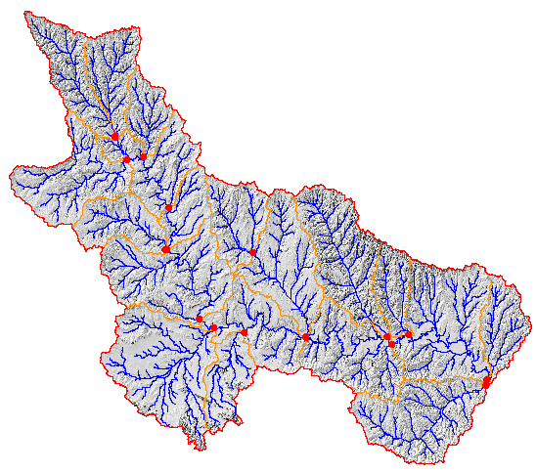
Watershed Boundary Dataset
National Program by USGS and USDA (NRCS)
Boundaries for 10- and 12- digit watersheds
First cut is by automated delineation from NED
Hand checked and edited
10-digit watersheds

Slide 8
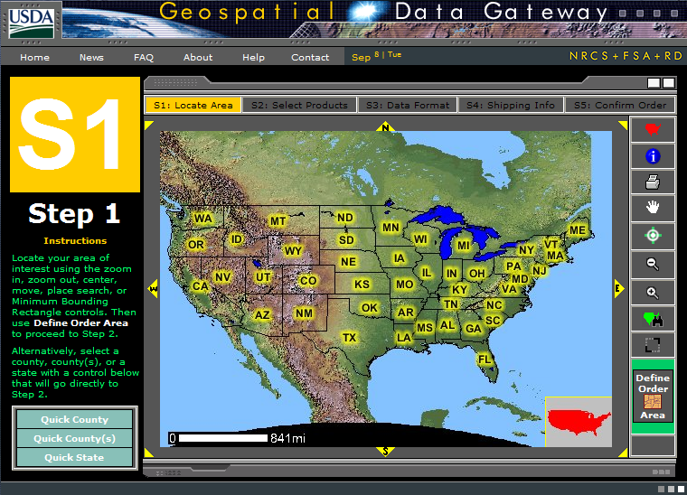
Watershed Boundary DataSet
http://www.ncgc.nrcs.usda.gov/products/datasets/watershed/

Slide 9
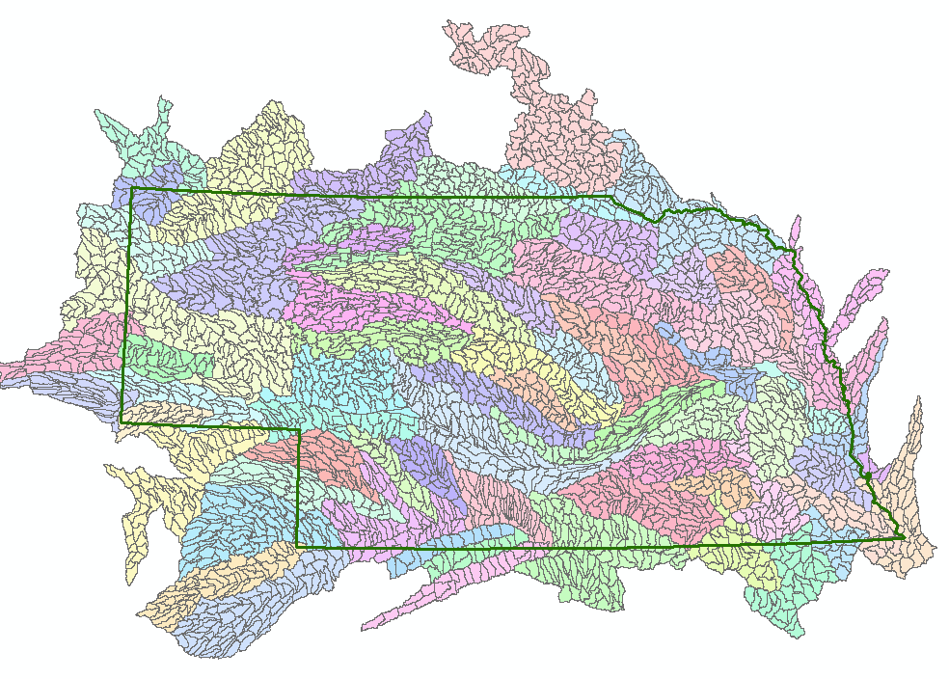
WBD for Nebraska
2990 HUC12 watersheds of average area 39.3 square miles
HUC12:HUC ~ 40:1 watersheds

Slide 10
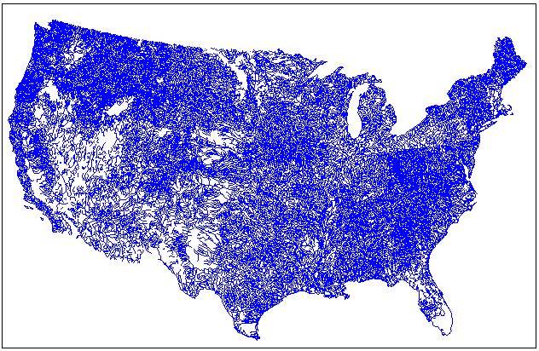
EPA River Reach File 1 (RF1)

Slide 11

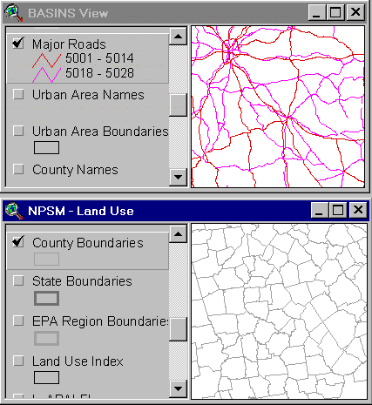
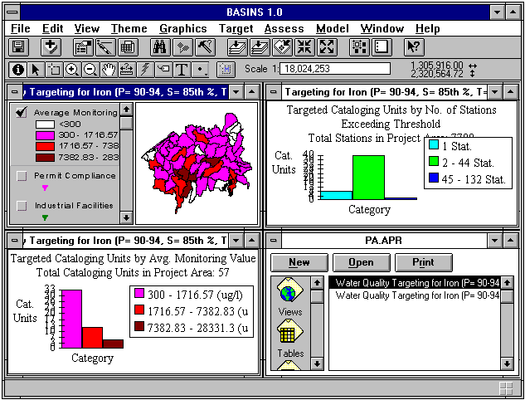

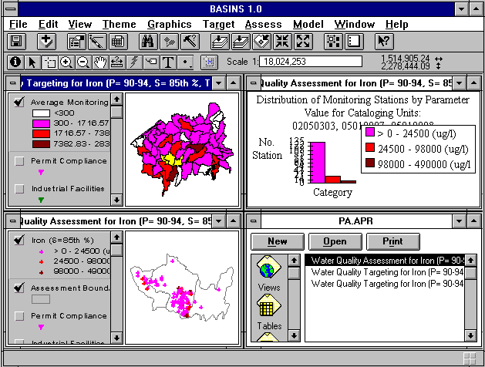

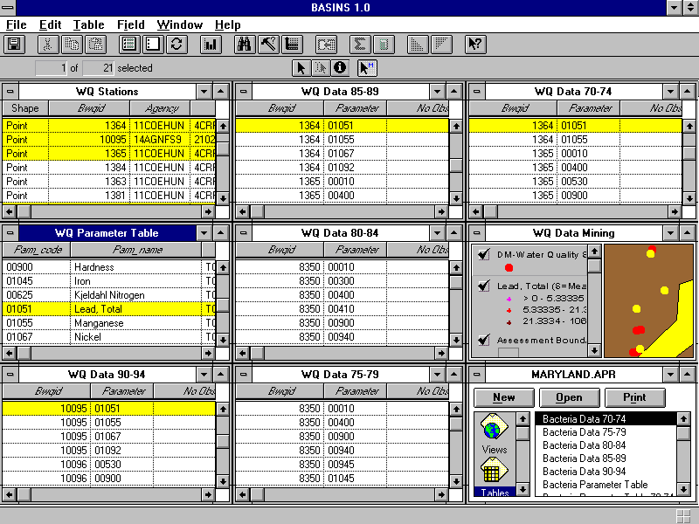
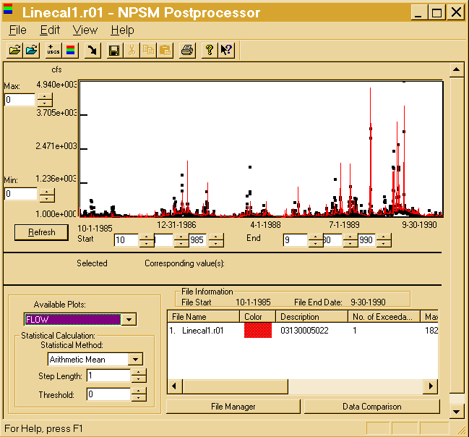
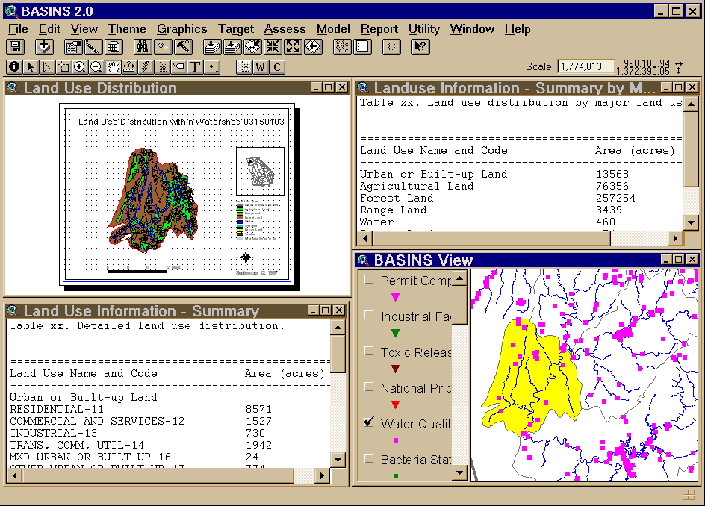
BASINS - Integrating GIS and Water Quality Modeling
Data
Cartographic
Monitoring
Loadings
Tools
Target
Assessment
Data Mining
Reporting
Models
HSPF - NPSM
QUAL2E
TOXIROUTE
Post-Processors
Target
Assess
DM
Decisions
Watershed Management
.
TMDL
.
Source Water Protection
.
Stormwater
State and Local Data

Slide 12

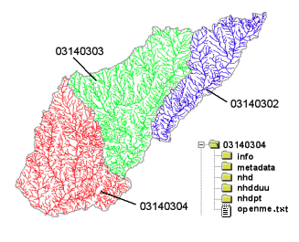
River networks
for 8-digit HUC
watersheds
http://nhd.usgs.gov/

Slide 13
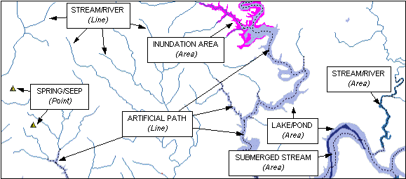

Slide 14

Lower West Fork, Trinity River Basin
HUC = 12030102

Slide 15
NHD River Reaches
412 River Reaches
In Upper West Fork of Trinity Basin

Slide 16
River Reach Codes
Used for river address locations
ReachCode =
12030102000151
ReachCode = 12030102000005
HUC#
Segment#
Location 0.392
on Reach
12030102000005

Slide 17
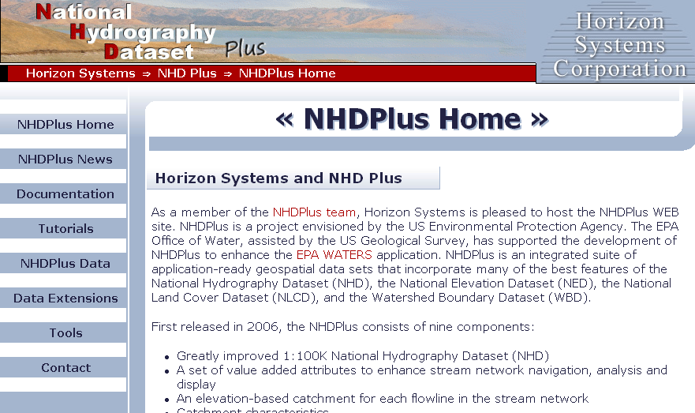
http://www.horizon-systems.com/nhdplus/

Slide 18
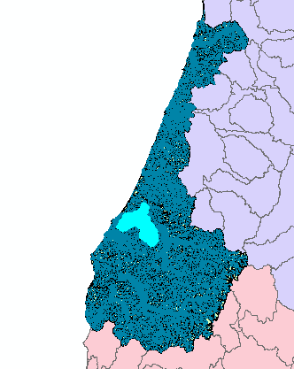
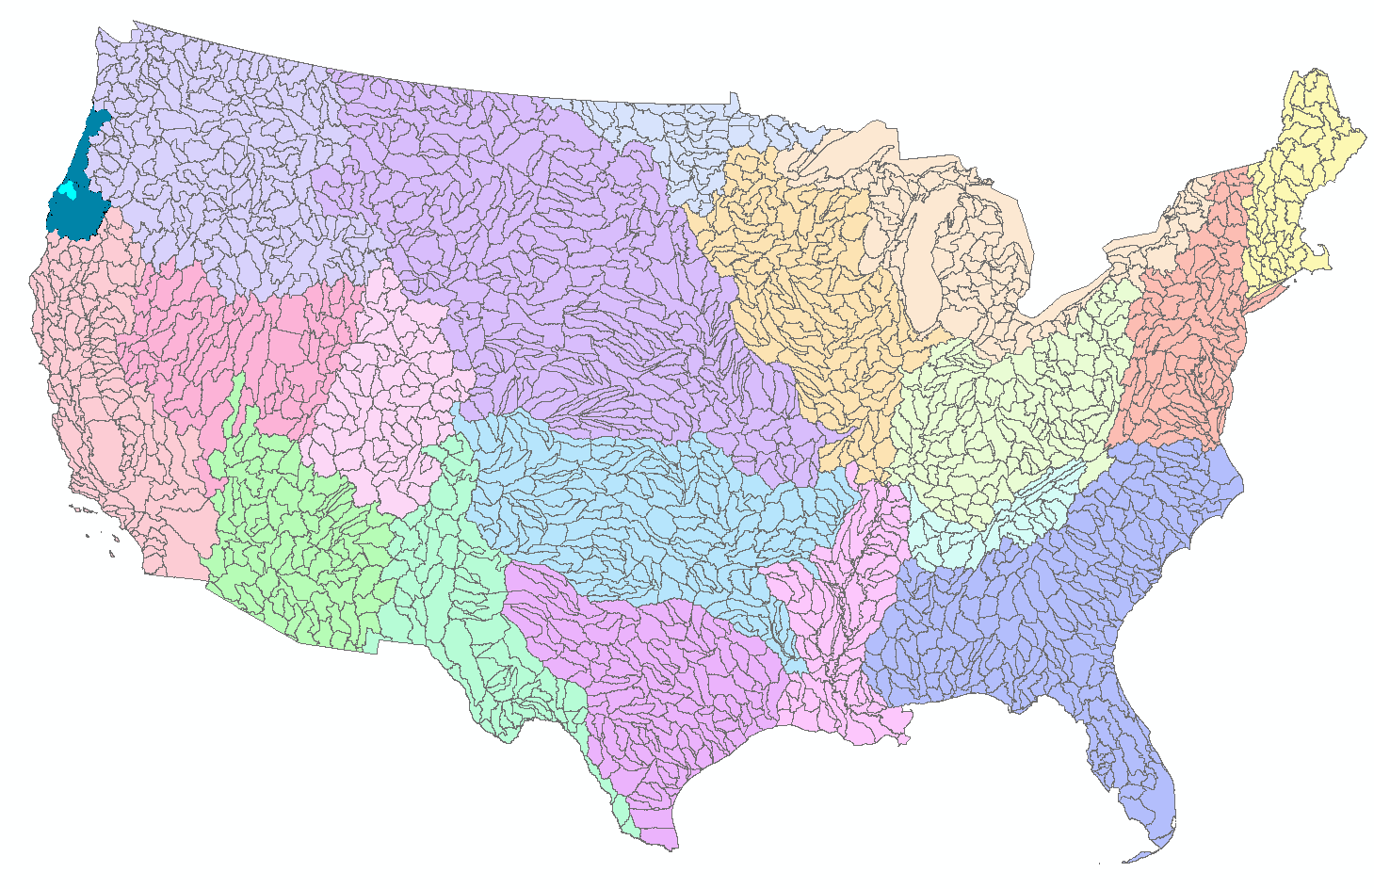
NHDPlus for a Portion of Oregon
http://www.horizon-systems.com/nhdplus/

Slide 19
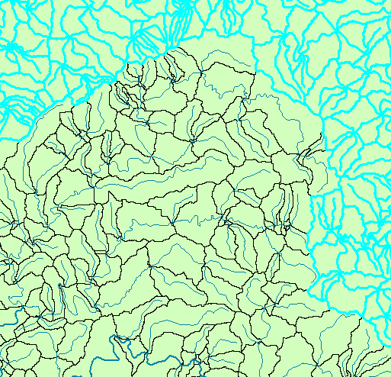
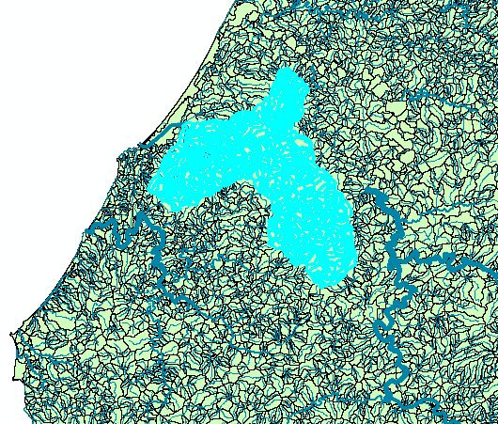
NHDPlus Reach Catchments ~ 3km²
Average reach length = 2km
2.3 million reaches for continental US
About 1000 reach catchments in each 8-digit HUC

Slide 20
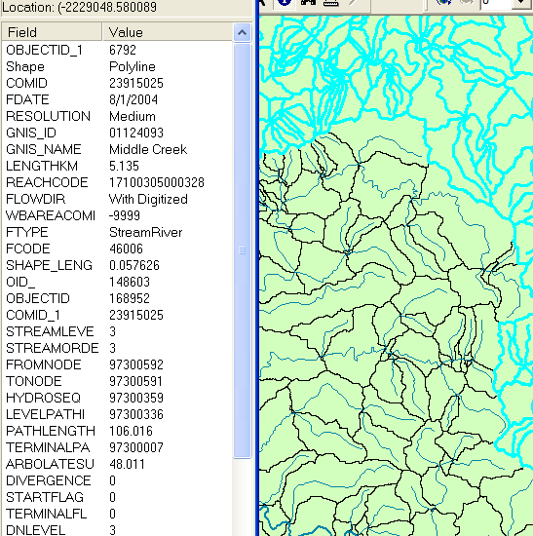
NHDPlus Reach Attributes
Slope
Elevation
Mean annual flow
  Corresponding velocity
Drainage area
% of upstream drainage area in different land uses
Stream order

Slide 21
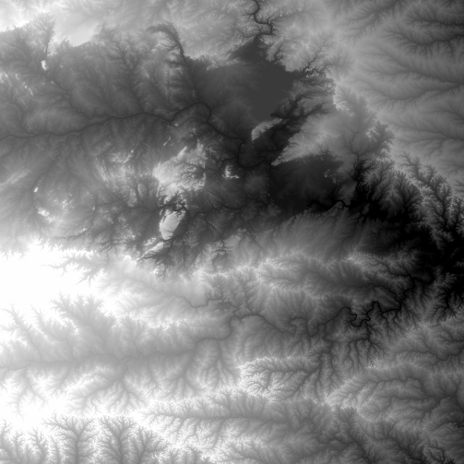
National Elevation Dataset
http://ned.usgs.gov/
Digital Elevation Model with 1 arc-second (30m) cells
Seamless in 1° blocks for the United States
10 billion data
Derived from USGS 1:24,000 quadrangle sheets
Get the data:
http://seamless.usgs.gov/

Slide 22
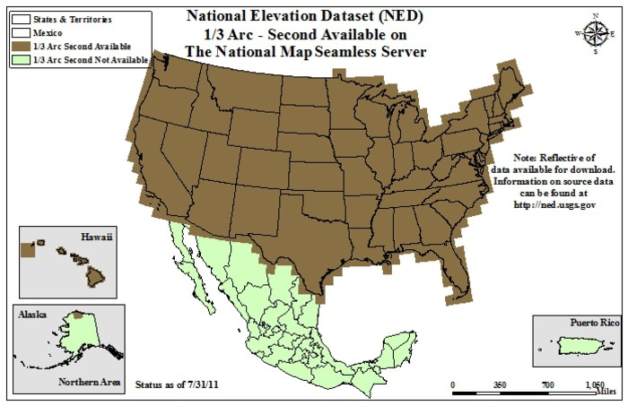
From http://seamless.usgs.gov

Slide 23
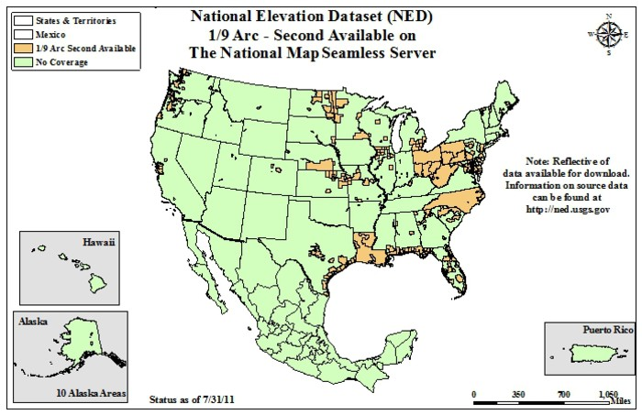
From http://seamless.usgs.gov

Slide 24
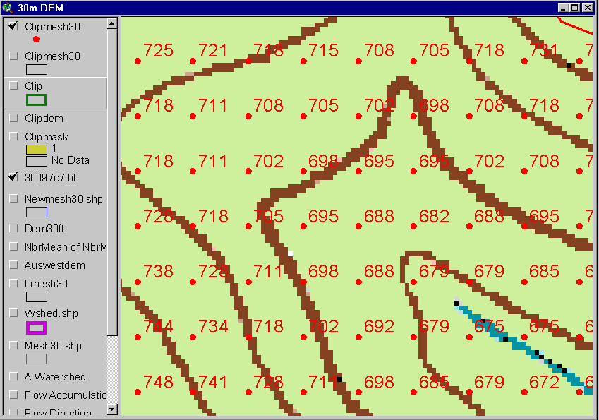
Digital Elevation Model (DEM)
720
720
Contours
740
720
700
680
740
720
700
680

Slide 25
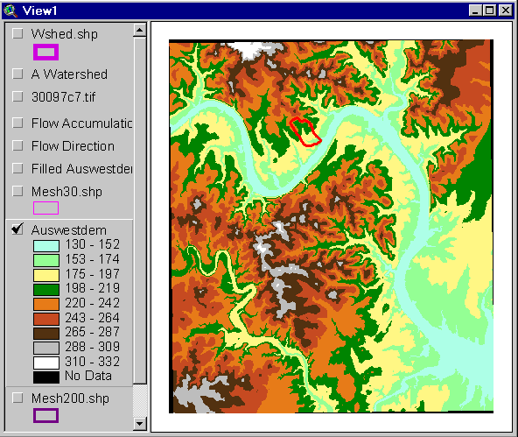
Austin West 30 Meter DEM

Slide 26
Eight Direction Pour Point Model
32
64
128
16
1
8
4
2
Water flows in the direction of steepest descent

Slide 27
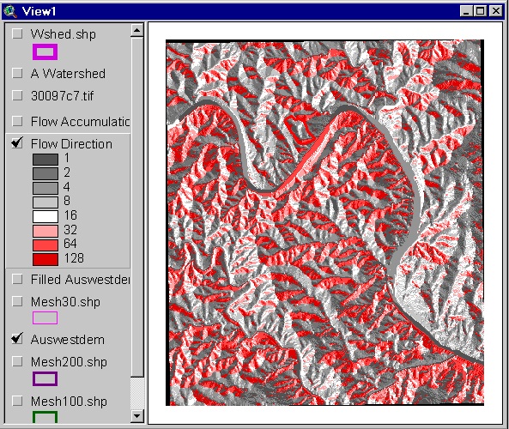
Flow Direction Grid
32
64
128
16
1
8
4
2

Slide 28
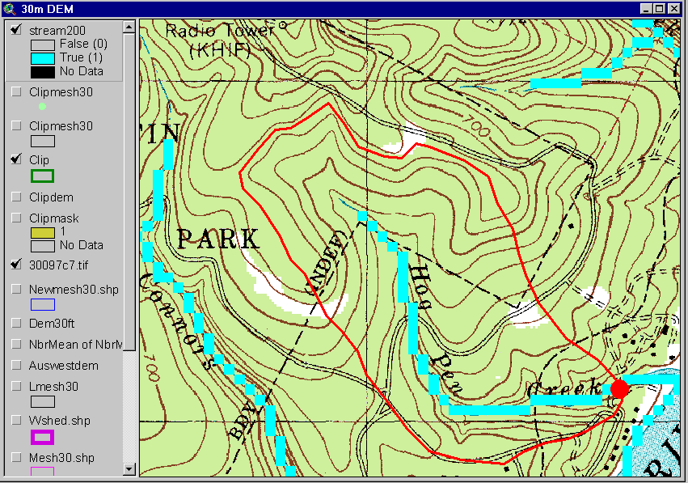
Delineation of Streams and Watersheds on a DEM

Slide 29

http://srtm.usgs.gov/

Slide 30
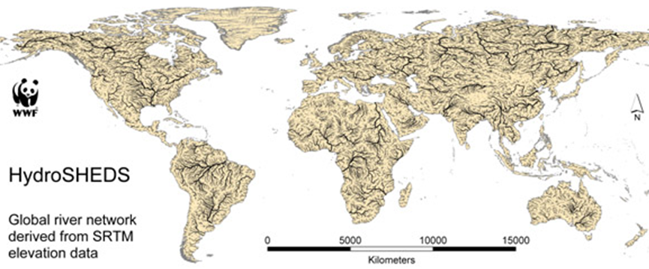
HydroSheds derived from SRTM
http://hydrosheds.cr.usgs.gov/

Slide 31
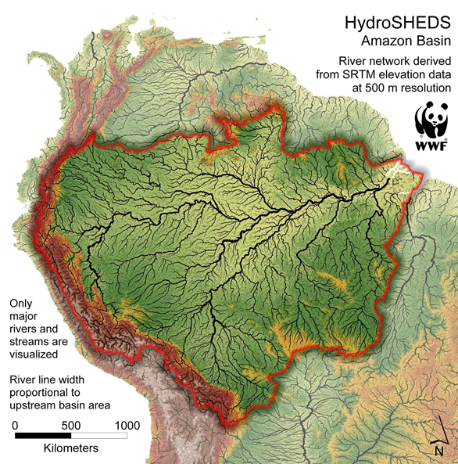

Slide 32
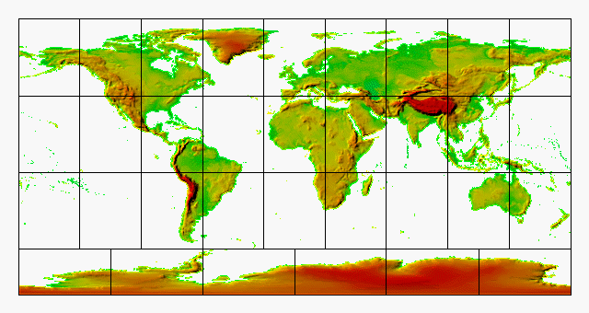
GTOPO30 - 1 km Digital Elevation Model of the Earth
http://eros.usgs.gov/#/Find_Data/Products_and_Data_Available/GTOPO30

Slide 33
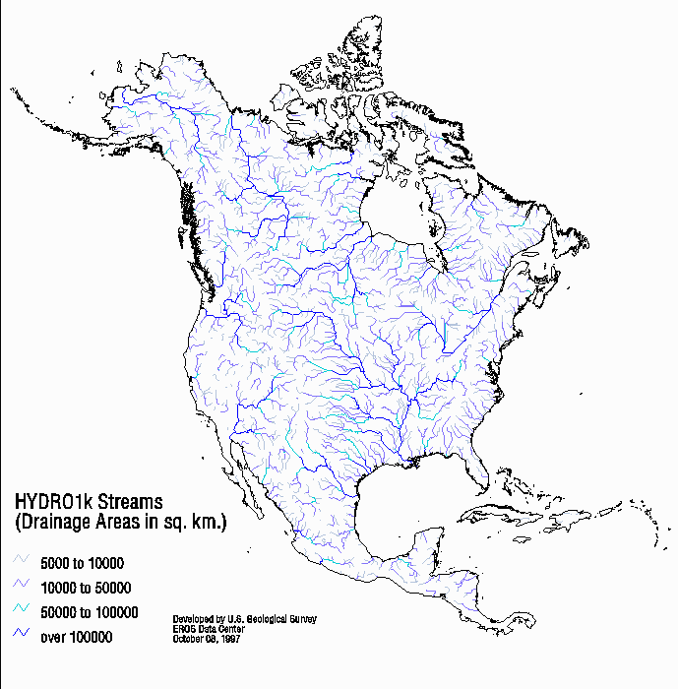
Drainage in North America
Hydro1K is
derived from
GTOPO30
using raster
GIS analysis
http://eros.usgs.gov/#/Find_Data/Products_and_Data_Available/gtopo30/hydro

Slide 34
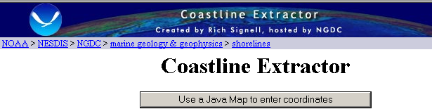
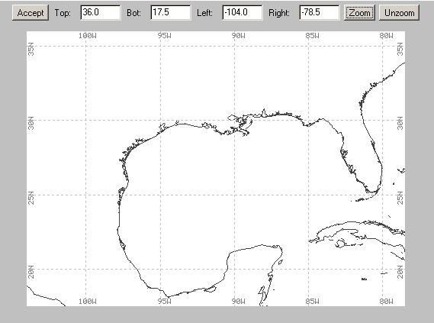
http://www.ngdc.noaa.gov/mgg/coast/

Slide 35

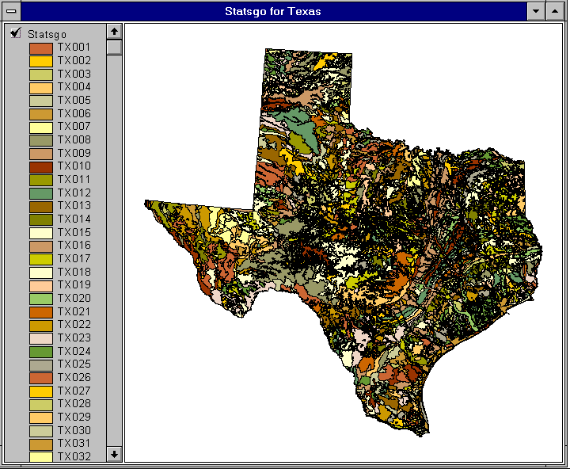

1:250,000 Scale Soil Information
http://www.soils.usda.gov/survey/geography/statsgo/

Slide 36
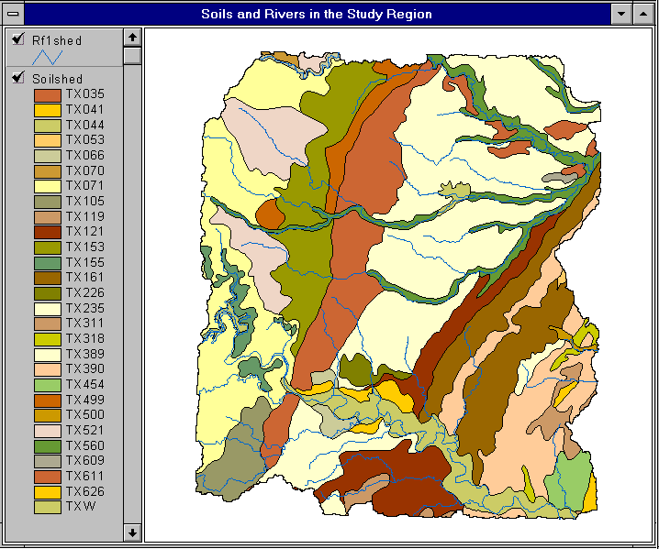

Slide 37
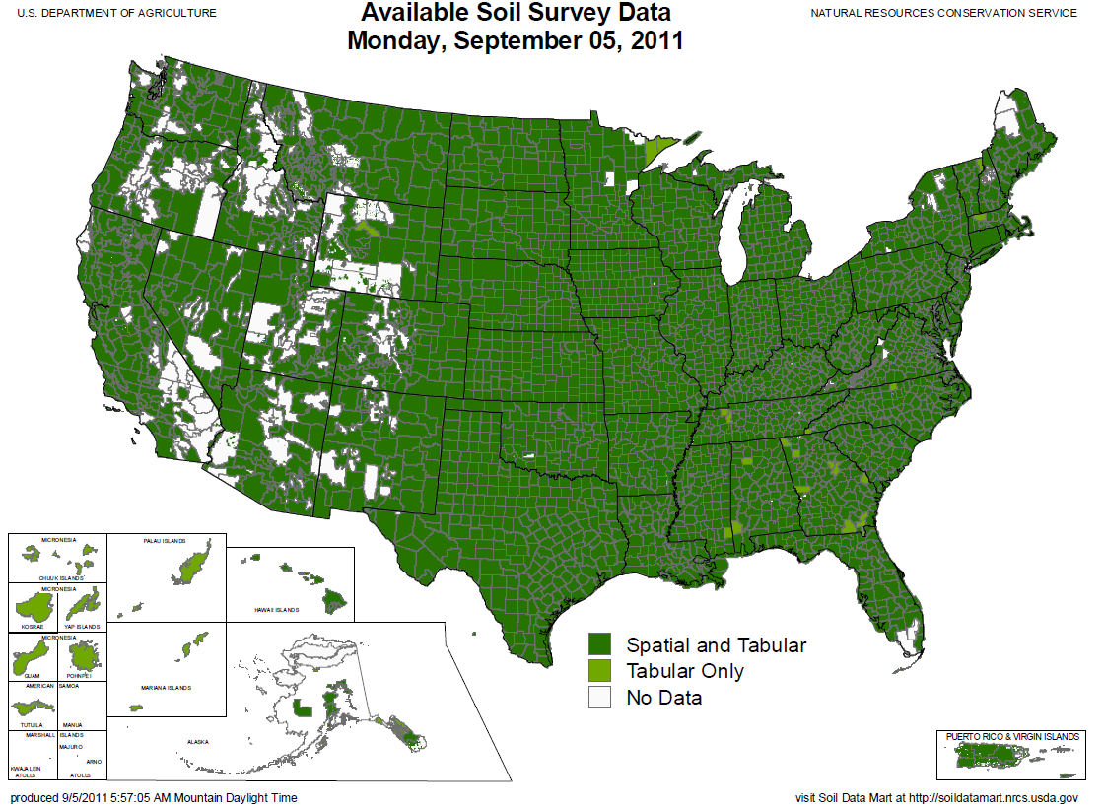
SSURGO:
County Level
Digital Soil Maps
1:24,000 scale
soil information
http://www.soils.usda.gov/survey/geography/ssurgo/

Slide 38
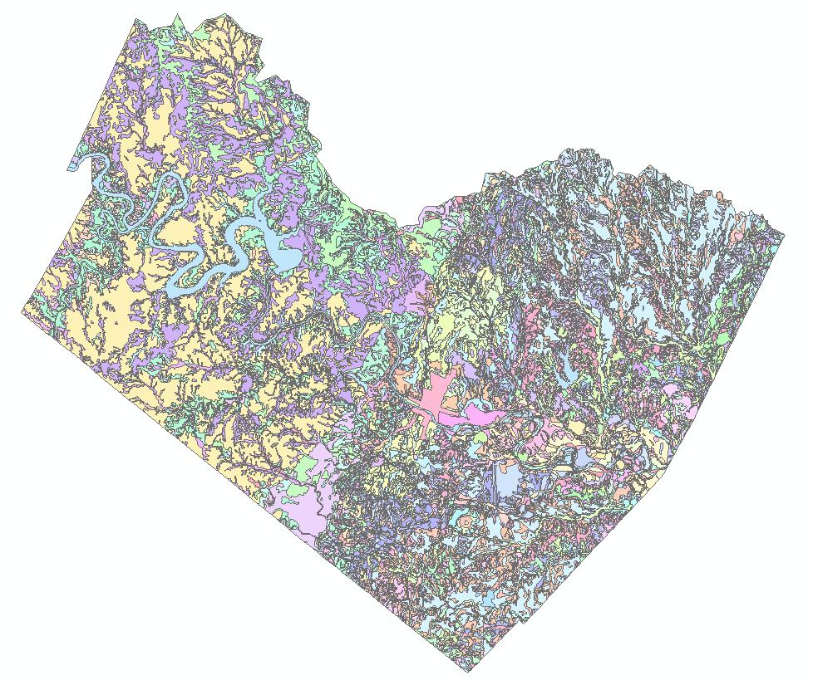
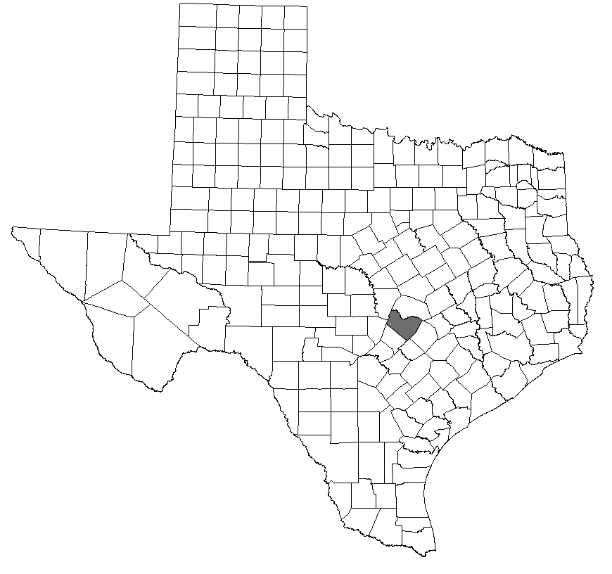
Ssurgo for Travis County
103 soil map units described by 7530 polygons of average area 35.37 ha (87 acres)

Slide 39

http://landcover.usgs.gov/

Slide 40
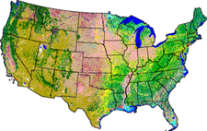
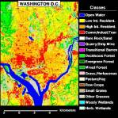
National Land Cover Dataset
Get the data:
http://seamless.usgs.gov/

Slide 41
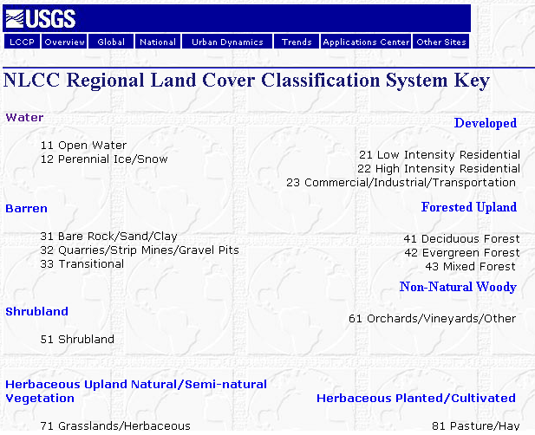

Slide 42

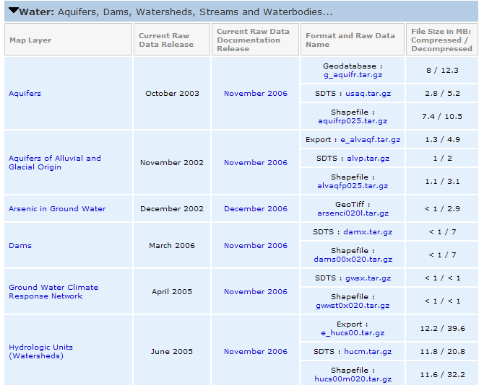
http://www.nationalatlas.gov/atlasftp.html

Slide 43
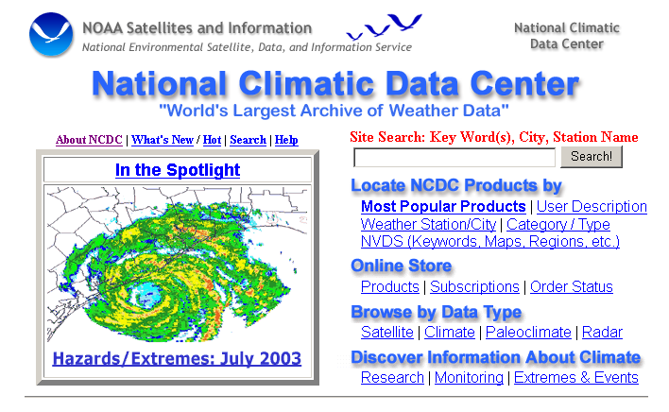
http://www.ncdc.noaa.gov/oa/ncdc.html

Slide 44

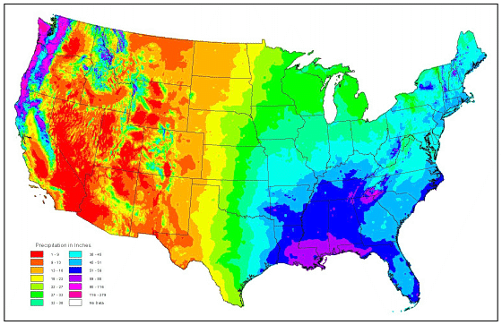
PRISM Mean Annual Precipitation
http://www.wcc.nrcs.usda.gov/climate/prism.html

Slide 45


http://www.daymet.org/

Slide 46

National Water Information System
Web access to USGS water
resources data in real time
http://waterdata.usgs.gov/usa/nwis/

Slide 47


USGS Water Watch
Web access to USGS water resources data in real time
http://waterdata.usgs.gov/nwis/rt

Slide 48


USGS National Water Information System.
Real-time and Historic Data
  Streamflow and stage
  Groundwater levels
  Water Quality
  Site information
Tabular or Graphical Format

Slide 49

NASA Satellite Data
https://lpdaac.usgs.gov/

Slide 50

Global Energy and Water Experiment
http://www.gewex.org/

Slide 51

http://water.weather.gov/ahps/

Slide 52

http://water.weather.gov/ahps/

Slide 53


http://www.wcc.nrcs.usda.gov/snotel/

Slide 54

http://www.cbrfc.noaa.gov

Slide 55

CBRFC SNOTEL Ensemble
http://www.cbrfc.noaa.gov/station/sweplot/sweplot.cgi?tglu1

Slide 56

http://www.arcgis.com

Slide 57



Slide 58

http://gis.utah.gov

Slide 59

Utah Terrain Basemap
To use as a basemap in ArcGIS see instructions at
http://gis.utah.gov/map-services/new-utah-terrain-base-map-and-cached-tile-service-available

Slide 60

Utah GIS Portal Download GIS Data
http://gis.utah.gov/download

Slide 61

http://geology.utah.gov/maps/gis/index.htm

Slide 62

http://www.wrcc.dri.edu/

Slide 63

http://dnr.ne.gov/databank/geospatial.html

Slide 64

http://dnr.ne.gov/databank/spat.html

Slide 65

“National Map” in Nebraska
http://nmviewogc.cr.usgs.gov/viewer.htm?bbox=-104.5,39.5,-95,43.5

Slide 66

http://nebraskaview.unl.edu/neview02.php

Slide 67

http://drought.unl.edu/

