Slide 1
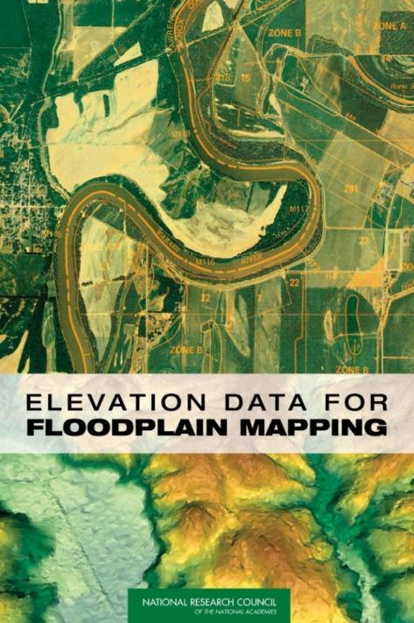
Elevation Data for Floodplain Mapping
David R. Maidment
GIS In Water Resources
Fall 2011

Slide 2
National Academy Reports
The National Research Council is the operating arm of the National Academy of Sciences, National Academy of Engineering, and the Institute of Medicine
chartered by Congress in 1863 to advise the government on matters of science and technology.
Voluntary service by Committee members
Very rigorous review of reports
The “supreme court” of academic science

Slide 3
Committee Membership
DAVID R. MAIDMENT, Chair, University of Texas, Austin
SCOTT EDELMAN, Watershed Concepts, Greensboro, North Carolina
ELVIN R. HEIBERG III, Heiberg Associates, Inc., Arlington, Virginia
JOHN R. JENSEN, University of South Carolina, Columbia
DAVID F. MAUNE, Dewberry and Davis, Fairfax, Virginia
KAREN SCHUCKMAN, URS Corporation, Gaithersburg, Maryland
RAMESH SHRESTHA, University of Florida, Gainesville
National Research Council Staff
ELIZABETH A. EIDE, Study Director
JARED P. ENO, Senior Project Assistant

Slide 4
National Flood Insurance Program
Begun in 1968
Federal government provides a national flood insurance program
Local communities regulate land development in floodplains
Requires floodplain maps
  Base Flood Elevation for 100 year flood is the key
  Keep building floor elevations above this level
  Keep building out of 100 year inundated area

Slide 5
Background I
The NFIP and the flood maps associated with it provide an alternative to federal disaster assistance to reduce the costs of repairing damage caused by floods and are used by communities for land planning to avoid flood damages.
FEMA is conducting an ambitious 5-year program (2003-2008) to update old, paper FIRMs to digital FIRMs (DFIRMs) in a ‘Flood Map Modernization Program’.
FEMA’s Flood Map Modernization program is nationally supported with a budget of $200 million per year ($1billion federal funds over 5 years, plus state and local funds)

Slide 6
Background II
Concerns have been expressed to Congress that the underlying base map information for the flood mapping process is not of adequate quality to properly support the new digital flood map creation.
Various technologies can be used to generate the base map information used in floodplain maps.
This study was commissioned by the National Academies for the purpose of informing Congress and the nation about these technologies and their ability to support DFIRM creation.

Slide 7
Statement of Task
1. Identify the current mapping technologies being used by FEMA to develop flood hazard maps;
2. Identify mapping technologies that are currently available; and
3. Determine if newer technologies are appropriate and would be of additional benefit to floodplain mapping.

Slide 8
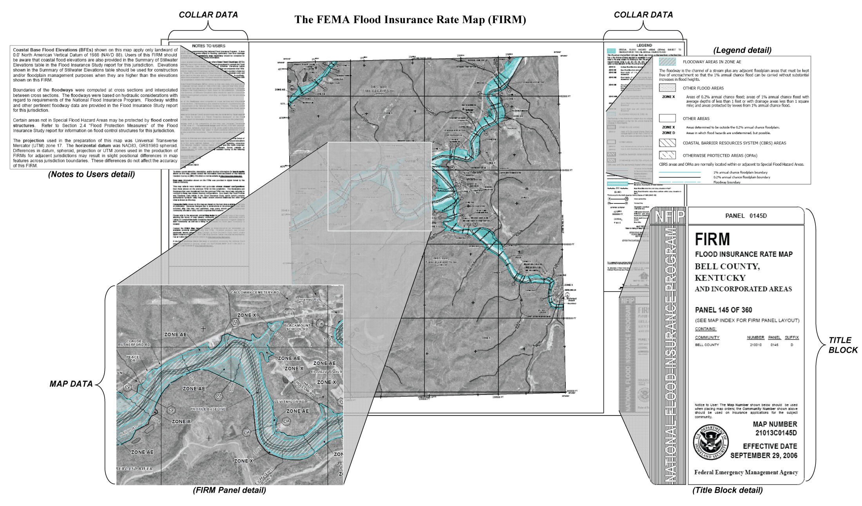
FEMA Floodplain Map

Slide 9
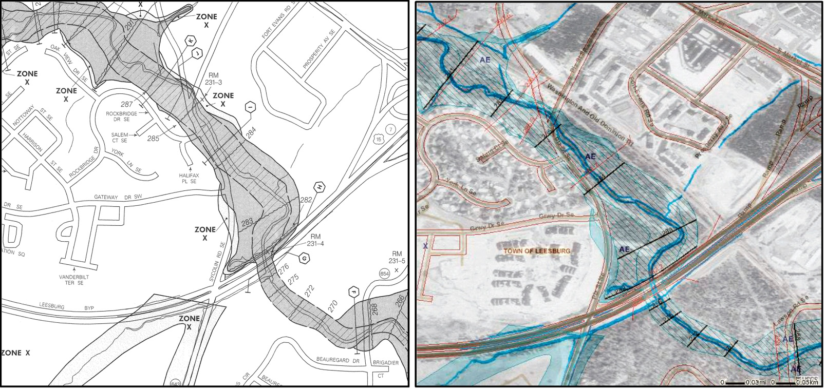
Old, paper FIRM
New, digital (D)FIRM
- The conversion from FIRMs to DFIRMs was intended to create national, digital floodplain map coverage
- The ideal DFIRM: more accurate than paper FIRM, more flexible to use and update, more versatile for community use

Slide 10
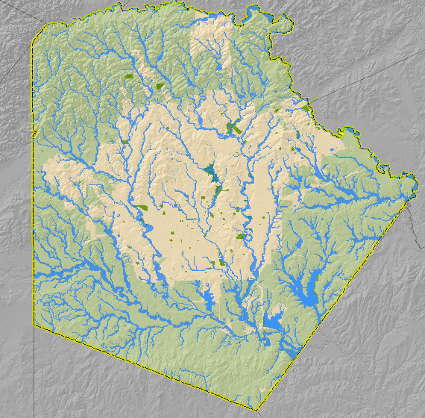
Map Showing Inundation in Bexar County, Texas

Slide 11
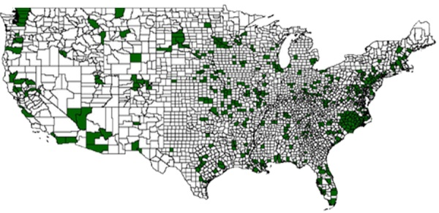
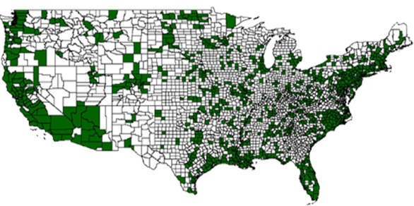
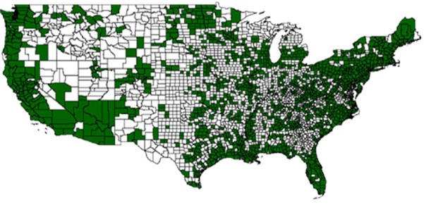
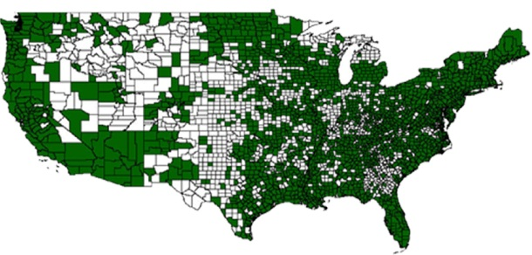
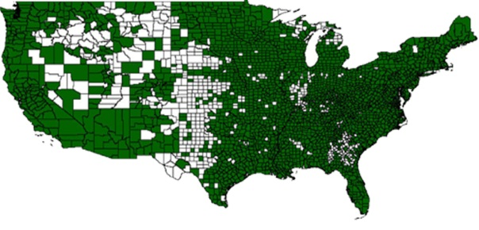
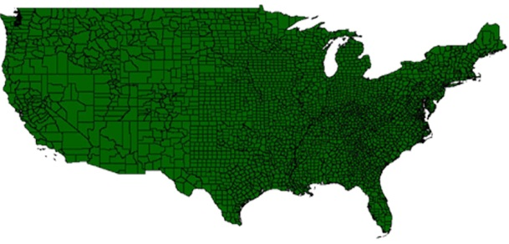
Flood Map Modernization (as of 2005)
Federal Emergency Management Agency (FEMA), embarked on Map Modernization to update the Nation’s flood hazard maps.
2004
2005
2006
2007
2008
2009
Slide: Paul Rooney, FEMA

Slide 12
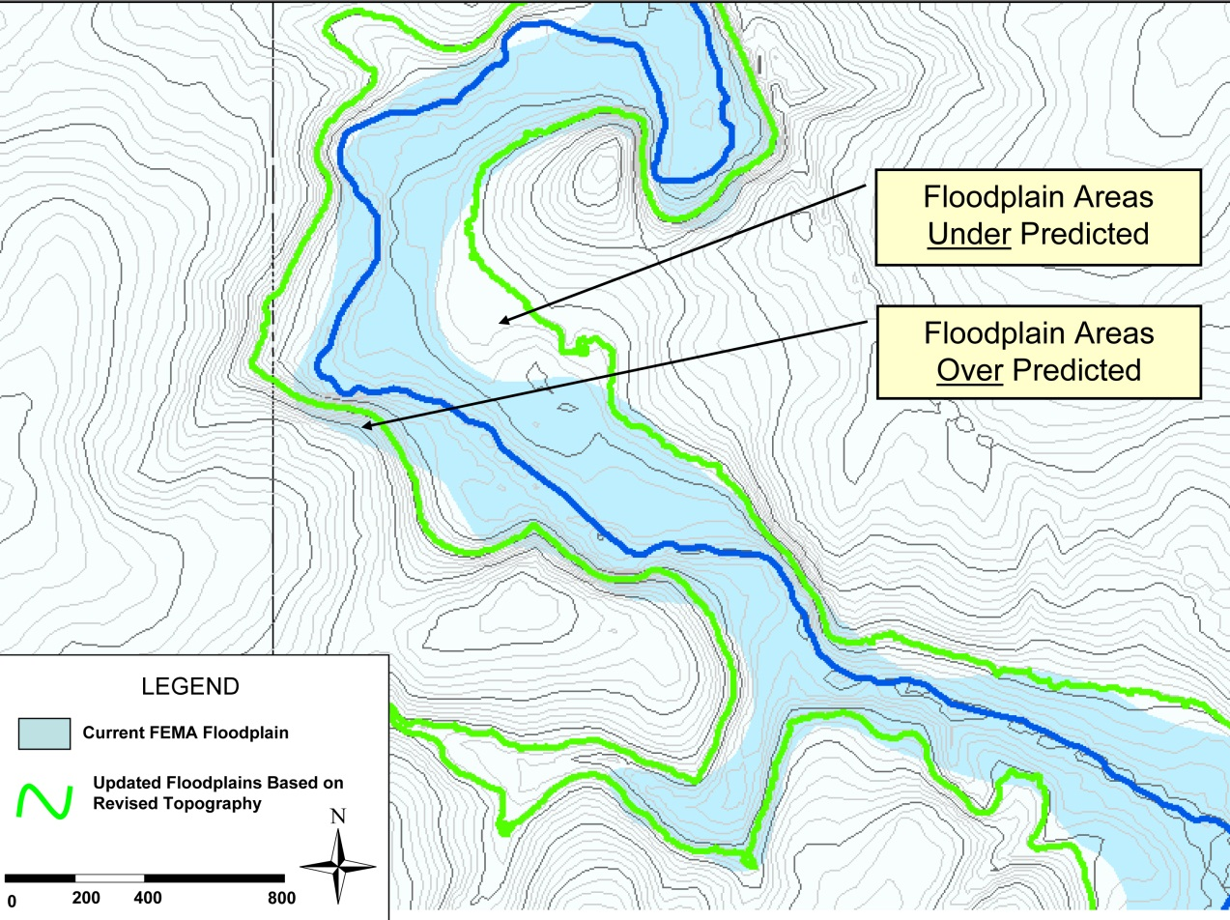
Base Elevation Data in Detail
New elevation data typically change the areas defined as flood prone. Some areas previously under predicted are now added to the special flood hazard areas, whereas other areas previously over predicted are now removed from the special flood hazard areas.

Slide 13
Map Modernization “Study Types”
Traditional Detailed Study (~$20,000/stream mile)
Automated Studies
  Enhanced Approximate Study
  Approximate Study (~$500/stream mile)
Redelineation: Re-mapping on revised topographic data
Notes:
Frame this that terrain data is the “backbone” of everything we do as mapping partners
I will review an overview of 3 types of study that we use the terrain data for to produce FEMA’s maps

Slide 14
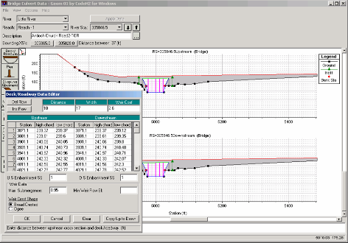
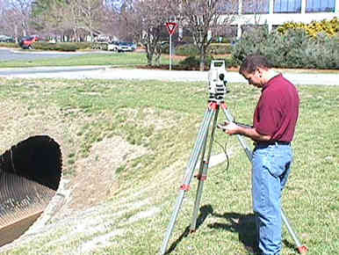
Detailed Study
Traditional Model Development
Most Extensive Model Development
Include Large Amount of Field Survey for model input development
Floodway Computation
Detailed Mapping/Reporting Information in Flood Insurance Study
Notes:
Talk about this being the most extensive of all modeling
Heavy on the field work causes the cost of this model to increase
Survey bridges
Culverts
Cross sections of floodplain valleys
Walking stream for roughness coefficinets
Interviewing residents for high water marks
Blending all this survey and field data together into a working model
Floodway is computed
Detailed mapping and model results in the FIS

Slide 15
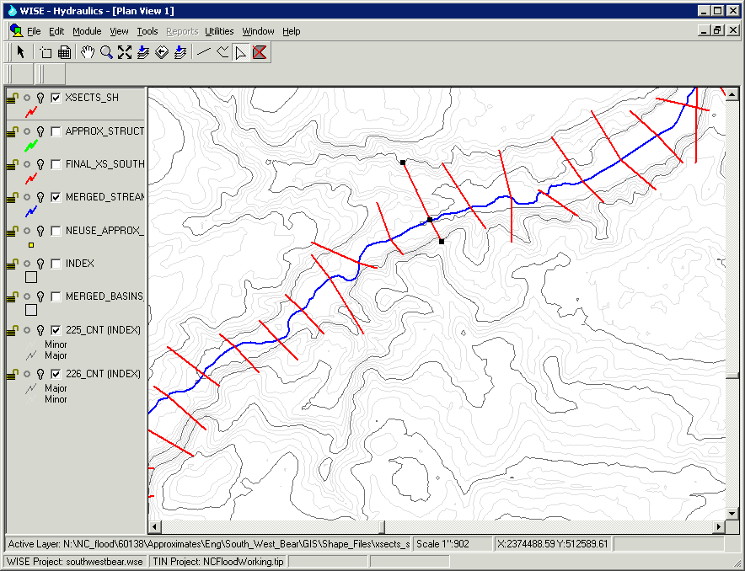
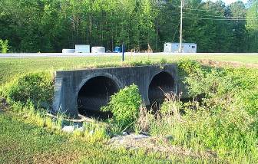
Enhanced Approximate Study
Partially Automated Model Development
Replaces Unnumbered A Zones with floodplains that match the topo
Engineering Models Developed for Streams
Some field measurements made of crossings
Base Flood Elevations may be shown on published maps
Approximately 1/10th the cost of Detailed Study
Dependant on quality of topo data
Notes:
a.k.a. Limited Detail Study
Newer technology has allowed mapping partners to eliminate much of the field work
Measurements are now made instead of true survey
Final product is very close to that of detailed stdy
Costs are lower and more miles of stream can be studied
This is HIGHLY dependant on the accuracy of the topo data used to develop the model

Slide 16
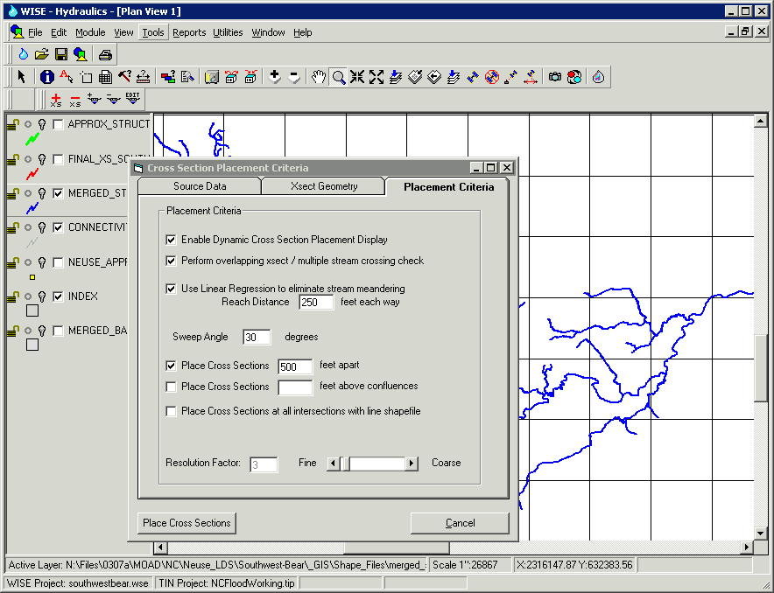
Approximate Study
Mostly Automated Model Development
Improves unnumbered A Zones with floodplains that match the topo
Based on existing topographic data
Limited Model Review / Modifications by Engineer
Base Flood Elevations typically are not shown on maps
Dependant on quality of topo data
Notes:
Mostly automated
Improves spatial quality of the A zones
Models are developed that can be modified later

Slide 17
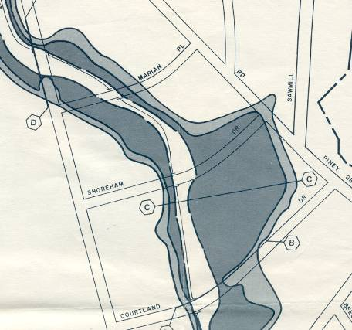
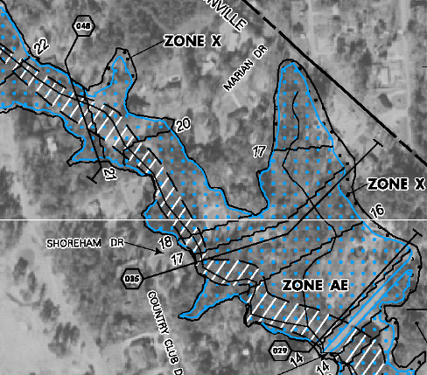
Redelineation of Effective Studies
Based on New Topographic Data
OLD
NEW
Notes:
Explain differences in these two maps
Show differences in quality and accuracy in the maps
Highlight
Old map shows only roads
New map shows streets, homes, driveways, treelines etc
User can find their house

Slide 18
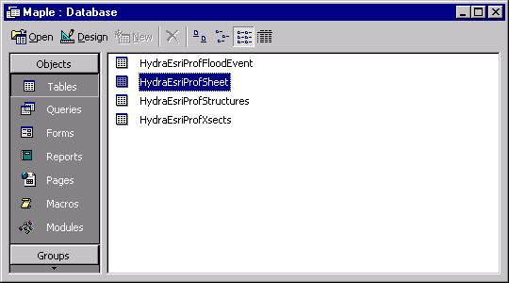
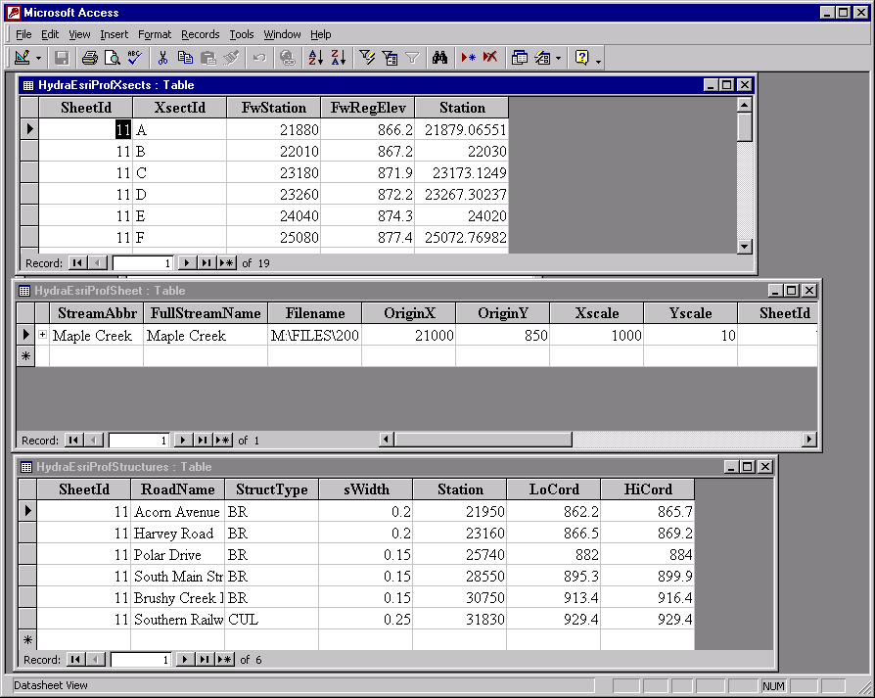
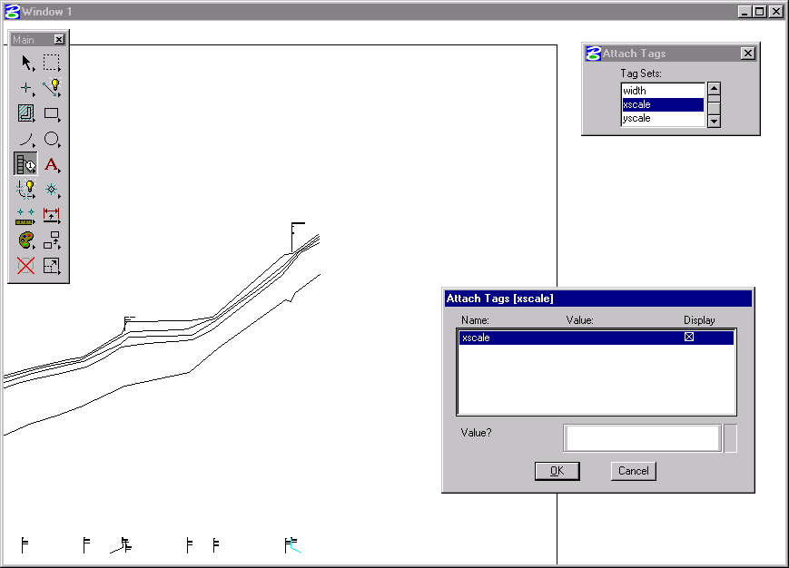
Redelineation of Effective Studies
Based on New Topographic Data
Used to Update Effective Mapping with new Terrain Data
No new engineering analysis – community scoping shows no new study needed
Datum Conversion
Foundation is the FEMA Profile
Floodways and Cross Sections are Digitized
New Floodplains match best available topo
Notes:
Stress
These are areas where scoping did not show that a new study was needed and community was in acceptance of current flood elevations
New floodplains now MATCH best available data which is much better for floodplain management

Slide 19
Progress to June 2005
The nation has about 4.2 million miles of riverine streams and about 60,000 miles of coastlines
About 1 million river miles are on federal lands – no flood insurance
As of June 2005 ~ 1 million miles had been mapped
  ¼ (247,000 stream miles) showing Base Flood Elevations (BFEs) (detailed studies)
  ¾ (745,000 stream miles) not showing BFE’s (approximate studies using existing topographic data)

Slide 20
Map Mod MidCourse Correction
Rather than attempting to cover all the nation with updated flood maps, focus on 65% of the nation’s land area containing 92% of the population
Implement a floodplain boundary standard which ensures alignment of flood map with existing topographic data

Slide 21
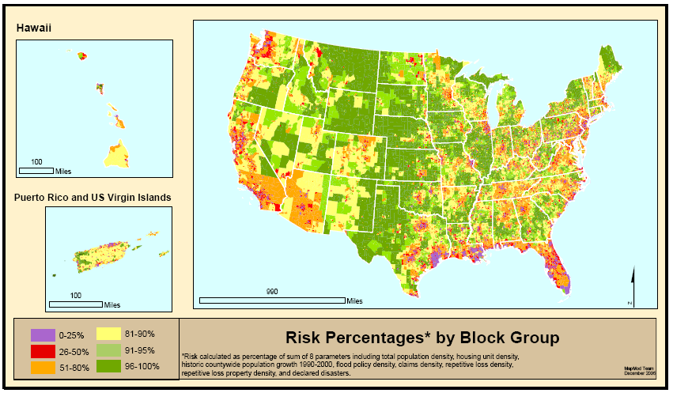
Where is Risk the Greatest?
Source: Scott Edelman (Watershed Concepts)
Notes:
Risk here is where floods and people are in general proximity (or will be)
Risk parameters for block groups
Population, population growth, housing units
Claims, repetitive losses, policies
Flood Disaster declarations (From county distribution)
We aggregate this information to a FEMA Regional level and allocate the majority of the appropriated map mod funding to the Regions who work with their state and local partners to develop flood production schedules at the county level.
All of this is explained in great detail in the Multi-Year Flood Hazard Identification Plan, which is published at least once a year.
Hard around the edges and somewhat softer in the middle.

Slide 22
Floodplain Boundary Standard
Compares ground elevation at floodplain boundary and computed flood elevation for different risk classes
It is NOT: a topo standard or a BFE accuracy requirement. Does not dictate zone type.
Not good
Good

Slide 23
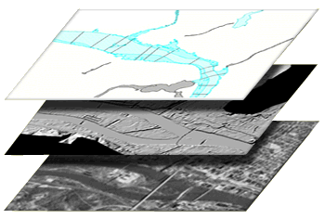
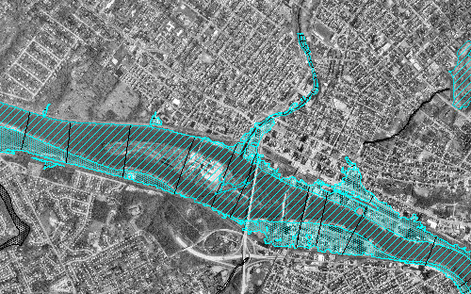
Flood Map Production Process –
Data Development
Flood Data
Topography
Base
Digital Map
Two key inputs:
base map imagery and vector line work
topography – land surface elevation

Slide 24
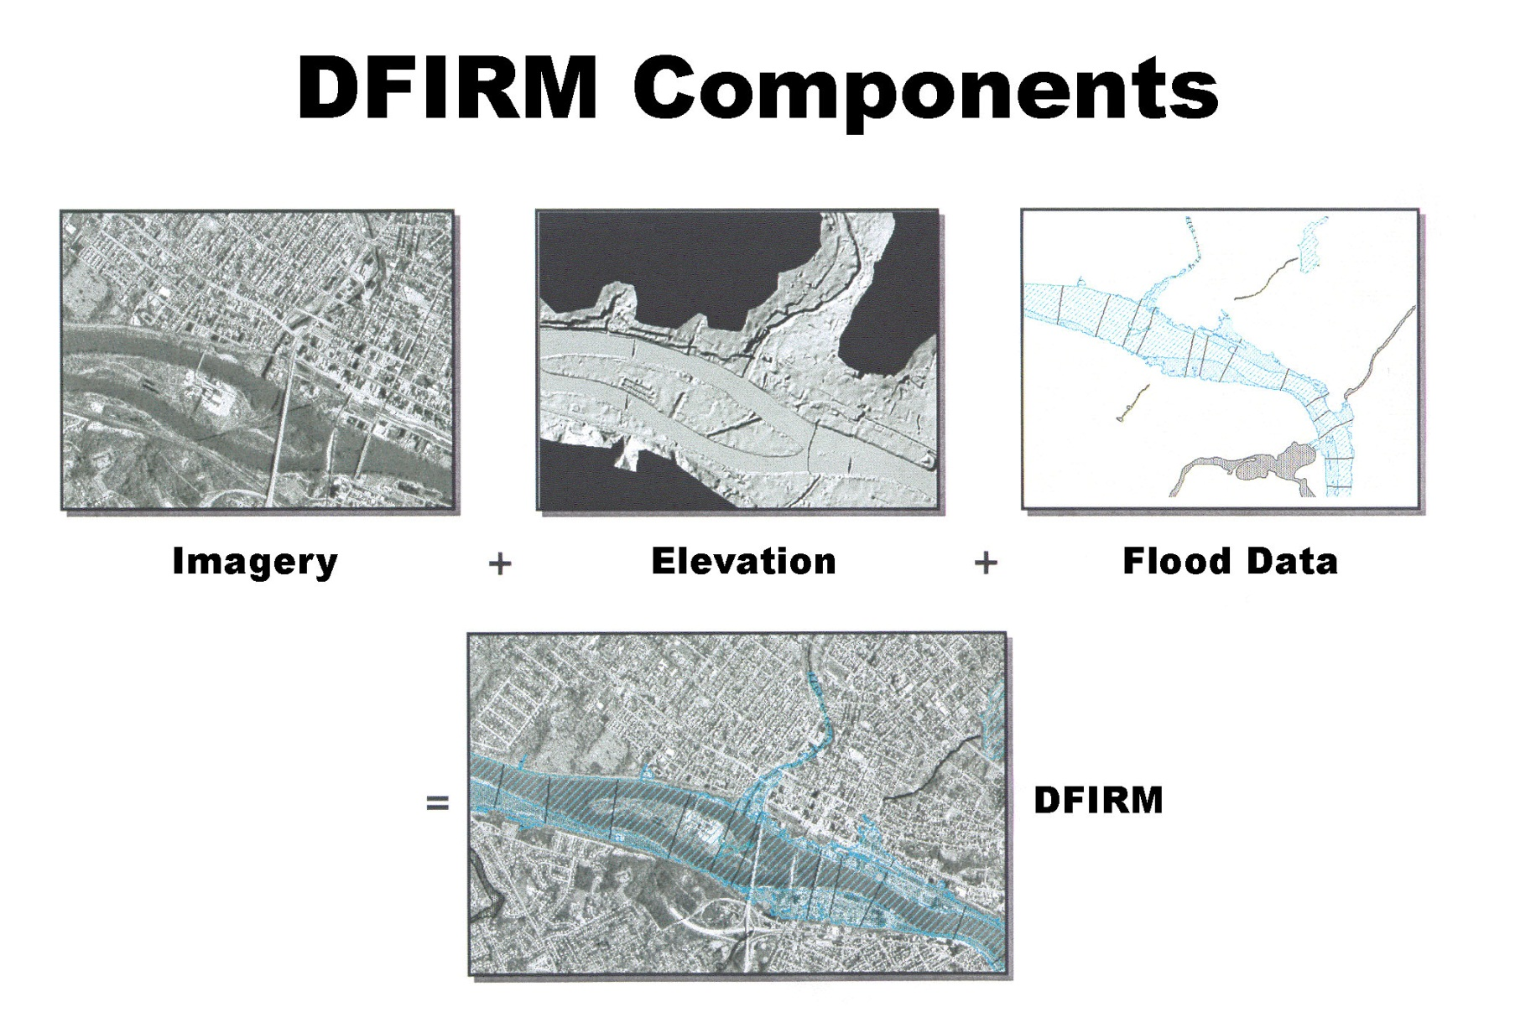
‘Base map information’
*
This study addressed the technologies producing Imagery and Elevation data components of the DFIRM
*New, 2-year NRC study sponsored by FEMA will look at Flood Map Accuracy and include analysis of Flood Data component of the DFIRM

Slide 25
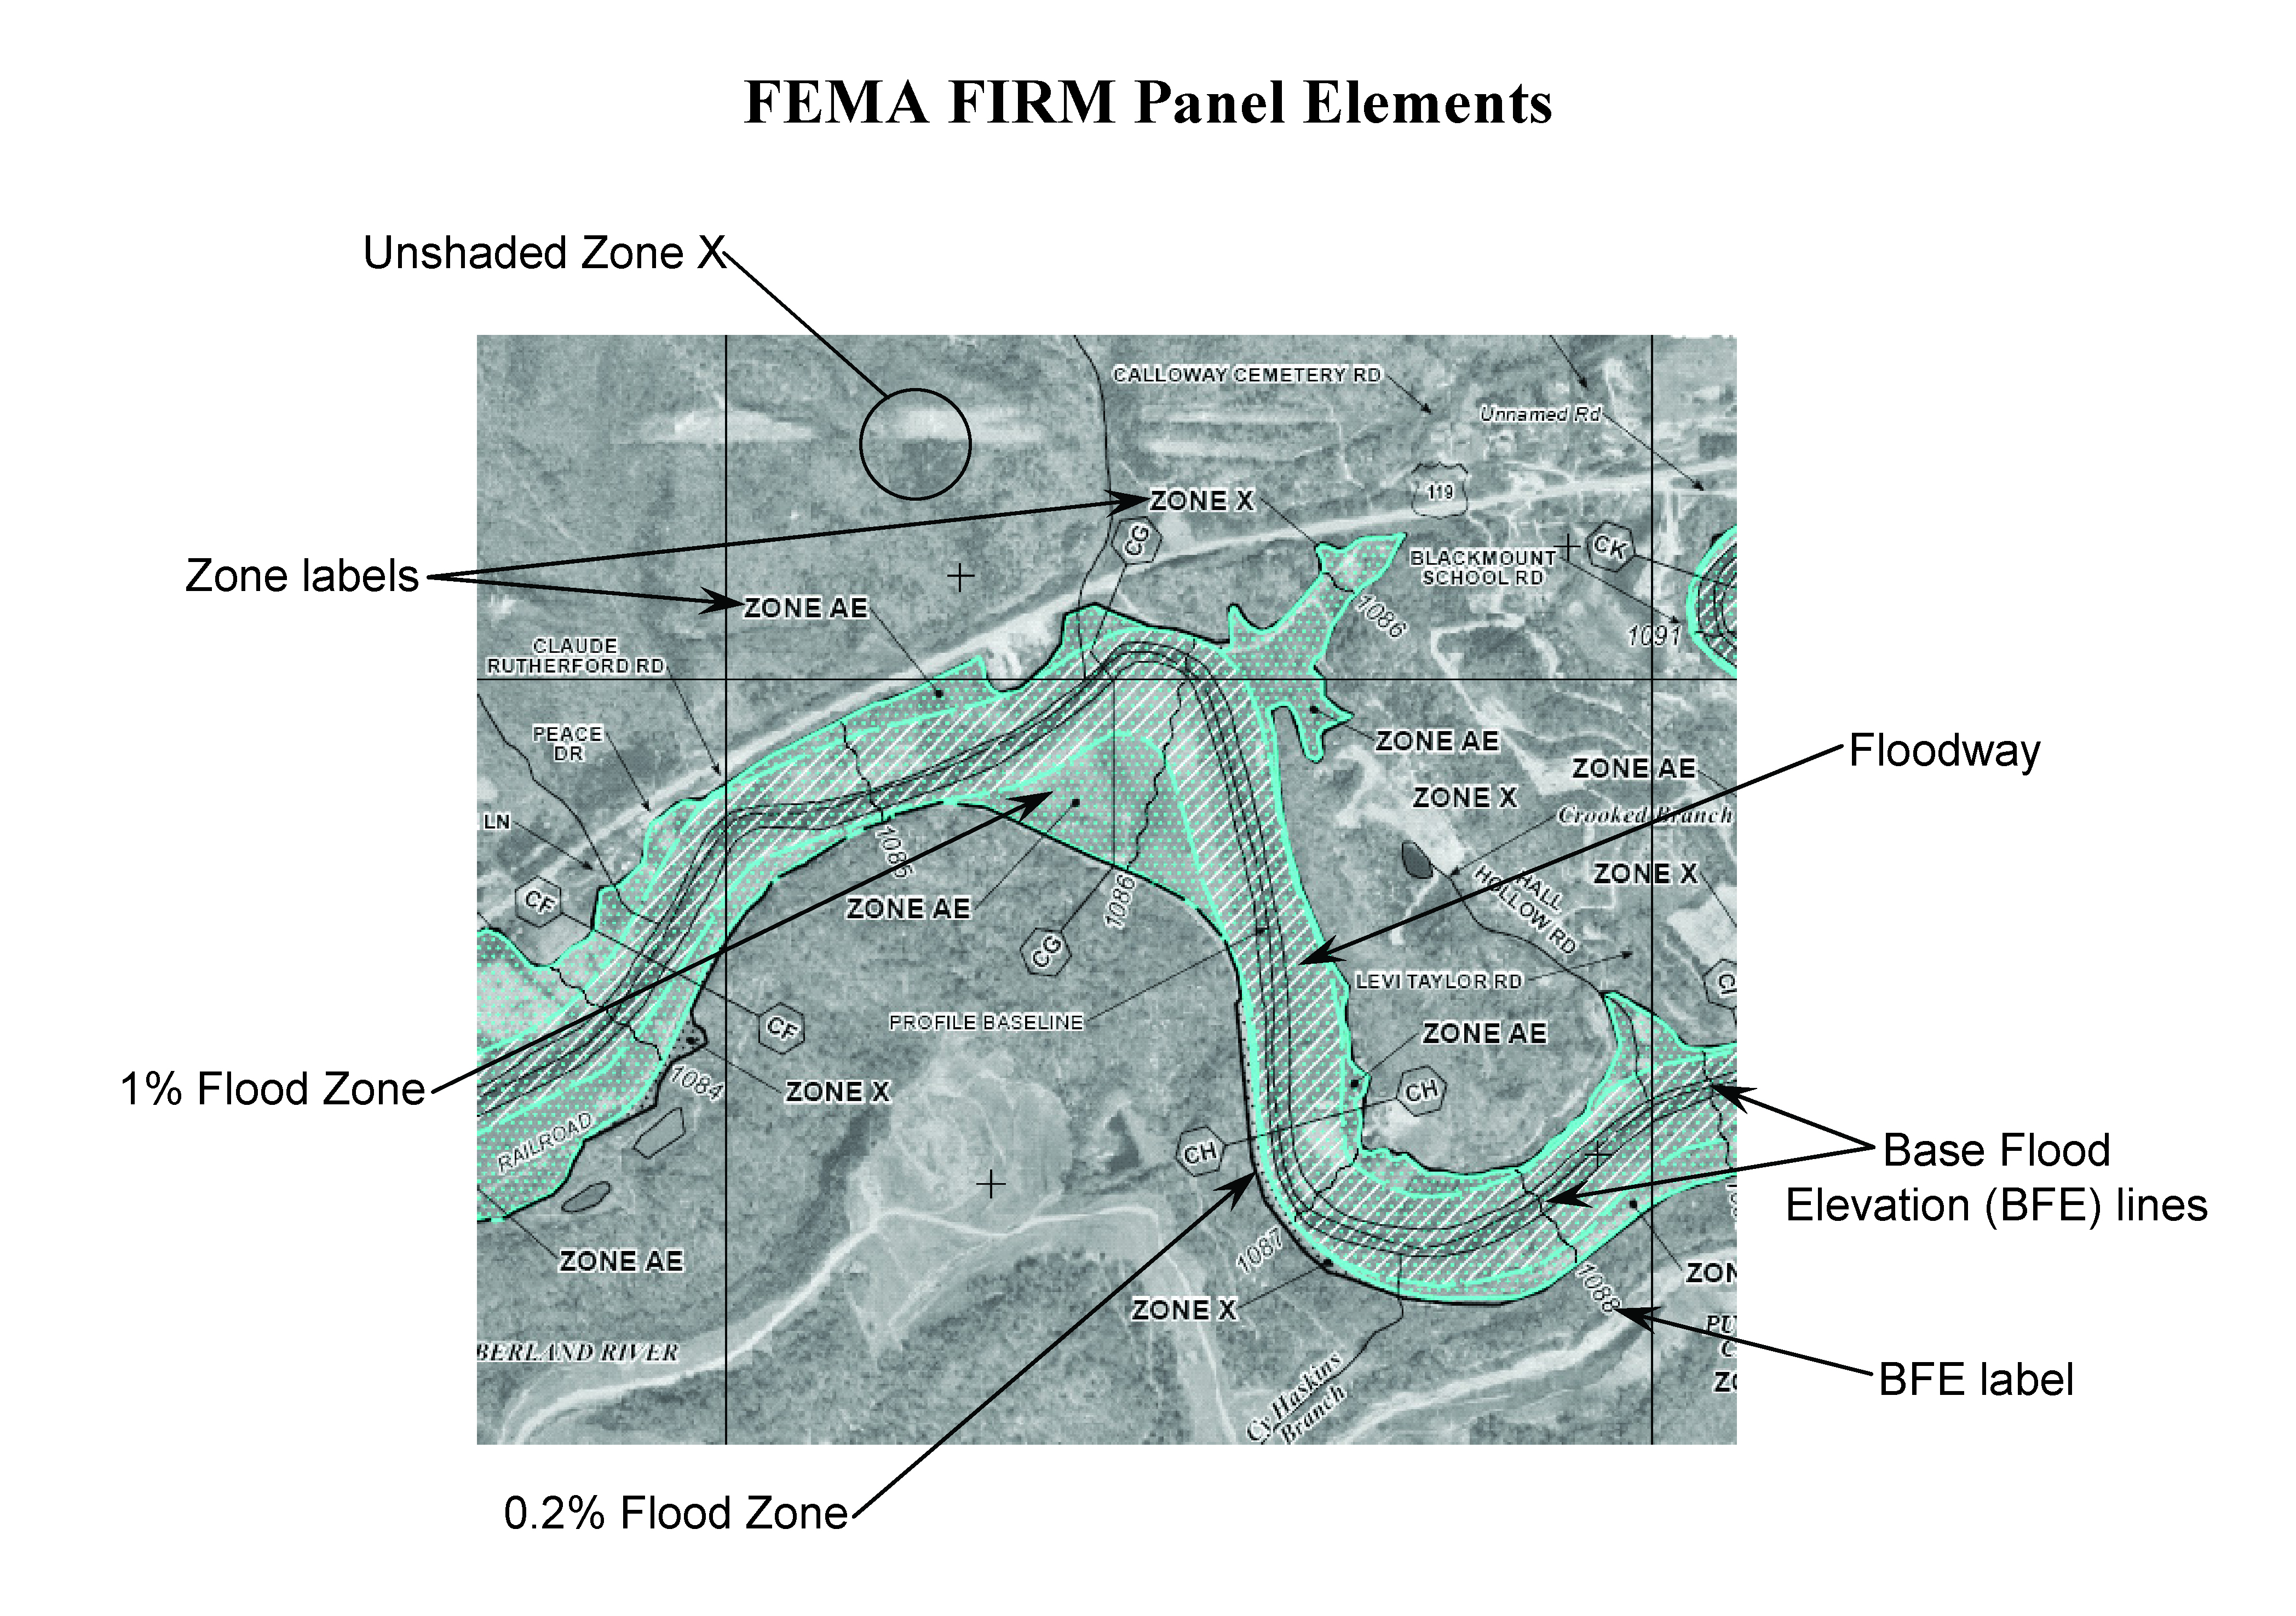
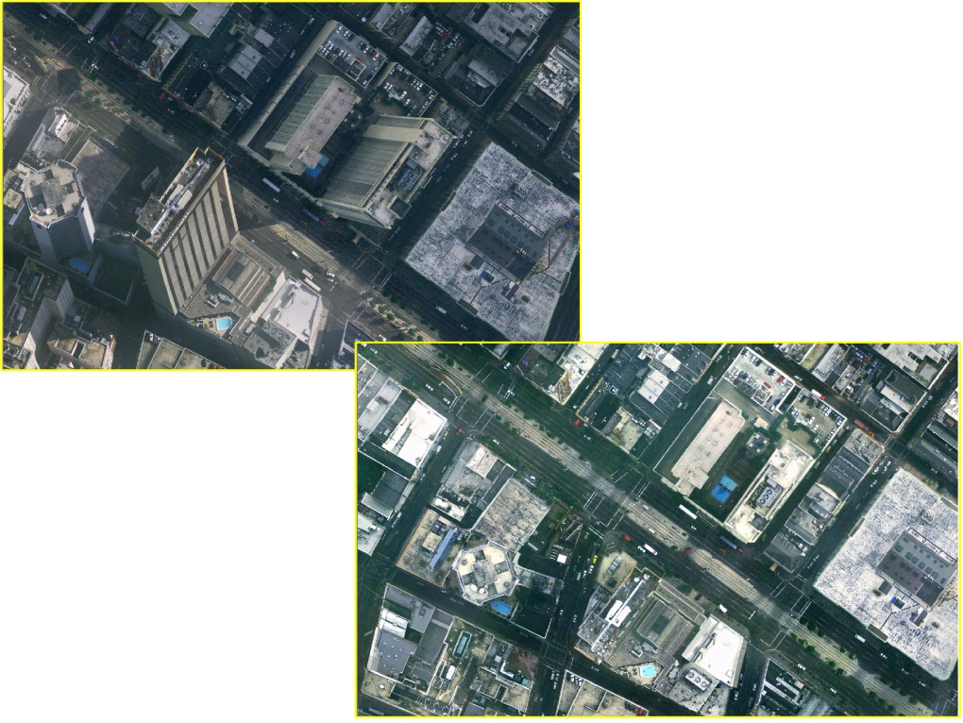
Base Imagery in Detail
Digital orthophotos show two-dimensional features like roads, buildings, vegetation, and rivers,
Photogrammetry is mature
Orthophotos are the ideal base imagery for FEMA Map Modernization purposes

Slide 26
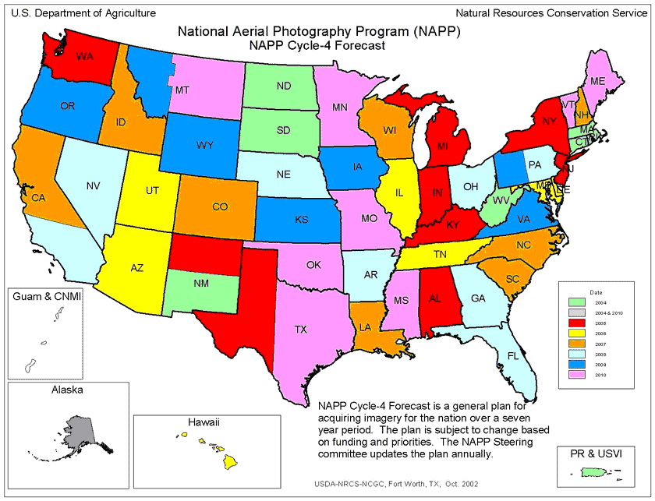
National Base Imagery
USGS and USDA each host digital orthophoto programs, National Aerial Photography Program (NAPP) & National Agricultural Imagery Program (NAIP), and are part of larger federal consortium, National Digital Orthophoto Program (NDOP)
Imagery for the Nation, a collaborative initiative at federal level, currently unfunded, could make nationwide orthophoto coverage available publicly with set standards for collection, distribution and archiving

Slide 27
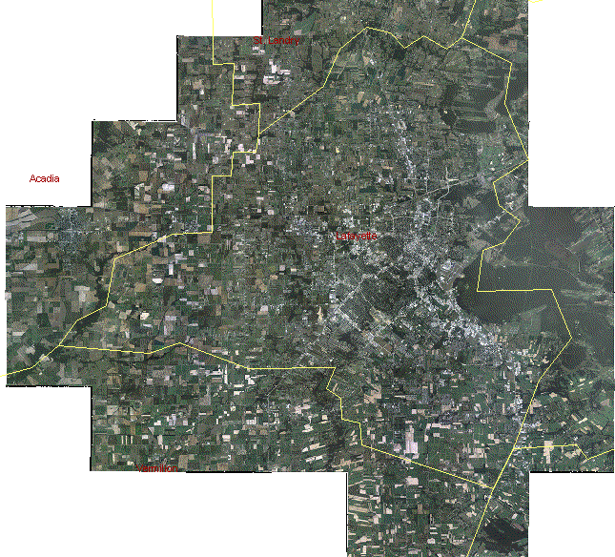
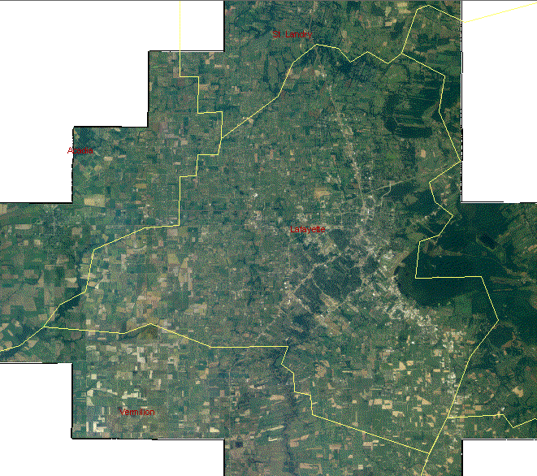
National Agricultural Imagery for Lafayette Parish, LA
2005
2004
NAIP: A new image for
each county each year
IMAGERY READY
TO USE

Slide 28
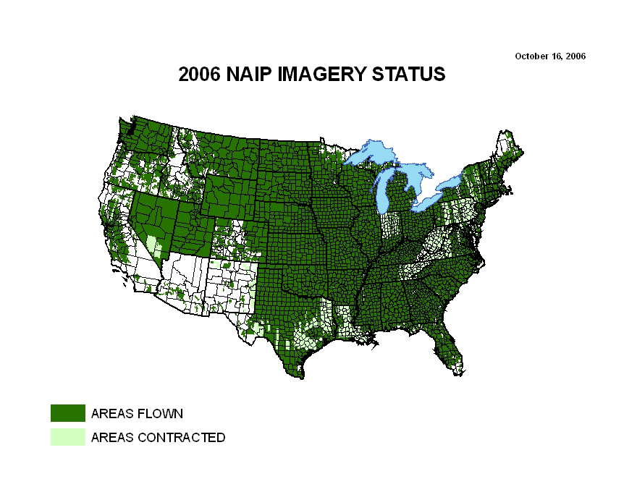
Notes:
Updated status map:
http://www.fsa.usda.gov/Internet/FSA_Image/naip06progress2.gif

Slide 29
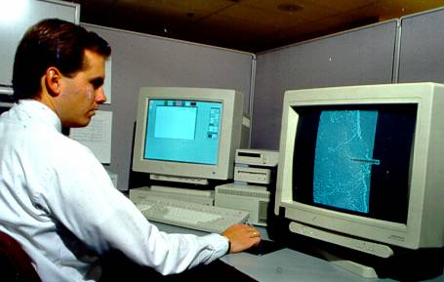
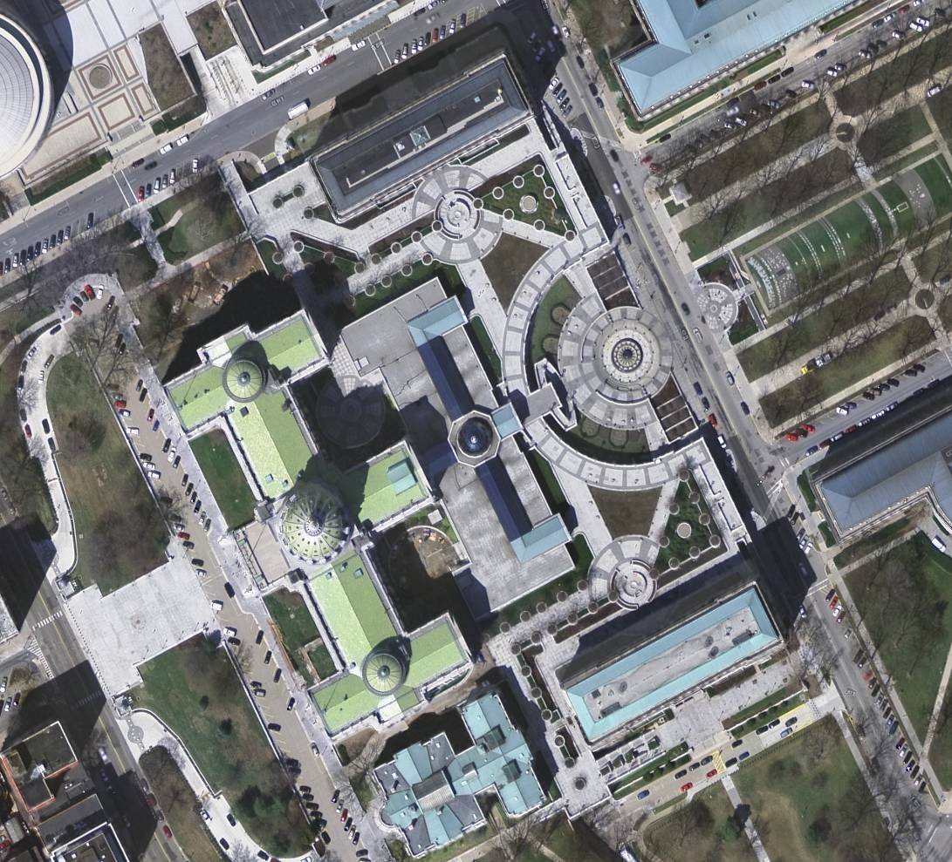
Base Elevation Data in Detail—Photogrammetry
Photogrammetry can also be used to produce bare-earth digital elevation models, but the process is expensive, labor intensive, and therefore inappropriate for a national program

Slide 30

Elevation Data in Detail—Photogrammetry
Photogrammetry uses multiple views of the same point on the ground from two (stereo) perspectives to create 3-D point measurements, including DEMs
Strength: Best for generation of breaklines for edges such as shorelines, tops & bottoms of stream banks, etc.
Weakness: Vegetation blocks stereo views necessary to map the bare earth terrain in forests and heavily vegetated areas

Slide 31
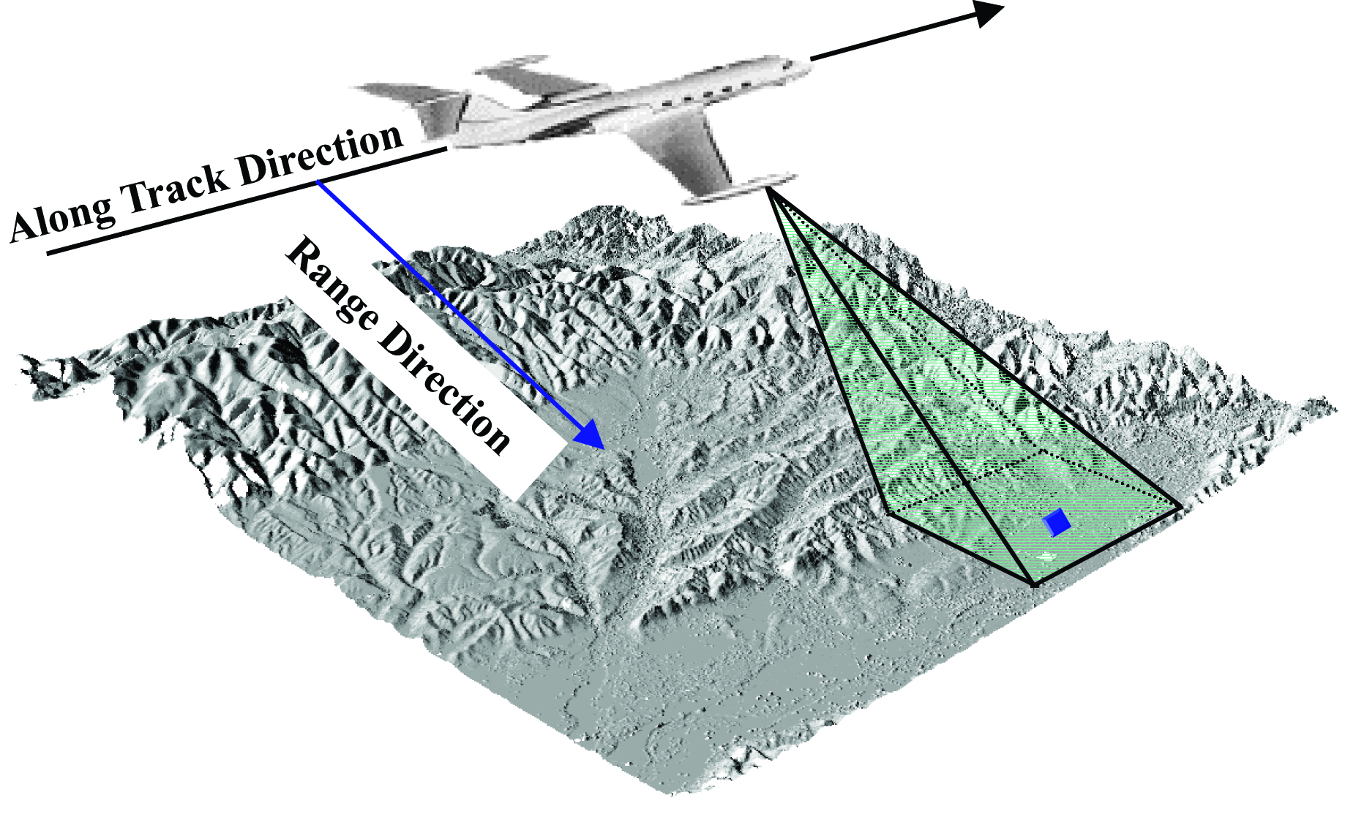
Base Elevation Data in Detail—
InterFerometric Synthetic Aperture Radar (IFSAR)
Uses microwave signal and radar antenna (measures echoes back from ground)—’sees’ roughness of surfaces
Advantage: Can be used in cloudy conditions, night/day, and relatively low cost
Disadvantage: Does not satisfy FEMA accuracy requirements; poorest along vegetated stream banks

Slide 32
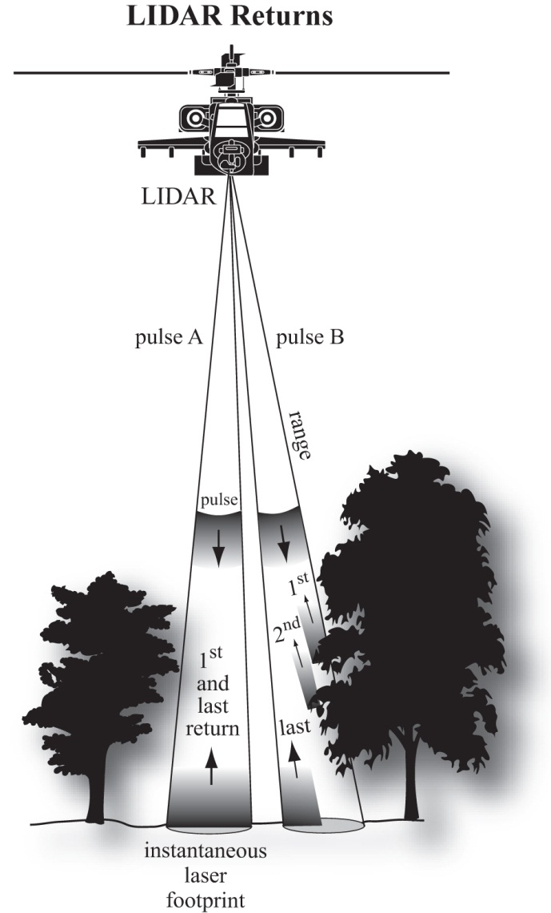
Base Elevation Data in Detail—
Light Detection and Ranging (lidar)
Lidar uses single laser pulses to see through or between the trees to create thousands of 3-D point measurements per second
Advantage: The most accurate method for mapping the bare-earth terrain in vegetated areas
Disadvantage: Poor for generation of breaklines for edges such as shorelines, tops & bottoms of stream banks,

Slide 33

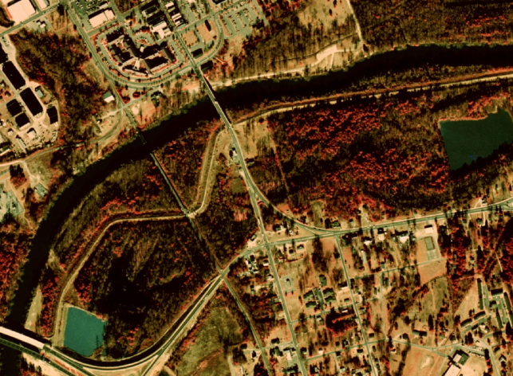
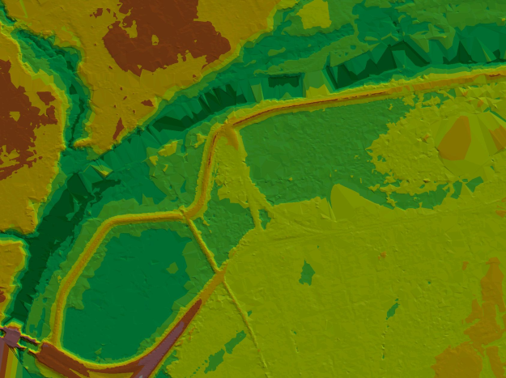
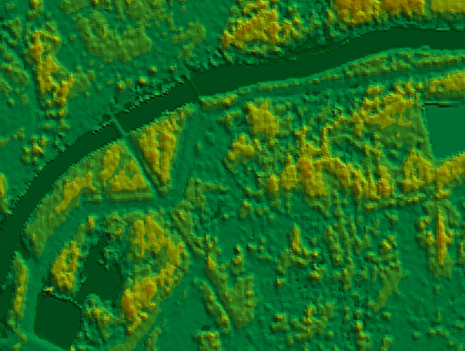
Base Elevation Data in Detail—
Strengths and Weaknesses Compared
Digital elevation model from National Elevation Dataset
Photogrammetry/digital orthophoto
Digital elevation model from lidar
Digital elevation model from IFSAR

Slide 34
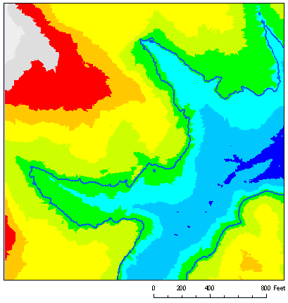
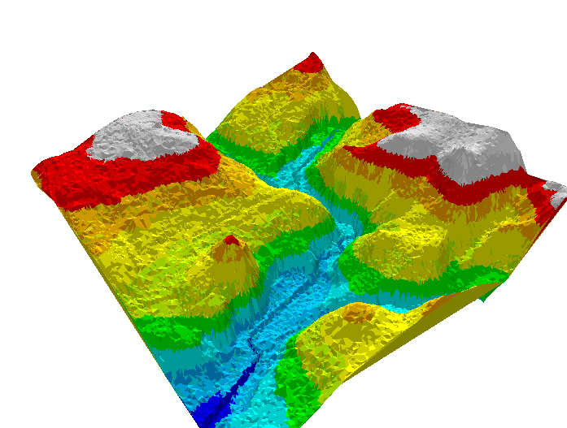
Base Elevation Data in Detail—
Light Detection and Ranging (lidar)
Current 2-D Determinations: Lidar data enables the most accurate delineation of floodplains consistent with current methodology for flood risk determinations based on horizontal location of a structure relative to Special Flood Hazard Areas depicted on flat Flood Insurance Rate Maps.
Future 3-D Determinations: Lidar data would also enable accurate flood risk determinations based on the vertical comparison of a structure’s lowest adjacent grade (LAG) relative to the Base Flood Elevation (BFE)

Slide 35
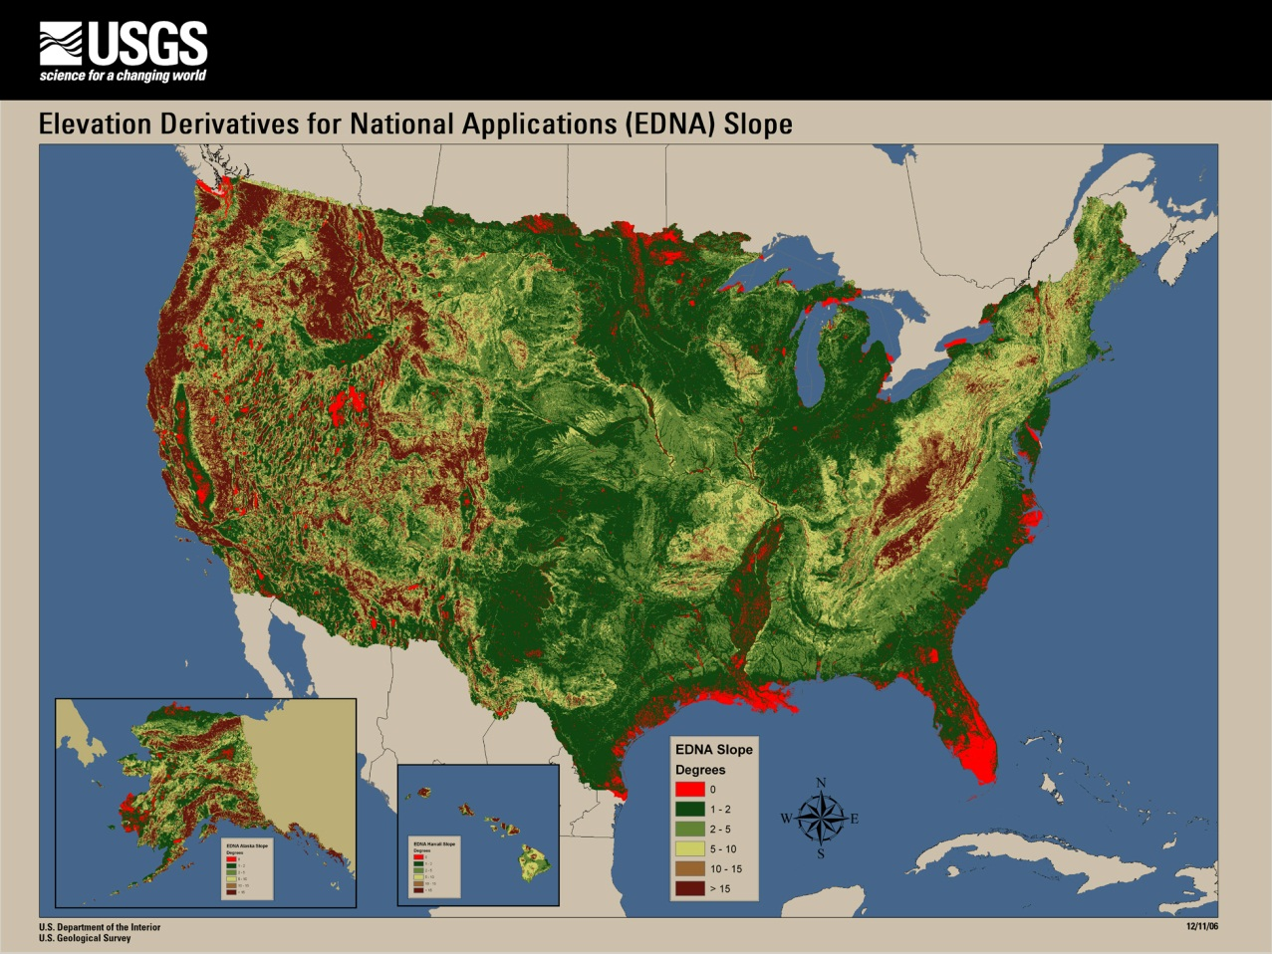
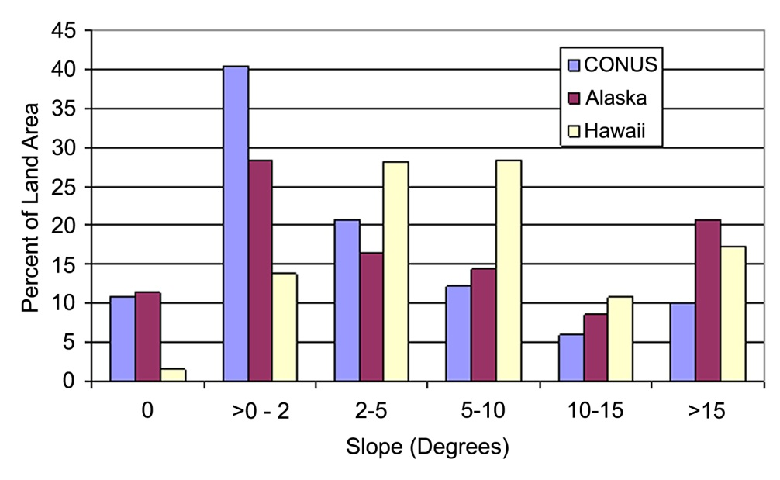
National Elevation Dataset
Slope map of the U.S. gives approximate scope of a national elevation program
Conversion of contours on 1:24,000 topographic maps to
  a 30m grid in continental United States
Root Mean Square error of national elevation data is 2.34 m (8 ft)
FEMA flood map standards call for error 17 -- 35cm (0.6 --1.2 ft)
11% of the continental US and Alaska has zero slope in the current National Elevation Dataset, much of which is in high-risk,
coastal flooding areas.

Slide 36
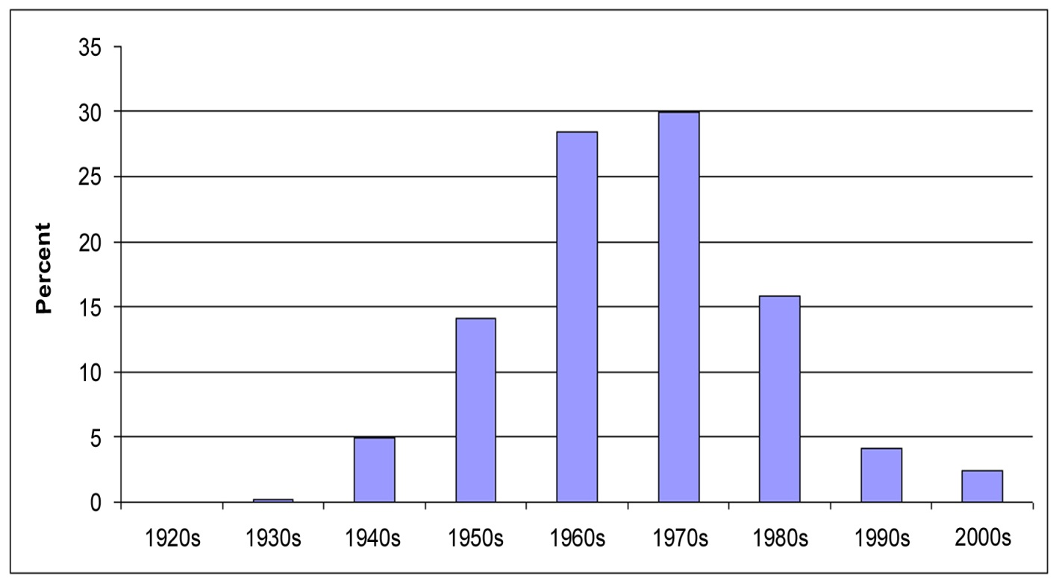
Elevation for the Nation
Age of USGS topographic maps in the
National Elevation Dataset (NED)
Terrain data in USGS topographic maps are on average 35 years old and flood mapping requires data that are either collected or considered for updating within the last 7 years.
Existing elevation data are thus ~ 1/10 accuracy and about 5 times older than needed for the flood mapping task.

Slide 37
Whats Happening in the States?
North Carolina is the national leader and has nearly state-wide lidar coverage with appropriate data collection standards (~$25 million)
Pennsylvania, Florida, and many local communites are in process of doing lidar
In Texas, coastal, Rio Grande and some interior counties are being flown with lidar

Slide 38
Summary
The committee concludes that the nation’s current information for land surface elevation is inadequate to support FEMA’s Flood Map Modernization needs and that a new program called Elevation for the Nation is needed.
We recommend lidar data with 1-ft equivalent contour accuracy in very flat coastal or inland floodplains; 4-ft equivalent contour accuracy in mountainous terrain; and 2-ft equivalent contour accuracy in most other areas.
The Elevation for the Nation database should contain the original lidar mass points , edited bare-earth surface, and breaklines required to define essential linear features.
A seamless nationwide elevation model, with applications beyond FEMA Map Modernization, should be disseminated to the public as part of an updated National Elevation Dataset.
Comprehensive standards for lidar data collection and processing are also needed. Funding to support these efforts should be considered as part of a nationwide effort.

Slide 39
Conclusions and Recommendations
CONCLUSIONS
1. Base Imagery Data:
New DFIRMs typically use a digital orthophoto as the base map image.
FEMA requirements for orthophoto standards for use in flood maps are satisfactory.
The nation has adequate image mapping to support Flood Map Modernization through the National Digital Orthophoto Program (http://www.ndop.gov) and National Agricultural Imagery Program (http://165.221.201.14/NAIP.html).
SUMMARY: Digital orthophotos are appropriate for flood map image base; current standards are adequate; existing programs should be supported

Slide 40
Conclusions and Recommendations
2. Base Elevation Data:
Rational flood management for the nation requires a three-dimensional view, quantifying both the variable Base Flood Elevations (BFEs) throughout the floodplain (vertical) and the areal extent (horizontal) of the 1% annual chance (100-year) flood where the BFEs intersect the terrain surface as depicted by digital elevation models.
To support the NFIP, analyzing these features in three-dimensions requires high-accuracy base map elevation data.
FEMA requirements for elevation data in DFIRMs are at “hydraulic model accuracy” (floodplain delineation) and the National Elevation Dataset is at “hydrologic model accuracy” (watershed delineation)
SUMMARY: A new digital mapping program for this land surface elevation is needed, which the committee has termed Elevation for the Nation

Slide 41
Why is Elevation for the Nation Needed?
Existing elevation data are old, and there is a large gap between their accuracy and the accuracy required for floodplain mapping
2. The required elevation mapping technology exists and has been commercially deployed such that implementing Elevation for the Nation is technically feasible with lidar.
Can Download the report the report in pdf format at National Academy Press
http://www.nap.edu/catalog.php?record_id=11829

